Slide 1
International Trade Institution
Chayun Tantivasadakarn
Faculty of Economics, Thammasat University

Slide 2
Outline
World Trade Organization
  Objectives
  Main Principles
  Important Agreements
Regional Agreements
Bilateral Agreements
Read: Understanding the WTO.pdf at
www.wto.org/english/thewto_e/whatis_e/tif_e/understanding_e.pdf

Slide 3
WTO
General Agreement on Tariffs and Trade: GATT
  took effect in 1947.
  There were 8 rounds of trade negotiations
World Trade Organizations was established as a conclusion of the Uruguay Round (1986-1993) on Jan 1, 1995.
There were 81 initial members, now 153 members.
Cover more than 97% of world trade.

Slide 4
Objectives
To develop free trade system
To oversee that trade is according to trade rules
A forum for governments to negotiate trade agreements.
A place to settle trade disputes.

Slide 5
Main Principles
1. Trade without discrimination
2. Freer trade: gradually, through negotiation
3. Predictability: Through Binding and Transparency
4. Promoting fair competition
5. Encouraging development and economic reform

Slide 6
Main Principles
1. Trade without discrimination
1.1 Most Favored Nation (MFN): treating imports from a country on the same basis as that given to the most favored other nation.
  every country gets the lowest tariff that any member country gets, and reductions in tariffs to one country are provided also to other members.
  some exceptions: FTAs, Generalize System of Preference (GSP) for developing countries.

Slide 7
Main Principles
1.2 National Treatment (NT): providing foreign producers and sellers the same treatment provided to domestic firms.
  applies once a product, service or item of intellectual property has entered the market. Thus, charging customs duty on an import is not a violation of NT.
  Example: charging different VAT for domestic goods and imports would violate NT.

Slide 8
Main Principles
2. Freer trade: gradually, through negotiation
  allow members to reduce trade restriction gradually, through “progressive liberalisation”. Developing countries are usually given longer to fulfil their obligations.
3. Predictability: Through Binding and Transparency
  trade barriers should not be raised arbitrarily.
  tariff rates and market-opening commitments are “bound” in the WTO.

Slide 9
Main Principles
4. Promoting fair competition
  discouraging “unfair” practices such as export subsidies and dumping products at below cost to gain market share.
5. Encouraging development and economic reform
  giving less developed countries more time to adjust, greater flexibility, and special privileges (e.g.; GSP)

Slide 10
The Logic of Multilateral Trade Agreements
    It is optimal for large countries to impose small tariffs, but that did not consider strategic interactions between multiple large countries.
    Is it still optimal behavior for these countries if every country imposes a small optimal tariff?
    We can use the payoff matrix to determine the Nash equilibrium outcome for each country’s tariff level.
    Assume the two countries are the same size so payoffs are symmetrical.
    Payoffs will be measured in any other situation as relative to free trade.

Slide 11
The impact of an import tariff: large country case
P
P
P
S
S*
P₃
S*_{E}
U
V
F/
N*
R*
P₁
M
T₁
P₀
T₁
E
B*
C*
P₀
P₀
C
B
P/₁
T₂
M*
T₂
P/₁
N
R
D
D_{M}
G
H
F
T
P₁
D_{M} - T
D*
Q
Q
Q
ΔPS = M
ΔCS*= M*
ΔCS = - [M+N+T₁+R ]
ΔPS* = - [M*+N*+T₂+R*]
ΔGR = T₁+T₂
Net = - [T₂+N*+R* ] < 0
Net = T₂ - [N+ R ]

Slide 12
Prisoner’s dilemma of tariff war
Foreign
 |  | No Tariff | Tariff
H ome | No Tariff
 | Tariff
0 , 0
-[T*₂+N+R]<0, T*₂-[N*+ R*] >0
Large loss , Gain
T₂-[N+ R]>0, -[T₂+N*+R*]<0
-[N+R+N*+R*], -[N+R+N*+R*]
Gain, Large loss
Loss, Loss

Slide 13
The Logic of Multilateral Trade Agreements
  Free Trade
    The upper left hand cell is when neither country imposes a tariff.
    The payoff for the two countries is 0.
  Tariffs
    Suppose Home imposes a tariff but Foreign does not.
    Home payoff is T₂-[N+ R]>0, and Foreign’s is -[T₂+N*+R*]<0.
    This is the lower-left quadrant.
    If the opposite occurs, the payoffs are exactly opposite, and this is the upper-right cell.

Slide 14
The Logic of Multilateral Trade Agreements
  Tariffs
    If both countries impose the optimal tariff, they are the same size.
    Terms-of-trade gain for each country is cancelled out by the terms-of-trade loss it suffers because of the other country's tariff.
    Both countries suffer DWL: -[N+R+N*+R*].
      Their own DWL, plus DWL from the other country’s tariff.
    This is the lower right cell of the matrix.

Slide 15
The Logic of Multilateral Trade Agreements
The pattern of payoffs we just saw has a special structure called the “prisoner’s dilemma”.
This is a game where two accomplices are caught in a crime and each has to decide whether or not to confess, when locked in separate rooms unable to communicate.
The best result for both is to not confess. However, since they cannot communicate and do not know what the other is doing, the best option for each is to confess.
This is similar to our situation where each country acting on its own has an incentive to apply the tariff, but doing so makes both worse off.

Slide 16

Prisoners’ Dilemma
Solving the problem with
  Dominant strategy,
  Nash, or
  Maximin
All give the same solution “confess”, “confess” = (-6,-6)
Playing this game sequentially give the same equilibrium
Prisoner B
Confess
Don’t Confess
Confess
-6, -6
-1, -12
Prisoner A
Don’t
Confess
-12, -1
-2, -2
Nash equilibrium is not Pareto efficient since at least one can be better of if they don’t confess
Need outside mechanism to maintain corporation
Pareto Efficient Solution
Notes:
33

Slide 17
The Logic of Multilateral Trade Agreements
Nash Equilibrium
  The only Nash equilibrium is the lower right cell—both countries apply a tariff.
  To move from that point would increase the countries’ loss, so the Nash equilibrium for both countries is to apply the tariff.
  The Nash equilibrium leads to an undesirable outcome for both countries, even though it is the best choice if the other country imposes a tariff.

Slide 18
The Logic of Multilateral Trade Agreements
Free Trade Agreement
  The bad outcome can be avoided if the countries enter into some type of free trade agreement.
  The WTO provides a mechanism to eliminate the prisoner’s dilemma by giving an incentive to remove tariffs.
  Those who join the WTO must agree to remove some tariffs, but in return they get lower tariffs from other members.
  This allows us to move closer to free trade.
  It is then more likely to end up in the upper left quadrant of the payoff matrix instead of the lower right.

Slide 19
Important Agreements:
The rules and commitments apply to
market access — various trade restrictions confronting imports
domestic support — subsidies and other programmes, including those that raise or guarantee farmgate prices and farmers’ incomes
export subsidies and other methods used to make exports artificially competitive

Slide 20
Important Agreements: Market Access
Industrial and Fishery
  tariff cuts on average 33% within 5 years (2000)
  special surcharges are prohibited unless already applied and informed.
Textile: Agreement on Textiles and Clothing (ATC) took over from the Multifibre Arrangement
  abolish import quotas within 10 years (2005).
Agriculture
  prohibit import quotas and changes to tariffs.

Slide 21
Targets for agriculture
DCs Developing
(1995-2000) (1995 -2004)
Targets for agriculture
Tariffs
- average cut -36% -24%
- minimum cut per product -15% -10%
Domestic support -20% -13%
Exports
- value of subsidies -36% -24%
- subsidized quantities -21% -14%

Slide 22
Important Agreements: Trade Rules
Sanitary and Phytosanitary Measures Agreement (SPS)
allows to set their own standards to govern imports.
are encouraged to use international standards, guidelines and recommendations where they exist.
regulations must be based on science.
should applied only to protect human, animal or plant life or health.
should not arbitrarily or unjustifiably discriminate between countries where identical or similar conditions prevail.
allow temporary “precautionary” measures.

Slide 23
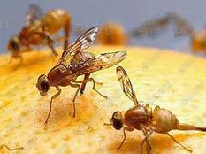
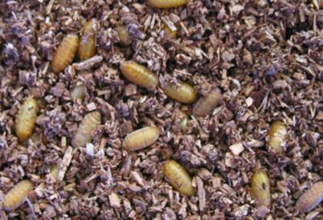
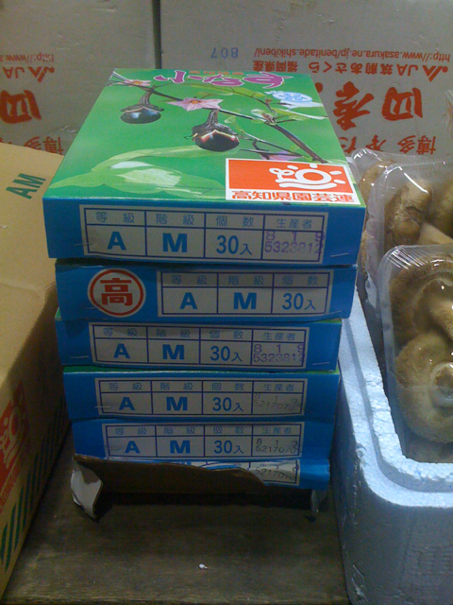
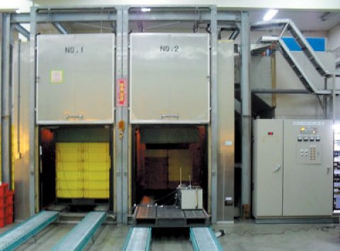
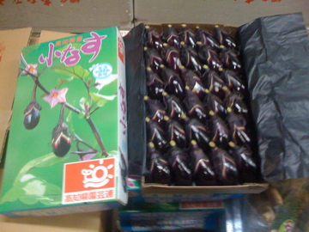
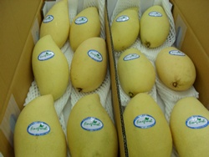
Fruit exports to Japan
Q: What process the Thai fruit, such as mango and mangosteen, need to go through before they are allow to export to Japan?
A: Vapor-heat treatment
  47^{O}C for 20 minutes for mango
  46^{O}C for 58 minutes for mangosteen

Slide 24
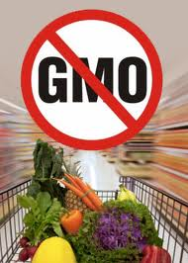
Important Agreements: Trade Rules
Technical Barriers to Trade Agreement (TBT)
recognizes countries’ rights to adopt the appropriate standards
  for human, animal or plant life or health, for the protection of the environment or to meet other consumer interests.
national standards have to be fair and equitable
discourages any methods that would give domestically produced goods an unfair advantage
encourages countries to recognize each other’s testing procedures

Slide 25
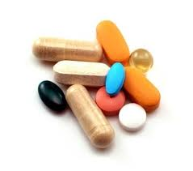
Important Agreements: Intellectual property
Agreement on Trade-Related Aspects of Intellectual Property Rights (TRIPS)
Creators can be given the right to prevent others from using their inventions, designs or other creations
and to use that right to negotiate payment in return from others who use them
copyrights, patents, trademarks, industrial designs, integrated circuit designs, geographical indications
governments can take action to prevent anti-competitive licensing that abuses intellectual property rights

Slide 26
Important Agreements: Investment measures
Trade-Related Investment Measures (TRIMs) Agreement
Abolish investment measures that restrict or distort trade
  Local content requirement
  Export performance requirement
  restrictions in quantities
should not discriminates against foreigners or foreign products

Slide 27

Important Agreements: Trade in Services
General Agreements on Trade in Services (GATS)
Services require instant consumption since they are
  intangible
  non-durable
  non-transferable
Why do we need special rules?
  GATT has been reducing the usage of tariffs
  Member countries switch to services
  Services have different mode of supply from goods

Slide 28
Important Agreements: Trade in Services
Service Provider Mode of Supply Example
Cross-boarder supply
Postal and telecom services
Locate outside of the nation of the consumers
Consumption abroad
Tourism, Education
Commercial Presence
Foreign branches: banks, insurance
Locate inside of the nation of the consumers
Presence of Natural Persons
Medical and legal services

Slide 29

Country (A) Thailand (T)
Mode 1
(~35%)
Provide ervices across boarder via some media
Supplier A Consumer T
Post and Telecommunication
Thai consumers travel abroad to get the services
Mode 2
(~10-15%)
Consumer T
Supplier A Consumer T
การท่องเที่ยว บริการการศึกษา
Set up subsidiaries in Thailand
Mode 3
(~50%)
Supplier A Consumer T
Mode 4
(~1-2%)
Foreign natural persons move to Thailand
Consumer T
Medical services or Legal services

Slide 30
GATS: General Obligations
Most-Favored-Nation (MFN) Treatment.
Transparency of regulations.
Mutual qualifications recognition.
Rules governing monopolies and Business practices.

Slide 31
The Doha round
Launched in November, 2001, in Doha, Qatar.
Agenda included:
  Further liberalization of production and trade in agriculture, industrial products, and services.
  Further tightening of antidumping regulations, investment and competition policies.
Intended to conclude by end of 2004, but still continues as of 2016.

Slide 32
Types of Economic Integration
1. Preferential Trade Arrangements: lower tariffs for specific countries (British Common Wealth)
2. Free Trade Area (FTA): lower tariffs among members but tariff rates for non-members aren’t the same (AFTA, NAFTA)
3. Customs Union: lower tariff for member and common tariff rates for non-members (Benelux)
4. Common Market: same as 3 and common trade policy and free factor mobility (EC 1958-1993)
5. Economic Union: same as 4 and common economic policies (EU 1993-) ->Monetary Union: same as 4 and same currency.

Slide 33
Regional Trade Agreements
an RTA is an international, inter-governmental legal instrument or a treaty.
Concluded by neighbouring states, or countries located in a given geographical region.
Aiming at the mutual liberalization of border impediments to trade in goods and services between the parties

Slide 34
RTAs notified to the GATT/WTO (1948-2002), cumulative

Slide 35
RTAs in force, as of June 2002, by type of agreement
72%

Slide 36
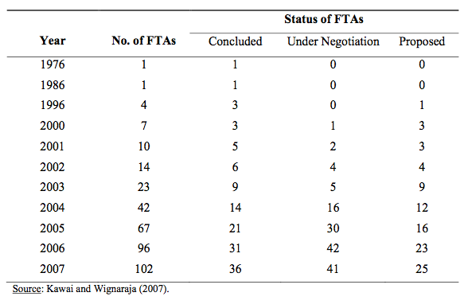
Proliferation of FTAs in East Asia

Slide 37
Types of RTAs
e.g., AFTA
Bilateral RTA
C
D
A
B
Plurilateral
e.g., Thai-US FTA
F
E
e.g., ASEAN+China
one party
is an RTA itself
I
all parties are distinct RTAs
H
G
K
J
N
e.g., ASEM
L
M

Slide 38
Examples of Economic Integration
Name
Year
Current Member
Liberalization & Integration
APEC
(21)
1989
US, Canada, Mexico, Chili, Peru,
China, H.K., Taiwan, Japan, S. Korea, Russia
ASEAN7
(Indonesia, Malaysia, Philippine,
Singapore, Thailand, Brunei, Vietnam)
Papua New Guinea, Australia, New Zealand
Free trade & investment
by 2010 for industrialized countries
by 2020 for developing countries
ASEAN
(10)
1967
Indonesia, Malaysia, Philippines,
Singapore Thailand, Brunei, Vietnam,
Laos, Myanmar & Cambodia
AFTA (ASEAN free trade area)
by 2003
EU
(25)
1993
(1958)
Germany, France, Italy, ,Belgium,
The Netherlands, Luxembourg, Denmark,
UK, Ireland, Greece, Portugal, Spain,
Austria, Finland, Sweden, Cyprus, Czech, Estonia, Hungary, Latvia, Lithuania, Malta, Poland, Slovakia and Slovenia
Single market & Customs Union
Economic Monetary Union by 1999
NAFTA
(3)
1994
US, Canada, Mexico
Free trade area

Slide 39
Impacts of FTA: Trade Creation
Before integration, P_{A} = (1+t)P_{B}
P
S
With integration, the tariff is removed and price drops to P_{B} and imports increase.
U
V
P_{A}= (1+t) P_{B}
150
M
T
N
R
ΔPS = - M
100
C
B
P_{B}
ΔCS = M + N + T + R
D
ΔGR = -T
Net = N + R, trade creation.
Q/_{S}
Q_{S}
Q_{D}
Q / _{D}
Q

Slide 40
Impacts: Trade Creation and Trade Diversion
Before integration, P_{A} = (1+t)P_{B}, P_{C} > P_{B}.
P
S
A integrates with C, the tariff is removed and price drops to P_{C} and imports increase.
U
V
P_{A}= (1+t) P_{B}
150
M
T₁
N
R
ΔPS = - M
120
C
T₂
B
P_{C}
ΔCS = M + N + T₁ + R
100
P_{B}
D
ΔGR = -[T₁ + T₂]
Net = N + R - T₂
N + R is trade creation
T₂ is the trade diversion
Q//_{S}
Q_{S}
Q_{D}
Q//_{D}
Q
FTA may lead to welfare reduction

Slide 41
The Second Best Theory
First Best: when all market imperfections are removed, the economy will be in a Pareto optimality situation.
Second Best: when only some of the market imperfections are removed, the social welfare of the economy may or may not be improved.
Example: The alcohol market is sufferred from monopoly and externality problems. Allowing competition removes the inefficiency from monopoly power but increases the external costs.
FTAs may face the second best problem.

Slide 42
Other Benefits on members
Trade and investment creation: cheaper import from member countries
  Economies of scale
  Larger market attracts investment
Improve efficiency via competition from abroad
Increase negotiation power in WTO

Slide 43
Other Costs on members
Trade and investment diversion: change from cheapest sources outside the group to more expensive source within the group
Tax revenue forgone
Loss of autonomy in trade policy
Unequal distribution of benefits among members
Dependence on particular export markets
Complex trade relationship and burden on customs processes --> Spaghetti-bowl effect

Slide 44
Benefits and Costs on non members
Benefits
Increased export opportunities, through higher demand
Prospect of freer global trade
Testing ground for global trade disciplines
Costs
Trade and investment diversion
Potential frictions between trade blocks
Confused and complex trade relations
Less commitment to WTO

Slide 45
Rules of Origin (ROO)
If China is looking to export a good to Thailand, but Thailand has high tariffs on that good, but Singapore has low tariffs, why not export to Singapore and then trade it freely to Thailand?
Free trade areas have complex rules of origin.
  Specifies what type of goods can be shipped duty-free within the free trade area.
The good from China to Thailand via Singapore would not get duty-free access to Thailand unless it has enough “ASEAN content” to qualify for duty-free access.

Slide 46
Rules of Origin
ROO specifies, for each and every product, how much of its production has been done in the free trade area.
These rules are clearly not needed in a customs union since all the countries have common tariffs with outside countries.
So why not just create a customs union and make it easier?
Because tariffs with outside countries are a political issue, of which many countries wish to maintain control.

Slide 47
APEC
ASEM
ASEAN
Russia
Chile
Canada
USA
Mexico
Singapore
Philippines
Indonesia
Brunei
Malaysia
Vietnam
Thailand
Myanmar
Cambodia
Laos
+
1
NAFTA
China
EU
Peru
+
3
Japan
Korea
TPP
New Zealand
Australia
CER
Papua New Guinea
AFTA + 6
India
Bangladesh
Sri Lanka
Bhutan
Nepal
Bahrain
BIMST-EC
Yunan
GMS

Slide 48
Thailand FTA strategy
Market Strengthening: Japan, USA.
Market Broadening and Deepening
  High Potential Markets: China, Australia, New Zealand.
  Gateway: Bahrain, Peru
  Regional markets: The Bay of Bengal Initiative for Multi-Sectoral Technical and Economic Cooperation or BIMST-EC

Slide 49
Bilateral FTA
Country
Year
Name
Objective
Bahrain
2002
Thai-Bahrain Framework on Closer Economic Partnership
654 categories 0-3%
Others by 2010
China
2003
Thailand China Free Trade Agreement on Vegetables & Fruits
108 categories vegetable 0%
80 categories fruits 0%
India
2004
Thailand India Closer Economic Relations Framework Agreement
0% on 82 categories by 2006
0% 6000 categories by 2010
Australia
2005
Thailand Australia Free Trade Agreement
(comprehensive)
Thailand on Australia 0%
53% now, 95% 2010, 100%, 2020
Australia on Thailand 0%
83% now, 96% 2010, 100% 2015
New Zealand
2005
Thailand New Zealand Closer Economic Partnership FTA
(comprehensive)
Complete liberalization 2015
Japan
2007
Japan-Thailand Economic Partnership Agreement
Trade & investment, Service &Financial, bilateral cooperation

Slide 50
ASEAN Free Trade Area (AFTA)
ASEAN initially consisted of Brunei, Indonesia, Malaysia, the Philippines, Singapore, Thailand. Established in 1967.
Cambodia, Myanmar, Laos, and Vietnam joined later.
Including more than 500 million people.
Set a free trade area, AFTA, in Jan 1992.
ASEAN is the largest export market for Thailand (22% in 2005).
Original target: remove tariffs down to 0-5% and remove NTBs within 15 years (on Jan 1, 2008)

Slide 51
ASEAN Free Trade Area (AFTA)
In 1994 moved the target to 10 years
  Finish liberalization on January 1, 2003
  remove some goods in the temporary exclusion list.
Liberalize trough Agreement on the Common Effective Preferential Tariff (CEPT) Scheme.
As of Jan 1, 2005, 92.99% of tariff lines is in the Inclusive List (IL) under CEPT scheme has an average tariff rate 0 – 5% (98.98% for the original 6 ASEAN members and 86.91% for the new members.

Slide 52
Average AFTA / CEPT Tariff Rates
 | 1998 | 1999 | 2000 | 2001 | 2002 | 2003
Brunei | 1.35 | 1.29 | 1.00 | 0.97 | 0.94 | 0.87
Indonesia | 7.04 | 5.85 | 4.97 | 4.63 | 4.20 | 3.71
Laos |  | 5.00 | 5.00 | 5.00 | 5.00 | 5.00
Malaysia | 3.58 | 3.17 | 2.73 | 2.54 | 2.38 | 2.06
Myanmar | 4.47 | 4.45 | 4.38 | 3.32 | 3.31 | 3.19
Philippines | 7.96 | 7.00 | 5.59 | 5.07 | 4.80 | 3.75
Singapore | 0.00 | 0.00 | 0.00 | 0.00 | 0.00 | 0.00
Thailand | 10.56 | 9.75 | 7.40 | 7.36 | 6.02 | 4.64
Vietnam | 6.06 | 3.78 | 3.30 | 2.90 | 2.89 | 2.02
ASEAN | 5.37 | 4.77 | 3.87 | 3.65 | 3.25 | 2.68
Source : ASEAN Secretariat
Common Effective Preferential Tariff (CEPT)

Slide 53
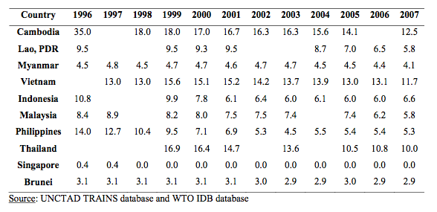
Trends in Average Applied Tariff Rates in ASEAN (unweighted %), 1996-2007
Thangavelu and Chongvilaivan (2009)

