Slide 1

EE212
Principles of Macroeconomic
Dr. Nessara Sukpanich
E-mail: nessara@econ.tu.ac.th
Office: ECON Building 463

Slide 2
Introduction to Macroeconomics
1

Slide 3
Materials covered in this chapter
Introduction to Economics
Macroeconomics objectives and policies
Types of macroeconomics variables
Key macroeconomics variables (indicators)
Brief history of macroeconomics

Slide 4
1.1 Introduction to Economics
What is Economics?
Relevant concepts
  Limits, alternatives and choices
  Three basic economic questions
Scope of economics Microeconomics vs. Macroeconomics
Positive Economics vs. Normative Economics

Slide 5
What is Economics
Economics: The study of how individuals and societies choose to use the scarce resources that nature and previous generations have provided.

Slide 6
Relevant concepts
(Limits, alternatives and choices)
Scarcity
Restricts options and demand choices
Because we “cannot have it all”,
We must decide what we will have and what we must forgo
Trade off: to obtain something you may have to loose something else
Opportunity cost: “The next best use”
To obtain more of one thing, you or the society forgoes the
opportunity of getting the next best thing
Famous quote: “There is no such thing as a free lunch”

Slide 7
Three basic questions in economics
The society faces three questions
Which goods and services to produce?
How to produce?
Who gets the goods and services?

Slide 8
Scope of economics
Microeconomics vs. Macroeconomics
Microeconomics: The branch of economics that examines the functioning of individual industries and the behavior of individual decision-making units—that is, business firms and households.
Macroeconomics: The branch of economics that examines the economic behavior of aggregates—income, employment, output, and so on—on a national scale.

Slide 9
Positive Economics vs. Negative Economics
Positive Economics:
Focuses on facts and cause-and-effect relationships.
Includes description, theory development, and theory testing.
Avoids value judgments.
Tries to establish scientific statements about economic behavior and deals with what economy actually like
Normative Economics:
Incorporate value judgments about what the economy should be like
Looks at the desirable of certain aspects of the economy
Economic policy normally involves normative economics

Slide 10
1.2 Macroeconomics objectives and policies
Criteria for judging economic outcomes:
1. Efficiency: In economics, allocative efficiency. An efficient economy is one that produces what people want at the least possible cost.
2. Equity: Fairness.
3. Growth: An increase in the total output of an economy.
4. Stability: A condition in which national output is growing steadily, with low inflation and full employment of resources.

Slide 11
1.2 Macroeconomics objectives and policies
Policy:
Fiscal Policy: Government policies concerning taxes and expenditures (spending).
2. Monetary Policy: The tools used by the Central Bank to control the quantity of money in the economy.

Slide 12
1.3 Types of Macroeconomics variables
Stock variables VS Flow variables
Nominal variables VS Real variables

Slide 13
Stock variable vs. Flow variable
Stock variable: A variable whose value depends on an instant rather than on a period of time.
Flow variable: A variable whose value depends on a period of time rather than an instant.

Slide 14
Example of Stock and Flow variables
Flow of inward foreign direct investment (FDI) value year 2011
Stock of inward foreign direct investment (FDI) value on Dec 31, 2011

Slide 15
Nominal vs. Real Variables
Nominal Variable: Variables that do not adjust for change in price, eg.
Nominal income
Nominal Interest Rate
Nominal GDP
Real Variable: Variables that adjust for change in price, eg.
Real income
Real Interest Rate
Real GDP

Slide 16
1.4 Key macroeconomics variables
Five major concerns of macroeconomics are:
Level and growth of output
Unemployment
Price level
Interest rate
Exchange rate

Slide 17
1.4.1 Level and growth of output
Business cycle: The cycle of short-term ups and downs in the economy.
Aggregate output: The total quantity of goods and services produced in an economy in a given period.

Slide 18
1.5.1 Level and growth of output
Recession: A period during which aggregate output declines. Conventionally, a period in which aggregate output declines for two
consecutive quarters.
Depression: A prolonged and deep recession.

Slide 19
Level of GDP 1993 – 2017 (unit millions of Baht)
Source: Draw using data from www.nesdb.go.th
21 of 38

Slide 20
Level of growth GDP 1993 – 2017 (unit percent)
Source: Draw using data from www.nesdb.go.th
22 of 38

Slide 21


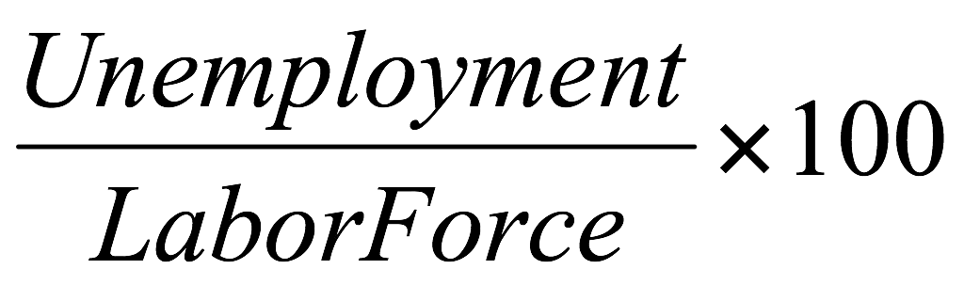
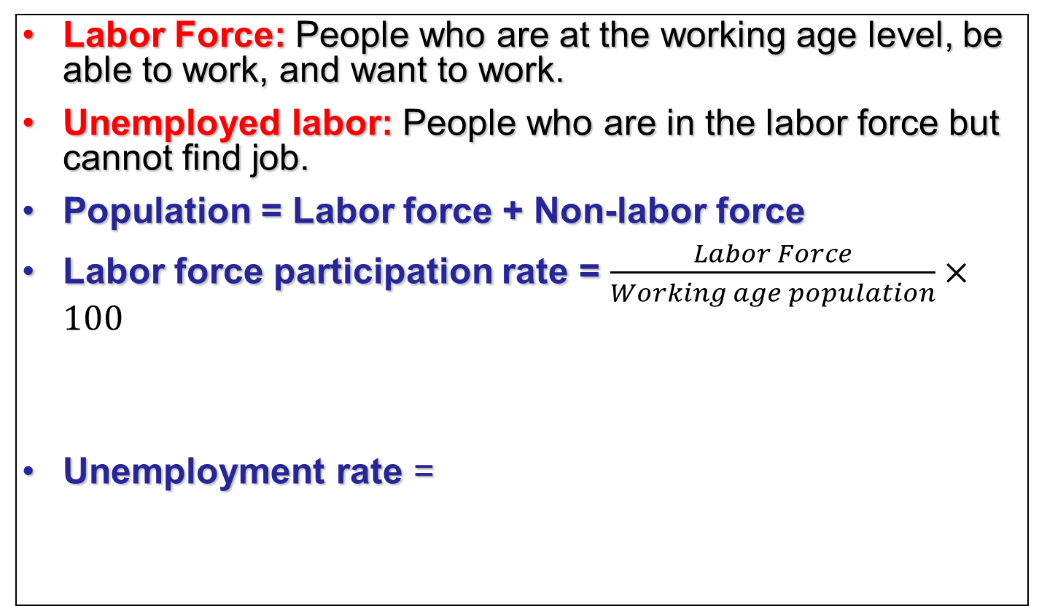
1.4.2 Unemployment Rate
Labor Force: People who are at the working age level, be able to work, and want to work.
Unemployed labor: People who are in the labor force but cannot find job.
Population = Labor force + Non-labor force
Labor force participation rate = $\frac{Labor Force}{Working age population}×100$
Unemployment rate =

Slide 22
Labor Force, Employment, Unemployment 2011-2017
Million persons or as stated
 | 2017 | 2016 | 2015 | 2014 | 2013 | 2012 | 2011
Population 15 years and over | 55,95730 | 55,610.14 | 55,238.46 | 54,843.08 | 55,024.16 | 54,514.03 | 54,003.96
Labor Force | 38,099.80 | 38,266.59 | 38,548.23 | 38,576.23 | 39,383.78 | 39,408.99 | 38,921.50
Employment | 37,458.30 | 37,692.65 | 38,061.17 | 38,077.43 | 38,906.88 | 38,941.10 | 38,464.66
Agriculture | 11,783.3 | 11,746.62 | 12,271.91 | 12,732.72 | 15,406.95 | 15,433.58 | 14,883.10
Non-Agriculture | 25,675 | 25,964.02 | 25,744.25 | 25,344.71 | 23,499.93 | 23,507.54 | 23,581.55
Unemployed Persons | 450.70 | 377.46 | 340.56 | 322.68 | 283.52 | 259.09 | 264.34
Rate of unemployed | 1.20 | 0.99 | 0.88 | 0.84 | 0.72 | 0.66 | 0.68
Source: Data from www.nesdb.go.th
24

Slide 23
Types of unemployment
Frictional unemployment
Structural unemployment
Cyclical unemployment

Slide 24
Types of unemployment
Frictional unemployment : The portion of unemployment that is due to the normal working of the labor market; used to denote short-run job/skill matching problems.
Structural unemployment : The portion of unemployment that is due to changes in the structure of the economy that result in a significant loss of jobs in certain industries.

Slide 25
Types of unemployment
Natural rate of unemployment : The
unemployment that occurs as a normal part of the functioning of the economy. Sometimes taken as the sum of frictional unemployment and structural unemployment.

Slide 26
Types of unemployment
Cyclical unemployment : The increase in unemployment that occurs during recessions and depressions.

Slide 27
1.4.3 Price level
Inflation: An increase in the overall price level.
Hyperinflation: A period of very rapid increases in the overall price level.
Deflation: A decrease in the overall price level.

Slide 28
Consumer Price Index (CPI) calculation, fix basket
 | Quantity of Good 1 | Quantity of Good 2 | Price of good 1 | Price of good 2 | Value of goods in the basket | CPI
2015 | 20 | 40 | 6 | 2
2016 | 20 | 40 | 8 | 3
2017 | 20 | 40 | 7 | 4
The rule of three in arithmetic
In 2015,
In 2016,
In 2017,
Inflation rate in 2016 compared to 2015 =
Inflation rate in 2017 compared to 2016 =

Slide 29

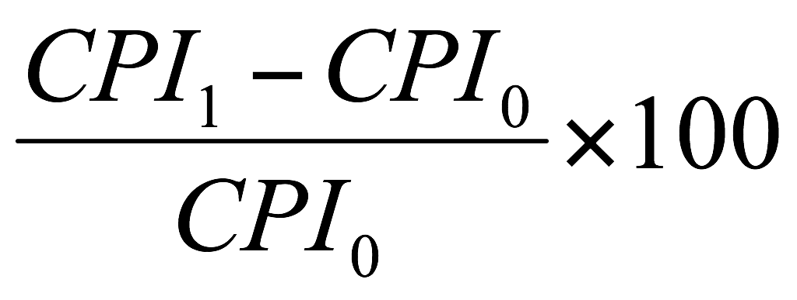
Consumer Price Index (CPI) and Inflation
Source: Data from www.bot.or.th
Inflation rate =
Core inflation eliminates products that can have temporary price shocks (i.e. energy, food products)
30

Slide 30
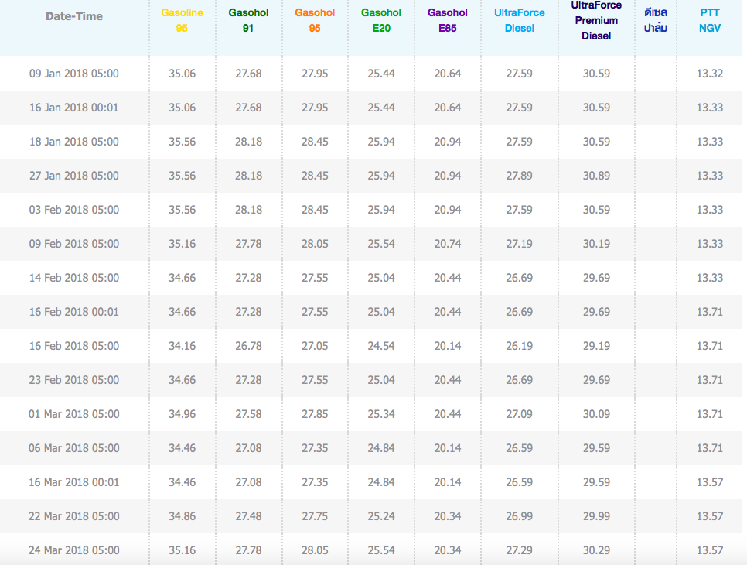
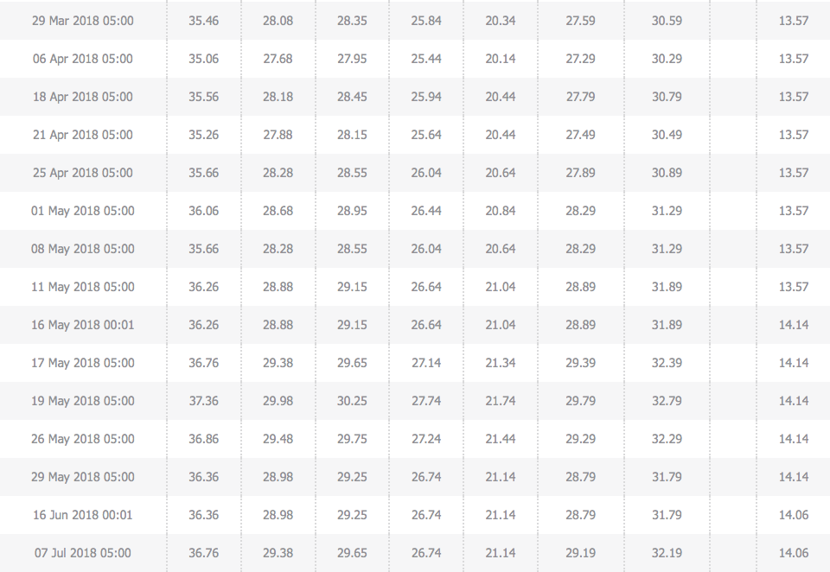
Oil price
Source: http://www.pttplc.com
31

Slide 31
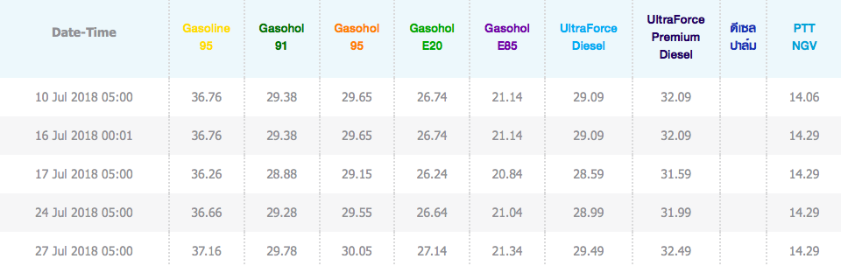
Oil price
Source: http://www.pttplc.com

Slide 32
Oil price
Source: http://www.pttplc.com

Slide 33
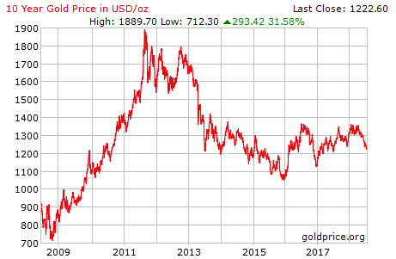
Gold Price
Source: http://www.goldprice.org/gold-price-history.html
32

Slide 34
1.4.4 Interest Rate
Loan rate vs. Deposit rate
Real interest rate
= Nominal interest rate – Inflation rate
Creditors want real interest rate to be high
Debtors want real interest rate to be low

Slide 35
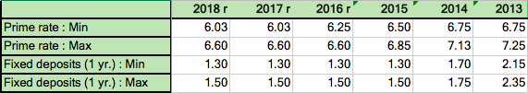
1.4.4 Interest Rate
Source: Data from www.bot.or.th

Slide 36
1.4.4 Interest Rate
Thammasat University Savings and Credit Cooperative Limited Rate
Deposit rate (August 7, 2017) | Rate
Saving | 1.00
Saving (Sintawee) | 1.25
Fixed Deposit (3 months) | 2.50
Fixed Deposit (6 months) | 2.75
Fixed Deposit (9 months) | 3.00
Fixed Deposit (12 months) | 3.00
Fixed Deposit (24 months) | 3.25
Fixed Deposit (36 months) | 3.50
Fixed Deposit (48 months) | 3.75
Fixed Deposit (60 months) | 3.75
Loan rate
Member loan rate (from March 1st,2016) | 5.00
Source: savings.tu.ac.th

Slide 37
1.4.5 Exchange Rate
Source: Draw using data from www.bot.or.th

Slide 38
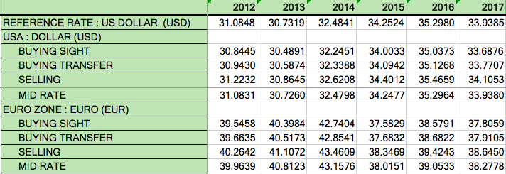
1.4.5 Exchange Rate
Source: Data from www.bot.or.th
38

Slide 39
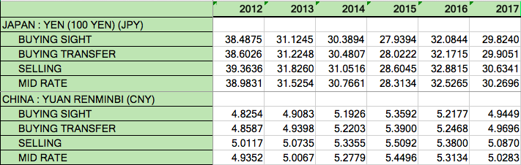
1.4.5 Exchange Rate
Source: Data from www.bot.or.th
39

Slide 40
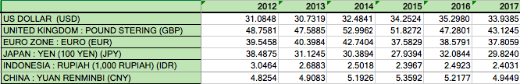
1.4.5 Exchange Rate
Baht per/1 unit of foreign currency
Source: Data from www.bot.or.th
40

Slide 41
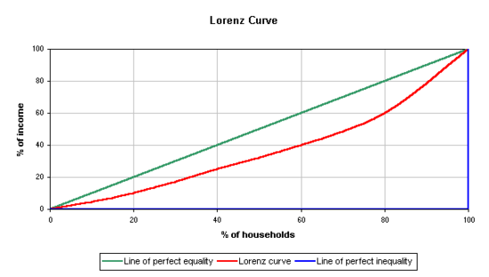
1.4.6 Income distribution (Lorenz Curve and Gini-coefficient)
A
X
B
Y
Z

Slide 42
1.4.6 Income distribution (Lorenz Curve and Gini-coefficient)
At point X
20% of household receives
20% of income
At point Y
20% of household receives
10% of income
At point Z
20% of household receives
0% of income
Point X is on the “Perfect Equality Line”
Point Y is on the “Lorenz Curve”
Point Z is on the “Perfect Inequality Line”
Gini-coefficient
=
area A
area A + area B
Gini-coefficient
Unequal income distribution

Slide 43
1.5 The History of Macroeconomics
Different historical periods brought about different concerns that underpinned development in macroeconomic ideas
From Classical to Keynesian (through Marx)
And from Keynesian to Monetarism, and finally to Neo-classical economics

Slide 44
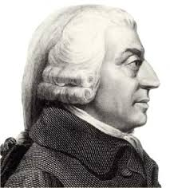
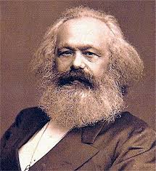
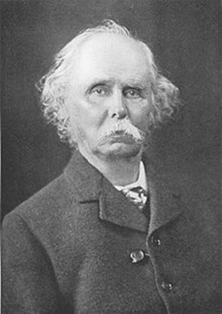
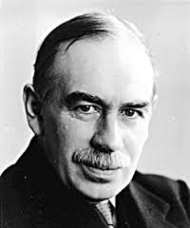
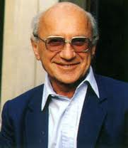
The History of Macroeconomics
1723-1790
1818-1883
1842-1924
1883-1946
1912-2006

Slide 45
The History of Macroeconomics
Classical period
  Adam Smith and "An Inquiry into the Nature and Causes of the Wealth of Nations”
  In the context of the beginning of industrialisation
    Division of labour (specialisation) is crucial to raising production
    Market can help coordinate self-interested actions of individuals so that they would ultimately serve the social good.
  Through the market system, “the invisible hand” bring the benefits to everyone.
    Note: Smith was a reaction to the prior “mercantilism” (controlled economy).

Slide 46
The History of Macroeconomics
  Marxist Economics
    In contrast to the pro-market view, Karl Marx raised a crucial observation on the (unfair) distributions of benefits from industrialisation
  The concern for Marx on the exploitation that occurred from “capitalism”
  And the way Marx sees the world is not just bounded to the working of the markets. He sees the whole society as proceeding through the systematic plot of history.

Slide 47

The History of Macroeconomics
  Marxist Economics
  History is the history of “class struggle”, i.e. conflicts between ownership class that controls means of production, and labour. In the modern context, this conflict arises between the capitalists and the working class.

Slide 48
The History of Macroeconomics
Neo-classical economists
  The revived belief in “markets”
    Market as the most efficient, and also self-regulating
  Alfred Marshall
    The “father” of modern economics
    Founded theories explaining “demand”, which underpins the modern microeconomic understanding of “markets”
    More importantly, Marshall also introduced the concept of “homo-economicus”(economic human), posing the understanding of economic agents as individuals seeking to fulfill “self-interests”

Slide 49
Markets: the core of neo-classical economics
Neo-classical economists tend to see the market system as the most efficient in allocating resources.
  Nonetheless, we should keep in mind that, even though most economists accept the advantages of the market, there can be different views on the degree of regulations needed for markets to work,
  In addition, we may also place different values to other economics-related objectives

Slide 50
The History of macroeconomics
Keynesian economics
  In the context of “the great depression”
  Recognize that classical economics, which sees the market as self-regulating, is not adequate in dealing with economic fluctuations
  Keynes offer solutions: boosting aggregate demand
    Through encouraging domestic consumptions, raising government spendings, and lowering interest rates
    Particularly through government investment

Slide 51
The History of Macroeconomics
The Monetarists
  Led by Milton Friedman
    Put the emphasis rather on the roles of bad monetary policies as the major factor behind economic crisis
    Government should leave the goods market alone, acting rather through controlling the money supply
Neo-liberalism (following Friedman)
  Keeping the trend of the“neo-classics”
  Arguing for reducing the government roles and privatising public services
  Pro “free-trade”

Slide 52
The History of Macroeconomics
Synthesising Classical and Keynesian perspectives
  Classical view: economics will naturally settle at full-employment, as wages and price manage to adjust to changes in money supply or unemployment
  Keynesian view: unemployment arises from failure of the labour market to adjust fast enough, leaving room for fiscal and monetary policies to be effective means in coping with fluctuations
  Classical is often seen as “long-run” perspective, while Keynesian is seen as the “short run” perspective.

Slide 53
The History of Macroeconomics
Debates remain:
  Macroeconomists toward classical (or neo-classical) tend to emphasize market efficiency and argue for the small role of the government.
  Macroeconomists toward Keynesian spectrum emphasize way in which unemployment can cause severe human suffering and persistent effects. They argue for a more active role of the government.
    Famous Keynes’s quote:
    “In the long run we are all dead.”

Slide 54
The History of Macroeconomics
Note:
Classic believes that price of goods and wages are flexible.
Keynes believes that price of goods and wages are sticky.

Slide 55
Present challenges
The integration between national economy and the creation of "globalised economy"
The fuel-based economy is reaching a critical juncture. Climate change has got nearer.
The persistency of global poverty and inequality. Is a more inclusive growth possible?
What about Thailand? What do you think is our current challenges?

Slide 56
1.6 Other issues
Per capita output vs. labor productivity
  Per capita output = Total output the economy can produce/total population
  Labor productivity = Total output the economy can produce/Labors used in production

Slide 57
1.6 Other issues
Economy with the situation of stagnation (output not increase, still or decline) and high inflation is called …………………………….
“___________________”

Slide 58
1.6 Other issues
Determinant of capacity in the long run
  ____________________________________
  ____________________________________
  ____________________________________

Slide 59
1.6 Other issues
Macroeconomics deals with three main markets
    Good market
    Money market
    Labor market

