Slide 1

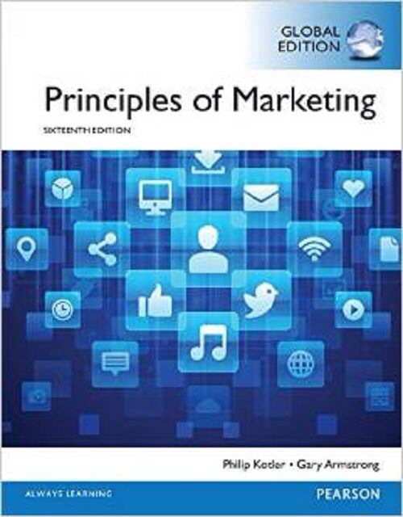
Pricing Strategy I
CHAPTER 10: Understanding and Capturing Customer Value
MK 202 Fundamentals of Marketing
By Aj.Suwalya K.

Slide 2
Objective Outline
Objective 1: Answer the question “What is a price?” and discuss the importance of pricing in today’s fast-changing environment.
Objective 2: Identify the three major pricing strategies and discuss the importance of understanding customer-value perceptions, company costs and competitor strategies when setting prices.
Objective 3: Identify and define the other important external and internal factors affecting a firm’s pricing decisions.

Slide 3
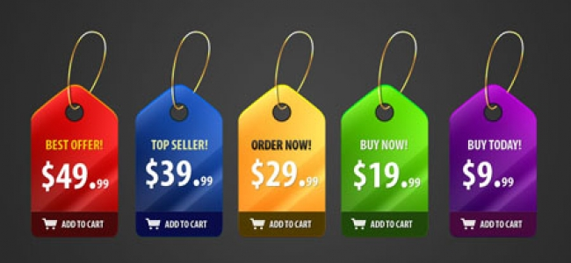
Objective 1: What is Price?

Slide 4
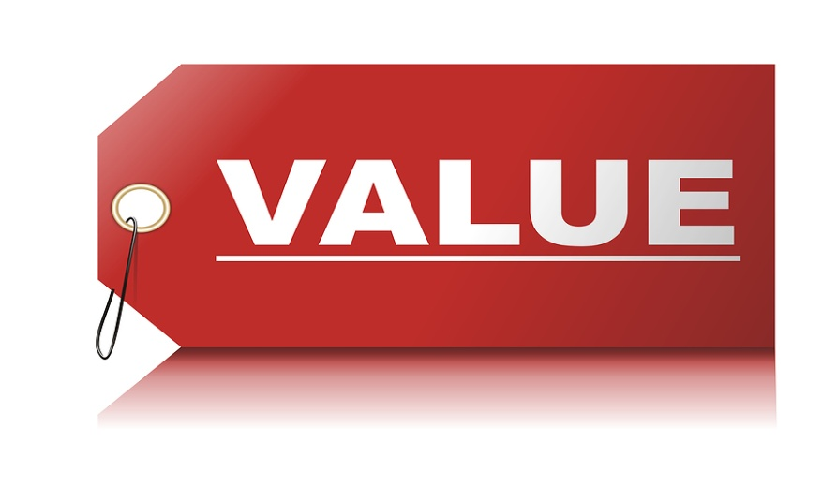
What is Price?
“Pricing: No matter what the state of economy, companies should sell value, not price.”
Price: The amount of money charged for a product or service, or the sum of the values that customers exchange for the benefits of having or using the product or service.

Slide 5
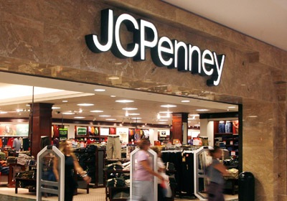
JCPENNEY: Struggling to Find a Successful Pricing Strategy
JC Penney faces a serious pricing challenge, one that's all too familiar to many retailers today. It can't live with sales prices, but it can't live without them either.

Slide 6


Air Arabia: Customer-Value-Based Pricing
With its “Be Smart, Pay Less, Fly more” tagline, Air Arabia puts customer value at the forefront of its strategy-offering the lowest fares in the market without sacrificing customer service.
Air Arabia offers a simple pricing plan to its customers, and invites them to “Be smart, pay less, fly more” in its adverts.

Slide 7
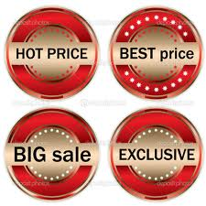
Objective 2: Major Pricing Strategies
Customer Value-Based Pricing
Cost- Based Pricing
Competition-Based Pricing

Slide 8
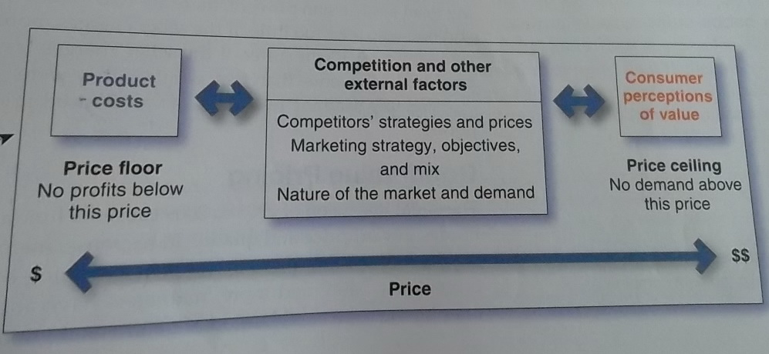
Customer Value –Based Pricing
Customer value-based pricing: Setting price based on buyers’ perceptions of value rather than on the seller’s cost.
Figure 10.1 Considerations in Setting Price
If customers perceive that a product’s price is greater than its value, they won’t buy it. If the company prices the product below its costs, profits will suffer. Between the two extremes, the “right” pricing strategy is one that delivers both value to the customer and profits to the company.

Slide 9
Customer Value –Based Pricing
Figure 10.2 Value-Based Pricing vs. Cost-Based Pricing
Cost-based pricing
Design a good product
Determine product costs
Set price based on cost
Convince buyers of product’s value
Assess customer needs and value perceptions
Set target price to match customer perceived value
Determine costs that can be incurred
Design product to deliver desired value at target price
Value-based pricing
Costs play an important role in setting prices. But, like everything else in marketing, good pricing starts with the customer.

Slide 10

Customer Value –Based Pricing
Perceived value: A Steinway piano-any Steinway piano-costs a lot. But to those who own one, price is nothing; the Steinway experience is everything.

Slide 11

Customer Value –Based Pricing
Good-value pricing: Offering just the right amount combination of quality and good service at a fair price.
Good-value pricing: With its no frills positioning and low prices, Snap Fitness is well positioned to take advantage of either good or bad economic conditions.

Slide 12


Ryanair: Really Good-Value Pricing-Fly for Free
Good –value pricing: Ryanair’s sometimes outrageous CEO, Michael O’Leary, hopes one day to “make flying free.”

Slide 13
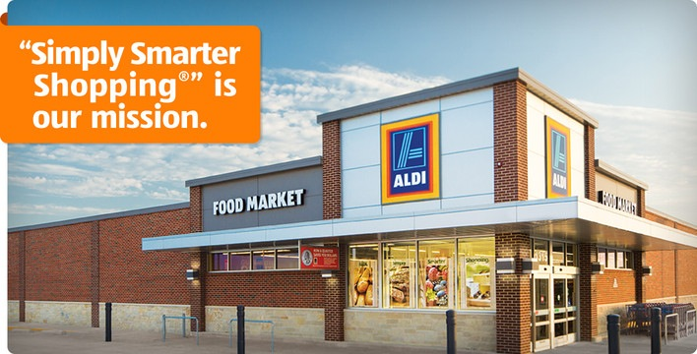
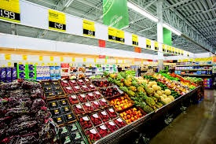
Real Marketing 10.1
ALDI:Impressively High Quality at Impossibly Low Prices, Every Day
Good-value pricing:ALDI keeps costs low so that it can offer customers "impressively high quality at impossibly low prices" every day.

Slide 14

Customer Value –Based Pricing
Value-added pricing: Attaching value-added features and services to differentiate a company’s offers and charging higher prices.

Slide 15

Value-added pricing: Rather than cutting services to maintain lower admission prices, premium theaters such as AMC’s Cinema Suites are adding amenities and charging more. “Once people experience it….they don’t want to go anywhere else.”

Slide 16
Cost-Based Pricing
Types of Costs
Fixed costs (overhead): Costs that do not vary with production or sales level
Variable costs: Costs that vary with the level of production
Total costs: The sum of the fixed and variable costs for any given level of production

Slide 17
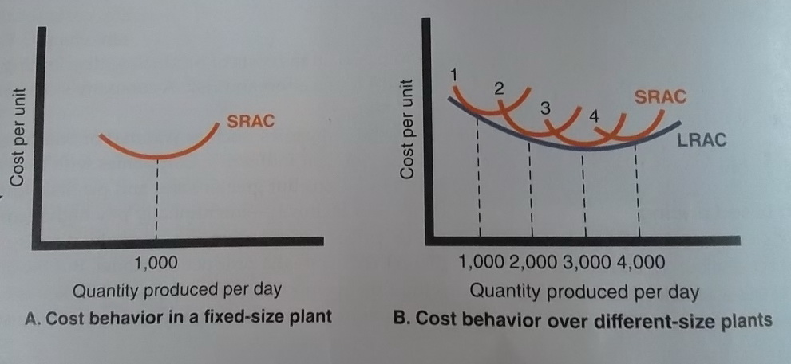
Cost-Based Pricing
Costs at Different Levels of Production
Figure 10.3 Cost per Unit at Different Levels of Production per Period
What’s the point of all the cost curves in this and the next few figures? Costs are an important factor in setting price, and companies must understand them well.

Slide 18
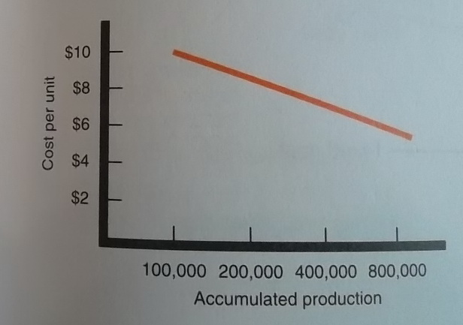
Cost-Based Pricing
Costs as a Function of Production Experience
Experience curve(learning curve): The drop in the average per-unit production cost that comes with accumulated production experience.
Figure 10.4 Cost per Unit as a Function of Accumulated production: The Experience Curve

Slide 19
Cost-Based Pricing
Cost-Plus Pricing (or markup pricing): Adding a standard markup to the cost of the product.
Variable cost $10
Fixed cost $300,000
Expected unit sales 50,000
Then the manufacturer’s cost per toaster is given by the following:
Unit cost=variable cost + fixed cost/unit sales =
$10 + $300,000/50,000 = $16
Now suppose the manufacturer wants to earn a 20 percent markup on sales. The manufacture’s markup price is given by the following.
Markup price = unit cost/(1-desired return on sales) = $16/1-0.2= $20
The manufacturer would charge dealers $20 per toaster and make a profit of $4 per unit. The dealers, in turn, will mark up the toaster. If dealers want to earn 50 percent on the sales price, they will mark up the toaster to $40 ($20 +50% of $40). This number is equivalent to the markup on cost of 100 percent ($20/$20).

Slide 20
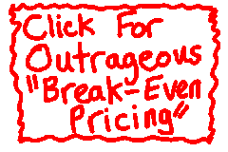
Cost-Based Pricing
Break-Even Analysis and Target Profit Pricing
Break –even pricing(target return pricing): Selling price to break even on the costs of making and marketing a product, or setting price to make a target return.

Slide 21
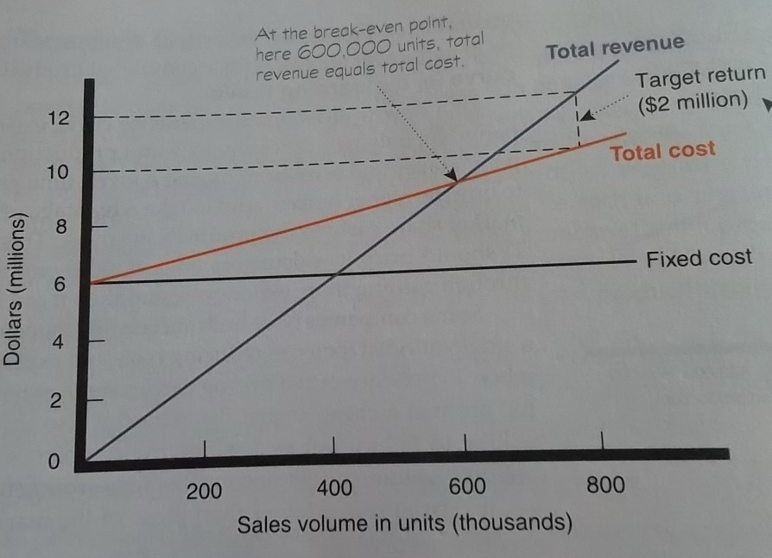
Cost-Based Pricing
Figure 10.5 Break –Even Chart for Determining Target-Return Price and Break-Even Volume
To make a target return of $2 million, the company must sell 800,000 units. But will customers buy that many units at the $15 price?

Slide 22
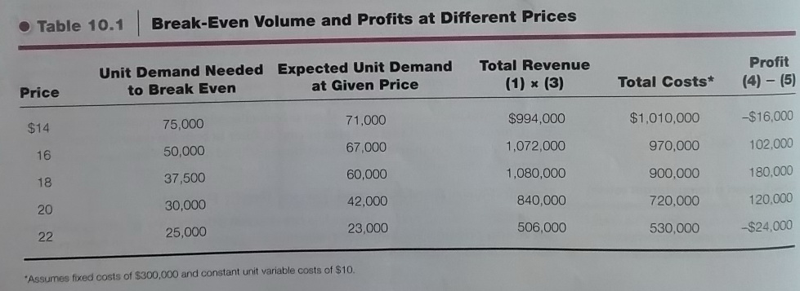
Cost-Based Pricing
Break-even volume = fixed cost/price-variable cost
= $300,000/$20-$10 = 30,000
Table 10.1 Break-Even Volume and Profits at Different Prices

Slide 23
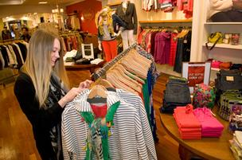
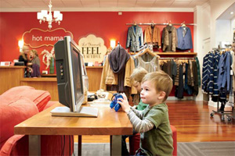
Competition-Based Pricing
Competition-based pricing: Setting prices based on competitors’ strategies, prices, costs and market offerings.
Pricing against larger, lower-price competitors: Fast-growing clothing boutique Hot Mama isn’t likely to win a price war against giants Macy’s or Kohl’s. Instead, it relies on personal service, a mom and kid-friendly atmosphere, and its knowledgeable staff to turn harried moms into loyal patrons. “It’s like shopping with a girlfriend.”

Slide 24
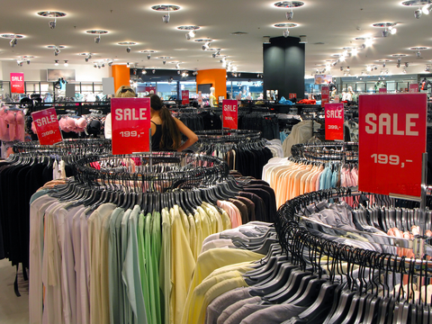
Objective 3: Other Internal and External Considerations Affecting Price Decisions

Slide 25

Overall Marketing Strategy, Objectives, and Mix
Target Costing: Pricing that starts with an ideal selling price, then targets costs that will ensure that the price is met.

Slide 26
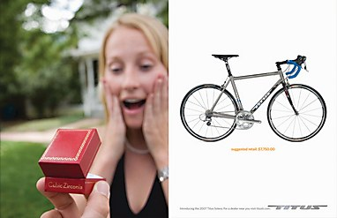
Positioning on high price: Titus features its lofty prices in its advertising “suggested retail price: $7,750,000.”

Slide 27
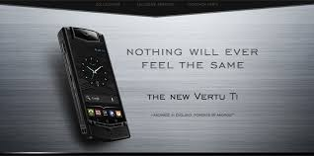
Nonprice positioning:Luxury smartphone maker Vertu puts very high value into its products and charges sky-high prices to match that value. Average price: nearly $6,000

Slide 28
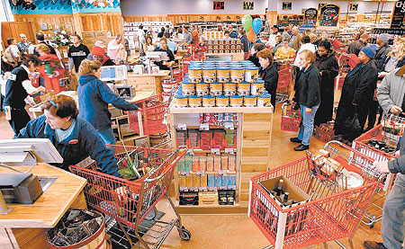

Real Marketing 10.2
Trader Joe’s Unique Price-Value Positioning: “Cheap Gourmet”
Trader Joe’s unique price-value strategy has earned it an almost cult- like following of devoted customers who love what they get for the prices they pay.

Slide 29
Organizational Considerations
Management should decide on who in the organization should set the price.
The Industries in which pricing is a key factor- airlines, aerospace, steel, railroads, oil companies), companies often have pricing departments to set the bet prices or help others set them.
The departments report to the marketing department or top management (others who have influence on pricing are involved)

Slide 30
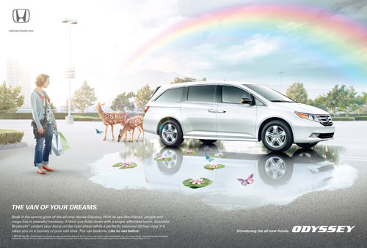
The Market and Demand
Pricing in Different Types of Markets
Pricing in monopolistic competition: Honda sets its Odyssey minivan apart through strong branding and advertising, reducing the impact on price. Its tongue-in-cheek “Van of Your Dreams” ads tell parents “the new Odyssey has everyone one would dream about in a van, if one had dreams about vans.”

Slide 31
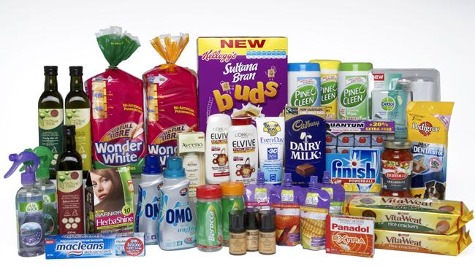
The Market and Demand
Analyzing the Price-Demand Relationship
Demand Curve: A curve that shows the number of units the market will buy in a given time period at different prices that might be charged.

Slide 32
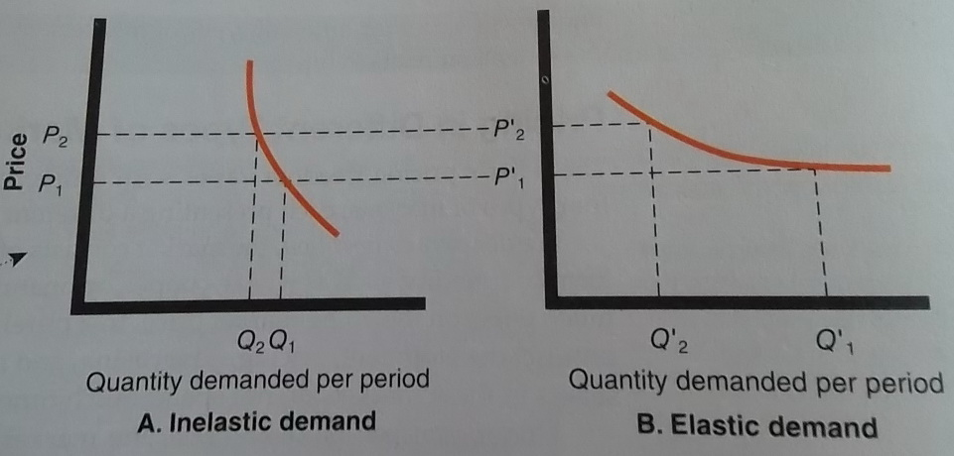
The Market and Demand
Figure 10.6 Demand Curves
Price and demand are related-no big surprise there. Usually, higher prices result in lower demand. But in the case of some prestige goods, the relationship might be reversed. A higher price signals higher quality and status, resulting in more demand, not less.

Slide 33
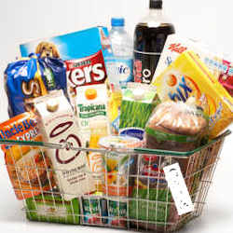
The Market and Demand
Price Elasticity of Demand
Price Elasticity: A measure of the sensitivity of demand to changes in price
Price elasticity of demand =
% change in quantity demanded
% change in price

Slide 34
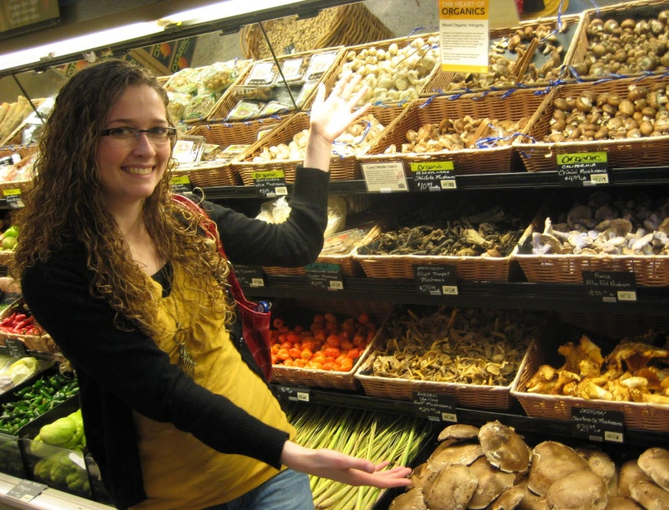
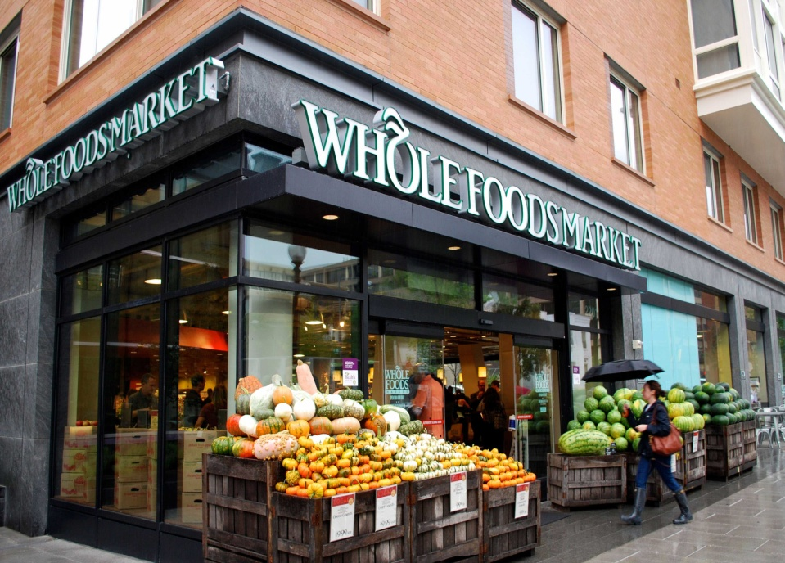
The Economy
When the economy dipped, rather than cutting everyday prices, Whole Foods set out to convince shoppers that it was, in fact, an affordable place to shop. It even assigned workers to serve as “value tour guides.” Like the one shown here, to escort shoppers around stores pointing out value items.

Slide 35
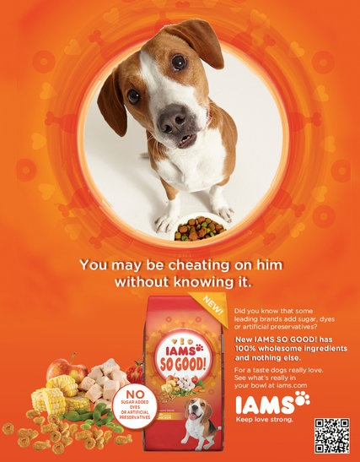
The Economy
Pricing and the economy:In line with tighter consumer budgets and thriftier spending habits, P&G launched Iams So Good dog food, a line designed as a "more accessible" addition to its premiums Iams brand.

