Slide 1

INTEGRATED BRAND COMMUNICATION
Massimiliano La Franca
Lesson 2
YAWP

Slide 2
Recap from last session
The big picture
Promotion as one of the marketing activities
Why integrated communication

Slide 3
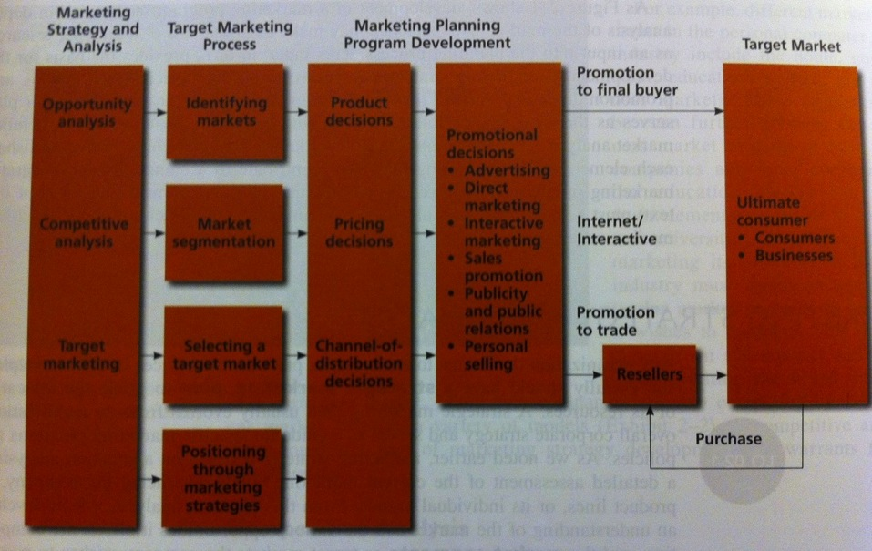
Marketing and promotions process model
Advantage
Page 43
Notes:
Before starting talking about strategic planning, I want to look at the big picture. I want you to understand what happens in the marketing office of a company during its normal life. This helps us understanding a few things and also helps us locating who are the key stakeholders (who does what) in this game

Slide 4

1. MKTG strategy and analysis
To develop a strategic marketing plan
Opportunities analysis:
  existing products in current market, new products in current markets, existing products in new markets…
  Builds from trends and behaviors, unmet needs, innovation
Competitive analysis:
  Understand competition
  Define a competitive advantage (product, price, distribution, benefit?)
Identify a what market we want to play in.
Notes:
Imagine this Our new company in day 1
It has a core line of products and you have been assigned to study the market in order to grow the business
Imagine let’s say it produces soy drink
What to do?

Slide 5
2. Target marketing process
Once decided the market we want to operate in, we need to define the one or more segments to focus on.
Market segmentation:
  Dividing up a market into distinct segments that have same needs and respond similarly to marketing activities
  Many kind of segmentation bases: geography, demographic, socio-economic, lifestyle, product usage
  The more you segment the smaller the size of the market but the more focused the action

Slide 6
2. Target marketing process
Select one or more segment to focus on
  Undifferentiated marketing: ignore differences - Apple
  Differentiated marketing: separate mktg strategies for different segments usually with different brands (Marriott hotels)
  Concentrated marketing: focus on one segment and own it (Aston Martin)
Determine the business potential of the segment and position your offer

Slide 7
Example: shampoo
shampoo
Split ends
antidandruff
Volume
Colour
Heat damage
shampoo
Cheap price
Mass market
Premium price
Top end
Benefit
shampoo
Local
Mass market brands
Salon brands
Retailers private labels
International top end
Price
Brand

Slide 8
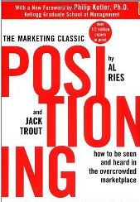
3. Mktg planning program development
To define “positioning” through marketing activities. Positioning: the process by which marketers try to create an image or identity in the minds of their target market for its product, brand, or organization in a way that sets the brand/product apart from competition.
Positioning by:
  Benefit: the only that…the fastest,
  Price: the cheapest, value for money, reassuringly expensive
  Other categories (airlines vs. trains) or competitors
  Values and image
Repositioning: the strategy of changing brand positioning
Notes:
Whats the tallest mountain>
Positioning of BMW? NIKE?

Slide 9
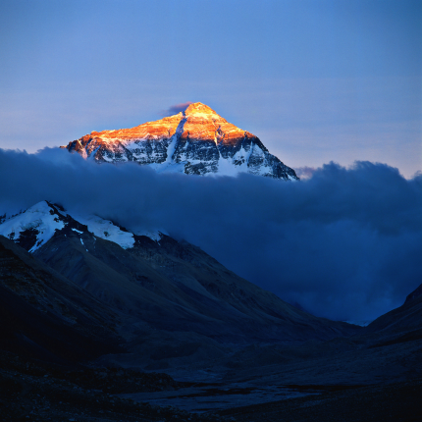
What’s the tallest mountain in the world?

Slide 10
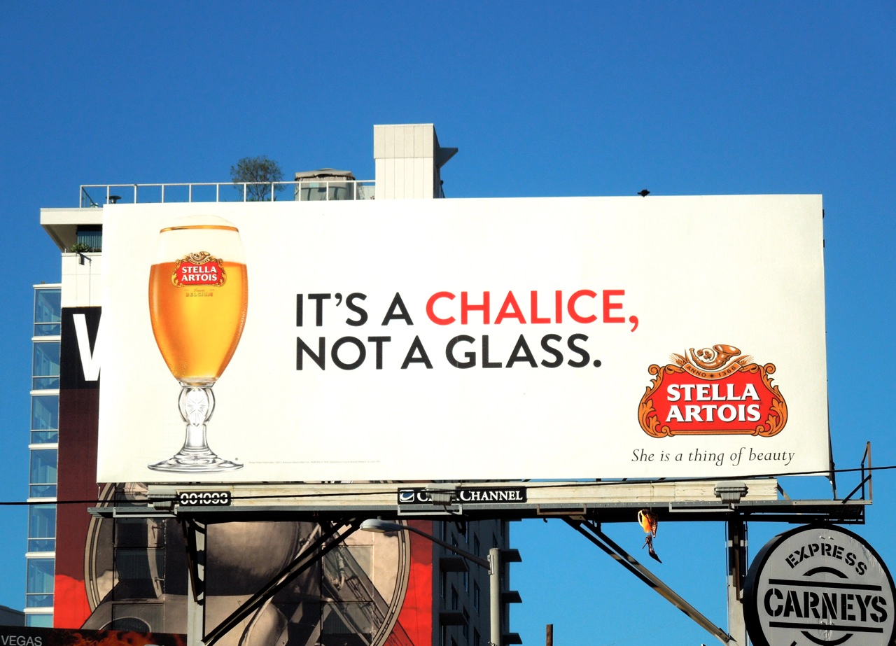
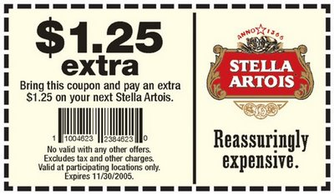
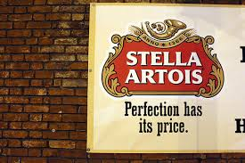
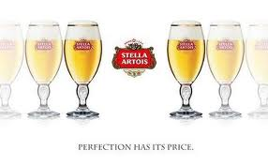

Slide 11
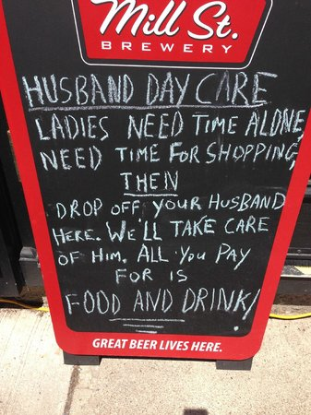
AND WHEN YOU DON’T LIKE THE POSITIONING…
REPOSITIONING
(In this case BY REFRAMING THE CATEGORY).

Slide 12
3. Mktg planning program development (follow)
Defining the marketing mix
Product (branding, packaging, R&D, quality, innovation…)
Price
Distribution channels (place)
Promotion

Slide 13
Exercise
Group and work on a segmentation project
  Airlines
  Ice Tea
  Cars
Task
  Segment the market you have been assigned
  Look at your segmentation and define a space in the market that you believe it is potential. Describe it at the best you can
Suggestions:
  Are there any different kind of target groups? Can you describe them? What type of people are not targeted today?
  Which benefit/needs are satisfied? And which are not?
  What new benefit you could create?
Assumptions:
  We don’t have information, use your knowledge!
  New product is not been developed yet, you are free to create it as you want (or better, according to the needs of your segment)

Slide 14
Stakeholders: who plays in this game

Slide 15
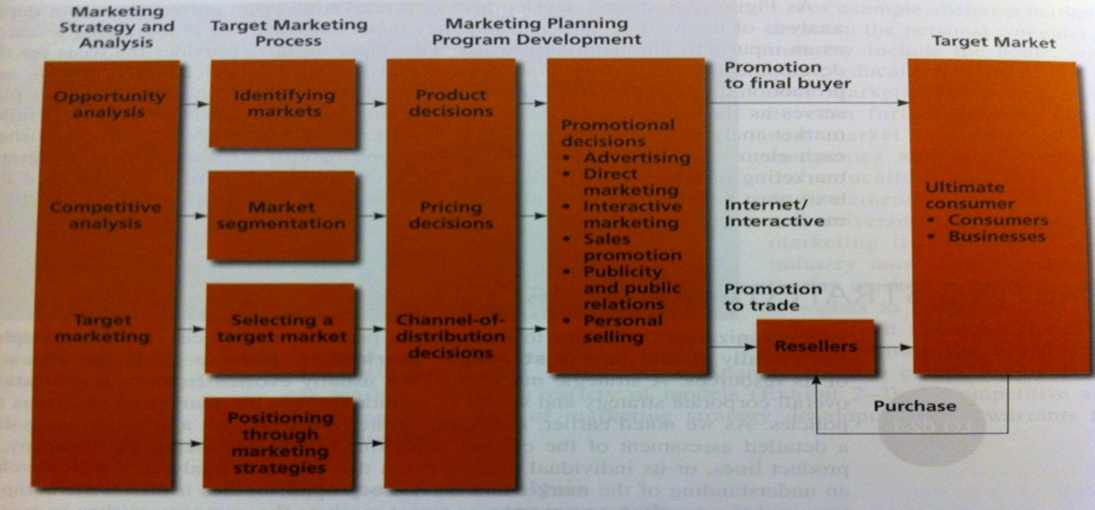
people
marketers
agencies

Slide 16
people
marketers
agencies

Slide 17
The client’s side
MD
Production
Marketing
Sales
Finance
R&D
HR
Brand manager
Trade marketing
Market Researches: Trends, Needs and Motivations, Market segmentation
Marketing mix development
Innovation
Communication
Pricing strategies
Positioning
Pack design
Agency management
Support to sales
Brand manager (…)
Mktg services

Slide 18
people
marketers
agencies
Deliver specific services according to the nature of the agency:
Researches
Advertising
Media planning and buying
Web solutions
PR and influence plans
Packaging design

Slide 19
The ad agency side
President
Client services
Planning
Creative
Digital
Production
Finance
HR
Manage clients and supervise the projects
Responsible for actual production (ex. shooting)
The boring things Finance and HR do
Define communication strategies and researches
Develop actual executions
Develop web solutions and integrate

Slide 20
Different type of advertising agencies
Big multinational groups (WPP, IPG, Omnicom, Publicis); full set of departments, highly integrated usually handling global accounts
Local strong players (in Thailand: Matchbox, Prakit, Bangkokshocase) born as spin-offs from bigger agencies or from local talents. Mid-small sizes focused on core services
“Creative boutiques” focused only in creative development. Known for out of the box thinking mainly work on ad hoc projects

Slide 22
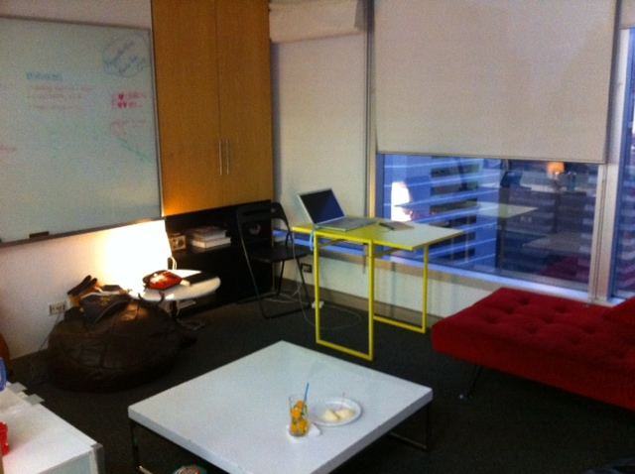


Slide 23
The typical flow
Brief from marketing to client services (C.S.)
Creative team to develop executions – Planners to work on strategy
Agency presents to client
Planners to understand the brief and develop creative brief
Planners and C.S. to brief creative team

