Slide 1

Chapter 9 & 10: Homework

Slide 2

Group Homework
Group Homework #1: Chapter Presentations
1.Each group will be assigned 2 cases/class
& presented in the following class.
2. You are allowed on more than 3 page ppt slides, and 7 minutes presentation for each case
3. Contents should include :Summary of case and answers, suggestions etc.
4. After each presentation, we will have class discussion therefore everyone should read the cases before coming to class.
Notes:
1

Slide 3

Chapter Presentation 9.2
Page 250
Notes:
1

Slide 4
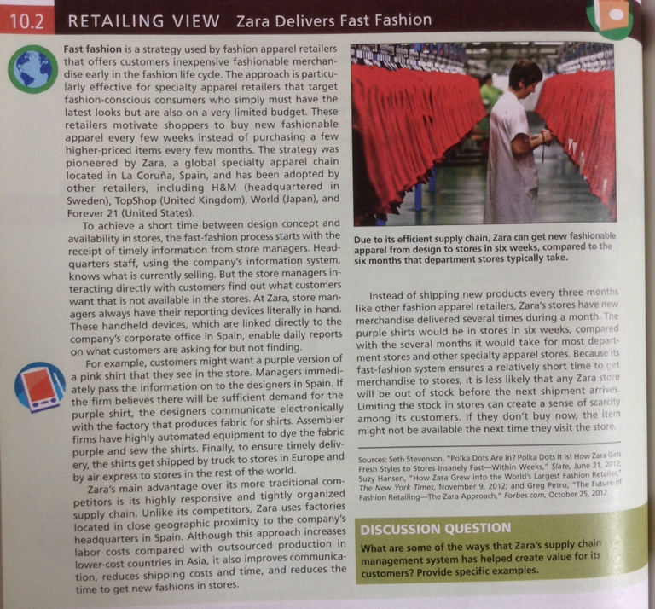
Chapter Presentation 10.2
Page 270
Notes:
1

Slide 5
Group Homework-New Retail Business Location
Group Homework #2: Project Mini-presentation 3
1.You are to discuss your new retail business in terms of location.
2. Prepare a 7-10 minute presentation about the direction of your new business location.
What location are you planning to open your store (flagship) at? Please specify direct address with map.
What factors justify this location?
What costs are you prepared to pay in terms of rental and please justify why?
What is your plan for future business expansion?
3. Presentation due this Thursday July 7, 2016, please include logo and name of group and member names on the slides.
Notes:
1

Slide 6


