Slide 1
U.S. Auto-parts trade with China
Jobs in the U.S. auto-parts industry are at risk due to subsidized and unfairly traded Chinese auto parts

Slide 2
Agenda
Intro
Methodology
Arguments this paper made
Conclusion
Discussion questions

Slide 3
Intro
Chinese auto-parts exports increased more than 900% from 2000 to 2010 because of;
  Chinese government subsidization in auto-parts industry
  China’s illegal currency manipulation, reducing cost of Chinese auto-parts (25-30%)
  Other unfair trade policies to illegally promote sales of auto-parts
All these activities pose threat to future employment in the U.S, auto-parts industry
Notes:
Page 1-2 put briefly tell the situation

Slide 4
Intro
China has had global trade surplus in auto-parts (with and without tires) throughout the past decade (2000-2010)
  China’s export of auto-parts increased from $3.9 billion in 2000 to $41.2 billion in 2010
  China’s import of auto-parts increased from $3.8 billion in 2000 to $32.1 billion in 2010
Notes:
Page 1-2 put briefly tell the situation

Slide 5
Intro
But without tires, China had a global trade deficit in auto-parts in seven of the past ten years
However, China still manage to have significant amount of trade surplus in auto-parts (with and without tires) with the U.S. in the same period of time

Slide 6
Intro
“ This paper wants to look at the potential broad impact of unfair trade competition and the failure of the U.S. to operate effective trade policies. ”

Slide 7
Methodology
Harmonized Tariff Schedule codes (HTS)
  Determines tariff classification for goods imported into the U.S. (same as exported goods) based on its name, use, and/or the material used in its construction. Assigns a ten-digit classification code number, and there are over 17,000 unique classification code numbers.
  But in this paper, six-digit HTS codes is used with some exception of five four-digit HTS codes
Tri-annual report by Hill, Menk, Cooper to calculate state-level employment.
Bureau of Labor Statistics data for North American Industry Classification System (NAICS) four- and five-digit industry codes for assembled vehicles to calculate national employment
Notes:
Definition of Harmonized Tariff Schedule codes (HTS)

Slide 8
Example of HTS codes
401310 Inner tubes, of rubber, of a kind used on motor cars, including station wagons and racing cars, buses, and lorries
830120 Locks used for motor vehicles, of base metal
850790 Plates, separators, and other parts of electric accumulators, n.e.s.

Slide 9
1. The decline of the U.S. motor-vehicle sector and auto-parts industry
Globalization
  Rapidly growing import competition has hollowed out the market for U.S.-made vehicle.
Collapse in the U.S. economy
  Severe impacts on demand for autos and other consumer durables.
Result
  Total domestic car and truck sales of U.S. automakers fell from 11.5 million units in 2000 to 4.6 million units in 2009 (decline about 60%)

Slide 10
1. The decline of the U.S. motor-vehicle sector and auto-parts industry
Sales
  Total sales of motor vehicles in the United States (domestically made vehicles and imports) were stable, averaging above 16 million units per year between 1994 and 2008.
  Total sales of 12.7 million units in 2011
  In 2011, the total sales were about 22.4 % smaller than the average annual market of the 15 years before crisis.

Slide 11
1. The decline of the U.S. motor-vehicle sector and auto-parts industry
Market share
  U.S. automakers suffered from a steadily declining market share beginning in 1990.
  U.S. automakers increased 3.3 % between 2009 and 2011.
    After crisis
    Restructuring of GM and Chrysler in 2009

Slide 12
1. The decline of the U.S. motor-vehicle sector and auto-parts industry
While total U.S. automaker sales in 2011 reached nearly 6 million units, they were 48.1 % below levels achieved in 2000.
  Declining overall demand and significant long-term loss of market share by the U.S.-based producers.

Slide 13
2. U.S. auto-parts employment level
Employment in the U.S. auto-parts industry
  Driven by demand for original equipment manufacturer (OEM) parts to supply auto assembly plants in the United States.
Since auto-parts industry follows the trends of the overall motor-vehicle sector
  Direct employment in the U.S. auto-parts industry has fallen by 419,600 jobs (45.8 %) from November 2000 to November 2011. (FIGURE A)

Slide 14
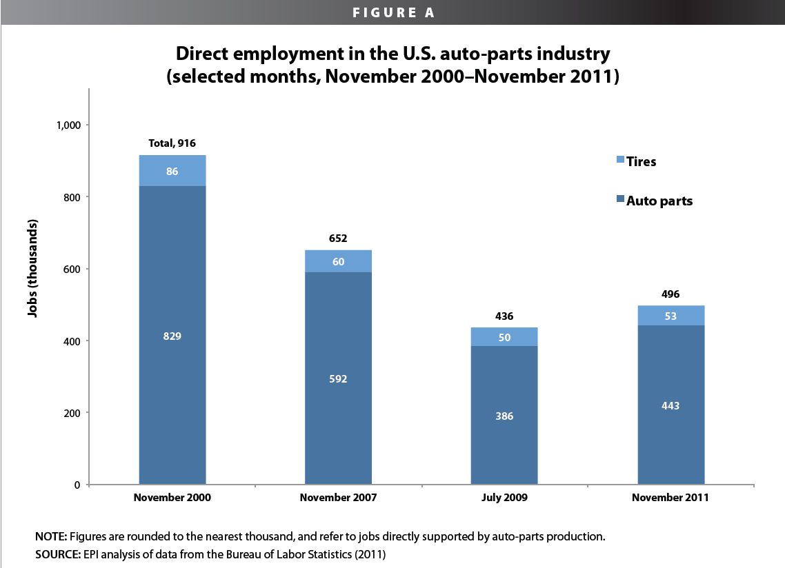
2. U.S. auto-parts employment level

Slide 15
3. Direct threat to employment in U.S. auto-parts industry
  Trade deficits in both completed auto and auto parts are major reason towards the job losses.
    Auto parts’ share has risen steadily 8.4% to 29.2%
Factor explains the deficit
  The shrinking of U.S. vehicle market
  An increase in foreign-owned vehicle assembly plants in U.S.
  The forward movement of foreign-affiliated suppliers

Slide 16
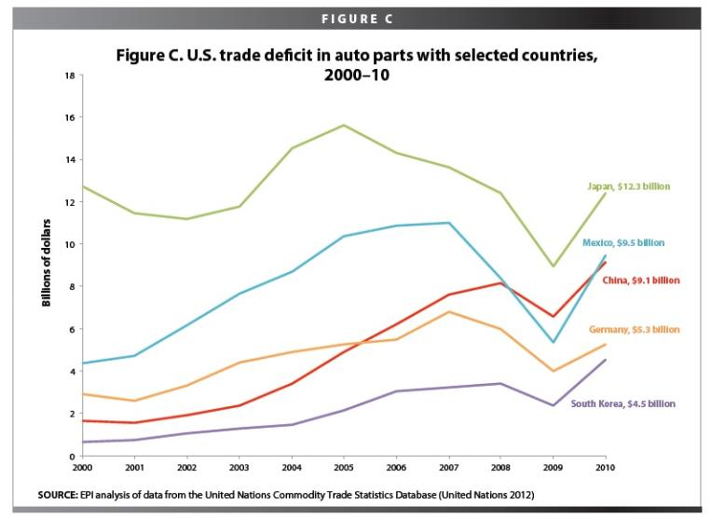
3. Direct threat to employment in U.S. auto-parts industry

Slide 17
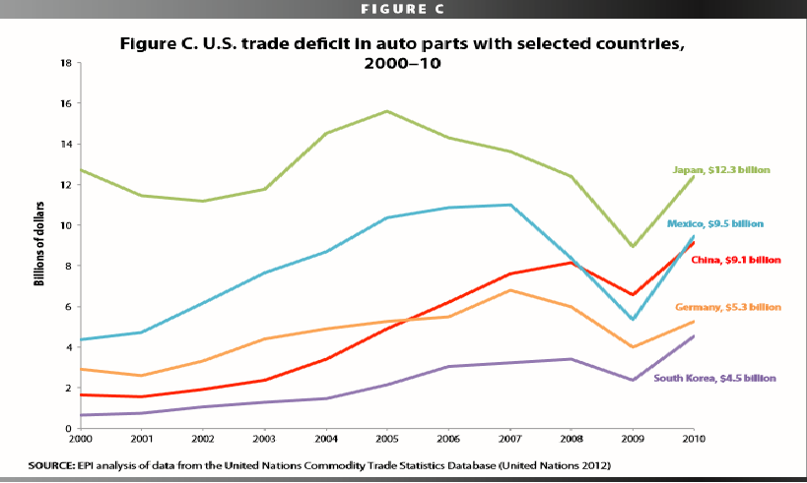
4. China's activity that affect U.S, auto-parts industry level of employment
- Between 2007 and 2010, the share of China in the U.S. auto-parts trade deficit rose the most. While those of other major producers declined

Slide 18
4. China's activity that affect U.S, auto-parts industry level of employment
China’s share gained 5.8 percentage point
South Korea’s share gained 4.5 percentage point
Japan’s share declined 2.2 percentage point
Mexico’s share declined 3.5 percentage point
Germany’s share declined 4.1 percentage point

Slide 19
4. China's activity that affect U.S, auto-parts industry level of employment
Policies
Between 2001 and 2010, Chinese government subsidized $27.5 billion to the auto-parts industry through coal, electricity, natural gas and steel
Illegal currency manipulation which reduced the cost of Chinese auto parts by 25-30 %
Imposed requirements that require the foreign investors to transfer their technology to local joint-venture partners

Slide 20
4. China's activity that affect U.S, auto-parts industry level of employment
Discriminated against imported goods
Imposed restrictions on the exports of many critical mineral resources
** All of these policies violated China’s WTO commitments and also gave an unfair advantage to China domestic auto-parts producers.

Slide 21
4. China's activity that affect U.S, auto-parts industry level of employment
As a result, the growth of China’s subsidy in auto-parts industry lower price of Chinese auto parts which reinforced U.S. automakers to substitute local products for global sourcing products (Chinese products).
China’s share of total U.S. auto-parts imports increased from 1% in 1996 to more than 10% in 2008.
Hence, it provided a negative effect for the level of employment in U.S. auto-parts and related industries

Slide 22
5. Job loss risk
In 2009, there are 1,584,503 jobs supported by the auto-parts industry. Thus, the growth of auto-parts imported from China make these jobs at risk
The tables include jobs that directly and indirectly supported by auto-parts industry. For example, steel, aluminum, electronics, accounting and engineering industries

Slide 23
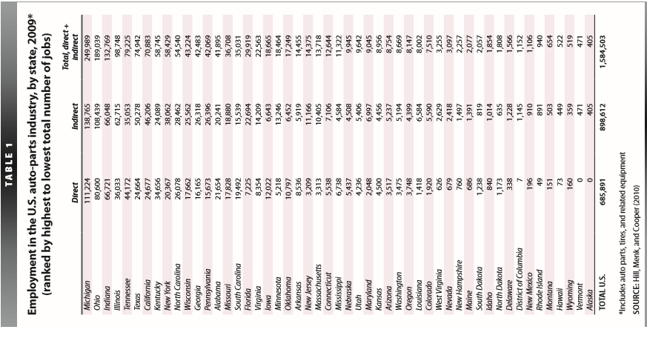

Slide 24
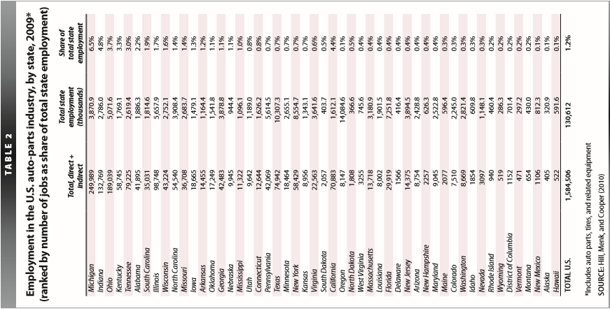

Slide 25
Conclusion
U.S. auto-parts suppliers have not benefited proportionately despite there’s increased in U.S. automakers’ sales since 2009
Due to : 1. Sourcing auto-parts production to
China, Mexico, South Korea
  2. share of U.S. vehicles
  3. Rapid growing trade deficit in auto-parts
U.S. auto-parts trade deficit with
  the world (2009-10) ( $31.2 Billion )
  China (2010) ( $9.1 Billion )

Slide 26
Conclusion
1.6 million jobs in the U.S. auto-parts and supplier industries are at risk due to rapidly growing trade deficit in auto-parts industries
U.S. has room to improve its policies in order to fight
- unfair currency manipulation
- illegal subsidies
- unfair trade barriers
by China and other countries

Slide 27
Discussion Questions
1.) Germany, Japan, South Korea are all faced with the same unfair trade practices emanating from China but appear to be doing a much better job of dealing with them. Why?
2.) What possibly could the U.S. done to counter the effect of subsidized and fairly traded Chinese auto parts?

