Slide 1
FN 281: Personal Finance
Thanachote Rungsitivat, CFA, FRM

Slide 2
An Introduction to Investment Basics
Keep in mind why you are investing
Determine how much you can set aside for investing
Just Do It!

Slide 3
Investing Versus Speculating
Investing -- putting your money into an asset that generates a return
  Examples -- stocks, bonds, mutual funds, or real estate
Speculating -- putting your money into an asset that the future value, or return, relies on supply and demand
  Examples -- collectors items, gold, baseball cards, or derivative securities

Slide 4
Setting Investment Goals
Write down your goals and prioritize them
Attach costs to the goals chosen
Determine the date when the money will be needed
Periodically reevaluate your goals

Slide 5
Questions You Should Ask Yourself About Your Goals
What are the consequences if I don’t achieve the goal?
How much am I willing to sacrifice to meet the goal?
How much money do I need to achieve the goal?
When do I need the money?

Slide 6
Don’t Forget the Time Value of Money
If your goal is to retire in 40 years with THB 5,000,000 and you assume an 8% return, how much will you need to invest annually?
FV = PMT(PVIFA _{i%, n yrs} )
THB 5,000,000 = PMT(259.052)
THB19,300 = PMT

Slide 7
Tax Savvy Investing
Determine your marginal tax rate
Consider tax-free alternatives
Capital gains beat current income
  20% instead of 35% or higher tax rate

Slide 8
Financial Reality Check
Balance your budget -- control spending
Put a safety net in place -- buy insurance
Maintain adequate emergency funds -- keep a proper level of liquidity

Slide 9
Investment Reality Check
If I don’t reach this goal, what are the consequences?
Am I willing to make the sacrifices to reach this goal?
IF SO….invest…..

Slide 10
Starting Your Investment Program
Pay yourself first
Make investing automatic
Take advantage of Uncle Sam and your employer
Invest your windfalls
Make 2 months a year investment months – live a “life of poverty”

Slide 11
Investment Choices
Lending investments
Ownership investments

Slide 12
Lending Investments
Placing your money into savings accounts and bonds which are issued by corporations and the government
Bonds -- debt instruments that provide a return in the form of a coupon interest rate payment and par value at the stated maturity date
Most have a fixed rate of return, although some rates vary or float

Slide 13
Ownership Investments
Placing your money into preferred and common stocks. You become part owner in the corporation and receive a portion of the profits as dividends.
  Dividends on preferred stock are generally fixed.
Buying real estate to generate a return through rent or capital appreciation.

Slide 14
Hierarchy of Payment to Investors
Bond holders
Preferred stockholders
Common stockholders

Slide 15
Returns From Investing
Capital gains/losses
Income
  from bonds you receive interest
  from stocks you receive dividends
Rate of return =
(ending value - beginning value) + income beginning value

Slide 16
Returns From Investing (cont’d)
Rate of return =
(ending value - beginning value) + income beginning value
Annualized rate of return =
(ending value - beginning value) + income X 1 beginning value N

Slide 17
A Brief Introduction to Market Interest Rates
Nominal and real rates of return.
Historical interest rates.
Interest rate risk.
Determinants of the quoted, or nominal, interest rate.
How interest rates affect returns on other investments.

Slide 18
Nominal and Real Rates of Return
Nominal (quoted) rate -- the rate of return without adjusting for inflation.
Real rate -- the inflation adjusted rate of return.
Premiums -- additional returns demanded by investors for taking on additional risk.

Slide 19
Historical Interest Rates
High-quality corporate bonds pay more than 30-year Treasury bonds.
30-year Treasury bonds pay more than 3-month Treasury bonds.
Rates rise and fall in response to increases and decreases in inflation.

Slide 20
What Makes Up Interest Rate Risk?
K* + Interest Risk Premium
K* = The cost for delaying consumption, or the interest rate due on a risk-free bond in a world with no inflation

Slide 21
Types of Risk Premiums
Inflation risk premium (IRP) -- compensation for the anticipated inflation over the life of the investment.
Default risk premium (DRP) -- compensation for the possibility that the issuer may not pay the interest or repay the principal.

Slide 22
Types of Risk Premiums (continued)
Maturity risk premium (MRP) -- compensation on longer-term bonds for value fluctuations in response to interest rate changes.
Liquidity risk premium (LRP) -- compensation for a bond that can not be quickly converted into cash at a fair market value.

Slide 23
Determinants of the Quoted, or Nominal, Interest Rate
Nominal (quoted) interest rate =
k* + IRP + DRP + MRP + LRP
where
  real risk-free rate of interest or return for delaying consumption
  premiums for taking on additional risk
  Remember Axiom 1

Slide 24
How Interest Rates Affect Expected Returns
If interest rates are down, the expected return on other investments goes down.
If interest rates are up, the expected return on other investment goes up.

Slide 25
Sources of Risk in the Risk-return Trade-off
Interest rate risk
Inflation risk
Business risk
Financial risk
Liquidity risk
Market risk
Political and regulatory risk
Exchange rate risk
Call risk

Slide 26
Interest Rate Risk
Risk associated with fluctuations in security prices due to changes in the market interest rate.
A rise in the market interest rate reduces the value of your lower rate security.
Impossible to eliminate.

Slide 27
Inflation Risk
Risk that rising prices will erode purchasing power
Closely linked to interest rate risk because of the effect of inflation on interest rates
Almost impossible to eliminate
Choose securities with a return higher than the expected inflation rate

Slide 28
Business Risk
Is the risk associated with poor company management or product acceptance in the marketplace
Varies by company

Slide 29
Financial Risk
The risk associated with the company’s use of debt.
Remember the hierarchy of payments.

Slide 30
Liquidity Risk
Risk associated with not being able to liquidate a security quickly and cost effectively.
Collectibles and real estate have high liquidity risk.
Less important with a longer investment horizon.

Slide 31
Market Risk
Risk associated with the swings in the overall market
Can be caused by the economy, supply and demand, and interest rates
Overlaps interest rate risk
Impossible to eliminate

Slide 32
Political and Regulatory Risk
Risk that results from unanticipated changes in the tax or legal environment.
Changes in the tax treatment of some investments are a strong source of regulatory risk.
Can be very difficult to predict.

Slide 33
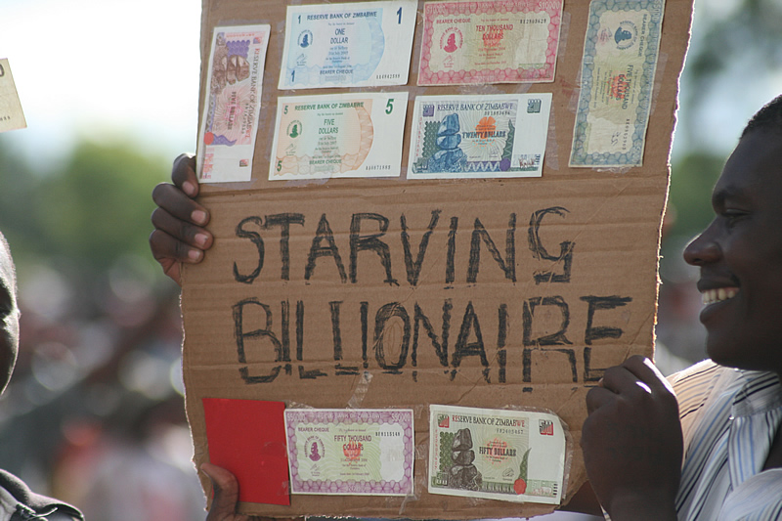
Exchange Rate Risk
Risk that results form varying exchange rates.
Very important for the international investor.
Virtually eliminated by investing in domestic companies with little or no foreign connection.

Slide 34
Call Risk
Risk that a callable security may be taken back before maturity.
If a bond is called, the investor normally receives the face value plus one year of interest payments.
Only applies to callable bonds.

Slide 35
Diversification and Investments
Diversification reduces risk
Two types of risk
  Systematic, market-related, or nondiversifiable risk
  Unsystematic, firm-specific, company-unique, or diversifiable risk
Investors demand a return for taking on additional systematic risk

Slide 36
Diversification and Risk
Diversification refers to the number of different types of securities owned.
The extreme good and bad returns average out, resulting in a reduction of risk without affecting expected return.

Slide 37
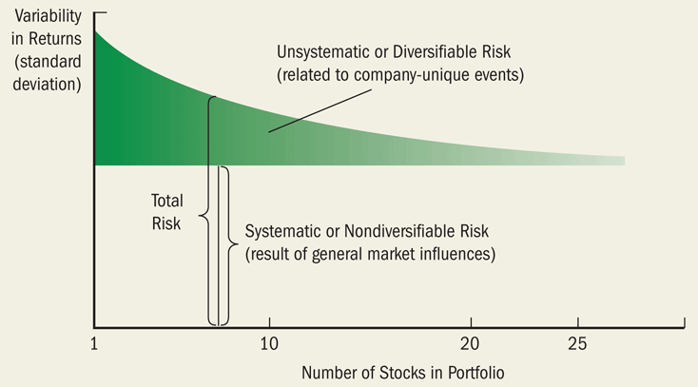
Systematic and Unsystematic Risk
Systematic risk refers to the risk associated with all securities and therefore can not be reduced through diversification.
Unsystematic risk refers to the risks associated with one particular investment and therefore can be reduced through diversification.

Slide 38
Understanding Your Risk Tolerance
Your ability to deal with the unknown, or the volatility of investment returns.
Recognize your risk tolerance and invest accordingly.
Don’t let risk aversion keep you from reaching your goals!

Slide 39
The Time Dimension of Investing
As the length of the investment horizon increases, invest in riskier assets.
Over time, riskier assets outperform less risky assets – but there is still uncertainty.
Even in the worst case, riskier assets probably outperform a more conservative approach.

Slide 40
Measuring Portfolio Risk
1. Variability of the average annual return on investments.
2. Uncertainty associated with the ultimate dollar value of the investment.
3. Distribution of ultimate dollar returns from one investment against another.

Slide 41
Variability of the Average Annual Return
Variability declines as the ownership period increases – good and bad years average out.

Slide 42
Ultimate Dollar Value of the Investment
As investment horizon lengthens, the range of ultimate dollar values gets bigger.

Slide 43
Ultimate Dollar Returns From Different Investments
As investment horizon lengthens, the range of ultimate dollar returns from different investments gets bigger.

Slide 44
Other Reasons for Risk With a Longer Time Horizon
There are more opportunities to adjust saving, spending, and working habits over a longer time period.
“No place to hide!” If stocks crash, ultimately so will bonds, so you may as well earn more.

Slide 45
Asset Allocation: Its Meaning and Role
Asset allocation – a plan for diversifying money among the major types of securities.
A good asset allocation will maximize returns while minimizing risk.
No two asset allocation plans should be exactly the same.

Slide 46
Factors Affecting Asset Allocation
Investment horizon
Risk tolerance
Individual goals
Current financial situation
Stage in the life cycle

Slide 47
What You Should Know about Efficient Markets
Market efficiency concerns the speed at which new information is reflected in security prices.
True market efficiency would result in prices accurately reflecting value.
If the market is purely efficient, no stocks would be undervalued or overvalued.

Slide 48
Can You Consistently Beat the Market? NO!!
“Superstar” underpriced stock picks, even from reputable sources, usually don’t perform well.
Projections on market timing, or buying before the market rises, are seldom right.

Slide 49
The Bottom Line -- What to Do?
Systems don’t beat the market. Long-term investing works best.
Keep to the plan.
Focus on the asset allocation process.
Keep the commissions down.
Diversify, diversify, diversify!
If you don’t feel comfortable, seek help!

Slide 50
The Situation
Will Robinson is 25 years old and has never done any investing. He thinks it is time for him to start saving for his retirement. He has seen his uncle do very well financially by investing early in life and investing consistently. His uncle has told him that the earlier in life he begins to invest – even if he only invests a small amount – the more money he will earn for is future. Will does not know anything about investing and wants to learn more.

Slide 51
Preparing for an Investment Program
Establishing Investment Goals
Performing a Financial Checkup
  Work to balance your budget
  Manage your debt
  Start an emergency fund
  Have access to other sources of cash for emergency needs
Getting the Money Needed to Start an Investment Program

Slide 52
Will’s Investment Goal
Will wants to save THB 500,000 over the next two years so he can start his internet based business.
Will wants to be able to save THB 1,000,000 over the next five years so that he has enough money for a down payment on a home.
Will wants to have THB 50,000,000 saved up by the time he retires at the age of 65 so he can enjoy his retirement.
Before Will learns about the different investment choices, he needs to identify his investment goals. Will knows that his investment goals should be written, specific, and measurable. They can be stated in terms of THB or in terms of particular things he desires. Will’s goals can also be divided into short term, medium term, and long term financial goals.

Slide 53
Will Performs a Financial Checkup
Will must work to create and balance a budget
Will needs to get adequate insurance protection if he does not already have it
Will needs to accumulate an emergency fund with at least 3 months of expenses in it
Will needs to have access to other sources of cash for emergency needs such as a line of credit
Before Will can carry out his future plans, he needs to be sure his personal financial affairs are in good shape. He has never had a budget and thinks it is time for him to develop his first one. He also does not have an emergency fund and wants to work to have this available for himself. He does have a credit card with a fairly high credit limit, and does have pretty good renter’s and car insurance.

Slide 54
Will Needs to get Funds for Investing
Will needs to pay himself first
Will needs to check and see if his work has a provident fund plan and sign up for it
Will needs to start an elective savings plan
Will needs to make a special effort once or twice a year to save extra
Will needs to take advantage of any gifts, windfalls or inheritances he receives
When he creates his budget, he needs to be sure to include his savings each month first.

Slide 55
Factors Affecting Investment Choices
Safety and Risk
Risk-Return Trade-Off
Components of the Risk Factor
Investment Income
Investment Growth
Investment Liquidity
Before Will can choose his investments, he needs to understand the factors that can affect the value of his investments and his investment choices. An investment that might be appropriate for his father or cousin might mot be the investment that is appropriate for him. Will wants to explore all of these factors in more detail before he looks at the different types of investments available to him.

Slide 56
Risk
Safety and Risk
The Risk-Return Trade-off
  Tolerance for Risk
  Calculating Return on an Investment
The first thing that Will needs to understand is that there is no perfect investment because of the relationship between safety and return. Safety in an investment means minimal risk of loss while risk means a measure of uncertainty about the outcome. If he wants a higher return on an investment, he needs to be willing to take on more risk. Will needs to understand that not everyone has the same tolerance for risk. An investment that he thinks looks pretty good might have too much risk for his father. He also needs to understand that speculative investments are highly risky investments that have a chance of a large profit in a relatively short period of time. However, it can be easy to lose most, if not all, of the money he puts into one of these speculative investments.

Slide 57
Evaluating Your Tolerance for Risk
Conservative Investors with Less Risk Tolerance
  People with no financial training
  Older investors
  Lower-income investors
  Families with children
  Employees worried about job loss
Speculative Investors with More Risk Tolerance
  People with financial training
  Younger investors
  Higher-income investors
  Married couples with no children or single
  Employees with secure employment

Slide 58
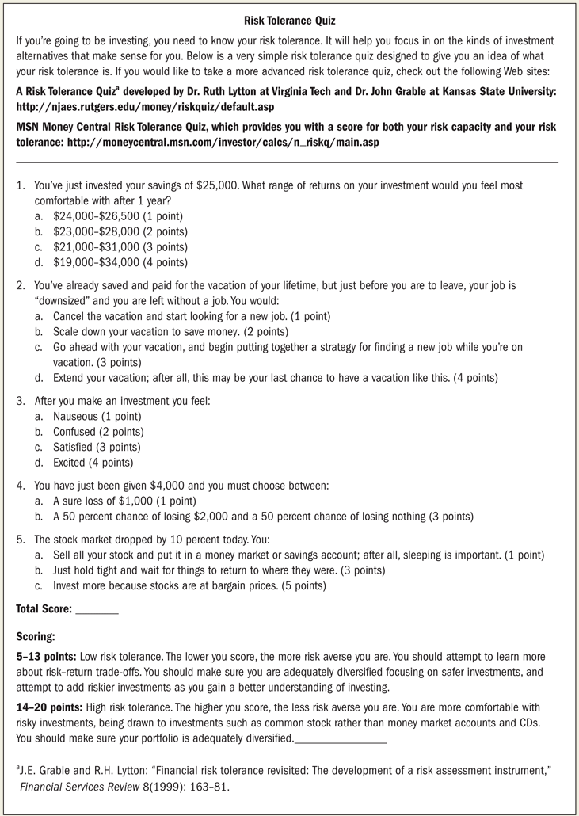

Slide 59
Calculating Return on an Investment
The rate of return on an investment is equal to
The total income received (or expected) on the original amount invested over a specified period of time divided by the original amount invested
This rate of return can be calculates using actual numbers at the end of the period or projections of the amount to be received. If projections are used, remember that there is no certainty that this is what will actually be received by the investor.

Slide 60
Will’s Rate of Return
Suppose Will has an investment opportunity where he invests $2,000 initially. During the year, he expects to receive $60 in dividend income from this investment, and he thinks the value of this investment at the end of the year will be $2,250. Will wants to calculate his potential rate of return on this investment.
$2,250 - $2,000 = $250
$250 + $60 = $310
$310/$2,000 = .155 or 15.5%
His rate of return will be the total dollar return divided by his initial investment.

Slide 61
Components of the Risk Factor
Inflation Risk – Risk that Will’s investments will not keep up with the inflation rate
Interest Rate Risk – Risk that the value of Will’s Stocks and bonds will decline if market interest rates increase
Business Failure Risk – Risk that bad management, poor products or other problems will lead to lower profits for the business
Market Risk – Risk that behavior of investors in the market will affect the prices of various investments in the market
Global Risk – Risk due to investments in stocks and bonds issued by foreign firms

Slide 62
Investment Income
Some Investors purchase investments in order to have predictable source of income.
If safety is the primary objective, then the safest investments are passbook savings accounts, certificates of deposit.
If investment income is the primary objective, then an investor can choose corporate bonds, preferred stocks, mutual funds, and real estate rental property that can provide income potential.

Slide 63
Investment Growth
Investment growth refers to the increase in the value of the investment. Often an investor has to choose between receiving dividend income from an investment and the amount of potential increase in the value of that investment in the future. For example, growth stocks of then reinvest most of their profits back into the company so that sales revenue and profits can grow in the future. These stocks often pay little or no dividends now.

Slide 64
Investment Liquidity
Liquidity is the ability to buy or sell investment quickly without affecting the investment’s value. Checking and savings accounts are very liquid, because they can be converted into cash very quickly. Real estate, on the other hand, is not very liquid, because it can often take weeks or months to sell a home at its true market value.

Slide 65
Asset Allocation and Diversification
One mistake that investors make is to put all of their money in one type of investment or one company.
Asset diversification or diversification is the process of spreading an investor’s assets among different types of investments and companies to lessen risk.

Slide 66
The Time Factor
The amount of time an investor has to invest is also a crucial factor that needs to be considered when making investment decisions. Investments that can be left for a longer period of time often have a higher rate of return.
Notes: Stock prices are very volatile, because the price tend to go up and down a lot. If Will invests money over a short period of time, then stocks prices may be low when he needs his money

Slide 67
The Investor’s Age
An investor’s age is also critical when making investment decisions. It is an indication of how long that investor has to invest. Age is also an indication of where that investor is in their life cycle and what responsibilities they have. Investors tend to grow more conservative as they get older and take on investments with less risk.

Slide 68
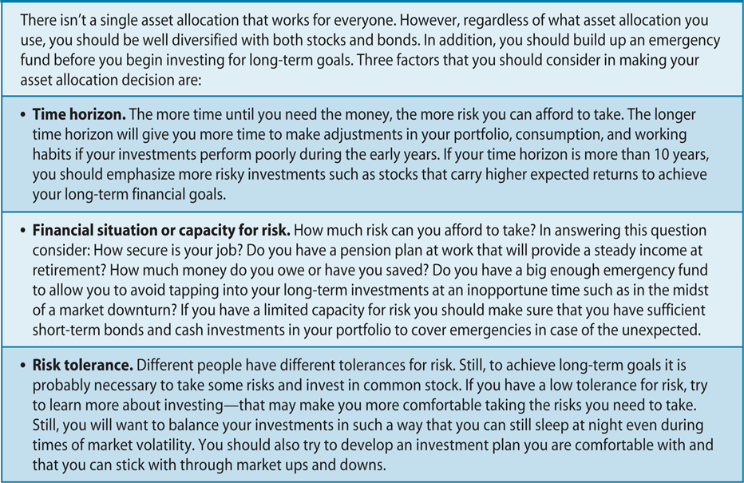
Factors Impacting Your Asset Allocation Decision

Slide 69
What You Should Know About Efficient Markets
Efficient market—a market in which information about the stock is reflected in the stock price.
The more efficient the market, the faster prices react to new information.
If the stock market were truly efficient, then there would be no benefit from stock analysts.

Slide 70
Beating the Market
Half the time you should outperform the market, and half the time you should underperform.
Difficult for “superstars” of investing to pick underpriced stocks and time the market.
Keep your plan and invest for the long term. If you try to time the market, you just as likely to miss an upswing as you are to avoid an downswing.

Slide 71
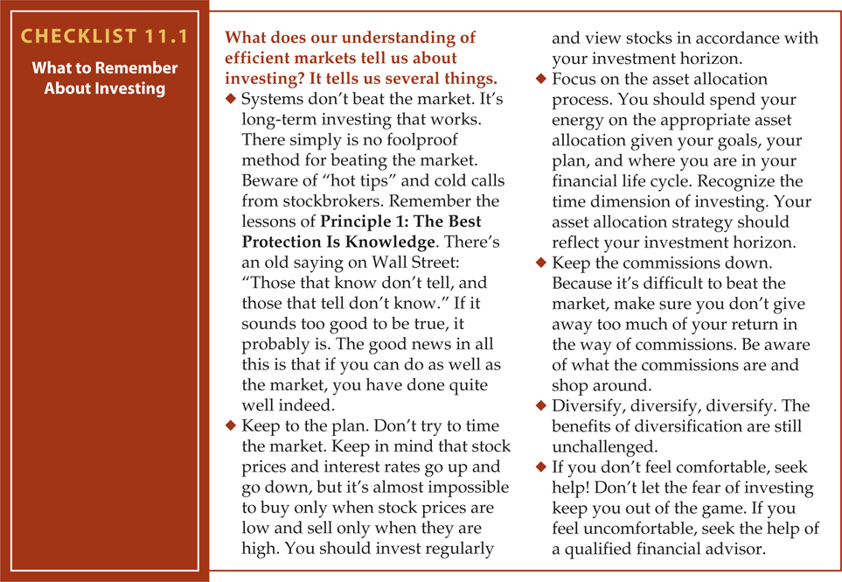
Checklist

Slide 72
Mind Games and Your Money
Overconfidence
Disposition Effect
House Money Effect
Loss then Risk Aversion Effect
Herd Behavior

Slide 73
Investment Alternatives
Stock or Equity Financing (Preferred and Common Stock)
Corporate and Government Bonds
Mutual Funds
Real Estate
Other Investment Alternatives

Slide 74
Preferred Stock
Preferred stock is an ownership claim on a company
Preferred stock pays a fixed dividend amount.
Preferred stock dividends must be paid before any common stock dividends can be paid

Slide 75
Common Stock
Common stock is the most basic type of ownership an individual can have in a company.
Common stock has three sources of return
  Dividend income
  Investment growth as the dollar value of the stock increases
  Profit potential if the company split its common stock
The company is not obligated legally to pay a dividend to stockholders.

Slide 76
Government Bond
A government bond is a written pledge by a government or municipality to repay a specified sum of money at maturity plus interest. Bondholders normally receive interest payments every 6 months.

Slide 77
Corporate Bond
A corporate bond is a company’s written pledge to repay a specified amount of money at the maturity of the bond plus interest. Inters on bond is normally paid every 6 months.

Slide 78
Thank you

