Slide 1
What is Consumer Behaviour?
Individuals or groups acquiring, using, and disposing of products, services, ideas or experiences.
Also includes acquisition and use of information.

Slide 2
Consumer Behaviour: 5W1H
Who
What
Why
When
Where
How
What a marketer need to know about his/her consumers.
Is this enough?

Slide 3
The Circle of Consumption
Patterns of Movement
Acquisition
Consumption
Disposal

Slide 4
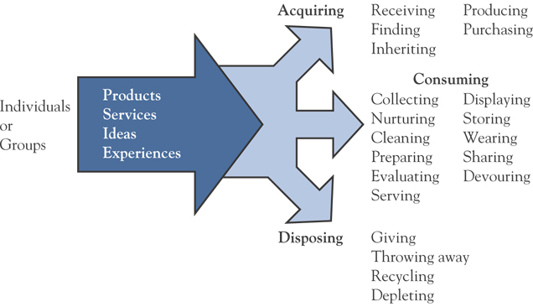
The Domain of Consumer Behaviour

Slide 5
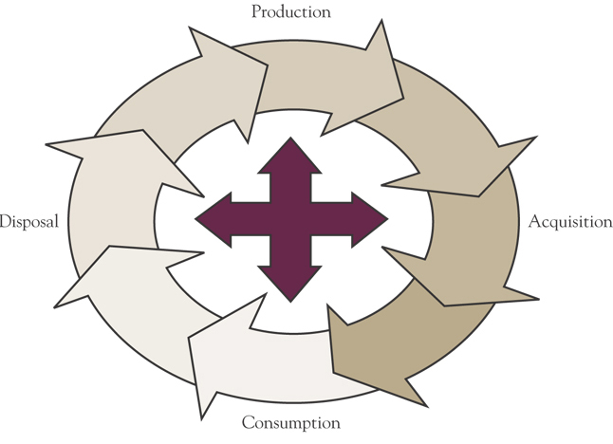
The Circle of Consumption

Slide 6
The Full Circle in Important
Something may be purchased as a momento, but end up as a collectible which is then sold for profit.
The links between all the phases are important.

Slide 7
Consumer Behaviour
& Marketing
Understanding Consumer Behaviour is the ♥ of Marketing
STP as a Starting Point of the Value Delivery Process in Marketing
Consumer as the ♥ of the 4 Ps
4 Ps and 4 Cs

Slide 8
The Value-Delivery Process
Value Creation & Delivery Sequence
Choose Value
Provide Value
Communicate Value
Strategic Marketing
“STP”
Tactical Marketing
“4 Ps”
Market Segmentation
Target Market Selection
Value Positioning
Product
Price
Place
Promotion

Slide 9
Consumer Insights
Marketing Strategy

Slide 10
The 4 Ps & The 4 Cs
The 4Ps
From
Communi-
cation
Customer
Value
to
Customer
Cost
Conve-
nience

Slide 11
Today Marketing
Mass Customisation
Market Fragmentation
Experiential Marketing
Customer Lifetime Value
Consumer Insight
Etc.

Slide 12
But...
How can we
understand
our consumers?

Slide 13
You Can’t Put Consumers in a Box
Knowing stereotypes might not be sufficient!
  People are not acting their age
  People are not acting their class
  People are not acting their sex

Slide 14
Consumer Behaviour is
Product—Person—Situation Specific!
Personal
Characteristics
Consumer
Behaviour
Product
Characteristics
Marketing
strategy
Consumption
Situation

Slide 15
Overall Model of Consumer Behaviour
SOCIO-CULTURALINFLUENCES
Culture
Subculture
Demographics
Social Status
Reference Groups
Family
Marketing Activities
SITUATIONS
Problem
Recognition
Information
Search
Alternative Evaluation
and Selection
Outlet Selection
and Purchases
Postpurchase
Processes
SITUATIONS
Experiences and Acquisition
SELF-CONCEPT
and
LIFESTYLE
Needs
Desires
PSYCHOLOGICAL INFLUENCES
Perception
Learning
Memory
Motives
Personality
Emotions
Attitudes
Experiences and Acquisition

Slide 16
And…
This course shall also embrace some new views and alternative theories.

Slide 17
Last Reminders:
Understanding Consumer Behaviour is the ♥ of Marketing
Mastering Consumer Behaviour is the  to Marketing Success
Consumer Behaviour is .
An Endeavour toConsumer Behaviour is Best through an Attempt to Reflect on Our Own Behaviour.

Slide 18
Session 2: Lecture Outline
Consumers As Individual
Perception

Slide 19
Overall Model of Consumer Behaviour
SOCIO-CULTURALINFLUENCES
Culture
Subculture
Demographics
Social Status
Reference Groups
Family
Marketing Activities
SITUATIONS
Problem
Recognition
Information
Search
Alternative Evaluation
and Selection
Outlet Selection
and Purchases
Postpurchase
Processes
SITUATIONS
Experiences and Acquisition
SELF-CONCEPT
and
LIFESTYLE
Needs
Desires
PSYCHOLOGICAL INFLUENCES
Perception
Learning
Memory
Motives
Personality
Emotions
Attitudes
Experiences and Acquisition

Slide 20
Perception
The process by which an individual selects, organises, and interprets stimuli into a meaningful and coherent picture of the world.
Perception vs. Sensation

Slide 21
Perception vs. Sensation
Sensation
  Refers to the immediate response of our sensory receptors (eyes, ears, nose, mouth, skin) to such basic stimuli as light, color, and sound.
Perception
  selected, organised, and interpreted.
  People process a small amount of information (stimuli).
  An even small amount is attended to and given meaning.

Slide 22

Vision
Sensory System
Nose
Smell

Sound
Skin
Touch

Taste

Slide 23
Perception Process
Sensation
Exposure
Attention
Interpretation
STIMULI or SENSORY INPUTS
Response
Meaning
Perception

Slide 24
Information Processing for Consumer Decision Making
Exposure
Random Deliberate
Attention
Low- High-
involvement involvement
Perception
Interpretation
Low- High-
involvement involvement
Short-term Memory Long-term
Active problem Stored experiences, solving values, decisions, rules, feelings
Purchase and Consumption Decisions

Slide 25
Exposure
AA
AA
AA
AA
AA
Degree to which people notice a stimulus that is within range of their sensory receptors.

Slide 26
Attention
Consumers often suffer Sensory Overload, exposure to far more information than they are capable of or willing to process.
Refers to the extent to which processing activity is devoted to a particular stimulus.

Slide 27
Interpretation
Consumers assign meaning to stimuli based on Schema, or set of beliefs, to which the stimuli is assigned. The schema will determine what criteria will be used to evaluate the marketing mix and activities.
Refers to the meaning that we assign to sensory stimuli.

Slide 28
Elements of Perception
Sensation
The absolute Threshold
The differential Threshold
Subliminal Perception

Slide 29
Sensory Threshold:
Range of Intensity of a Stimulus That Consumers are Capable of Perceiving:
Differential Threshold
refers to the ability of a sensory system to detect changes or differences between two stimuli.
  Just Noticeable Difference (j.n.d.)
  Weber’s Law
Absolute Threshold
refers to the minimum (maximum?) amount of stimulation that can be detected on a sensory channel.

Slide 30
Weber’s Law
A theory concerning the perceived differentiation between similar stimuli of varying intensities (i.e., the stronger the initial stimulus, the greater the additional intensity needed for the second stimulus to be perceived as different).

Slide 31
Subliminal Perception
Perception of very weak or rapid stimuli received below the level of conscious awareness.

Slide 32
Concepts Concerning Selective Perception
Selective Exposure
Selective Attention
Perceptual Defense
Perceptual Blocking

Slide 33
Selective Perception
Consumers:
  Concentrate on some stimuli,
  Are unaware of others,
  Even go out of their way to ignore some messages.

Slide 34
Determinants of Perception
Individual Characteristics
Perception
Stimulus Characteristics
Gestalt
Situational Characteristics

Slide 35
Stimulus Characteristics
Size
Intensity
Colour
Movement
Position
Isolation
Format
Contrast
Quantity
Novelty
Adaptation Level Theory
Over time, we adjust to the level and type of stimuli to which we are accustomed. Thus, an advertisement that stands out when new will eventually lose its contrast effect and its ability to capture or hold attention.

Slide 36
Individual Characteristics
Interest & Involvement
Ability to Attend to Information
Attitudes toward Stimuli
Experience Learning & Expectations
  Perceptual Vigilance
  Perceptual Defense
  Adaptation

Slide 37
Situational Characteristics
Context of the Situation
Time Pressure
Crowded Space
Situational Involvement
etc.

Slide 38
Distorting Influences
Physical Appearances
Stereotypes
Irrelevant Cues
First Impressions
Jumping to Conclusions
Halo Effect

Slide 39
Perception &
Marketing Strategy
How can we apply our knowledge of perception in our marketing strategy?

Slide 40
Perception and Product
Perceptual Mapping & Positioning
Stimuli Cues & Product Characteristics
Brand Name and Logo Development
Package & Label Design
etc.

Slide 41
Perception and Price
Price & Quality
Competitive Price
Price Changes
Price Reference
etc.
Sale!
Was B199
20% to 70% Off!
Now B99!

Slide 42
Perception and Place
Channel & Outlet Selection
Point-of-purchase Display
Store Layout & Interior Design
Shelf Position
In-store Promotion
etc.

Slide 43
Perception and Promotion
Advertising Design
  Media
  Creative
Sales Promotion Campaign
PR Campaign
Salespeople
  Characteristics
  Uniform
etc.

Slide 44
Session 3: Lecture Outline
Consumers As Individual
Learning
Memory

Slide 45
Overall Model of Consumer Behaviour
SOCIO-CULTURALINFLUENCES
Culture
Subculture
Demographics
Social Status
Reference Groups
Family
Marketing Activities
SITUATIONS
Problem
Recognition
Information
Search
Alternative Evaluation
and Selection
Outlet Selection
and Purchases
Postpurchase
Processes
SITUATIONS
Experiences and Acquisition
SELF-CONCEPT
and
LIFESTYLE
Needs
Desires
PSYCHOLOGICAL INFLUENCES
Perception
Learning
Memory
Motives
Personality
Emotions
Attitudes
Experiences and Acquisition

Slide 46
Learning Is a Key to
Consumer Behaviour
Culture
Learning
Values
Attitudes
Tastes
Preferences
Skills
Feelings
Products/brand features
Symbolic meanings
behaviours
Subcultures
Social class
Purchase and Use Behaviour
Family
Friends
Institutions
Personal experiences
Advertising
Mass media

Slide 47
Learning: Definition
A process by which individuals acquire the purchase and consumption knowledge and experience that they apply to future related behaviour.

Slide 48
Consumer Learning
Consumer
Stimulus
Response
Consumer’s Black Box

Slide 49
Two Approaches to
Understand Learning
Behavioural theories emphasise response to external events (conditions)
Cognitive theories emphasise information processing
not either / or, but complimentary

Slide 50
Behavioural Learning Theories
Classical Conditioning
  conditioned stimulus evokes response
Instrumental (Operant) Conditioning
  responses that are rewarded are repeated

Slide 51
Classical Conditioning
A behavioural learning theory according to which a stimulus is paired with another stimulus that elicits a known response that serves to produce the same response when used alone.

Slide 52
Classical Conditioning
Schematic Presentation of Classical Conditioning
Conditioned
Stimulus (CS)
Comes to Elicit
Unconditioned Stimulus (US)
Elicits
Unconditioned
Response (UR)

Slide 53
An Analogous Model of
Classical Conditioning
Unconditioned Stimulus
Dinner aroma
Unconditioned Response
Salivation
Conditioned Stimulus
6 O’clock news
AFTER REPEATED PAIRINGS
Conditioned Stimulus
6 O’clock news
Conditioned Response
Salivation

Slide 54
Consumer Learning through Classical Conditioning
UCS
(Popular Music)
UCR
(Positive Emotion)
CS
(Soda Pop)
CR
(Positive Emotion)

Slide 55
Instrumental
(Operant) Conditioning
A behavioural theory of learning based on a trial-and-error process, with habits forced as the result of positive experiences (reinforcement) resulting from certain responses or behaviours.

Slide 56
Reinforcement
A positive or negative outcome that influences the likelihood that a specific behaviour will be repeated in the future in response to a particular cue or stimulus.

Slide 57
Learning Principles:
Instrumental Conditioning
Positive Reinforcement
  An inducement to repeat a behaviour to receive a reward.
Negative Reinforcement
  An inducement to repeat a behaviour to remove an adverse situation.
Punishment
  An aversive consequence that decreases the likelihood a particular response will recur.

Slide 58
A Model of
Instrumental Conditioning
Try
Brand A
Unrewarded
Legs too tight
Try
Brand B
Unrewarded
Tight in seat
Stimulus Situation (Need good-looking jeans)
Try
Brand C
Unrewarded
Baggy in seat
Try
Brand D
Reward
Perfect fit
Repeat behaviour

Slide 59
Consumer Learning by
Instrumental Conditioning
Stimulus
(Dove Sample)
Desired response
(Consumption)
Reinforcement
(Softer Skin)
Increases probability
of response to stimulus

Slide 60
The Process of Shaping in
Purchase Behaviour
Consume a free sample of “Dove” that was distributed in front of the university
Purchase a second package using the discount coupon that accompanied the free sample
Repurchase the product at full price

Slide 61
Cognitive Learning Theory
A theory of learning based on mental information processing, often in response to problem solving.

Slide 62
Cognitive Learning
storage, organisation, and retrieval of information
long-term memory and associative networks
knowledge retrieval
  familiarity, relevance, form of information, and repetition increase ability to retrieve

Slide 63
Cognitive Learning Theories
Iconic Rote
Vicarious or Modelling
Reasoning or Analogy

Slide 64
Range of
Learning Situations
Low-involvement Learning
  Case where we are less motivated to attend to or process material
  to be learned.
High-involvement Learning
  Case where we are
  motivated to process
  information to be learned.

Slide 65
Learning Theories in High- and
Low- Involvement Situations
High-involvement learning situation
Classical
Low-involvement learning situation
Conditioning
Operant
Conditioning
Iconic Rote
Cognitive
Vicarious/
Modeling
Cognitive
Reasoning
Commonly Used
Occasionally Used

Slide 66
Consumers and Learning
Rewards increase learning
  consumers will buy things for which they’re rewarded
  pleasures and the dark side
Repetition increases learning
  bombard consumers with marketing communications
Samplings and Trials increase learning

Slide 67
Consumers and Learning
Stimulus Generalisation: generalisation of similar stimuli through signs and symbols
  Brand Extensions
  Private Brands VS. Market Leaders
  Imitations
Stimulus Discrimination: discrimination between dissimilar stimuli
  Product Differentiation

Slide 68
Stimulus Generalisation
  Brand Extension

Slide 69
Stimulus Generalisation
  Private Brands

Slide 71
Stimulus Generalisation
  Imitated Product

Slide 72
Stimulus Discrimination
  Product Differentiation

Slide 73
Learning, Memory and Information Processing
How Consumers Store, Retain and Retrieve Information

Slide 74
Information Processing for Consumer Decision Making
Exposure
Random Deliberate
Attention
Low- High-
involvement involvement
Perception
Learning
Interpretation
Low- High-
involvement involvement
Short-term Memory Long-term
Active problem Stored experiences, solving values, decisions, rules, feelings
Purchase and Consumption Decisions

Slide 75
The Structure of Memory
Memory consists of three storage systems:
Sensory Memory: A storage system where incoming data undergo preliminary processing.
Short-term Memory: A storage system that momentarily holds acquired information.
  If information is significant, it may undergo:
    Rehearsal
    Encoding
Long-term Memory: An information warehouse where data are organised and extendedly stored.

Slide 76
The Memory Process
Input (Learning)
Encoding
Information is
Placed in Memory
Storage
Information
is Retained in Memory
Retrieval
Information Stored
in Memory is Found as Needed

Slide 77
Encoding Information for Later Retrieval
Sensory Meaning
Semantic Meaning
Color or Shape
Symbolic Associations
Events That are Personally
Relevant
Especially Vivid Association
Episodic Memories
Flashbulb Memories

Slide 78
Storing Information in Memory
Activation Models of Memory
Short-Term and Long-Term Memory are
Interdependent.
Associative Networks
Incoming Information is Organised by
Relationships and Stored in Knowledge Structures.
Spreading Activation
Allows Consumers to Shift Back and Forth
Between Levels of Meaning such as Brands.
Levels of Knowledge
Knowledge is Coded to Produce Meaning
Concepts, then Propositions, then Schemas.

Slide 79
Information Retrieval,
Extinction & Forgetting
Information Retrieval: Sifting through memory to activate stored information.
Forgetting: When knowledge recedes into the mind’s unconscious recesses and cannot be recalled.
Retroactive Interference: When recent
learning interferes with recall of previous learning.
Proactive Interference: When prior learning interferes with recall of recent learning.

Slide 80
Information Processing
and Memory Stores Revisited
Sensory Store
Working Memory (Short-term Store)
Long-term Store
Sensory
Input
Rehearsal
Encoding
Retrieval
Forgotten;
lost
Forgotten;
lost
Forgotten;
unavailable

Slide 81
Session 4: Lecture Outline
Consumers As Individual
Motivation
Involvement
Emotion

Slide 82
Overall Model of Consumer Behaviour
SOCIO-CULTURALINFLUENCES
Culture
Subculture
Demographics
Social Status
Reference Groups
Family
Marketing Activities
SITUATIONS
Problem
Recognition
Information
Search
Alternative Evaluation
and Selection
Outlet Selection
and Purchases
Postpurchase
Processes
SITUATIONS
Experiences and Acquisition
SELF-CONCEPT
and
LIFESTYLE
Needs
Desires
PSYCHOLOGICAL INFLUENCES
Perception
Learning
Memory
Motives
Personality
Emotions
Attitudes
Experiences and Acquisition

Slide 83
What Is Motivation?
A state in which bodily energy is mobilised and directed in a selective fashion toward desirable goals.
Two conditions for
a motivated state:
  Arousal
  Direction

Slide 84
Motivation refers to the processes that cause people to behave as they do.
Once a need is aroused, a state of tension exists that drives the consumer to attempt to reduce or eliminate the need.
Needs can be:
  Utilitarian: a desire to achieve some functional or practical benefit.
  Hedonic: an experiential need, involving emotional responses or fantasies.

Slide 85
Elements of Motivation
Four elements of motivation:
Needs: Internal forces that prompt behaviour toward goal-oriented behaviour.
Motives: A state of tension that pushes the individual to act.
Goals: The sought after objective of motivation.
Desires: Passions that involve longing and wishing for something.

Slide 86
Classifying
Consumer Motivations
Conscious Vs. Unconscious
High Vs. Low Urgency
Positive Vs. Negative Polarity
Intrinsic Vs. Extrinsic
Rational Vs. Emotional

Slide 87
Theories of Motivation
Instinct Theories: Suggest that behaviour is innate
Drive Theories: Suggest that behaviour reflects one’s effort to restore physical or psychological equilibrium
Arousal Theories: Suggest that we often seek stimulation and display arousal-seeking behaviour
Cognitive Theories: Suggest that behaviour is a rational act undertaken by intelligent, information-processing individual

Slide 88
Other Views of Motivation
Maslow’s Hierarchy of Needs
  Basic needs are ranked in a hierarchy.
  Higher-order needs arise and motivate us only after lower-order needs are satisfied.
Social Motivation Theories
  Murray’s instrumental motives (such as harm avoidance).
  McClelland’s trio of needs (power, affiliation, and achievement).
  McGuire’s internal (nonsocial) and external (social) needs.

Slide 89
Maslow’s Hierarchy of Needs
Self
Actualisation
Esteem
Social
Safety
Physiological

Slide 90
McGuire’s Psychological Motives
Need for Consistency
Need for Independence
Need for Self-Expression
Need for Ego-Defense
Need for Reinforcement
Need for Novelty
Need for Modeling

Slide 91
Motivation Process
Tension
Drive Strength
Drive Direction
Behaviour
Want
Goal

Slide 92
Motivational Strength
The Degree to Which a Person is Willing to Expend Energy to Reach One Goal as Opposed to Another.
Biological Vs. Learned Needs
Drive Theory
Expectancy Theory
Focuses on Biological Needs that Produce Unpleasant States of Arousal, i.e. Hunger.
Homeostasis: Behavior Which Tries to Reduce or Eliminate This Unpleasant State and Return to Balance.
Behaviour is Largely Pulled by Expectations of Achieving Desirable Outcomes - Positive Incentives - Rather Than Pushed From Within.

Slide 93
Motivation:
Socially-constructed?
Human motivation
  The interaction between events and things in the social world and interpretations of those events and things in people’s minds.
Consumers’ perceptions of social and cultural situations shape their desires and goals for action.

Slide 94
Latent and Manifest Motives
In a Purchase Situation
A large car is more comfortable
It will demonstrate that I’m successful
Purchase a BMW
It’s a high-quality car that performs well
A number of my friends drive a BMW
It’s a powerful, sexy car and it will help make me powerful and sexy
The linkage between behaviour and motives that are known and freely admitted
The linkage between behaviour and motives that are either unknown or are such that the consumer is reluctant to admit or reveal them

Slide 95
Motivational Conflict
Situations where multiple contradictory needs simultaneously act upon an individual.
Lewin’s 3 types of motivational conflict:
Approach-Approach
Go on an
extended vacation
Buy a new car
Incur
a huge
mortgage
Approach-Avoidance
Buy a new house
Surrender your
driver’s license
for speeding
Pay B 400
to keep
your license
Avoidance-Avoidance

Slide 96
Consumer Involvement
Involvement
The Level of Perceived Personal Importance
and/or Interest Evoked by a Stimulus
Involvement
The Motivation to Process Information
Levels of Involvement
Simple Processing
Elaboration

Slide 97
Consumer Involvement
Cognitive involvement
  involvement that includes heightened thinking and processing of information about the goal object.
Affective involvement
  involvement that includes heightened feelings and emotional energy.
Enduring involvement
  represents the long-term interest that a consumer has in a product class.
Situational involvement
  temporary interest in a purchase or consumption process.

Slide 98
The Many Faces of Involvement
Product
Related to a Consumer’s
Level of Interest in
a Particular
Product.
Message-Response
Refers to a Consumer’s
Interest in Processing
Marketing
Communications.
Ego-Involvement
Refers to the Importance
of a Product to a
Consumer’s
Self-Concept.

Slide 99
Strategies to Increase Involvement
Build a Bond
With the
Consumer
Appeal to
Hedonic Needs
Increasing Consumers’ Attention
Use Novel
Stimuli
Include Celebrity Endorsers
Use Prominent
Stimuli

Slide 100
Marketing Implications of Different Levels of Involvement
High-Involvement Purchase and Consumption
  Complex purchase process by highly involved consumers
  Attention is increased and more importance is attached to the stimulus object.
Low-Involvement Purchase and Consumption
  Minimal decision making for low-involvement products
  Attention is low and less importance is attached to the stimulus object

Slide 101
Low-Involvement
Marketing Strategies
Strategies that increase consumers’ involvement with a product or brand over a short period or for longer period
  Use creative marketing strategies, such as effective advertising or product usage campaigns
  Link low-involvement products with high-involvement issues
  Adapt the advertising medium to the product category.
  Promote the product in a high-involvement medium (e.g., the Web) instead of a low-involvement medium (e.g., radio)
  Use extensive distribution networks, clever in-store displays.

Slide 102
Emotions
Emotions: Feeling states such as joy, love, sorrow, fear, and anger.
Significance to consumer behavior:
  A product’s emotional value represents
  a major part of the appeal
  in product acquisition.
  Stirring consumers’ emotions
  is a powerful promotional strategy.

Slide 103
Nature of Emotions
Specific
feelings
Environmental
event
Affect
Physiological changes
Interpreted as emotions based on situation
Mental
imagery
Behaviours
Thoughts

Slide 104
Emotion Versus Mood
Mood: A temporary feeling state or frame of mind as in being in a good or bad mood.
Significance to consumer behaviour:
  Mood influences whether or not we shop
  Mood influences the way
  we respond to shopping
  environments and cues.
  Mood influences
  consumers’ flexibility.

Slide 105
Emotion-Related Concepts
Bonding
  Involve connecting the consumer and the product through an emotional tie.
  Consider the connection: Individuals, red roses, and love.
Expression of Emotions
  Bodily and facial expressions serve as social signals of a person’s emotions.

Slide 106
Session 5: Lecture Outline
Consumers As Individual
Attitudes
Attitude Change

Slide 107
Overall Model of Consumer Behaviour
SOCIO-CULTURALINFLUENCES
Culture
Subculture
Demographics
Social Status
Reference Groups
Family
Marketing Activities
SITUATIONS
Problem
Recognition
Information
Search
Alternative Evaluation
and Selection
Outlet Selection
and Purchases
Postpurchase
Processes
SITUATIONS
Experiences and Acquisition
SELF-CONCEPT
and
LIFESTYLE
Needs
Desires
PSYCHOLOGICAL INFLUENCES
Perception
Learning
Memory
Motives
Personality
Emotions
Attitudes
Experiences and Acquisition

Slide 108
Overview
Consumers make choices every day.
Some brand choices consumers make are relatively simple; in other situations, consumers make brand choices that require extensive information search and difficult choices.
Attitudes are key internal factors that shape individual consumer choices.

Slide 109
Consumer Attitudes and Attitude Models
Attitude
  a way to summarise consumers thoughts, feelings, and actions.
Attitude models
  provide a description of how consumer information processing, including cognitions and emotions, influence consumer choice processes.

Slide 110
What Are Attitudes?
Learned predispositions to respond in a consistent manner to a given object
This definition reveals
that attitudes are:
  Learned
  Consistent
  Responsive

Slide 111
Attitude Components
Cognition
  the beliefs a consumer has about an attitude object
Affect
  the way a consumer feels about an attitude object
Behaviour
  the person’s intentions to do something with regard to an attitude object

Slide 112
Attitude Components and Manifestations
Initiator Component Component Manifestation Attitude
Stimuli:
Products, situations, retail outlets, sales personnel, advertisementsand other attitude objects
Affective
Emotions or feelings about specific attributes or overall object
Overall orientation toward object
Cognitive
Beliefs about specific attributes or overall object
Behavioural
Behavioural intentions with respect to specific attributes or overall object

Slide 113
Dimensions of Attitudes
Valence: An attraction or repulsion felt toward an attitude object.
Intensity: The magnitude of one’s feelings toward an attitude object.
Centrality: Closeness of the attitude to one’s core values and beliefs.

Slide 114
Sources of Attitudes
Personal Experience with Objects
Social Interaction
Exposure to Mass Media

Slide 115
The Functions of Attitudes
Functional theory of attitudes – help consumers cope with their environments.
Utilitarian Function
Ego-defensive Function
Value-expressive Function
Knowledge Function
Social-adjustment Function

Slide 116
Basic Attitude Perspectives
The Traditional Model
The Multi-attribute model
The Theory of Reasoned Action
Theories of Goal Pursuit and Trying

Slide 117
The Traditional Model of Attitudes
Cognitive Component
What we think we know
about an attitude object
Cognitive
Component
Leads to
Behavioural
Component
Our action
tendency toward
an attitude object
Affective
Component
Our positive
or negative
reaction to
an attitude object
behavioural
Component
Affective
Component
Leads to

Slide 118
But...
Can cognition lead to affection then behaviour?
Can affection lead to cognition then behaviour?
Can behaviour lead to cognition then affection?
Can behaviour lead to affection then cognition?

Slide 119
The Multi-Attribute
Model of Attitudes
An attitude object can have a number of attributes that differ in importance to the same person.
Attitude is a function of
  Attitudes on each attribute
  Importance of each attribute

Slide 120
The Theory of
Reasoned Action
Behaviour is determined by a person’s intention to behave.
According to this view, behaviour is influenced by two factors:
  Attitude-toward-the-behaviour: One’s overall appraisal of an act.
  Subjective Norms: One’s beliefs regarding significant others’ reaction to the behaviour.

Slide 121
A Simplified Version of the Theory of Reasoned Action
Beliefs that the behaviour leads to certain outcomes
Evaluation of the outcomes
Beliefs that specific referents think I should or should not perform the behaviour
Motivation to comply with the specific referents
Attitude toward the behaviour
Subjective norm
Intention
Behaviour

Slide 122
Theories of
Goal Pursuit and Trying
Uncertainty of goal achievement reduces behaviour to a mere trying to achieve a goal.
Trying is influenced by:
  Attitudes toward the consequences of succeeding to achieve.
  Attitudes toward the consequences of failing to achieve.
  Attitudes toward the process of goal achievement.

Slide 123
Issues in Attitude Formation
How attitudes are learned
Sources of influence on attitude formation
Personality factors
Affect
Cognition
Attitude

Slide 124
Strategies of Attitude Change
Changing the Basic Motivational Function
Associating the Product With a Special Group, Event,or Cause
Resolving Two Conflicting Attitudes
Altering Components of the Multi-attribute Model
Changing Beliefs About Competitors’ Brands

Slide 125
Attitude Change Strategy
Focusing on Cognitions
Marketing Stimuli
advertisingpackage
Cognitions (beliefs)
Increased affect (liking)
Behaviour (purchase)
Overall Attitude Change
Behaviour (purchase)
Increased affect (liking)

Slide 126
Attitude Change Strategy
Focusing on Affect
Marketing Stimuli
Increased affective response (liking) toward product
Increased Positive Beliefs
Behaviour (purchase)
Overall Attitude Change
Behaviour (purchase)
Increased Positive Beliefs

Slide 127
Matching Endorser with
Product and Target Audience
Target Audience
Actual or Ideal
Self-concept
Image of the
Product
Image of the
Endorser

Slide 128
Attitude Change Strategy
Focusing on Behaviour
Marketing Stimuli
Free Sample
Behaviour
Purchase
Consumption
Increased Affect
Increased Positive Beliefs
Overall Attitude Change
Increased Positive Beliefs
Increased Affect (liking)

Slide 129
Approaches to Achieving
Attitude Change
Two frequently employed approaches are:
  Cognitive Consistency Theories
  Information-Processing Theories

Slide 130
The Cognitive Consistency Approach
Cognitive Consistency
  We strive to maintain congruity between our beliefs, emotions, and behaviour.
Cognitive Dissonance
  Inconsistencies between our beliefs and behaviour cause psychological tension.
To change consumers’ attitudes, a cognitive dissonance state is created by marketers.

Slide 131
Information-Processing:
Attitude Change Strategies
Add Information...
Making comparisons against competition
Emphasising brand attributes
Adding new attributes
Providing knowledge of alternatives or consequences
Changing the relative value of attributes

Slide 132
Consumer Reactions to Attitude-Change Strategies
The Elaboration-Likelihood Model
The degree to which we elaborate on a message depends on its relevance to us.
Two routes to persuasion:
  The Central Route: Consumers under high involvement conditions diligently process message information.
  The Peripheral Route: Consumers under low involvement conditions act as cognitive misers.

Slide 133
ELABORATION LIKELIHOOD MODEL
Exposure to
Marketing Message
High involvement with
product, message, or decision
Low involvement with product,
message, or decision
Strong attention focused on central, product-
related features and factual information
Limited attention focused on peripheral,
non-product features and feelings
Conscious thoughts about product
attributes and use outcomes;
considerable elaborative activities
Low or nonconscious information
processing; few or no elaborative
activities
Persuasion generally alters product
beliefs, which influence brand attitude
which influences purchase intentions
Persuasion operates through classical
conditioning. Affect change, attitude toward
the ad, and non-conscious belief changes led
to a behavioural and attitude change

Slide 134
Attitude-Toward-the-Ad Models
Focus on advertising’s influence on attitude toward a product
Attitude is a function of
  attitude-toward-the-ad
  attitude toward the product’s attributes

Slide 135
A Conception of the Relationship among Elements in an Attitude-toward-the-Ad Model
Exposure to an Ad
Judgments about the Ad (Cognition)
Feelings from the Ad (Affect)
Beliefs about the Brand
Attitude toward the Ad
Attitude toward the Brand

Slide 136
What about
attitude towards
the store (and etc.)?

Slide 137
Session 6: Lecture Outline
Consumers As Individual
The Self: The Traditional View
The Self: An Alternative View
Personality

Slide 138
Overall Model of Consumer Behaviour
SOCIO-CULTURALINFLUENCES
Culture
Subculture
Demographics
Social Status
Reference Groups
Family
Marketing Activities
SITUATIONS
Problem
Recognition
Information
Search
Alternative Evaluation
and Selection
Outlet Selection
and Purchases
Postpurchase
Processes
SITUATIONS
Experiences and Acquisition
SELF-CONCEPT
and
LIFESTYLE
Needs
Desires
PSYCHOLOGICAL INFLUENCES
Perception
Learning
Memory
Motives
Personality
Emotions
Attitudes
Experiences and Acquisition

Slide 139
Self-Concept:
The Traditional View

Slide 140
The Self-Concept
The sum total of an individual’s beliefs and feelings about him or herself.
Actual Self vs. Ideal Self
Private Self vs. Social Self

Slide 141
Interactive Sources of Selfhood
Significant Others
  individuals with whom we interact in various kinds of role relations, are crucial in the formation of our self.
Materials and Objects
  the physical environment that we rely on for survival and the technologies that support and mediate our social relations affect the development of our self.
Ideas, Beliefs and Values
  ideology and religious beliefs influence the way we perceive and respond to our social and physical environment

Slide 142
Self Concept
Intrapersonal Processes
  including information processing, affect and motivation
Interpersonal Processes
  including social perception, choice of situation, partner, interaction strategy and reaction to feedback

Slide 143
Different Self-Concepts
Private
Actual Self-Concept
Ideal Self-Concept
Ideal Social
Self-Concept
Social Self-Concept
Social

Slide 144
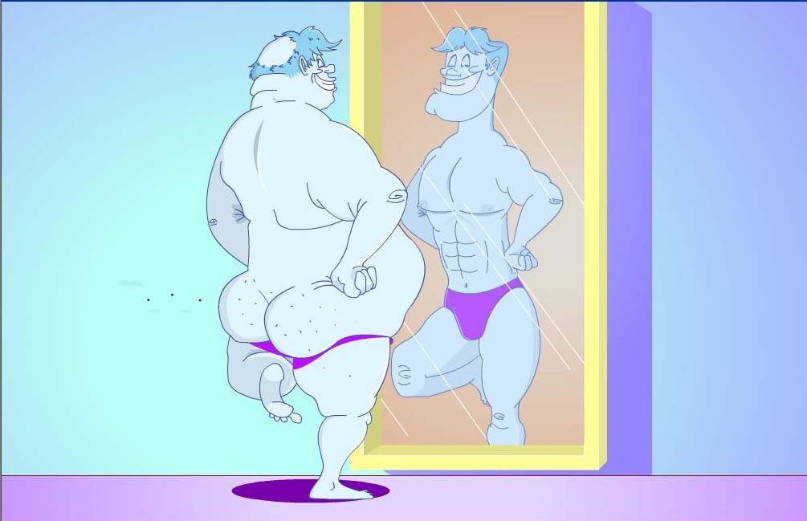
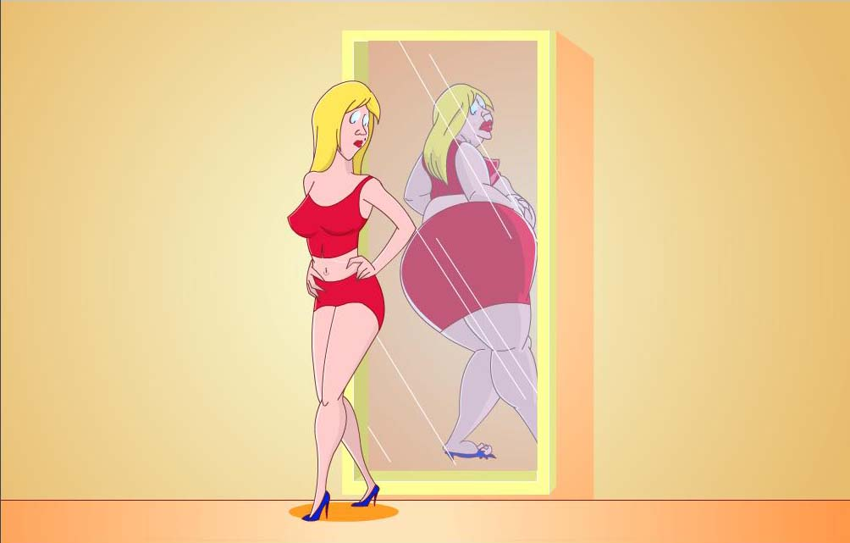
Self Concept

Slide 145
Consumption and Self-Concept
Self-Concept Congruence Models predict that products will be chosen when their attributes match some aspect of the self.
  Ideal-self : more relevant for highly expressive social products.
  Actual-self: more relevant for everyday, functional products.

Slide 146
Image congruence hypothesis
  Self-concept is enhanced through the transfer of socially accepted meanings of the product or brand to oneself.

Slide 147
The Relationship between
Self-Concept and Brand Image
Product Brand Image
Relationship Between self-concept and brand image
Behaviour
Seek products and brands that match self-concept
Satisfaction
Purchase contributes to desired self-concept
Consumer Self-Concept
Reinforces Self-Concept
Reinforces self-concept

Slide 148
Self-Concept is Changeable
Self-concept is flexile and changeable
Consumers’ self-concepts are especially dynamic during certain role transitions
Role transitions and self-esteem
  the degree to which people have a positive attitude towards themselves
Role transitions are marked by changes in consumption patterns

Slide 149
The Self:
An Alternative View

Slide 150
The Self: An Alternative View
Does the self exist?
If so, is it single or multiple?
Is it constant or changeable?
Is it to discover or to create?
?????????????????????????

Slide 151
The Self…
is multifaceted
is dependent on situations and motives
is malleable and dynamic
is socially-constructed

Slide 152
Behavioural Constraints and Possible Selves
Behaviour is constrained by factors other than one’s self-concept
Self-concept is composed of self-schemas
  system of knowledge structures organised in memory and consisting of self-relevant information
Possible selves
  past, present or future views of self

Slide 153
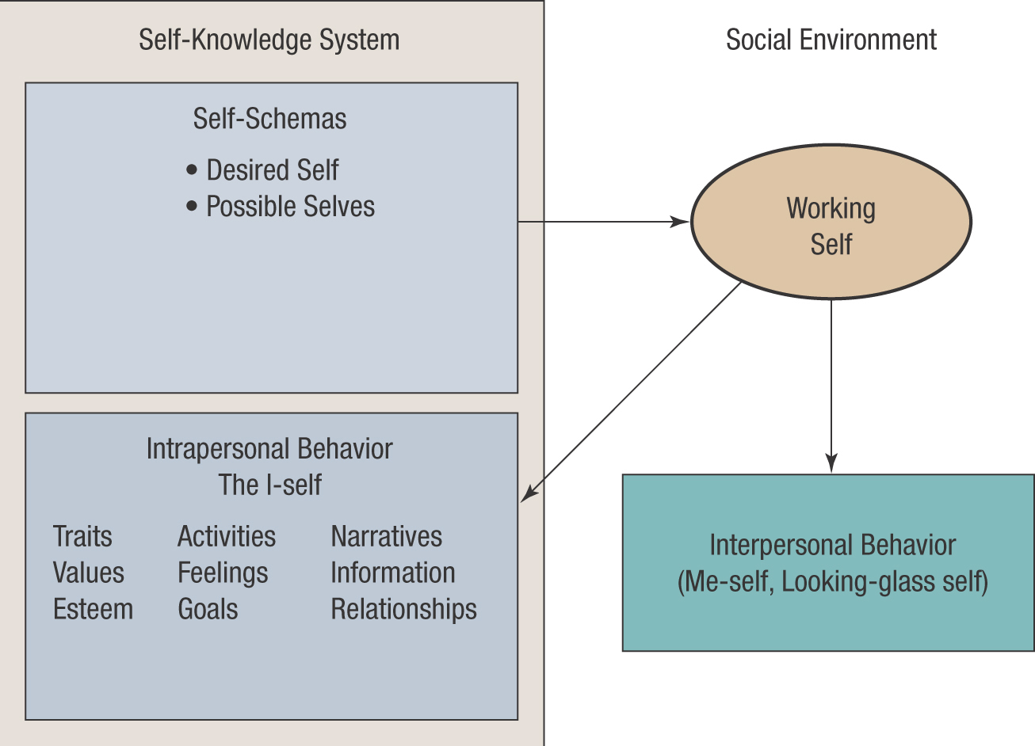
A Dynamic Model of Self-Concept

Slide 154
Eastern Views
of The Self

Slide 155
The Self
in
Buddhism
Anatta?

Slide 156
Overall Model of Consumer Behaviour
SOCIO-CULTURALINFLUENCES
Culture
Subculture
Demographics
Social Status
Reference Groups
Family
Marketing Activities
SITUATIONS
Problem
Recognition
Information
Search
Alternative Evaluation
and Selection
Outlet Selection
and Purchases
Postpurchase
Processes
SITUATIONS
Experiences and Acquisition
SELF-CONCEPT
and
LIFESTYLE
Needs
Desires
PSYCHOLOGICAL INFLUENCES
Perception
Learning
Memory
Motives
Personality
Emotions
Attitudes
Experiences and Acquisition

Slide 157
Personality
Personality is an individual’s characteristic response tendencies across similar situations.

Slide 158
Freudian Theory
Three Elements:
  Id: Pleasure Principle/Temptation
  Superego: Conscience (Societal Rules)/Virtue
  Ego: Reality Principle/Referee
Applications in Marketing:
  The Sexuality of Products

Slide 159
Examples of Cattell’s Personality Traits
Reserved
Shy
Humble
Emotional
Sober/Serious
Practical
Conservative
Relaxed
Outgoing
Assertive
Happy-go-lucky
Tender-minded
Tough-minded
Imaginative
Group dependent
etc.

Slide 160
Theory of Personality Values
Theoretical Personality
Economic Personality
Social Personality
Political Personality
Aesthetic Personality
Religious Personality

Slide 161
Applications in Marketing
Consumer
Personality
Brand
Personality

Slide 162
Session 7: Lecture Outline
Consumers As Individual
Lifestyle
Values
The Self and Symbolic Consumption

Slide 163
Overall Model of Consumer Behaviour
SOCIO-CULTURALINFLUENCES
Culture
Subculture
Demographics
Social Status
Reference Groups
Family
Marketing Activities
SITUATIONS
Problem
Recognition
Information
Search
Alternative Evaluation
and Selection
Outlet Selection
and Purchases
Postpurchase
Processes
SITUATIONS
Experiences and Acquisition
SELF-CONCEPT
and
LIFESTYLE
Needs
Desires
PSYCHOLOGICAL INFLUENCES
Perception
Learning
Memory
Motives
Personality
Emotions
Attitudes
Experiences and Acquisition

Slide 164
Lifestyle
Lifestyle refers to a pattern of consumption reflecting a person’s choices of how he or she spends time and money.

Slide 165
Lifestyle and the Consumption Process
Lifestyle Determinants
Demographics
Subculture
Social class
Motives
Personality
Emotions
Values
Family Life Cycle
Culture
Past Experiences
Impact on Behaviour
Purchases
How
When
Where
What
With whom
Consumption
Where
With whom
How
When
What
Lifestyle
How we live
Activities
Interests
Like/dislikes
Attitudes
Consumption
Expectations
Feelings

Slide 166
AIO’s as Lifestyle
Activities
Interests
Opinions

Slide 167
Lifestyle
Lifestyles as Identities
  Lifestyles are statements about who one is in society and who one is not.
  Each person adds their own individuality to a chosen lifestyle.
Products Being Consumed Are the Building Blocks of Lifestyles
  Consumers often choose products, services, and activities over others because they are associated with a certain lifestyle.

Slide 168
Product Constellations
Lifestyle
  pattern of behaviour that reflects consumption of interrelated product constellations
Product constellations
  clusters of complementary products, specific brands, and/or consumption activities
Product constellations can be matched with demographic and media preferences to improve targeting

Slide 169
People, Products, and Settings are Combined to Express a Certain Consumption Style.
Product
Person
Lifestyle
Setting

Slide 170
Lifestyle: An Alternative View
If the self is multiple, what about the lifestyle?
Protean Lifestyles?
An Executive by Weekday,
A Biker by Weekend!!

Slide 171
Values
A belief that some condition is preferable to its opposite.
Every culture has a set of values that it imparts to its members called Core Values.
The process of learning the beliefs and behaviours endorsed by one’s own culture is Enculturation.
Acculturation is the process of learning the value system and behaviours of another culture.

Slide 172
Applications of Values to
Consumer Behaviour
Research has tended to classify values as being:
  Cultural such as security or happiness,
  Consumption-specific such as convenient shopping or prompt service,
  Product-specific such as ease of use or durability.
The Rokeach Value Survey identified:
  Terminal Values - desired end-states that apply to many cultures,
  Instrumental Values - composed of actions needed to achieve these terminal values.

Slide 173
Values and
Lifestyles Systems
VALS 1
  partitions market into 9 groups based on Maslow’s hierarchy of needs
VALS 2
  classifies people into segments based on their control of resources and three aspects of their basic motivational self-orientation: principles, status, action
Japan VALS

Slide 174
VALS 1
The Needy
  Survivors
  Sustainers
Outer-Directed Orientation
  Belongers
  Emulators
  Achievers
Inner-Directed Orientation
  I Am Me
  Experiential
  Societally Conscious
  Integrated

Slide 175
VALS2
Abundant
Resources
Actualizers
Fulfilleds
Achievers
Experiencers
Principle Oriented
Status Oriented
Action Oriented
Believers
Strivers
Makers
Minimal
Resources
Strugglers
Source: SRI International.

Slide 176
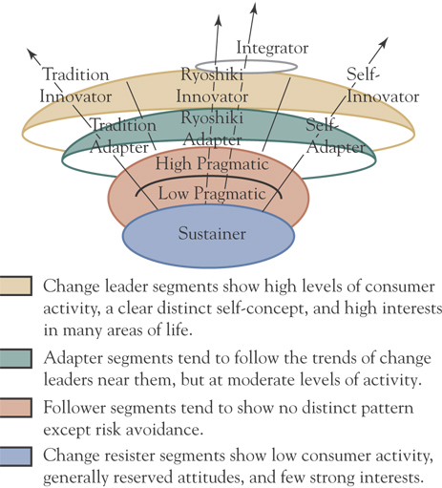
Japan VALS Segments

Slide 177
Values and
Lifestyles Systems
LOVs (List of Values)
  assesses adaptation to various roles through fulfillment of values such as self-respect, sense of belonging, excitement, etc.
Cohort Analysis
  understanding power of cohorts

Slide 178
Shifting Lifestyles
Lifestyle trends are triggered by major demographic (women entering workforce) and attitudinal shifts (growing organic food consumption)
Lifestyle trends affect industries as well as products and services
Lifestyle can be personified by a single person (e.g., Add Carabao)

Slide 179
Regional Lifestyles
Consumer cultures vary geographically as a result of change in climate, topography, ethnic history, distribution of jobs and industries, etc.
Japan VALS
  identifies 5 important dimensions: exploration, self-expression, achievement, tradition, realists
PRIZM
  a lifestyle segmentation system which identifies 62 distinct clusters composed of people with similar lifestyles

Slide 180
International
Lifestyle Segments
Global Scan measures a wide variety of attitude and consumer values, media use, and buying patterns primarily of Triad and Pacific Rim countries and assigns them to five segments
    adapters
    traditionals
    pressureds
    achievers
    strivers

Slide 181
What about
the Thai Values?

Slide 182
Thai Values Clusters
Source: Komin 1991
Ego Orientation
Grateful Relationship Orientation
Smooth Interpersonal Relationship Orientation
Flexibility and Adjustment O.
Religio-psychical O.

Slide 183
Thai Values Clusters (cont.)
Education and Competence O.
Interdependence O.
Fun-pleasure O.
Achievement-task O.

Slide 184
The Self Revisited
Consumers As Social Beings
The Self & Symbolic Consumption in Consumer Culture
Appropriation of Consumption Symbolism
Possession and the Extended Self

Slide 185
The Self
and
Symbolic Consumption

Slide 186
Having, Doing and Being
To Have is To Be.
To Have is To Belong.
Not to Have is To Be.
To Have is To Enslaved ?

Slide 187
Brands as
Symbolic Resources
for Identity Construction

Slide 188
Meaning Appropriation in Consumer Culture

Slide 189
Possessions
and
the Extended Self

Slide 190
The Extended Self
?

Slide 191
Consumption
and
Symbolic Immortality

Slide 192
Session 8: Lecture Outline
Consumers As Social Beings
Social Structure
Demographics
Social Class

Slide 193
Overall Model of Consumer Behaviour
SOCIO-CULTURALINFLUENCES
Culture
Subculture
Demographics
Social Status
Reference Groups
Family
Marketing Activities
SITUATIONS
Problem
Recognition
Information
Search
Alternative Evaluation
and Selection
Outlet Selection
and Purchases
Postpurchase
Processes
SITUATIONS
Experiences and Acquisition
SELF-CONCEPT
and
LIFESTYLE
Needs
Desires
PSYCHOLOGICAL INFLUENCES
Perception
Learning
Memory
Motives
Personality
Emotions
Attitudes
Experiences and Acquisition

Slide 194
Social Structures
Social
Class
Economics
Demographics

Slide 195
Demographics
Sex/Gender
Sexuality
Age
Income
Education
Occupation
Religion
Ethnicity

Slide 196
Demographics
Let's Look at
Demographics
from various
Perspectives

Slide 197
GENDER
Biological Sex
Cultural Conceptions of Gender
Cultural Conceptions of Masculinity and Femininity
Gender Bending and Blending

Slide 198
Sexuality
Straight
Gay
Bi-sexual
???

Slide 199
AGE
Life Cycle Stages
Consumer Socialisation
Consumption Choices
Rites of Passage
Chronological vs. Psychological Age
Age cohorts and Shared Values

Slide 200
RELIGION
Source of enduring consumer values
Source of consumption taboos
Emerging field of marketing
Targeting opportunities
Positioning opportunities

Slide 201
Ethnicity
frequent association and identification with common national or cultural origins of a subgroup found within the larger society

Slide 202
Ethnicity (continued)
Situational Ethnicity
  when expressions of ethnicity vary with social context
Acculturation
  changes in knowledge, beliefs, values, and behaviours when an individual member of an ethnic group comes into prolonged contact with a dominant culture

Slide 203
Ethnicity (continued)
Assimilation
  process of interpretation and fusion in which persons and groups acquire memories, sentiments and attitudes of other persons or groups and, by sharing their experience and history, are incorporated with them in a common culture life

Slide 204
Social Status Is Derived and Influences Behaviour
Socioeconomic
Factors
Occupation
Education
Ownership
Income
Heritage
Social
Status
Upper class
Middle class
Working class
Lower class
Unique
Behaviours
Preferences
Purchases
Consumption
Communication

Slide 205
Consumer Capitals
Economic Capital
  financial resources, including income
Social Capital
  relationships, organizational memberships and social networks that are often nurtured in schools, jobs, or neighborhoods
Cultural capital
  implicit practical knowledge and skills, access to consumer goods and objects such as fine arts and heirlooms, degrees, diplomas, and memberships in clubs and associations that certify certain qualities to others.

Slide 206
Symbolic Capital
Status-oriented Consumption
  behaviour involving competition for symbolic capital often associated with status symbols
Status Symbols
  consumer products, activities, or services that indicate ones position in the class hierarchy

Slide 207
Consumption Patterns and Class-Based Segments
Three main class-based segments
  Upper Class
    Old Money
    Nouveau Riche
    Professional (e.g., CEO)
    Get Set?
  Middle Class
  Working-Class and Under-Class

Slide 208
Not All Behaviours within a Social Class Are Unique
Behaviours associated
with a particular
social class
Behaviours shared
with other social
classes
Unique Shared
Behaviours Behaviours
Excluded
Behaviours
Behaviours not
engaged in

Slide 209
“Upward Pull” Strategy Targeted at Middle Class
Middle class
Aspirations
To belong to upper-middle class
Prefer
Products consumed by upper-middle class
Positioning
Upper-middle class symbolism for middle-class products

Slide 210
Positioning Within
Social Class
Working-class
Disdain
Upper-Middle Class
Proud to Be Working Class
Prefer
Working-class products and brands
Positioning
Working-class symbolism for working-class products

Slide 211
Positioning to
Social Class Segments
Upper-class
lifestyle
Aspiring
Upper-middle-class
target market
Upper-middle-
class lifestyle
Hieneken- Upper-middle-class Product Position: Premium Price; Prestige Themes; Status/Professional Backgrounds
Aspiring
Middle-class
target market
Middle-class
lifestyle
Singha- Middle-class
Product Position: Neutral Price; Achievement, Sharing themes; Middle-class backgrounds
Contented
Aspiring
Working-class
target market
Working-class
lifestyle
Thai Beer- Working-class
Product Position: Low price; Working-class Backgrounds

Slide 212
Using Social Stratification to Develop Marketing Strategy
Relate status variables to product consumption
Brand usage
Purchase Motivation
Symbolic meaning
Use situation
Target social strata
Actual lifestyle
Desired lifestyle
Media usage
Shopping patterns
Etc.
Develop product position
Select desired image based on actual or desired lifestyle of target strata
Marketing mix decisions
Develop mix to achieve desired position:
Product
Price
Promotion
Distribution

Slide 213
Changes in Society that Affect Marketing Strategy
Changes in
Thai Society
Changes in
Market Behaviour
Changes in
Marketing Strategy
Cultural Values
Subcultures
Demographics
Gender Roles
Social Class
Products
Service
Outlets
Media
Images
Occasion
Understanding
these changes
is a key input in
developing a
successful
strategy

Slide 214
Session 9: Lecture Outline
Consumers As Social Beings
Social & Reference Groups
Family

Slide 215
Overall Model of Consumer Behaviour
SOCIO-CULTURALINFLUENCES
Culture
Subculture
Demographics
Social Status
Reference Groups
Family
Marketing Activities
SITUATIONS
Problem
Recognition
Information
Search
Alternative Evaluation
and Selection
Outlet Selection
and Purchases
Postpurchase
Processes
SITUATIONS
Experiences and Acquisition
SELF-CONCEPT
and
LIFESTYLE
Needs
Desires
PSYCHOLOGICAL INFLUENCES
Perception
Learning
Memory
Motives
Personality
Emotions
Attitudes
Experiences and Acquisition

Slide 216
Social Group
A group (or a person) that serves as a point of comparison (or reference) for an individual in the formation of either general or specific values, attitudes, or behaviour.

Slide 217
Meaning and Importance of Groups
A Group: Two or more individuals who share beliefs, have role relationships, and experience interdependent behaviour.
Socialisation: The process by which we develop socially relevant behaviour through interaction with others.
Modeling: Our conscious attempt to emulate others in a group.

Slide 218
Types of Groups
Primary Groups: Intimate groups that meet regularly and communicate face-to-face.
Secondary Groups: Groups where regular, fact-to-face contact is lacking.
Formal Groups: Groups with an explicit structure and specified objectives.
Informal Groups: Loosely organised groups where structure is less evident.

Slide 219
Selected Consumer-Related Reference Groups
Friendship groups
Shopping groups
Work groups
Virtual groups or communities
Consumer-action groups

Slide 220
Reference Groups and Their Types
Reference groups provide a perspective for evaluating or patterning our own behaviour.
Types of reference groups:
  Membership: Groups in which one qualifies for membership
  Aspirational: Groups which one desires to join but lacks qualifications
  Anticipatory: Groups that one has reasonable expectation of joining
  Symbolic: Groups where chances of joining are remote

Slide 221
Dissociative Reference Groups
Not all groups provide consumers with a positive frame of reference.
Types of dissociative reference groups:
  Negative Reference Groups:
  Groups that we avoid association or identification with.
  Disclaimant Reference Groups:
  Groups that we may have belonged to, but whose values we now reject.

Slide 222
Reference Groups Change as the Situation Changes
Friends from
Summer Camp
Immediate family
Hometown Friends
Friends
from
Work
Individual
Friends from
Old School
Consumer behaviour classmates

Slide 223
Nature of Reference Group Influence
Informational Influence
Normative Influence
Identification Influence

Slide 224
Degrees of Reference Group Influence
Three degrees of group influence are identified:
  Compliance: Going along with group mandates to obtain approval.
  Identification: Abiding by group mandates to maintain a self-defining relationship with the group.
  Internalisation: Accepting group norms and values as one’s own.

Slide 225
Factors That Affect Reference Group Influence
Information and experience
Credibility, attractiveness, and power o the reference group
Conspicuousness of the product

Slide 226
Reference Group in Communication Strategy
Testimonial
Endorsement
Presenter or Spokesperson
Actress/Actor

Slide 227
Family as Important
Reference Groups
Friends from
Summer Camp
Immediate family
Hometown Friends
Friends
From
Work
Individual
Friends from
Old School
Consumer behaviour classmates

Slide 228
Families and Households
Domestic groups comprise a primary, involuntary unit of social life between the individual and the community.
Families comprise individuals related by blood, marriage, adoption, and emotional commitment.
Households are defined as co-resident, activity groups
  Fictive Kin: individuals informally adopted into a household as family members.

Slide 229
Consumer Socialisation
Consumer Socialisation refers to imparting the values, norms, beliefs, and procedures associated with behaving as competent consumers in a given cultural setting.
  Direct socialisation: parents purposively train children in consumer knowledge
  Indirect socialisation: involves more passive learning through modeling of children’s behaviours based on parental models.
  Co-shopping: involves children accompanying parents on shopping trips.

Slide 230
Family Influences Most Consumption Decisions
Structure of Family
Unit
Household purchases and consumption behaviour
Marketing strategy
Stage of the Family
Life cycle
Family
Decision Process

Slide 231
Structure of Family
Nuclear family: comprised of a married couple and their children
Extended family: households comprised of multiple generations of family members, or joint households comprising of the families of married adult brothers.
Co-residence and Dwellings:
  significant to marketers because it implies acquisition and maintenance of a home

Slide 232
A Family life Cycle
Middle-Aged
Divorced without Children
Young
Divorced without Children
Middle-Aged
Married without Children
Young
Single*
Young
Married without Children*
Young
Married with Children*
Middle-Aged
Married with Children*
Middle-Aged
Married without Dependent Children*
Older
Married*
Older
Unmarried*
Young
Divorced with Children*
Middle-Aged
Divorced with Children
Middle-Aged
Divorced without Children
Usual Flow
Recycled Flow
Traditional Family Flow
*

Slide 233
A Model of the Socialisation Process
Young Person
Other Family Members
Friends
Influence More Basic
Values/Behaviour
Moral/Religious Principles
Interpersonal Skills
Dress/grooming Standards
Manners and Speech
Educational Motivation
Occupational Career Goals
Consumer Behaviour Norms
Influence More Expressive
Attitudes/Behaviour
Style
Fashion
Fads
“In/Out”
Acceptable Consumer Behaviour
Pre-adolescent
Adolescent
Teens
Older

Slide 234
Session 10: Lecture Outline
Consumers As Social Beings
Culture & Subculture
Cultural Changes
Consumer Culture

Slide 235
Overall Model of Consumer Behaviour
SOCIO-CULTURALINFLUENCES
Culture
Subculture
Demographics
Social Status
Reference Groups
Family
Marketing Activities
SITUATIONS
Problem
Recognition
Information
Search
Alternative Evaluation
and Selection
Outlet Selection
and Purchases
Postpurchase
Processes
SITUATIONS
Experiences and Acquisition
SELF-CONCEPT
and
LIFESTYLE
Needs
Desires
PSYCHOLOGICAL INFLUENCES
Perception
Learning
Memory
Motives
Personality
Emotions
Attitudes
Experiences and Acquisition

Slide 236
Culture
&
Subculture

Slide 237
Culture
What Is Culture?
Why Does Culture Matter?
Components of Culture
Cultural Changes

Slide 238
Meaning and Nature of Culture
Culture consists of shared blueprints or schemas both for action and for understanding.
Cultural Categories
  time, space, nature, and the human community
Cultural Principles
  values, norms, and beliefs that allow things to be grouped into cultural categories, ranked, and interrelated
Marketing challenge: aligning products with cultural blueprints, categories, and principles.

Slide 239
Cultural Factors
Shared Meanings
(Language & etc.)
Custom & Norms
Culture
Consumer
Behaviour
Beliefs & Values
Myths & Rituals

Slide 240
Marketing and
Cultural Meanings
Marketing
Communication
Cultural
Meanings

Slide 241
Cultural Values
Cultural values are those shared broadly across a society, values that are conditioned at the society level and reinforced and augmented at successive subcultural levels.
  Instrumental values
    shared beliefs about how people should behave and desired end states.
  Terminal values
    desirable life goals

Slide 242
Cultural Values (continued)
Value-Attitude-Behaviour Hierarchy
  abstract values affect midrange attitudes that led to specific consumer behaviours
Consumer Ethnocentrism
  preference for one’s own system of tastes and preferences over those of another cultural group

Slide 243
Conspicuous consumption
  acquisition and visibility of “luxury” goods and services to demonstrate one’s ability to afford them
Materialism
  importance consumer attaches to worldly possessions or consumption-based orientation to happiness seeking

Slide 244
Cultural Myths and Symbols
Myth
  a story containing symbolic elements that express shared emotions and cultural values, maintain social order by authorizing a social code
Urban Legends
  stories passed by word of mouth that purport to be nearly first hand accounts of real events, but are fictions
Cultural Symbols
  objects that represent beliefs and values

Slide 245
Cultural Rituals
Repetitive behavioural sequences
Taken-for-granted scripts
Exhibit arbitrary patterns
Incorporate values
Sustain social consensus
Integrate interpersonal behaviours
Examples include entry, exit, grooming, support, possession, exchange, divestment

Slide 246
Cultural Rituals (continued)
Exchange Rituals
  Holiday gift giving
  Rites of passage
Life cycles of Rituals
Global Consumption of Rituals

Slide 247
Guidelines for
Cultural Awareness
Diderot effect
  force that encourages an individual to maintain a cultural consistency in his/her complement of consumer goods
Culture is adaptive and dynamic
Culture is an open system
  it influences and is influenced by changes in their environment

Slide 248
Cultural Symbols
Cultural symbols are shared symbolic meanings.
Culture is reflected in core symbols.
Consumer goods often become core symbols in a culture.

Slide 249
From Culture
to
Subculture

Slide 250
Identification with a Subculture Produces Unique Market Behaviours
Individuals
Identification with Core Culture
Identification with a Subculture
Core Culture Values and Norms
Subculture Values and Norms
Mass Market Behaviours
Unique Market Behaviours

Slide 251
Consumption and Cultural Changes
Consumption Patterns and Preferences
Trends and Changes in Consumer Behaviour

Slide 252
Consumer Culture:
Popular/Media Culture
Body Culture
Globalised Culture
Postmodern Culture
  Fragmented Culture
  Hyperreal Culture
  Aestheticised Culture

Slide 253
Globalization, Consumer Culture, and Cultural Creolisation
Trends:
Global spread of brands and consumption practices
Creolisation
  consumption patterns that combine elements of local and foreign consumption traditions
Nostalgic Defense
  ethnocentric consumer reaction against globalization, rejecting foreign consumption consumption and values

Slide 254


What is Thai anyway?
Creolisation?

Slide 255
Fragmented Culture
Lots of small sub-culture
Against Diderot Effect?
Mix & Match Culture
Fragmented Self

Slide 256
Consumer in
Changing Culture?
Health Conscious?
Environmentally-friendly?
Materialistic?
Yearning for Spiritualism?
Striving for Immortality?
??????????????????????

Slide 257
Consumer Culture and Identities
Consumer Culture and Gender
Consumer Culture and Sexuality
Consumer Culture and Thainess
Consumer and Social Class
Consumer Culture and ???

Slide 258
Gender Imagery
Cultural Meaning
Body Imagery
Attitudes
Relationship
Gender and etc.

Slide 259
Session 11:
Lecture Outline
Buying Decision Process
Individual Decision

Slide 260
Overall Model of Consumer Behaviour
SOCIO-CULTURALINFLUENCES
Culture
Subculture
Demographics
Social Status
Reference Groups
Family
Marketing Activities
SITUATIONS
Problem
Recognition
Information
Search
Alternative Evaluation
and Selection
Outlet Selection
and Purchases
Postpurchase
Processes
SITUATIONS
Experiences and Acquisition
SELF-CONCEPT
and
LIFESTYLE
Needs
Desires
PSYCHOLOGICAL INFLUENCES
Perception
Learning
Memory
Motives
Personality
Emotions
Attitudes
Experiences and Acquisition

Slide 261
Purchases
Consumers make many kinds of purchase decisions
The different types of purchase decisions include:
  basic purchase decision
  product category decision
  brand purchase decision
  channel purchase decision
  payment decision
  initial vs. repeat purchase decision
Purchase decisions need not be made in the order indicated above.

Slide 262
Are all purchase processes the same?
Vary by Situation
Vary by Product
Vary by Consumer
Yes, indeed!
All purchases are not the same!

Slide 263
Several factors may affect the buying-decision process:
The prospect can withdraw at any stage.
Stages may overlap, and are likely to be of different lengths.
Consumers are often involved in several buying decisions simultaneously.
The consumer’s involvement level, the effort exerted, can vary.

Slide 264
Levels of Consumer Decision Making
Extensive Problem Solving
Limited Problem Solving
Routinised Response Behaviour

Slide 265
The Nature of Situation
The Communications Situation: The situation in which consumers receive information.
The Purchase Situation
The Usage Situation
The Disposition Situation
The Ritual Situation

Slide 266
Situational Influences
Physical Surroundings -location, décor, sounds, aromas, lighting, crowding..
Social Surroundings - others present/not
Temporal Perspectives - time, day, season, since last purchase, until payday.
Task Definitions - self/gift, work/play
Antecedent States - moods, cash on hand

Slide 267
Consumer Characteristics
Culture and Values
Family Life-Cycle
Demographics
Psychographics
Personality, Lifestyle, and Self-Concept

Slide 268
Influences on
Levels of Decision Making
Involvement: Degree of personal relevance a product or service holds for the consumer.
Perceived Risk
Experience with Product Category
Frequency of Purchase
Cognitive Resources and Time

Slide 269
Effects of Involvement
The higher involvement, the greater cognitive effort
  more sensitive perception
  more search for information
  extensive decision making
Results in different steps through the purchase process

Slide 270
Involvement and
Types of Decision Making
Low-purchase Involvement High-purchase Involvement
Routinised Decision Making Limited Decision Making Extended Decision Making
Problem recognition
Selective
Problem recognition
Generic
Problem recognition
Generic
Information search
Limited internal
Information search
Internal
Limited external
Information search
Internal
External
Alternative evaluation
Few attributes
Simple decision rules
Few alternatives
Alternative evaluation
Many attributes
Complex decision rules
Many alternatives
Purchase
Purchase
Purchase
Postpurchase
No dissonance
Very limited evaluation
Postpurchase
No dissonance
Limited evaluation
Postpurchase
Dissonance
Complex evaluation

Slide 271
Wait a minute…
What about “Impulse Buying”?

Slide 272
Problem Recognition
A consumer’s incongruity or tension state resulting from variance between an actual and a desired
state of affairs.
Problem recognition
and its associated
dissonance trigger
behaviour.

Slide 273
Problem Recognition
Occurs Whenever the Consumer Sees a Significant Difference Between His or Her Current State and Some Desired or Ideal State.
Consumer’s Ideal State
Need Recognition
Occurs By:
Running Out of a Product
Inadequate Product
Creating New
Needs
Opportunity Recognition Occurs By: Exposure to Different or Better-Quality Products
Consumer’s Actual State

Slide 274
The Process of Problem Recognition
Desired Consumer Lifestyle
The way the consumer
would like to live and feel
Current Situation
Temporary factors affecting the consumer
Desired State
The condition the consumer would like to be in at
this point in time
Actual State
The condition the consumer perceives himself or herself to be in at this point in time
Nature of Discrepancy
Difference between the consumer’s desired and perceived conditions
No difference
Desired state exceeds actual state
Actual state exceeds desired state
Satisfaction
Problem Recognised
Search decision initiated

Slide 275
Information Search
Familiarising oneself with courses of action available to solve the problem.
Types of search:
  Internal Search: Retrieving
  relevant information
  from memory
  External Search: Seeking
  information from external
  sources

Slide 276
Information Sources for
a Purchase Decision
Information Sources
Internal
Information
External
Information
Actively Acquired
Passively Acquired
Actively Acquired
Past Searches
Personal Experience
Low-involvement Learning
Independent Groups
Personal Contacts
Marketer Information
Experiential

Slide 277
Perceived Costs and Benefits of
Consumer Search Guide Search Effect
Do the expected benefits of external search exceed the expected costs?
Benefits obtained
Financial
Psychological
Physical
Product
NO
Terminate search effort
Costs of search
Out-of-pocket expenses
Psychological
Time
Activities missed
YES
Continue search effort

Slide 278
All
Alternatives
Evaluation of Alternatives
Evoked Set
Actively
Considered
Inert Set
Not Entering
Consideration
Inept Set
Aware of, But
Would Not Buy
Retrieval
Set
Prominent
Products in
Environment

Slide 279
Alternative Evaluation and
Selection Process
Evaluation of Alternatives on Each Criterion
Evaluative Criteria
Decision Rules Applied
Alternative Selected
Importance of Criteria
Alternatives Considered

Slide 280
Product Choice:
Selecting Among Alternatives
Evaluative Criteria are the dimensions used to judge the merits of competing options.
The attributes actually used to differentiate among choices are Determinant Attributes.
Marketers can educate consumers about a new decision criterion.

Slide 281
Decision Rules
Used by Consumers
Conjunctive: Select brands that surpass a minimum level on each relevant evaluative criterion.
Disjunctive: Select brands that surpass a satisfactory level on any relevant evaluative criterion.
Elimination-By-Aspects: Rank the evaluative criteria in terms of importance and establish satisfactory levels for each. Start with the most important attribute and eliminate all brands that do not meet the satisfactory level. Continue through the attributes in order of importance until only one brand is left.

Slide 282
Decision Rules
Used by Consumers (cont.)
Lexicographic: Rank the evaluative criteria in terms of importance. Start with the most important criterion and select the brand that scores highest on that dimension. If two or more brands tie, continue through the attributes in order of importance until one of the remaining brands outperforms the others.
Compensatory: Select the brand that provides the highest total score when the performance ratings for all the relevant attributes are added (with or without importance weights) together for each brand.

Slide 283
Heuristics
Heuristics are Mental Rules-of-Thumb
That Lead to a Speedy Decision.
Country
of Origin
Product
Signal
Brand
Loyalty
Market
Beliefs
Common
Heuristics
Retail
Outlets
Price/ Quality
Relationship
Brand
Names

Slide 284
Store Atmosphere
and Shopper Behaviour
Store Atmosphere Individual Characteristics Response
Ambient Conditions
Temperature • Air quality •
Noise • Music • Odour
Sales Personnel
Career objectives • Training • Personal Situation • Social Class • Stage in FLC
Sales Personnel
Mood • Effort • Commitment • Attitude • Knowledge • Skill
Physical Conditions
Layout • Equipment • Colors • Furnishings • Space
Social Conditions
Customer Characteristics • Number of Customers • Sales Force Characteristics
Consumers
Lifestyle • Shopping Orientation • Stage in FLC • Situation
Consumers
Enjoyment • Time in Store • Items Examined • Information Acquired • Purchases • Satisfaction
Symbols
Signs • P-O-P Displays • Decor Style

Slide 285
In-Store Influences that Impact Alternative Evaluation and Purchase
Displays
Price Reductions
Modify Intended Purchase Behaviour
Alternative Evaluation
Store Layout
Stockouts
Sales Personnel

Slide 286
Post-purchase Considerations
Feelings of satisfaction or dissatisfaction due to product performance are natural outcomes.
Distinguish between:
  Instrumental performance: The utilitarian performance of the product
  Expressive Performance: The social or psychological aspects of the product
Satisfaction is a function of expectations rather than of actual product performance.

Slide 287
Post-purchase Consumer Behaviour
Purchase
Postpurchase Dissonance
Nonuse
Usage
Product Disposal
Compliant Behaviour
Evaluation
Satisfaction
Committed Customers
Repeat Purchases
Increased Use
Brand Switching
Discontinued Use

Slide 288
Product Disposition Alternatives
Product
Keep it
Get rid of it permanently
Get rid of it temporarily
Use it to serve original purpose
Convert it to serve new purpose
Store it
Rent it
Loan it
Recycle it
Throw it away
Give it away
Trade it
Sell it
To be (re)sold
To be used
Direct to consumer
Through middleman
To middleman

Slide 289
Committed Customers
Committed
Customers

Slide 290
Dissatisfaction Responses
Dissatisfaction
Take action
Take no action
Less favourable attitude
Complain to store or manufacturer
Stop buying that brand or store
Warn friends
Complain to private or government agencies
Initiate legal action

Slide 291
How do Consumers
Judge Satisfaction?
Expectations: anticipation or predictions of future events.
Expectancy-Disconfirmation Model of Satisfaction:
  disconfirmation of pre-consumption expectations is the key influence on consumer satisfaction.
    Positive disconfirmation: performances exceed expectations
    negative disconfirmation: expectations are not met
Ceiling floor effect:
  Very high expectations (ceiling) are more likely to result in negative disconfirmation and very low expectations (floor) in positive disconfirmation.

Slide 292
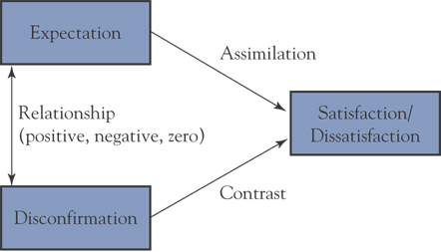
A Simplified Expectancy-Disconfirmation Framework

Slide 293
How do Consumers
Judge Satisfaction?
Sources of expectations include:
  memories of past experiences, word-of-mouth communications, third party information, cultural milieu.
Expectations vary in abstractness, complexity, accessibility.
  active expectations
  passive expectations
Satisfaction is a process extending across the entire consumption experience.

Slide 294
Desires as a Satisfaction Standard
Desires model of satisfaction
  Satisfaction is a function of the consumer’s assessment of the degree to which a product meets or exceeds his or her desires, the outcome being called desires congruency
  Desires are levels of products’ attributes and benefits that a consumer believes will lead to, or are connected with, higher-level values.

Slide 295
Fairness as a Satisfaction Standard
Fairness
  Perceptions of fairness affect consumers’ satisfaction
  Homans’s rule of justice proclaims parties’ rewards in exchanges with others should be proportional to their investments (or losses)
  Three dimensions of fairness and satisfaction/ dissatisfaction
    Distributional fairness
    procedural fairness
    interactional fairness

Slide 296
Satisfaction Management
We need
to manage
our customers'
expectations!

Slide 297
Session 12: Lecture Outline
Group Buying Decision

Slide 298
Group Buying Decision
Purchase Roles
Types of Purchase
Dynamic of Group Decision

Slide 299
Group Purchase Roles
Initiator(s)
Information Gatherer(s)
Influencer(s)
Decision Maker(s)
Purchaser(s)
User(s)

Slide 300
Types of Purchase
New-task Buying (the most difficult and complex buying situation), which is the first-time purchase of a major product.
Straight Rebuy. This is a routine, low-involvement purchase.
Modified Rebuy. The buying situation is somewhere between the other two in terms of:
  The time and people involved, the information needed, and the location of buying authority.

Slide 301
Dynamics of Group Decision Making
Someone-Dominated
Joint
  Equal
  Syncretism
Autonomic
  Solitary
  Unilateral

Slide 302
Factors Affecting Purchase Roles
Culture & Subculture Determinants
Role Specialisation
Involvement
Personal Characteristics

Slide 303
Conflict Resolution
Bargaining
Impression Management
Use of Authority
Reasoning
Playing on Emotion
Additional Information

Slide 304
Session 13: Lecture Outline
Impulsive Buying Behaviour
Consumer Fantasies, Feeling and Fun
Dark Side of the Consumer
Consumer Abuse & Critical Marketing
Marketing Ethics & Public Policy
Consumer Research & Ethics

Slide 305
Impulse Buying

Slide 306
Impulse Purchases
Impulse purchases occur when consumers experience a sudden, often powerful, and persistent emotional urge to buy immediately.
Impulse purchases also entail a sudden mental match between the meaning of a product and a consumer’s self-concept.
Impulse purchases do not conform to economic man or decision-making man perspectives.
The impulse to buy is hedonic (pleasure-seeking).In some cases, impulse purchase behaviour is compulsive and represents a “darkside” of consumer behaviour.

Slide 307
Self-Gifts
In self-gifts, consumers give to themselves.
Self-gifting often occurs in in the context of personal accomplishment, distress, or holiday occasion.
Two types of self-gift experiences are reward and therapeutic self-gifts.
Self-gifts are a form of personal, symbolic self-communication.
In terms of outcomes, self-gifting can positively enhance self-concept, consistency, or esteem.

Slide 308
Consumer
Fantasies & Fun

Slide 309
Consumer Fantasy
Theme Parks
Theme Restaurants
Movies
Novels
Picture Studio
Etc.

Slide 310
The Dark Side of
Consumer Behaviour
Addictive Consumption
  Cigarette, Gambling, Internet, etc.
Compulsive Consumption
  Born to Shop, Shopaholic
Illegal Activities
  Consumer Theft
  Consumption of Counterfeit Products
  Illegal Consumption: Prostituted, Stolen

Slide 311
Consumers
&
Marketers

Slide 312
Critical Marketing
Customer Satisfaction VS. Customer Seduction?
Customer Relationship VS. Customer Captivity?
…???

Slide 313
Marketing Ethics
What is it
anyway?

Slide 314
Public Policy
Do Consumers
Need to Be
Protected?

Slide 315
Consumer Research
Traditional View
Alternative View
  Incredulity toward Metanarratives
  Welcoming Pluralism
  Sensitive to the Other
  De-centring Human Subject

Slide 316
Note
There is no limit to the ways in which the world can be interpreted.

Slide 317
Consumer Research Ethics
How far can we go to study consumer behaviour?
  Consumer Privacy
Other Controversial Issues

