Slide 1
Regional Comprehensive Economic Partnership (RCEP) and Thai Industry
Monthien Satimanon (Thammasat University)

Slide 2
Outline
Background of RCEP
International Trade Theory
  Trade creation
  Trade diversion
  Potential Impact of RCEP on Thai Industry

Slide 3
Background of RCEP
A free trade area (FTA) negotiation that has been developed among 16 countries
10 ASEAN members
+ Australia, China, India, Japan, the
Republic of Korea and New Zealand
On going negotiation

Slide 4
International Trade Theory
Two types of preferential trading agreements (near zero tariff rates)
  A free trade area:
  Allows free trade among members, but each member can have its own trade policy towards non-member countries.
  A customs union:
  Allows free trade among members, and requires a common external trade policy towards non-member countries.

Slide 5
International Trade Theory
Two types of preferential trading agreements (near zero tariff rates)
  A free trade area:
  Allows free trade among members, but each member can have its own trade policy towards non-member countries.
  A customs union:
  Allows free trade among members, and requires a common external trade policy towards non-member countries.

Slide 6
International Trade Theory (cont.)
Are preferential trading agreements necessarily good for national welfare?
No, it is possible that national welfare decreases under a preferential trading agreement.
Why?
  Concept of trade creation and trade diversion

Slide 7
Trade creation and
Trade diversion
Trade creation
  occurs when high-cost domestic production is replaced by low-cost imports from other members.
Trade diversion
  occurs when low-cost imports from nonmembers are diverted to high-cost imports from member nations.

Slide 8
Trade Creation and Trade Diversion
(cont.)

Slide 9
Price, P
S
CS
P_{M}+T
PS
D
Quantity, Q

Slide 10
Price, P
S
CS’
P_{M}
PS’
D
Quantity, Q

Slide 11
Price, P
S
CS
P_{M}+T
CS’
P_{M}
D
Quantity, Q

Slide 12
Price, P
S
P_{M}+T
ΔCS= +
P_{M}
D
Quantity, Q

Slide 13
Price, P
S
P_{M}+T
P_{M}
PS
PS’
D
Quantity, Q

Slide 14
Price, P
S
P_{M}+T
ΔPS=-
P_{M}
D
Quantity, Q

Slide 15
Price, P
S
P_{M}+T
ΔG=
-
T
P_{M}
D
Import Quantity
Quantity, Q

Slide 16
Price, P
S
ΔPS=-
P_{M}+T
P_{M}
D
Quantity, Q
ΔCS= +
ΔG=
-

Slide 17
Price, P
S
ΔPS=-
P_{M}+T
ΔCS= +
P_{M}
D
Quantity, Q
ΔG=
-

Slide 18
Price, P
S
P_{M}+T
ΔPS=-
ΔCS= +
P_{M}
D
Quantity, Q
ΔG=
-

Slide 19
Price, P
S
P_{M}+T
+
P_{M}
D
Quantity, Q
ΔG=
-

Slide 20
Price, P
S
P_{M}+T
ΔG=
-
+
P_{M}
D
Quantity, Q

Slide 21
Price, P
S
P_{M}+T
+
+
P_{M}
D
TRADE CREATION
Quantity, Q

Slide 22
Price, P
S
P_{M}+T
P_{NM}+T
T
P_{M}
D
Quantity, Q

Slide 23
Price, P
S
P_{NM}+T
P_{M}
D
Quantity, Q

Slide 24
Price, P
S
ΔCS= +
P_{NM}+T
P_{M}
D
Quantity, Q

Slide 25
Price, P
S
P_{NM}+T
P_{M}
ΔPS=-
D
Quantity, Q

Slide 26
Price, P
S
P_{NM}+T
P_{M}
ΔG=
-
T
P_{NM}
D
Import Quantity
Quantity, Q

Slide 27
Price, P
S
ΔG=
-
ΔPS=-
P_{NM}+T
P_{M}
T
P_{NM}
D
ΔCS= +
Quantity, Q

Slide 28
Price, P
S
ΔG=
-
ΔPS=-
ΔCS= +
P_{NM}+T
P_{M}
T
P_{NM}
D
Quantity, Q

Slide 29
Price, P
S
ΔG=
-
ΔCS= +
P_{NM}+T
P_{M}
ΔPS=-
T
P_{NM}
D
Quantity, Q

Slide 30
Price, P
S
ΔG=
-
+
P_{NM}+T
P_{M}
T
P_{NM}
D
Quantity, Q

Slide 31
Price, P
S
+
P_{NM}+T
P_{M}
ΔG=
-
T
P_{NM}
D
Quantity, Q

Slide 32
Price, P
S
P_{NM}+T
P_{M}
+
+
-
T
P_{NM}
D
TRADE DIVERSION
Quantity, Q

Slide 33
TPP in Brief
The Trans-Pacific Partnership (TPP), also known as the Trans-Pacific Strategic Economic Partnership Agreement, is a trade agreement currently under negotiation that has its roots in an existing agreement between Brunei, Chile, New Zealand, and Singapore.

Slide 34
Part A Evolution of The Trans-Pacific Partnership (TPP)
The original Trans-Pacific Agreement negotiations were launched by Chile, New Zealand and Singapore at the APEC Leaders’ Summit in 2002.
The original agreement between the countries of Brunei, Chile, New Zealand and Singapore (P-4) was signed on June 3, 2005.

Slide 35
Part B Outlines of The Trans-Pacific Partnership (TPP) Agreement
Trans-Pacific Partnership (TPP) Leaders met in Honolulu on 12 November,2011 in the margins of the APEC Leaders' meeting to review progress in the negotiations and consider next steps in the development of a 21st century free trade agreement, which would forge a pathway to free trade across the Asia-Pacific.

Slide 36
5 Pillars
The agreement’s broad framework is as follows:
1.Comprehensive market access
2. Fully regional agreement
3.Cross-cutting trade issues:
4. New trade challenges:
5 Living agreement:

Slide 37
Part C Comment on TPP
By Gong, Baihua, Fudan University
TPP could be as one of the most promising region building efforts in the Pacific region. However, there are a number of issues that must be resolved before an expanded TPP could become a reality. These issues comprise substantive obstacles in the negotiating process as well as procedural hurdles that must be addressed once an agreement is reached.

Slide 38
TPP’s purpose is said to weld the region together and lock in growth of trans-Pacific economic relationships. But people also worry that the biggest risk of TPP is political: that it might divide the region strategically between its members and the rest.

Slide 39
Desirably TPP will contribute to the global system by making it easier for others to join. A transparent and established process with clear criteria in application for membership is needed .It will give members less discretion over the conditionality they can add to individual members for accession. And to avoid excluding key countries from participating, TPP needs clear accession protocols that are transparent and robust. That includes avoiding giving individual members veto power on new membership bids.

Slide 40
The question arises, whether TPP should and could include provisions for special treatment for developing countries, and what other aspects of TPP have special effects on the growth of developing countries. Since TPP is hoped to have an expanding membership, and is heralded as a ―21st Century trade agreement, it is worthwhile to consider what types of special provisions would be appropriate to be included relating to developing countries.

Slide 41
Since TPP is hoped to have an expanding membership, and is heralded as a ―21st Century trade agreement, it is worthwhile to consider what types of special provisions would be appropriate to be included relating to developing countries.

Slide 42
.
There are a number of potential issues regarding substantive matters within TPP negotiation
1. Intellectual Property
Intellectual property protection has been an important part of trade agreements, and a part of PTAs. Few developing countries believe that these requirements to establish a minimum level of protection helps them，because they reduce the ability of developing country manufacturers to appropriate wealthy country intellectual property, effectively transferring wealth from the wealthy country to the developing country.

Slide 43
PTAs, especially those with the U.S., often include provisions for enhanced intellectual property protection, going beyond the WTO TRIPS agreement’s requirements: so-called ―TRIPS plus. Examples of TRIPS plus requirements include extensions of patent terms beyond 20 years, additional restrictions on compulsory licensing, and restrictions on parallel imports. The P-4 also imposes TRIPS plus obligations, although they are not as extensive as those found in U.S. FTAs.

Slide 44
TPP contained TRIPS plus provisions that can undermine the flexibilities and disturb the delicate balance provided by the TRIPS Agreement and adversely affect access to health in the developing countries. There are only two previous free trade agreements with the US to include chapters restricting the operation of pharmaceutical reimbursement programs — the US-Korea FTA, including its side letter (KORUS) and the US-Australia FTA, including its side letter (AUSFTA).
India at WTO TRIPS Council on IP Enforcement Trends noting concerns with ACTA and TPPA, TRIPS council Feb 28, 2012.

Slide 45
We consider that any intellectual property rights provisions agreed to by TPP member should not prevent them from taking the steps to protect public health, particularly in relation to access to medicines. Negotiators should do that in accordance with TRIPs and public health.

Slide 46
2. Service
Service is an increasingly important component of international trade. Modern PTAs often contain service provisions. Preferential liberalization of service under a PTA will serve to allow greater market access, and so should result in more efficient provision of service. However, preferential liberalization will also cause trade diversion, whereby a less efficient supplier based in a PTA member may be able to win market share from a more efficient supplier that does not benefit from preferential liberalization.

Slide 47
Much depends on the rules of origin or limitation of benefits type of provision, and how easy it is for third country suppliers to make use of PTA liberalization. The existing P-4 contains liberal limitation of benefits provisions, denying benefits where the service supplier has no substantive business operations in the territory of a P-4 party.

Slide 48
Some developing countries may be sensitive regarding liberalization of particular sectors. For example, Malaysia has been reluctant to liberalize in the financial services sector. These sensitivities could raise issues regarding the negotiation of a TPP, or even about the legality of a TPP that does not address sufficient sectors.

Slide 49
In contrast to the GATS ―positive list approach, the existing P-4 service schedule uses a negative list approach, which means that all service sectors are covered, except those specifically excluded. The service schedules represent a significant expansion compared to the parties’ services commitments under the WTO. It is expected that TPP will also follow the negative list approach.

Slide 50
3. Investment
The investment chapter of TPP will raise a number of issues relevant to development. One such issue is whether TPP will restrict the ability of member states to impose capital controls in connection with an economic crisis.

Slide 51
We are concerned that if recent U.S. treaties are used as the model for TPP, the agreement will unduly limit the authority of participating parties to prevent and mitigate financial crises. Increased financial stability is in the interest of TPP members and non-members.

Slide 52
When one member country falls into crisis, its trading partners lose export markets. When one member country cannot control financial bubbles that drive up currency values, consumers in trading partner countries may be hurt by rising prices on imported goods. When exchange rates are unstable, long-term investors and businesses engaged in exporting or importing face uncertainty.

Slide 53
4. State-Owned Enterprises
U.S. businesses have become increasingly concerned about the trade-distorting effects of state-owned enterprises (SOEs), and have proposed including provisions addressing this issue in TPP. In TPP negotiations, the U.S. seeks provisions that would require SOEs to operate according to commercial considerations.

Slide 54
The proposed developing country parties to TPP are not yet subject to any enhanced obligations with respect to SOEs. They hope no agreement at all in this area, leaving them maximum public policy flexibility.
The TPP Chapter on State Owned Enterprises (SOEs) was not mentioned in the November 2011 status report. The US draft on SOEs has been rejected by Vietnam with good reason — some 34% of Vietnam’s GDP is accounted for by SOEs.

Slide 55
5 Labor standards
We concern that labor standards should not be used as a disguised barrier to trade.

Slide 56
6 Dispute Settlement
It remains to be seen how far the TPP parties will go in creating a regional dispute settlement system patterned after the WTO system. One issue has already sparked differences: the investor-state arbitration chapter. Investor-state dispute settlement (ISDS) clauses in trade agreements would allow foreign investors to have their grievances against governments arbitrated by dispute-specific panels. The United States argues that foreign investors are sometimes subject to discriminatory expropriation and regulatory takings, and will press for investor-state chapter in TPP.

Slide 57
An investor-state arbitration system could impede governments from regulating dangers in the environment, public health and safety. In fact Australia is strongly opposed, arguing that it does not support provisions that would confer greater legal rights on foreign businesses than those available to domestic businesses.
We believe that there should be a balance between ensuring governments right to regulate in the public interest and avenues for investors to be able to pursue their interests in certain types of circumstances.

Slide 58
Progress with TPP, and how it is managed, is important to the global trading system, especially post-Doha. A major regional agreement such as this now needs to be tied to buttressing the global trading system and supporting multilateral outcomes.
If TPP does expand in the near future into a larger agreement that captures a significant percentage of trans-Pacific trade, it may impact the ability of WTO members to complete the current Doha Round of negotiations. The nature of this impact could be negative because TPP members and others could determine that expanding TPP is an easier and more fruitful path towards new trade liberalization gains than is the multilateral framework.

Slide 59
TPP would need to be convinced that its discussions were open, inclusive, and abide by the principles of transparency; respect WTO multilateral trading regulations; and actually promote global trade liberalization.
It remains unclear whether TPP will turn out to be a stepping stone or stumbling block towards regional or global economic integration.

Slide 60
RCEP in Brief
The upcoming negotiation of 10 ASEAN members and another 6 regional partners including Japan, Korea, China, Australia, New Zealand, and India, known as Regional Comprehensive Economic Partnership or RCEP.
Consolidate existing FTAs among each other and to formulate a Mega FTA.
RCEP negotiation was launched by May 2013 and scheduled to be completed within 2 years. In short, RCEP is a FTA on existing FTAs.

Slide 61
RCEP in Brief
 | Australia | New Zealand | China | India | Japan | South Korea
ASEAN | S/E | S/E | S/E | S/E | S/E | S/E
Australia | - | S/E | S | N | N | N
New Zealand | S/E | - | S/E | N | P | N
China | S | S/E | - | P | N | N
India | N | N | P | - | S/E | S/E
Japan | N | P | N | S/E | - | P
South Korea | N | N | N | S/E | P | -
S (Signed) S/E (Signed and in effect) N (Negotiation launched)
P (Proposed and under study)

Slide 62
RCEP in Brief
TOPICs | AGREEMENT
 | AEC (AFTA) | ASEAN -China | ASEAN -Japan | ASEAN -Korea | ASEAN -ANZ | ASEAN -India | TPP | RCEP
Free Trade | P | P | P | P | P | P | P | WG
Investment | P | P | P | P | P | P | P | WG
Service | P | P | P | P | P | P | P | WG
Government Procurement |  |  |  |  |  | P | P | PD
Financial liberalization | P | P |  | P | P | P | P
Labor movement | P |  |  |  | P | P
Environmental Standard |  | P | P |  |  |  | P

Slide 63
RCEP in Brief
TOPICs | AGREEMENT
 | AEC (AFTA) | ASEAN -China | ASEAN -Japan | ASEAN -Korea | ASEAN -ANZ | ASEAN -India | TPP | RCEP
Competition Law |  |  |  |  |  |  | P | WG
(SPS) | P | P | P | P | P | P | P | WG
(TBT) | P | P | P | P | P | P | P | WG
Intellectual Property rights | P | P | P | P | P | P | P | WG
Labor Standard | P |  | P | P |  |  | P

Slide 64
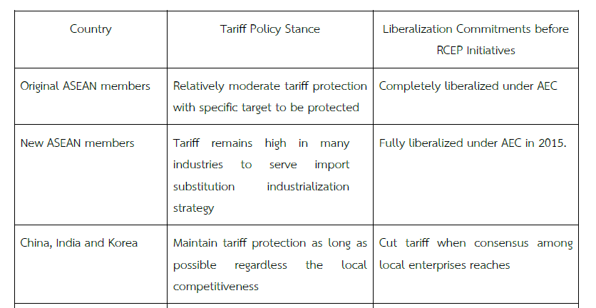
Tariff Policy Stance and Liberalization Commitments made Prior RCEP Initiatives.
continued

Slide 65
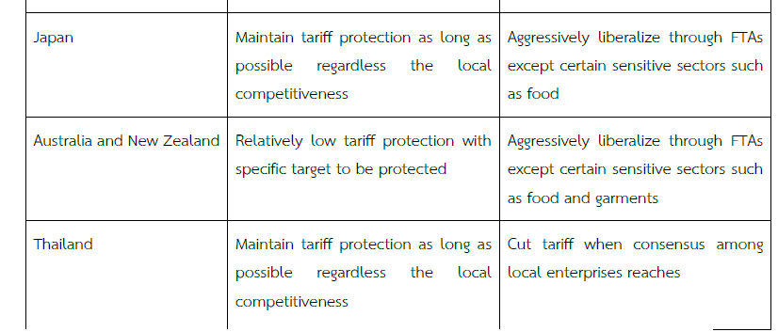
Tariff Policy Stance and Liberalization Commitments made Prior RCEP Initiatives.

Slide 66
Implications for Industry
More pressure on market access for protective industry.
Negotiation on restrictive measures for already opened sector, such as rules of origin and other constraints.
Investment, service, government procurement, and etc.

Slide 67
Tools to Study Potential Impacts on Thai Industry
Statistical analysis
  Gravity Equation
Comparative FTA reviews
  Existed FTAs
  MFNs
  FTA Rate
  ROOs
  Technical barrier to trade
Industry surveys
  Current competitiveness level
  Global Positioning
  Global Value Chain

Slide 68
Dynamic Gravity Equation
Short-run and long-run effects of trade policy change
Rarely used in East Asian Studies
Arellano and Bond estimators by Roodman(2009)

Slide 69
Dynamic Gravity Equation
Export
  Long-run effects: Australia, Indonesia, Philippines and Vietnam are positive and significant
  Short-run effects: Australia, Indonesia and Malaysia are significant
Import
  Long-run effects: Australia, New Zealand, Indonesia, Philippines and Vietnam are positive and significant.
  Short-run effects: Australia and Philippines are positive and significant.

Slide 70
Case Study of Thai Jewelry Industry
Existed FTAs
  Thai side
    Low MFNs and Low FTA rates
  Export Partners
    MFN Rate
    FTA rates are almost zero
    ROOs can be accumulated and easy to follow
    Inclusion of Australia will be a plus
    No technical barrier to trade

Slide 71
Case Study of Thai Jewelry Industry
Industry surveys
  Strength
    OEM, OBM, ODM
  Weakness
    Labor and Raw Material
  Opportunity
    Gemstones
  Threat
    Brand Image
  Global Production Network
    Pranda Jewelry
  Global Value Chain
    Swarovski and Pandora

Slide 72
Using RCEP
Regional accumulated ROOs
Transshipment Problem
Agglomeration effects of gem and jewelry testing
FDI investment
Tariff reduction of South Korea and Vietnam

Slide 73
Case Study of Thai Petroleum Industry
Existed FTAs
  Thai side
    Low MFNs that are closed to zero
  Export Partners
    MFN Rates is also closed to zero
    FTA rates are almost zero, except South Korea
    ROOs can be accumulated and easy to follow
    Inclusion of China will be a plus
    No technical barrier to trade

Slide 74
Case Study of Thai Jewelry Industry
Industry surveys
  Strength
    Commodity, Medium-end, High-end, and customizable
  Weakness
    High-Skilled Labor and Raw Material
  Opportunity
    Advancement of Plastic Industry
  Threat
    Shale Gas
  Global Production Network
    Indorama ventures, PTT and SCB
  Global Value Chain
    Dow Chemical, Solvay, Siam Mitsui, Mitsubishi, etc.

Slide 75
Using RCEP
Regional simplified ROOs
Sustainable Consumption and Production initiatives
Stronger forward and backward linkages in local and regional market
Product Champion
Tariff reduction of South Korea and Vietnam

