Slide 1

Innovation & Creativity
MK 341: Special Topics in Marketing 1
Marketing Leadership Development and Cross-cultural Management
By Ajarn Suwalya K.

Slide 2
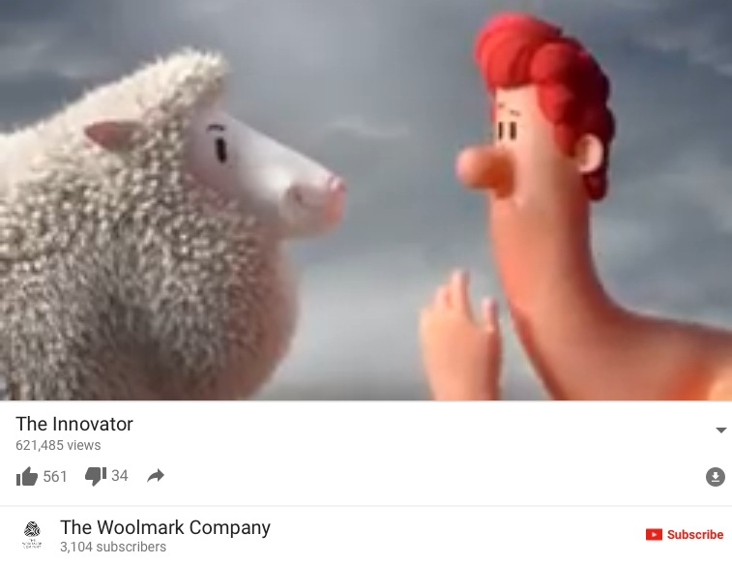


Slide 3
What we plan to achieve
Innovation/Creativity
Activities
Why is Innovation is Key to Corporate Success
Six Thinking Hats for Innovation

Slide 4
What is Innovation?
"The process of translating an idea or invention into a good or service that creates value or for which customers will pay. ... In business, innovation often results when ideas are applied by the company in order to further satisfy the needs and expectations of the customers"
www.businessdictionary.com › definition

Slide 5
What is Product Innovation?
"A product innovation is the introduction of a good or service that is new or has significantly improved characteristics or intended uses; a process innovation refers to the implementation of a new or significantly improved production or delivery method."
Product and process innovation | Innovation Policy Platform
https://www.innovationpolicyplatform.org › ...

Slide 6
Why is Innovation a Key to Corporate Success?
"Innovation can be a catalyst for the growth and success of your business, and help you to adapt and grow in the marketplace. ... Innovation can mean changing your business model and adapting to changes in your environment to deliver better products or services.Nov 20, 2017"
Innovation | business.gov.au

Slide 7


Slide 8


Slide 9


Slide 10


Slide 11


Slide 12
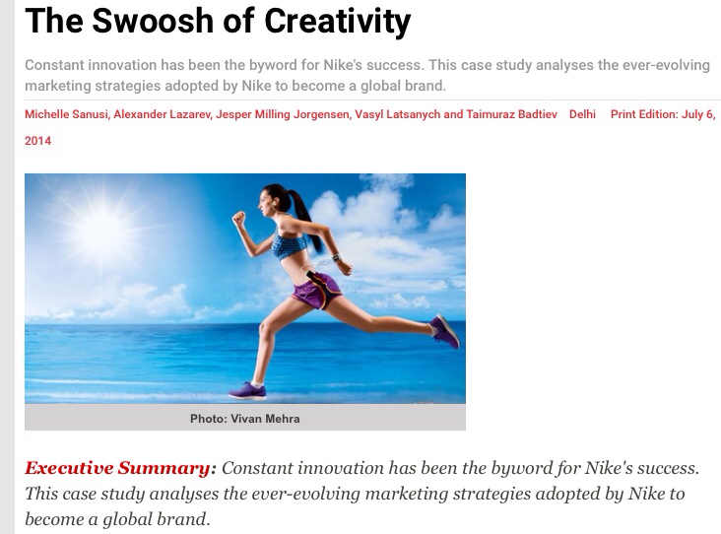


Slide 13
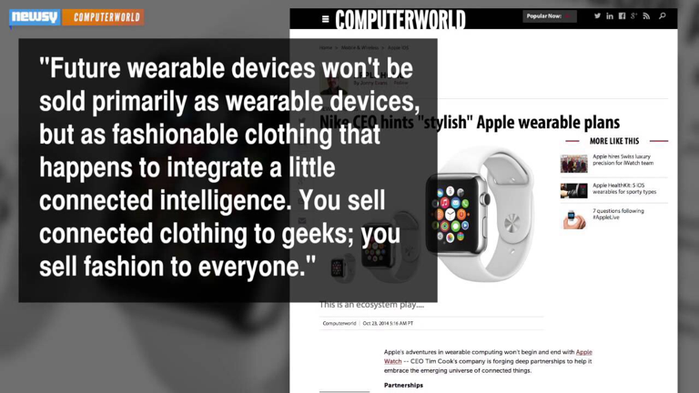

Slide 14
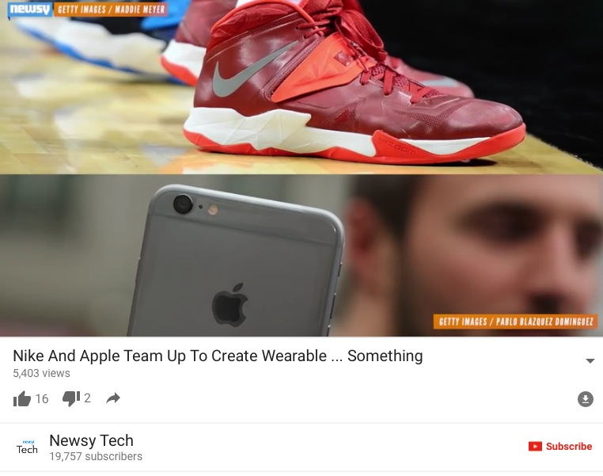

Slide 15


Slide 16
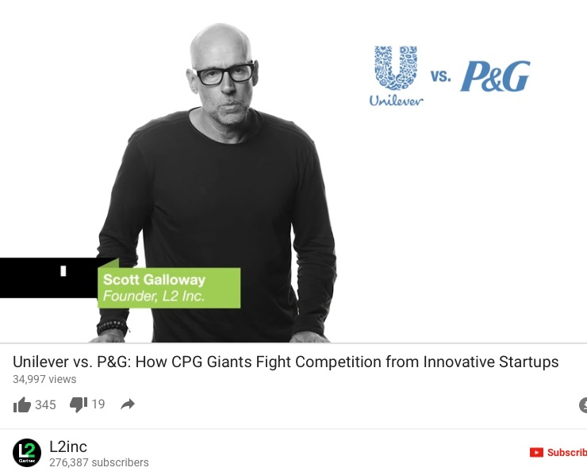

Slide 17
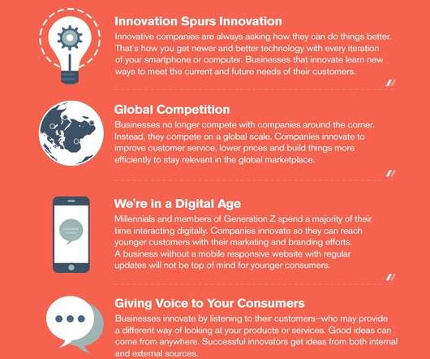

Slide 18

Creativity

Slide 19
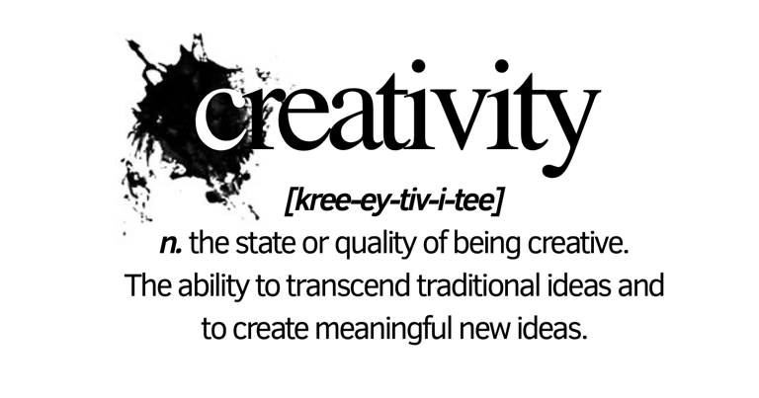
What is Creativity?

Slide 20
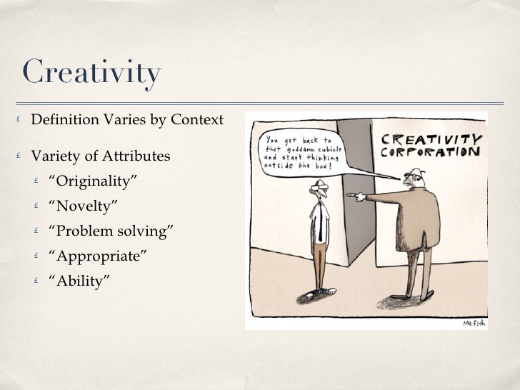

Slide 21
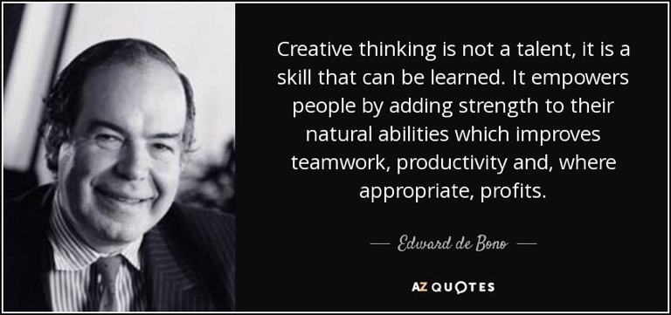

Slide 22
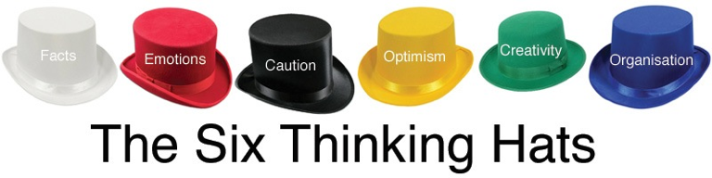
Creativity

Slide 23
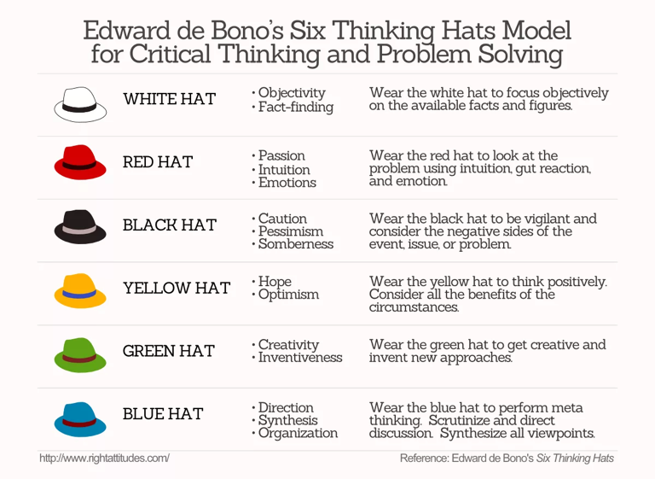

Slide 24
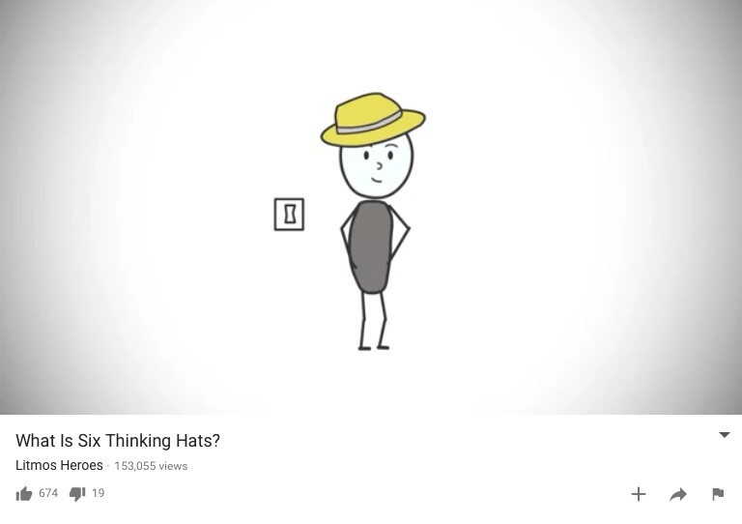

Slide 25
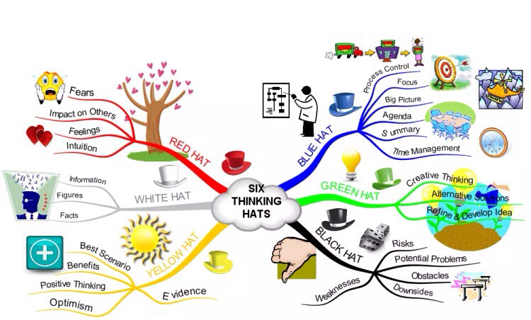

Slide 26


Slide 27
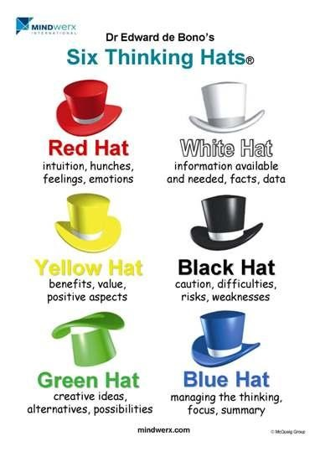

Slide 28
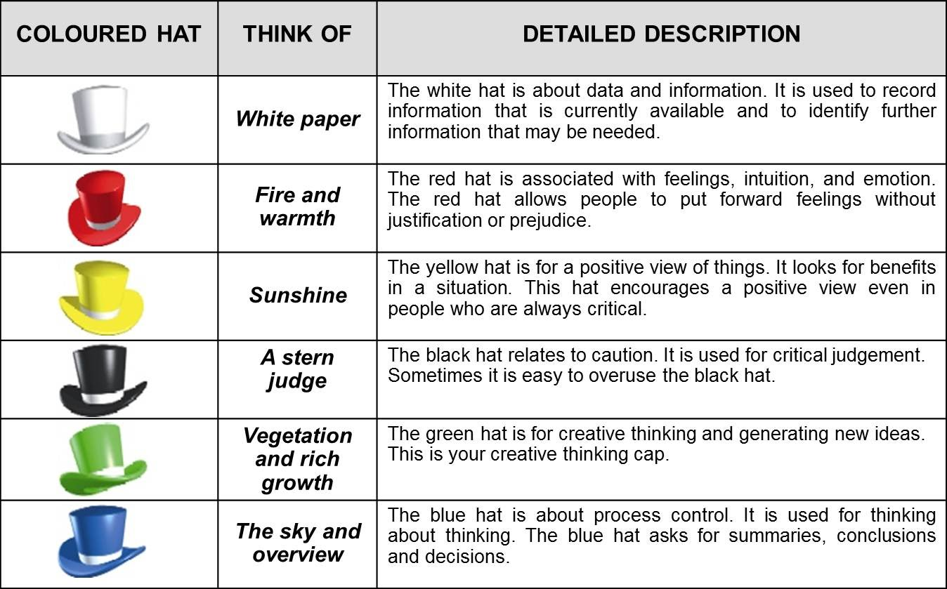

Slide 29
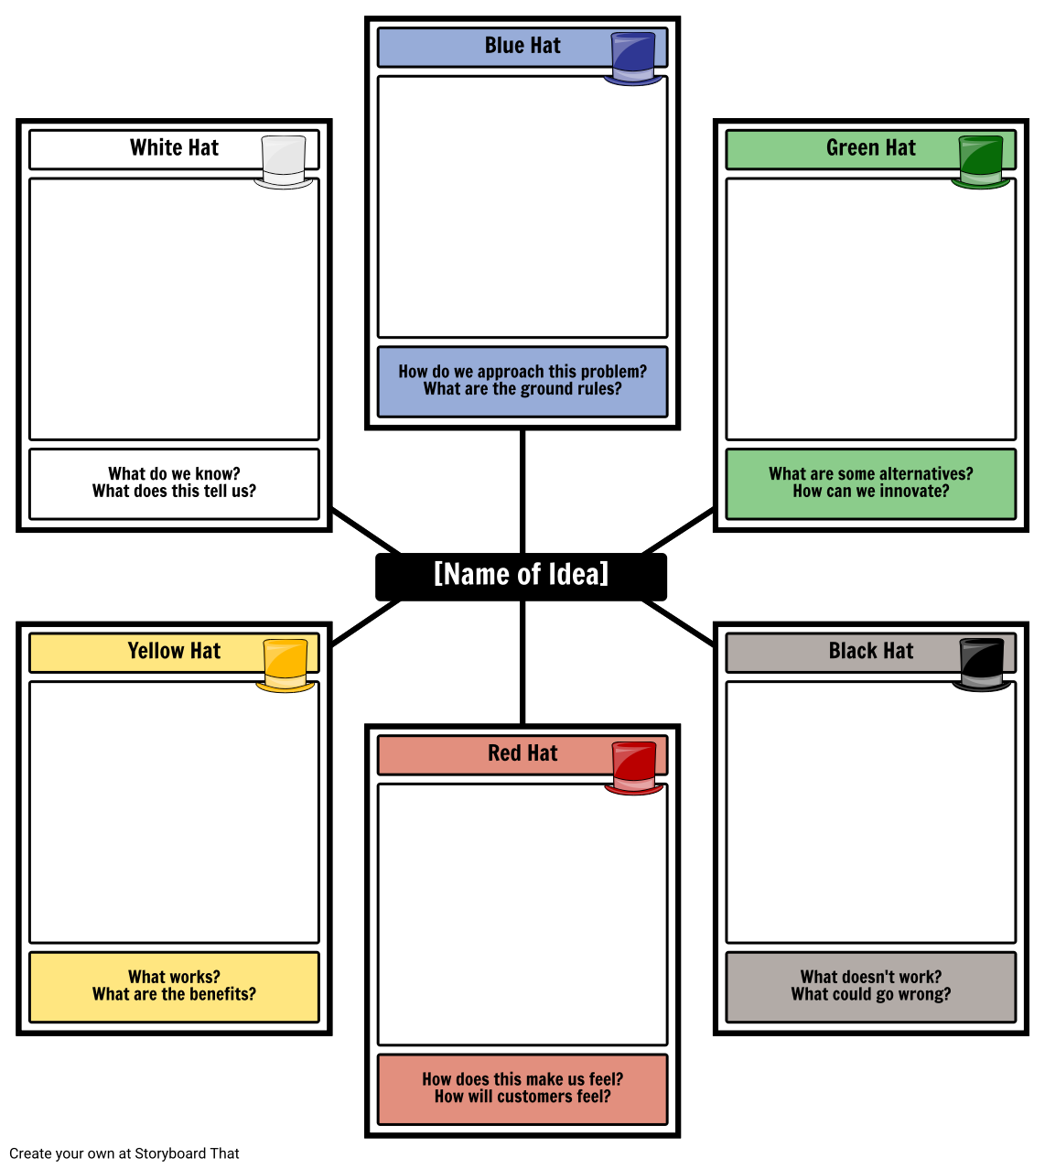

Slide 30
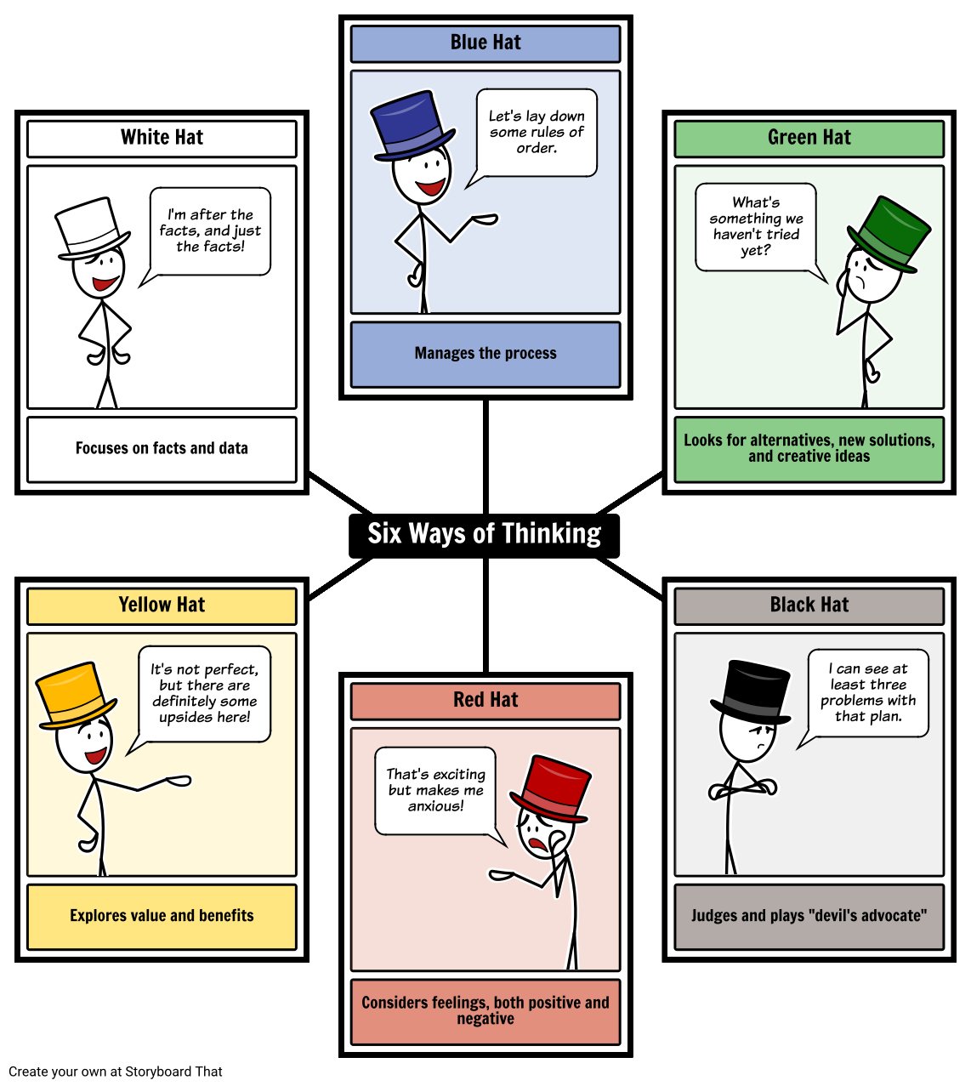

Slide 31
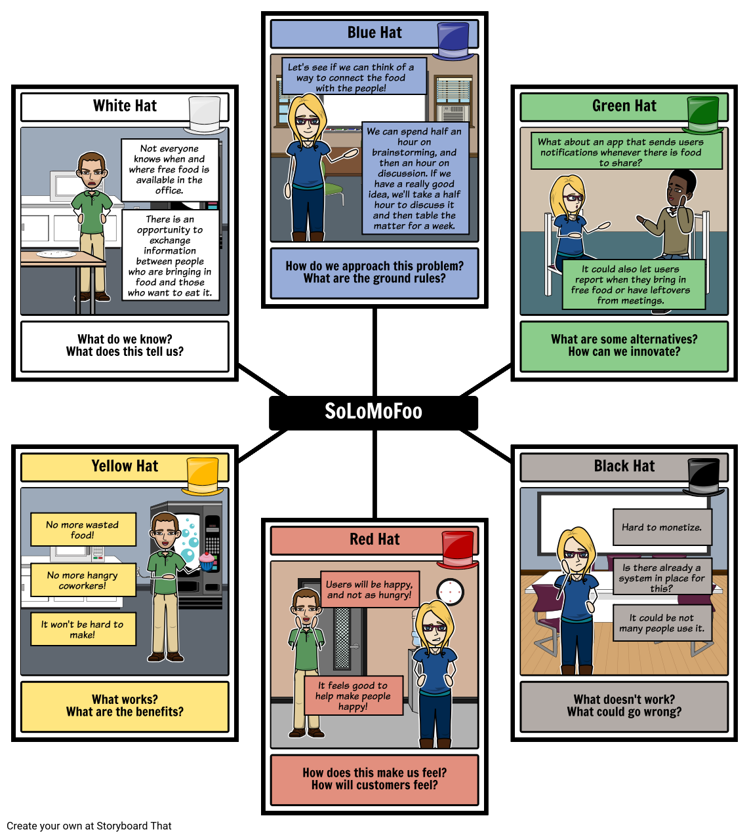

Slide 32


Exercise 2: The Six Thinking Hats
Briefing to leaders for in-class activity
Ready, Set, Go!!!!

Slide 33
What we accomplished
Innovation/Creativity for Marketeers
Activities
Why is Innovation is Key to Corporate Success
Six Thinking Hats for Innovation

Slide 34

Individual Assignment
Please assess your creativity level and discuss next class.

Slide 35


