Slide 1

EE390
Economics of Agricultural and Rural Development
Lecture 2: Global Agricultural and Rural Development Part 1
(The materials used in this lecture was prepared by Ajarn Chol Bunnag
Faculty of Economics, Thammasat University)
Kiatanantha Lounkaew
Email: klounkaew@econ.tu.ac.th
Line: k_lounkaew
ที่มาของรูป https://www.hexagongeospatial.com/industries/natural-resources/agriculture

Slide 2
Economics of being poor
“Most of the people in the world are poor, so if we knew the economics of being poor, we would know much of the economics that really matters. Most of the world’s poor people earn their living from agriculture, so if we knew the economics of agriculture we would know much of the economics of being poor”
T.W. Schultz
1979 Nobel Prize lecture

Slide 3
Overview: the periods of Agricultural Development ideas
Food security
Food price crisis
Environmental sustainability
World War II (1939 – 1945)
Growth-with-equity
1950s & 1960s
1970s
1980s & 1990s
2000s
Economic-growth-and-modernization era
Macroeconomic and policy reform
Institutional restructuring

Slide 4
Overview of Academic themes in economics of agricultural development
Agricultural Development and Economic Growth
Microeconomics of Markets and Institutions
Inter-sectoral linkages and agriculture in the Macroeconomy
Political Economy of Agricultural Development
Market Performance and Participation
Agricultural Household Models and the Institutions of Exchange
Agrarian Contracts
Technology and Agricultural Development
Agricultural Development and other Development Issues
Technological Change
Adoption
Risk
Efficiency
Poverty
Food Insecurity
Gender

Slide 5
Overview the periods of Agricultural Development Thinking
Food security
Food price crisis
Environmental sustainability
World War II (1939 – 1945)
Growth-with-equity
1950s & 1960s
1970s
1980s & 1990s
2000s
Economic-growth-and-modernization era
Macroeconomic and policy reform
Institutional restructuring
Agricultural Development and Economic Growth
Agricultural Development and Economic Growth
Microeconomics of Markets and Institutions
Microeconomics of Markets and Institutions
Technology and Agricultural Development
Agricultural Development and other Development Issues

Slide 6
Agricultural Development ideas in 1950s and 1960s
“It is fairly obvious from reading their works that the leading development economists of the 1950s knew little about tropical agriculture or rural life. They had no time for rural rides and there was no considerable body of empirical grassroots literature on which they could draw”
(Little 1982, 106: cited from Staatz and Eicher 1998)

Slide 7
Agricultural Development ideas in 1950s and 1960s
In the 1950s and 1960s
Processes that define structural transformation
Economic Development
A declining share of agriculture in GDP and employment;
Rural-to-urban migration that stimulates urbanization;
The rise of a modern industrial and service economy;
A demographic transition from high birth and death rates common in backward rural areas to lower ones associated with better health standards in urban areas
(Timmer 2002, chapter 8, 2009).
Economic Growth
Structural Transformation

Slide 8
Agricultural Development ideas in 1950s and 1960s
How to achieve structural transformation ?
W. Arthur Lewis (1954) – Dual-Sector Model
Facilitate economic growth through reinvestment of profits
Resources, especially labor, abundance
Labor productivity approaches zero
An indigenous non-capitalist sector
A modern capitalist exchange sector
Traditional agriculture?
Industry?

Slide 9
Agricultural Development ideas in 1950s and 1960s
How to achieve structural transformation ?
W. Arthur Lewis (1954) – Dual-Sector Model
Product
Total product
- Earning in the subsistence sector is very low because of the low marginal productivity
MP₂
Marginal product
MP₁
L₂
L₁
Labor

Slide 10
Agricultural Development ideas in 1950s and 1960s
How to achieve structural transformation ?
W. Arthur Lewis (1954) – Dual-Sector Model
Labor market in the capitalist sector
Wage
Demand for labor from capitalist sector
Unlimited Supply of labor
Labor

Slide 11
Agricultural Development ideas in 1950s and 1960s
How to achieve structural transformation ?
W. Arthur Lewis (1954) – Dual-Sector Model
Transfer of labor and other resources to the capitalist sector
An indigenous non-capitalist sector
A modern capitalist exchange sector

Slide 12
Agricultural Development ideas in 1950s and 1960s
How to achieve structural transformation ?
W. Arthur Lewis (1954) – Dual-Sector Model
Capital and labor productivity in agriculture is equalized with other sectors through well-functioning labor and capital markets
One-sector Neoclassical Model

Slide 13
Agricultural Development ideas in 1950s and 1960s
How to achieve structural transformation ?
W. Arthur Lewis (1954) – Dual-Sector Model
This framework leads to …
Neglect the agricultural sector
Readily assume that a surplus can and should be extracted from agriculture
Neglect the difficult requirements that must be met if agriculture is to play a positive role in facilitating overall economic growth

Slide 14
Agricultural Development ideas in 1950s and 1960s
Other similar ideas
Raul Prebisch and Hans Singer (1949): The Secular-decline hypothesis”
Overtime the terms of trade would turn against countries that export primary products and import manufactures.
This hypothesis reinforced the tendency to downplay agriculture’s potential role in development.

Slide 15
Agricultural Development ideas in 1950s and 1960s
Other similar ideas
Albert Hirschman (1958) – “Concept of Linkage”
“Agriculture certainly stand convicted on the count of its lack of direct stimulus to the setting up of new activities through linkage effects–the superiority of manufacturing int his respect is crushing”.
Investment in industry would lead to more rapid and broadly based economic growth than would investment in agriculture.

Slide 16
Agricultural Development ideas in 1950s and 1960s
Other similar ideas
Johnston and Mellor (1961): Importance of agriculture in economic growth
Provide labor, capital, foreign exchange, and food
Market for domestically produced industrial goods
An indigenous non-capitalist sector
A modern capitalist exchange sector

Slide 17

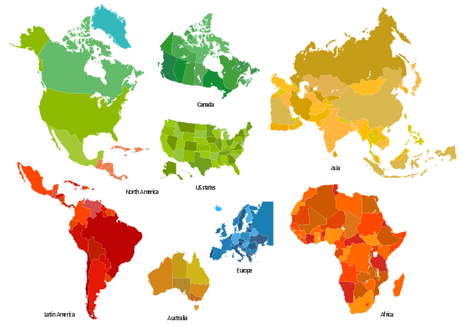
Agricultural Development Experience in the 1950s and 1960s
Influence of the “Marshall Plan”
Assuming that agricultural technologies and models of agricultural extension could be transferred directly from high-income to low-income countries.
Community development program would help solving the problems of poverty, inequitable land tenure systems. Food aid could serve humanitarian needs and provide jobs for the rural poor

Slide 18


Agricultural Development Experience in the 1950s and 1960s
Diffusion model of Agricultural Development
Assuming that farmers have not allocated their existing resources efficiently.
Farmers could substantially increase their agricultural productivity by allocating existing resources more efficiently and by adopting agricultural practices and technologies from the industrial countries.
Community development
Western Specialists can help rural people design and implement self-help program aimed at promoting rural development.

Slide 19
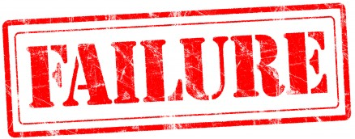
Agricultural Development Experience in the 1950s and 1960s
Why?
Structural barrier to rural development, such as highly concentrated political power and asset ownership.
Wrong assumption about the farmers

Slide 20

Agricultural Development Experience in the 1950s and 1960s
“Efficient But Poor” argument
Farmers and herders are far from being irrational…
They are calculating economic agents who carefully weigh the marginal costs and benefits associated with different agricultural techniques.
“An outside expert, however skilled … will not discover any major inefficiency in the allocation of factors.” Schultz (1964)
The Key to agricultural development:
Gain access to new and more productive factors of production
Gain new skills needed to exploit them.

Slide 21
Agricultural Development Experience in the 1950s and 1960s
“Efficient But Poor” argument
This idea called for a shift towards investment in agricultural research and human capital.
Establishment of
  International Rice Research Institute (IRRI) in the Philippines
  International Maize and Wheat Improvement Center (CIMMYT) in Mexico
The “Green Revolution” (high-payoff input) model
  High-yield, fertilizer-responsive varieties
Down-sides of Green revolution
  Benefit mainly landlords and larger farmers in ecologically favored area..
  Lower grain prices
  Eviction from the land as landlords found it profitable to farm the land themselves through mechanization

Slide 22
Agricultural Development Experience in the 1950s and 1960s
“Efficient But Poor” argument – Stressing role of technological change
Down-sides of Green revolution
Benefit mainly landlords and larger farmers in ecologically favored area..
Lower grain prices
Eviction from the land as landlords found it profitable to farm the land themselves through mechanization
Up-side of the Green revolution
More grains and cereals for food.
Reduce real price of food for the poor
Reduce the needs to cultivate environmentally fragile areas.

Slide 23
Radical Political Economy and Dependency Perspectives on Agriculture
Baran (1952):
  Institutional and structural barrier to development and the effective demand
  His perspective downplays the role of agriculture in development.
Dependency Theory:
  “By dependency we mean a situation in which the economy of certain countries is conditioned by the development and expansion of another economy in which the former subjected” (Dos Santos (1970))
  Trade was often a “zero-sum game” because of the unequal exchange between the low-income countries (the periphery) and the industrialized countries (the center).
The Center
The peripheries

Slide 24
Radical Political Economy and Dependency Perspectives on Agriculture
Important contributions
Each country’s economic development had to be understood in the context of that country’s historical experience.
Stress the importance of linkages and exchange arrangements that tied villages to the global economy.
Development involved restructuring institutional and political relationships.
“Economic policy without political economy is a useless and utopian exercies.”
De Janvry 1981
The Center
The peripheries

