Slide 1
Urban and rural development
EE463 Globalization and international development
Faculty of economics
Thammasat university

Slide 2
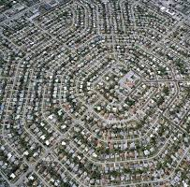
definitions
City. a permanent and densely settled place with defined administrative boundaries. A city has networks, systems, and services
Urban. has the characteristics of a city (being city)
Urban development. improvement/evolution of an urban area
Urbanization. the process of becoming urban; shift from agriculture land to urban land

Slide 3
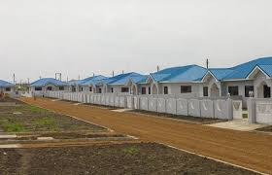
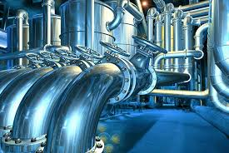
definitions
Infrastructure. Basic physical structures and facilities needed for the operation and functionality of a city; this includes, among others, water supply, road transportation, electricity, drainage, sewers, wastewater treatment, garbage collection
Urban-rural linkages. Flows of goods, people, information, finance, information and social relations across space, linking urban and rural areas

Slide 4
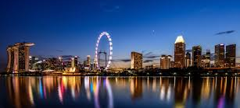
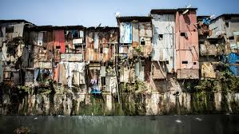
Importance of cities
Currently 55% of the world’s population (4.2 billion) live in cities; by 2050, the figure is expected to be 70%
Cities play an important role in economic development; as centers of innovation, finance, administration, culture and education
Cities contribute to sustainable growth by increasing productivity and promoting innovation
Cities provide infrastructure and services through concentration in transportation, communications, power, human interactions, water and sanitation services

Slide 5
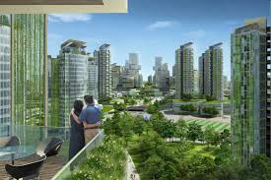
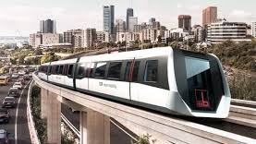
Importance of cities
Cities provide economies of scale and agglomeration and cost advantages to producers and consumers
Wealth is concentrated in cities; more than 80% of global GDP is generated in cities
Demand increases for affordable housing, well-connected transport systems, infrastructure, basic services, and jobs; these create opportunities as well as challenges

Slide 6
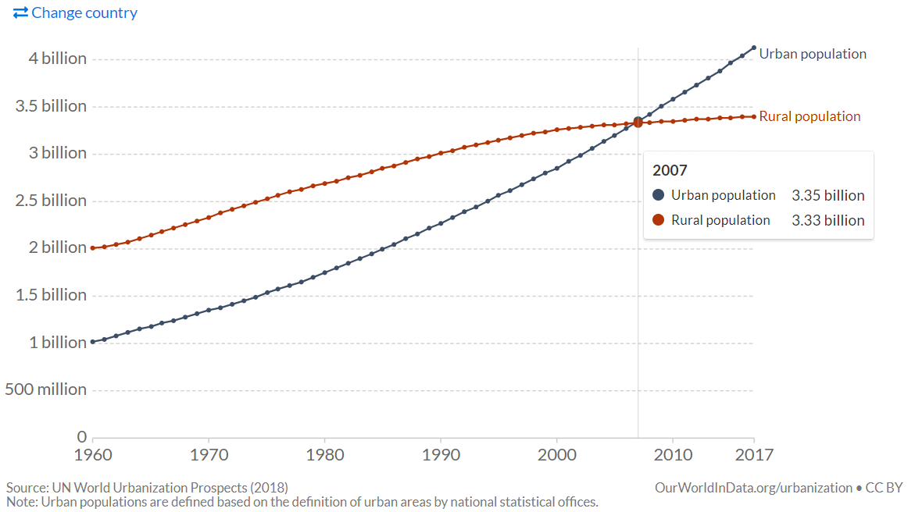
Number of People Living in Urban Areas, 1960-2017

Slide 7
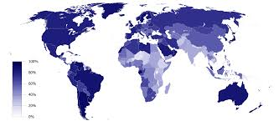
Urbanization Levels Worldwide

Slide 8
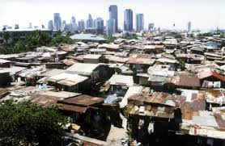
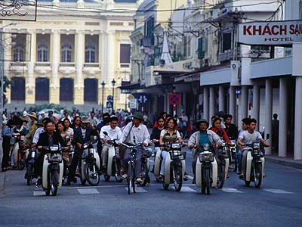
Challenges of urbanization
Uncontrolled spatial development due to rapid population growth and lack of planning and development controls
Poverty and vulnerability as migration continues and jobs become scarce, inequality gap widens and becomes more visible
Lack of financing for infrastructure increased demand for infrastructure and services places financial burden on city officials to meet the growing demand
Environmental pollution due to congestion and density

Slide 9
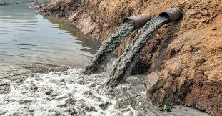
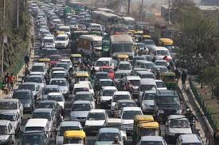
Challenges of urbanization
Ineffective governance and institutions and lack of capacity to develop and maintain public services
Increasing land prices limit investments and infrastructure development
Less-than-sustainable development. Adding more built up areas increases environmental risks such as flooding and pollution
Non-inclusive development. Widening gap between the haves and have-nots due to exclusion of certain groups in society

Slide 10
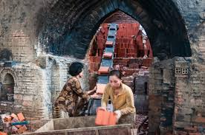
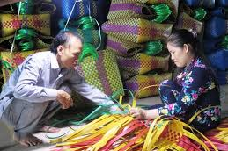
Rural transition
Most developing countries are agriculture-based whereby population live in rural areas
Labor productivity is relatively low; there is a gradual shift from farm work to non-farm activities
Farming is no longer attractive for many rural residents; opportunities for non-farm work has become an alternative to farming

Slide 11
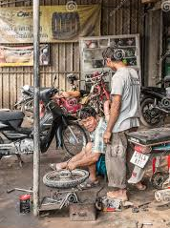
Rural transition
Improved transportation has increased mobility of people and access to once remote areas → rural-urban migration occurs
Social change, particularly among the young population is occurring because of advancements in communication and more widespread education; thereby raising expectations
Rapid rural diversification and agriculture transformation has implications on urban development and urban-rural linkages

Slide 12
Urban and Rural linkages
Farmers engage in agricultural production; excess production (surplus) is sold to the urban market
Proceeds earned are used to buy agriculture inputs
Farmer is able to produce more and diversifies production
Additional income is further invested, resulting in creation of non-farm employment
Urban centers provide technology and innovative ideas
Intensified urban-rural linkages creates demand for roads, infrastructure, finance, technology, and other economic goods
These create opportunities for economic growth

Slide 13
DIAGRAM OF URBAN-RURAL LINKAGES
creation of non-farm employment
5
increased/diversified production
3
agricultural production/output
1
Urban
market, capital
Rural
land, labor
2
agricultural inputs
4
increased investment
6
technology transfer and innovation
Based on Douglass (1998) and Satterthwaite and Tacoli (2003)

Slide 14
Towards competitive, sustainable and liveable cities
Accelerate efforts to alleviate poverty
Promote better planning and land management
Identify potential revenue streams to finance urban infrastructure and public services
Improve accountability of government and institutions
Develop management plans and climate change adaptation and mitigation
Involve private sector and key societal actors

