Slide 1
International Economics
Part 2

Slide 2
Absolute and Comparative Adv.
This theory supports free trade, stating that all countries gain from free trade.
This may not be the case in reality!!!
Absolute Advantage was developed by Adam Smith. It is the same as “Specialization”.
Comparative Advantage was developed by David Ricardo. It is about the opportunity cost of production.

Slide 3
Absolute and Comparative Adv.
Absolute Advantage is the advantage of one country when it uses fewer resources to produce a good than the other country does.
Comparative Advantage is the advantage of one country when that it produces a good at a lower opportunity cost (in terms of other goods that must be forgone) than the other country does.

Slide 4
Absolute Advantage (AA)
Suppose that NZ and AUS each have 5 acres of land.
1 acre can give either wheat or cotton as follows:
NZ has AA in wheat production: given 1 acre of land, NZ can produce 6 units of wheat (4 units for AUS).
AUS has AA in cotton production: given 1 acre of land, AUS can produce 6 units of cotton (4 units for NZ).
 | New Zealand (NZ) | Australia (AUS)
Wheat | 6 units | 4 units
Cotton | 4 units | 6 units

Slide 5
Absolute Advantage (AA)
To simplify the analysis, suppose that both countries want to consume wheat and cotton equally.
Without trade,
  NZ can allocate 2 acres for wheat and 3 acres for cotton to enjoy 12 units of wheat and 12 units of cotton.
  AUS can allocate 3 acres for wheat and 2 acres for cotton to enjoy 12 units of wheat and 12 units of cotton.

Slide 6
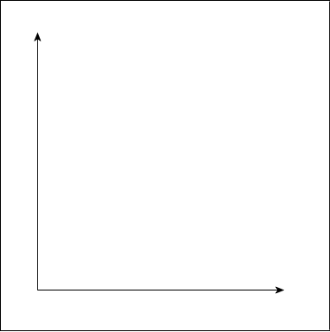
Absolute Advantage (AA)
Production Possibility Frontier (PPF), showing all the combinations of wheat and cotton that can be produced.

Slide 7
Absolute Advantage (AA)
A country should “specialize” in producing the good that it has absolute advantage.
Two countries with different specialization can trade, and both countries will benefit.
With trade,
  NZ can allocate 5 acres for wheat to produce 30 units of wheat.
  AUS can allocate 5 acre for cotton to produce 30 units of cotton.
  NZ and AUS can trade. Each country can enjoy 15 units of wheat and 15 units of cotton.

Slide 8
Absolute Advantage (AA)
Production Possibility Frontier (PPF), showing all the combinations of wheat and cotton that can be produced.

Slide 9
Comparative Advantage (CA)
Suppose that NZ and AUS each have 5 acres of land.
1 acre can give either wheat or cotton as follows:
NZ has AA in wheat and cotton production.
However, each country has different comparative advantage, and BOTH can still benefit from trade.
We need to look at the opportunity cost.
 | New Zealand (NZ) | Australia (AUS)
Wheat | 6 units | 4 units
Cotton | 4 units | 2 units

Slide 10
Comparative Advantage (CA)
Production Possibility Frontier (PPF), showing all the combinations of wheat and cotton that can be produced.

Slide 11
Comparative Advantage (CA)
Production Possibility Frontier (PPF), showing all the combinations of wheat and cotton that can be produced.

Slide 12
Comparative Advantage (CA)
Opportunity Cost of Wheat
NZ: to produce 1 wht, 4/6 cot must be sacrificed.
AUS: to produce 1 wht, 2/4 cot must be sacrificed.
Opportunity Cost of Cotton
NZ: to produce 1 cot, 6/4 wht must be sacrificed.
AUS: to produce 1 cot, 4/2 wht must be sacrificed.
AUS has lower opportunity cost in wheat production.
NZ has lower opportunity cost in cotton production.

Slide 13
Comparative Advantage (CA)
AUS has lower opportunity cost in wheat production.
NZ has lower opportunity cost in cotton production.
Theory of CA suggests that NZ should produce cotton while AUS should produce wheat.
NZ will produce 20 wht and AUS will produce 20 cot.
Both countries will gain from trade.
Let’s check!!!

Slide 14
Comparative Advantage (CA)
Production Possibility Frontier (PPF), showing all the combinations of wheat and cotton that can be produced.

Slide 15
Balance of Payment (BoP)
BoP: a statement of all transactions made between agents in one country and the rest of the world over a defined period of time, such as a quarter or a year
BoP = current account + capital account
For some institutions, e.g. IMF,
BoP = current account + (capital account + financial account)

Slide 16
Current Account (CA)
Current Account is the sum of
  the balance of trade (exports minus imports),
  factor income (earnings on foreign investments minus payments made to foreign investors),
  and unilateral transfers (scholarship from abroad, foreign aid, donation to abroad, etc.).
Balance of trade constitutes a large proportion of the current account.
X > M => trade surplus => CA surplus
X < M => trade deficit => CA deficit

Slide 17
Capital Account (KA)
The capital account records the net change in ownership of foreign assets. It contains “reserve account”.
KA = ∆ in foreign ownership of domestic assets
– ∆ in domestic ownership of foreign assets.
A surplus in the capital account (KA > 0) means money is flowing into the country, and it suggest borrowing or sales of domestic assets to foreigners.
A deficit in the capital account (KA < 0) means money is flowing out of the country, and it suggests the nation is increasing its ownership of foreign assets.

Slide 18
BoP Identity
In theory, BoP = CA + KA = 0.
That is, if we have CA deficit, we must have KA surplus.
For example,
The US imports 100$ cars from Germany (thus, the US has X < M: trade and CA deficit).
Since the payment is made in $, and the Germans do not spend this money, they will have to keep this money as deposits in the US banks (thus, we have KA surplus).

Slide 19
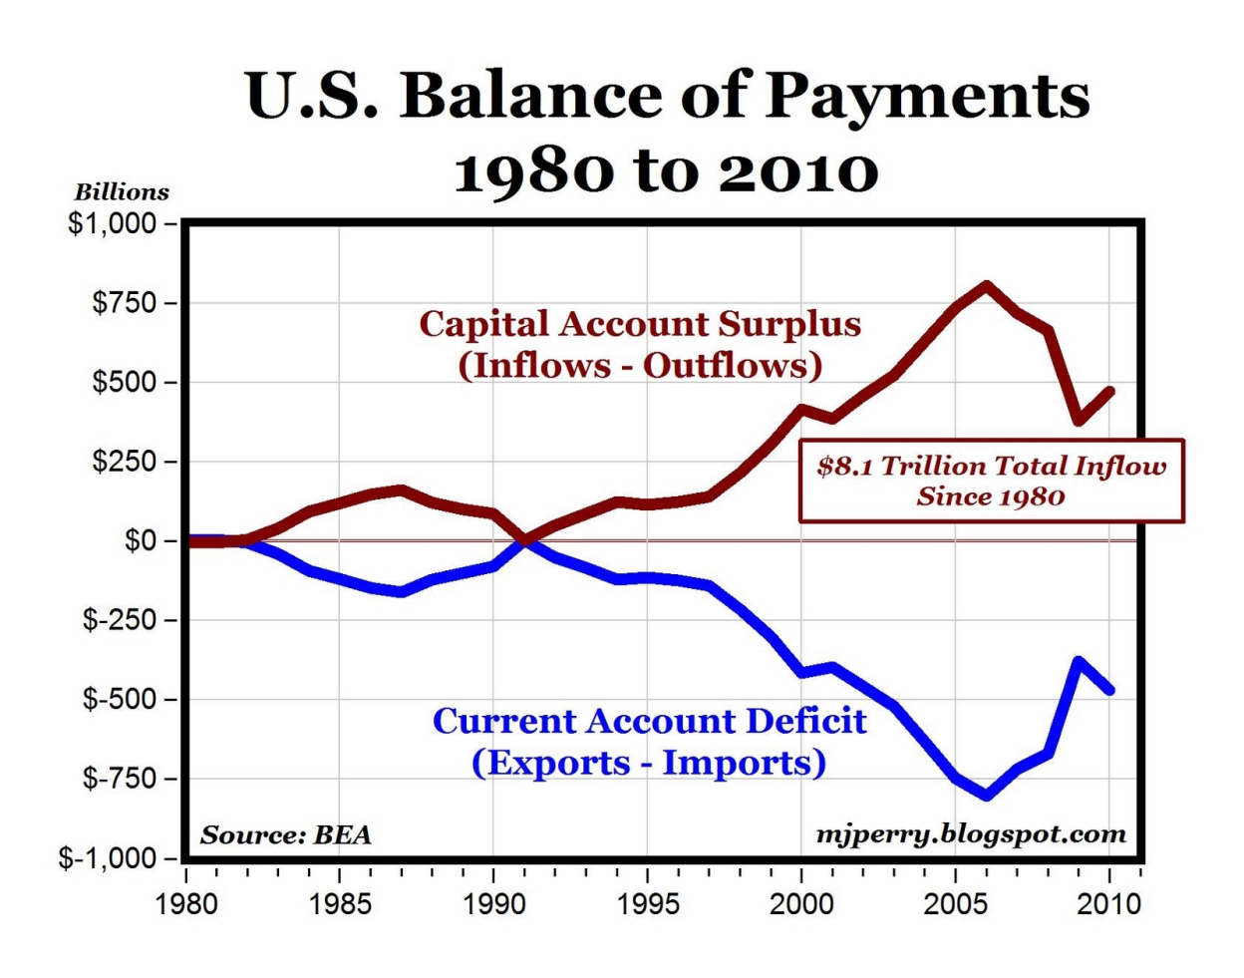
BoP Identity
In reality, the BoP Identity does not hold.
The reason is mainly due to unilateral transfers.

