Slide 1
Topic 4
Development Across Lifespan

Slide 2
Developmental Psychology
The study of progressive changes in behavior and abilities from conception to death.

Slide 3
Nature and Nurture: Which is more important?
Heredity
Transmission of physical and psychological characteristics from parents to their children through genes.

Slide 4
Nature and Nurture
Heredity (cont.)
Readiness
A condition that exists when maturation has advanced enough to allow the rapid acquisition of a particular skill.
Ex. Toilet training 18 – 24 months of age.

Slide 5
Nature and Nurture (cont.)
Environment
All external conditions that affect development, and learning.

Slide 6
Nature and Nurture
Environment (cont.)
Parental Influence
Congenital Problem: Birth defect - A problem or defect that occurs during prenatal development
1. Genetic Disorder: Problem caused by inherited characteristics from parents
2. Teratogen: Problem caused by environment

Slide 7
Nature and Nurture
Environment (cont.)
Sensitive Period
Sensitive Periods: A period of increased sensitivity to environmental influences; also, a time when certain events must occur for normal development to take place.

Slide 8
Nature and Nurture
Environment (cont.)
Deprivation and Enrichment
Deprivation: Lack of normal stimulation, nutrition, comfort, or love.
    Deprivation may lead to sickness, cognitive development lags, poor school and performance.
Enrichment: When an environment is deliberately made more loving, stimulating, and emotional supporting.

Slide 9
Nature and Nurture (cont.)
Reaction Range
Reaction Range: The limits environment places on the effects of heredity.

Slide 10
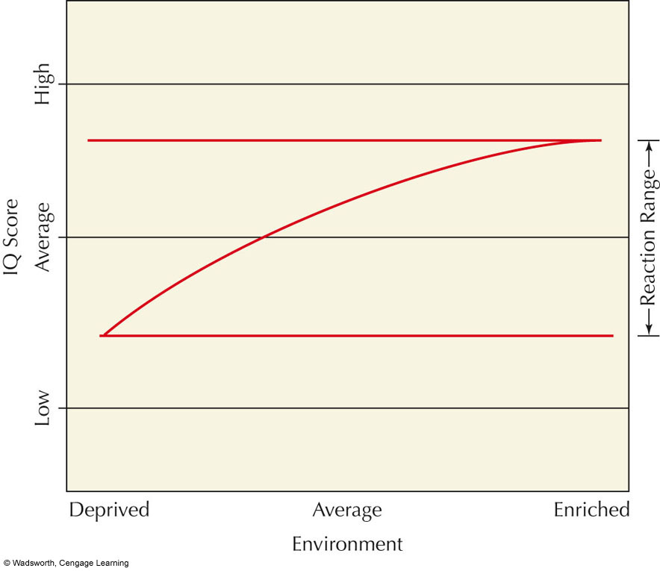
Notes:
FIGURE 3.5 The effect of heredity on the development of human traits,
such as intelligence, can often influenced by environmental circumstances. A
child with average genes for intelligence growing up in an average environment might have an average IQ score as an adult. However, growing up in a deprived environment might result in a somewhat lower IQ score and growing up in an enriched environment might result in a somewhat higher IQ score. In this way, the environment sets a range within which our hereditary potential is actually expressed. This range is called the reaction range.

Slide 11
Nature and Nurture
Reaction Range (cont.)
The Whole Person
The person’s development is determined by three factors: heredity, environment, and the person’s behavior.

Slide 12
Nature and Nurture
Reaction Range (cont.)
The whole Peron (cont.)
Each person was born with different temperament and he/she is in different environment that cause them the behave differently.

Slide 13
Nature and Nurture
Reaction Range (cont.)
The whole Peron (cont.)
New Born Temperament
Easy Children: 40 %; relaxed and agreeable
Difficult Children: 10 %; moody, intense, easily angered
Slow-to-Warm-Up Children: 15 %; restrained, unexpressive, shy
Remaining Children: Do not fit into any specific category

Slide 14
The New Born
The Newborn and Their Reflexes
Grasping Reflex:
  If an object is placed in the infant’s palm, she’ll grasp it automatically.
Sucking Reflex:
  Touch an object or nipple to the infant’s mouth and she’ll make rhythmic sucking movements.

Slide 15
The Newborns
The Newborn and Their Reflexes (cont.)
Moro Reflex:
  If a baby’s position is abruptly changed or if he is startled by a loud noise, he will make a hugging motion

Slide 16
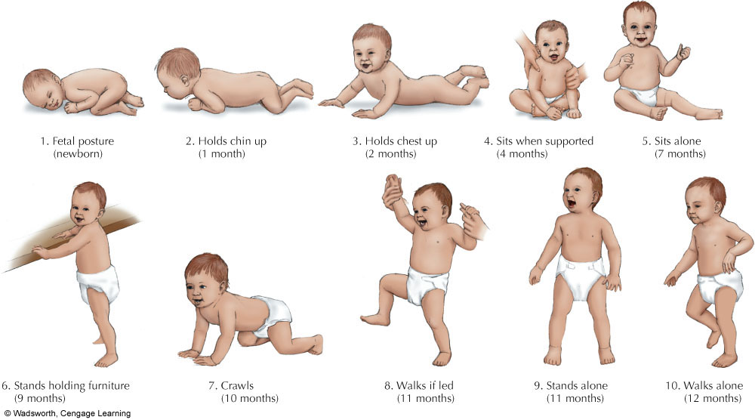
The Newborn (cont.)
Motor Development
Notes:
FIGURE 3.8 Motor development. Most infants follow an orderly pattern of motor development. Although the order in which children progress is similar, there are large individual differences in the ages at which each ability appears. The ages listed are averages for American children. It is not unusual for many of the skills to appear 1 or 2 months earlier than average or several
months later (Harris & Liebert, 1991). Parents should not be alarmed if a child’s behavior differs some from the average.

Slide 17
The Newborn (cont.)
Cognitive Development
  3 days: prefer complex pattern to simple ones.
  3- 8 week : recognize the mother’s voice.
  20 days: can imitate facial gestures and actions (Mimicry)
  9 months: imitate actions a day later

Slide 18
The Newborn (cont.)
Emotional Development
Basic emotions start at 10 weeks of age.
The most common expression interest→ joy→ anger→ sadness.
Before 8 months, smile is random.
8 -12 months - start social smile

Slide 19
Social Development
Social Development: Development of self-awareness, attachment to parents or caregivers, and relationships with other children and adults

Slide 20
Social Development (cont.)
Attachment
Emotional Attachment:
Close emotional bond that infants form with their parents, caregivers, or others.
  Separation Anxiety
Crying and signs of fear when a child is left alone or is with a stranger; generally appears around 8-12 months.

Slide 21
Social Development
Attachment (cont.)
Attachment Quality (Mary Ainsworth)
  Secure: Stable and positive emotional bond
  Insecure-Avoidant: Tendency to avoid reunion with parent or caregiver; anxious or emotional bond

Slide 22
Social Development
Attachment (cont.)
  Quality of Attachment (Mary Ainsworth)
  Insecure-Ambivalent: Desire to be with parent or caregiver and some resistance to being reunited; also anxious emotional bond

Slide 23
Parental Influences
Parenting Styles (Baumrind-1991, 2005)
1.Authoritarian Parents: Enforce rigid rules and demand strict obedience to authority; children tend to be emotionally stiff and lacking in curiosity.
2.Overly Permissive: Give little guidance, allow too much freedom, or don’t hold children accountable for their actions; children tend to be dependent and immature and frequently misbehave

Slide 24
Parental Influences
Parenting Styles (cont.)
3.Authoritative: Provide firm and consistent guidance combined with love and affection; children tend to be competent, self-controlled, independent, and assertive

Slide 25
Language Development
Cooing:
  Spontaneous repetition of vowel sounds by infants; at 6-8 weeks
Babbling:
  Repetition of meaningless language sounds (e.g., babababa); 7 months

Slide 26
Language Development
Single-Word Stage:
  The child says one word at a time; 1 year –mama, dada
Telegraphic Speech:
  Two word sentences that communicate a single idea (e.g., “Want yogurt”) ; 18 – 24 months.

Slide 27
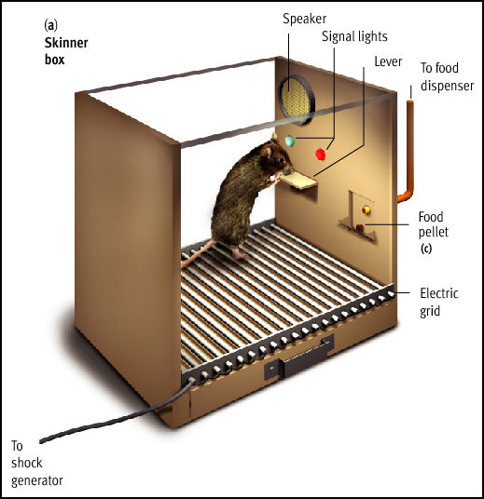
Language Development
The Root of Language
1. Skinner - Learning Theory
- association, imitation, reinforcement

Slide 28
Language Development
The Root of Language (Cont.)
2. Language – acquisition Device Linguist - Noam Chomsky Environment
provides input to
Genes design Psychological Behavior
mechanisms, (e.g.language)
including language
mechanism

Slide 29
2. Language – acquisition Device Linguist - Noam Chomsky (Cont.)
  Chomsky: Language patterns are inborn
  He presumed hereditary readiness of ALL humans to learn certain skills such as how to use language
Criticism of Chomsky’s theory:
  Underestimates importance of learning and social context

Slide 30
Language Development (Cont.) Parentese (Motherese)
Pattern of speech used when talking to infants
  Marked by higher-pitched voice; short, simple sentences, slowed speech and exaggerated voice inflections, and repetition

Slide 31
Cognitive Development : Think Like a Child
Piaget’s Theory of Cognitive Development
Piaget believed that all children pass through a set series of stages during their cognitive development.
Mental Processes : Intellect grows through assimilation and accommodation process.
Assimilation refers to using existing mental patterns in new situations.
Accommodation refers to modifying existing ideas to fit new requirements.

Slide 32
Cognitive Development : Think Like a Child
Piaget’s Theory of Cognitive Development (Cont.)
1.Sensorimotor (0-2 Years): All sensory input and motor responses are coordinated; most intellectual development here is nonverbal
  Object Permanence: After 8 months old, children know that objects still exist when they are out of sight.

Slide 33
Cognitive Development : Think Like a Child
Piaget’s Theory of Cognitive Development (Cont.)
2.Preoperational Stage (2-7 Years): Children begin to use language and think symbolically, BUT their thinking is still intuitive and egocentric.

Slide 34
Cognitive Development : Think Like a Child
Piaget’s Theory of Cognitive Development (Cont.)
3.Concrete Operational Stage (7-11Years)
Children become able to use concepts of time, space, volume, and number BUT in ways that remain simplified and concrete, not abstract

Slide 35
Cognitive Development : Think Like a Child
Piaget’s Theory of Cognitive Development (Cont.)
  3.Concrete Operational Stage (Cont.)
  Reversibility of Thought: Relationships involving equality or identity can be reversed.
Conservation: Mass, weight, and volume remain unchanged when the shape or appearance of objects changes.

Slide 36
Cognitive Development : Think Like a Child
Piaget’s Theory of Cognitive Development (Cont.)
4.Formal Operations Stage (11 Years and Up)
Thinking now includes abstract, theoretical, and hypothetical ideas

Slide 37
Cognitive Development : Think Like a Child
Lev Vygotsky’s Sociocultural Theory
Children’s cognitive development is heavily influenced by social and cultural factors.
A child’s thinking develops through dialogues with more capable persons.

Slide 38
Cognitive Development : Think Like a Child
Lev Vygotsky’s Sociocultural Theory (Cont.)
Zone of Proximal Development
Range of tasks a child cannot master alone even though they are close to having the necessary mental skills; they need guidance from a skilled partner in order to complete the task.

Slide 39
Cognitive Development : Think Like a Child
Lev Vygotsky’s Sociocultural Theory (Cont.) Scaffolding
Framework or temporary support. Adults help children learn how to think by scaffolding, or supporting, their attempts to solve a problem or to discover principles
  Scaffolding must be responsive to a child’s needs

Slide 40
Adolescence and Young Adulthood Lawrence Kohlberg and Moral Development
Moral Development: When we acquire values, beliefs, and thinking abilities that guide responsible behavior
Stage theorist, like Freud and Erikson

Slide 41
Moral Development(cont.)
Basic Stages of Moral Development
Level 1: Pre-conventional Morality
Stage 1: Obedient and Punishment Orientation
Stage 2: Reward Orientation

Slide 42
Moral Development
Basic Stages of Moral Development (Cont.)
Level 2: Conventional Morality
Stage 3: “Good Boy” Morality
Stage 4: “Right” is what society defines as right. (conform to rules and laws)

Slide 43
Moral Development
Basic Stages of Moral Development (Cont.)
Level 3: Post-Conventional Morality
Stage 5: Individual Right, Self respect
Stage 6: Individual Principles & Conscience

Slide 44
The Story of a Lifetime
Etrikson’s Stages of Psychological Development
Stage
Trust and mistrust
Autonomy vs.shame and doubt
Initiative vs. guilt
Approx. Ages
Birth – 1½ yrs
1½ - 3
3 - 6

Slide 45
Erikson’s Stages of Psychological Development
Stage
Industry vs. inferiority
Identity vs. role-confusion
Intimacy vs. isolation
Approx. Ages
6 - 12
Adolescence (13-19)
Early adulthood

Slide 46
Erikson’s Stages of Psychological Development
Stage
Generativity vs. Stagnation
Ego integrity vs. despair
Approx. Ages
Middle adulthood
Late adulthood

Slide 47
Erik Erikson’s Eight Stages of Psychosocial Dilemmas

Slide 48
Erikson’s Stages of Psychological Development
Stage One: Trust versus Mistrust (Birth-1)
Trust: Established when babies given adequate warmth, touch, love, and physical care
  Mistrust: Caused by inadequate or unpredictable care and by cold, indifferent, and rejecting parents

Slide 49
Erikson’s Stages of Psychological Development Stage Two: Autonomy versus Shame and Doubt (1-3)
Autonomy: Doing things for themselves
Overprotective parents may cause children to doubt abilities and feel shameful about their actions

Slide 50
Erikson’s Stages of Psychological Development
Stage Three: Initiative versus Guilt (3-5)
Initiative: Parents reinforce via giving children freedom to play, use imagination, and ask questions
Guilt: May occur if parents criticize, prevent play, or discourage a child’s questions

Slide 51
Erikson’s Stages of Psychological Development Stage Four: Industry versus Inferiority (6-12)
Industry: Occurs when child is praised for productive activities
Inferiority: Occurs if child’s efforts are regarded as messy or inadequate

Slide 52
Erikson’s Stages of Psychological Development Stage Five (Adolescence): Identity versus Role Confusion
Identity: For adolescents; problems answering, “Who am I?”
Role Confusion: Occurs when adolescents are unsure of where they are going and who they are

Slide 53
Erikson’s Stages of Psychological Development
Stage Six (Young Adulthood): Intimacy versus Isolation
Intimacy: Ability to care about others and to share experiences with them
Isolation: Feeling alone and uncared for in life

Slide 54
Erikson’s Stages of Psychological Development
Stage Seven (Middle Adulthood): Generativity versus Stagnation
Generativity: Interest in guiding the next generation
Stagnation: When one is only concerned with one’s own needs and comforts

Slide 55
Erikson’s Stages of Psychological Development Stage Eight (Late Adulthood): Integrity versus Despair
Integrity: Self-respect; developed when people have lived richly and responsibly
Despair: Occurs when previous life events are viewed with regret; experiences heartache and remorse

Slide 56
Death and Dying
Reaction to Impending Death
Kubler-Ross was a thanatologist: One who studies emotional and behavioral reactions to death and dying

Slide 57
Death and Dying
Reaction to Impending Death (Cont.)
1.Denial and Isolation: Denying death’s reality and isolating oneself from information confirming that death will occur: “It’s a mistake; the doctors are wrong.”
2. Anger: Asking “Why me?” Anger may then be projected onto the living.

Slide 58
Death and Dying
Reaction to Impending Death (Cont.)
3.Bargaining: Terminally ill will bargain with God or with themselves: “If I can live longer I’ll be a better person.”
4.Depression: Feelings of futility, exhaustion, and deep sadness
5.Acceptance: If death is not sudden, many will accept death calmly: person is at peace finally with the concept of death.

Slide 59
Reading Assignment
Psychology in Action: Effective Parenting – Always kiss Your Children Goodnight pp. 105 – 107.

