Slide 1
Financial Sector in Thailand

Slide 2
References
วเรศ อุปปาติก เศรษฐศาสตร์การเงินและธนาคาร 2544 บทที่ 6 และ 9
อรวรรณ รัตนภากร “โครงสร้างทางการเงินไทยในระดับมหภาค” บทความเสนอในการสัมมนาทางวิชาการประจำปี 2548 จัดโดย คณะเศรษฐศาสตร์ มหาวิทยาลัยธรรมศาสตร์ 14-15 มิถุนายน 2548

Slide 3
References
3
ธาริษา วัฒนเกส “การเปิดเสรีและเสถียรภาพของระบบธนาคารพาณิชย์ไทย” เอกสารวิจัยส่วนบุคคลตามหลักสูตรการป้องกันราชอาณาจักรภาครัฐ เอกชน และการเมือง รุ่นที่ 3 พ.ศ. 2548-49 http://www.bot.or.th/Thai/FinancialInstitutions/FIStructure/FI_System/THFISYS/Documents/Thai_FISystem.pdf

Slide 4
References
รุ่ง โปษยานนท์ มัลลิกะมาส, ดอน นาครทรรพ และ ผจงจิต จิตตะมัย “ความท้าทายของธนาคารพาณิชย์ภายใต้การเปลี่ยนแปลงของสภาพแวดล้อมทางเศรษฐกิจและการเงิน” บทความเสนอในการสัมมนาทางวิชาการประจำปี 2548 จัดโดยธนาคารแห่งประเทศไทย

Slide 5
Introduction
Financial sector: saving, lending, borrowing, investing
  Role of intermediation between savers and investors
  Promote efficiency in resource allocation

Slide 6
Structure of financial sector
Informal and formal sector
Informal sector: No state regulation e.g. personal loans
  was significant (90% of total credit in 1962)
  but much reduced and replaced by formal sector

Slide 7
Structure of financial sector
Formal sector: supervised and regulated by Bank of Thailand and other agencies
  financial institutions, capital market

Slide 8
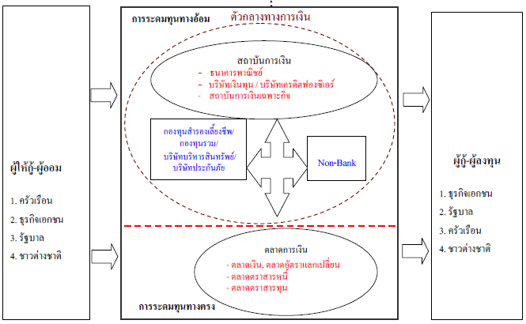
การเงินในระบบ

Slide 9
Structure of financial sector
Financial institutions:
  Commercial banks
  Development banks (Savings, Housing, SME and EXIM)

Slide 10
Structure of financial sector
Financial institutions:
  non banks (finance companies, securities companies, asset management, small credit providers)
  Others (insurance, agricultural and savings co-operatives, pawn shops)

Slide 11
Structure of financial sector
Commercial banks play biggest role
But capital market has expanded after the 1997 crisis

Slide 12
Commercial banks (before the crisis)
Before WW2, foreign banks dominated; business mainly related to foreign trade transactions
During WW2 Thai banks started to play more role e.g. Bangkok Bank and Kasokornthai Bank
In 1942, the Bank of Thailand was established

Slide 13
Commercial banks (before the crisis)
After WW2
  Policy of “no new entry, no exit” led to “moral hazard” problem
  Financial liberalization in 1990 allowed Bangkok International Banking Facilities (BIBF), leading to foreign borrowing and financial crisis in 1997

Slide 14
Finance and Securities Companies
( before the crisis)
Finance companies are similar to banks, except they cannot accept deposits, so they borrow by issuing promissory notes and lend with higher risk
Finance companies were combined with securities brokers, thus subject to risks in stock market

Slide 15
Financial institutions during the 1997 crisis
Capital outflow, and bubble burst in real estate and stock market led to no confidence in financial institutions (start with finance and securities companies and then banks)
Bank run, liquidity problem, and finally insolvency problem

Slide 16
Financial institutions during the 1997 crisis
BOT and Finance Ministry intervened by:
  FIDF took over weak finance co’s and banks
  New organizations dealing with bad assets
  Allowed 49% foreign ownership in banks for 10 years (ABN Amro, DBS, Standard Chartered, UOB)
  100% deposit guarantee by the government

Slide 17
Financial institutions during the 1997 crisis
Government finances FIDF through sale of bonds : taxpayers’ burden
Now 15 banks: Big Four + Medium + Retail banks
Many banks are majority-owned by foreign banks

Slide 18
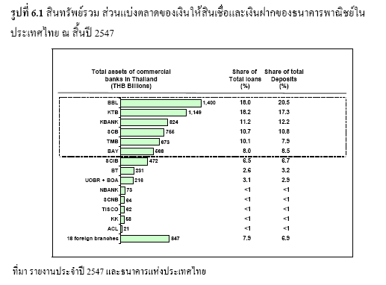

Slide 19
FI Recovery 2003- Present
Past lessons: important to have sound system with adequate nationwide services
FI Development Plan for nationwide financial service (rural and SME) and adaptive to future changes (universal banking) in 5-10 years

Slide 20
FI Recovery 2003- Present
New Financial Institution Law 2008 enables BOT to improve its regulatory practices
  All financial institutions in one law
  Improvements of supervision tools for better risk management
  More power and transparency by BOT in dealing with “problem institutions”

Slide 21
FI Recovery 2003- Present
New Financial Institution Law 2008 enables BOT to improve its regulatory practices
  10% shareholding limit by one person
  25% shareholding limit by foreigners (can approve up to 49%)
Improvement of “credit bureau” as central information on credit worthiness of debtors

Slide 22
FI Recovery 2003- Present
New Deposit Protection Institution to replace 100% deposit guarantee (moral hazard?)
  100% guarantee in the first year 2009 (extended to 3 years due to the hamburger crisis)
  100 million baht guarantee in the next year
  50, 10 and finally 1 million guarantee in consequent years

Slide 23
FI Recovery 2003- Present
Gradual opening of the sector for competition from foreign banks; as part of ASEAN Economic Community
Thai banks still weak in personnel and technology

