Slide 1


Alternative Trade Theories
Chayun Tantivasadakarn
Faculty of Economics, Thammasat University
1

Slide 2
Outline
Intra-Industry Trade
The Imitation Lag Hypothesis and The Product Cycle Theory
The Kemp Model and External Economies of Scale
The Krugman Model and Internal Economies of Scale with Monopolistic Competition
Monopoly and Dumping
Reciprocal Dumping
2

Slide 3
Intra-industry Trade
The trade theories studied so far emphasize on trade in different goods or inter-industry trade between developed and developing countries.
But most trade between developed countries involve goods in the same industry or intra-industry trade. (cars, vine)
The Grubel-Lloyd (GL) index
If X_{i} = 0 or M_{i} = 0, IIT_{i} = 0, no intra-industry trade.
If X_{i} = M_{i}, IIT_{i} = 1,
3

Slide 4
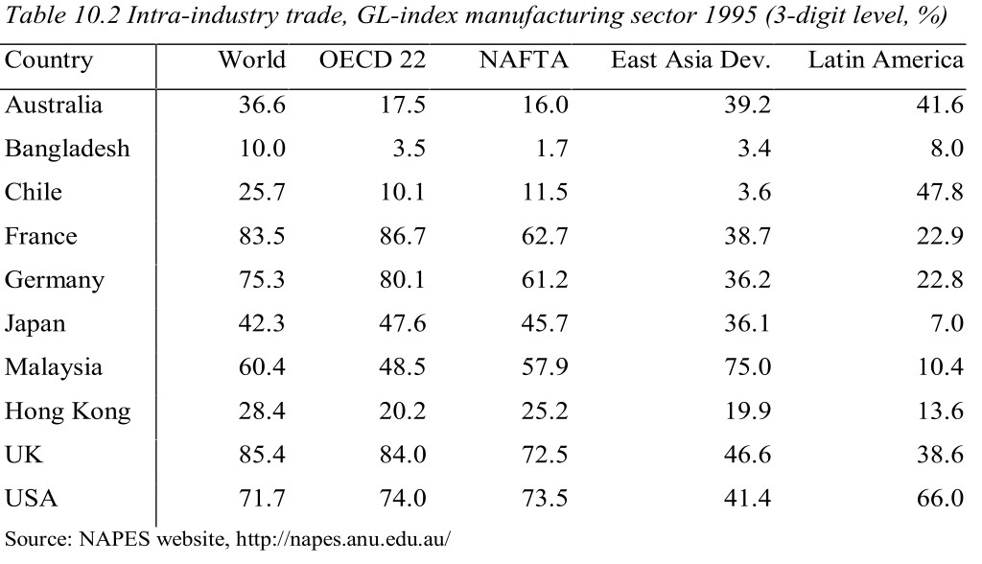
Intra-industry Trade: GL index x 100
4

Slide 5
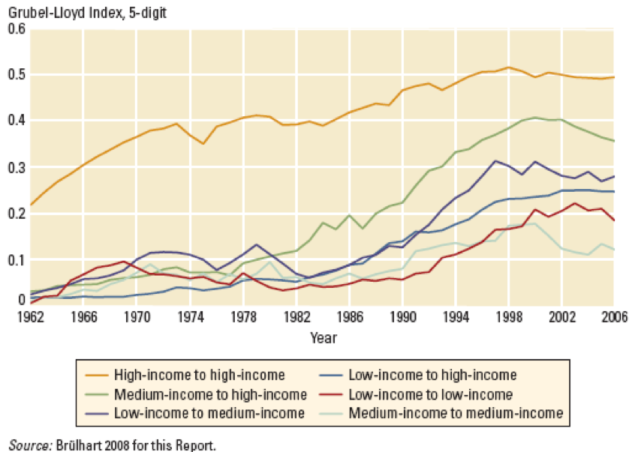
Intra-industry Trade: GL index
4

Slide 6
The Imitation Lag Hypothesis and The Product Cycle Theory
This group of theories concern about the dynamic comparative advantage which changes over time
The Imitation Lag Hypothesis (Michael Posner):
  There is a delay in transmission or diffusion of technology from country A to country B.
  There is a delay in consumer acceptance in country B after the the new product is introduced in country A.x
5

Slide 7
The Product Cycle Theory
The Product Cycle Theory (Raymond Vernon): the life cycle of the new product has 3 stages
  New product stage
  Maturing product stage
  Standardized product stage
New product stage:
  the product is produced and consumed only in Developed countries (DCs) where the demand is located. No international trade.
6

Slide 8
The Product Cycle Theory
Maturing product stage:
  product standards start to emerge and mass production process and economies of scale start to be realized. Foreign demand in other DCs starts to grow. There is export from the original DC to other DCs.
  The original DC starts to invest in other DCs to lower the production costs via FDI. Exports from the original DC are displaced by the production in these new production sites.
  The original DC may start to import from these new plants.
7

Slide 9
The Product Cycle Theory
Standardized product stage:
  Product characteristics and production process are well known.
  Production may shift to the developing countries (LDCs) to utilize lower labor costs.
  LDCs export the product to DCs.
8

Slide 10
The Product Cycle Theory
Production and consumption
Consumption in DC
Imports
Exports
Production in DC
Time
New product stage
Maturing product stage
Standardized product stage
9

Slide 11
The Kemp Model and External Economies of Scale
This model relax the assumption about CRTS technology used in H-O model (which implies no economies of scale) by assuming external economies of scale.
External economies of scale: the situation in which the long run average cost curve of each firm falls as the total industry output increases.
Firms in this case tend to concentrate in one places; e.g., Silicon Valley for semiconductor, New York for investment banking, Hollywood for movies, Siam square for tutoring services, RCA for night clubs and pubs.
10

Slide 12
The Kemp Model
Reasons for external economies of scale:
  Specialized suppliers: viability of new products or services need sufficiently large market; e.g., PCs, high ways.
  Pecuniary economies of scale: larger market lower the cost of inputs; e.g., labor pooling allows more selection of skilled workers and cheaper wage.
  Knowledge spillover: clustering of firms together in one area helps knowledge of new discovery to be spread out and improved upon faster; e.g., Silicon Valley.
11

Slide 13
The Kemp Model
External economies of scale is still consistent with U-shaped LAC.
It is not a barriers to entry for new firms like internal economies of scale.
Perfect competition assumption is still consistent with this case.
However external economies of scale will generate convex production possibility curves.
12

Slide 14
PPC under external economies of scale
Production Function for Y
Production Possibility Curve
Y = G(L_{Y})
Y
A
B
X
L_{Y}
L
X
Production Function for X
Full employment condition for labor
X = F(L_{X})
L
L_{X}
13

Slide 15
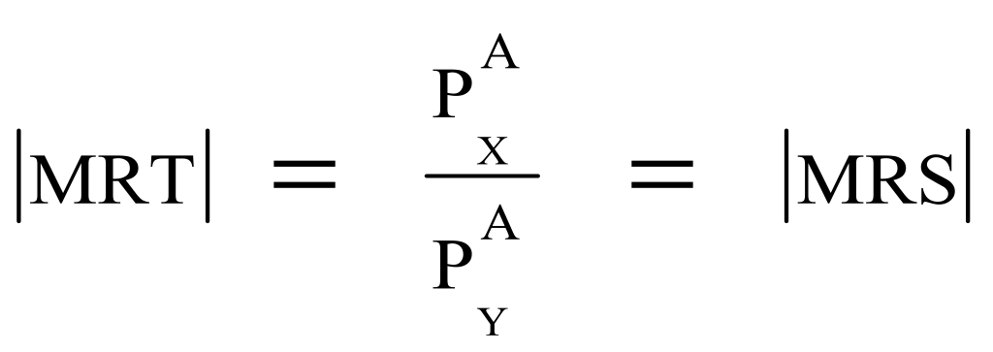
The Kemp Model: Autarky equilibrium
With external economies of scale and perfect competition, each firm produces until
P_{X} = MC_{X}, P_{Y} = MC_{Y}
Y
Y
Y_{A}
A representative consumer maximizes utility
A
CIC_{A}
P_{A}
X
X_{A}
X
14

Slide 16
The Kemp Model:
Assume 2 identical countries, the autarky price ratio must be the same and there is no pattern of comparative advantage. --> should be no trade.
Y
Y
But suppose H specializes in X and F specializes in Y. Then each consume a half of what is produced and trade the other half. Both will be at M and definitely better off than autarky.
M
Y/2
M/
Y/
Y_{A}
A
CIC_{A}
P_{A}
X_{A}
X/2
X/
X
15

Slide 17
The Kemp Model:
If the indifference curve of both country accidentally tangents at point M, this point will be the trade equilibrium. However, it is unlikely.
Suppose consumers like X more and CIC tangents at point M/ instead. There will be shortage of X and surplus of Y which force P_{X}/P_{Y} to rise.
Since H specializes in X, its budget line rotates outward. The budget line for F rotates inward.
The price adjustment process continues until the trade triangles of both countries are equalized.
16

Slide 18
The Kemp Model:
Y
Note P_{X}/P_{Y} adjusts until YBC^{F} equals to C^{H}EX.
Y
Both countries gain from trade.
But there is no guarantee for equal gains from trade.
The distribution of gains depends on the initial state of specialization.
The model cannot predict the pattern of specialization.
C^{H}
B
C^{F}
Y_{A}
A
CIC^{F}
CIC_{A}
X_{A}
E
X
17

Slide 19
The Kemp Model:
The specialization pattern may be determined by historical reasons.
There is some possibility of losses from trade. For instance if preferences are sufficiently bias toward X, P_{X}/P_{Y} will increase until the budget line for F is in the interior of the PPC.
In our example factor prices are equalized in autarky but they are not equalized after trade!
18

Slide 20
Internal Economies of Scale and Monopolistic Competition
External Economies of scale
  The cost per unit depends on the size of the industry but not necessarily on the size of any one firm.
  An industry will typically consist of many small firms and be perfectly competitive.
Internal Economies of scale
  The cost per unit depends on the size of an individual firm but not necessarily on that of the industry.
  The market structure will be imperfectly competitive with large firms having a cost advantage over small.
19

Slide 21
Natural Monopoly
Single monopoly can make profit by setting price at P_{M} and produc at Q_{M}
P
AC₂
If two identical firm share the market, each will incur loss at P₂ and Q_{M}/2
P_{M}
P₂
AC
MR
MC
D
Q
Q_{M}/2
Q_{M}
20

Slide 22
The Krugman Model: Monopolistic competition
Assumptions:
  an industry consisting of a number of firms producing differentiated products
  Each firm is assumed to be able to differentiate its product from its rivals.
  Each firm is assumed to take the prices charged by its rivals as given.
  The demand facing by each firm depends
    positively with the market size and competitors’ prices.
    negatively with its own price and number of firms.
21

Slide 23
The Krugman Model: Monopolistic competition
Demand: Q = [1/n – b(P – P)] S (1)
where
Q is the firm’s sales
S is the total sales of the industry
n is the number of firms in the industry
b is a constant term representing the responsiveness of a firm’s sales to its price
P is the price charged by the firm itself
P is the average price charged by its competitors
22

Slide 24
The Krugman Model: Monopolistic competition
We want to determine the number of firms, n, and the price charged, P.
First, derive the relationship between n and P. If each firms treat the average price as given, rewrite (1) as
Q = [1/n + bP]S - bSP
Hence, P = A - Q/(bS)
and TR = AQ - Q²/(bS), MR = A - 2Q/(bS)
or MR = A - Q/(bS) - Q/(bS)
MR = P - Q/(bS)
23

Slide 25
The Krugman Model: Monopolistic competition
Assume a constant MC = c, maximize profits require MR = MC or
MR = P - Q/(bS) = c --> P = c + Q/(bS)
Assuming that all firms in this industry are symmetric, P = P, which implies that Q = S/n. Hence,
P = c + 1/(bn) (2)
the more firms, the more competition, and hence the lower the price.
Plotting (2) as P curve. The curve is downward sloping.
This curve represents P that maximizes profits for given n.
24

Slide 26
The Krugman Model: Monopolistic competition
Second, derive the relationship between n and AC. By symmetry, P = P, which implies that Q = S/n
Suppose total cost, C, consists of a fixed cost, F, and a variable cost, cQ
C = F + cQ (3)
The firm’s average total cost is
AC = F/Q + c (4)
25

Slide 27
The Krugman Model: Monopolistic competition
Combining (4) and Q = S/n gives
AC = nF/S + c (5)
The more firms there are in the industry the higher is the individual firm’s average cost since each firm produce less.
Plotting (5) as AC curve. The curve is upward sloping.
This curve represents the average cost that increase with n.
Since each firm must have zero profit in the long run or P = AC. The equilibrium must occur at the intersection between P and AC curves.
26

Slide 28
The Krugman Model: Equilibrium
At n₁, P₁ > AC₁. Profits are positive which attract more firms into the industry; n increases.
P
AC
At n₃, P₃ < AC₃. Profits are negative; firms exit the industry; n decreases.
P₂
At n₂, P₂ = AC₂. Profits are zero and the firm is in an equilibrium .
P
c
n₂
n
27

Slide 29
The Krugman Model: Increase in market size
Suppose the market size, S, is increased
The PP curve in (2) is not affected: P = c + 1/(bn)
The CC curve shift to the right: AC = nF/S + c
A larger market allows larger sales and lower AC.
Positive profits attracts more firms n rises and P falls.
P
P
AC
P₂
P₄
P
c
n₂
n₄
n
28

Slide 30
The Krugman Model: Gains from integrated market
Suppose there are two identical countries open up trade to each other. This will create a larger market of each country.
This is the same as an increase in S.
A larger market allows better utilization of economies of scale.
New entry drives the market price down until each firm earns normal profit again.
Consumers are better off with lower prices and more varieties.
To get the gains from trade via economies of scale, each variety must be produced in one country and sold in both domestic and foreign markets. --> intra-industry trade.
29

Slide 31
The Krugman Model: Gains from integrated market
Gains From Trade: There are two sources of gains
  Price is lower after trade.
    The lower price is due to the increased productivity for surviving firms due to increasing returns to scale.
  Consumers obtain higher surplus when there are more product varieties from which to choose.
    Although there are fewer product varieties made within each country (by fewer firms), consumers have more product variety because they can choose products from the firms of both countries after trade opens.
30

Slide 32
Monopoly and Dumping
While product differentiation is a good assumption for many goods, it does not hold for unprocessed goods traded between firms.
  Chemicals, lumber, minerals, steel, can all be treated as homogeneous.
However, in many of these goods, the markets are not perfectly competitive.
  They are often sold by large firms that have some control over prices.
  We want to assume imperfect competition here even thought the goods are homogeneous.

Slide 33
Monopoly and Dumping
A Model of Product Dumping
  Dumping occurs when a firm sells a product abroad at a price that is either less than the price it charges in its local market, or less than its average cost to produce the product.
  Not only can firms charge a price higher than MC, but can also charge different prices in their domestic market as compared to their export market.
  This is price discrimination.
    The firm is able to choose how much different groups of customers pay.
    There must be some reason that consumers in the high-price market cannot import directly from the low-cost market.
33

Slide 34
Monopoly and Dumping
Discriminating Monopoly
  Assume a foreign monopolist sells both to its local market and exports to Home.
  The monopolist is able to charge different prices in the two markets.
    Discriminating monopoly
  The firm’s demand in the export market will be more elastic since there is more competition.
    It will lose more customers by raising prices than in the local market.

Slide 35
Imperfect Competition with Homogeneous Products: The Case of Dumping
Monopoly and Dumping
Discriminating Monopoly
  If there is enough competition in the export market, they will face a horizontal demand curve at price P, as in a perfectly competitive market.
  If the price in the export market is set at P, then they can sell all they want at that price—selling more does not change the price.
  In this case, the marginal revenue for exports equals the price.

Slide 36
Imperfect Competition with Homogeneous Products: The Case of Dumping
Monopoly and Dumping
Equilibrium Condition
  For the discriminating monopolist, profits are maximized where MR = MR* = MC*.
  If the Foreign firm produces at Q₁, at point B, the MC* = MR in export market.
    But not all product is exported
  The amount sold locally is determined by MR*=MC*, at point C.
  The price sold locally is P* and the price in the export market is P.
  The firm is maximizing profits across both markets.

Slide 37
Imperfect Competition with Homogeneous Products: The Case of Dumping
Monopoly and Dumping
Price
MC*
AC*
Export Demand, D, and export marginal revenue, MR
Export Price, P
Local Marginal Revenue, MR*
Local Demand, D*
Foreign Quantity
Notes:
Figure 6.10 Foreign Discriminating Monopoly The Foreign monopoly faces different demand curves and charges different prices in its local and export markets. Locally, its demand curve is D* with marginal revenue MR*. Abroad, its demand curve is horizontal at the export price P, which is also its marginal revenue of MR. To maximize profits, the Foreign monopolist chooses to produce the quantity Q₁ at point B, where local marginal cost equals marginal revenue in the export market, MC* = MR. The quantity sold in the local market, Q₂ (at point C ), is determined where local marginal revenue equals export marginal revenue, MR* = MR. The Foreign monopolist sells Q₂ to its local market at P*, and Q₁ − Q₂ to its export market at P. Because P < P* (or alternatively P < AC₁), the firm is dumping.

Slide 38
Monopoly and Dumping
The Profitability of Dumping
  The Foreign firm charges P* selling Q₂ in the local market.
  The local price is higher than the export price.
    It is dumping its product into the export market.
  The average costs are lower than the local price but higher than the export price.
  Since AC is above the export price, the firm is also dumping according to this cost comparison.

Slide 39
Monopoly and Dumping
Numerical Example of Dumping
  Suppose the following data:
    Fixed costs = $100
    Marginal costs = $10/unit
    Local price = $25
    Local quantity = 10
    Export price = $15
    Export quantity = 10
  Profits from the local market are:
    $25(10) - $10(10) - $100 = $50
  Average costs for the firms are $20 [=200/10].

Slide 40
Monopoly and Dumping
Numerical Example of Dumping
  Suppose the firm sells an additional 10 units at $15; less than average costs of production.
  Is it still profitable? Profits are:
    [$25(10) + $15(10)] - $10(20) - $100 = $100
  Profits have increased because the extra units are sold at $15, but at a marginal cost of $10.
  Profits still rise from dumping in the export market
  So it is clear why firms dump—it is profitable
40

Slide 41
Reciprocal Dumping
Reciprocal Dumping
  It can happen that firms in both countries are accused of dumping in the other—this is reciprocal dumping.
  For example, shortly after the U.S. ruled that Canadian greenhouse tomatoes were being dumped into the U.S., the Canadian government investigated dumping against American fresh tomatoes.
  The final ruling was that there was no harm or injury to the firms in either country, so no antidumping duties were applied.

Slide 42
Reciprocal Dumping
Reciprocal Dumping
  How can it be profitable for both firms to charge prices for their exports that are below their local prices?
  We show that, in fact, it is a common feature of imperfectly competitive markets.
  Rather than selling additional units in the local market and depressing its own price, a firm can enter the export market.
  It then depresses the price of firms abroad by increasing quantity.
  Since both firms have this incentive, equilibrium will have both firms selling abroad.

Slide 43
Reciprocal Dumping
Numerical Example of Reciprocal Dumping
  Assume Home and Foreign have identical demand curves shown in the next figure.
    P = 100 – Q
  Marginal revenue:
    MR = 100 – 2Q
    MR = (100 – Q) – Q or
    MR = P – Q

Slide 44
Reciprocal Dumping
No-Trade Equilibrium
  Assume Home and Foreign have identical marginal costs = $20/unit.
  Without trade, equilibrium will occur as we showed before with a monopoly—where MR = MC and price from the demand.
    100 – 2Q = 20 --> 2Q = 80 or
    Q = 40 and P = 100 – 40 = $60
    Shown by A and A*

Slide 45
Reciprocal Dumping
(a) Home
(b) Foreign
Price
Price
No-trade monopoly equilibrium
No-trade monopoly equilibrium
A
A*
$60
$20
MC
D
D*
MR
MR*
40
Quantity
40
Quantity
Notes:
Figure 6.11 Reciprocal Dumping With identical demand curves in both countries, the monopoly equilibrium in Home and in Foreign is shown by A and A*, at which each country sells 40 units at the same no-trade price of $60 per unit. Selling additional units locally would require each firm to lower its price on all units, which would not be profitable. However, the firms in each country have an incentive to sell in the other market because price is still above marginal cost and because doing so depresses the price for the other firm.

Slide 46
Reciprocal Dumping
Trade Equilibrium in the Home Market
  Foreign has an incentive to export to Home (since price is still above marginal cost and doing so depresses price for the other firm).
  Selling one more unit in Home would increase sales in that market from 40 to 41 and lower Home price from $60 to $59.
  The marginal revenue is $59 which is much higher than the marginal cost of $20.
    It will export to the Home market.
  The Foreign firm will export more than one unit since the MR>MC.

Slide 47
Reciprocal Dumping
Trade Equilibrium in the Home Market
  The Foreign firm sells in the Home market where the MR = MC* as before.
  In this case we will assume there are transportation costs for the exports of $10 per unit, so the equilibrium condition is:
    MC = MR --> $20 + $10 = P – Q_{F}
    Q_{F} = P - $30
  The entry of Foreign into the Home market reduces the Home firm’s profits since it reduces Home’s price.
  This means the Home firm will reduce the quantity it produces in Home.

Slide 48
Reciprocal Dumping
Trade Equilibrium in the Home Market
  Home firm will choose the Home quantity by comparing MR to MC in the Home market:
    MC = MRH --> $20 = P – Q_{H} --> Q_{H} = P – $20
  The price in the Home market is related to the total quantity sold:
    P = 100 – Q = 100 – Q_{F} – Q_{H}
  Using the profit maximizing conditions and the demand equation, we get:
    P = 100 – (P - $30) – (P - $20)
    We get P = $50
  The equilibrium price with trade is $50. Home produces 30 for domestic market and 20 for Foreign.

Slide 49
Reciprocal Dumping
Two-way Trade
  Since the Foreign firm has an incentive to enter the Home market and both firms are the same, the Home firm has the same incentive in the Foreign market.
  Foreign price with trade will also be $50 with Foreign producing 30 units for its own market and importing 20 units from Home.
    B and B* in the figure.
  Notice that as each firm sells in the other market, prices fall in both market. Firms are engaged in “reciprocal dumping”

Slide 50
Reciprocal Dumping
Price
(a) Home
Price
(b) Foreign
No-trade monopoly equilibrium
No-trade monopoly equilibrium
A
A*
$60
$20
MC
D
D*
MR
MR*
30
40
Quantity
30
40
Quantity
Local Sales
Exports=Imports
Local Sales
Exports=Imports
Notes:
Figure 6.11 Reciprocal Dumping With identical demand curves in both countries, the monopoly equilibrium in Home and in Foreign is shown by A and A*, at which each country sells 40 units at the same no-trade price of $60 per unit. Selling additional units locally would require each firm to lower its price on all units, which would not be profitable. However, the firms in each country have an incentive to sell in the other market because price is still above marginal cost and because doing so depresses the price for the other firm. As each firm sells in the other market, prices fall in both markets, and firms are engaged in “reciprocal dumping.” As described in the text, the equilibrium with reciprocal dumping occurs at points B and B*: both countries charge a price of $50 per unit and sell 50 units (30 units are produced and sold locally and 20 units are exported).

Slide 51
Reciprocal Dumping
Measurement of Dumping
  In trade disputes over dumping, the government in each country compares the price that a Foreign firm earns in the country’s market, net of transportation costs, to the price the Foreign firm earns in its local market.
  In our example, Foreign exports at $50 with $10 in transportation costs: net $40.
  Since the price in local market is $50, Foreign is dumping in the Home market.
  Similarly, Home is dumping into the Foreign market.
  Reciprocal dumping is occurring.

Slide 52
Reciprocal Dumping
Measurement of Dumping
  This example has allowed us to illustrate the incentives for firms to enter markets abroad.
  For the first units sold to the export market, the MR for the exporting firm will always be higher than the MR of the local firm abroad.
    The exporting firm does not lose as much revenue from existing sales by selling additional units in the export market.
  The Foreign firm has an incentive to enter the Home market and the Home firm has an incentive to enter the Foreign market.
  We should not be surprised to see two-way trade even with homogeneous products.
52

Slide 53
Conclusions
When firms have increasing returns to scale, there is potential for gains from trade above and beyond what we have seen so far.
Two identical countries with external economies of scale may trade even there is no pattern of comparative advantage. Each country gain by completely specialize in different products.

Slide 54
Conclusions
The model of monopolistic competition with differentiated products and internal economies of scale shows that trade will occur even between countries that are identical because the potential to sell in a larger market will induce firms to lower their prices below those charged in the absence of trade.

Slide 55
Conclusions
The reduction in average costs lowers the prices charged by firms, creating gains for consumers in the importing country.
Additionally, since each firm produces a differentiated product, trade between countries allows for more product varieties available for consumers.
In fact there are some firms exit the market which allow the remaining firms to utilize the economies of scale even more.

Slide 56
Conclusions
When products are homogeneous, it is still possible to get two-way trade between countries. This leads to dumping.
Dumping arises due to a more elastic demand curve in the export market.
Dumping can also occur even when the demand curves in the two markets are the same, as firms compete to enter each other markets.
When the firms in both countries act this way they are engaged in reciprocal dumping.

