Slide 1

What is a Business Model ?
EE 488

Slide 2

Definition
Business model is a company’s plan for how it will generate revenue and make a profit.
It explains what products or services the business plans to manufacture and market, and how it plan to do so, including what expenses it will occur.

Slide 3
What do you need to know?
1. Value Proposition.
  Value proposition is a statement of what company offers in the form of goods or services that is of value to potential customers, in a way that differentiates the company from its competitors.

Slide 4
2. need to know projected start up costs and sources of financing, the target customer base for the business, marketing strategy, competition, and projections of revenues and expenses.
  One of the most common mistakes leading to the failure of business s a failure to project the necessary expenses to fund the business to the point of profitability.

Slide 5
Types of Business Model
There are many types of business models.
The traditional business models are direct sales, franchising, advertising-base, brick-and-mortar, and click-and-mortar business model.
Two businesses operate within the same industry may have different business model because they have different comparative advantages.

Slide 6
Brick And Mortar
Brick and mortar refers to a traditional street-side business that deals with its customers face-to-face in an office or store that the business owns or rents.
The local grocery store and the corner bank are examples.
Today brick-and-mortar businesses can find it difficult to compete with mostly web-based businesses like Amazon.com (AMZN) and Lazada.co.th, because the latter usually have lower operating costs and greater flexibility.

Slide 7
Questions
Do you think brick-and-mortar model has been completely dead? And why? Provide an example.
Provide the case of a company that applies business model successfully.

Slide 8
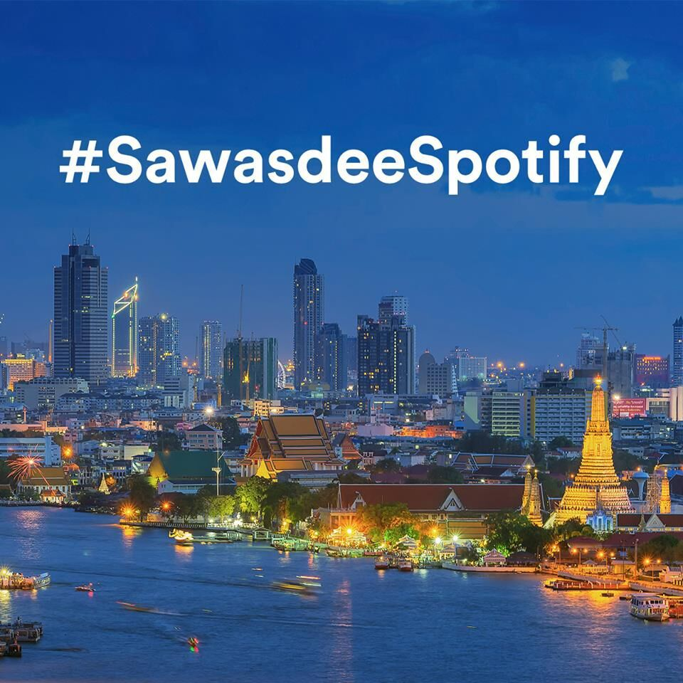
Since its initial launch in 2008, Spotify has made its way to Thailand, making it the 61st country enjoying streaming service.
Spotify offers
  30 day free trial
  Free option with ads
  129TB/month for 1 user
  199TB/month for 6 users.
  What is Spotify business model and why does it success?

Slide 9


Value Proposition

Slide 10

Grab in Thailand

Slide 11
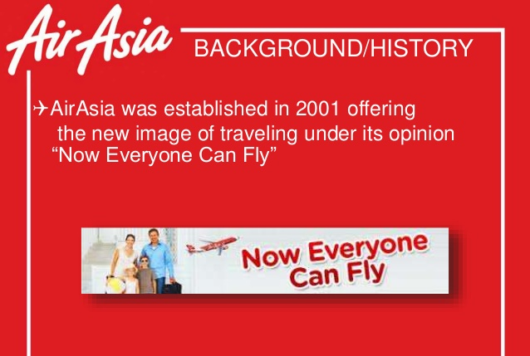

Slide 12
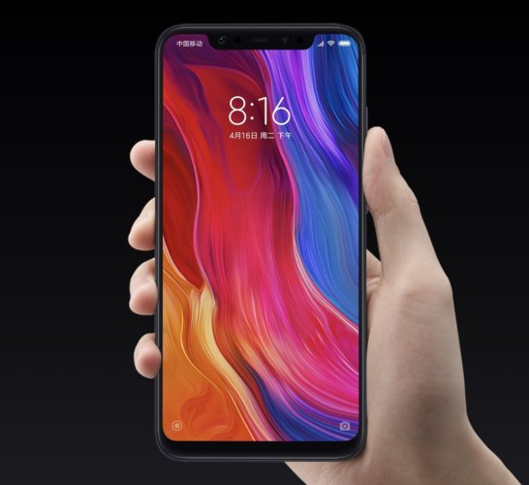
Xiaomi
An e-commerce company
Offline is secondary to online
Lowers the prices of premium

