Slide 1
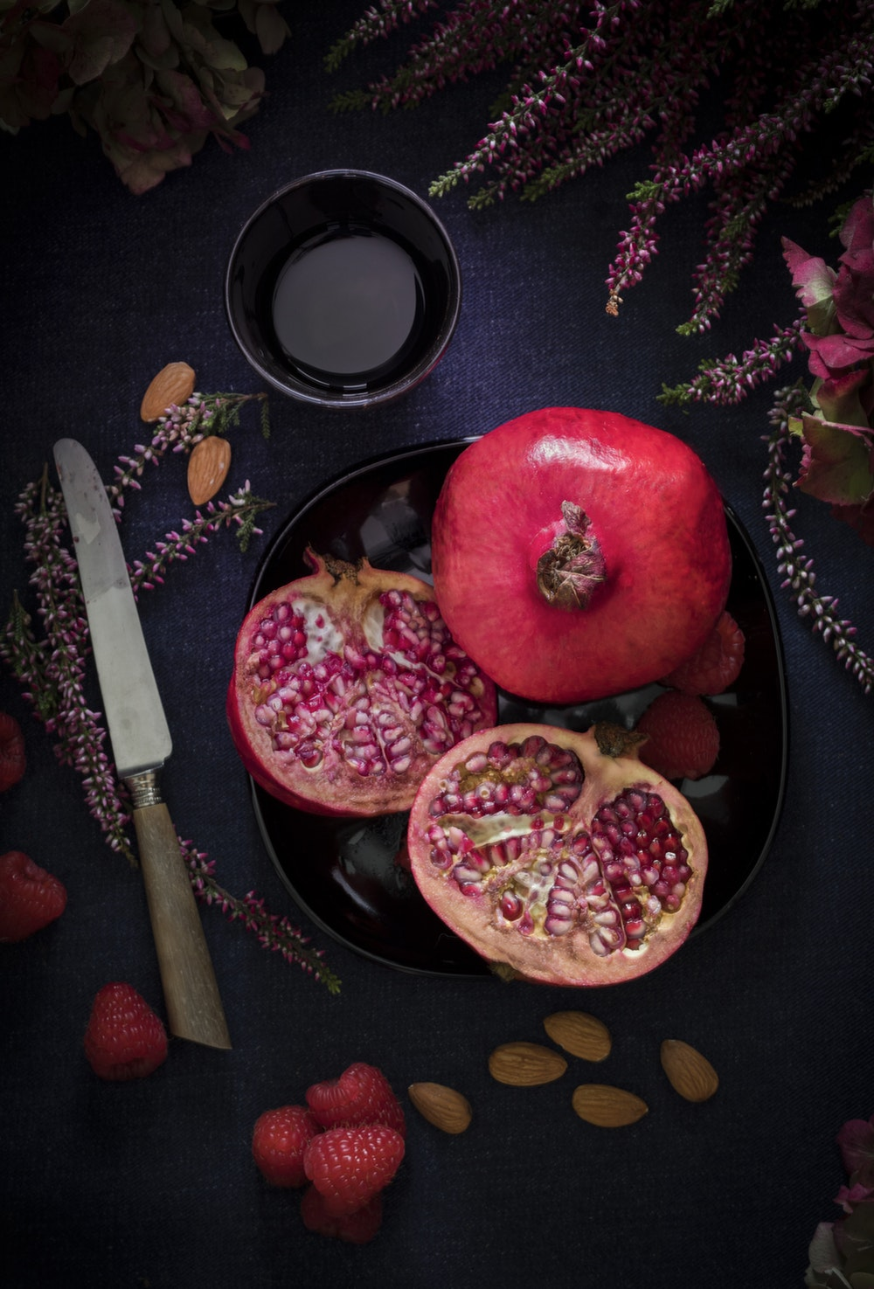
Project Pomegranate
1

Slide 2
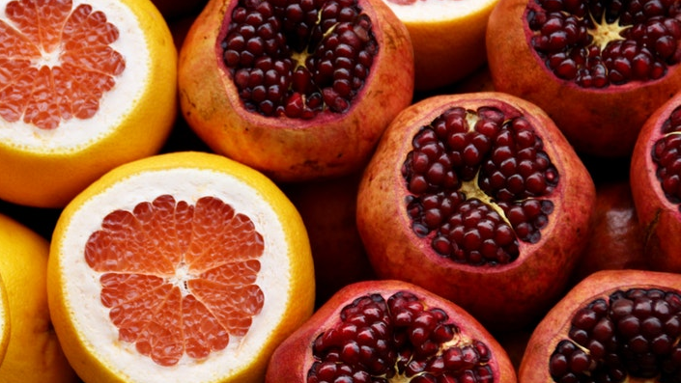
Background & Objectives
2

Slide 3



Study Background
Understanding the situation
Background
The “Super Fruit” juice market in Zimbabwe has been growing rapidly with Fizzy Foo as the market leader (i.e., 60% share), followed by ZA. Sales of ZA, the second leader with 30% share, is mainly driven by the pomegranate flavor, which is the flavor in which Fizzy Foo is not available. Therefore, it is an opportunity for Fizzy Foo to offer this pomegranate flavor as a line extension in order to grow sales as well as gain share from ZA.
Main Objectives & Action Standard
To identify the winning “Super Fruit” pomegranate juice prototype (out of the two prototypes) against ZA Pomegranate for actual market launch as well as identify areas to optimize the products further; the winning product needs to be significantly more preferred than ZA Pomegranate flavor at the 90% confidence level in forced preference.
To evaluate product sensory, understand consumers' preference on the taste profile of the prototypes, and identify any room for improvement for the new prototypes
To obtain the quantitative evaluation on likes/dislikes, relevance, uniqueness, purchase intention,
concept & product fit, attribute ratings, product acceptance, etc. toward the new
products and concept
To evaluate the preference / acceptance of the new concept as well as to understand how the concept could convey certain aspects such as young, brand for me, refreshing, fun, and cool

Slide 4
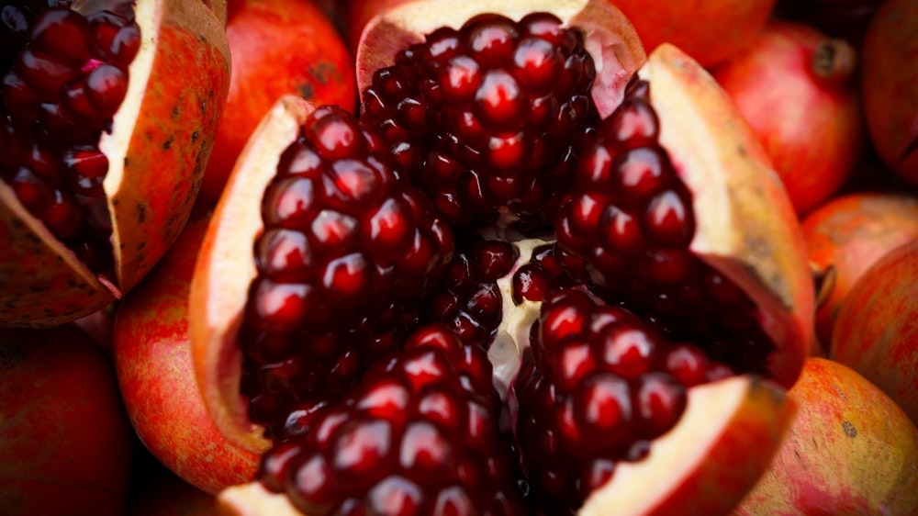
Test Design &
Sample Definition
4

Slide 5





Research Design
Methodology
Pre-recruitment to central location (on-the-spot taste test)
Geographical Coverage
Harare (the capital of Zimbabwe)
Specification
Males / females (50%/50%) aged 15-39 years old (equal split among aged 15-19, 20-29, and 30-39)
Household income: Social economic class = ABC
“Super Fruit” juice users: Regularly drink any type of “Super Fruit” juice in the past 7 days
ZA Pomegranate regular drinkers: Have consumed ZA Pomegranate at least 2-3 times per month in the past one month
Do not reject the Fizzy Foo brand
Do not reject the pomegranate flavor
Sample Size
Total sample size = 200
(sequential monadic (n=100 per cell))

Slide 6
Sample Design
Total Sample Size n = 200 (Sequential Monadic)
Product Stage
Cell 1: PA - 396 (n = 100)
Cell 2: PB - 518 (n = 100)
Cell 1.A: n = 50
Cell 1.B: n = 50
Cell 2.A: n = 50
Cell 2.B: n = 50
1st
Position
PA - 396
ZA Pomegranate
PB - 518
ZA Pomegranate
The product order is rotated to minimize positioning bias.
2nd Position
ZA Pomegranate
PA - 396
ZA Pomegranate
PB - 518
Comparison between PA - 396 vs. ZA Pomegranate
(n = 100)
Comparison between PB - 518 vs. ZA Pomegranate
(n = 100)
Concept Stage

Slide 7
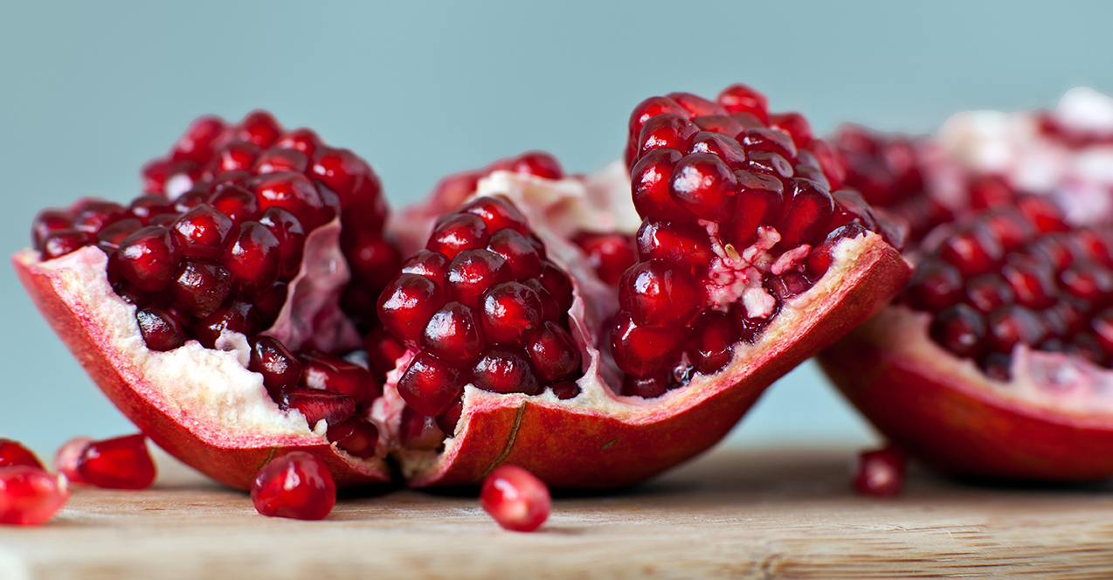
Product Evaluation
Product Appearance Before Tasting the Product
Product Liking & Purchase Intention After Trial
Sensory & Imagery Aspects
7

Slide 8
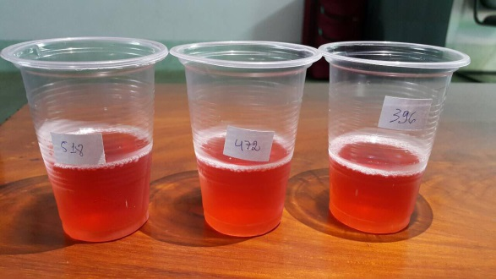
Product Appearance Rating – Before Tasting the Product
Comparing Within Each Cell
 | Cell 1 |  | Cell 2
 | PA – 396 (B) | ZA – 472 (C) | PB – 518 (D) | ZA – 472 (E)
Base: | 100 | 100 | 100 | 100
Mean | 3.87 | 3.89 | 4.12 | 4.25
Top 2 Boxes | 28% | 25% | 36% | 39%
*Upper case alphabets denote significant difference at 95% 2-tailed.
*Lower case alphabets denote significant difference at 90% 2-tailed.
P.2 What is your overall opinion of the Overall appearance of this "Super Fruit" juice? (6-point scale)

Slide 9
Product Evaluation
Product Appearance Before Tasting the Product
Product Liking & Purchase Intention After Trial
Sensory & Imagery Aspects
9

Slide 10
Overall Product Likeability & Purchase Intention: After Trial
Comparing Within Each Cell
Product Liking
Purchase Intention
 | Cell 1 |  | Cell 2
 | PA – 396 (B) | ZA – 472 (C) | PB – 518 (D) | ZA – 472 (E)
Base: | 100 | 100 | 100 | 100
Mean | 4.06 | 4.16 | 4.39B | 4.46
Top 2 Boxes | 33% | 36% | 50%B | 49%
 | Cell 1 |  | Cell 2
 | PA – 396 (B) | ZA – 472 (C) | PB – 518 (D) | ZA – 472 (E)
Base: | 100 | 100 | 100 | 100
Mean | 4.45 | 4.54 | 4.51 | 4.61
Top 2 Boxes | 89% | 98% | 91% | 96%
B
a
*Upper case alphabets denote significant difference at 95% 2-tailed.
*Lower case alphabets denote significant difference at 90% 2-tailed.
P.14a/b: How do you LIKE OR DISLIKE this drink in overall?
P.13a/b: Which statement best describes how likely you would be to buy this product if it is available at the shop you regularly shop?

Slide 11
Reasons for Liking / Disliking the Products
LIKES | PA - 396 | PB - 518 | ZA - 472
Base: | 100 | 100 | 200
 | % | % | %
Nice sweet taste | 69 | 66 | 68
Nice pomegranate aroma | 63 | 57 | 60
Nice sour taste | 33 | 35 | 34
Nice red color | 14 | 24 | 19
Refreshing feeling after drinking | 9 | 24 | 17
Thirst quenching | 12 | 19 | 16
Nice pomegranate taste | 13 | 18 | 16
Nice overall aroma | 9 | 14 | 12
Provide energy after drink | 3 | 13 | 8
Easy to drink | 3 | 12 | 8
Sweet after taste | 3 | 9 | 6
Nice pomegranate color | 4 | 8 | 6
Like the clearness of the drink | 7 | 7 | 7
Not too sweet | 3 | 7 | 5
Delicious after taste | 6 | 5 | 6
Not too tart | 2 | 5 | 4
Not too sour | 4 | 4 | 4
Has mild taste | 3 | 3 | 3
Has natural taste | 2 | 2 | 2
No after taste | 0 | 2 | 1
DISLIKES | PA - 396 | PB - 518 | ZA - 472
Base: | 100 | 100 | 200
 | % | % | %
NET: Negative | 29 | 39 | 34
Too sweet | 6 | 12 | 9
Not sweet enough | 2 | 5 | 4
Too strong pomegranate aroma | 1 | 5 | 3
Too tart | 5 | 5 | 5
Not enough pomegranate taste | 2 | 4 | 3
Not enough after taste | 1 | 2 | 2
Too sour | 3 | 1 | 2
Too strong overall aroma | 2 | 1 | 2
Too weak pomegranate aroma | 2 | 1 | 2
Not sour enough | 2 | 1 | 2
The color is too red | 2 | 0 | 1
Not enough pomegranate aroma | 1 | 1 | 1
Does not like the color of the product | 1 | 1 | 1
Watery flavor | 1 | 0 | 1
The color is too dark | 0 | 1 | 1
NONE | 71 | 61 | 66

Slide 12
Product Evaluation
Product Appearance Before Tasting the Product
Product Liking & Purchase Intention After Trial
Sensory & Imagery Aspects
12

Slide 13
T-Plot – Prototype 396 vs. ZA Pomegranate (Sensory Rating)
Gap Deflation Attributes | Overall Liking Improvement Amount
1. Overall refreshing feeling * | 0.12
2. Overall easy to drink/swallow | 0.09
4. Overall Pomegranate concentration | 0.06
6. Overall taste balance | 0.05
7. Overall aftertaste | 0.04
8. Overall pomegranate taste concentration | 0.04
9. Overall taste concentration | 0.02
10. Overall color | 0.02
13. Overall appearance | 0.01
ZA Pomegranate
*
ZA -472 (4.16)
Gap Inflation Attributes
3. Overall sweetness
5. Overall aroma
11. Overall pomegranate aroma
12. Overall tartness taste
14. Overall naturalness
15. Overall clearness
16. Overall sourness
Prototype 396
* Attribute(s) significantly different at 90% significance level 2-tailed
** Attribute(s) significantly different at 95% significance level 2-tailed
Prototype A -396 (4.06)
Note: Products perform significantly different at 95% significance level two-tailed on attributes (with solid fill) fall outside grey area.
Base: Prototype A [396], N=100 ; ZA [472], N=100

Slide 14
How to Read Penalty Analysis?
What is “Penalty Analysis”?
Penalty Analysis is a driver analysis that determines the “penalty” a product pays for not being “just right” on a particular characteristic.
Penalty Analysis Charting Interpretation Guideline
Penalty
Penalty
Opportunity
Thickness
-0.42
Too Thin
6%
68%
26%
Too Thick
-1.15
Primary
Decrease
If Just Right % = 75%* or more, then no change is required on this attribute.
Step 2
Ensure there is 10% point difference between the two skews in order to give clear direction on the modification.
Step 1
Identify a skew of approximately 20%
or more in one direction.
Step 3
Evaluate the size of the penalty to determine whether it is meaningful.
Primary Penalty ≥ .75
Secondary Penalty = .65-.75
14

Slide 15
Penalty Analysis for Prototype 396
Just Right Score for ZA
Among those who also drink Prototype 396
(n = 100)
Color
68%
64%
59%
63%
68%
51%
55%
55%
45%
55%
62%
Clearness
Aroma
Pomegranate aroma
Sweetness
Sourness
Taste concentration
Pomegranate concentration
Pomegranate taste concentration
Tartness taste
Aftertaste
Base: PA 396 = 100 and ZA Pomegranate = 200

Slide 16
Sensory Rating (Just-Right Score) of
Prototype 396 vs. ZA Pomegranate (ZA – 472)
Much too light |  | Much too dark
Color
Clearness
Overall aroma
Pomegranate aroma
Sweetness
Sourness
Taste concenttration
Pomegranate concentration
Pomegranate taste concentration
Tartness Taste
After taste
Much too clear |  | Much too opaque
Much too weak |  | Much too strong
Much too weak |  | Much too strong
Not sweet at all |  | Much too sweet
Not sour at all |  | Much too sour
Not rich at all |  | Much too rich
Not rich at all |  | Much too rich
Not rich at all |  | Much too rich
Not tart at all |  | Much too tart
Much too weak |  | Much too strong
Base: PA 396 = 100 and ZA Pomegranate = 200

Slide 17
T-Plot – Prototype 518 vs. ZA Pomegranate (Sensory Rating)
Gap Deflation Attributes | Overall Liking Improvement Amount
1. Overall sweetness ** | 0.16
2. Overall taste concentration | 0.11
3. Overall aftertaste | 0.11
4. Overall pomegranate aroma | 0.09
5. Overall aroma | 0.08
6. Overall appearance | 0.08
7. Overall color * | 0.07
8. Overall taste balance | 0.07
9. Overall clearness | 0.07
10. Overall tartness taste | 0.07
11. Overall naturalness | 0.06
12. Overall sourness | 0.06
13. Overall refreshing feeling | 0.04
14. Overall easy to drink/swallow | 0.03
15. Overall pomegranate taste concentration | 0.01
16. Overall Pomegranate concentration | 0.01
ZA Pomegranate
ZA-472 (4.46)
*
**
Prototype 518
* Attribute(s) significantly different at 90% significance level 2-tailed
** Attribute(s) significantly different at 95% significance level 2-tailed
Prototype B-518 (4.39)
Note: Products perform significantly different at 95% significance level two-tailed on attributes (with solid fill) fall outside grey area.
Base: Prototype B [518], N=100 ; ZA [472], N=100

Slide 18
Penalty Analysis for Prototype 518
Just Right Score for ZA
Among those who also drink Prototype 518
(n = 100)
Color
63%
53%
65%
56%
68%
47%
35%
53%
42%
58%
68%
Clearness
Aroma
Pomegranate aroma
Sweetness
Sourness
Taste concentration
Pomegranate concentration
Pomegranate taste concentration
Tartness taste
Aftertaste
Base: PA 518 = 100 and ZA Pomegranate = 100

Slide 19
Penalty Analysis for Prototype 518
Much too light |  | Much too dark
Color
Clearness
Overall aroma
Pomegranate aroma
Sweetness
Sourness
Taste concenttration
Pomegranate concentration
Pomegranate taste concentration
Tartness Taste
After taste
Much too clear |  | Much too opaque
Much too weak |  | Much too strong
Much too weak |  | Much too strong
Not sweet at all |  | Much too sweet
Not sour at all |  | Much too sour
Not rich at all |  | Much too rich
Not rich at all |  | Much too rich
Not rich at all |  | Much too rich
Not tart at all |  | Much too tart
Much too weak |  | Much too strong
Base: PA 518 = 100 and ZA Pomegranate = 100

Slide 20
T-Plot – Prototype 396 vs. ZA Pomegranate (Imagery Rating)
ZA Pomegranate
Gap Deflation Attributes | Overall Liking Improvement Amount
2. Is a product for me | 0.03
3. Is good to drink at every time of the day | 0.02
5. Is refreshing | 0.01
6. Is the high quality product | 0.01
ZA -472 (4.16)
Gap Inflation Attributes
1. Is delicious/has a nice taste
4. Is thirst quenching
Prototype 396
* Attribute(s) significantly different at 90% significance level 2-tailed
** Attribute(s) significantly different at 95% significance level 2-tailed
Prototype A -396 (4.06)
Note: Products perform significantly different at 95% significance level two-tailed on attributes (with solid fill) fall outside grey area.
Base: Prototype A [396], N=100 ; ZA [472], N=100

Slide 21
T-Plot – Prototype 518 vs. ZA Pomegranate (Imagery Rating)
Gap Deflation Attributes | Overall Liking Improvement Amount
1. Is a product for me * | 0.13
2. Is delicious/has a nice taste | 0.08
3. Is good to drink at every time of the day | 0.08
4. Is refreshing | 0.07
5. Is thirst quenching | 0.04
ZA Pomegranate
*
Gap Inflation Attributes
6. Is the high quality product
ZA-472 (4.46)
* Attribute(s) significantly different at 90% significance level 2-tailed
** Attribute(s) significantly different at 95% significance level 2-tailed
Prototype 518
Prototype B-518 (4.39)
Note: Products perform significantly different at 95% significance level two-tailed on attributes (with solid fill) fall outside grey area.
Base: Prototype A [518], N=100 ; ZA [472], N=100

Slide 22
Product Evaluation – Forced Preference
22

Slide 23
Forced Preference
Cell 1
Cell 2
43%
57%
46%
54%
PA - 396 (A) | ZA - 472 (B)
PA - 518 (A) | ZA - 472 (B)
Base: 100
Base: 100
*Upper case alphabets denote significant difference at 95% 2-tailed.
*Lower case alphabets denote significant difference at 90% 2-tailed.
P56 : Now I would like you to think of both products that you have just drunk. Compared these two products, which one do you most prefer?

Slide 24
Concept Evaluation
24

Slide 25
Overall Liking of Products vs. Concept
Product Liking
Concept Liking
 | PA – 396 (B) | PB – 518 (C) | ZA – 472 (D)
Base: | 100 | 100 | 200
Mean | 4.06 | 4.39B | 4.31b
Top 2 Boxes | 33% | 50%B | 43%
 | PA – 396 (B) | PB – 518 (C) | Total (D)
Base: | 100 | 100 | 200
Mean | 4.55 | 4.55 | 4.55
Top 2 Boxes | 49% | 56% | 53%
68%
76%
B
74%
87%
79%
84%
C
d
a
*Upper case alphabets denote significant difference at 95% 2-tailed.
*Lower case alphabets denote significant difference at 90% 2-tailed.
P.14a/b: How do you LIKE OR DISLIKE this drink in overall?
C.3: Which of these phrases best describes your opinion of the product concept board you just read?

Slide 26
Reasons for Liking / Disliking the Concept
 | PA - 396 | PB - 518 | Total
Base: | 100 | 100 | 200
 | % | % | %
Taste of pomegranate fruit | 31 | 29 | 30
Refreshing feeling after drinking | 27 | 30 | 29
Bottle color is beautifully red | 13 | 38 | 26
Pomegranate flavor | 28 | 19 | 24
Delicious taste | 17 | 28 | 23
Packaging design is attractive | 12 | 30 | 21
Delicious pomegranate aroma | 20 | 18 | 19
New product | 15 | 15 | 15
Reasonable price | 9 | 17 | 13
Picture of pomegranate fruit is pretty | 8 | 7 | 8
Delicious pomegranate aroma | 8 | 5 | 7
Natural color | 4 | 10 | 7
Thirst quenching | 3 | 9 | 6
C.4 What do you like about this concept?
 | PA - 396 | PB - 518 | Total
Base: | 100 | 100 | 200
 | % | % | %
NONE | 90 | 91 | 91
C.5 What do you dislike about this concept?

Slide 27
Overall Purchase Intention of Products vs. Concept
Purchase Intention at the Product Stage
Purchase Intention at the Concept Stage
 | PA – 396 (B) | PB – 518 (C) | ZA – 472 (D)
Base: | 100 | 100 | 200
Mean | 4.45 | 4.51 | 4.57
Top 2 Boxes | 89% | 91% | 97%BC
 | PA – 396 (B) | PB – 518 (C) | Total (D)
Base: | 100 | 100 | 200
Mean | 4.53 | 4.52 | 4.53
Top 2 Boxes | 94% | 89% | 92%
C
D
D
B
a
*Upper case alphabets denote significant difference at 95% 2-tailed.
*Lower case alphabets denote significant difference at 90% 2-tailed.
P.13a/b: Which statement best describes how likely you would be to buy this product if it is available at the shop you regularly shop?
C.1: How likely you would be to buy this product if it is available at the shop you regularly shop in?

Slide 28
Reasons for Purchase Intention
 | PA - 396 | PB - 518 | Total
Base: | 100 | 100 | 200
 | % | % | %
Pomegranate taste | 41 | 30 | 36
New product | 23 | 31 | 27
Refreshing feeling after drinking | 17 | 34 | 26
Bottle color is beautifully red | 22 | 16 | 19
Reasonable price | 15 | 21 | 18
Delicious taste | 11 | 22 | 17
Want to taste it again | 11 | 16 | 14
Pomegranate color is beautifully red | 11 | 11 | 11
Delicious pomegranate aroma | 8 | 14 | 11
Thirst quenching | 6 | 12 | 9
Natural | 5 | 8 | 7
No bad impact on health | 4 | 7 | 6
Packaging is attractive | 7 | 1 | 4

Slide 29
Concept Suitability with the Fizzy Foo Brand
C.9a: Which of the following phrases best describes your opinion on the SUITABILITY of the concept you just read with Fizzy Foo brand ?
B
C
c
Top 2 boxes | 47 | 66B | 57
Mean | 3.67 | 3.92B | 3.8
Base: | 100 | 100 | 200
*Upper case alphabets denote significant difference at 95% 2-tailed.
*Lower case alphabets denote significant difference at 90% 2-tailed.

Slide 30
Concept Comparison with ZA Pomegranate
C.11a: Compared to the "Super Fruit" juice - Pomegranate that you currently drink, which statement best describes how you feel about the product in the concept board?
69%
65%
67%
Top 2 boxes | 69% | 65% | 67%
Mean | 3.9 | 3.92 | 3.91
Base: | 100 | 100 | 200
*Upper case alphabets denote significant difference at 95% 2-tailed.
*Lower case alphabets denote significant difference at 90% 2-tailed.

Slide 31
Concept Imagery Ratings
Is the cool brand
Is premium
Is modern
Is a brand for me
Is suitable with teens
Is refreshing
Is delicious/ has a nice taste
Is the enjoyable brand
Mean Score
Top box %
Increasing correlation with
purchase intention
(PI)

Slide 32
Conclusions & Recommendations
32

Slide 33
Pyramid Principle
Key Insight
Support /
Recommendation #1
Support /
Recommendation #2
Support /
Recommendation #3

