Slide 1

Community Forest
Notes:
For many of Thailand's rural people, community management of local forests has been a way of life for centuries.
1. ป่าชุมชนคืออะไร (รวมไปถึงประเภทของที่ดินที่เกี่ยวข้อง)
2. ป่าชุมชนมีกี่ประเภท
3. ทำไมถึงต้องมีป่าชุมชน

Slide 2
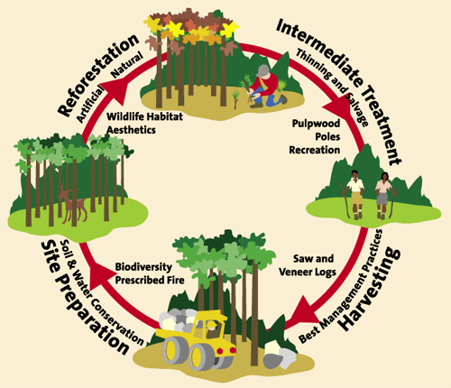
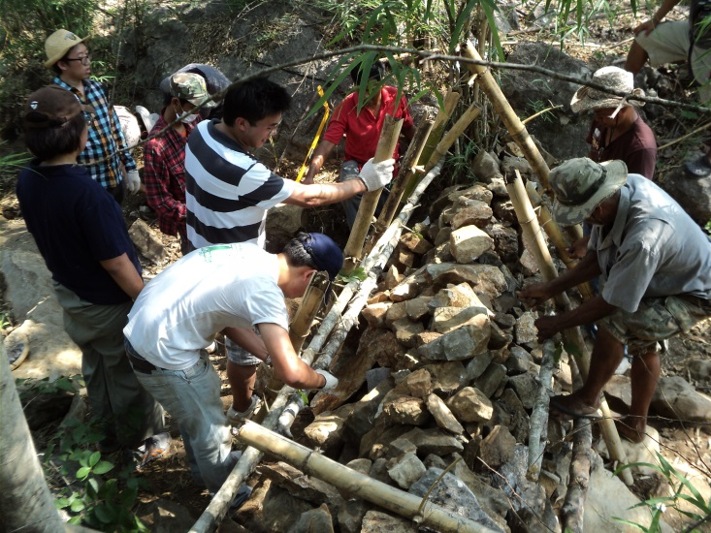
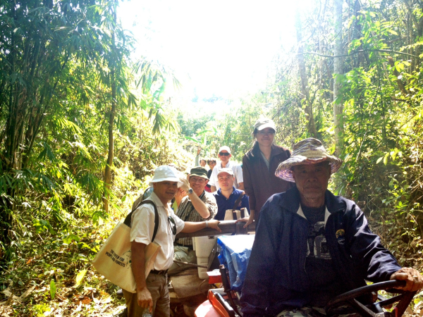
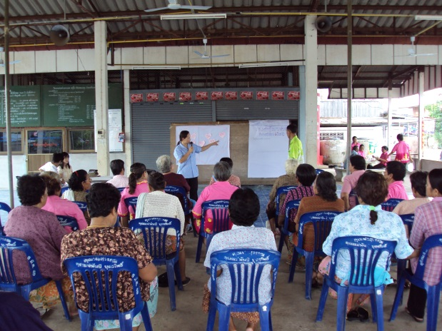
WHAT IS COMMUNITY FOREST ?
A community forest can be any area the community wants to be designated a community forest whether it is within the limits of a conservation zone such as a national park, wildlife sanctuary, watershed area; or non-conservation zone such as a national forest or public use area. (COMMUNITY FOREST ACT DRAFT in 1996)

Slide 3

TYPE OF COMMUNITY FOREST
1 Indigenous Forest
  Forbidden Forest: conserve in order to do the religious ceremony
  Headwaters Forest: the area that local people conserved as the river source.
2. Community forest that started by the local people for the specific proposed
  Conserved headwaters resource
  Resisted the deforestation
  Reserved the area for local people.
3. Community forest that supported by the outside organization such as NGO’s.
Notes:
And may be it is occurred from the scrambling to allocate the resource

Slide 4
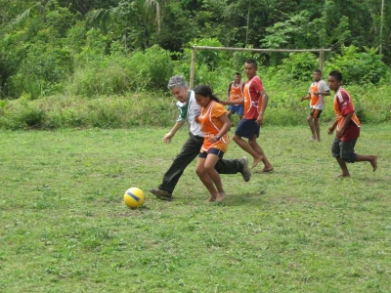

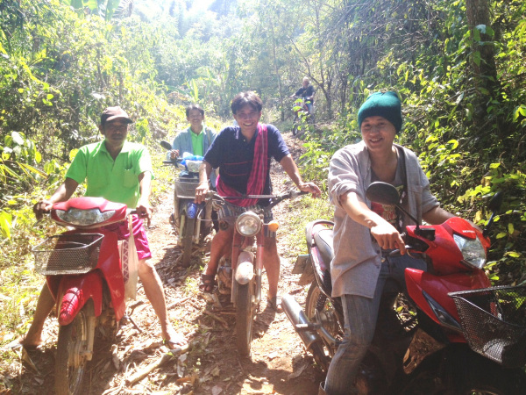
WHY DO WE NEED TO HAVE
COMMUNITY FOREST BILL ?
Notes:
1 the increasing on the number of people who cut the tree for sale lead to the reduction on forest area
2 the government considers the forest area owe by state therefore people cannot encroach on forests and those people reconsider to be an invader.
As a result, people need the community forest in order to be able to manage and conserve the trees.
In the 1970s, looking for ways to address the country's rampant deforestation, the Thai government officially recognized community forestry as a tool for sustainable forest management and drafted the forest community bill

Slide 5
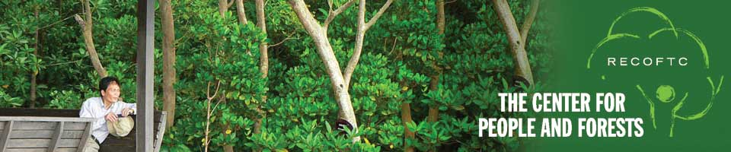
THAILAND'S COMMUNITY FOREST ACT DRAFT
1. This bill is one of the tools in environmental protection and development. It is not meant to be used to define and grant land rights.
2. It is a framework for utilizing natural resources sustainably in order to protect the forest's ecosystem.
3. To underlie and support the roles of communities that protect, use and develop forests their traditional ways.
4. To promote the process whereby the state and the community cooperate in supporting the state's development process.

Slide 6
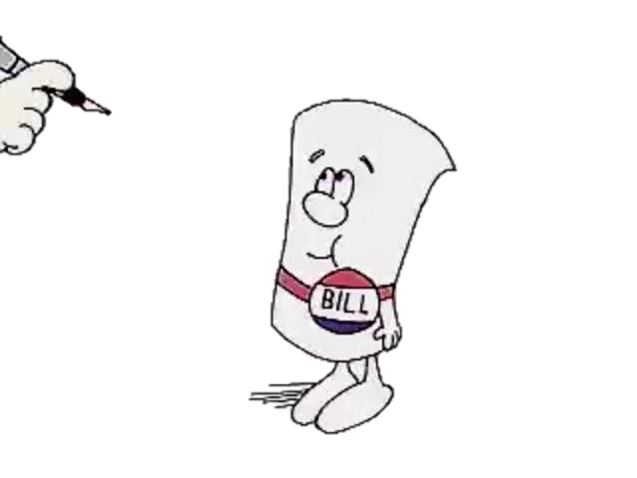
TIMELINE OF COMMUNITY FOREST BILL…
Year 1990: Villagers cooperate with professors and private developmental organization starting to draft unofficial community forest bill.
Year 1991: supported by nongovernment organizations (NGOs) and communities, the government began drafting a Community Forest Bill to guide the formalization of community engagement in forest management.

Slide 7


General Sujinda Kraprayoon period :
  Forest department drafts community forest act but it is not allowed from people because department just supports only economy
Chuan Leekpai period :
  Department of Forestry’s community forest bill got rejected from the people
  In the same year, people gathered together to write a new community forest bill, resulted in 5 bills being written in Chuan Leekpai’s era.
  1994 Dissolve the parliament due to fraudulent in patents

Slide 8


Year 1995:
  Government of Banharn Policy Committee established a brainstorming meeting between the forest villagers NGOs and academics to draft Community Forest Act that all parties agree to before.
Year 2002:
  On March 15, the senate consider the draft of community forest bills and decides to cut off a key of this act which is people around the community forest are not allowed to establish the community forest because the key point of this act is to make people be a part of managing the forest of their own country.

Slide 9
Item 25
Item 34
distinguishes three types of communities that live within or near to protected areas in Thailand and utilize forest areas for resources within those protected areas :
A-type communities: have lived within a protected area and managed resources within it for more than ten continuous years to the present day.
B-type communities: live within the protected area but have withdrawn from managing resources within the protected area at the present day.
C-type communities: live outside the protected area but manage resources within a protected area.
points out that CF can only take place within a protected area if the community collects NTFP.
Therefore, despite a community having access to the resources within a protected area, this access still does not allow them to cut down trees within the protected area, given apparent political concern about the ability of those communities to conserve their resources for the future.
Notes:
Year 2007:
November, National Legislative Assembly passed the community forest bills with 57 to 2 votes. This new community forest bills changes 2 important items which is item 25 and item 34. However, The end result is that today there is no Community Forestry Bill in place. There is also no recognition for community forests that overlap with protected areas. This affects between 1 million and 2 million local people who depend on forest resources from these forest areas.

Slide 10
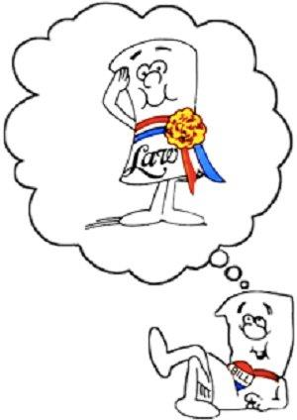

As of 2010,
  the Royal Forest Department had formally recognized and registered around 7,000 community forests, all outside of protected areas, and it is actively seeking to register more.

Slide 11
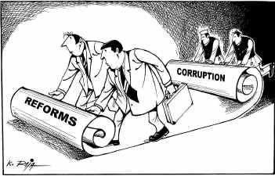
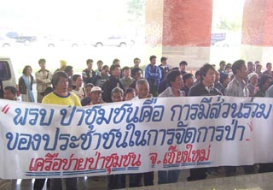


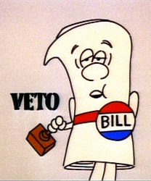
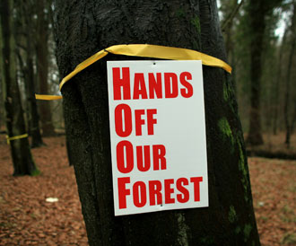

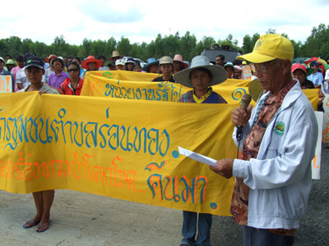
Notes:
the bill has been a constant source of national debate and considerable frustration, particularly for local people seeking legal protection and support for their community forests.
The original draft has undergone a number of rewrites, and has been rejected, passed, and then rescinded.

Slide 12
Community’s View

Slide 13
Business’ view

Slide 14

VILLAGERS
Problem
  Compromising problem: Villagers are asking for national reserved forest to be included in community forest. These reserved forests belong to department of forestry.
  Exploitation of wood and forest: According to law of national reserved forest, villagers are not allowed to exploit these forests at any circumstance. Only R&D and visiting from outside people are permitted not villagers.

Slide 15

BUSINESS
Problem
  Ownership: These villagers are asking for the right they do not possess. They are claiming that they have been living here many years ago, but that’s not how ownership is given. They haven’t given up anything to earn this resource, in other word they are asking resources for free.
Pass or Not
  NO
  There are unforeseeable consequence after giving these right to villagers that are needed to be concerned

Slide 16


CONFLICTION BETWEEN PARLIAMENT AND LOCAL PEOPLE
Parliament Bill | Local people Bill
Right structure -Only provincial government committee, no local people involve Reason of community forest establishment -Base on deteriorated forest Resources allocation -Support economic forest plantation; Eucalyptus -Push for minimal human activity in Thailand's protected areas, apart from recreation: can use only self-plated woods, not natural growing Fund arrangement -not mention | -Many parties; Forest director-general and proxies of local people, scholar and university etc. -Base on readiness of each community -Plant for persistent living; local trees -forest-dependent people should be able to manage and use forest areas within protected areas like before conservation boundary was established -Require public aid funds; patrol, meeting and preventing forest fire costs etc.

Slide 17
Suggestion
Business sector
1. Imposing tax on everyone who received benefit from using forest
2. Clarifying community right
Community
1. Requiring representatives to educate the process of law

Slide 18


PROPOSED SOLUTION
1. Identifying a boundary of property right and community right
2. Reducing transaction of cost
Notes:
As the stakeholder talking about the over right that local people are going to receive it’s not fair for others > we offer that the community bills have to limit the benefit of local people. Example, allow them to collect fruit or conserve but not allow them to cut the tree for trading.

Slide 19

THANK YOU
By Group 8

