Slide 1
The Reforms of King Chulalongkorn
EE 460

Slide 2
Outlines
Traditional Pollical Structure
The Reforms (1893-1915)

Slide 3
Traditional Structure
Palatine Law (1805)
Twenty semi-independent vassal states with its own hereditary rulers recognized by the Thai capital. They offered the symbolic tribute to the Thai capital.
Luang Phra Bang, Phu Khieu, Suvannaphum
Muang Lom (Lomsak) was a small state ruled by a littleking who maintains friendly relations with Siam by sending yearly tribute in the form of local products

Slide 4
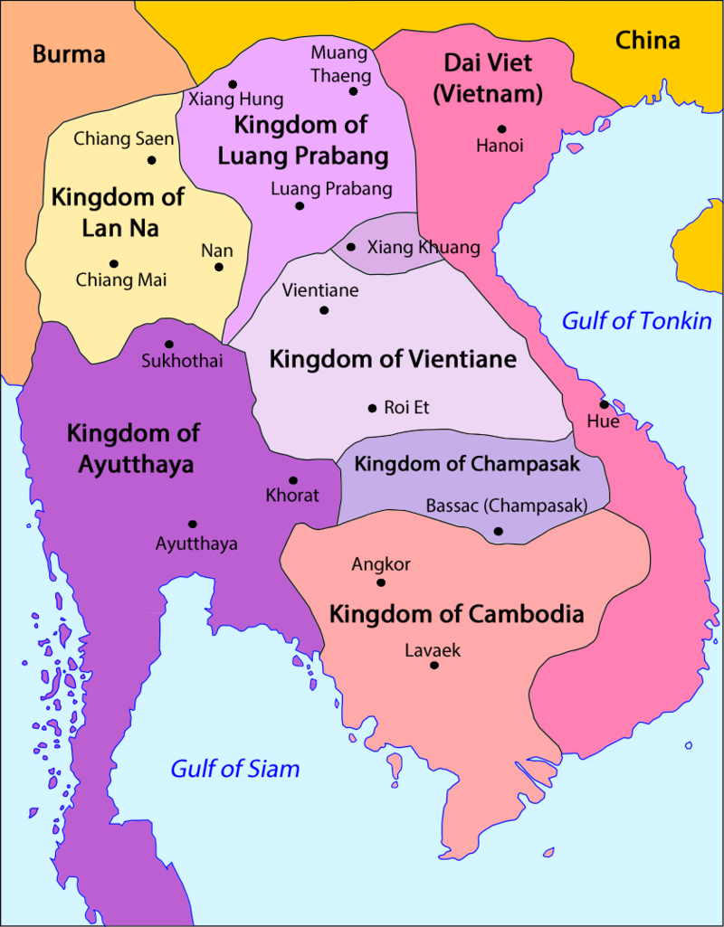
Vassal States

Slide 5
Inner province of the Kingdom grouped according to their status as first, second, third, and fourth class provinces. The rulers drank the oath water
First class: Phisanulok, Nakhon Sri Thammarat
Second class: Sawankhaloke, Sukhothai, Kampheng Phet, Pechabun, Nakorn Rachasima
Third class: Phichai, Pichit,Nakhon Sawan, Chantaburi, Phathalung, Chumphon.
Fourth class: 34 provinces near capital and around Gulf of Siam, such as, Chaibadan. Inth, Kuy, manarom, Pranburi, Paknam, Mae Klong, Tha Chin.

Slide 6
Administration of the provinces
Administration of the provinces was divided among three of the six ministries.
Mahat Thai is the Ministry of the North
Kalahom is the Ministry of the South (Kanchanaburi and province from Phetburi southwards.)
Khlang is the Ministry of the East side of the Gulf of Thailand and Krom Tha is in charge of province administration and foreign affairs.

Slide 7
Local Ruling Families
Chaiyaphum
  Settled by people from Vientiane in 1817
  Started to send tribute to King Rama Ii and III
  In 1828 became provice of Siam Kingdom and got title of Phraya Phakdi Chumphon.
  In 1897, ruler was replaced by Royal Commissioner from Bangkok.

Slide 8
Nakhon Sri Thammarat
Independent state during the regime of King Taksin
Became vassal state during King Rama I
Became first class province (?)
The ruler was the founder of “Na Nakhon”

Slide 9
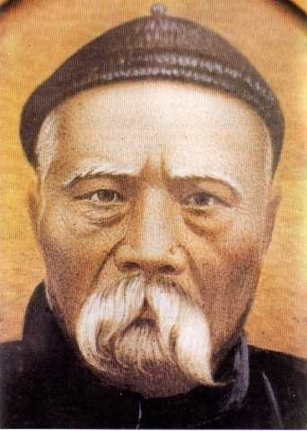
Na Ranong
Its founder was Chinese, Khaw Soo Chean, a tin miner and tax-farmer in the province of Ranong.
In 1854, e became governor of Raning, a fourth class province under Chumphon.
In 1884, his son became governor of Tra.
In 1890, Bangkok promoted him to be a governor of Trang
In 1900, ha was made Royal Commissioner to Monthon Phuket until 1913.

Slide 10
Kin Moung provincial Administrative System
There were no provincial office buildings.
Neither he nor his subordinates received salaries from the capital and they were expected to live off a portion of the fees and taxes they collected.
The system limited the potential income of the central government, but reduced the financial burden to the central government to support local administration.
The provinces wished to avoid central government interference and the central government concerned only income received.
Lack of being Siamese.

Slide 11
Governmental and Administrative Reforms
Why did Thailand need reforms?
How to
Results

Slide 12
Problems of Old System
Internal Problems
Budget deficit
Power of the old Siam Some
External Problems
Colonialism
Loss of large areas to foreigners
Northeast attachment with the other side of Mekong river.

Slide 13
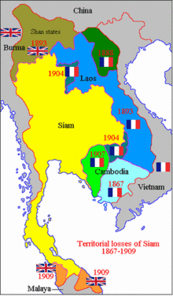
Loss large areas to Westerners

Slide 14
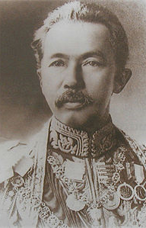
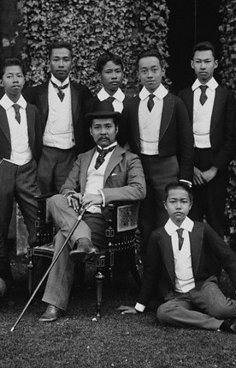
Modernization
Prince Damrong Rajanuphap
King Chulalongkorn and his sons at the Eton collage, 1907

Slide 15
Administration Centralization
A Thai official, Luang Thesachitvichan, was sent to Burma and Malay for six months to study British colonial administration in Burma and Malaya.
The first step was to establish the Monthon as a administrative area comprising several of the old provinces.
The purpose of the new system was to tighten central control over the provinces by sending out a Royal Commissioner and reported directly to the Ministry of Interior.
The second purpose was to improve revenue collection by eliminating the system of Kin Moung.
The first three monthon were Phisanulok, Prachinburi, and Nakhon Rachasima in 1894.
Finally, twenty monthon had ben established throughout the country.
Monthom Burapho and monthon Saiburi were given up to the West in 1907 and 1909.

Slide 16
Prince Damrong gained control of those three Ministries. Prince Damrong chise the Royal Commissioners for their loyalty to the central government and gave them very broad powers.
The treasurer was responsible for collecting taxes and paying salaries. All of these officials belonged to the Ministry of Interior, but latter they were sent from various ministries ( extension of all ministries into the countryside)
The old vassal states in the North became Monthon Phayup and the seven Islamic states in the south became Monthon Pattani. (elimination of independent ruling families ).
Monthon system was slightly different among monthons.

Slide 17
Monthon Phayap
Establised in 1900.
Comprised of Chiengmai, Lampang, Lamphun, Nan.
The ruling family of Phrae lost its position in 1902.
The old family ruling in Chiengmai, Lampang and Lumphun were still on till 1940 (?)

Slide 18
Kin moung system was still used in monthon Pattani till 1940.

Slide 19
Effects of the Reforms
The new system was very successful innits purpose of unifying the country and consolidating central control.
Taxes were taken out of the hands of local officials and revenue increased from year to year.
Popular election of village and sub-district headmen was initiated and central government officials were sent into the lower levels of the provincial and district administrations.
The hereditary rulers of the vassal states were outflanked and those of the provinces, which remained as subordinate administrative units within the monthon, were replaced by central government officials.
The effects on the status and interests of the provincial ruling class
The Bunnag family lost control of the gulf provinces and some of the important ministries, but eight of them held positions of monthon Royal Commissioner.

Slide 20
The elites of the Northeast are almost excluded from high office under the reform system. None of them got appointed to be Royal Commissioner. Some fled across Mekong river and some got appointed to position in French colony.
The ruling family of Battambang apparently maintained its status under new system. Khuang Aphaiwong was Prime Minister and remained a national political leader until his death in 1968.
New centralization system led to the uneven development between rural and urban area.

Slide 21
Reading Lists
Vickery Michael, “Thai Regional Elites and the Reforms of King Chulalongkorn”, the Journal of Asia Studies, No.29 vol. 4 , 1970, pp. 863-881

