Slide 1
Post 1932 Politics
The rise and fall of Khana-ratsadorn
Thai Economic History
Thorn Pitidol
1/2018

Slide 2
Topics
Phibul’s military nationalism
Pridi’s social revolution
The rise of Sarit Thanarat

Slide 3
The rise of military
The events of 1932-3 revealed the critical importance military units in Bangkok.
Occupying the center of power, the military consolidate and extend its power.
  From 1933-1937, military budget accounted to around 26% of national budget.
  In 3 years after 1932, military personnel almost doubled.
Military and its new political ideology.
  "Your country if your house, the army is its fence".

Slide 4
The rise of military
The rise in military power was not held back by Khana-Ratsadorn, who wanted to remain the guiding force in post 1932 politics.
  1933, 1937, and 1940 Constitution all with limited roles of elected representatives
For a decade after 1932, Khanarat effectively controlled political power
  The reformists who supported 1932 hoped to participate.
    Businessmen who eventually formed Chamber of Commerce.
    Labour leaders, journalists, progressive Buddhist Sangha.
  But they were neglected or suppressed under Phibul’s military nationalism.

Slide 5
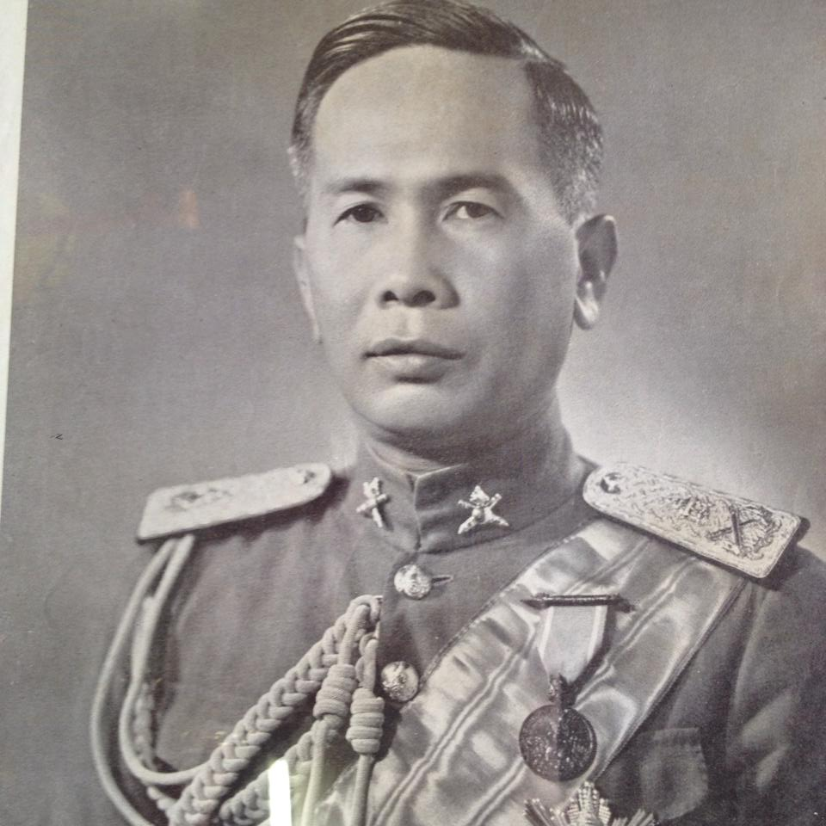
Phibun
Developed the ideology of the military as the central institution of SIam.
  Monarchy, assembly, bureaucracy, and the (abiding and permanent) military
Concentrated the army power in Bangkok, and having his allies controlling the key positions.,
  Raise military budget while refused to reveal details.
Phibul’s rise to power eventually led to his neglect of other Khanarat.

Slide 6
Military nationalism
The rise of military power brought with it the ideology of military nationalism.
Military-bureaucrats as those who bring progress to the nation
  Core of military nationalist ideas include
    Combining Fascism and absolutist nationalism
    Fighting for territories & Economic nationalism
    Ratthaniyom culture

Slide 7
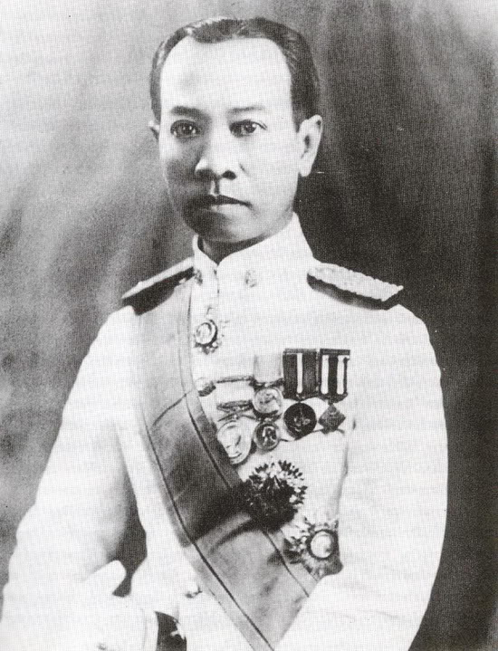
Luang-Wichit
Wichit Wathakarn (Luang-wichit) was a chief ideologist of Phibun
Borrowed fascist from Europe and Japan, combined with Thai nationalism built under absolutism
Military as expression of popular will.
Musolini and Bushido
Anti-Chinese sentiment

Slide 8
Military nationalism
Luang-wichit’s justification of military dictatorship
  Thai nation needed strong leadership to oppose internal and external threats.
  Require people’s complete subjection to power.
  Thais as fundamentally militaristic people.

Slide 9
ตื่นเถิดชาวไทย (Wake up Thais)
(สร้อย)ตื่นเถิดชาวไทย อย่ามัวหลับใหลลุ่มหลงชาติจะเรืองดำรง ก็เพราะเราทั้งหลายถ้ามัวหลับมัวหลง เราก็คงมลายเราต้องเร่งขวนขวาย ตื่นเถิดชาวไทย
บ้านเมืองยามเฟื่องฟุ้งรุ่งเรือง ก็อย่าลืมขวนขวายเผลอตัวศึกมา เราจะพากันตายจำไว้เถอะสหาย ตื่นเถิดชาวไทย
(สร้อย)ชาติไทยเราไม่น้อมยอมใคร จะสู้จนชีพสลายหวังผดุงแหลมทอง เราพี่น้องหญิงชายอย่าให้ชาติสูญหาย ตื่นเถิดชาวไทย(สร้อย)

Slide 10
Economic Nationalism
Economic nationalism
  Support gov't intervention in the economy
    prosperity and self-reliance.
    “Thai economy for the Thai people”.
  Against the role of Chinese in Thai economy. Gov't control trade, distribution, industries. Jobs reserved for Thais.

Slide 11
Maha-Anachak Thai
The idea of “lost territories”
  Khmer, Mon, Shan, all part of "golden peninsula".
  The idea of “Thai” as major race.
Based on Hitler's model, Phibun promoted the the idea of "Maha-anachak-Thai".
  Military campaign to recover lost territories from France, invasion of Burma and Chinese to reclaim Shan territories.

Slide 12
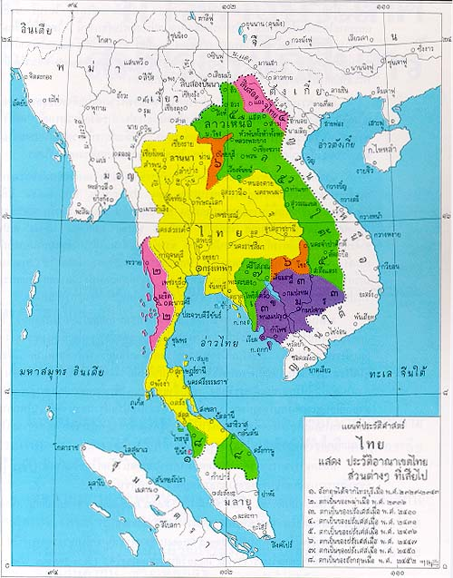

Slide 13
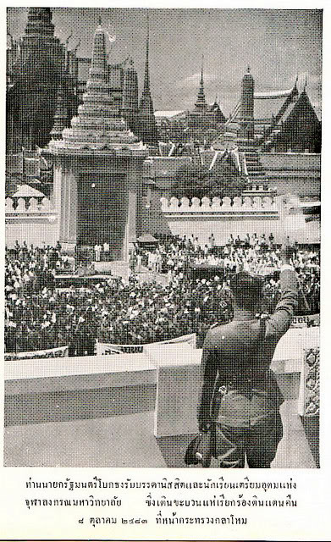
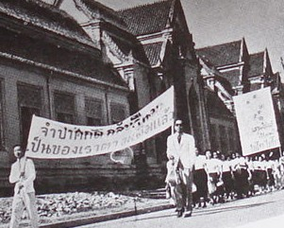
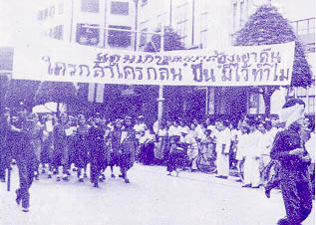
March for the lost territories

Slide 14
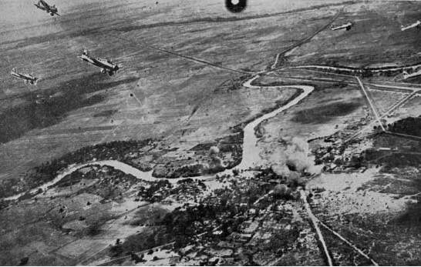
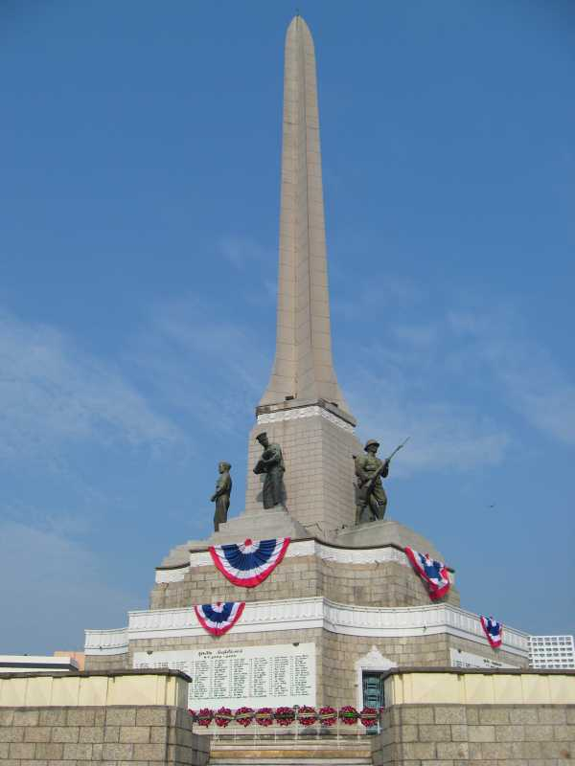
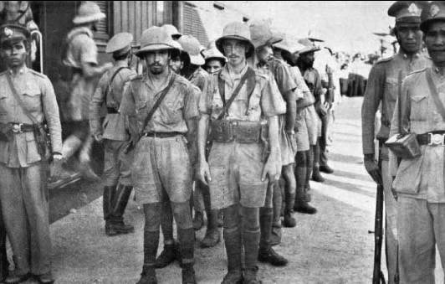
สงครามอินโดจีน

Slide 15
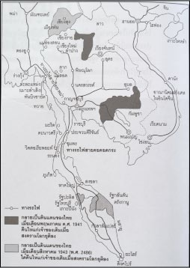

Slide 16
Phibun’s Ratthaiyom
A new cultural project "Ratthaniyom"
  Thailand as modern nation. Western standard for dress, discouraging local habits. National events replaced many royal-focused festivities. 24 June as national day.
  Undermining Royalism and old order.
    Abolished royal titles, and against the Royal priviledges of Thammayut.
  Phibun as "the leader".
    “Our Nation's Security Depends on Believing in Our Leader” (เชื่อผู้นำชาติพ้นภัย).

Slide 17
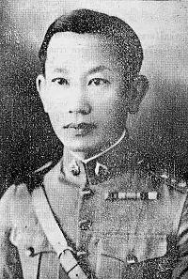
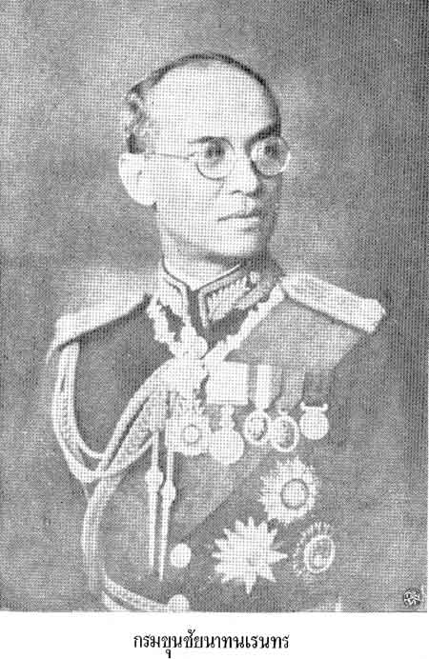
Phraya Song’s Rebel

Slide 18
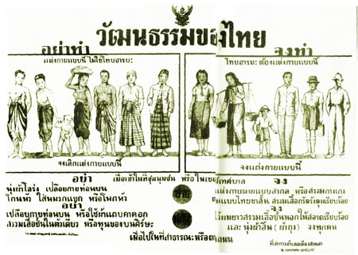
Phibun’s Ratthaiyom

Slide 19
Pridi's social revolution
Phibun's reign interrupted by the invasion of Japan.
Phibun’s military already faced challenges from groups who aspired to change Siam in pre 2475 times
  Merchants, leaders of labour, urban intellectuals, provincial notables.
  Against Phibun, they galvanized under Pridi Banomyong.

Slide 20
Pridi's social revolution
Pridi's ideology VS Phibun’s.
  Pridi → end of absolutism as opening up participation in economic progress and politics.
  Intended to give "freedom, equality, and security to all". Promote economic development and provide "the greatest education possible".
    As reflected in Pridi's economic plan
    Thammasat as alternative to Chulalongkorn.
      Modern bureaucrats VS King’s bureaucrats

Slide 21
Pridi’s alliances
Merchants
  Rebuilding alliance after the failure of his economic plan. Pridi played crucial roles in renegotiating unequal treaties.
  Pridi supported joint government-business ventures and the business enterprises return supports.
Isan politicians
  The Isan MPs resented the centralisation of power and wealth in Bangkok.
  Isan MPs requested for equal treatment of Isan people, diversion of funds to Isan provinces.
  Also against Phibun's control of press and his military spending.

Slide 22
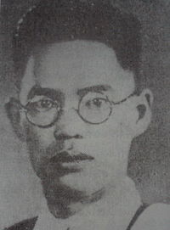
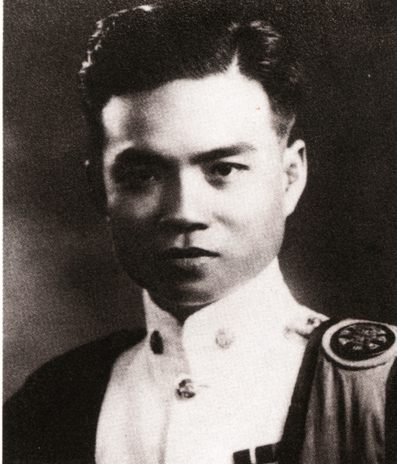
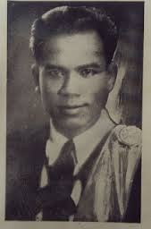
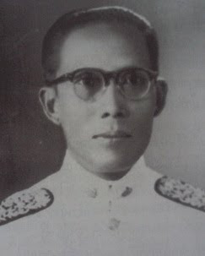
Isan’s 4 Tigers
ถวิล อุดล
ทองอินทร์ ภูริพัฒน์
จำลอง ดาวเรือง
เตียง ศิริขันธ์
"ข้าพเจ้าต้องการให้ทุก ๆ คนบนพื้นอันเป็นสยามประเทศนี้ เป็นราษฎรเสมอหน้ากันหมด ปราศจากความเหลื่อมล้ำต่ำสูง"
เตียง ศิริขันธ์

Slide 23
Seri-Thai
Pridi's political opportunities came with Japan's invasion.
"Seri-Thai" became opposition to Phibun's alignment with Japan.
Seri-Thai 2 fractions 1) Seni Pramoj’s (international); and 2) Pridi’s (domestic)
Pridi’s Seri-Thai fraction
  Pridi's civilian group, some naval officers, Isan MPs, some Bangkok-Chinese
  Isan MPs, for example, envisioned the independence of Laos or gaining back of Laos territories.

Slide 24
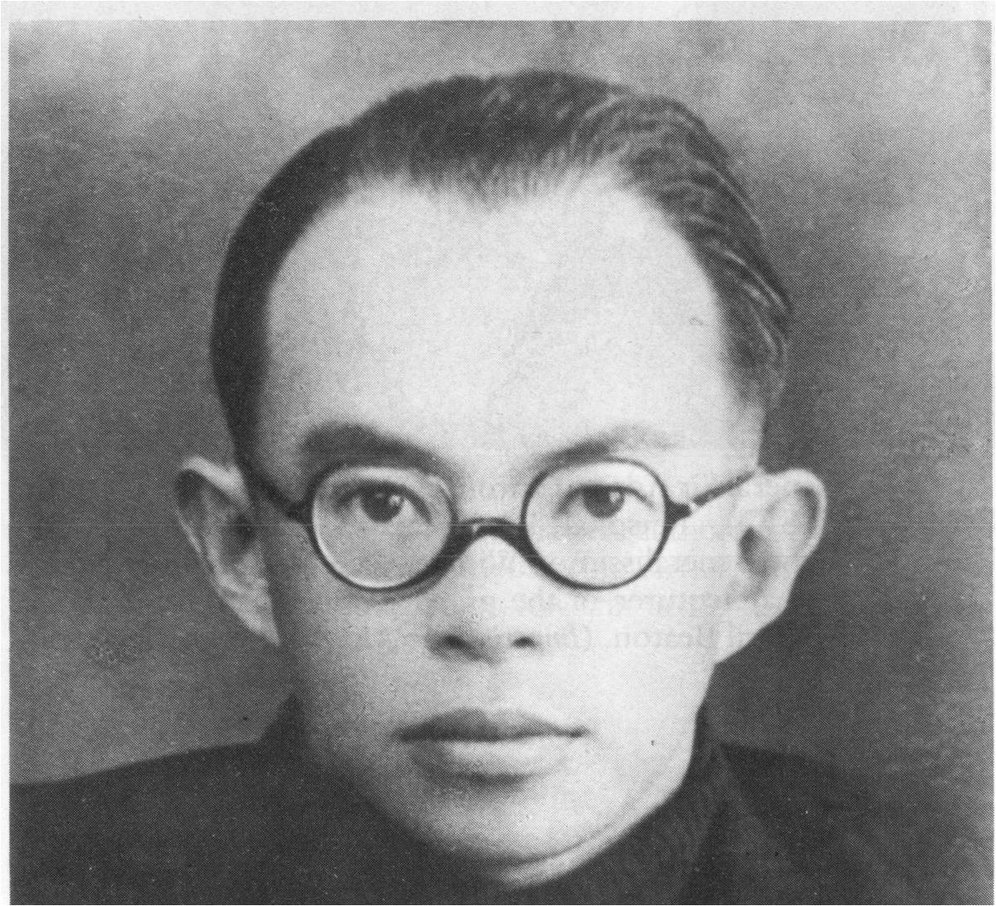
Seri-Thai
The story of Chumkad Palangul

Slide 25
The end of Khanarat and
The rise of Sarit Thanarat
As WWII ended, political conflict and debate broadened.
Pridi VS Phibun absorbed to a wider contest, sparked by the revival of royalism.
  “Socialism VS Royalist Restoration"
  Pridi pulled to radical alliances, while Phibun dragged to army alignment to royal causes.

Slide 26
Pridi’s brief leadership
Pridi initially propelled to power post-WWII
  Tried to reduce the military's power and increased the power of the elected.
  Russia’s influence & repeal of anti-communist law
    CPT entered election, found supports among students, labour, and had its own newspaper.
  Labour leaders expanded and carried out strikes, while Isan MPs supported Indo-Chinese nationalist groups.

Slide 27
The Re-emergence of Royalism
Royalists and Pridi initially cooperated.
  Released of imprisoned royals, returning those in exile
  The royalists re-expanded their ideas that the "King" is the core institution of Thailand.
  Formation of the Democrat Party.
But the cooperation ended quickly. Royalist shifted their alliance to the army.
  The alliance between the army and the royalists was alarmed by the victory of the Communist Party in China.
  Growing urban disorder seen as prelude to the rise of communism in Thailand linked to Pridi.
Pridi political future ended with the death of Rama VIII

Slide 28
The return of Phibun
As US pledge to support gov't that opposed communism, Phibun returned to power with 1947 Coup
  But Phibun was no longer “the leader”
    New power fractions include Khuang, Kat Katsongkram, Phin Choonhavan, Phao Siriyanond, an Sarit Thanarat.
Royalists gained back their influences

Slide 29
The return of Phibun
A different ideology after 1947 Coup
  Uphold the honour of army, resolve the question of royal assassination, get rid of communism
  Gov't that respect "nation, religion, and King".
The power of the elected assembly was limited.
  Reintroduced appointed senate, and increased the King's power.
  Military power as control of the government.
The return of Phibun saw the use of military power to destroy all oppositions.

Slide 30
Suppressing Oppositions
Pridi's failed attempts and his exile
  Palace Coup, and Manhattan Rebel
Further suppressions for
  The navy
  Isan MPs.
    To suppressed the roles of MPs, Phibun suspended cabinet, constitution, assembly, and political parties.
Suppression expanded to Seri-Thai, leaders of Far-South, labour leaders, Chinese community leaders, and intellectuals.

Slide 31
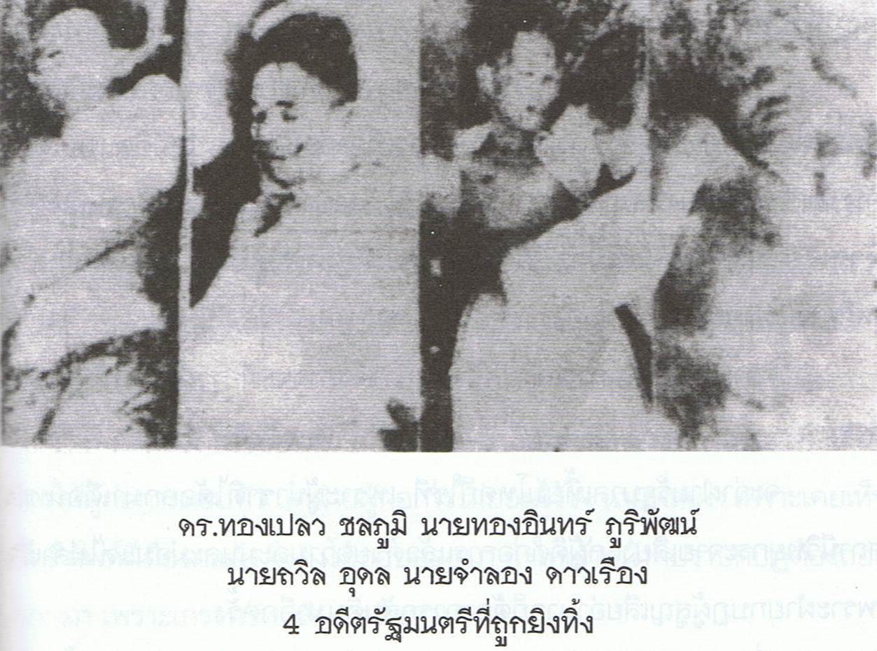
Suppressing Oppositions

Slide 32
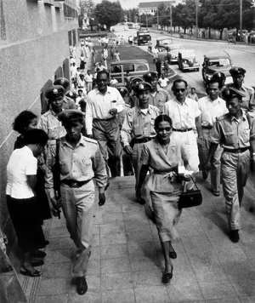
Suppressing Oppositions
Peace League
Rebel

Slide 33
The rise of Sarit
The real power within Pro-Phibun groups belonged to (1) the police led by Phao Sriyanonda, and (2) the army led by Sarit Thanarat
  Phao's police force received US support (most notably from CIA), and had weapons and capacity equivalent to the army.
  Sarit Thanarat’s "First Division Army“, with US military aid.
Phibun’s time ended with Sarit's coup in 1957.

Slide 34
The rise of Sarit
Sarit consolidated all power under the army.
  Took control of the police, air-force, and navy.
  He dissolved the parliament, suspended the constitution.
Sarit assumed position of Prime Minister, Supreme Commander, Commander in Chief of the Army.
  Thanom Kittikachorn & Praphas Charusathien
  Continued oppression of far south and Isan.
  Communism still used as political tool.

Slide 35
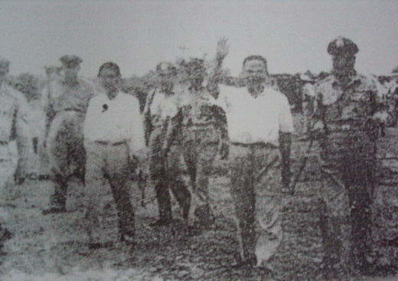
The rise of Sarit
Public executions of Isan politicians

