Slide 1

Confidence
MK 341: Special Topics in Marketing 1
Marketing Leadership Development and Cross-cultural Management
By Ajarn Suwalya K.

Slide 2

Exercise 1: Show your confidence!
Lucky Draw…

Slide 3
What we plan to achieve
Reflection on Vision, Mission &Self Assessment Assignment
Why Confidence can make you become a good leader
How to build Confidence
The Power of Attitude
Practice Confidence Building

Slide 4
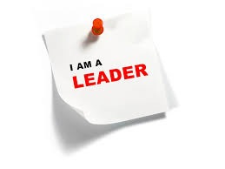

Reflection Session
Dear Diary….
Vision, Mission, Self Assessment Sharing
Proactive vs. Reactive Leadership
Discuss in Groups

Slide 5
How Confidence could make you become a good leader?
"There is one particular component of leadership that is so important, so necessary, that without it, leadership cannot exist. That component is confidence. Self-confidence is the fundamental basis from which leadership grows. ... lack of confidence to commit to her decisions and goals does not make a good leader"… Cr: Sarmed Hasan

Slide 6
How Confidence could make you become a good leader?
"To be an effective leader, you should be confident enough to ensure that other follow your commands. If you are unsure about your own decisions and qualities, then your subordinates will never follow you. As a leader, you have to be oozing with confidence, show some swagger and assertiveness to gain the respect of your subordinates. This does not mean that you should be overconfident, but you should at least reflect the degree of confidence required to ensure that your followers trust you as a leader."

Slide 7
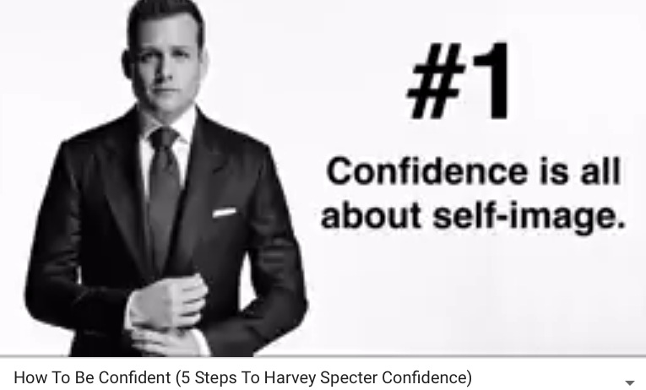


Slide 8
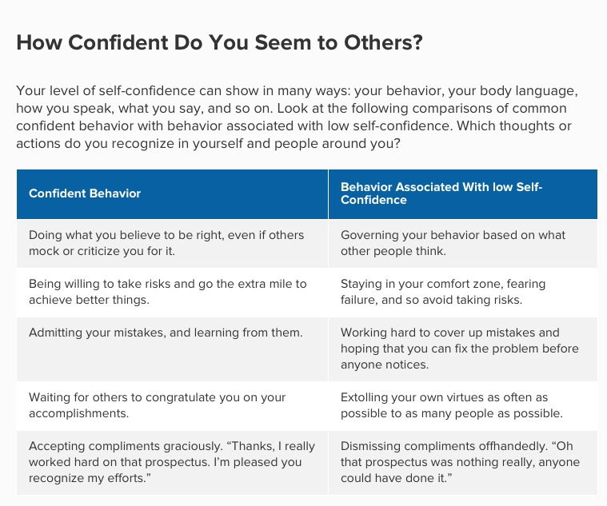


Slide 9
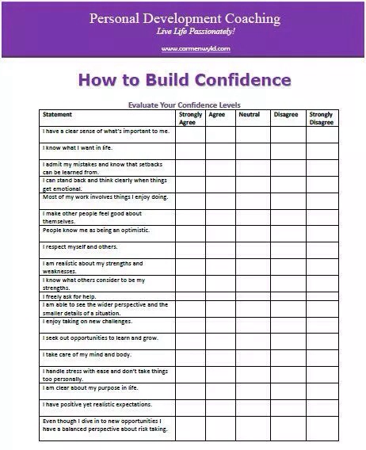


Slide 10
Exercise 1: Confidence Building
Please complete the worksheet
Share within Group

Slide 11


Slide 12


Slide 13
Definition of an Attitude
"An attitude is an evaluation of an attitude object, ranging from extremely negative to extremely positive. Most contemporary perspectives on attitudes also permit that people can also be conflicted or ambivalent toward an object by simultaneously holding both positive and negative attitudes toward the same object."

Slide 14
Why your Attitude is everything…
"In truth, people generally don't have a high level of attitude awareness. They'll know if they are hungry or if their feet hurt, but they usually don't have a good handle on their attitude. That is a mistake because attitude is everything. It governs the way you perceive the world and the way the world perceives you." Sep 22, 2016

Slide 15
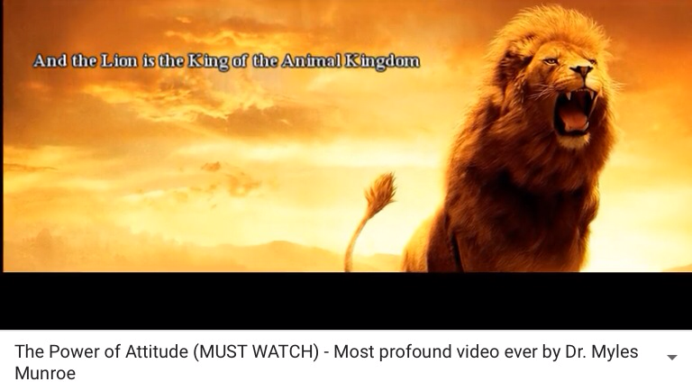

Slide 16
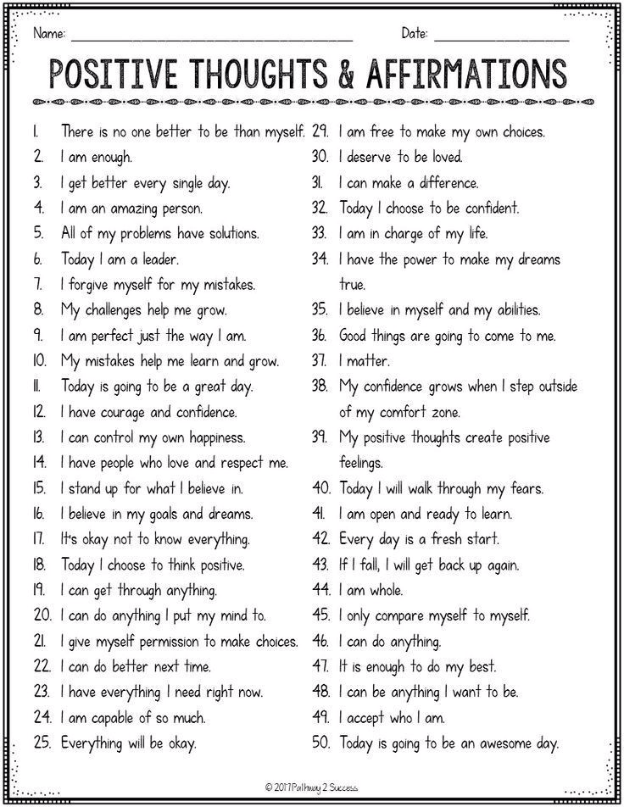

Slide 17
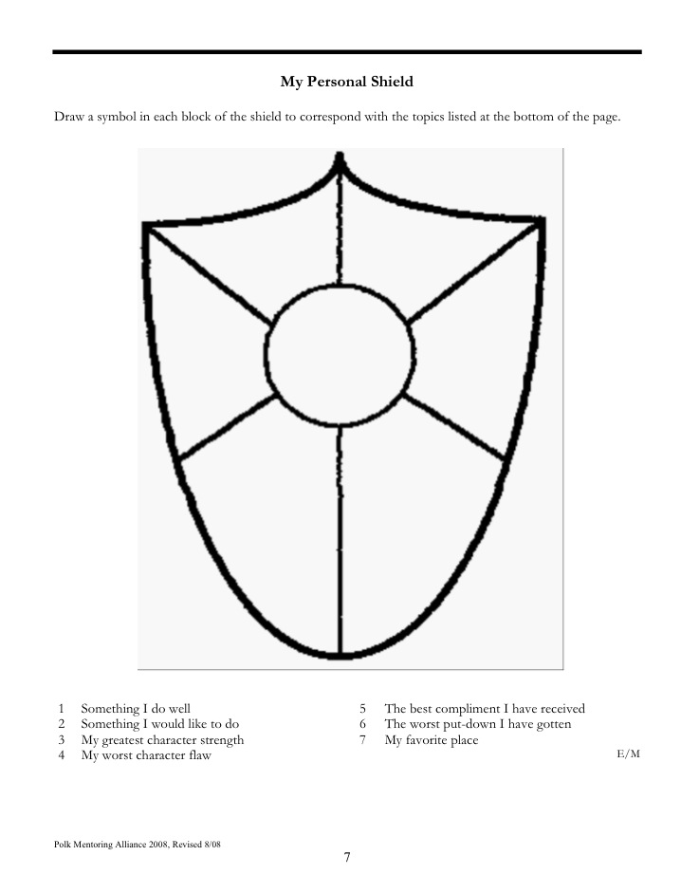

Individual Homework
My Personal Shield
- fill in & to be shared next session

Slide 18

Individual Homework
My Beautiful Self
- fill in & to be shared next session

Slide 19

Project Update 2
Progress Update
Share any concerns/help
Direction
Feedback

Slide 20
What we accomplished
Reflection on Vision, Mission &Self Assessment Assignment
Activities
Why Confidence can make you become a good leader
How to build Confidence
The Power of Attitude
Practice Confidence Building

Slide 21


