Slide 1
Comparative Statics and the Concept of Derivative III
Pawin Siriprapanukul
CW Ch. 8

Slide 2
Outline
Differentials
Total Differentials
Rules of Differentials

Slide 3
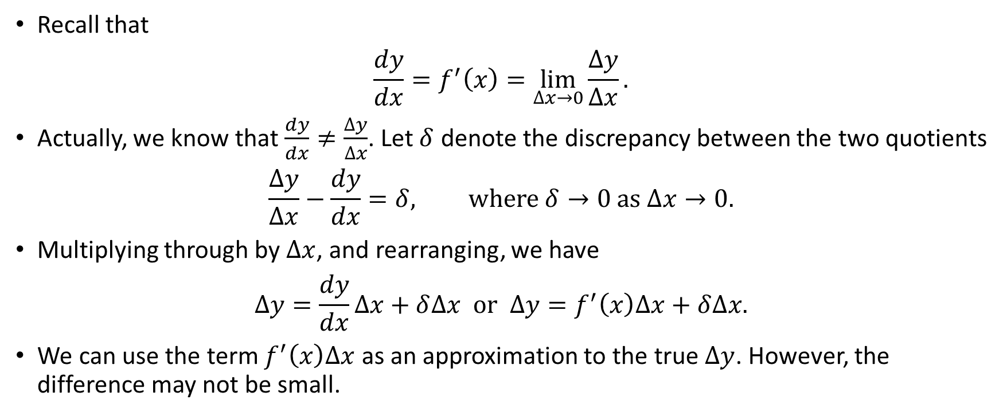
Differentials
Recall that
$$\frac{dy}{dx}=f^{′}\left(x\right)=\lim_{∆x→0}{\frac{∆y}{∆x}}.$$
Actually, we know that $\frac{dy}{dx}≠\frac{∆y}{∆x}$. Let $δ$ denote the discrepancy between the two quotients
$$\frac{∆y}{∆x}−\frac{dy}{dx}=δ, where δ→0 as ∆x→0.$$
Multiplying through by $∆x$, and rearranging, we have
$$∆y=\frac{dy}{dx}∆x+δ∆x or ∆y=f^{′}\left(x\right)∆x+δ∆x.$$
We can use the term $f^{′}\left(x\right)∆x$ as an approximation to the true $∆y$. However, the difference may not be small.

Slide 4
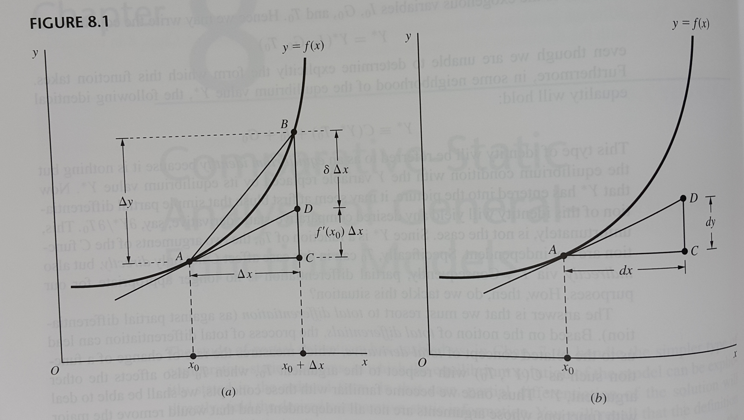

Slide 5
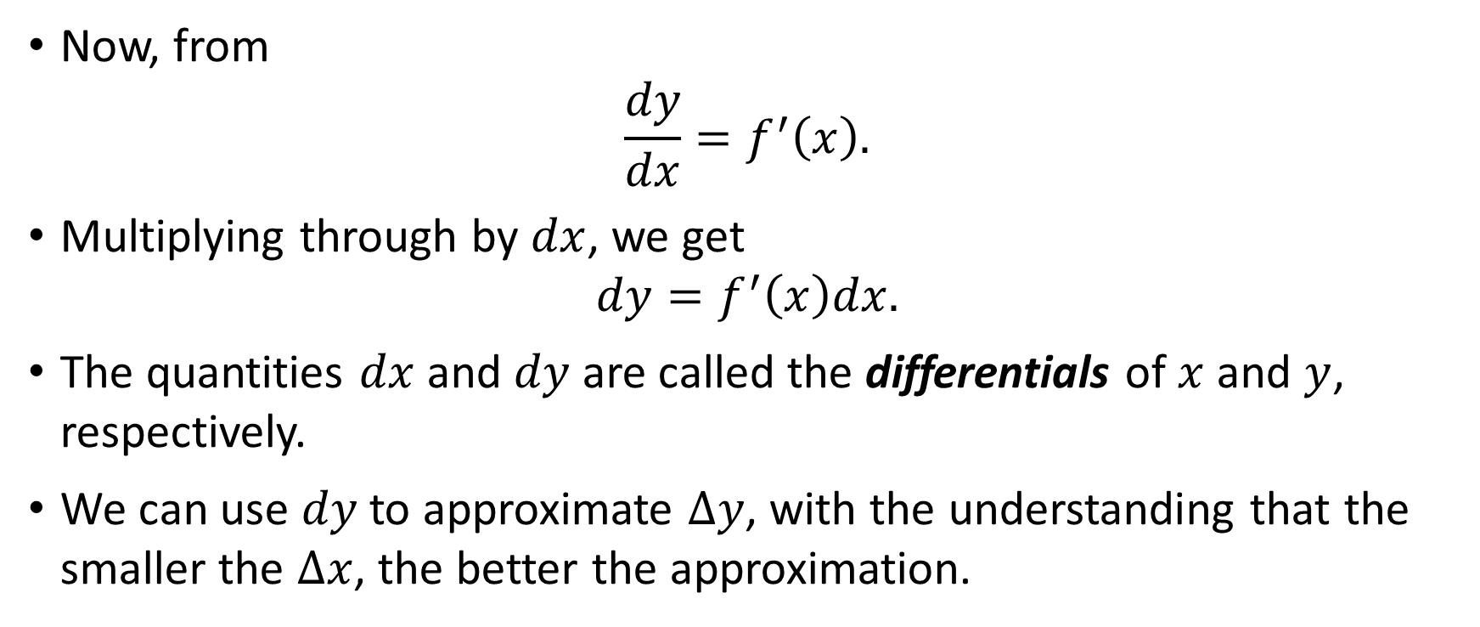
Differentials
Now, from
$$\frac{dy}{dx}=f^{′}\left(x\right).$$
Multiplying through by $dx$, we get
$$dy=f^{′}\left(x\right)dx.$$
The quantities $dx$ and $dy$ are called the differentials of $x$ and $y$, respectively.
We can use $dy$ to approximate $∆y$, with the understanding that the smaller the $∆x$, the better the approximation.

Slide 6
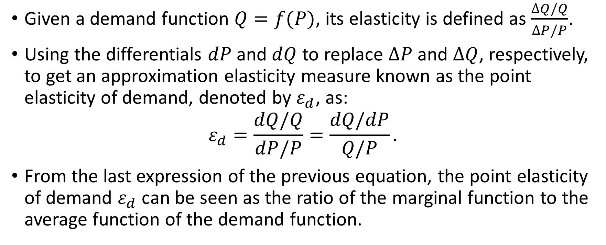
Differentials and Point Elasticity
Given a demand function $Q=f(P)$, its elasticity is defined as $\frac{∆Q/Q}{∆P/P}$.
Using the differentials $dP$ and $dQ$ to replace $∆P$ and $∆Q$, respectively, to get an approximation elasticity measure known as the point elasticity of demand, denoted by $ε_{d}$, as:
$$ε_{d}=\frac{dQ/Q}{dP/P}=\frac{dQ/dP}{Q/P}.$$
From the last expression of the previous equation, the point elasticity of demand $ε_{d}$ can be seen as the ratio of the marginal function to the average function of the demand function.

Slide 7
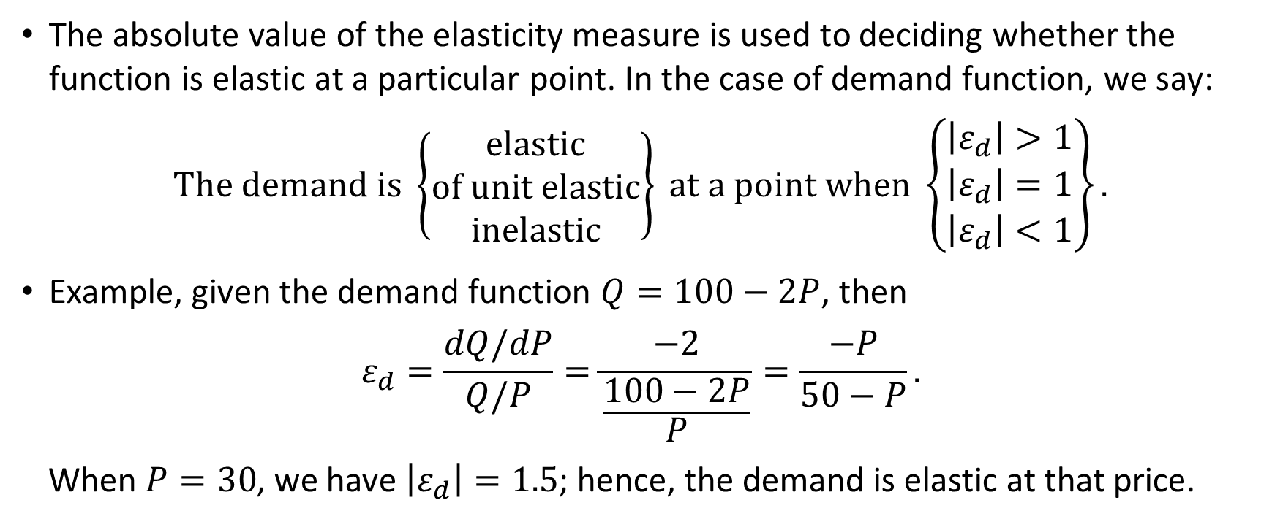
Differentials and Point Elasticity
The absolute value of the elasticity measure is used to deciding whether the function is elastic at a particular point. In the case of demand function, we say:
$$The demand is \left\{\begin{matrix}elastic \\ of unit elastic \\ inelastic\end{matrix}\right\} at a point when \left\{\begin{matrix}\left|ε_{d}\right|>1 \\ \left|ε_{d}\right|=1 \\ \left|ε_{d}\right|<1\end{matrix}\right\}.$$
Example, given the demand function $Q=100−2P$, then
$$ε_{d}=\frac{dQ/dP}{Q/P}=\frac{−2}{\frac{100−2P}{P}}=\frac{−P}{50−P}.$$
When $P=30$, we have $\left|ε_{d}\right|=1.5$; hence, the demand is elastic at that price.

Slide 8
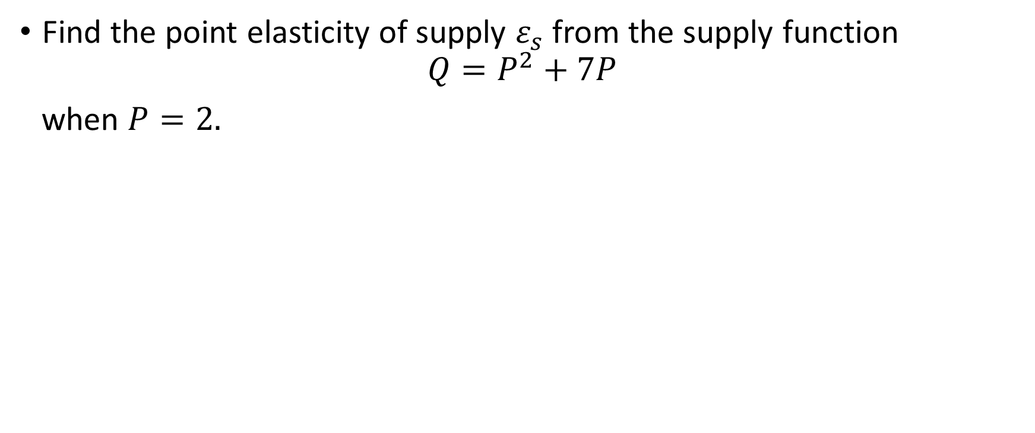
Example
Find the point elasticity of supply $ε_{s}$ from the supply function
$$Q=P^{2}+7P$$
when $P=2.$

Slide 9
Differentials and Point Elasticity
The transformation of the elasticity formula of a function into ratio of its marginal to its average makes possible a quick way of determining the point elasticity graphically.
The value of the marginal function is represented by the slope of line touching the function at the point, while the value of the average function is represented by the slope of the line from the origin to the point.

Slide 10
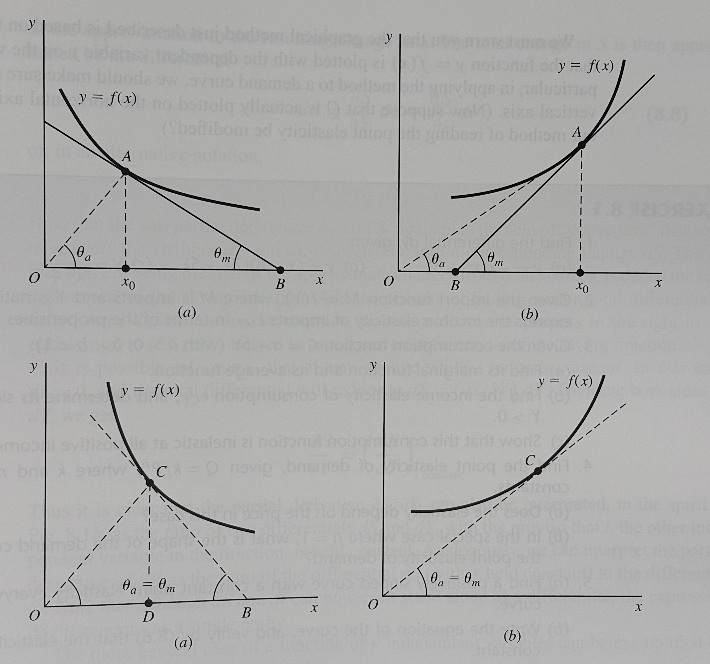

Slide 11
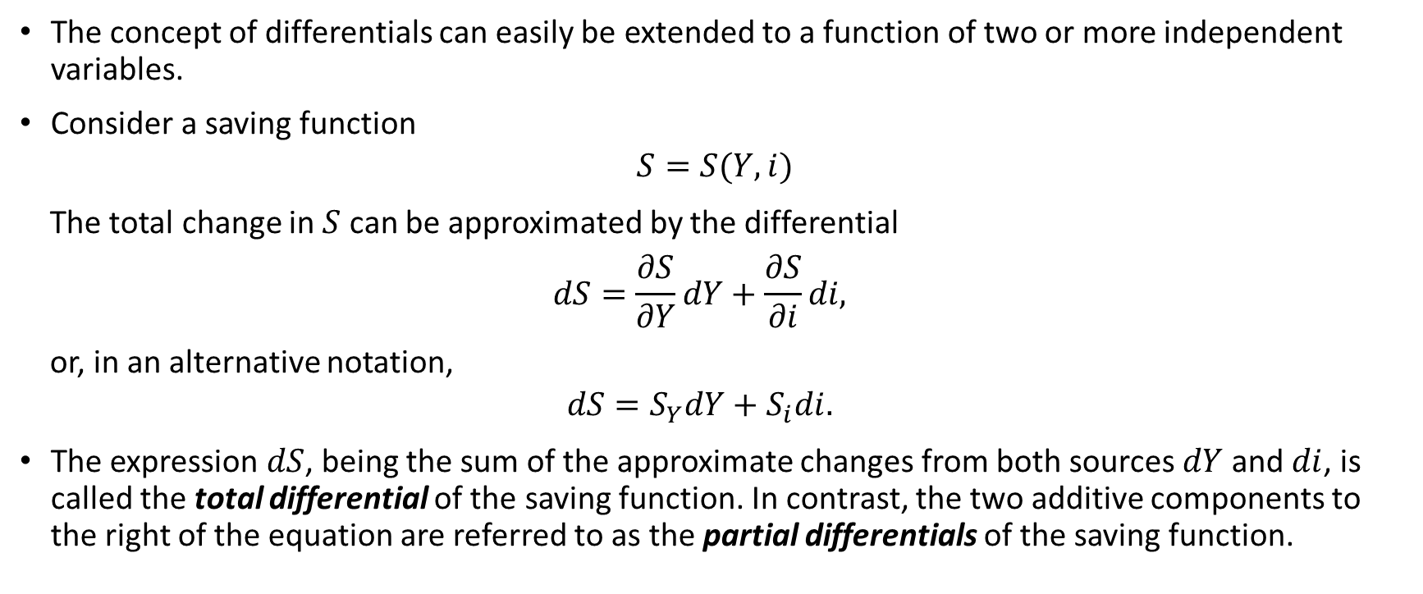
Total Differentials
The concept of differentials can easily be extended to a function of two or more independent variables.
Consider a saving function
$$S=S(Y,i)$$
The total change in $S$ can be approximated by the differential
$$dS=\frac{∂S}{∂Y}dY+\frac{∂S}{∂i}di,$$
or, in an alternative notation,
$$dS=S_{Y}dY+S_{i}di.$$
The expression $dS$, being the sum of the approximate changes from both sources $dY$ and $di$, is called the total differential of the saving function. In contrast, the two additive components to the right of the equation are referred to as the partial differentials of the saving function.

Slide 12
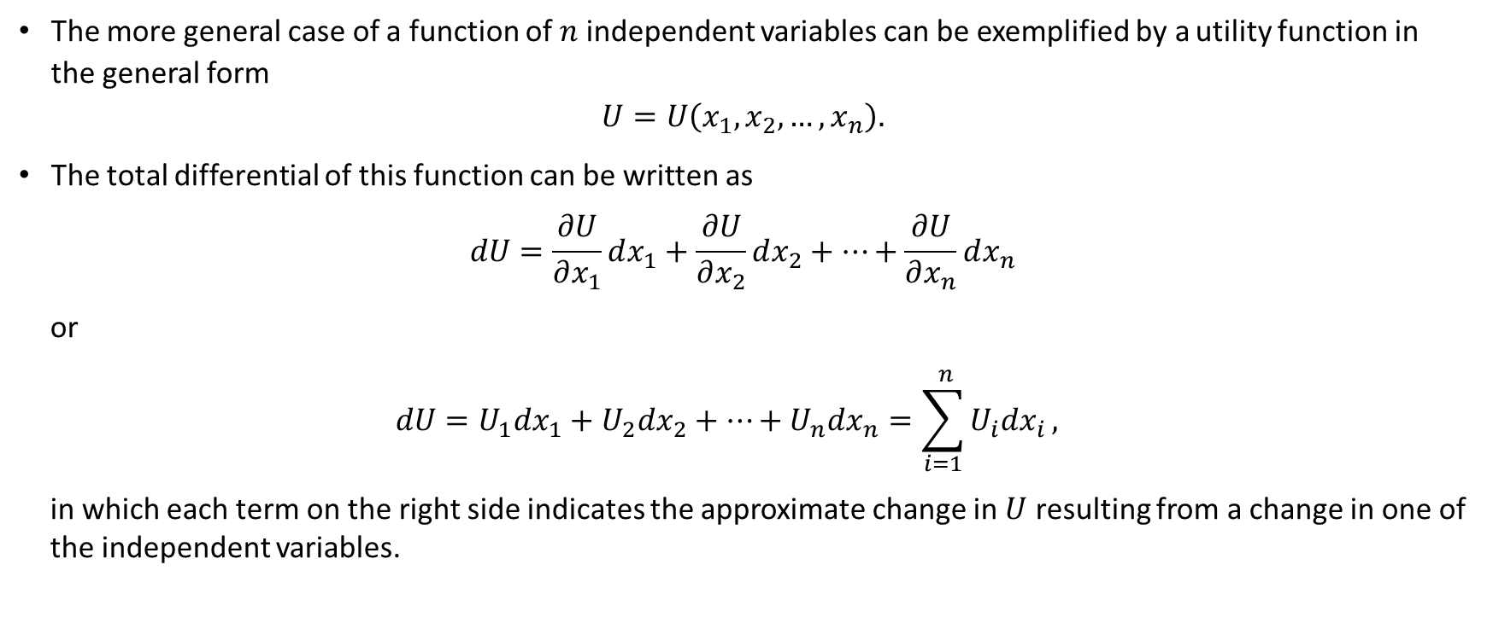
Total Differentials
The more general case of a function of $n$ independent variables can be exemplified by a utility function in the general form
$$U=U\left(x_{1},x_{2},…,x_{n}\right).$$
The total differential of this function can be written as
$$dU=\frac{∂U}{∂x_{1}}dx_{1}+\frac{∂U}{∂x_{2}}dx_{2}+…+\frac{∂U}{∂x_{n}}dx_{n}$$
or
$$dU=U_{1}dx_{1}+U_{2}dx_{2}+…+U_{n}dx_{n}=\sum_{i=1}^{ n}{U_{i}dx_{i}},$$
in which each term on the right side indicates the approximate change in $U$ resulting from a change in one of the independent variables.

Slide 13
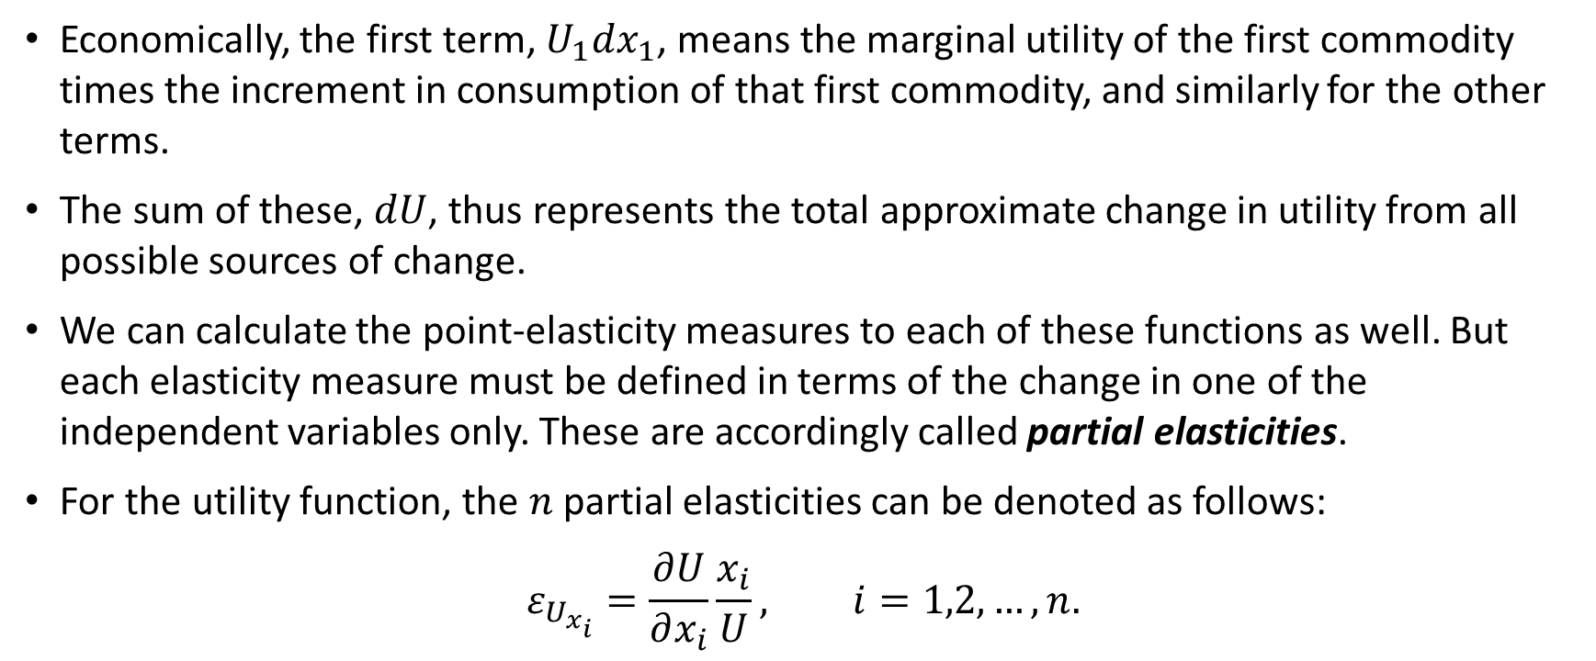
Total Differentials
Economically, the first term, $U_{1}dx_{1}$, means the marginal utility of the first commodity times the increment in consumption of that first commodity, and similarly for the other terms.
The sum of these, $dU$, thus represents the total approximate change in utility from all possible sources of change.
We can calculate the point-elasticity measures to each of these functions as well. But each elasticity measure must be defined in terms of the change in one of the independent variables only. These are accordingly called partial elasticities.
For the utility function, the $n$ partial elasticities can be denoted as follows:
$$ε_{U_{x_{i}}}=\frac{∂U}{∂x_{i}}\frac{x_{i}}{U}, i=1,2,…, n.$$

Slide 14
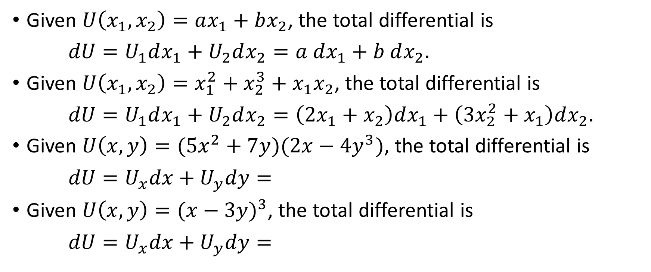
Examples
Given $U\left(x_{1},x_{2}\right)=ax_{1}+bx_{2}$, the total differential is
$dU=U_{1}dx_{1}+U_{2}dx_{2}=a dx_{1}+b dx_{2}.$
Given $U\left(x_{1},x_{2}\right)=x_{1}^{2}+x_{2}^{3}+x_{1}x_{2}$, the total differential is
$dU=U_{1}dx_{1}+U_{2}dx_{2}=\left(2x_{1}+x_{2}\right)dx_{1}+\left(3x_{2}^{2}+x_{1}\right)dx_{2}.$
Given $U\left(x,y\right)=(5x^{2}+7y)(2x−4y^{3})$, the total differential is
$dU=U_{x}dx+U_{y}dy=$
Given $U\left(x,y\right)={(x−3y)}^{3}$, the total differential is
$dU=U_{x}dx+U_{y}dy=$

Slide 15
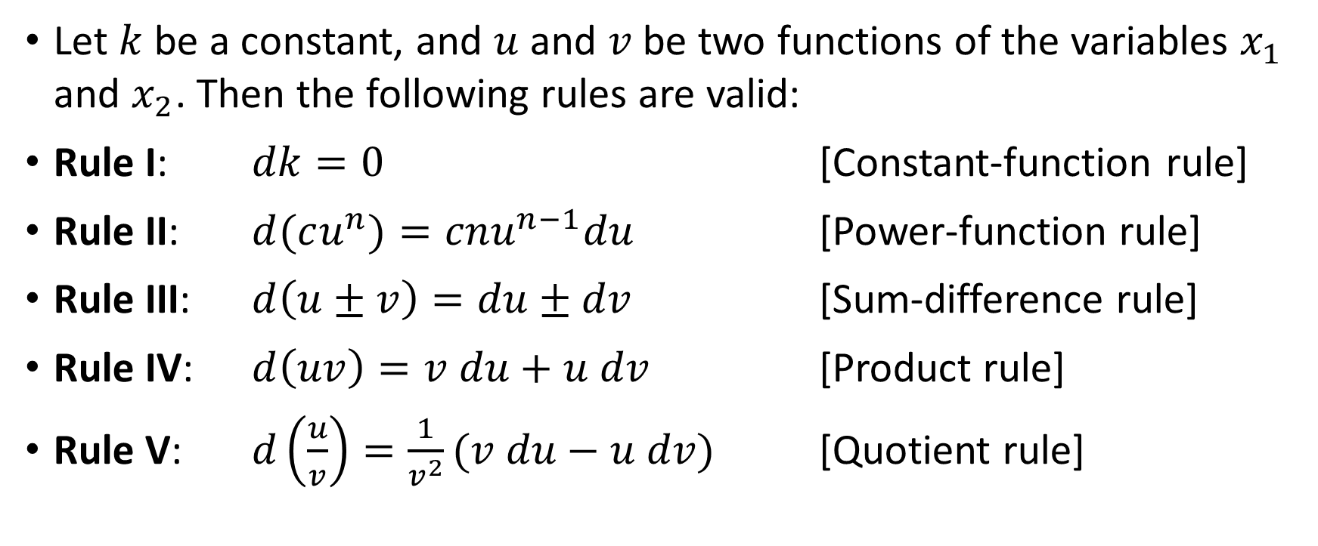
Rules of Differentials
Let $k$ be a constant, and $u$ and $v$ be two functions of the variables $x_{1}$ and $x_{2}$. Then the following rules are valid:
Rule I: $dk=0$ [Constant-function rule]
Rule II: $d(cu^{n})=cnu^{n−1}du$ [Power-function rule]
Rule III: $d\left(u±v\right)=du±dv$ [Sum-difference rule]
Rule IV: $d\left(uv\right)=v du+u dv$ [Product rule]
Rule V: $d\left(\frac{u}{v}\right)=\frac{1}{v^{2}}(v du−u dv)$ [Quotient rule]

Slide 16
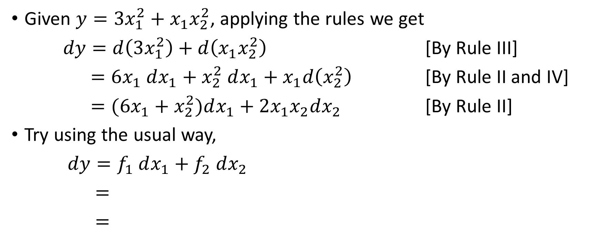
Example
Given $y=3x_{1}^{2}+x_{1}x_{2}^{2}$, applying the rules we get
$dy=d\left(3x_{1}^{2}\right)+d\left(x_{1}x_{2}^{2}\right)$ [By Rule III]
$=6x_{1} dx_{1}+x_{2}^{2} dx_{1}+x_{1}d\left(x_{2}^{2}\right)$ [By Rule II and IV]
$=(6x_{1}+x_{2}^{2})dx_{1}+2x_{1}x_{2}dx_{2}$ [By Rule II]
Try using the usual way,
$dy=f_{1} dx_{1}+f_{2} dx_{2}$
$=$
$=$

