Slide 1

EE390
Economics of Agricultural and Rural Development
Lecture 6: Agricultural supply chain in developing countries
Kiatanantha Lounkaew
Email: klounkaew@econ.tu.ac.th
Line: k_lounkaew
ที่มาของรูป https://www.hexagongeospatial.com/industries/natural-resources/agriculture

Slide 2
Challenges Faced in Developing Countries
How can developing country producers become more efficient and value adding and collaborate with parties in value chains that are able to capture new market opportunities?
How can value chains, as embedded in the international, domestic and local economic, legal and social-cultural environment, optimally use their business environment?
What major upgrading opportunities are available and which parties are most suited tofacilitate value chain upgrading?

Slide 3
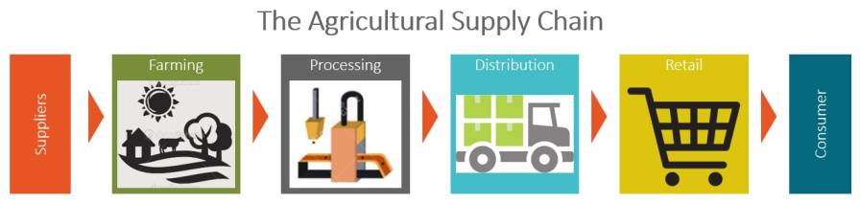

Slide 4
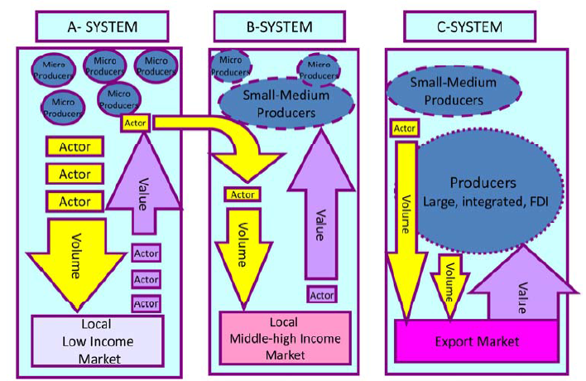
Three Types of Economic Systems
(Reuben et al. 2007)

Slide 5
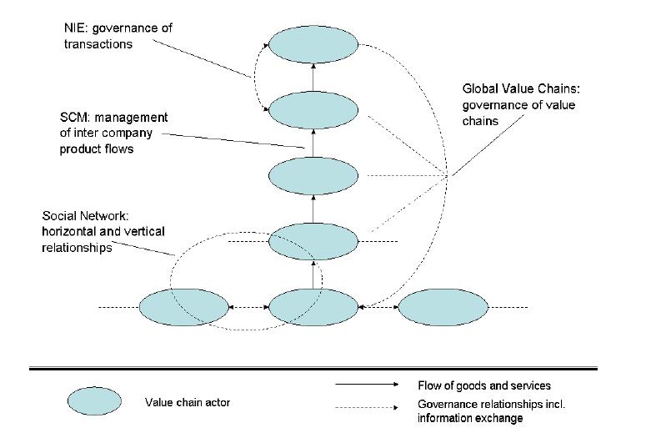
Value Chain Framework in Developing Countries
Source: (Trienekens, 2011)

Slide 6
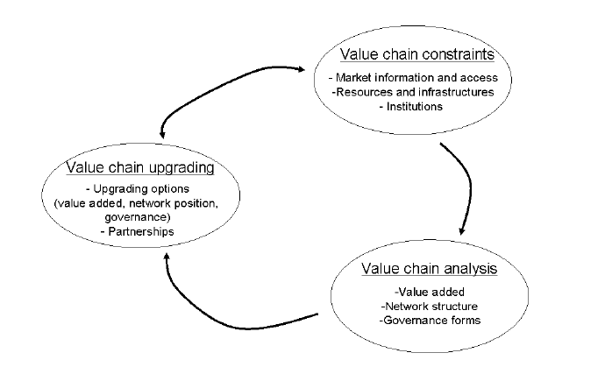
Analysis of Value Chain Development
Source: (Trienekens, 2011)

Slide 7
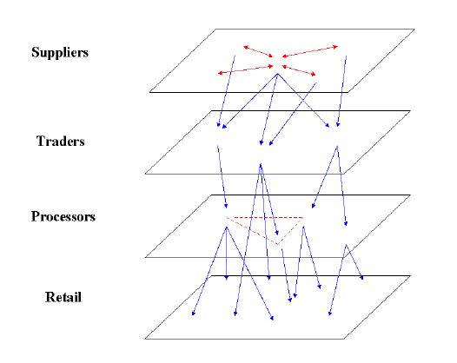
Network Structure
Source: (Lazzarini et al., 2001)

Slide 8
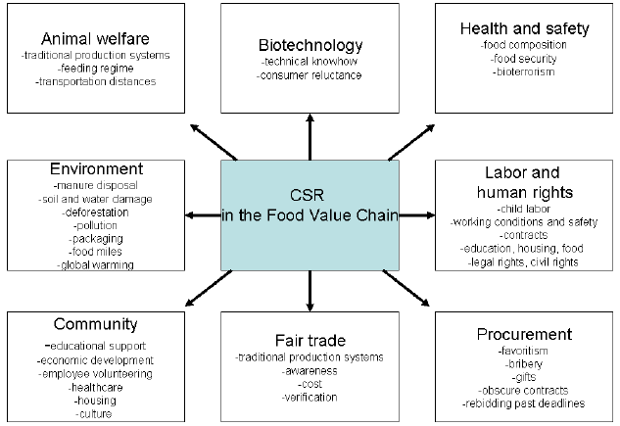
Adding Value via CSR

Slide 9
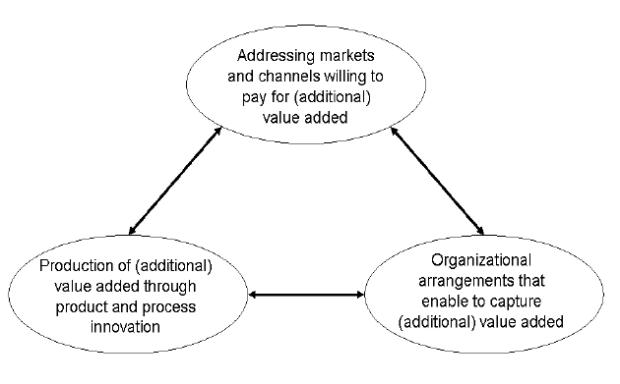
Value Chain Upgrading Options
Source: (Trienekens, 2011)

Slide 10
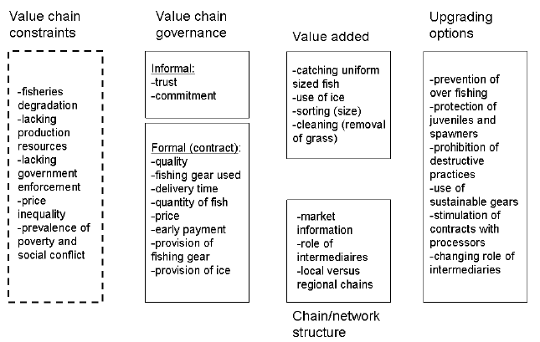
Philippine Case Study
Source: (Trienekens, 2011)

