Slide 1
EE460: Regional Integration
Mr. Bhanupong
Lecture 19

Slide 2
Outline
ASEAN integration: trade, investment, and capital flows
New economic geography
New regionalism: Multiple Free Trade Agreement
Source of data: ADB Asian Integration

Slide 3
Integration indicators

Slide 4
Integration through FDI
Cumulative foreign direct investment (FDI) share is the percentage of regional FDI inflows to total FDI from the investing region beginning 1995.
A higher share indicates a stronger preference for the region and a higher degree of integration.

Slide 6
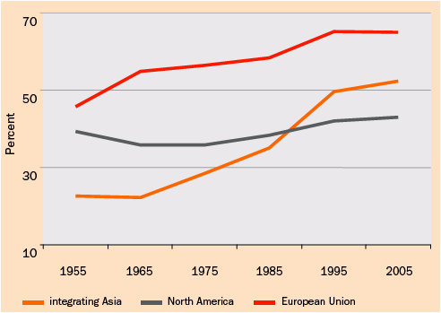
Increasing regional trade
Source: ADB

Slide 7
Trade intensity index
The trade intensity statistic is the ratio of two export shares.
The numerator is the share of the destination of interest in the exports of the region under study.
The denominator is the share of the destination of interest in the exports of the world as a whole.

Slide 8
The statistic tells us whether or not a region exports more (as a percentage) to a given destination than the world does on average.
It is interpreted in much the same way as an export share.

Slide 9
Trade share
Trade share is the percentage of trade with a partner to total trade of a country/region. A higher share indicates a higher degree of integration between partner countries/regions.

Slide 11
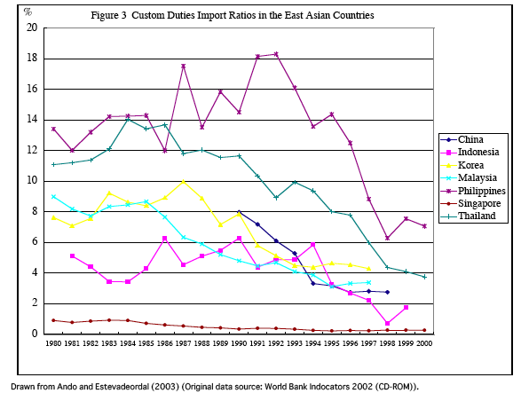

Slide 12
Engaging in foreign trade
Thailand has increasingly become an integral part of the world economy.
The degree of Asian regional integration of Thailand has been more pronounced through foreign investment in product fragmentation.

Slide 13
Relatively small, but increasing

Slide 14
Greater integration with closer neighbors

Slide 15
For most of ASEAN 5, Asian markets have been increasingly significant.
ASEAN 5 are trading more within the Asian bloc.
For new ASEAN countries, outside Asian blocs are more important.
Different production structures lead to different geographical distribution of export markets.

Slide 16
AEC in 2015
The tariff rates among ASEAN countries were cut to 5 percent in 2005, covering about 95 percent of intra-ASEAN trade.
Fully liberalized trade among ASEAN took place in 2010; for the new members (CLMV) by 2015.
The deadline has been set at 2015 for the establishment of Asian Economic Community (AEC).

Slide 20
Regional economic bloc in Asia
FDI in Asian region had been declining; a large part of investment was diverted into China.
Foreign direct investment in industrial sector of Thailand declined sharply after 2001.
For restoring the attractiveness of FDI in the region, ASEAN countries formed a regional economic bloc to attract foreign direct investment.
Since Japan and Hong Kong are the largest investors in Thailand, the idea of establishing ASEAN plus 3 and Asian Economic Community (AEC) provides some hope and lessens the fear of losing FDI to China.

Slide 21
Greater Mekhong Subregion
GMS nations, comprising Cambodia, Laos, Myanmar, Thailand, Vietnam, and Yunnan province in China, have agreed to promote trade and investment in the region.
Asian Development Bank provided loans worth 770 million USD to finance transportation projects by establishing networks of roads between GMS countries and building bridges across Mekong River.

Slide 22
GMS Economic Corridors
The East-West Economic Corridor (R9)
connects four countries from the port city of Da Nang on the South China Sea in Vietnam to Mawlamyine, a port city on the Andaman Sea in Myanmar, connecting roads passing through Khon Khan and Phitsanulok in Thailand, and Suvanakhet in Laos.
On the North-South Economic Corridor (R3-through Burma)
Chiang Rai province in Northern Thailand can be linked to Kunming in Yunnan via roads passing through Burma.
Uneven qualities of the R3 road in three countries
Infrastructure-led growth Hypothesis

Slide 23
Routes to link three ASEAN countries
Laos and Vietnam jointly opened a highway for trucks in June 2009.
The road is aimed to facilitate low-cost freight transportation.
The 500-kilometre route links Thailand's northeastern province of Mukdahan with Laos' Suvannakhet city and its Dansavan trade zone, and Vietnam's Lao bao.

Slide 25
North-South Economic Corridors and non-tariff trade cost
Another route on the North-South Economic Corridor, goods can also be transported from Kunming to Chiang Rai via Laos.
Bangkok can also be linked to Phnom Penh and Ho Chi Min City by the Southern Economic Corridor.
The infrastructure development in the GMS would develop secondary cities along the road networks and provide access of hinterlands to sea ports.
The planned road networks would connect six countries in the Greater Mekong Region, integrating these countries geographically more than ever.
The GMS sub-regional trading bloc is a natural consequence of a reduction in non-tariff trade cost, reinforcing the trade pattern.

Slide 26
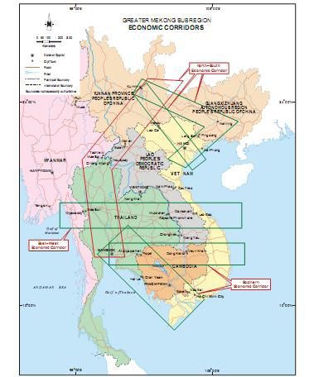

Slide 27
High logistic costs
Logistics costs relative to Thailand's gross domestic product (GDP) were expected to fall just one percentage point in 2010 year from 2009, due mainly to higher oil prices and interest rates.
Rising oil prices have had a significant impact on logistics costs because the country is so overwhelmingly dependent on road transport.
Can infrastructure investment lead to high growth?

Slide 28
High logistic costs
The NESDB has set a five-year target to lower logistics costs from 19% of GDP to 15% by the end of the 11th national economic and social development plan in 2016.
The cabinet endorsed a rail system overhaul worth 1.7 trillion baht, including upgrading 660 kilometers of existing track and signaling infrastructure, buying more locomotives, and constructing five double-track routes to the northern, northeastern and southern regions.
Examine the impact of two trillion baht investment in transportation development.

Slide 29
Factor endowment theory of international trade
Until the end of the 1970s, the Heckscher-Ohlin theory for which Bertil Ohlin won the prize--Eli Heckscher died before the Nobel Prize in economics was instituted--dominated the field.
This theory explained well why labor-abundant countries such as China exported labor-intensive products such apparel, toys and footwear and capital-abundant countries such as the United States would export machinery and aircraft.
What is Leiontief paradox?

Slide 30
What factor endowment theory cannot explain
But it could not satisfactorily explain the two-way trade that was widely known to exist: Many countries exported automobiles and televisions, but they also imported them (Intra-industry trade).
The Heckscher-Ohlin theory also did not adequately explain why rich entities such as Europe and the United States, which had very similar endowments of capital and labor, traded more intensively than those with very dissimilar endowments.
While descriptive explanations of these phenomena existed, a tight theory explaining them was lacking.

Slide 31
Krugman on product variety
Starting in 1979, Krugman published a series of papers that successfully tackled these and many other related questions.
He postulated that consumers like variety in what they consume.
For the same expenditure, their satisfaction is greater if they have a larger variety of products available.
This creates the incentive for firms to produce a large variety of products.

Slide 32
Market size and distance
But the production of a new variety has setup costs. This leads to declining per-unit costs as a larger quantity of the variety is produced and places a limit on the number of varieties the market can profitably supply.
A firm produces a new variety only if it can capture a large enough market to allow profitable sales.
Krugman won the Nobel Prize in 2008.
Economies of scale explains intra-industry trade, while H-O theorem cannot.

Slide 33
New Economic Geography
Paul Krugman: Four propositions
Transportation costs, or more broadly transaction costs across distance, play a crucial role in shaping international and interregional trade. (Distance matters)
The interaction of market size with increasing returns plays an important role in determining the location of production. Home market effect is a major explanation of trade through differences in population density and localized specialization.
A cumulative process in which large markets attract production leads to agglomeration.
The same processes that shape economic geography within countries also shape international trade.

Slide 34
Newton and law of gravity
Newton’s law of gravity: the gravitational attraction between any two objects is proportional to the product of their masses and diminishes with distance.
Large economies tend to spend large amounts of imports because they have large incomes.
They tend to attract larges shares of other countries' spending because they produce a wide rage of products.
Trade between any two economies is larger, the larger in either economy.

Slide 35
Gravity model
The value of trade between any two countries is proportional, other things equal, to the product of the two countries’ GDP, and diminishes with the distance between the two countries.

Slide 37
Size and distance matter for trade among nations
Percent of US trade
With EU
(volume of trade)
Canada
120
Mexico
European Countries
10
Netherlands
Ireland
25
Percent of EU GDP
(Size of economies)

Slide 38
Distance matters

Slide 39
Does common language matter?

Slide 40
Cross-boarder trade
The closure of the Thai-Burmese border checkpoint between Mae Sot and Myawaddy since early July 2010 cost traders about 88 million baht a day, according to Commerce Minister (August 8, 2010).
Both sides must negotiate to settle the problem. Cross-border trade had suffered significantly as goods could not be transported between the two countries.
“Changing the battle field to the market place”

Slide 41
Trade diversion vs. creation
Lower tariff rates among CLMV countries in the region would not create much trade diversion because their trade volumes with countries outside the bloc are small.
On the contrary, trade creation effect would be welfare improving for the sub-region.
Always check these two static impacts of trade integration

Slide 42
New Regionalism: Multiple FTAs
Thailand’s rush to negotiate FTAs with many countries, including USA, Japan, Australia, New Zealand, Bahrain, India, China, Chile, and Peru, can be described as new regionalism.
Although Japan had already established FTAs with Singapore, Thailand was a more difficult case for Japan, since negotiations involved agriculture and labor issues.
Singapore had already removed most of her tariff barriers, while the two countries’ levels of per capita income do not differ much.

Slide 43
Regrettably?
Thailand had to withdraw rice from the FTA negotiation with Japan.
Rice is also excluded from Korea’s FTAs with other countries
Other sensitive products for Japan are chicken, sugar, and tapioca.
Most of bilateral trade agreements exempt agriculture.
What commodity was exempted from the FTA between USA and Australia?
Perhaps the FTAs between Thailand and Japan can be an example of the FTAs that include agricultural sectors—albeit without rice.

Slide 44
Economic Partnership Agreement (EPA): Beyond the FTA
EPA between Thailand and Japan includes cooperation in education, environment, energy, sciences and technology, tourism, and human resource development.
EPA goes beyond what WTO has stipulated since it allows partners to take advantage of each other’s strength and recognize the value of cooperation.

Slide 45
ROO and NTBs
Rules of origin (ROO) must be simplified to facilitate administration procedure without causing trade diversion or act as a hidden instrument to protect domestic industry.
If Thailand continues to reduce MFN tariff rates, the cost associated with the rules of origin can also be reduced.
The spaghetti bowl effect has been exaggerated.
Non-tariff barriers such as Sanitary and Phytosanitary (SPS) conditions must be agreed upon to make sure that they are not substitutes for the tariff reductions.

Slide 46
To forge ahead with FTAs
There are trade-offs between benefits and adverse consequences of new regionalism.
As long as the net benefits of expansion along the line of globalization exist, we should cautiously go ahead with multiple FTAs.
We should not let short-term micro adverse impacts obscure the long-term macro dynamic gains from rapid integrating into the world economy.

Slide 47
As of January 2010
ASEAN Free Trade Area (In Effect)
ASEAN-Australia and New Zealand Free Trade Agreement (In Effect)
ASEAN-China Comprehensive Economic Cooperation Agreement (In Effect)
ASEAN-EU Free Trade Agreement (Under Negotiation)
ASEAN-India Regional Trade and Investment Area (In Effect)
ASEAN-Japan Comprehensive Economic Partnership Agreement (In Effect)
ASEAN-Korea Comprehensive Economic Cooperation Agreement (In Effect)
Bay of Bengal Initiative for Multi-Sectoral Technical and Economic Cooperation (BIMSTEC) Free Trade Area ((FA) signed/FTA Under Negotiation)
Comprehensive Economic Partnership for East Asia (CEPEA/ASEAN+6) (Proposed/Under consultation and study)
East Asia Free Trade Area (ASEAN+3) (Proposed/Under consultation and study)
India-Thailand Free Trade Area ((FA) signed/FTA Under Negotiation)
Japan-Thailand Economic Partnership Agreement (In Effect)

Slide 48
FTA galore
Source: Asian Regional Integration center www.aric.adb.org
Korea-Thailand Free Trade Agreement (Proposed/Under consultation and study)
Laos-Thailand Preferential Trading Arrangement (In Effect)
Pakistan-Thailand Free Trade Agreement (Proposed/Under consultation and study)
People's Republic of China-Thailand Free Trade Agreement (In Effect)
Thailand-Australia Free Trade Agreement (In Effect)
Thailand-Bahrain Free Trade Agreement ((FA) signed/FTA Under Negotiation)
Thailand-Chile Free Trade Agreement (Proposed/Under consultation and study)
Thailand-European Free Trade Association Free Trade Agreement (Under Negotiation)
Thailand-MERCOSUR Free Trade Agreement (Proposed/Under consultation and study)
Thailand-New Zealand Closer Economic Partnership Agreement (In Effect)
Thailand-Peru Free Trade Agreement ((FA) signed/FTA Under Negotiation)
United States-Thailand Free Trade Agreement (Under Negotiation)

Slide 49
Multiple FTAs, as of January 2010
COUNTRY |  | UNDER NEGOTIATION |  | CONCLUDED |  | TOTAL
 | Proposed | Framework Agreement Signed/Under Negotiation | Under Negotiation | Signed | In Effect
Australia | 6 | 1 | 5 | 0 | 8 | 20
China | 8 | 2 | 4 | 1 | 9 | 24
India | 12 | 4 | 6 | 1 | 10 | 33
Philippines | 4 | 0 | 1 | 0 | 7 | 12
Singapore | 5 | 0 | 9 | 2 | 18 | 34
Viet Nam | 2 | 0 | 2 | 0 | 7 | 11
Thailand | 6 | 4 | 3 | 0 | 11 | 24

Slide 50
Definition of terms
Proposed - parties are considering a free trade agreement, establishing joint study groups or joint task force , and conducting feasibility studies to determine the desirability of entering into an FTA.
Framework Agreement Signed/Under Negotiation - parties initially negotiate the contents of a framework agreement (FA), which serves as a framework for future negotiations.
Under Negotiation - parties begin negotiations without a framework agreement (FA).
Signed - parties sign the agreement after negotiations have been completed. Some FTAs would require legislative or executive ratification.
In Effect - when the provisions of an FTA becomes effective, e.g., when tariff cuts begin.

Slide 51
Concluding remarks
Integrating the Thai economy with regional trade blocs can serve as an instrument to speed up domestic reform.
Temporary subsidies to adversely affected industries are required to ease adjustment costs.
Without firm datelines imposed by FTAs, there would be less enthusiastic efforts to carry out difficult reform.
Utilization of FTA provisions remain relatively low due to high marginal transaction costs imposed by Rule of origin.
A surge in the number of Thailand’s FTA negotiations should not be interpreted as diminished commitment to the multilateralism.

Slide 53
Based on Figure 1, what are implications on Thailand’s agricultural policy that can alleviate poverty and enhance competitiveness?

Slide 54
Compare and contrast economic transformation in Thailand with Taiwan and Vietnam. Discuss problems during the transformation in Thailand and its relationship with Economic Development Planning.

Slide 55
Examine Figure 3 and analyze the relationship between the stock and property markets in Thailand in light of the AFC and the GFC.

