Slide 1
PY200/PY211 General Psychology
Social psychology

Slide 2
Social Psychology
Scientific study of how people’s thoughts, feelings, and actions are affected by others

Slide 3
Attitudes and Social Cognition
How do people form impressions of what others are like and of the causes of their behavior?
What are the biases that influence the ways in which people view others’ behavior?

Slide 4
Social Cognition: Understanding Others (1)
The cognitive processes by which people understand and make sense of others and themselves
Social schemas: Sets of cognitions about people and social experiences
  Organize information stored in memory
  Provide a framework to recognize, categorize, and recall information relating to social stimuli
  Help predict what others are like based on relatively little information
Notes:
Darley and Gross (1983) – Hannah Study

Slide 5
Social Cognition: Understanding Others (2)
Forming impressions of others
  Impression formation - Process by which an individual organizes information about another person to form an overall impression of that person
    Central traits: Major traits considered in forming impressions of others
    E.G. researchers told a group of students that a guest lecturer was either (Kelley, 1950):
      Condition 1: Warm, industrious, critical, practical, and determined
      Condition 2: Cold, industrious, critical, practical, and determined
    Students in the first condition rated the lecturer more positively

Slide 6
Social Cognition: Understanding Others (3)
Attribution processes: Understanding the causes of behavior
  Attribution theory: Considers how we decide, on the basis of samples of a person’s behavior, what the specific causes of that behavior are
    Focuses on why is someone acting in a particular way - Asks the “why” question

Slide 7
Social Cognition: Understanding Others (4)
Situational causes of behavior: Causes of behavior that are external to a person
Dispositional causes of behavior: Causes of behavior brought about by a person’s traits or personality characteristics

Slide 8
Attribution Biases: To Err is Human (1)
Halo effect: Phenomenon in which an initial understanding that a person has positive traits is used to infer other uniformly positive characteristics
Assumed-similarity bias: Tendency to think of people as being similar to oneself even when meeting them for the first time

Slide 9
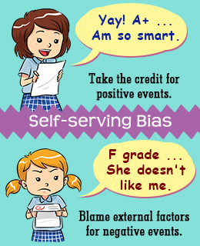
Attribution Biases: To Err is Human (2)
Self-serving bias: Tendency to attribute success to personal factors and failure to factors outside oneself
Fundamental attribution error: Tendency to overattribute others’ behavior to dispositional causes and minimize the importance of situational causes

Slide 10
Social Influence and Groups
What are the major sources and tactics of social influence?

Slide 11
Introduction (1)
Social influence: Social groups and individuals exert pressure on an individual, either deliberately or unintentionally
Group: Two or more people who:
  Interact with one another
  Perceive themselves as part of a group
  Are interdependent
  Develop and hold norms

Slide 12
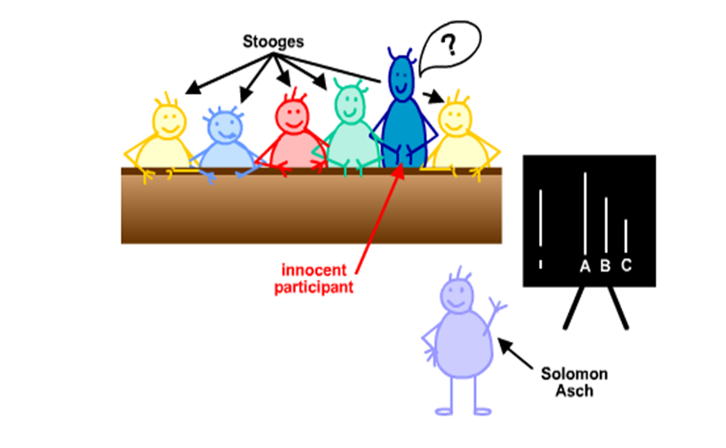
Conformity: Following What Others Do
Conformity: A change in behavior or attitudes brought about by a desire to follow the beliefs or standards of other people
  E.g. Asch study

Slide 13
Conformity Conclusions: Significant Findings Focus On
Characteristics of the group
  Status: Social standing of someone in a group
Situation in which the individual is responding
Kind of task
Unanimity of the group
  Social supporter: Group member whose dissenting views make nonconformity to the group easier

Slide 14
Groupthink: Caving in to Conformity
Type of thinking in which group members share such a strong motivation to achieve consensus that they lose the ability to critically evaluate alternative points of view
  Entrapment: Circumstance in which commitments to a failing point of view or course of action are increased to justify investments in time and energy that have already been made

Slide 15
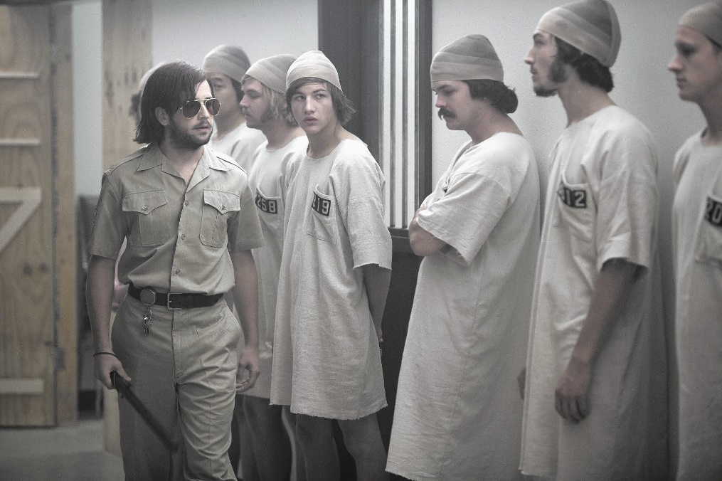
Conformity to Social Roles
Conformity influences behavior is through social roles
  Social roles: Expectations for people who occupy a given social position
Experiment conducted by Philip Zimbardo and colleagues:
  Guards vs. prisoners
    Conforming to social roles can have a powerful effect on behavior
    Can induce people to change behavior in undesirable ways

Slide 16
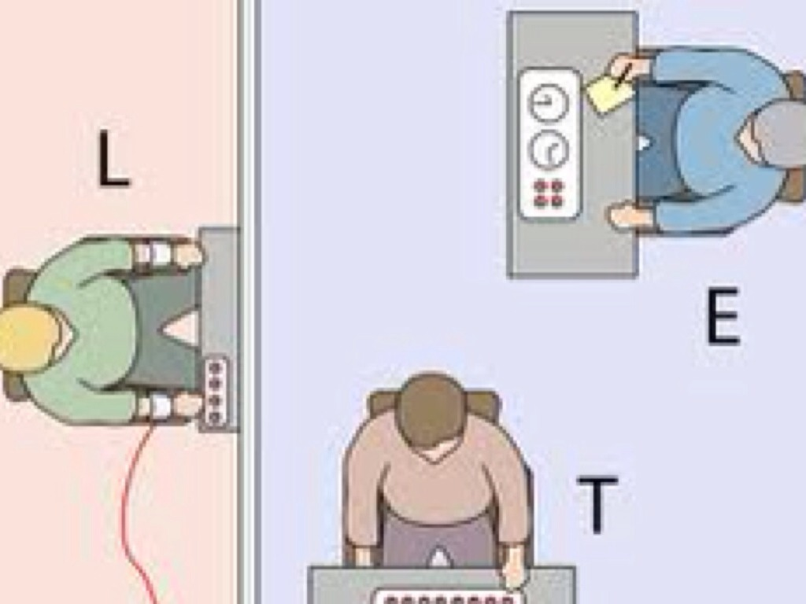
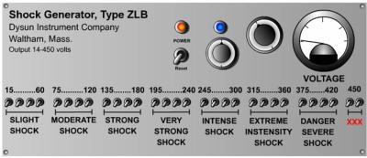
Obedience: Following Direct Orders
Obedience: A change in behavior in response to the commands of others
Milgram’s classic obedience study
  Teacher: administer electric shock
  Learner: (research confederate) ‘receiving’ electric shock
  65% of participants eventually used the highest setting labelled on the shock generator, in response to experimenter’s commands

Slide 17
Prejudice and Discrimination
How do stereotypes, prejudice, and discrimination differ?
How can we reduce prejudice and discrimination?

Slide 18
Introduction (2)
Stereotype: Set of generalized beliefs and expectations about a specific group and its members
Prejudice: Negative (or positive) evaluation of a group and its members
Discrimination: Behavior directed toward individuals on the basis of their membership in a particular group
Self-fulfilling prophecy: expectations about the occurrence of a future event or behavior that act to increase the likelihood the event or behavior will occur
Notes:
Pygmalion in the classroom (Rosenthal & Jacobson, 1968)

Slide 19
The Foundations of Prejudice (1)
Observational learning approaches suggests that children’s feelings about members of various groups are shaped by:
  Stereotyping and prejudice, the behavior of parents, other adults, and peers
Mass media provides information about stereotypes for children and adults

Slide 20
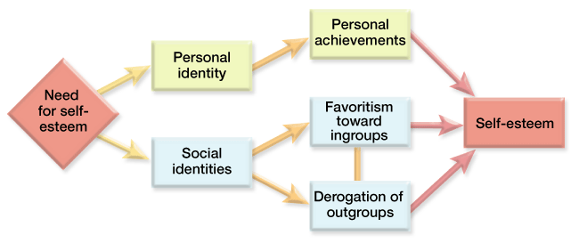
The Foundations of Prejudice (2)
Social identity theory suggests that people tend to be ethnocentric
  Ethnocentric: Viewing the world from their own perspective and judging others in terms of their group membership
    Ingroups and outgroups

Slide 21
Measuring Prejudice and Discrimination: The Implicit Association Test
Measure of prejudice that permits a more accurate assessment of people’s discrimination between members of different groups
  Criticism of the test
    Having an implicit bias does not mean that people will overtly discriminate

Slide 22
Reducing the Consequences of Prejudice and Discrimination
Increase contact between the target of stereotyping and holder of the stereotype
Make values and norms against prejudice more conspicuous
Provide information about the targets of stereotyping
Reducing stereotype threat
Increasing the sense of social belonging of ethnic minority students

Slide 23
Positive & Negative Social Behavior
Why are we attracted to certain people, and what progression do social relationships follow?
What factors underlie aggression and prosocial behavior?

Slide 24
Interpersonal Attraction and the Development of Relationships (1)
Interpersonal attraction: Positive feelings for others; liking and loving
  Factors that attract people to each other:
    Proximity: Tendency to like those that are near us
    Familiarity: Mere-exposure-effect: Tendency to like those we see often
    Similarity: Tendency to like those who are like us
    Reciprocity: Tendency to like those who like us
    Physical attractiveness: Tendency to like those who look attractive

Slide 25
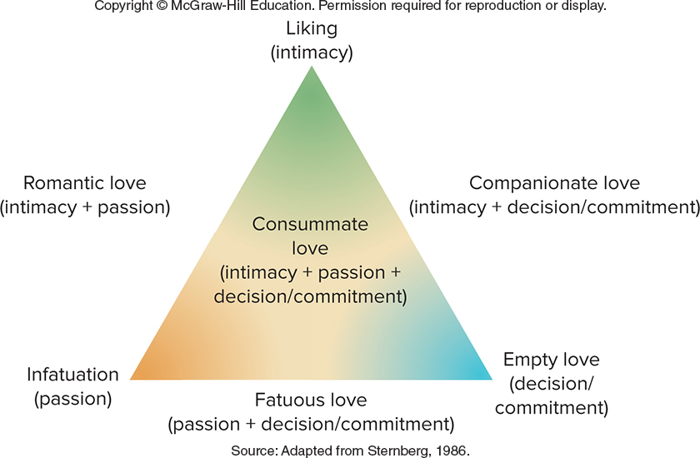
Interpersonal Attraction and the Development of Relationships (2)
Differentiation between types of love by psychologist Robert Sternberg
  Commitment (decision to commit) - Initial thoughts that one loves someone and the longer-term feelings of commitment to maintain love
  Intimacy component - Feelings of closeness and connectedness
  Passion component - Motivational drives relating to sex, physical closeness, and romance

Slide 26
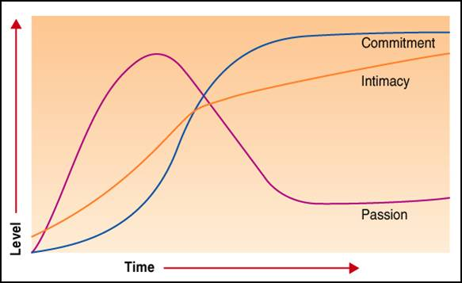
Interpersonal Attraction and the Development of Relationships (3)
Types of love
  Romantic love: State of intense absorption in someone that includes intense physiological arousal, psychological interest, and caring for the needs of another
  Companionate love: Strong affection we have for those with whom our lives are deeply involved
Notes:
Types of love based on Sternberg’s Theory

Slide 27
Interpersonal Attraction and the Development of Relationships (4)
  Cross-cultural differences in choosing a marriage partner

Slide 28
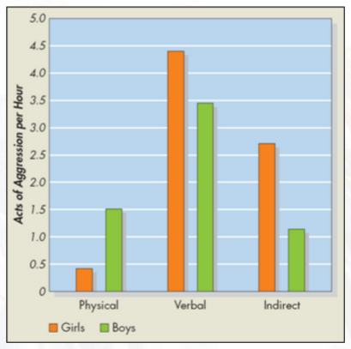
Aggression and Prosocial Behavior: Hurting and Helping Others (1)
Hurting others: Aggression
  Aggression: Intentional injury of, or harm to, another person. The other person must want to avoid this
Instinct approaches: Aggression as a release
  Freudian theory
  Catharsis: Process of discharging built-up aggressive energy

Slide 29
Aggression and Prosocial Behavior: Hurting and Helping Others (2)
Biological and biochemical approaches
  Evolutionary
    Daly & Watson (1988, 1996, 2005)
      Birth parents less likely to abuse or murder own offspring than stepparents are to harm stepchildren
      Preschool children living with stepparent or foster parent 70 -100 times more likely to be fatally abused than those living with both biological parents
  Testosterone
    Berthold (1949): Castrated roosters without transplanted testicles displayed less aggression than castrated roosters with transplanted testicles

Slide 30
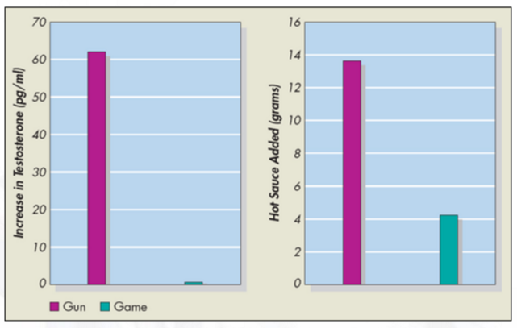
Aggression and Prosocial Behavior: Hurting and Helping Others (3)
Frustration-aggression approaches: Aggression as a reaction to frustration
  Explains aggression in terms of reactions to frustration
  Frustration: Reaction to the blocking of goals
Weapon’s effect: tendency for presence of weapons to increase aggression
  E.G. Klinesmith et al. (2006) hotsauce study

Slide 31
Aggression and Prosocial Behavior: Hurting and Helping Others (4)
Observational learning approaches: Learning to hurt others
  Emphasizes that social and environmental conditions can teach individuals to be aggressive
  Suggests that people learn to be aggressive by viewing the rewards and punishments that models provide
    Models: Individuals who provide a guide to appropriate behavior through their own behavior

Slide 32
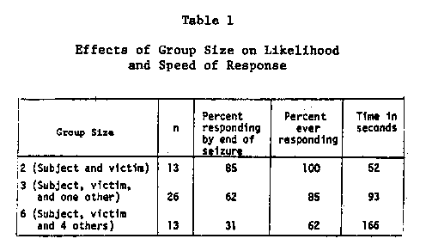
Helping Others: The Brighter Side of Human Nature (1)
Prosocial behavior: Helping behavior
  Bystander effect: the presence of others inhibits helping behavior (e.g. Darley & Latane, 1968)

Slide 33
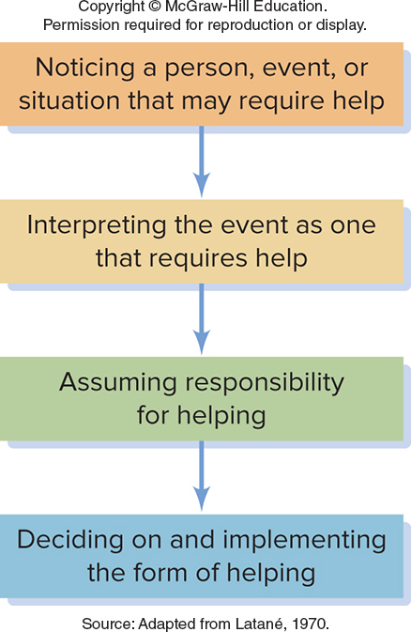
Helping Others: The Brighter Side of Human Nature (2)
  Diffusion of responsibility: the belief that responsibility for intervening is shared, or diffused, among those present
  Pluralistic ignorance: the erroneous inference that others accept a norm, therefore causing the person to go along with it
  Rewards-costs analysis
    Suggests that individuals tend to use the least costly form implementing help
  Altruism: Helping behavior that requires self-sacrifice
  Altruism is based on temporary situational factors

