Slide 1
Consumer Behavior
EE311
Chayun Tantivasadakarn
Faculty of Economics
Thammasat University

Slide 2



Consumer Preferences – Basic Assumptions
Preferences are complete.
  Consumers can rank market baskets; i.e., either prefer A to B, B to A, or indifferent
Preferences are transitive.
  If prefer A to B, and B to C, the must prefer A to C
Consumers always prefer more of any good to less.
  More is better --> rule out “Bads”. This assumption can be relaxed.
Variety is preferred to extreme

Slide 3
Consumer Preferences
Consumer preferences can be represented graphically using indifference curves or ICs
Indifference curves represent all combinations of market baskets that the person is indifferent to
  A person will be equally satisfied with either choice or attain the same utility level

Slide 4
Indifference Curves: An Example
Clothing (C)
50
B
Indifferent between B, A, & D
E is preferred to U₁
U₁ is preferred to H & G
H
40
E
A
30
D
20
G
U₁
10
10
20
30
40
Food (F)

Slide 5

Indifference curves are the contour on the utility hill
TU
C
30
20
U₁
F
0
20
40
Copyright©2004 South-Western

Slide 6
Indifference Curves: Properties
They slope downward to the right.
  Goods are substitutable
  If F rises, C must fall to maintain the same U₁.
Any basket lying northeast of an IC is preferred to any on the IC
Convex to the origin
  Variety is preferred to extreme
Indifference curves can not cross
Continuous: no gaps

Slide 7
Indifference Map
Clothing
Market basket A
is preferred to B.
Market basket B is
preferred to D.
D
B
A
U₃
U₂
U₁
Food

Slide 8
Indifference Map
Convex to the origin
Prefer varieties
Concave to the origin
Prefer extreme
Butter
Chili Paste
B
B
U₁
U₀
D
D
U₂
U₁
A
A
Jam
Jam

Slide 9
Indifference Curves
The more clothing and less food a person has, the more clothing they will give up to get more food
An IC is convex to the origin
Along an indifference curve there is a diminishing Marginal Rate of Substitution (MRS)
A
Clothing
16
14
12
-6
10
B
1
8
-4
D
6
Observation: The amount
of clothing given up for
1 unit of food decreases
from 6 to 1
1
-2
E
4
G
1
-1
2
1
Food
1
2
3
4
5

Slide 10
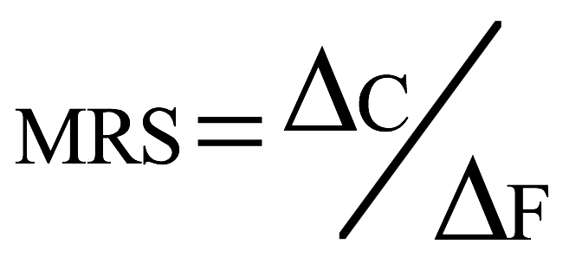
Marginal Rate of Substitution
Clothing
16
A
MRS = 6
14
MRS measures how a person trades one good for another
It is the slope of the IC
The willingness to substitute is less as we consume more of one good.
12
-6
10
B
1
8
-4
MRS = 2
D
6
1
-2
E
4
G
1
-1
2
1
1
2
3
4
5
Food

Slide 11
Marginal Rate of Substitution
Y
From A to C, utility decreases by (ΔY)(MU_{Y})
IC
From C to B, utility increases by (ΔX)(MU_{X})
Α
If we are holding utility constant, the net effect of increasing X and decreasing Y must be zero
(ΔY)(MU_{Y})
Β
(ΔY)(MU_{Y}) + (ΔX)(MU_{X}) = 0
C
(ΔX)(MU_{X})
X

Slide 12
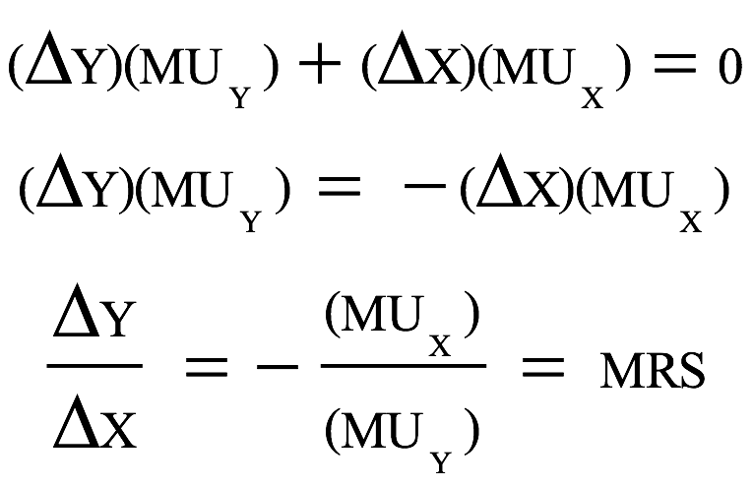
Marginal Rate of Substitution
Rearranging equation, we can see the relationship between MRS and MUs

Slide 13

MRS and Preferences
Styling
performance
Styling
styling
Y₀
Y₀
X₀
Performance
X₀
Performance

Slide 14
Shapes of the IC and types of goods
Indifference curves with different shapes imply a different willingness to substitute
Two polar cases are of interest
  Perfect substitutes
  Perfect complements
Other types
  Neuters
  Bads

Slide 15

Consumer Preferences
Perfect
Substitutes
U(X, Y) = aX + bY
Two goods are perfect substitutes when the marginal rate of substitution of one good for the other is constant.
Note: MRS needs not to be 1.
Coke
(Cans)
4
3
Slope = -a/b
2
1
Pepsi
(Cans)
0
1
2
3
4

Slide 16

Consumer Preferences
U(X, Y) = Min {aX, bY}
Two goods are perfect complements when the indifference curves for the goods are shaped as right angles.
Always consume in the same proportion Y/X = a/b.
Perfect
Complements
Keyboards
a/b
4
3
2
1
0
1
2
3
4
Monitors

Slide 17

Consumer Preferences
If one care only about the taste of the food he eats, but does not care about its appearance, the appearance is a neuter to him.
U(X) = aX
Neuter
Food Appearance
4
3
2
1
0
1
2
3
4
Taste

Slide 18

Bads are commodities we don’t want more of; e.g., air pollution, stress
Food
Food
4
4
3
3
2
2
1
1
0
1
2
3
Air pollution
1
2
3
Clean air

Slide 19
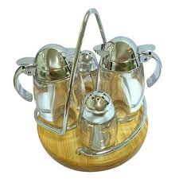
Satiation or Bliss point
Salt (Y)
X is a good
Y is a bad
X and Y are bads
Y is a bad
2
4
Y₁
Satiation point
1
3
Y is a good
X is a good
Y is a good
X is a bad
Y is a good
Sugar (X)
O
X is a good
X is a bad
X₁

Slide 20
Utility
Utility function
  Formula that assigns a level of utility to individual market baskets
  If the utility function is
U(F,C) = F + 2C
    A market basket with 8 units of food and 3 units of clothing gives a utility of
14 = 8 + 2(3)
F and C are perfect substitutes

Slide 21
Utility - Example: Cobb-Douglas
Clothing
Basket U = FC
C 25 = 2.5(10)
A 25 = 5(5)
B 25 = 10(2.5)
15
C
10
A
U₃ = 100
5
B
U₂ = 50
U₁ = 25
Food
0
5
10
15

Slide 22
Budget Constraints
The Budget Line
  Indicates all combinations of two commodities for which total money spent equals total income.
  We assume only 2 goods are consumed, so we do not consider savings for the time being

Slide 23
The Budget Line
A consumer chooses food (F) and Clothing (C)
Price of food = PF and price of clothing = PC
The budget line then can be written:
P_{F}F + P_{C}C = I
All income is allocated to food (F) and/or clothing (C)

Slide 24
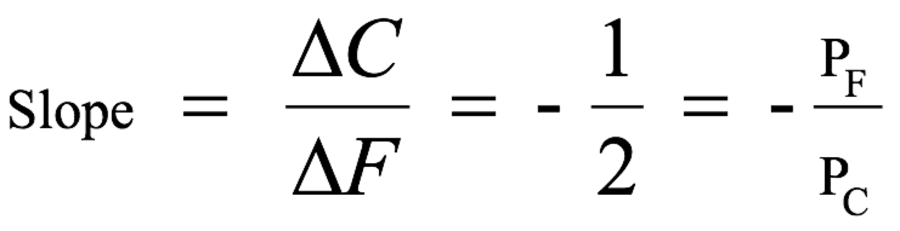
The Budget Line
Clothing
Assume income (I) of $80, P_{F} = $1 and P_{C} = $2
A
(I/P_{C}) = 40
B
J
30
The slope of the line measures the relative cost of food and clothing that can be substituted without changing the amount of money spent.
10
D
20
20
E
H
10
G
0
20
40
60
80 = (I/P_{F})
Food

Slide 25
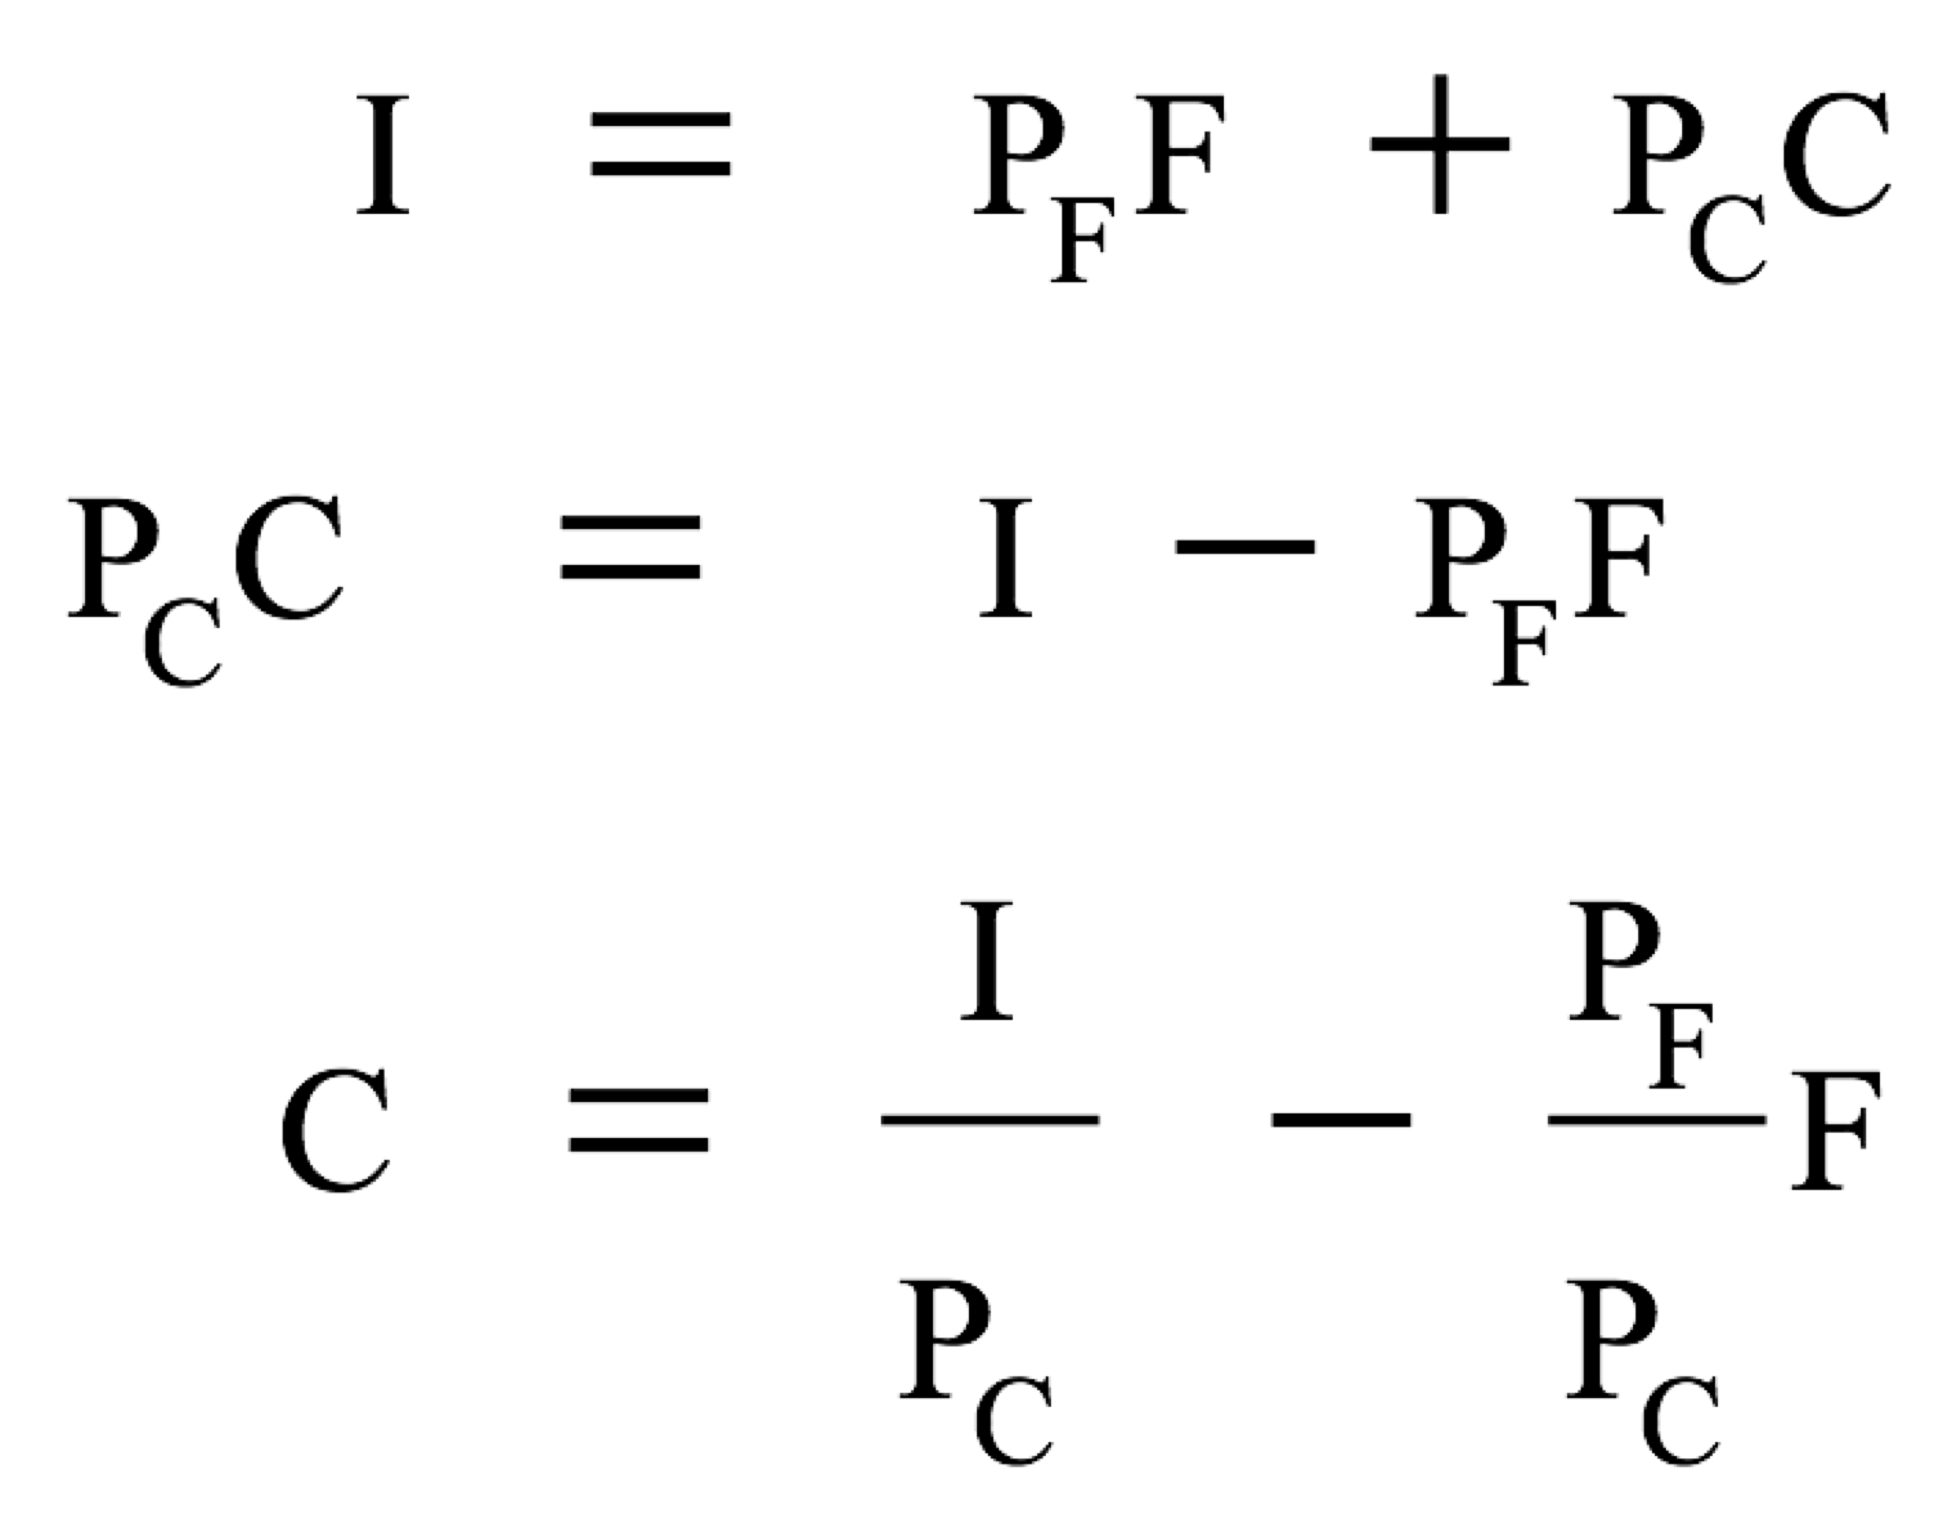
The Budget Line
Y intercept
slope

Slide 26
The Budget Line: Changes in income
Clothing
(units
per week)
A increase in
income shifts
the budget line
outward
(1600/2) =
80
60
A decrease in
income shifts
the budget line
inward
(80/2) =
40
(40/2) =
20
L₃
L₁
L₂
(I = $40)
(I = $80)
(I = $160)
Food
(units per week)
0
40
80
120
160

Slide 27
The Budget Line: Changes in a price
Clothing
(units
per week)
A decrease in the
price of food to
$.50 changes
the slope of the
budget line and
rotates it outward.
An increase in the
price of food to
$2.00 changes
the slope of the
budget line and
rotates it inward.
40
L₃
L₁
L₂
(P_{F} = 1)
(P_{F} = 0.5)
(P_{F} = 2)
Food
(units per week)
40
80
120
160
||(80/2)
|| (80/0.5)

Slide 28
Consumer Choice
Optimal consumption point is where MRS = the relative prices
MRS = the rate that the consumer is willing to sacrifice some clothing to get 1 unit of food
P_{F}/P_{C} = cost of additional unit of food in terms of clothing

Slide 29
Consumer Choice
Clothing
(units per
week)
Point B does not maximize satisfaction because the
|MRS| = 10/10 = 1 is greater than the price ratio = 1/2
more F less C
40
B
30
-10C
20
C
U₂
+10F
U₁
0
20
40
80
Food (units per week)

Slide 30
Consumer Choice
If |MRS| ≠ P_{F}/P_{C} then individuals can reallocate basket to increase utility
If |MRS| > P_{F}/P_{C} -> Consumer is willing to give up clothing for food more than what the market requires
  Will increase food and decrease clothing until |MRS| = P_{F}/P_{C}
If |MRS| < P_{F}/P_{C}
  Will increase clothing and decrease food until |MRS| = P_{F}/P_{C}

Slide 31
Optimal condition
Max U(X,Y) such that I = P_{X}X + P_{Y}Y
Since I = P_{X}X + P_{Y}Y implies
Y = I/P_{Y} - XP_{X}/P_{Y}.
Substituting this gives
Max U(X,I/P_{Y} - XP_{X}/P_{Y})
MU_{X} - MU_{Y} P_{X}/P_{Y} = 0
MU_{X} P_{X}
MRS = =
MU_{Y} P_{Y}

Slide 32
Consumer Choice
Normally MRS should equal P_{X}/P_{Y} and the equilibrium is call an interior solution
A corner solution exists if a consumer buys in extremes, and buys all of one category of good and none of another.
  MRS is not necessarily equal to P_{X}/P_{Y}

Slide 33
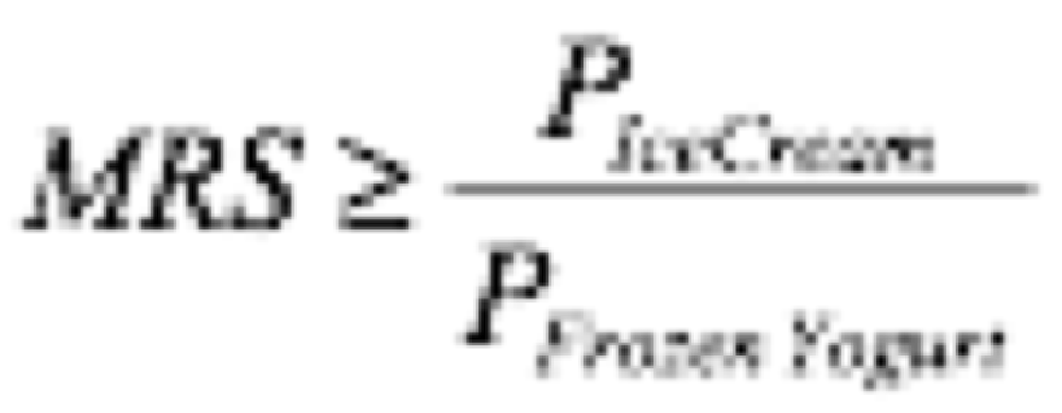
A Corner Solution
Frozen
Yogurt
(cups
monthly)
A corner solution exists if a consumer buys all of one good and none of another.
  MRS is not necessarily equal to P_{X}/P_{Y}
U₁
U₂
U₃
A
A corner solution
exists at point B.
B
Ice Cream (cup/month)

Slide 34
Corner Solutions
Y
Y
IC₁
IC₂
IC₃
IC₁
IC₂
IC₃
A
A
(A)
E
X
(B)
E
X
Y
IC₁
IC₂
IC₃
Y
IC₂
A
A
IC₁
X
(D)
E
X
(C)
E

Slide 35
Effects of Income Changes
Clothing
(units per
month)
Assume: P_{f} = $1, P_{c} = $2
I = $10, $20, $30
An increase in income,
with the prices fixed,
causes consumers to alter
their choices of
market basket.
Income Consumption Curve (ICC)
7
D
The Income Consumption Curve traces out the utility maximizing market basket for each income level
U₃
5
U₂
B
3
A
U₁
Food (units
per month)
4
10
16

Slide 36
An Inferior Good
Steak
(units per
month)
Both noodle
and steak behave
as a normal good,
between A and B...
Income-Consumption
Curve
C
10
U₃
…but noodle
becomes an inferior
good when the income
consumption curve
bends backward
between B and C.
5
B
U₂
A
U₁
Noodle
(units per month)
5
10
20
30

Slide 37
Engel Curves
Income
($ per
month)
30
Engel curves slope
upward for
normal goods.
20
10
Food (units
per month)
4
8
12
16

Slide 38
Individual Demand
Engel Curves
  Engel curves relate the quantity of good consumed to income.
  If the good is a normal good, the Engel curve is upward sloping.
  If the good is an inferior good, the Engel curve is downward sloping.

Slide 39
Engel Curves
Income
($ per
month)
30
Inferior
Engel curves are
backward bending
for inferior goods.
20
Normal
10
Food (units
per month)
4
8
12
16

Slide 40
Effect of a Price Change
Clothing
Assume:
I = $20
P_{C} = $2
P_{F} = $2, $1, $0.50
Each price leads to different amounts of food purchased
10
6
A
PCC
The Price-Consumption Curve(PCC) traces out the utility maximizing market basket for each price of food
5
U₁
C
B
4
U₃
U₂
Food (units
per month)
4
12
20

Slide 41
Effect of a Price Change
Price
of Food
A
Individual Demand relates
the quantity of a good that
a consumer will buy to the
price of that good.
$2.00
B
$1.00
Demand Curve
$.50
C
Food (units
per month)
4
12
20

Slide 42
Decreasing PCC
Clothing
Assume:
I = $20
P_{C} = $2
P_{F} = $2, $1
As P_{F} decreases, P_{C}C decreases which means P_{F}F increases. Hence %ΔF > %ΔP_{F} or F is price elastic.
As P_{F} decreases, C decreases while F increases. That means they are substitutes.
10
6
A
U₁
B
4
PCC
U₂
4
12
20
Food (units
per month)

Slide 43
Effect of a Price Change
Assume:
I = $20
P_{C} = $2
P_{F} = $1, $0.50
As P_{F} decreases, P_{C}C increases which means P_{F}F decreases. Hence %ΔF < %ΔP_{F} or F is price inelastic.
As P_{F} decreases, C increases while F increases. That means they are complements.
Clothing
Price Consumption Curve (PCC)
5
C
B
4
U₃
U₂
Food (units
per month)
12
20

