Slide 1
USA’s Public Debt
ลางวันกินอะไรคะ
จ้อยกินมาม่าเกาหลีซุปกิมจิหมูที่ food court emquartier
เค็มไปหน่อยค่ะ
เลยกินไม่หมดจ้ะ
มาซื้อสับปะรดกับชาดำใส่เฉาก๊วยกินต่อ
Miles Fidino

Slide 2
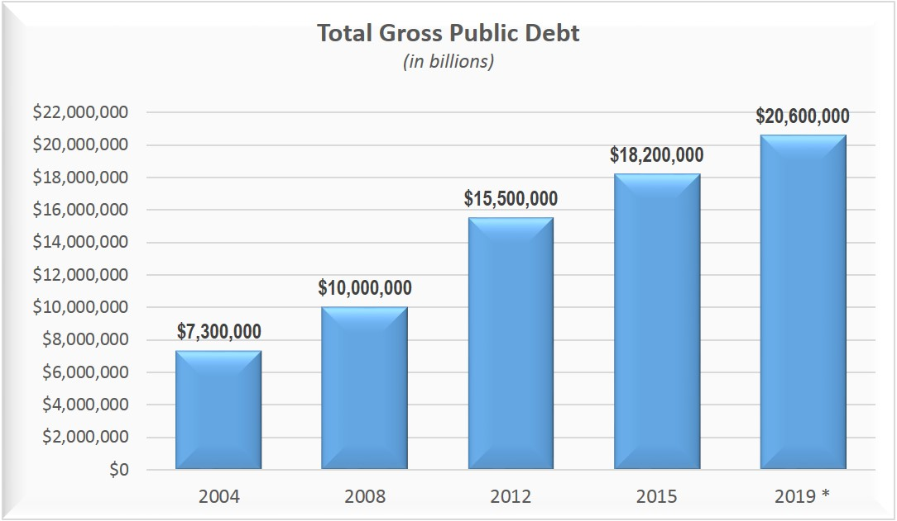
What is it??
A Deficit, Receipts to Expenses of government spending
2015 Topping 18 trillion ($18,000,000,000)

Slide 3
Common Misconceptions
International spending makes up most of the public debt.
  Many US citizens believe this notion (Due to media as well as statements from politicians)
  In actuality most expenditures are domestic

Slide 4
Major contributing factors:
Medicare/ Medicaid
SSA
Defense Spending
Income Security
National Interest on Debt
Federal Pensions

Slide 5
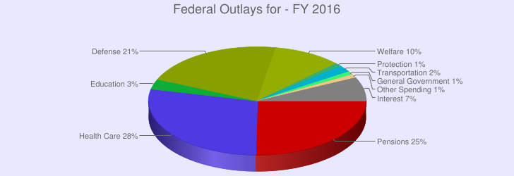
Domestic Expenditures

Slide 6
Reasons For Public Debt
Overburdened Social Security system
Tax Cuts
Healthcare Entitlements
Wars

Slide 7
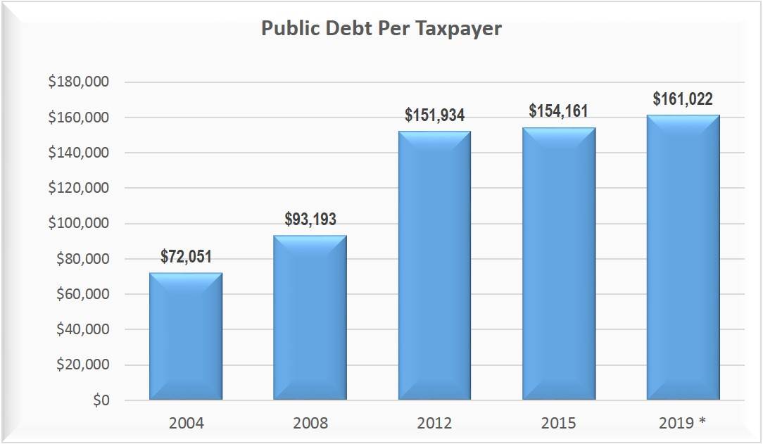
Public Debt Per Citizen

Slide 8
Fun Internet Site
http://www.usdebtclock.org/

Slide 9
Sources
http://www.usgovernmentdebt.us/federal_budget
http://www.forbes.com/sites/mikepatton/2015/04/24/national-debt-tops-18-trillion-guess-how-much-you-owe/
http://www.investopedia.com/articles/investing/102914/top-reasons-behind-us-national-debt.asp
http://www.cnbc.com/id/43840296

