Slide 1
Foreign aid
EE361 economies of CLMV
Faculty of economics
Thammasat university

Slide 2
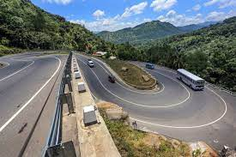
What is foreign aid?
Foreign aid: financial flows, technical assistance and commodities given by residents of one country to another country for development purposes
Foreign aid is also known as official development assistance (ODA)
Aid comprises loans, grants and technical assistance; these are called modalities

Slide 3
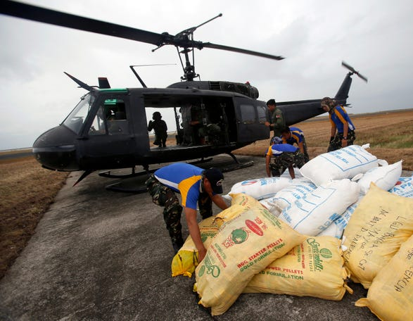
What is foreign aid?
Not all transfers from developed to less-developed countries can be considered as foreign aid; it depends on who gives it, for what purpose, and the terms and conditions
Commercial foreign lending, technical assistance for military purposes, and grants from religious groups are not foreign aid

Slide 4

Objectives of foreign aid
Stimulate economic growth through building infrastructure, supporting productive sectors or bringing in new ideas or technologies
Promote other development objectives, such as strengthening education, health, environment, or political systems
Support subsistence food consumption and other commodities, especially in emergencies after natural disasters or humanitarian crisis
Help stabilize an economy after economic shocks

Slide 5
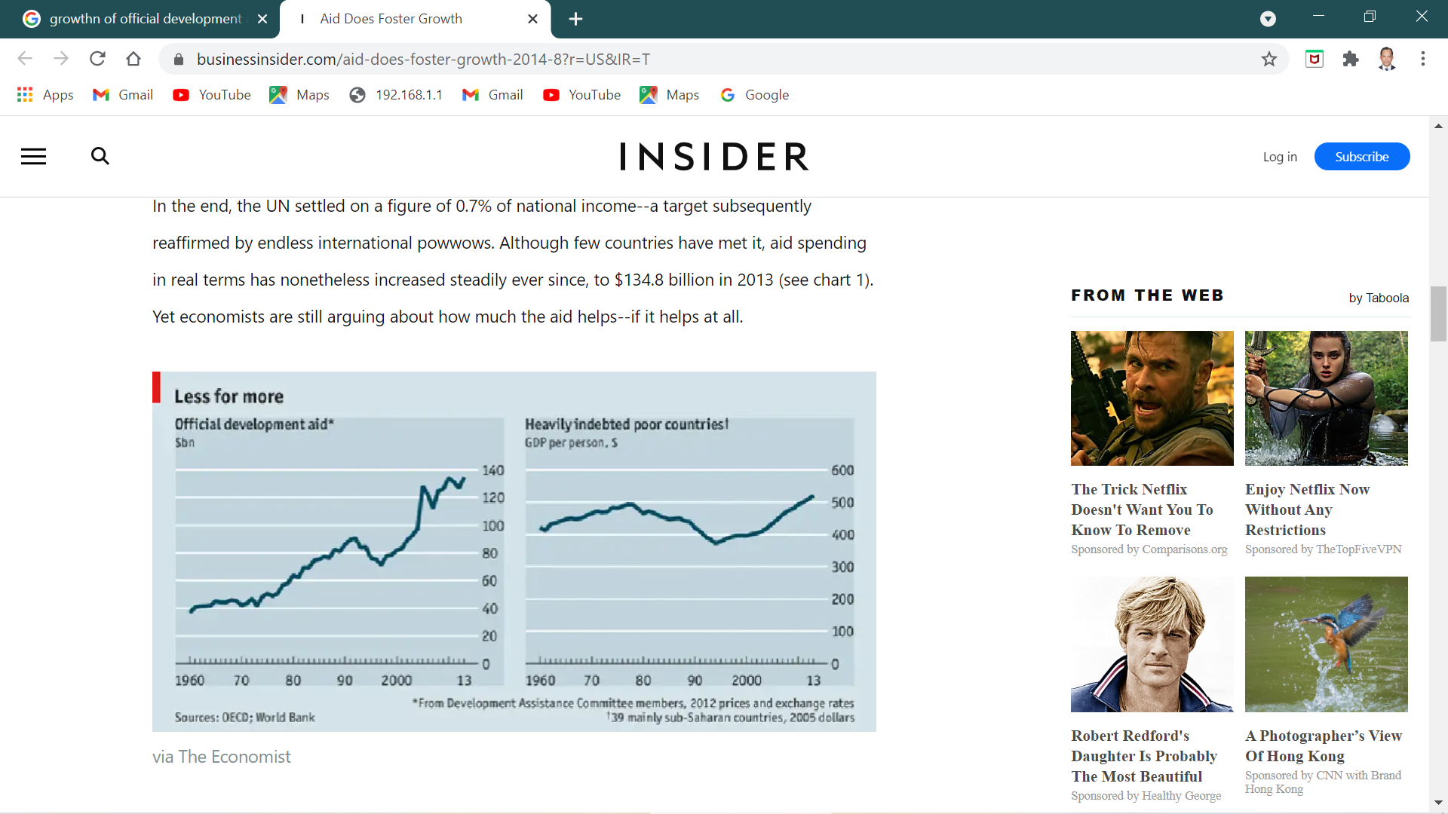
Trends in foreign aid, 1960 – 2013
In nominal terms, global aid rose steadily from the 1960s until it reached a peak of $90 billion in 1991, just after the end of the Cold War
Global aid declined in the 1990s and started to rebound in the early 2000s
The global financial crisis in 2008 caused a decline in global aid but rebounded the following year

Slide 6
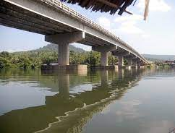
Bilateral aid
Bilateral aid is assistance directly from one country to another; examples are USAID (US), JICA (Japan), DFID (UK), CIDA (Canada), SIDA (Sweden), AFD (France)
Bilateral aid is usually provided to support recipient country governments (government-to-government)
However in some cases aid is disbursed through research organizations, universities, and not-for-profit organizations

Slide 7

Multilateral aid
Multilateral aid is assistance from international institutions which have pooled financial sources provided by their member countries; examples are World Bank, Asian Development Bank, United Nations, European Commission
Multilateral aid provides larger amounts of aid compared to bilateral aid; provides lower bureaucratic costs; and requires fewer political ties

Slide 8
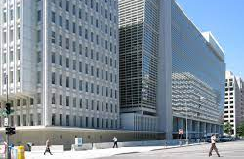

The world bank
Largest multilateral aid donor: World Bank, located in Washington, DC, USA. Established in Bretton Woods in 1946 together with IMF and began as a reconstruction bank to aid Europe after WWII
Because of its favorable credit rating, it is able to borrow from world capital markets and relend to developing countries at slightly higher rates
Aside from sourcing from world capital markets, the World Bank generates funds from paid-in capital from its member countries and relends it to poor countries

Slide 9

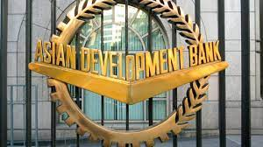
Asian development bank
Asian Development Bank, located in Manila and established in 1966 equipped with 23 field offices, or resident missions: operates similar to World Bank, but focuses on the Asia-Pacific region
Aside from sourcing from world capital markets, ADB generates funds from paid-in capital from its member countries and relends it to poor countries
Terms of loan repayment: 32 years with a grace period of 8 years and interest of 1% per year during the grace period and 1.5% per year thereafter

Slide 10
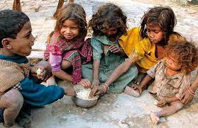

Debate on foreign aid
Foreign aid enriches elites in recipient countries and therefore does more harm than good; it reinforces corrupt practices and distorts incentives; example: widespread poverty in Africa and South Asia despite 4 decades of foreign aid
Foreign aid accelerates growth, reduces poverty helps achieve development objectives in countries unable to generate resources needed to finance investment; example: Marshall Plan

Slide 11

Perspectives on Aid and economic growth
View 1: Although not always successful, on average aid has a positive impact on economic growth and development
Aid promotes growth by financing new investments, especially investments in public goods such as roads, ports, electricity generation and distribution. Schools and health facilities
Aid promotes capital accumulation/ formation as driver for economic growth, and transfer of knowledge/innovation

Slide 12
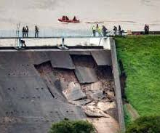
Perspectives on Aid and economic growth
View 2: Aid has little or no effect on growth, and could actually undermine growth
This happens when most of the aid is spent on large bureaucracies, expensive consultants who writes reports no one reads and bank accounts of officials of recipient countries
Aid is not effective if the absorptive capacity of recipient governments is low; in short implementers with lacking skills in managing aid
Aid may crowd out the domestic private sector

Slide 13
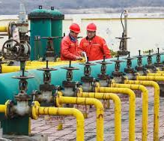
Perspectives on Aid and economic growth
View 3: Aid has a conditional relationship with growth, stimulating growth only under certain circumstances
Depends on the characteristics of the recipient country (quality of institutions and policies)
Depends on the type of aid: short term (humanitarian assistance); medium term (infrastructure) or long term (education, health)
Depends on donor practices; multilateral aid is deemed more effective than bilateral aid because of less influence of political factors

Slide 14

Foreign aid in clmv
CLMV countries have received approximately $68.6 billion in foreign aid during the period from 1997 to 2014, with Vietnam as the largest recipient followed by Cambodia, Myanmar, and Lao PDR
Based on foreign aid share of GDP, Lao PDR has been the most aid-dependent among the four, followed by Cambodia, Vietnam, and Myanmar

Slide 15

Foreign aid in clmv
Overall dependency of CLMV on foreign aid has been declining. All of the four countries demonstrated spectacular economic performance during the study period, and have achieved impressive annual GDP growth.
Cambodia achieved annual average growth rate of 7.84%, Lao PDR at 6.92%, Myanmar at 10.61%, and Vietnam at 6.38% during the period from 1997 to 2014

Slide 16
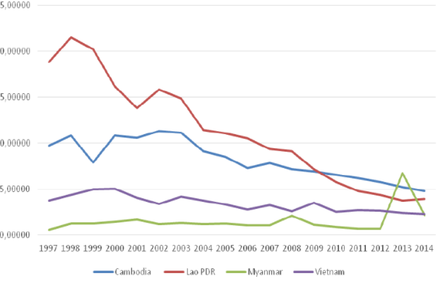
Foreign aid in clmv
Foreign aid as percentage of GDP
20
15
10
5
5
0

Slide 17
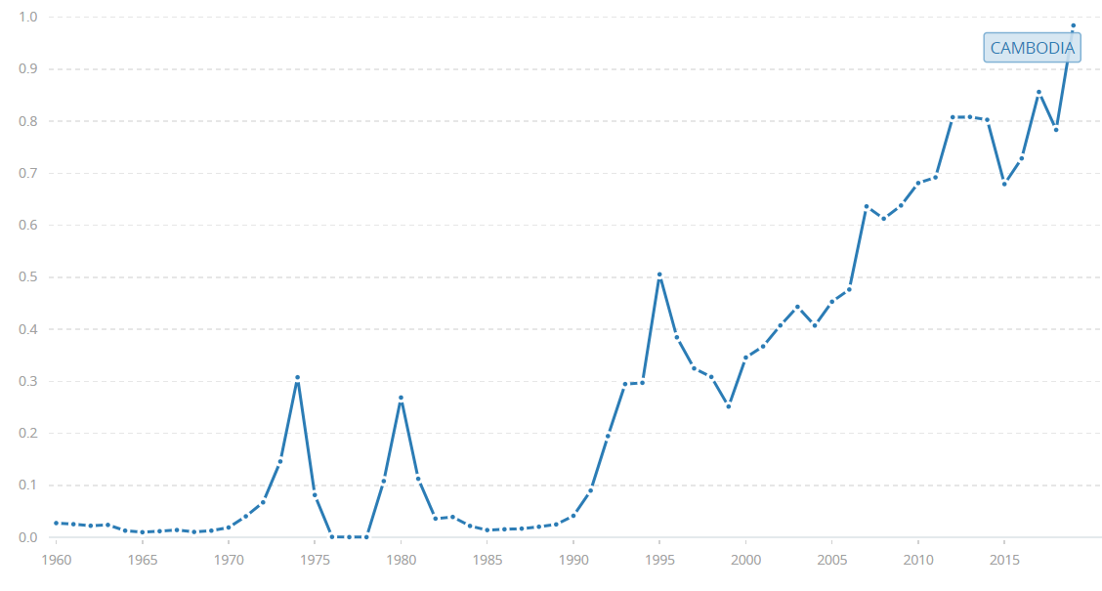
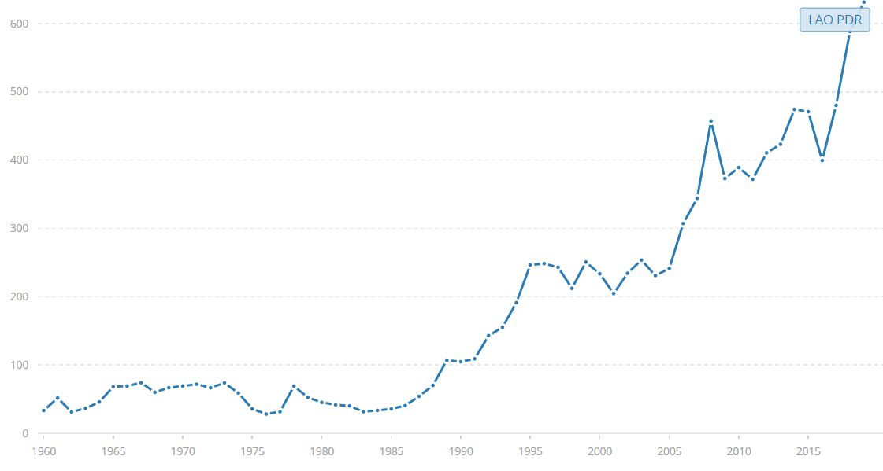
Foreign aid for CAMbodia and Lao PDR
Foreign aid receipts for Cambodia, 1960-2018
Foreign aid receipts for Lao PDR, 1960-2018

Slide 18
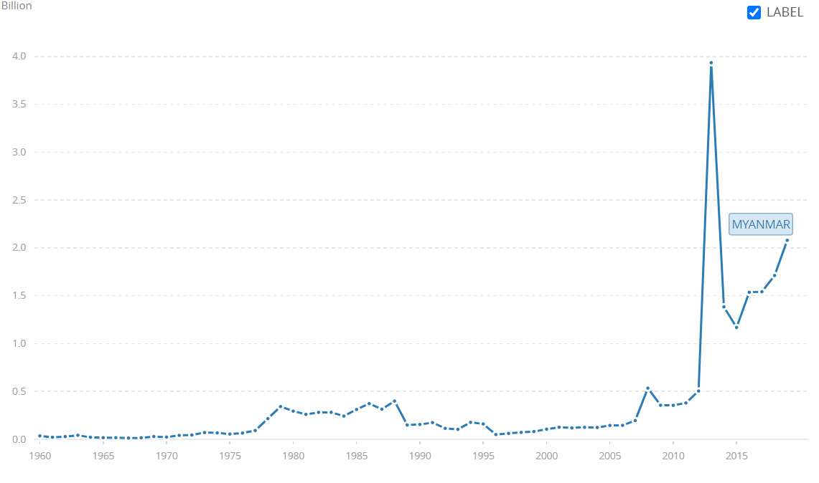
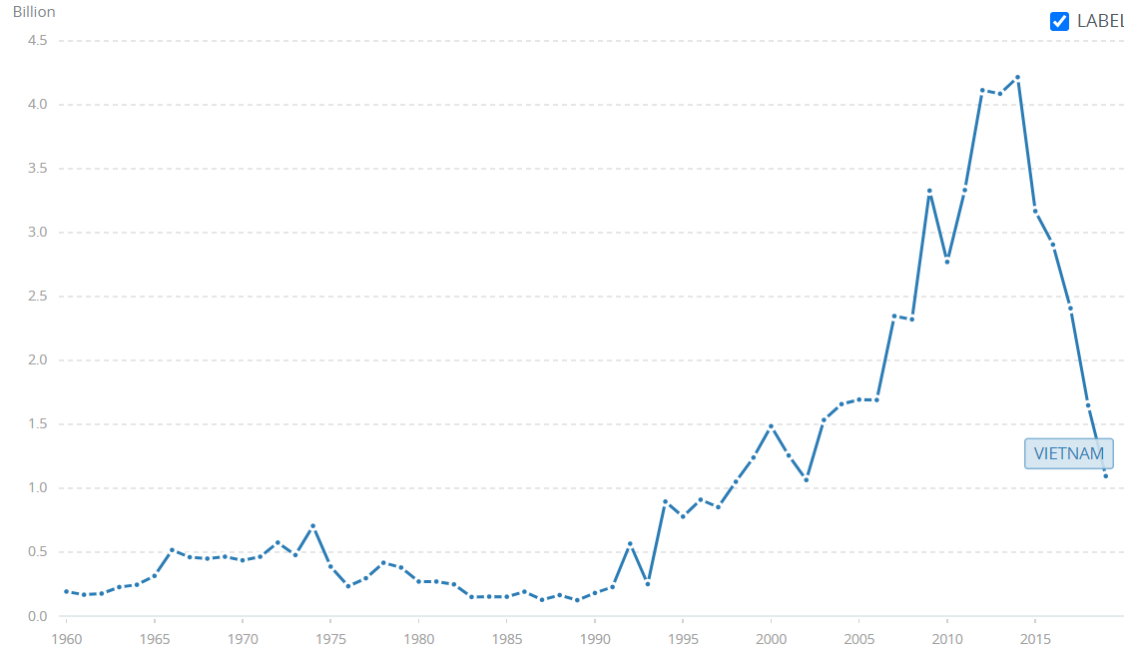
Foreign aid for myanmar and vietnam
Foreign aid receipts for Myanmar, 1960-2018
Foreign aid receipts for Vietnam, 1960-2018

Slide 19

summary
Aid is provided by bilateral and multilateral donors; global aid peaked in 1991 then declined in real and nominal terms until 1997, and rebounded thereafter. In 2015, global aid reached about $150 billion
There are three broad views on aid and economic growth:
First is that aid supports growth and development by adding to investments and capital stock and in transferring technology from high income to lower income countries

Slide 20
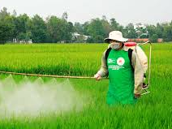
summary
Second is that aid has no impact on economic growth and stifles private sector participation, induces inflation and creating aid dependency
Third is that aid works under some conditions and not under others, depending on institutional and policy environment of the recipient country

