Slide 1
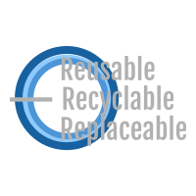

3Rs
Reusable Recyclable
Replaceable

Slide 2
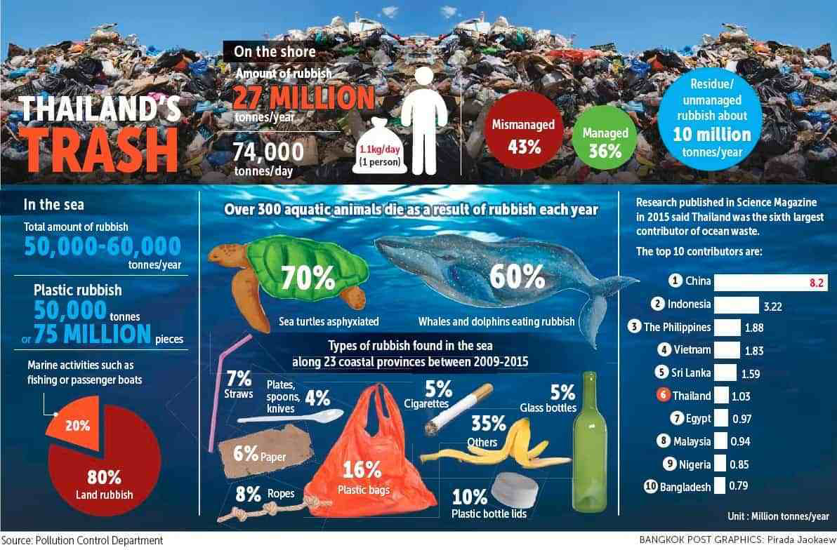
Emphatise
Consumers wishes to be eco-friendly by using recyclable bottles.
Plastic bottles are by far the most polluting waste
HOWEVER, it is very inconvenient/impractical to be eco-friendly

Slide 3
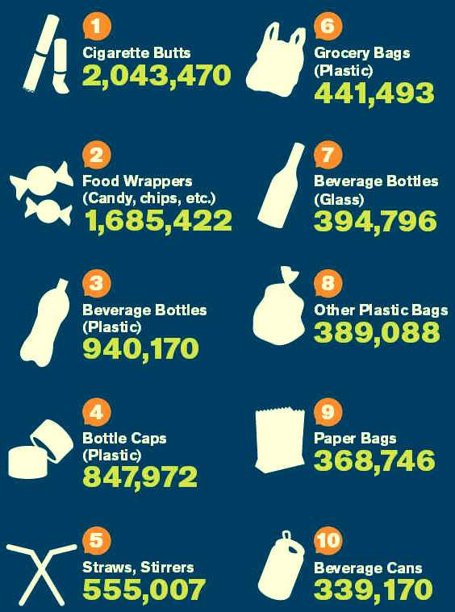
Define
Reducing pollutions requires a multi-faceted approach, we have to break it down into its various aspects
In Thailand, there are very little water dispensers around and the tap water is not drinkable (Specific Problems)
This results in a huge increase of the usage of disposable plastic bottles
Therefore, we wish to reduce plastic bottles
Notes:
-According to the Department of Pollution Control, Thailand produces 4.4 billion plastic drinking water bottles per year ( of which 60% were sealed with a plastic cap. )
-The quality of recycled plastics in Thailand is relatively low, mainly because most people fail to separate their trash and recycled plastics become tainted by surrounding trash. Most of the waste separation and plastic collection is done by an informal network, lacking strong central planning.
- Ever since population has increased, the water quality in Thailand has declined. As a result, almost 67% of the people are drinking contaminated water, causing diseases like diarrhea and typhoid into their system. Where เdoes this come from ? The pollutants that flow into thel rivers and canals.
- Currently, about 2 million tonnes of plastic waste are produced in Thailand each year but only 500,000 tonnes are recycled.
In 2017, 185 000 tons of plastic bottles have been sold in Thailand.

Slide 4
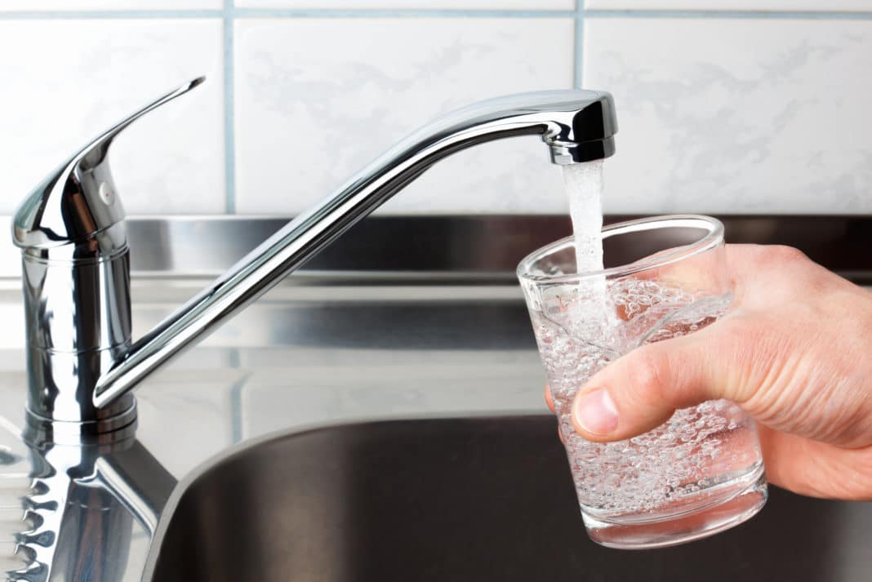
Ideate
Problems :
Not enough water dispensers
Tap water in Thailand is not drinkable
Plastic waste problem

Slide 5
Ideate
Ideas :
Getting the Government to make tap water drinkable or increase the amount of water dispensers seems impractical
Create a biodegradable bottle - Not ideal as companies (Singha etc) producing disposal drinking bottled waters are unlikely to adopt it
Therefore we shall target the CONSUMERS
  We will create a 3Rs Bottle
  Recyclable and Replaceable water filter to be used in a Reusable bottle (3Rs)

Slide 6
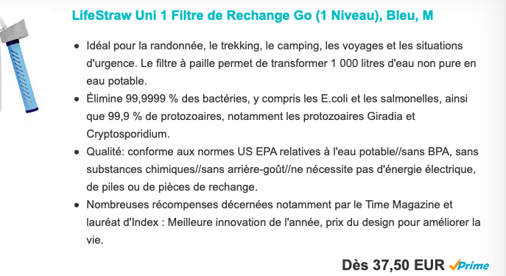
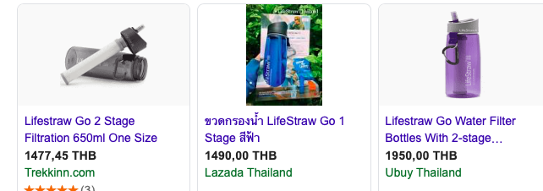
Ideate
Biggest problem with current water filter bottles → both water bottle and filter are too expensive
Import taxes makes the product even more expensive for thais

Slide 7
Ideate
Filters
The reason why the filters are so expensive is because it is heavy duty
  Filters 1000 litres of water
  Consumers are usually not willing to part with such a huge sum of money
  Consumers cant keep track of how much water they drink

Slide 8
Ideate
Therefore, we create a biodegradable filter that is less heavy duty
  To be replaced in 1 month
  A colour indicator
    Blue → Still new
    White → Time to replace
The bottle have to be durable → Made of steel
Priced at 500 - 1000 Baht range
Use 750ml volume
  Not too big and not too small
  Research done by Singha Drinking Water

Slide 9
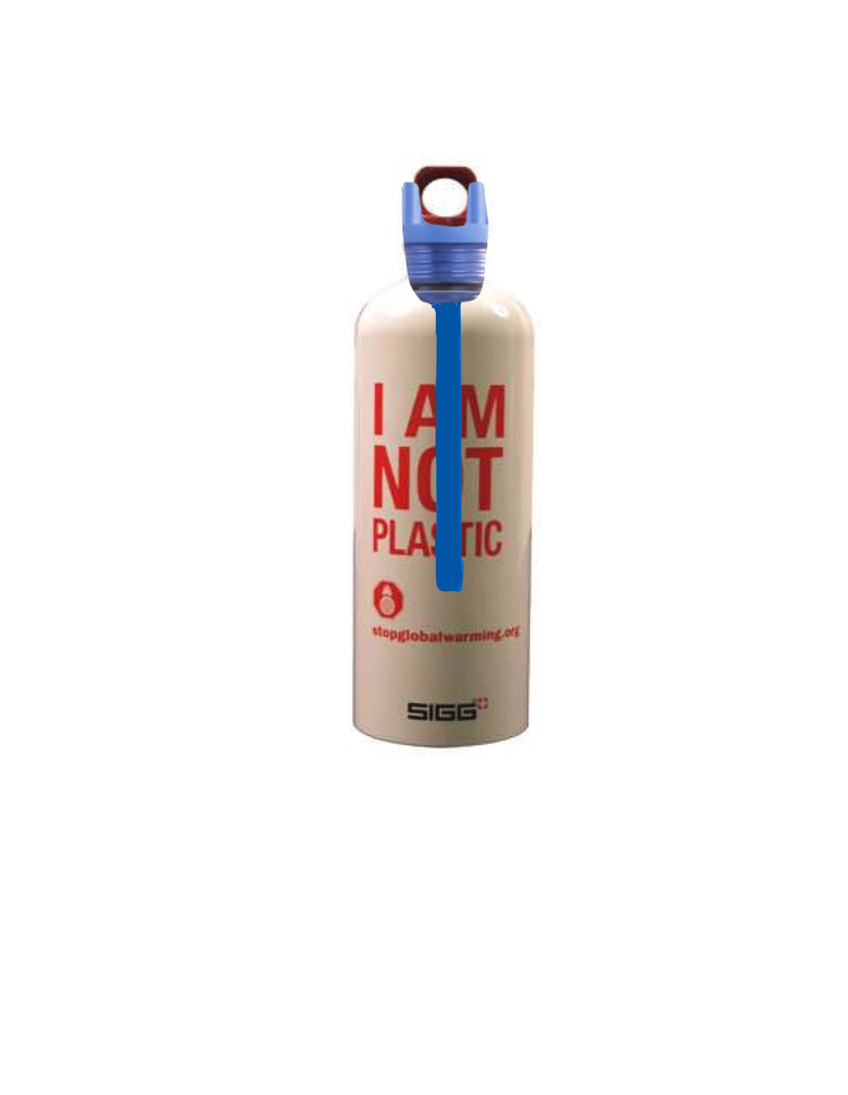
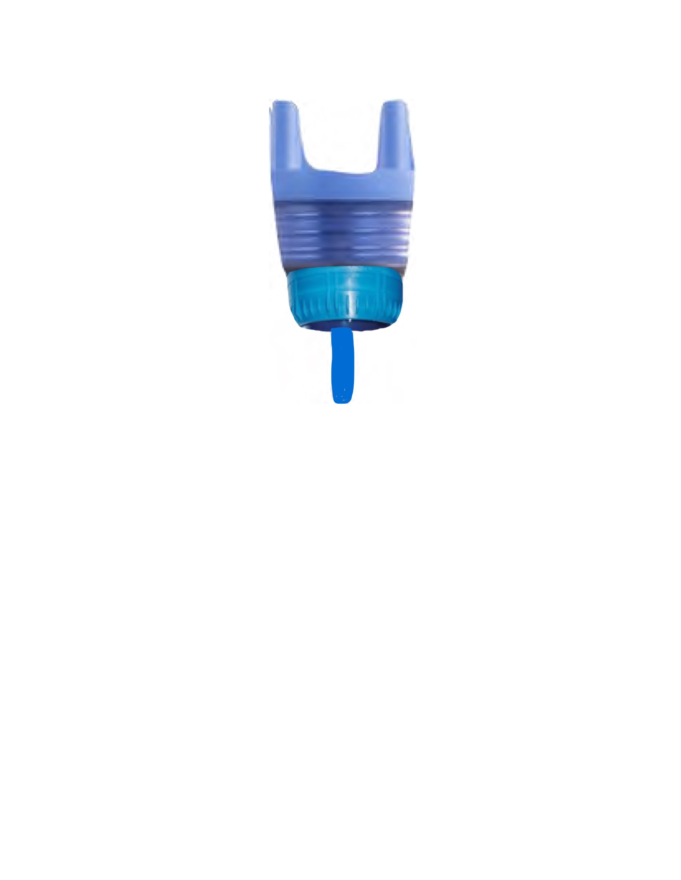
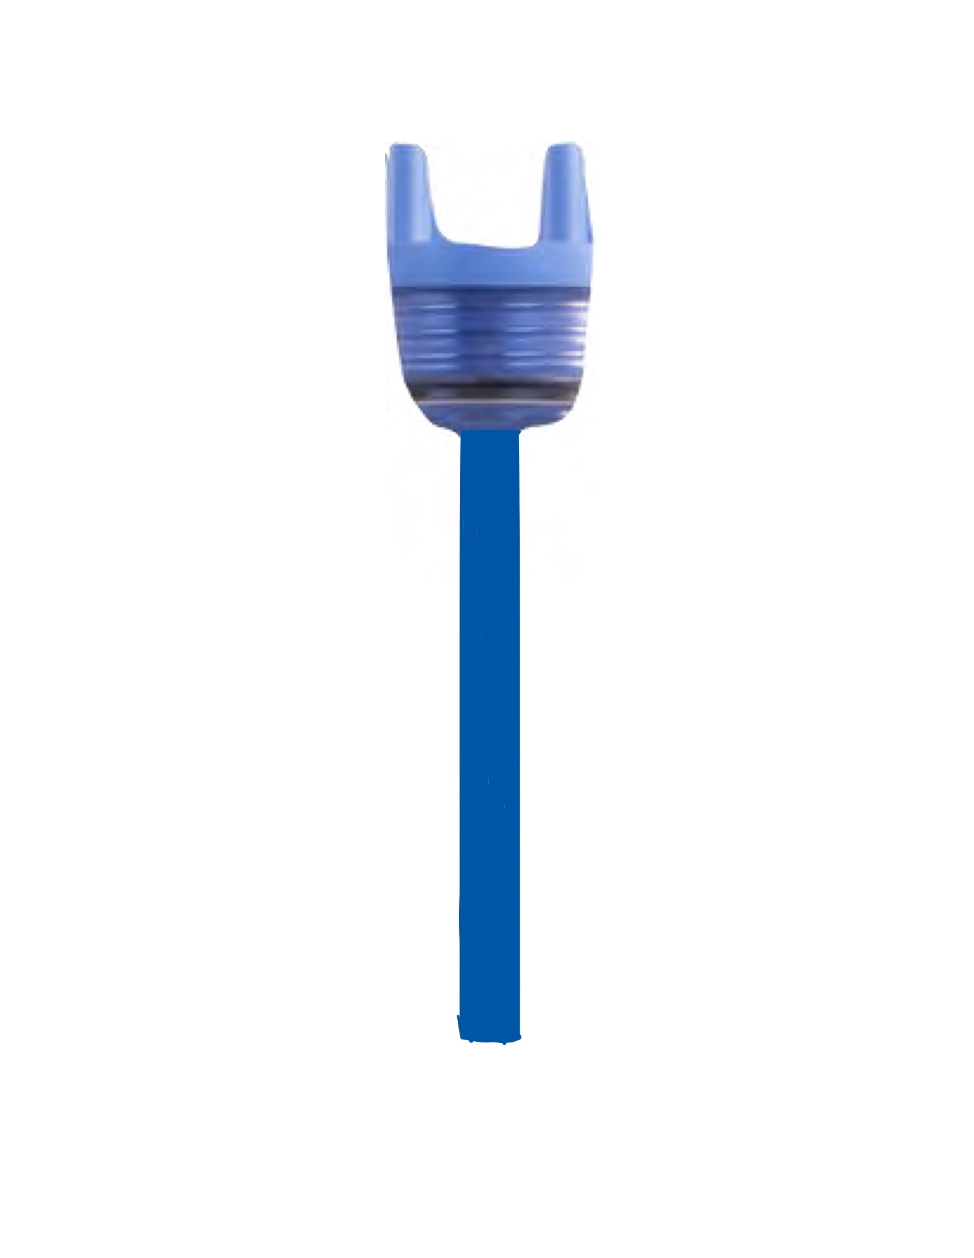
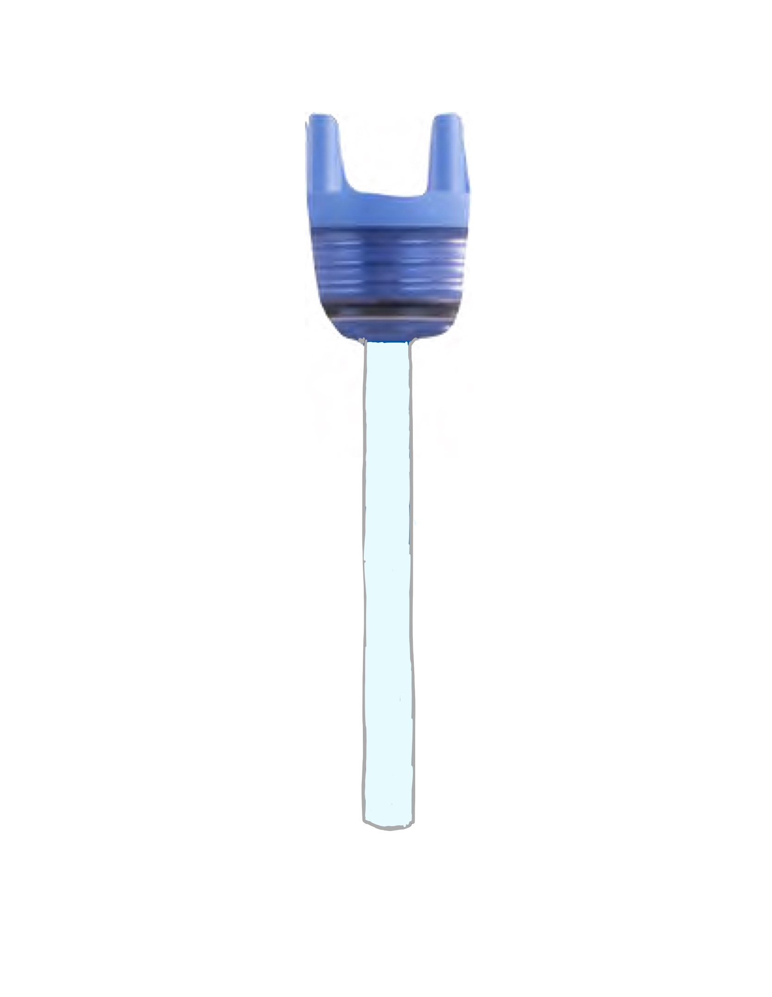
Prototype
Color indicator
Not be easy convenient to take out the filter and refill the bottle

Slide 10
Test
Do ethnographic research and usability/ergonomics test among various demographics
  Childrens
  Adults
  Elderly
Water test by SGS Thailand
  Determine if the filtered water is safe to drink

Slide 11
Implementation
Marketing Campaign → To show efficacy of the product
  Run test and show test results to public
  Get influencers to demonstrate how to use and drink the water that has been filtered
  Promote it on social media
Create various limited edition versions of the 3Rs bottle with a nice design

Slide 12
References
https://borgenproject.org/water-quality-in-thailand/
https://thethaiger.com/hot-news/plastics/thailand-to-ban-import-of-plastic-waste
https://www.bangkokpost.com/thailand/special-reports/1482237/plastic-waste-fight-steps-up

Slide 13
Members :
Inthad Thassaneephab 6104641292
Jeerawat Janhom 6104640815
Beeyaporn Teepanart 6104640989
Isarinya Yongpiyakul 6104640179
Lea Sunisa Remond 6204930215
Eugene Tan YuanHao 6202930126

