Slide 1
Sustainable Development

Slide 2
Brief History
1962 “Silent Spring” by Rachel Carson
1972 “Limits to Growth” by Club of Rome
1972 UN Conference on the Human
Environment in Stockholm
1973 First Oil Shock
1987 Brundtland Commission Report : “Our Common Future”
1989 Montreal Agreement in reducing CFC

Slide 3
Brief History
1991 World Business Council on Sustainable Development
1992 Earth Summit in Rio
1997 Kyoto Protocol
2005 Katrina / GE launch “Ecomagination”
2010 Organisation for Economic Co-operation and Development (OECD): Interim Green Growth Report
2011 United Nations Environment Programme (UNEP) Green Economy Report
2011 European Commission’s EU Low Carbon Roadmap
3
Notes:
3

Slide 4
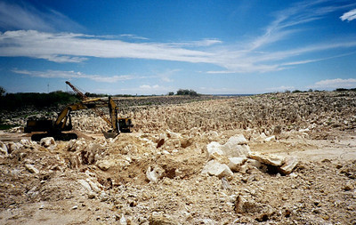
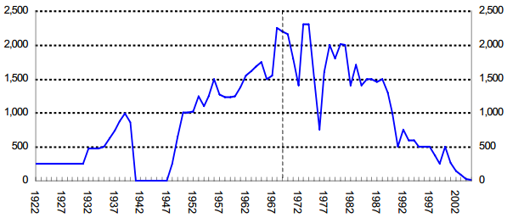
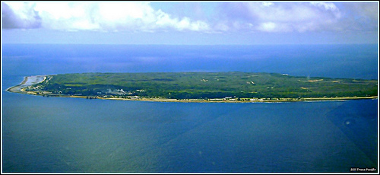
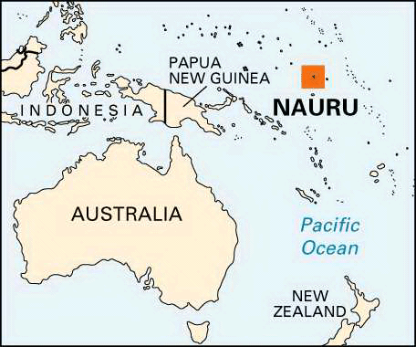
The Nauru Islands - 8.5 sqMile 1970s
The second highest GNP per Capita
“Phosphate”
The 1990s → Financial crisis
In 2009, GNP per capita was $5300, The UAE’s was $54,000

Slide 5
Sustainable Development
"Sustainable development is development that meets the needs of the present without compromising the ability of future generations to meet their own needs”
Ref. :Our Common Future. World Commission on Environment and Development (WCED), 1987. p.43.
5
Notes:
5

Slide 6
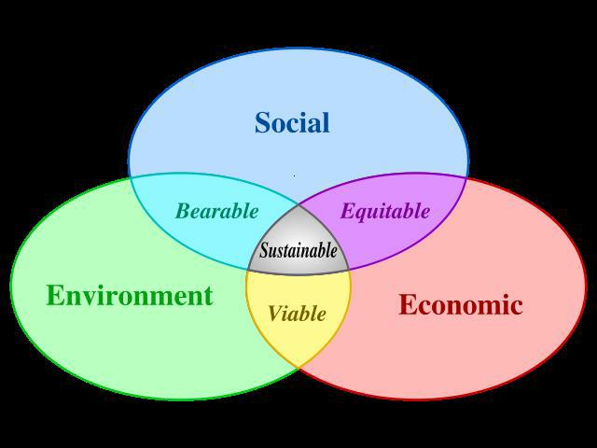
Sustainable Development

Slide 7
Two regimes of Globalization
Environmental Globalization
1970s
1980s
1990s
2000s
Environmental Globalization
Stockholm Conference (1972)
Sustainable Development (1987)
Earth Summit (1992)
Rio+ 10 (2002)
Rio+ 20 (2012)
Economic Globalization
Economic Globalization (Neo-Liberalism)
GATT(1947)
Washington Consensus (1989)
WTO (1995)
FTA (2004)

