Slide 1
Economic growth: conceptS and patterns
EE361-Globalization and international development
Faculty of economics
Thammasat university

Slide 2
Economic growth
Economic growth across countries are different:
Rapid growth of East Asian countries within the last 40 years
Economic stagnation in African countries; few signs of growth
Economic revival of Eastern European countries
Economic decline of former Soviet Russian states
Rapid economic growth is a relatively recent phenomenon. Until 500 years ago, most people in the world were poor – food, clothing, shelter, nutrition and health care were rudimentary.
Despite gains from economic growth worldwide, a majority of the world’s population, however, still remain poor.

Slide 3
Differences in Economic growth
Negative growth
<0%
Madagascar
Zambia
Slow growth
1%-3%
Peru
Philippines
Nigeria
Moderate growth
3%-4.5%
Turkey
Chile
Brazil
Rapid growth
>4.5%
Thailand
Malaysia
Sri Lanka
Exceptional growth
>10%
South Korea
Singapore
Botswana
China
Industrialized
Countries
<5%
United States
France
Japan
Evident in long term average annual growth (30 years). An average growth rate of 1%, will increase income by 65% in 50 years, and income doubles in 70 years. If growth rate is 2%, income will increase by 270% during the same time and income will take 35 years to double).

Slide 4


A perplexing question
What factors make some countries develop rapidly while other countries stagnate or decline?

Slide 5
TWO COUNTRIES, TWO TRAJECTORIES

Slide 6


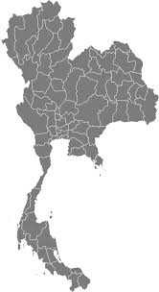
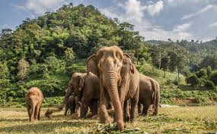
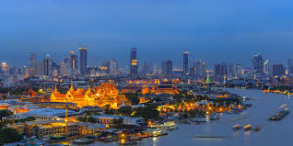
THAILAND
 | Thailand
 | 1960 | 2009
GDP per capita ($) | 961 | 7,794
Life expectancy (years) | 54 | 69
Infant mortality (per 1000 births) | 103 | 12
Literacy rate | 80 | 94

Slide 7
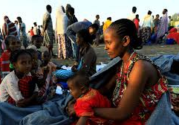
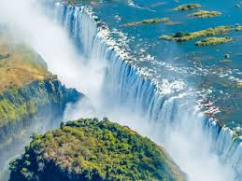
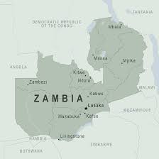
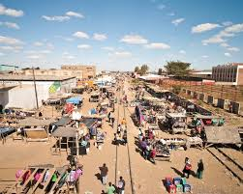
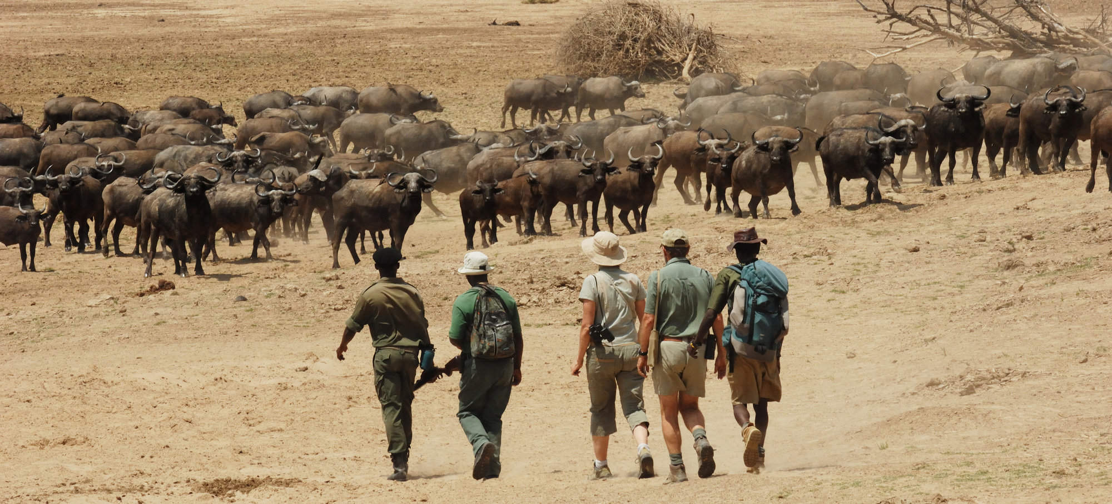
ZAMBIA
 | Zambia
 | 1960 | 2009
GDP per capita ($) | 1,803 | 1,765
Life expectancy (years) | 45 | 45
Infant mortality (per 1000 births) | 126 | 86
Literacy rate | 48 | 71

Slide 8
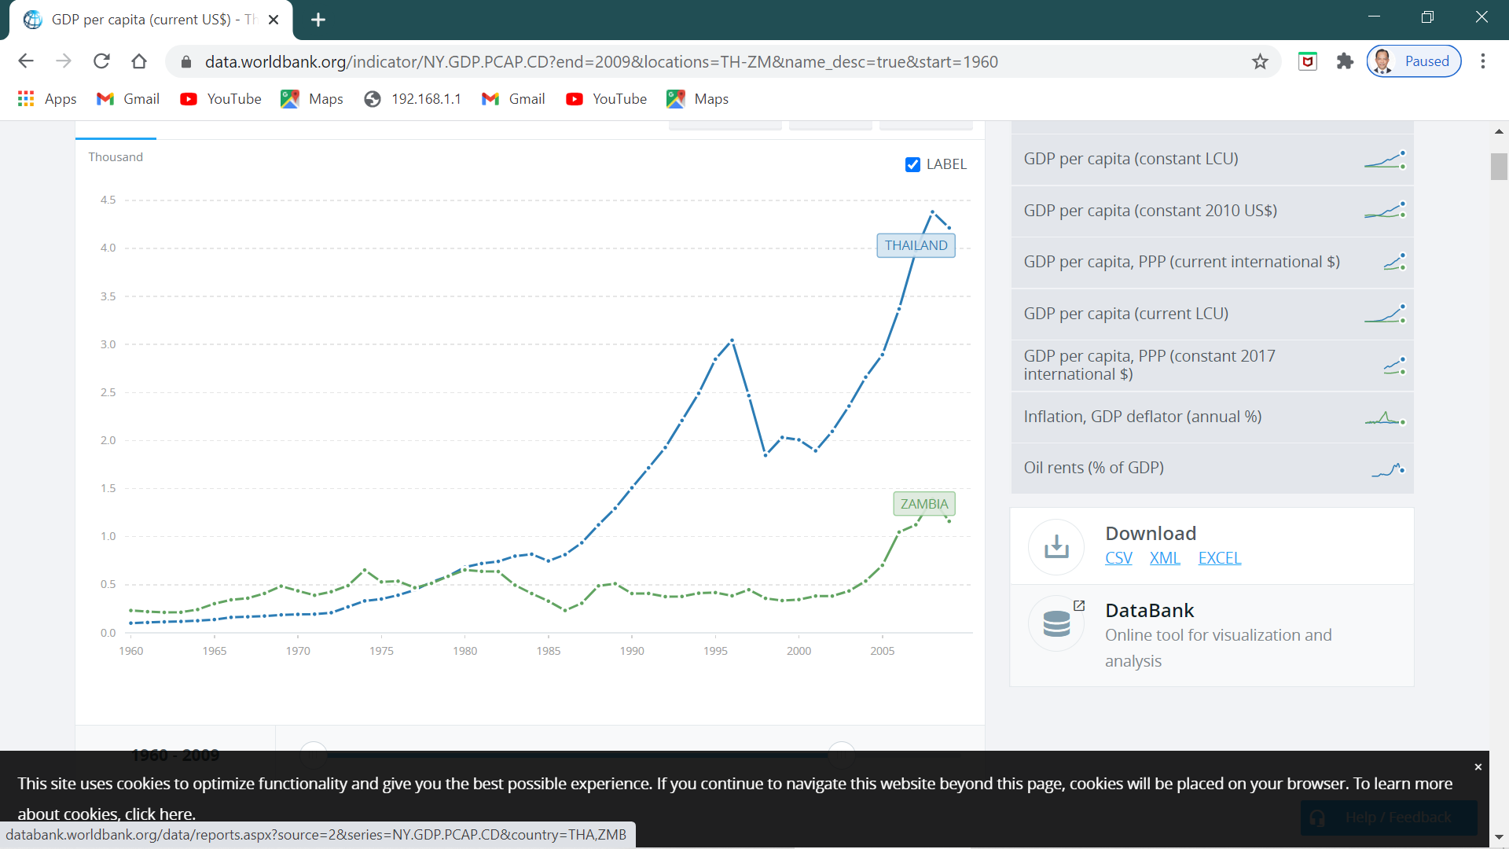
GDP per Capita Comparisons,
1960-2009
Thailand and Zambia

Slide 9
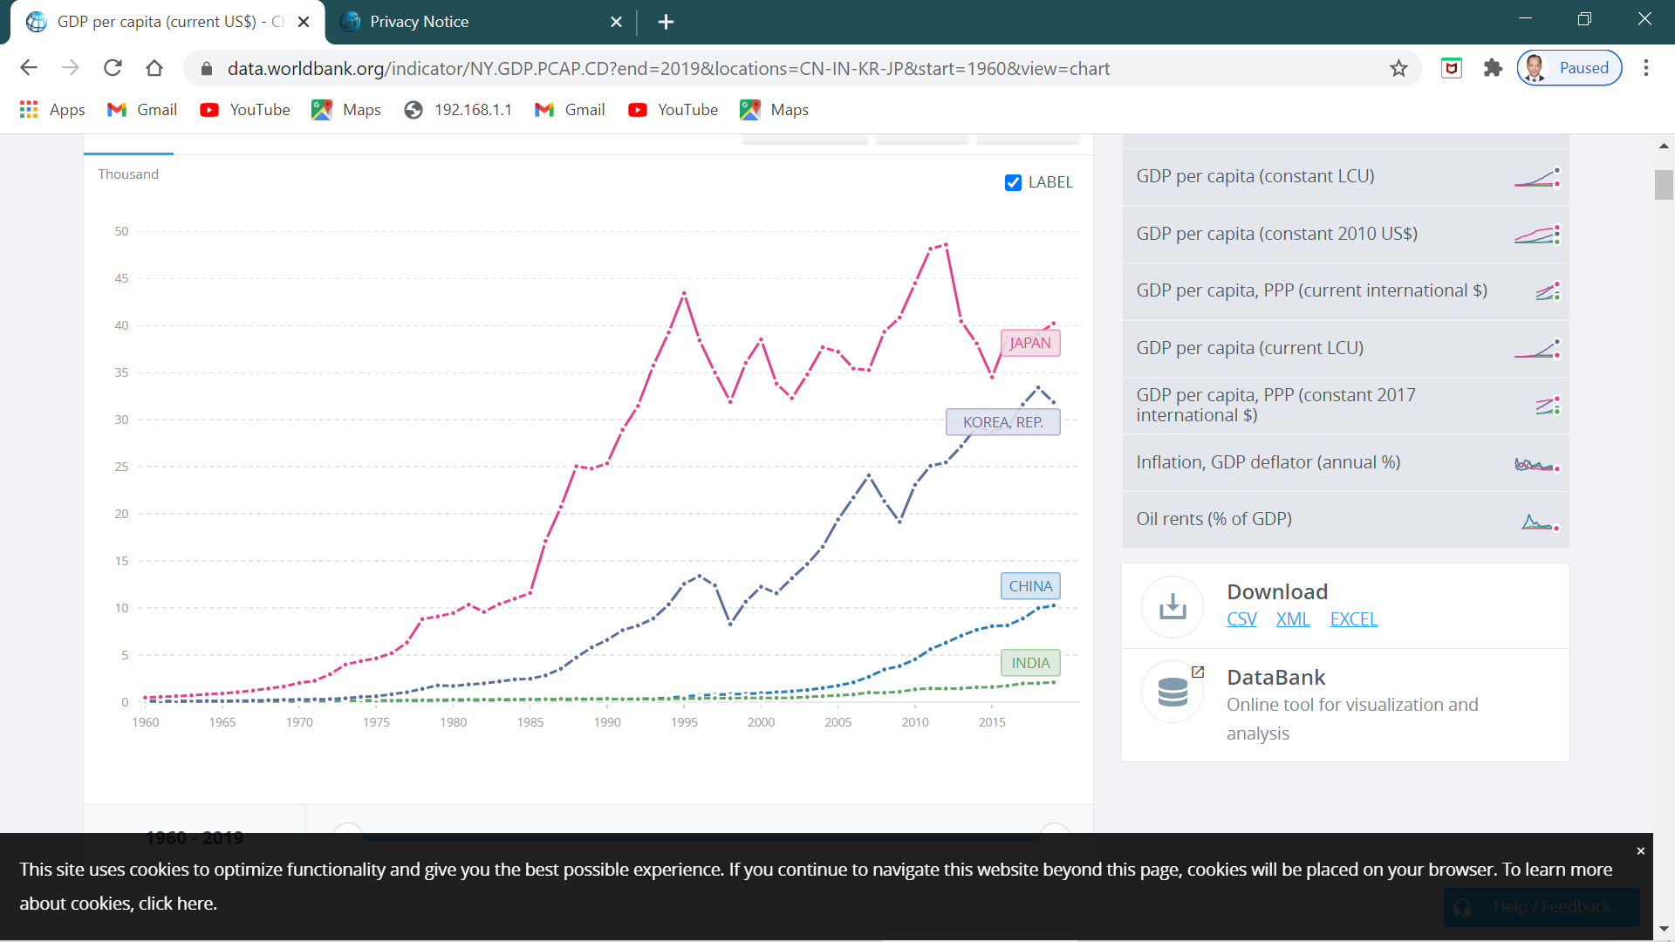
GDP per Capita Comparisons,
1960-2019
India, PR China,
South Korea
and Japan

Slide 10



Economic growth
Economic growth depends on:
Factor accumulation: increasing the size of the capital stock and/or increasing the labor force
Productivity growth: improving efficiency and introducing technological change

Slide 11
Solow growth model
Personal Income
Generating saving and investment is a necessary but not sufficient condition for growth
Sustaining growth requires both generating new investment and ensuring that the investment is productive
Personal saving
?
Investment
Capital stock

Slide 12
Characteristics of rapidly growing countries

Slide 13
Macroeconomic and political stability
Economic growth requires macroeconomic and political stability. Some examples of instability:
Democratic Republic of Congo (1990-1992): suffered inflation (2,800%) due to civil war and social conflict
Cambodia, Lao PDR and Viet Nam (1960s-1980s): post war social conflicts; isolated from the outside world
Sub-Saharan Africa (late 1990s): cross-border and civil war
The Balkans (late 1980s): conflict led to genocide and ethnic cleansing in Bosnia
The Asian financial crisis of 1998: Negative growth for South Korea, Malaysia, Thailand and Indonesia

Slide 14
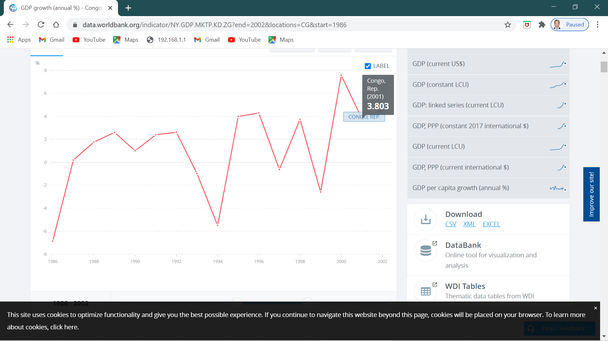
Decline in economic growth: Democratic Republic of Congo, 1990-1994)
Democratic Republic of Congo (1990-1992): suffered inflation (2,800%) due to civil war and social conflict. Lowest growth rate occurred in 1994 (-4%) before resuming growth the following years.
Period of civil war

Slide 15
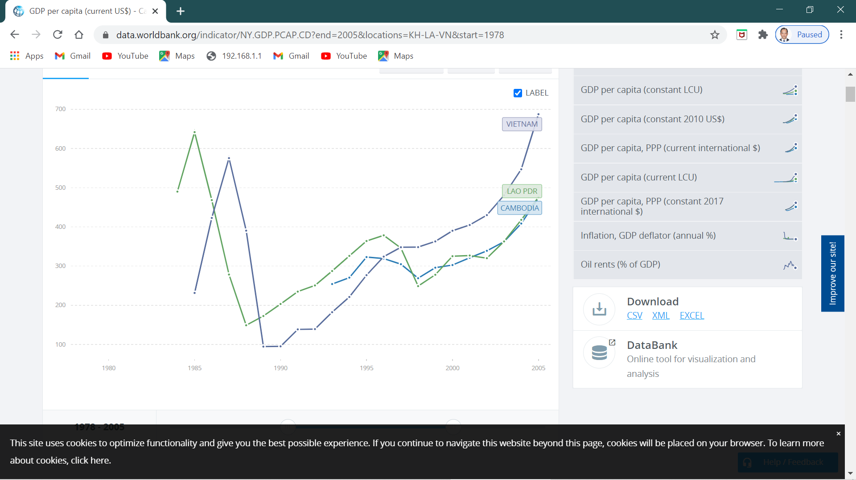
Post war isolation, conflict and reform: Cambodia, Lao PDR and Viet Nam (1970s-1990s)
After suffering from social conflicts (1970s-1980), isolation (1980-1990), the region embarked on economic reforms and resumed economic growth
War and conflict
Period of isolation
Period of economic reform and resumption of economic growth

Slide 16
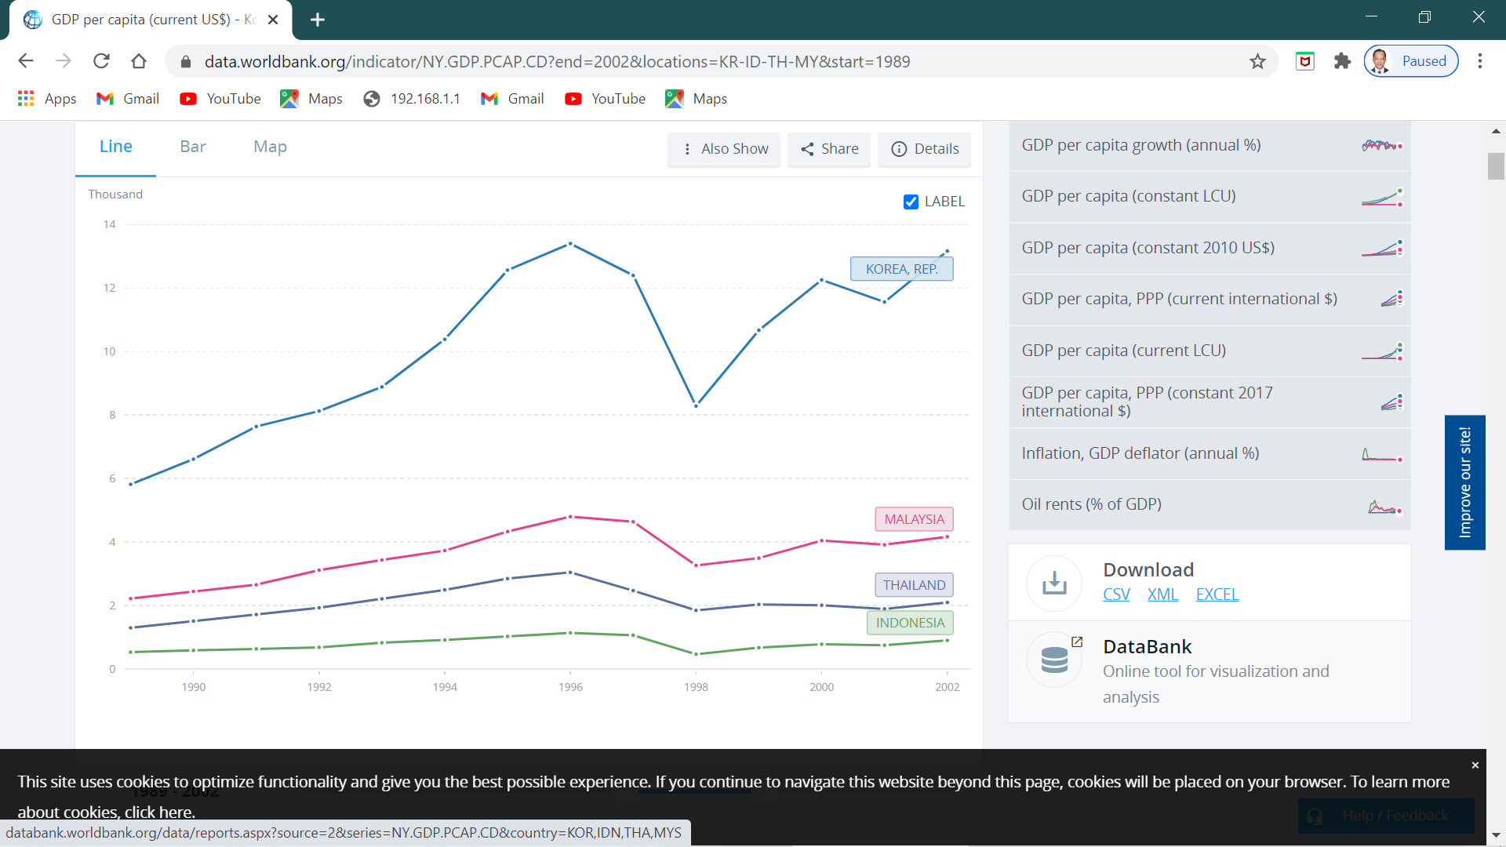
Asian financial crisis 1998
Asian financial crisis, 1998
GDP per Capita Comparisons ($000), for South Korea, Malaysia, Thailand and Indonesia from 1990-2002

Slide 17
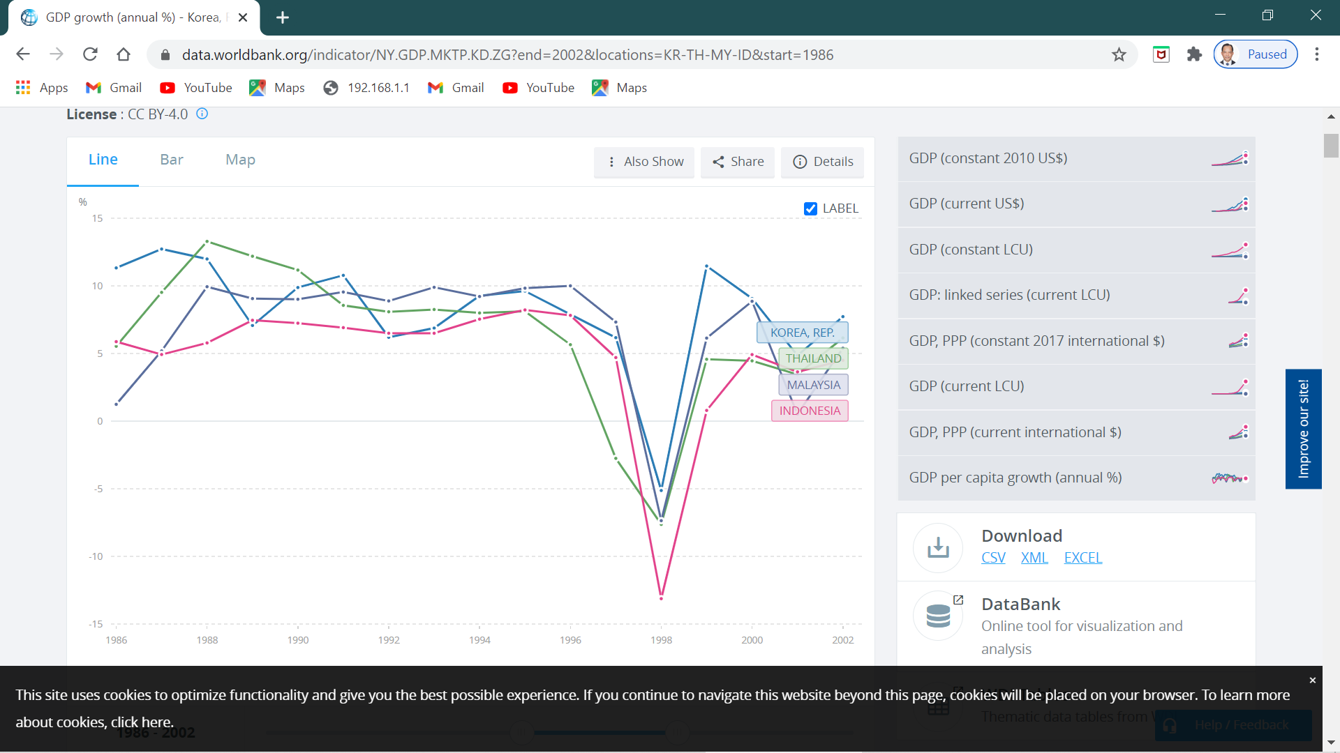
Asian financial crisis 1998
GDP Growth Comparisons (%)
1985-2002
South Korea, Malaysia,
Thailand and Indonesia

Slide 18
Investment in health and education
Health
Healthy workforce = productive workforce (can live longer)
Access to affordable health care facilities, clean water and sanitation
Disease control, reproductive maternal and child health programs
Education
Skilled workforce = productive workforce
Need a good mix of vocational and educational training programs
Supply of needed skills attracts investments
High returns to education (including girls’); however it is a long term investment

Slide 19
Effective governance and institutions
Studies have shown the positive relationship between economic growth and the strength of the rule of law (D. North, D. Kaufmann)
Strong institutions are central to managing financial systems, building health and education systems, ensuring trade and commerce and governing legal systems’
Strong governance and institutions help improve the environment for investment by reducing risks and increasing profitability
Strong legal systems can help settle commercial disputes in predictable, rational manner
Low level of corruption can reduce the costs of investment

Slide 20
Favorable business environment
Private individuals and firms make various decisions regarding saving, investment, education and job opportunities.
Most of these decisions are based on government regulations and policies. Some examples:
Taxes
Subsidies
Penalties/fines
Benefits
Permits
Licenses
Businesses will need a healthy/conducive environment, which includes, among others:
A strong legal system
Access to financial systems/resource

Slide 21
Trade, openness and growth
Trade encourages countries to accumulate physical and human capital and by increasing productivity
Outward oriented policies (which encourages exports) have fared relatively better that inward-oriented policies (import substation)
Countries applying export-oriented policies: South Korea, Taiwan Singapore, Malaysia
Countries applying import-substitution policies: Brazil, Argentina

Slide 22
Favorable geography
Most advanced industrialized countries are located between the Tropic of Cancer and Tropic of Capricorn (temperate and subtropical zones)
Tropical areas are prone to spread of disease and erratic climate
Most of the poorest countries are located in the tropics (mainly Sub-Saharan Africa)
The presence of natural resource endowment alone does not guarantee economic growth

Slide 23
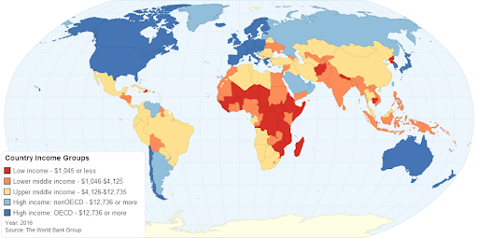

Slide 24


