Slide 1
Macroeconomics:
The very first introduction
Thorn Pitidol
Faculty of Economics, Thammasat University
EE212, Semester 2/2556

Slide 2
Outline
The introduction
  Ten principles of economics
  Thinking like an economist
    An economist as scientist: scientific method and economic models
    Example model: Production Possibility Frontier

Slide 3
What is economics?
Approach to manage the world?
  Economic as the study of actions that people take to achieve economic welfare (Alfred Marshall)
    The study of the way people organise themselves to sustain life and enhance its quality.
Approach to understand the world?
  Understanding social phenomena through the use of scientific method and mathematical models

Slide 4
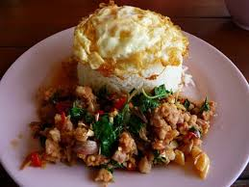
10 principles of economics
How people make decisions
  Principle 1: people face trade-offs
    But there is no such thing as free lunch

Slide 5
10 principles of economics
How people make decisions
  Principle 1: people face trade-offs
    Private trade-offs
      Time you spend doing one thing can always be used to do another thing
    Public trade-offs
      Equity VS Efficiency
      Growth VS Sustainability
    But be careful of how you see trade-offs

Slide 6
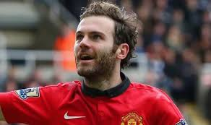
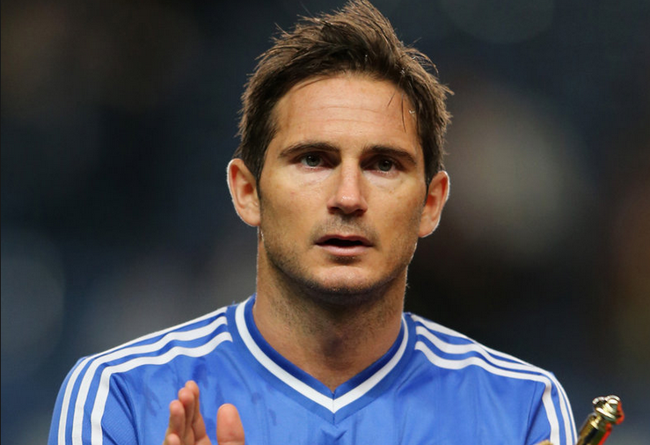
10 principles of economics
How people make decisions
  Principle 2: the cost of something is what you give up for it
    Opportunity cost: what you have to give up to get something you want

Slide 7
10 principles of economics
How people make decisions
  Principle 3: rational people think at the margin
    Marginal changes: small or incremental changes to your current position
      You thinking about spending an additional time reading for the exam
      Producer thinking about adding one more labour
  Principle 4: people respond to incentives
    When marginal benefits of doing something exceed marginal costs, people are motivated to do such a thing

Slide 8
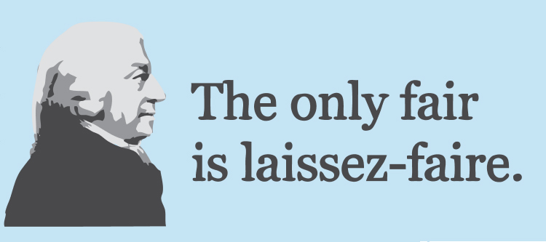
10 principles of economics
How people interact
  Principle 5: trade can make everyone better off
    Trade allows people to specialise in what they do best.
  Principle 6: markets are usually a good way to organise economic activity
    Allowing markets to determine price is more efficient than having a centrally command system

Slide 9
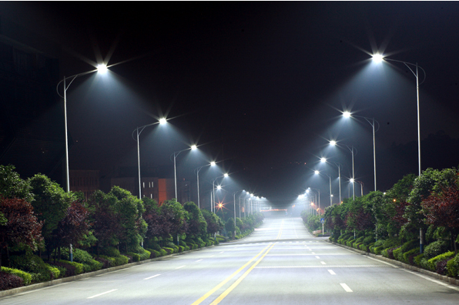
10 principles of economics
How people interact
  Principle 7: government can sometimes improve market outcomes
    But markets sometimes fail to deliver
    Gov’t can step in to provide public goods and solve inequality problem

Slide 10
10 principles of economics
How the economy as a whole works
  Principle 8: a country’s standard of living depends on its ability to produce goods and services
    Higher GDP means higher income.
    And “productivity” plays an essential role in determining the level of GDP that a country to attain.

Slide 11
10 principles of economics
How the economy as a whole works
  Principle 9: price rise when the government print too much money
    In Germany: January 1921, a daily newspaper cost 0.30 marks. In November 1922, the same newspaper cost 70,000,000 marks.
  Principle 10: society faces a short run trade-off between inflation and unemployment.
    Boosting the demand side of macroeconomy tends to lead to the overall price-level increase, in the short-run.

Slide 12
Thinking like an economist
The economist as scientist
  The scientific method
    Economics way of seeing the world is similar to physics
      Observe, construct model, and test through empirical observations
  Assumptions and economic models
    A model of a social phenomena explains what happens through mathematical representation.
    But to do so, there usually needs to be simplification. That’s why economists always make assumption before proposing models.

Slide 13
Thinking like an economist
Economic model 1: Production Possibility Frontier
  Assumptions
    1 country with no trade
    2 goods: guns and butter
    Some resources are more suited to making guns, some are more suited to making butter.

Slide 14
Thinking like an economist
Economic model 1: Production Possibility Frontier

