Slide 1

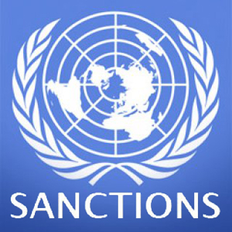
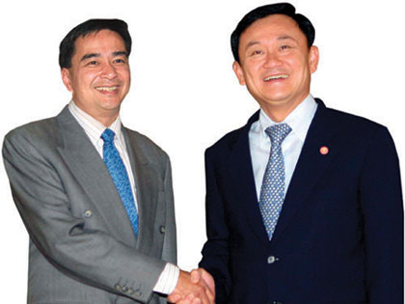
The impact of
International economic sanctions on trade

Slide 2
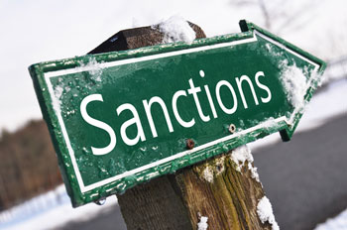
Introduction
- Economics sanctions is common and recurring after WWII.
- Main features of work is cost of target country.

Slide 3
Focuses
- Effects of unilateral and multilateral sanctions
- Impact on bilateral trade between US and target countries
- Impact on third countries

Slide 4
Defining sanctions and impact on trade
-Negative sanction
-Objective
- Primary
- Secondary
- Tertiary

Slide 5

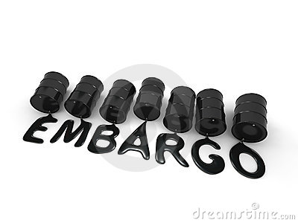
Defining sanctions and impact on trade
Three kinds of sanctions
- Boycotts
- Embargoes
- Financial sanction

Slide 6
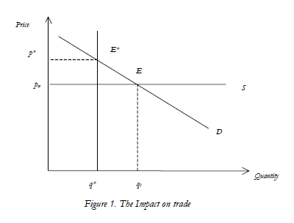
Example Embargo

Slide 7
Methodology
Gravity model
ln TRADEijt = β0 + β1 ln GDPit + β2 ln GDPjt + β3 ln POPit + β4 ln POPjt +β5 lnDISTij + β6At + uijt
Augmented gravity model
ln TRADEijt = β0 + β1 ln GDPit + β2 ln GDPjt + β3 ln POPit + β4 ln POPjt +β5 lnDISTij + β6 LMSANC + β7 XSANC + β8 MULTSANC+ β9 INTERWAR + β10INTRAWAR + uijt

Slide 8
Source of data
Bilateral trade data from OECD statistical compendium 2001
GDP and population from Penn World table
Interstate and intrastate war from dataset of Correlates of War project on website of Pennsylvania State University

Slide 9
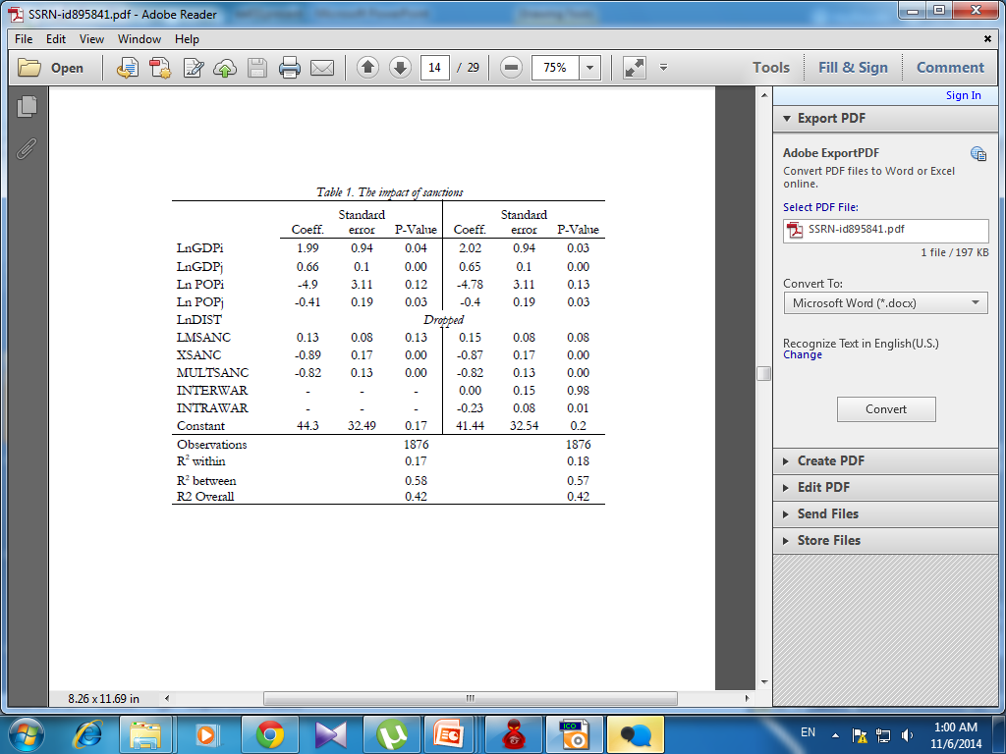
Estimation and results
First estimation

Slide 10
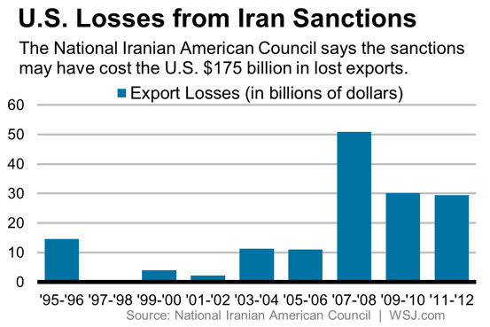
http://blogs.wsj.com/riskandcompliance/2014/07/14/study-iran-sanctions-costing-u-s-billions-in-lost-trade/

Slide 11
Sanction busting
U.S. competitors trade with U.S.-targeted countries to capture the business when U.S. impose unilateral sanctions.
Impact of boycotts and embargoes does spill-over to trade partners.

Slide 12
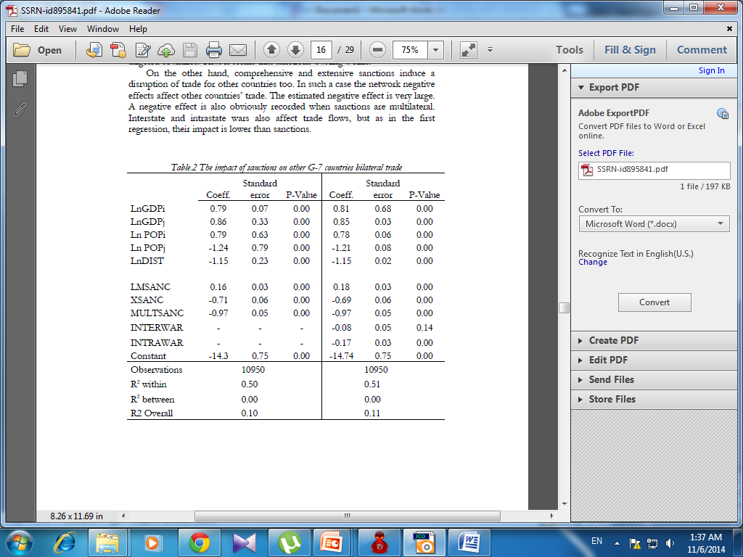
Second estimation

Slide 13
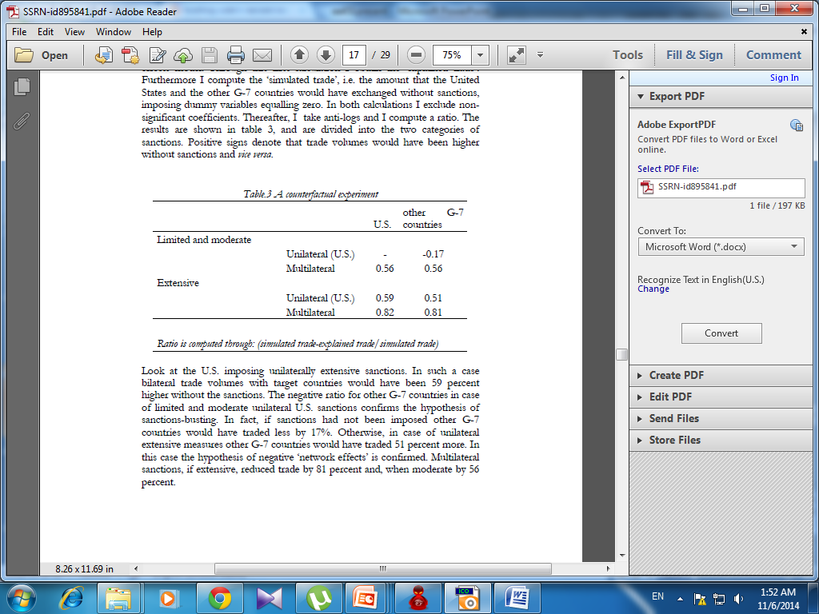
Counterfactual experiment

Slide 14
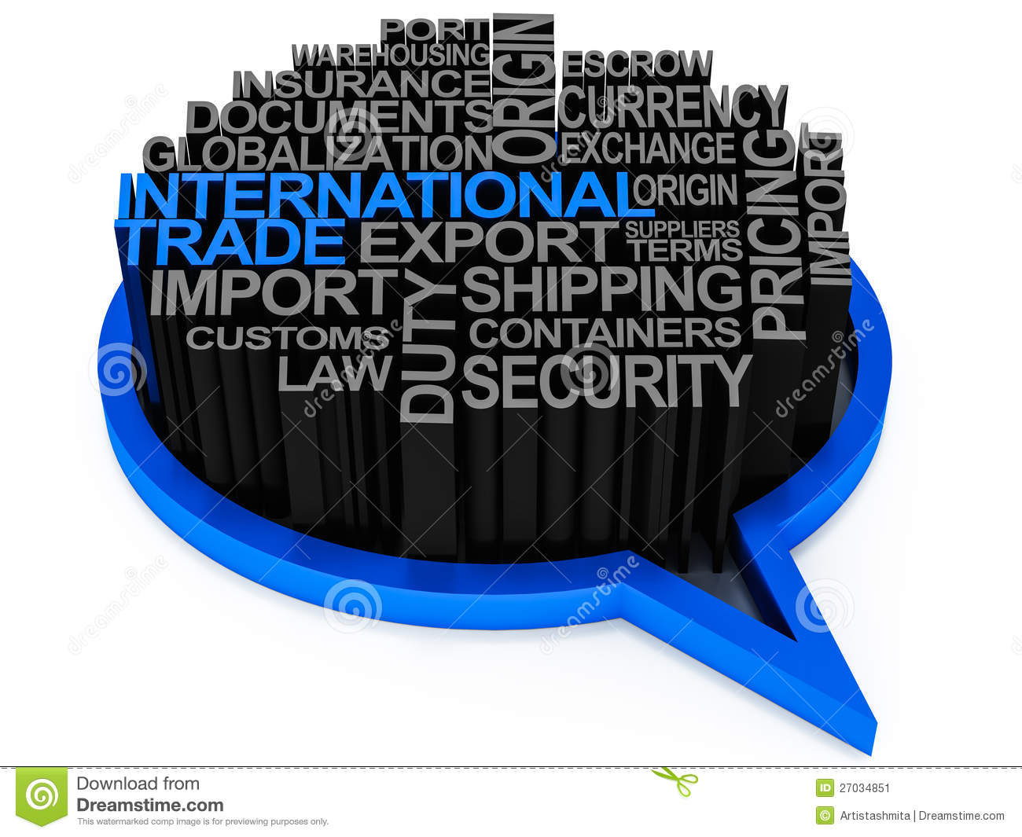

Conclusion

Slide 15
Q&A
As mentioned in the article, the cost of being sanctioned occurred in the target country is highly considered by the sender. Which sector do you think would be US’s choice to sanction Thailand ?
According to the first question what would be Thailand’s alternative destination country to engage with ?

Slide 16
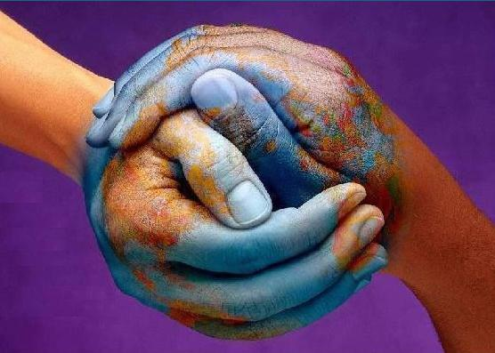
THANK YOU

