Slide 1

Trade Finance
FN312 Credit Management

Slide 2
Member
Jatupat Trongpradit 5504640318
Pimnipa Booasang 5504641159
Puvadol Pulput 5504641415
Sahaphon Vairungroj 5504641506
Sirichai Juengudomporn 5504641621
Tanapon Mongkolsuntonchot 5504641811

Slide 3
OUTLINE
Overviews
  What is trade finance ?
  Why do we need trade finance?
Trade Finance Products
  Guarantees
    Shipping guarantee
    Letter of credit
  Import
    Trust receipt
  Export
    Pre-Shipment finance: Packing Credit
    Post-Shipment finance : L/C Sold at Discount

Slide 4
What is trade finance ?
Trade finance is a source of working capital for many traders in need of financing to procure, process or manufacture products before sale in future.
Basically related to “International Trade Transaction”
Major Players : Sellers (or Exporter) & Buyers (Importers)
Intermediaries : Banks & Financial institutions
Notes:
Trade finance instruments allow companies to perform international trade transactions effectively whilst reducing the risks to which the companies are exposed. This means that trades can be made, working capital can be unlocked, operating costs can be reduced and the efficiency of financial supply chains can be improved upon.
Depending on the relative importance of each of the factors, a set of different instruments exists, ranging from L/Cs through to open account trade and supply chain solutions.
Trade finance facilitates trade by helping overcome the information asymmetry between buyers and sellers, enabling them to trust a system whereby sellers will be paid under certain conditions and buyers will get the products they paid for. Trade finance contributes to international trade in four areas: payment facilitation, risk mitigation, and financing and the provision of information about the status of payments or shipments. Every trade finance transaction involves some combination of these four elements, adjusted to suit the circumstances of a particular market or of a trading relationship. Trade finance is the lifeline of trade because more than 90% of trade transactions involve some form of credit, insurance or guarantee. The financial crisis is striking at the heart of the global economic system. Many normally stable banks are wary of capital depletion and are consolidating balance sheet positions, often in response to regulatory imperatives, thereby limiting the amount of money available to be lent against the reduced capital base. Trade finance is not exempt from this liquidity crunch. It is estimated that the trade-financing gap (between funds needed and funds available) has exceeded US$ 300 billion, with the result that trade flows are directly and adversely affected. The gap in trade finance has resulted in a substantial reduction in the movement of goods between producer and consumer markets, and is threatening to stall the trading system.
rtance of each of the factors, a set of different instruments exists, ranging from L/Cs through to open account trade and supply chain solutions.

Slide 5
Why do we need trade finance?
Payment facilitation - enable secure and timely payment across borders
Financing - provide liquidity to exporters and importers
Risk mitigation – avoid risk associated with international trade such as economic risk, foreign currency risk and asymmetric information through bank’s diversification
Provision of information – provide information about the status of payments or shipments which help reduce transaction cost to traders

Slide 6
Trade Finance Products
Guarantees | Shipping Guarantee (S/G) Letter of credit (L/C)
Import | Trust Receipt (T/R)
Export | Pre-shipment Finance: Packing credit Post-shipment Finance: Letter of credit sold at discount

Slide 7


Guarantees

Slide 8
Shipping Guarantee
Bill of lading (B/L)
- Document that evidences the receipt of goods for shipment to a specified destination and person or company
- Document of Title to the goods
Shipping Guarantee (S/G)
A Letter of Guarantee issued by bank to a shipping company that allows a buyer to obtain goods prior to the arrival of the original Bill of Lading.

Slide 9
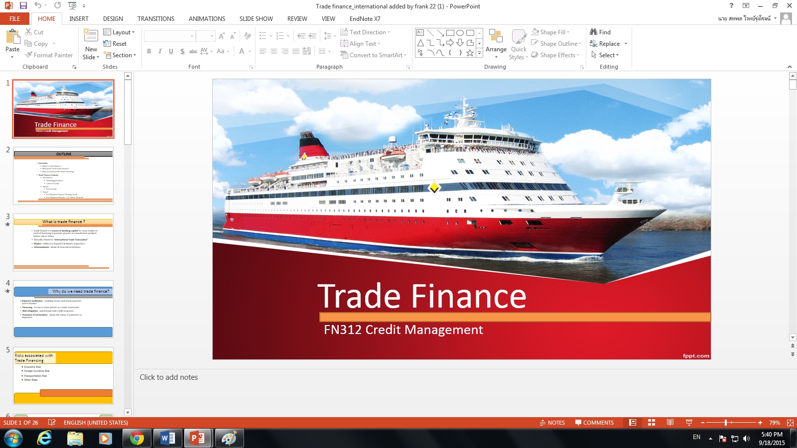
Shipping Guarantee
5. Bill of Lading (B/L) arrive
Importer
6. Exchange B/L for S/G
4. Pick up goods using S/G
Shipping Company
1. Goods arrive at port without
original B/L
7. S/G
3. S/G
2. Apply
for S/G
Bank

Slide 10
Shipping Guarantee
Required Documents
- Copy of invoice
- Copy of Bill of Lading
- Trust Receipt
- Shipping Guarantee of sea Freight Company
Benefit
Immediately proceed with goods release process, providing more time and opportunities to produce or sell goods
Minimize storage cost at the port

Slide 11


Letter of credit (L/C)
?
“A letter from a bank to guarantee that a buyer will pay
to a seller on time and full amount of payment when the conditions are met.”
$
Shipment
EXPORTER
IMPORTER

Slide 12
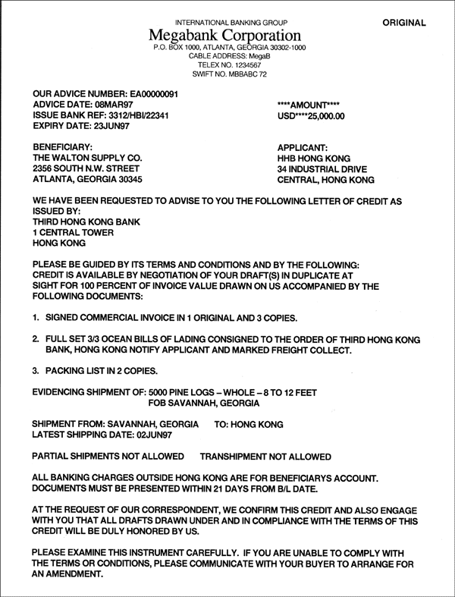
Letter of credit (L/C)
A letter of credit usually includes :
  Importer’s name and address
  Exporter’s name and address
  Issuing bank
  Advising bank
  Specification and quantity of the goods
  Amount of money
  Loading port and destination port
  Shipment date
  The validity date of the L/C
  Terms and conditions agreed by both the importer and exporter
    Revocable or Irrevocable , payment at sight or maturity
  The documents required by the importers
    Bill of lading , Commercial invoice, Packing list, Insurance certificate , etc.

Slide 13
Letter of credit (L/C)
1. Sale Contract
Exporter
Importer
5. Shipment
4. Advise
for L/C
2. Apply
for L/C
8. $
6. $
Advising Bank
(Exporter’s Bank)
Issuing Bank
(Importer’s Bank)
3. L/C Submission
7. $

Slide 14

IMPORT

Slide 15
Trust Receipt (T/R)
“Short-term import loan to provide the importers with financing to settle goods imported under Letter of credit (L/C)”
1. Sale Contract
Exporter
Importer
5. Shipment
4. Advise
for L/C
2. Apply
for L/C
6. Set up the Trust Receipt
8. $
Advising Bank
(Exporter’s Bank)
Issuing Bank
(Importer’s Bank)
3. L/C Submission
7. $
Notes:
A short term import loan provided by the bank to the importer under Letter of Credit where titles of goods is held by the bank, which bank allows the importer to take possession of the goods on trust for resale before paying the Bank on T/R due date.
Interest rate is come from LIBOR+
Procedure of Trust Receipt
1. Importer requests to set up the Trust Receipt.
2. After the Trust Receipt credit is approved, importer submits related documents at the International Trade Service Center so that the Bank can check the credit burden and condition of credit line usage.
3. KBank submits the original shipment document to importer to declare the goods. The Bank makes an advance payment to the seller in a foreign country on behalf of the importer.
4. Importer repays the Bank on the due date.

Slide 16
Trust Receipt (T/R)
Terms & Conditions
Customer must be approved with Trust Receipt from the Bank first, which is usually approved together with the L/C.
Required Documents
1. Trust Receipt
2. Bill of Exchange
3. Invoice
4. Goods shipment document
5. Other documents refer from L/C
Benefits
1. Liquidity support for importer.
2. Can choose T/R in Thai Baht or other foreign currency.
  Fixed Rate T/R
  Non-Fixed Rate T/R

Slide 17


Slide 18
Pre-Shipment finance: Packing Credit
Purpose: To provide money for pre-export cost
1. Sale Contract
Exporter
Importer
6. Shipment
5. Ask for
Packing
Credit
4. Advise
for L/C
2. Apply
for L/C
7. $
Issuing Bank
(Importer’s Bank)
Advising Bank
(Exporter’s Bank)
3. L/C Submission
8. $

Slide 19
Pre-Shipment finance: Packing Credit
Required documents
1. Promissory Note or Bill of Exchange
2. The original of the irrevocable L/C (in case of Packing Credit against L/C) or
3. The copy of Purchase Order, Sales Contract (in case of Packing against Contract) or

Slide 20
Post-Shipment finance: L/C sold at discount
“Any loan or advance granted provided by bank to an exporter of goods after shipment of goods to the date of realization of export proceeds.”
1. Sale Contract
Exporter
Importer
5. Shipment
6. Ask for
L/C sold at
discount
4. Advise
for L/C
2. Apply
for L/C
7. $
Advising Bank
(Exporter’s Bank)
Issuing Bank
(Importer’s Bank)
3. L/C Submission
8. $

Slide 21
Post-Shipment finance: L/C sold at discount
Required documents
1. Original L/C
2. Commercial Invoice
3. Delivery Note – Shipping order or booking note for shipping
Example
- Shipping the rubber on the end of January
- Getting the money on the end of March.
- You realize that at that time you need the money to facilitate your business.
- However, there are three month gaps and you did not get the money yet.
- You can sold L/C at discount in order to get money for your business first.

Slide 22


