Slide 1

EE 366 Economics of Services Sector
CHAPTER 4
Supply, Demand and Market Equilibrium in service
Dr. Nessara Sukpanich

Slide 2
Supply, demand and market equilibrium in service
1. Supply of service
  1.1 Production costs of non-storable goods
  1.2 Distribution costs of non-transportable goods
  1.3 The basic trade-off and the resulting market areas
  Reading: Jansson (2013) Chapter 3, 4, 5
2. Demand for service
  2.1 Demand for service consumption and its income elasticity
  2.2 Intermediate demand for service
  Reading: Zhou (2016) chapter 4
3. Supply and demand at system level and market equilibrium
  3.1 The system cost function
  3.2 The system demand function
  3.3 Market equilibrium
  Reading: Jansson (2013) Chapter 7

Slide 3
Supply of service
Conventional microeconomic cost theory treats production costs and distribution costs as one, in analysis of service sector look at both costs separately and together.
Non-storability of immaterial goods
  Concern about production costs of non-storable goods
  Variability of demand cannot be met by the buffer stock → concern about peak-load pricing
  Random fluctuations of demand → the application of queuing theory
Non-transportable goods
  Concern about distribution costs of non-transportable goods

Slide 4
Source: Jansson (2013), Figure 3.1, P.32
The General Shape of long-run total production cost (LRTC_{prod}) and long-run average production costs (LRAC_{prod})
C
LRTC_{prod}
Initially, with increasing return to scale (IRS) production, LRTC_{prod} increase digressively with respect to q
Then, with constant return to scale (CRS), LRTC_{prod} increase proportionately with respect to q
After that, with decreasing return to scale (DRS) production, LRTC_{prod} increase progressively with respect to q
LRAC_{prod} is in U-shaped form, relative flat part of LRAC_{prod} corresponds to the part where LRTC_{prod} increases nearly proportion to q
There could be case that LRAC_{prod} is closed to L-shape form
TOTAL COST
q
C
AVERAGE COST
LRAC_{prod}
q
1st interval
2nd interval
3rd interval

Slide 5
Source: Jansson (2013), Figure 3.1, P.32
The General Shape of long-run total production cost (LRTC_{prod}) and long-run average production costs (LRAC_{prod})
C
LRTC_{prod}
Observations in the 3rd output interval is less likely to occur in reality. A production plant with such a large capacity would not be realistic since the same output could be produced at lower cost per unit of output by two plants
Observations in the 1st output interval is less likely to occur in reality. Low capacity plants (of storable and transportable goods) could not exist if it is possible to produce such goods for substantially lower average cost at plants with higher capacity
However, low capacity, relatively high cost plants are kept in operation as long as the price (or marginal revenue) > current cost
Mainstream price theory focuses on the second output interval.
TOTAL COST
q
C
AVERAGE COST
LRAC_{prod}
q
1st interval
2nd interval
3rd interval

Slide 6
Two extreme cases of the shape of LRTC_{prod} and output relationship
$
$
LRTC_{prod}
LRTC_{prod}
q
q
LRTC_{prod} = aq
LRTC_{prod} = F
Small-scale operations are natural
Represented by simple service such as manual car wash, shoeshine service in the street
Could Still incur small-scale-disadvantages (like higher queuing costs)
Public good characteristics –> inexhaustible (non-rival)
Examples: National defense, police force service, institutions for maintaining law and order within nation (quasi-public goods b/c these services has finite capacity)
Source: Jansson (2013), Figure 3.2, P.34

Slide 7
Combination cases
LRTC_{prod} = F + aq
LRTC_{prod} = F + aq^{α} + kq whereas 0<α<1
F represents “public” factor of production or fixed cost such as costs of R&D, costs of preparing final manuscript for publishing a book
Costs that are strictly proportional to output
Costs that increase digressively with output
Two main causes of small-scale disadvantages
A relatively high F-value
  Normally services produced by technical sophisticated, industrial methods such as airport service, high speed train, etc.
Services of a relatively low unit cost (low-value service)
  not require sophisticated production apparatus
  pre-booking system would be too cumbersome
  the main cause of small-scale disadvantages is non-storability
  So, random arrival of customers gives rise to high queuing costs unless the rate of capacity utilization is initially kept low.

Slide 8
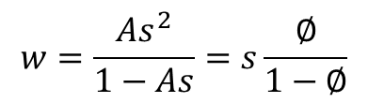
Queuing theory
Queuing time at single station facility
Assumptions
Customer arrive at random, with the distribution of arrivals described by the Poisson probability distribution
Similarly, the service time is a random variable fitting the negative exponential probability distribution
There is no upper limit to the queue length. Customers are patient and there is no restriction on waiting room space
The expected (mean) queuing time in a statistical equilibrium (w) is
$$w=\frac{As^{2}}{1−As}=s\frac{∅}{1−∅}$$
w = expected queuing time per customer
A = expected number of arrivals per hour, which equals total output (q) on average
s = expected service time per customer (hours)
Ø = expected occupancy rate (Ø = As < 1)
The mean queuing time (w) starts to rise at low levels of capacity utilization (Ø) and will rise more and more sharply as the level of full capacity is approached
Source: Jansson (2013), Chapter 3 (Appendix)

Slide 9
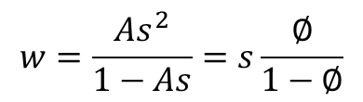
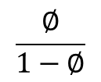
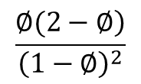
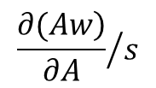
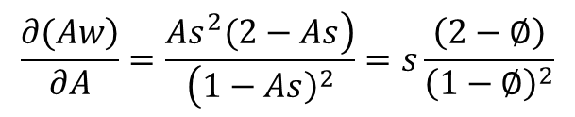
Queuing time at single station facility
Expected mean queuing time in statistical equilibrium
$$w=\frac{As^{2}}{1−As}=s\frac{∅}{1−∅}$$
w = expected queuing time per customer
A = expected number of arrivals per hour, which equals total output (q) on average
s = expected service time per customer (hours)
Ø = expected occupancy rate (Ø = As < 1)
The marginal queuing time: the additional total queuing time that results from another arrival
$$\frac{\left.∂(Aw\right)}{∂A}=\frac{\left.As^{2}(2−As\right)}{\left(1−{\left.As\right)}^{2}\right.}=s\frac{\left(2−∅\right)}{{\left(1−∅\right)}^{2}}$$
The ratio of marginal queuing time to s =
$${\frac{\left.∂(Aw\right)}{∂A}}/s$$
=
$$\frac{\left.∅(2−∅\right)}{{\left(1−∅\right)}^{2}}$$
Average queuing time = w/s
=
$$\frac{∅}{1−∅}$$
, This shows that w is proportion to s given Ø
Therefore, the marginal queuing time to s increases much faster than the average queuing time (see Table A3.1 in Jansson (2013)
Source: Jansson (2013), Chapter 3 (Appendix)

Slide 10
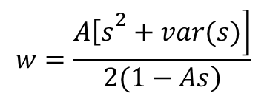
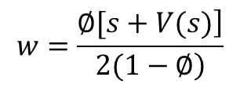
Queuing time at single station facility
The importance of service time variability
The root cause of the queuing that occurs is the variability of A and s
How would assumption of service time distribution affect the mean queuing time?
According to Saaty (1961), Pollaczek-Khintchine formular provides general answer to this question
For any arbitrary distribution of the service time (s) the steady state mean queuing time (w) can be expressed as a function of the mean and variance of the service time (s) and the arrival rate (A)
$$w=\frac{\left.A{\left[s\right.}^{2}+var(s)\right]}{\left.2(1−As\right)}$$
$$w=\frac{\left.∅[s+V(s)\right]}{\left.2(1−∅\right)}$$
From Ø = As and let’s the relative variance var(s)/s = V(s) , then
This shows that given the occupancy rate (Ø), the mean queuing time (w) is proportional to the sum of service time (s) and it’s relative variance [V(s)]
Implication, to reduce queuing time, it is important to reduce the variance of service time by homogenizing customer requirements as it is to reduce average service time
Source: Jansson (2013), Chapter 3 (Appendix)

Slide 11
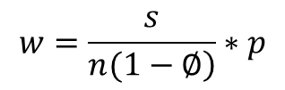
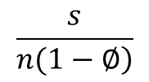
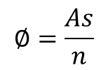
Queuing theory
Queuing time at multiple station facility
Given the probability (p) that an arrival will find all stations occupied
$$w=\frac{s}{\left.n(1−∅\right)}∗p$$
w = expected queuing time per customer
A = expected number of arrivals per hour, which equals total output (q) on average
s = expected service time per customer (hours)
Ø = expected occupancy rate (Ø = As < 1)
n = number of service stations
represents mean occupancy rate
$$∅=\frac{As}{n}$$
represents the expected queuing time of those customers who actually meet
with a delay
$$\frac{s}{\left.n(1−∅\right)}$$
P represents probability that a delay will occur

Slide 12
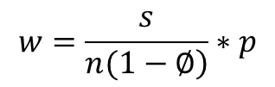
Queuing time at multiple station facility
Given the probability (p) that an arrival will find all stations occupied
$$w=\frac{s}{\left.n(1−∅\right)}∗p$$
w = expected queuing time per customer
A = expected number of arrivals per hour, which equals total output (q) on average
s = expected service time per customer (hours)
Ø = expected occupancy rate (Ø = As < 1)
n = number of service stations
The total effects on queuing time of adding service stations (n) comes from two key factors
From above equation, if the occupancy rate (Ø) is constant (number of service stations increases in proportional to demand), when n w
Relationship btw p and n is quite complicated (see equation 3.2 in Jansson, 2013). However, given the occupancy rate (Ø), probability that delay will occur (p) slightly falls as n increased or n p
From both effects total queuing time tends to decrease when demand and capacity expanded at the same rate There are very important economies of scale inherent in multi-station service facilities

Slide 13
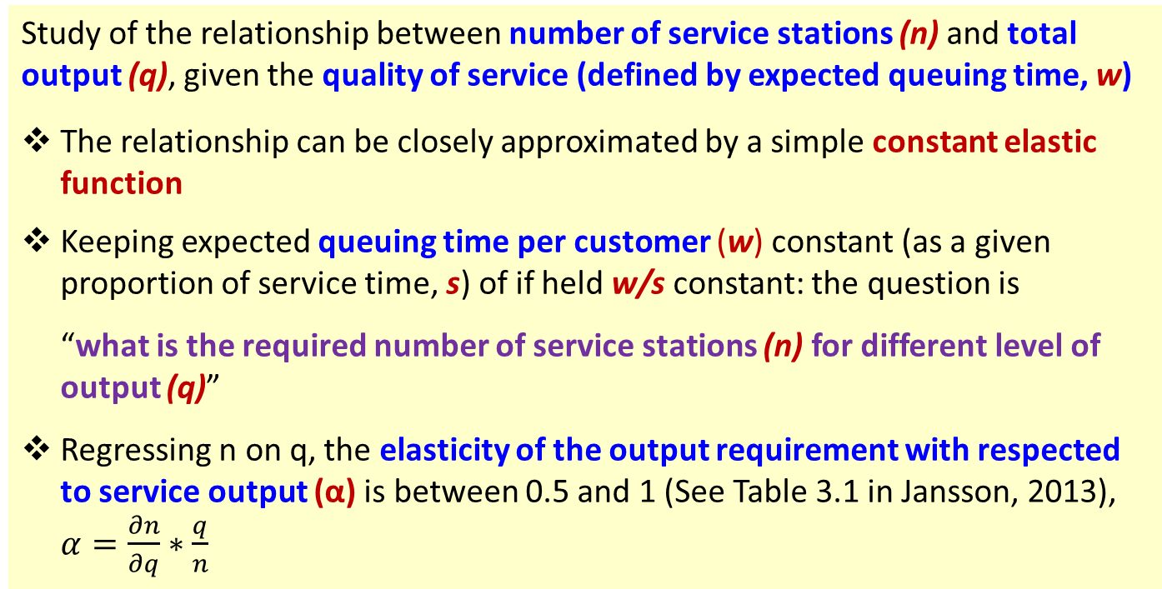
Queuing time at multiple station facility (cont.)
The capacity requirement function for a given quality of service
Study of the relationship between number of service stations (n) and total output (q), given the quality of service (defined by expected queuing time, w)
The relationship can be closely approximated by a simple constant elastic function
Keeping expected queuing time per customer (w) constant (as a given proportion of service time, s) of if held w/s constant: the question is
“what is the required number of service stations (n) for different level of
output (q)”
Regressing n on q, the elasticity of the output requirement with respected to service output (α) is between 0.5 and 1 (See Table 3.1 in Jansson, 2013), $α=\frac{∂n}{∂q}∗\frac{q}{n}$

Slide 14
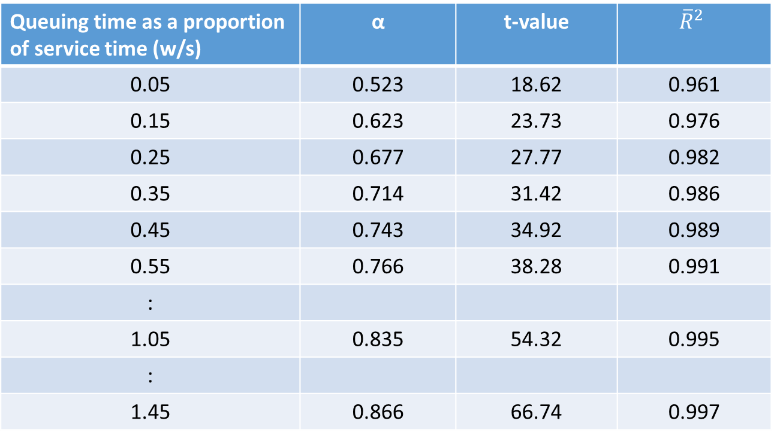
Queuing time at multiple station facility (cont.)
The output elasticity (α) of the capacity requirement of a multi-station service facility for different levels of the quality of service
(Results when regressing n against q then calculate α)
Queuing time as a proportion of service time (w/s) | α | t-value | $${\overline{R}}^{2}$$
0.05 | 0.523 | 18.62 | 0.961
0.15 | 0.623 | 23.73 | 0.976
0.25 | 0.677 | 27.77 | 0.982
0.35 | 0.714 | 31.42 | 0.986
0.45 | 0.743 | 34.92 | 0.989
0.55 | 0.766 | 38.28 | 0.991
:
1.05 | 0.835 | 54.32 | 0.995
:
1.45 | 0.866 | 66.74 | 0.997
Source: Jansson (2013), Table 3.1, P. 38

Slide 15
Queuing time at multiple station facility (cont.)
The capacity requirement function for a given quality of service
From Table 3.1 in Jansson (2013) of regressing n on q
When quality of service is at very high level (represented by low w/s), α approaches 0.5
At the other end of scales when long queues are allowed (represented by high w/s), α approaches 1
So, α is between 0.5 and 1 (0.5 < α < 1)
Which quality of service level should be chosen depends on the relative cost of the service users’ queuing time versus the capacity cost of the service facility
The results support the following LRTCprod function: LRTCprod = aq^{α}, 0.5 < α < 1
In case there are also economies of scale in the building costs (the capital cost per service station is decreasing with the number of service stations of the capacity concerned), the lower limit of α (at 0.5) can be lower
The applicability of the constant elasticity property is necessary limited to a particular range that varies in different cases

Slide 16
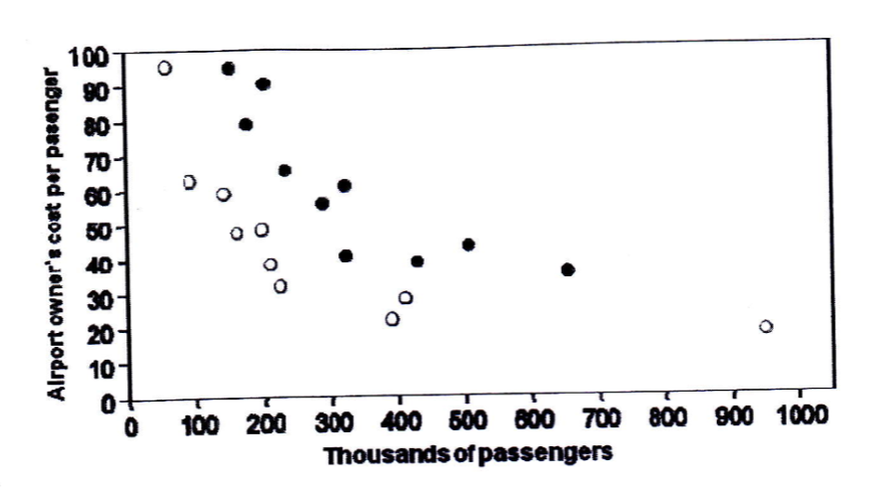
Empirical evidence of small-scale diseconomies
Airport service
Regional airport cost per passenger versus passenger volume
Data sample:
20 regional airports in Sweden
2 categories
  State-owned civilian airports
  Military and/or municipal-owned airports
Source: Jansson (2013), Figure 3.3, P. 40
Results
From graph: airports in the range of 100,000 to 200,000 passengers per year are five times more costly per passenger than airports serving one million passengers
Corresponds to regression results: an elasticity of the average airport cost with respect of output = -0.67

Slide 17
Empirical evidence of small-scale diseconomies
Airport service
Results of logarithm regression of average airport cost on passenger volume
Explanatory variables | Coefficients | t-values
Constant | 12.02 | 20.57
Passenger volume | -0.67 | -14.22
Dummy for airport category | 0.53 | 9.25
Source: Jansson (2013), Table 3.2, P. 41
Data sample:
20 regional airports in Sweden
2 categories
  State-owned civilian airports
  Military and/or municipal-owned airports
Results: An elasticity of the average airport cost with respect of output = -0.67

Slide 18
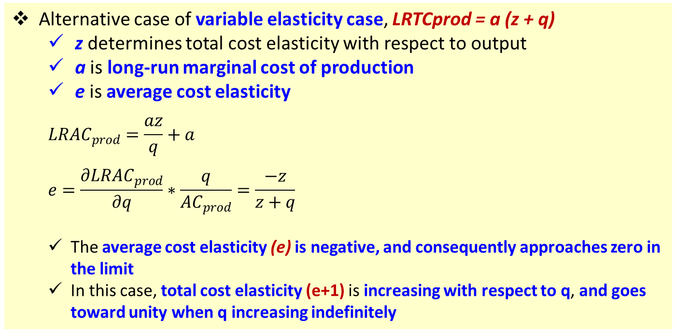
Empirical evidence of small-scale diseconomies
Variable Elasticity Cases (LRTC elasticity with respected to q)
Constant elasticity case, LRTCprod = aq^{α}
  With some respects facilitates mathematical operations, but might not be applicable in a very wide range
  Elasticity less than 1 (α < 1) cannot remain endlessly constant because that means that the average cost may approach zero at the end
Alternative case of variable elasticity case, LRTCprod = a (z + q)
  z determines total cost elasticity with respect to output
  a is long-run marginal cost of production
  e is average cost elasticity
  $${LRAC}_{prod}=\frac{az}{q}+a$$
  $$e=\frac{∂{LRAC}_{prod}}{∂q}∗\frac{q}{{AC}_{prod}}=\frac{−z}{z+q}$$
  The average cost elasticity (e) is negative, and consequently approaches zero in the limit
  In this case, total cost elasticity (e+1) is increasing with respect to q, and goes toward unity when q increasing indefinitely

Slide 19
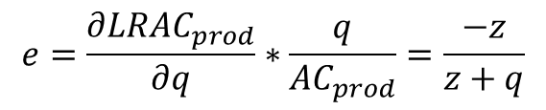
Long-run and short-run total production cost functions of an individual plant
LRTC
SRTC_{prod}
There are plant size economies both in the capacity costs and the operating costs (larger plants are typically labor-saving)
The larger the plant size, the slope of SRTC less steep
LRTC_{prod}
LRTC_{prod} is truncated at the low end, and defined only for q more than a particular threshold
In the initial output range, the exact shape of LRTC is undetermined
If the costs of very small plants can be observed, It is possible that small-scale plants are too costly to be viable
“az” represent fixed cost
“a” represent slope of LRTC_{prod}
“z and q” indicates plant size economies
Total production cost elasticity with respect to q is continuously increase from low positive values towards unity in the limit
$
SRTC_{i}
a_{i}z_{i}
SRTC_{i} = a_{i} (z_{i} + q)
q < K_{i}
az
q
Source: Jansson (2013), Figure 3.4, P. 45
total cost elasticity = e+1
$$e=\frac{∂{LRAC}_{prod}}{∂q}∗\frac{q}{{AC}_{prod}}=\frac{−z}{z+q}$$

Slide 20
Total production costs, given the elasticity α
$
$
LRTC_{prod} = a_{i}q^{α}
(a₁)
(a₂)
(a₃)
(a₄)
q
$
(a₁)
LRTC_{prod} = a_{i} (z + q)
(a₂)
Total production costs,
given the scale-elasticity indicator z
(a₃)
(a₄)
q
Source: Jansson (2013), Figure 3.5a and Figure 3.6b, P. 45

Slide 21
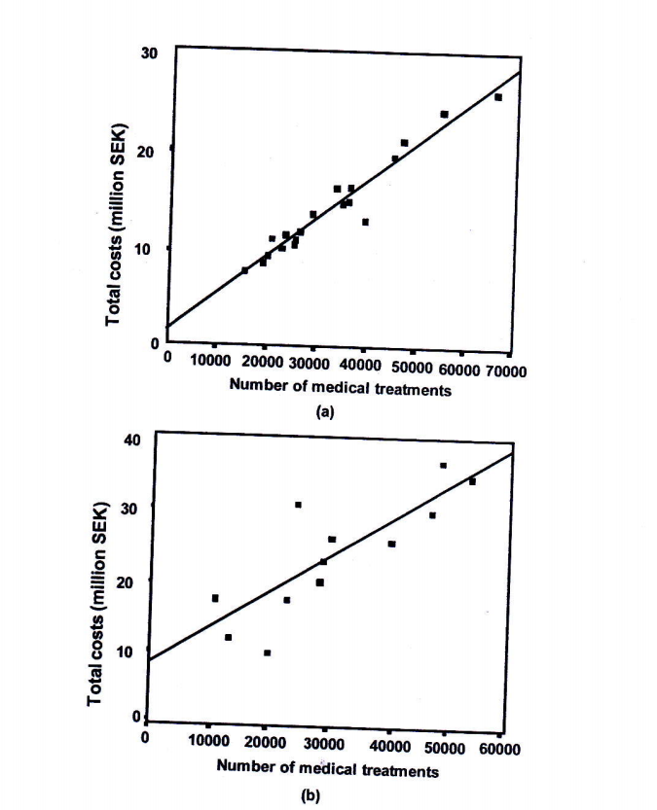
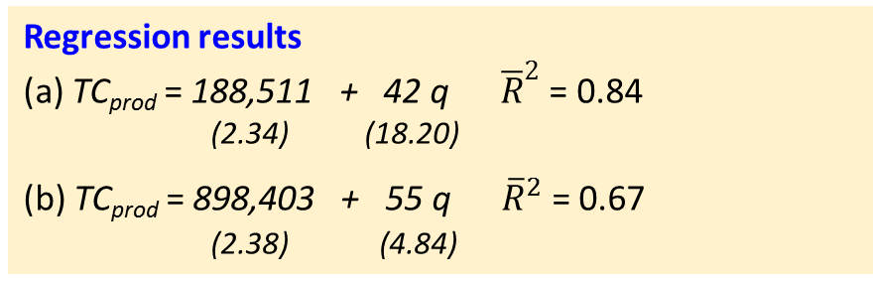
Empirical evidence of small-scale diseconomies
Variable Elasticity Cases (LRTC elasticity with respected to q)
Long-run total production cost and output functions for public health centres in
Ӧstergӧtland, a south eastern county (top chart)
The northernmost part of Sweden (bottom chart)
Huge difference in density of demand in the two areas
The annual number of treatments per km² is 70
The annual number of treatments per km² is 4
Regression results
(a) TC_{prod} = 188,511 + 42 q ${\overline{R}}^{2}$ = 0.84
(2.34) (18.20)
(b) TC_{prod} = 898,403 + 55 q ${\overline{R}}^{2}$ = 0.67
(2.38) (4.84)
Assuming a linear long-run total cost function, the total cost elasticity (e+1) with respect to output is non-constant, and goes up with increases in output volume with two following range
0.78 < e+1 < 0.94
0.38 < e+1 < 0.75
Source: Jansson (2013), Figure 3.6, P. 47

Slide 22
Empirical evidence of small-scale diseconomies
A word of caution
In reality we seldom see the small scale disadvantages fully reflected in the service producer’s production function costs alone.
They are to some extent passed on to the users, either in the form
of a low quality of service (e.g. longer expected queuing time, higher
travel costs for the users or both)
In modeling work based on empirical cross-section study
  it is essential to take a wide view, and include both the producer and user costs in the analysis
  At least make sure that the quality of service is kept constant when examining the economies of scale and similar production and distribution system concerned

