Slide 1

Bra Problems Every Woman Understands
Members
Miss Piangprae Lertviriyavarangkool 5904640462
Miss Pattaratida Hansirirpongsakul 610460955
Miss Nichanun Subsomboon
6104640716
Miss Narueporn Thiamchivasin 6104640740
Miss Natchaya Laokham
6104641425

Slide 2
Why wearing a bra is important ?
A bra is a form-fitting undergarment designed to cover, support and elevate a woman’s breasts.
It is important that a woman chooses the right type of bra in order to protect the general health of the breasts.
Credit: https://www.hunimed.eu/news/advantages-disadvantages-wearing-bra/

Slide 3
Advantages & Disadvantages
POSITIVE
NEGATIVE
Keep your breast in shape
It helps your confidence
Balance your breast shape
Conceal your nipples
Discomfort
Wrong sizes of bras lead to bad breast health.
Problem with blood circulation
Bra
Comfortableness
Less time consumption
when you get dressed.
For heavy and big breast women
Your breast becomes saggy !!
No Bra

Slide 4

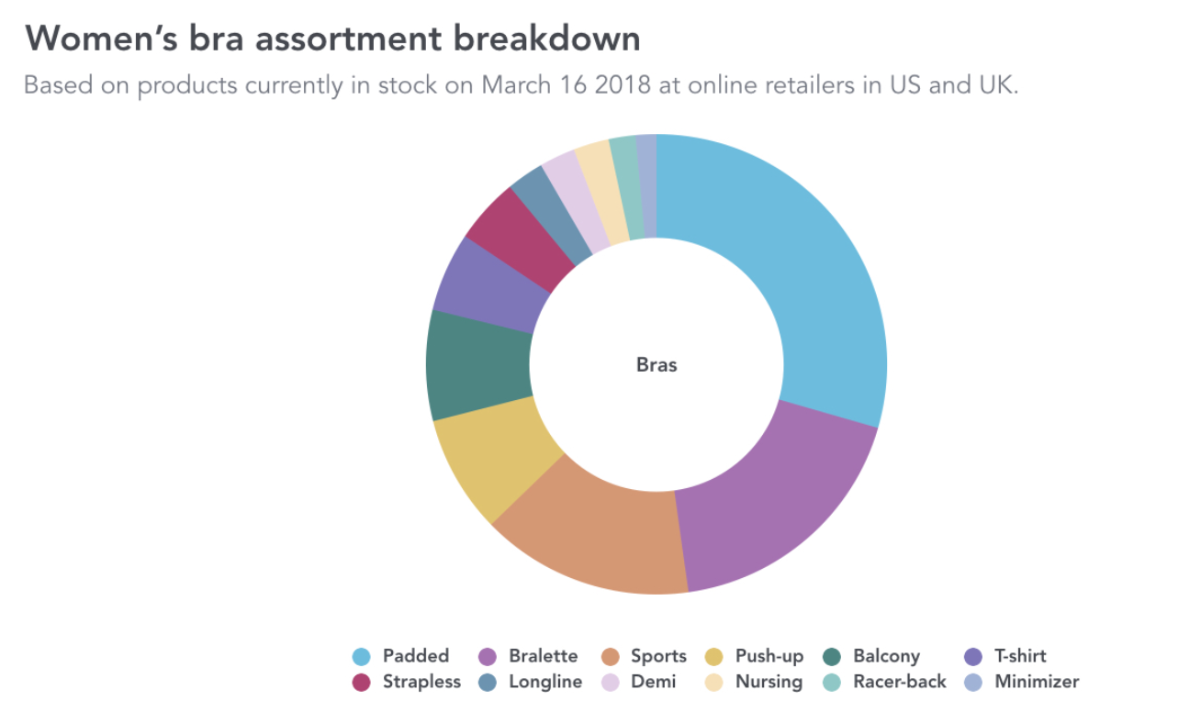
Market Segmentations
=

Slide 5
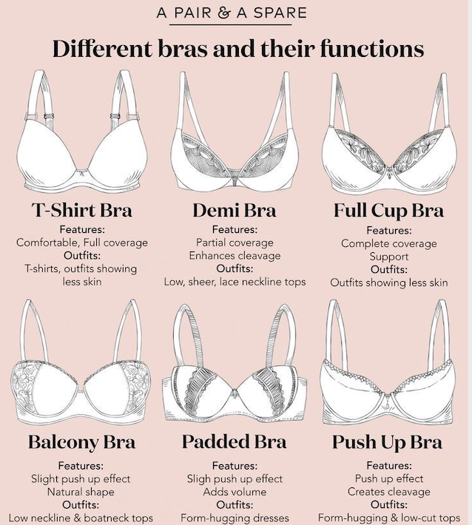
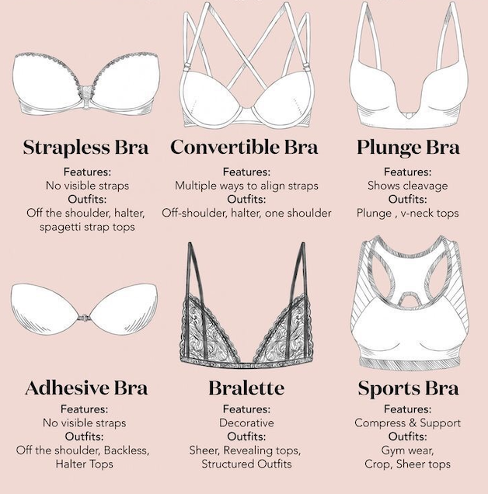

Slide 6
5 Process of Design Thinking
Experiences
& Motivations
Define (problems)
Ideate
Prototype
Test
Sweating Uncomfortable feeling
Inconvenient to pack for travelling not suitable for some outfits or dresses
Overpriced
Expansion of breast sizes
Teenage group (over 13 years old)
Adult group (working age)
Female traveller group
Transgender group
Not suitable
for lifestyles
and outfits
Uncomfortableness
Characteristics
Adjustable straps
Foldable bra
Seamless bra
Strapless bra
Expandable bra
Launch a prototype to pre-test usage
Online Customer Reviews

Slide 7
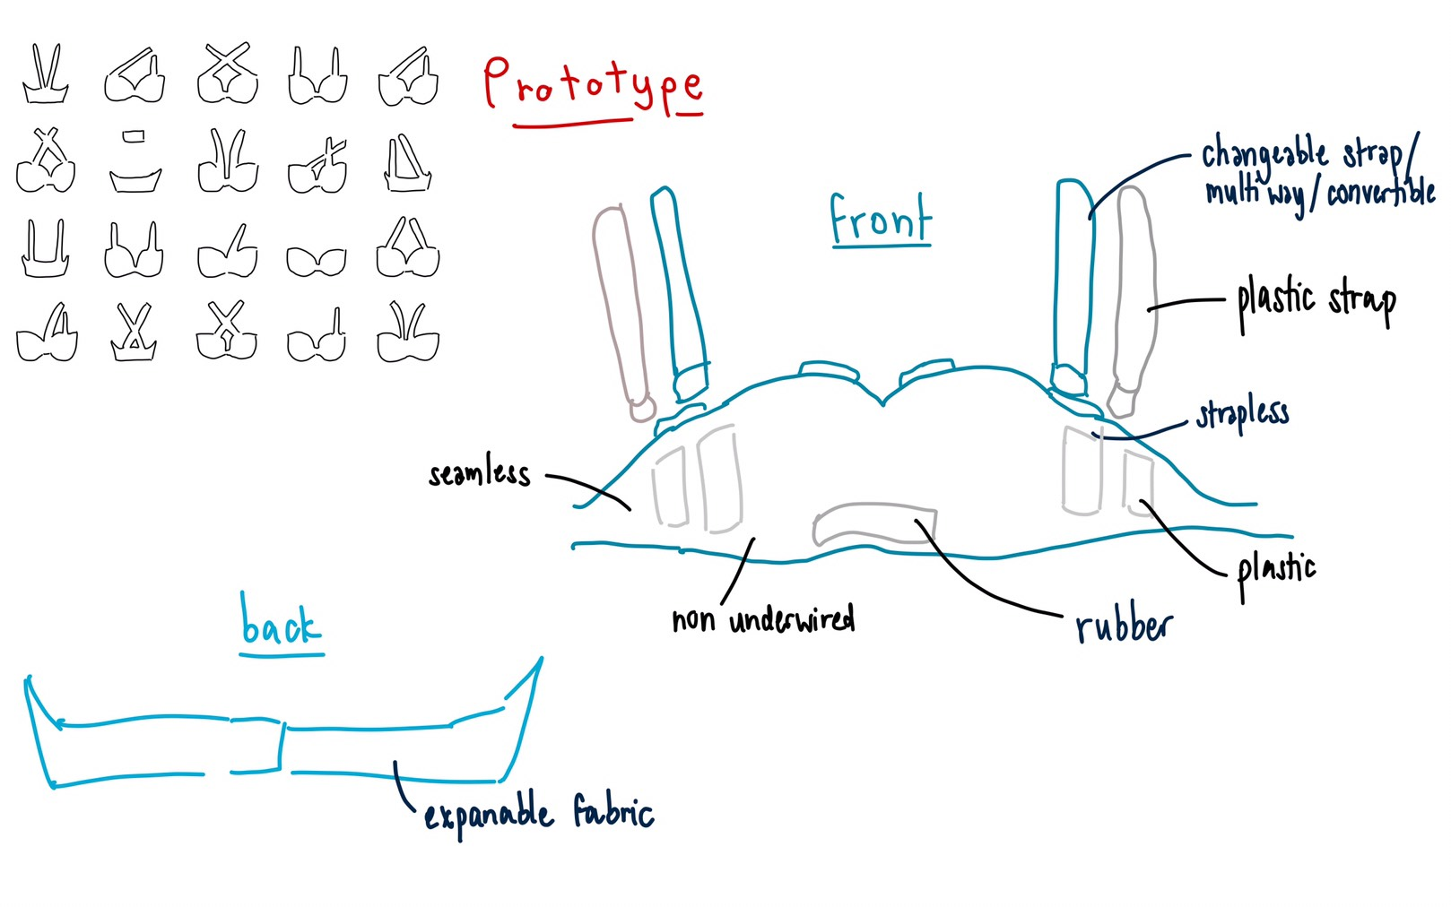
Prototype

Slide 8
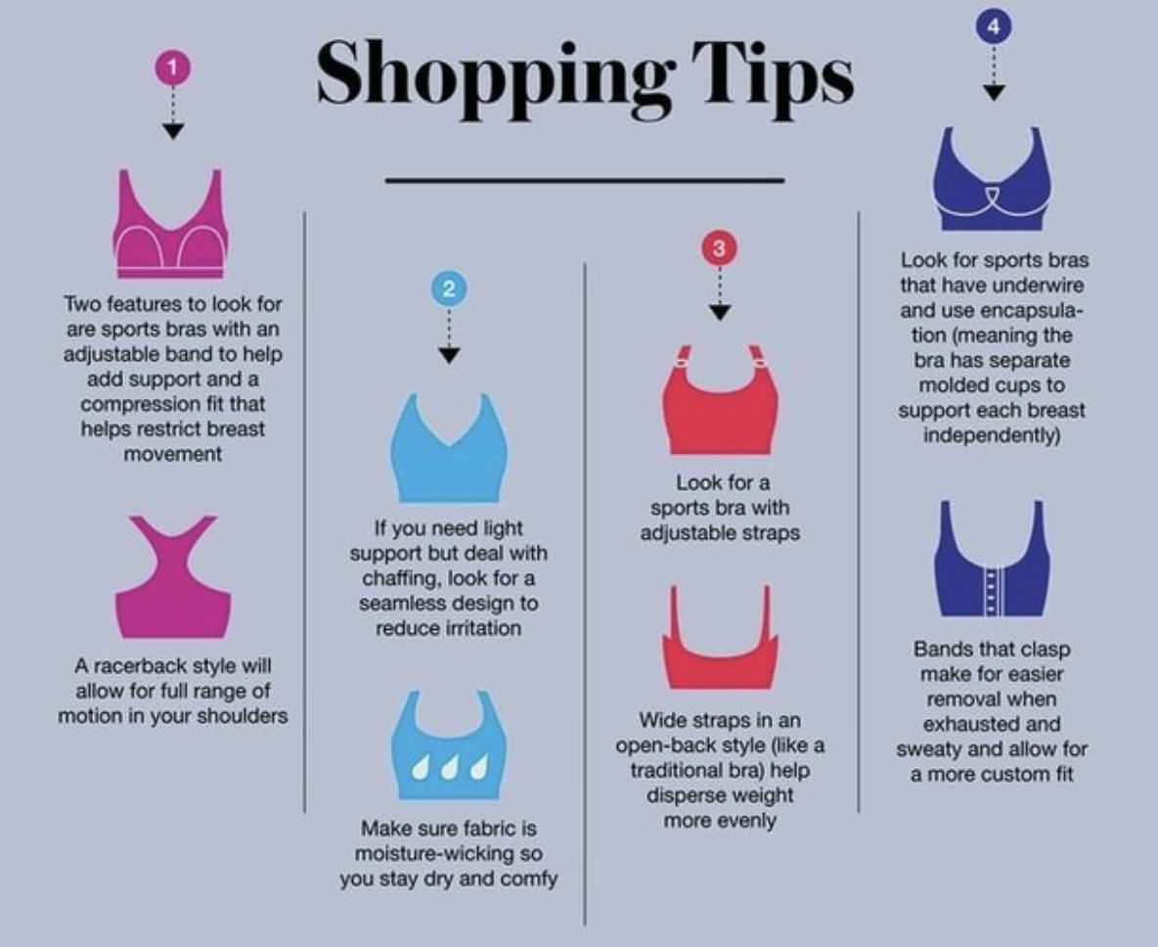
Credit: https://goforwarddownsize.com/charts_rm.php

Slide 9


