Slide 1
International Equity Markets
Chapter Thirteen
Notes:
This chapter continues coverage of international capital markets with a discussion of both the primary and secondary equity markets throughout the world.

Slide 2
Chapter Outline
A Statistical Perspective
  Market Capitalization
  Measures of Liquidity
Market Structure, Trading Practices, and Costs
Trading in International Equities
  Magnitude of International Equity Trading
  Cross-Listing of Shares
  Yankee Stock Offerings
  The European Stock Market
  American Depository Receipts
  Empirical Findings on Cross-Listing and ADRs
13-2

Slide 3
Chapter Outline (Continued)
International Equity Market Benchmarks
iShares MSCI
Factors Affecting International Equity Returns
  Macroeconomic Factors
  Exchange Rates
  Industrial Structure
Summary
13-3

Slide 4
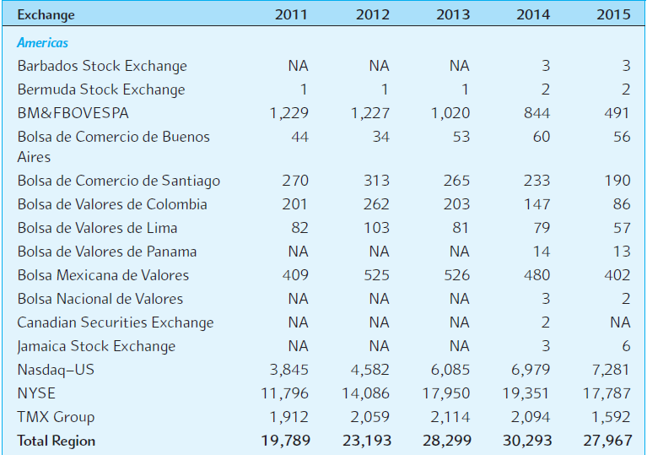
EXHIBIT 13.1 (Excerpt)
Market Capitalization (in billions of U.S.D.)
13-4

Slide 5
Market Capitalization
At year-end 2015, total market capitalization of the 80 organized stock exchanges
tracked by the World Federation of Exchanges stood at $67,125 billion.
13-5

Slide 6
Emerging Markets
Standard & Poor’s Emerging Markets Database classifies a stock market as “emerging” if it meets at least one of two general criteria:
  It is located in a low- or middle-income economy as defined by the World Bank.
  Its investable market capitalization is low relative to its most recent GNI figures.
13-6

Slide 7
Measures of Liquidity
The equity markets of the developed world tend to be much more liquid than emerging markets.
  Liquidity refers to how quickly an asset can be sold without a major price concession.
So, while investments in emerging markets may be profitable, the investor’s focus should be on the long term.
13-7

Slide 8
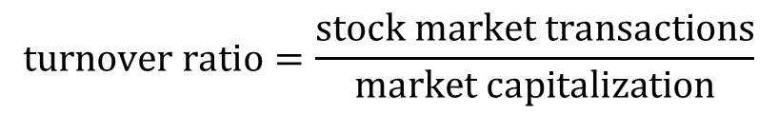
Measures of Liquidity
One measure of liquidity for a stock market is the turnover ratio:
The higher the ratio, the more liquid the market.
Turnover ratios are relatively stable over time for most national stock exchanges.
Many national stock exchanges had relatively high turnover ratios, with over 40 percent of the exchanges in most years in excess of 30 percent turnover per month.
13-8

Slide 9
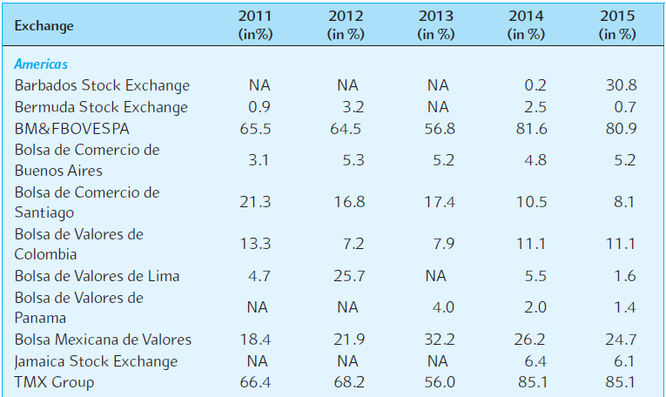
EXHIBIT 13.2 (Excerpt)
Share Turnover Velocity (December)*
13-9

Slide 10
Market Structure, Trading Practices, and Costs
Primary markets
  Shares offered for sale directly from the issuing company.
Secondary markets
  Provide market participants with marketability and share valuation.
13-10

Slide 11
Market Structure, Trading Practices, and Costs
Market order
  An order to your broker to buy or sell share immediately at the market price.
Limit order
  An order to your broker to buy or sell at a price you want, when and if he can.
If immediate execution is more important than the price, use a market order.
13-11

Slide 12
Market Structure, Trading Practices, and Costs
Dealer market
  The stock is sold by dealers, who stand ready to buy and sell the security for their own account.
  In the U.S., the OTC market is a dealer market.
Auction market
  Organized exchanges have specialists who match buy and sell orders. Buy and sell orders may get matched without the specialist buying and selling as a dealer.
Automated exchanges
  Computers match buy and sell orders.
13-12

Slide 13
Market Consolidations And Mergers
There are approximately 80 major national stock markets.
  Western and Eastern Europe once had more than 20 national stock exchanges where at least 15 different languages were spoken.
  It appears that over time a European stock exchange will eventually develop. However, a lack of common securities regulations, even among the countries of the European Union, is hindering this development.
Today, stock markets around the world are under pressure from clients to combine or buy stakes in one another to trade shares of companies anywhere, at a faster pace.
13-13

Slide 14
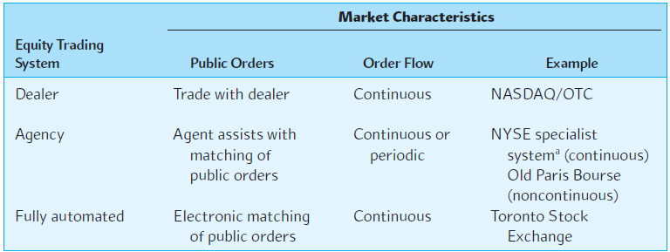
EXHIBIT 13.3
Characteristics of Major Equity Trading Systems
13-14

Slide 15
Trading in International Equities
Magnitude of international equity trading
Cross-listing of shares
Yankee stock offerings
The European stock market
American Depository Receipts (ADRs)
13-15

Slide 16
Magnitude of International Equity Trading
During the 1980s world capital markets began a trend toward greater global integration.
This trend was caused by diversification, reduced regulation, improvements in computer and communications technology, and an increased demand from MNCs for global issuance.
13-16

Slide 17
Cross-Listing of Shares
Cross-listing refers to a firm having its equity shares listed on one or more foreign exchanges.
The number of firms doing this has exploded in recent years.
13-17

Slide 18
Advantages of Cross-Listing
It expands the investor base for a firm.
  Very important advantage for firms from emerging market countries with limited capital markets.
Establishes name recognition for the firm in new capital markets, paving the way for new issues.
May offer marketing advantages.
Cross-listing into developed markets with strict securities regulations and information discloser may signal investors that improved corporate governance is forthcoming.
May mitigate possibility of hostile takeovers.
13-18

Slide 19
Yankee Stock Offerings
The direct sale of new equity capital to U.S. public investors by foreign firms.
  Privatization in South America and Eastern Europe.
  Equity sales by Mexican firms trying to “cash in” following implementation of NAFTA.
13-19

Slide 20
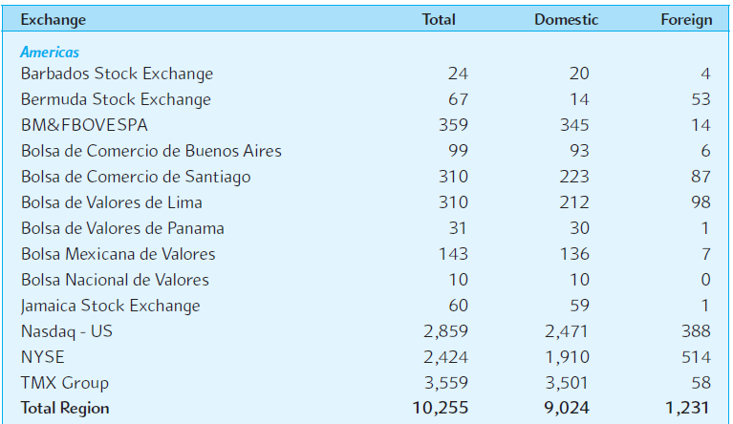
EXHIBIT 13.4 (Excerpt)
Total, Domestic, and Foreign Company Listings on Major National Stock Exchanges for 2015
13-20

Slide 21
American Depository Receipts
Foreign stocks often trade on U.S. exchanges as ADRs.
It is a receipt that represents the number of foreign shares that are deposited at a U.S. bank.
The bank serves as a transfer agent for the ADRs.
13-21

Slide 22
Advantages of ADRs
There are many advantages to trading ADRs as opposed to direct investment in the company’s shares:
  ADRs are denominated in U.S. dollars, trade on U.S. exchanges, and can be bought through any broker.
  Dividends are paid in U.S. dollars.
  Most underlying stocks are bearer securities and the ADRs are registered.
  ADR trades clear in 3 business days whereas settlement practices for the underlying stock vary in foreign countries.
13-22

Slide 23
Volvo ADR
A good example of a familiar firm that trades in the U.S. as an ADR is Volvo AB, the Swedish car maker.
Volvo trades in the U.S. on the NASDAQ under the ticker VOLVY.
  The depository institution is JPMorgan ADR Group.
  The custodian is a Swedish firm, S E Banken Custody.
Of course, Volvo also trades on the Stockholm Stock Exchange under the ticker VOLVB.
13-23

Slide 24
Mechanics of Issuance & Cancellation of ADRs
ADR Investor
Place order
Delivery
Broker buys existing ADR
U.S. Broker
Depository issues new ADR
Depository
NYSE
OTC
Broker
orders
shares for new ADR
Depository receives confirmation
of
share deposit
NASDAQ
Foreign Broker
Foreign broker deposits shares
Custodian
Foreign broker buys shares
Foreign Exchange
13-24

Slide 25
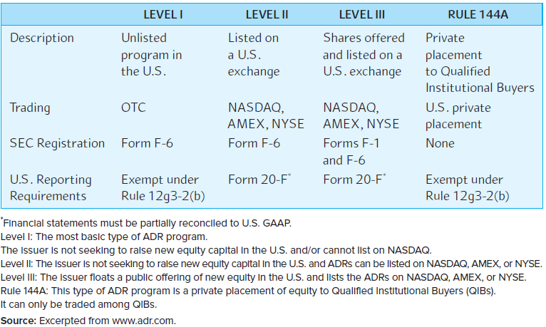
EXHIBIT 13.6 Types of ADRs
13-25

Slide 26
Global Registered Shares
The merger of Daimler Benz AG and Chrysler Corporation in November 1998 created DaimlerChrysler AG, a German firm. The merger simultaneously created a new type of equity share, called Global Registered Shares (GRSs).
GRSs are traded globally, unlike ADRs, which are traded on foreign markets.
The company was renamed Daimler AG in October 2007 when it spun off Chrysler. The primary exchanges for Daimler GRSs are the Frankfurt Stock Exchange and the NYSE; however, they are traded on a total of 20 exchanges worldwide.
The shares are fully fungible—a GRS purchased on one exchange can be sold on another. They trade in both U.S. dollars and euro.
13-26
Notes:
A global share registrar that links the U.S. and German transfer agents and registrars facilitates clearing.

Slide 27
Global Registered Shares
The main advantage of GRSs over ADRs appears to be that all shareholders have equal status and direct voting rights.
The main disadvantage of GRSs appears to be the greater expense in establishing the global registrar and clearing facility.
GRSs have met with limited success; many companies that considered them opted instead for ADRs.
Deutsche Bank, UBS, and NYSE Euronext also trade as GRSs.
13-27

Slide 28
Empirical Findings on Cross-Listings and ADRs
An internationally diversified portfolio of ADRs outperforms both a U.S. stock market and a world stock market benchmark on a risk-adjusted basis.
For most stocks, the home-market price and the ADR price is within 20-85 basis points—thus limiting any arbitrage opportunities.
13-28

Slide 29
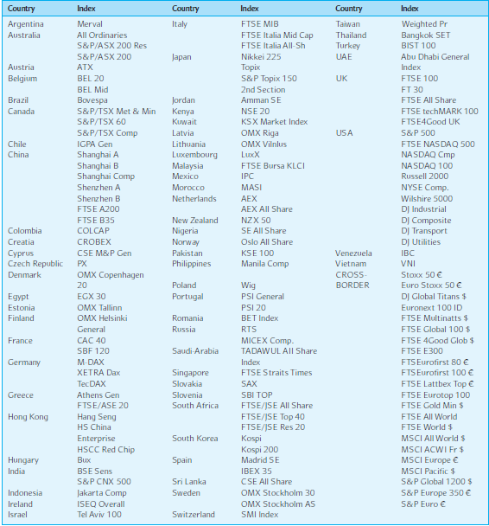
EXHIBIT 13.8 Major National Stock Market Indexes
13-29

Slide 30
iShares MSCI
Country-specific baskets of stocks designed to replicate the country indexes of 22 countries.
iShares are exchange-traded funds that trade on the American Stock Exchange and are subject to U.S. SEC and IRS diversification requirements.
  Low cost, convenient way for investors to hold diversified investments in several different countries.
13-30

Slide 31
Factors Affecting International Equity Returns
Macroeconomic factors
Exchange rates
Industrial structure
13-31

Slide 32
Macroeconomic Factors Affecting International Equity Returns
The data do not support the notion that equity returns are strongly influenced by macro factors.
This is correspondent with findings for U.S. equity markets.
13-32

Slide 33
Exchange Rates
Exchange rate movements in a given country appear to reinforce the stock market movements within that country.
One should be careful not to confuse correlation with causality.
13-33

Slide 34
Industrial Structure
Studies examining the influence of industrial structure on foreign equity returns are inconclusive.
13-34

Slide 35
Summary
This chapter provides an overview of international equity markets.
A considerable amount of discussion was devoted to differences in secondary equity market structures.
Cross-listing of a company’s shares on foreign exchanges was extensively discussed.
A variety of international equity benchmarks was also presented.
Several empirical studies that tested for factors that might influence equity returns indicate that domestic factors, such as the level of domestic interest rates and expected changes in domestic inflation, as opposed to international monetary variables, had the greatest effect on national equity returns. Industrial structure did not appear to be of primary importance. Equity returns were also found to be sensitive to own-currency exchange rate changes.
13-35

