Slide 1

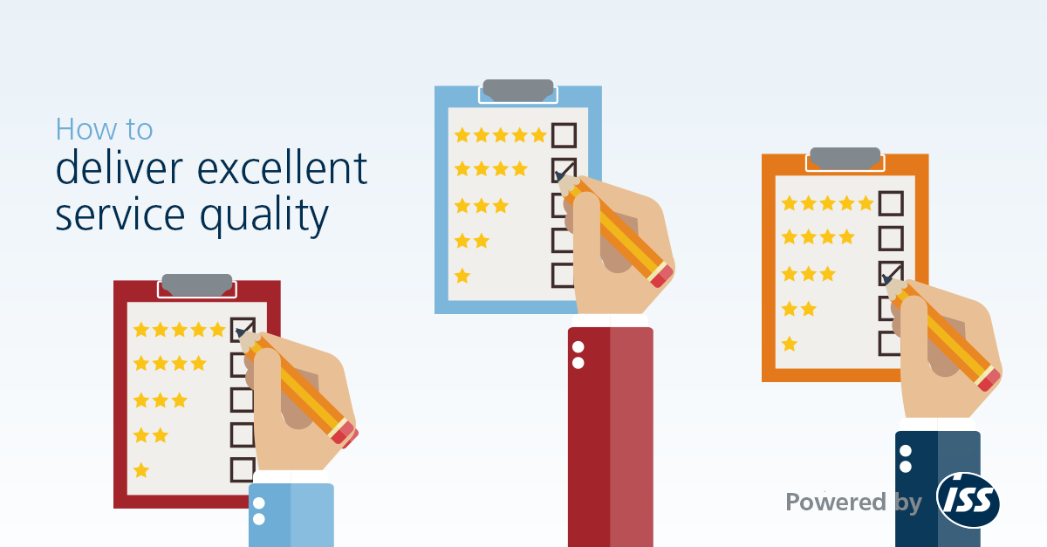
EE 366 Economics of Services Sector
Service Quality

Slide 2
Outline
1
Dimension of Service Quality
2
GAPS Model of Service Quality
Measuring Service Quality
3
Customer Satisfaction Survey
Walk-through Audit
4
Quality Service by Design
Quality in the Service Package
Taguchi Method (Robust Design)
Poka-Yoke
Quality Function Deployment
5
Achieving Service Quality
Cost of Quality
Statistical Process Control
Unconditional Service Guarantee
6
Service Recovery Framework

Slide 3
1
Dimension of Service Quality
DIMENSION
DEFINITION
EXAMPLES (Airline)
1
Reliability
Perform promised service dependably and accurately
Is my flight on time?
Are the ticket counter attendants, flight attendants and pilot knowledgeable about their jobs?
2
Assurances
  Ability to convey trust and
  confidence.
3
Tangibles
  Physical facilities and facilitating goods.
Are the gate, the plane and the baggage area clean?
4
  Ability to be approachable,
  caring, understanding and relating with customer needs.
Do the employees determine if I have special seating, meal
and baggage?
Empathy
5
Responsiveness
  Willingness to help customers
  Are the flight attendances willing to answer my questions?
Source: Fitzsimmons and Fitzsimmons: Service Management

Slide 4
1
Dimension of Service Quality (Cont.)
Word of
mouth
Personal
needs
Past
experience
Service Quality
Dimensions
1.Reliability
2.Responsiveness
3.Assurance
4.Empathy
5.Tangibles
Expected
service
Service Quality Assessment
1. Expectations exceeded
ES<PS (Quality surprise)
2. Expectations met
ES=PS (Satisfactory quality)
3. Expectations not met
ES>PS (Unacceptable quality)
Perceived
service
Source: Fitzsimmons and Fitzsimmons: Service Management, P144

Slide 5
Service Quality GAP model
2
  Customer satisfaction depends on minimizing the four gaps
Improving market research to fully understand what consumers need
Integrated service marketing communication
X Not matching performance to promises
X Not knowing what customers expect
X Not delivering to service standards
X Not selecting the right service designs and standards
Adequate training for employees
Setting goals and Standardizing service delivery tasks
Source: Fitzsimmons and Fitzsimmons: Service Management, P147 with some adaption

Slide 6
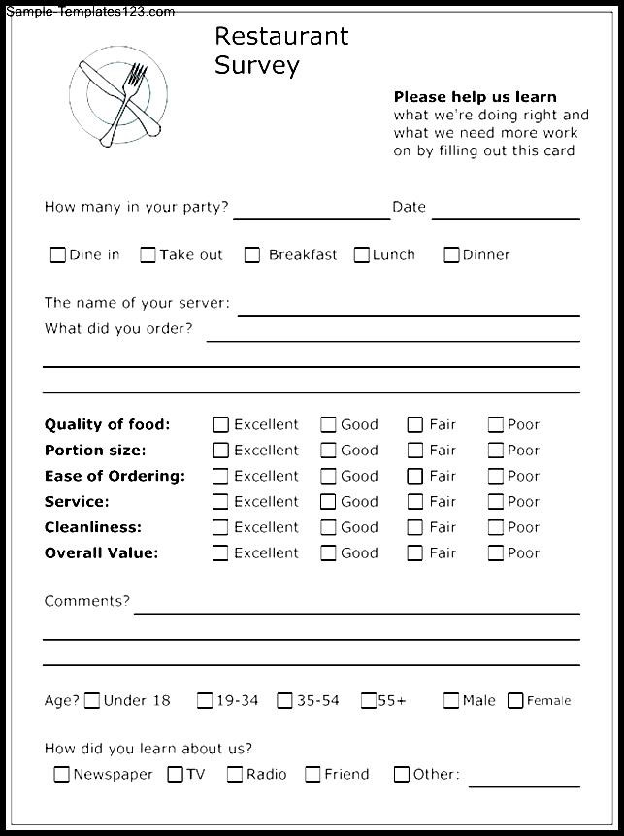

3
Measuring Service Quality
Companies try to measure the gap between expected service and perceived service through the use of surveys. (We call SERVQUAL)
Customer Satisfaction Survey
Walk-through Audit
Determine overall satisfaction associate with the current level of service quality
Conduct a systematic assessment of the entire customer service experience from beginning to end
http://www.awic2007.net/survey-forms-template/survey-forms-template-38-survey-forms-template-fantasticar-customer-satisfaction-survey-printable/
http://www.websurveymaster.com/t/32/Samples

Slide 7
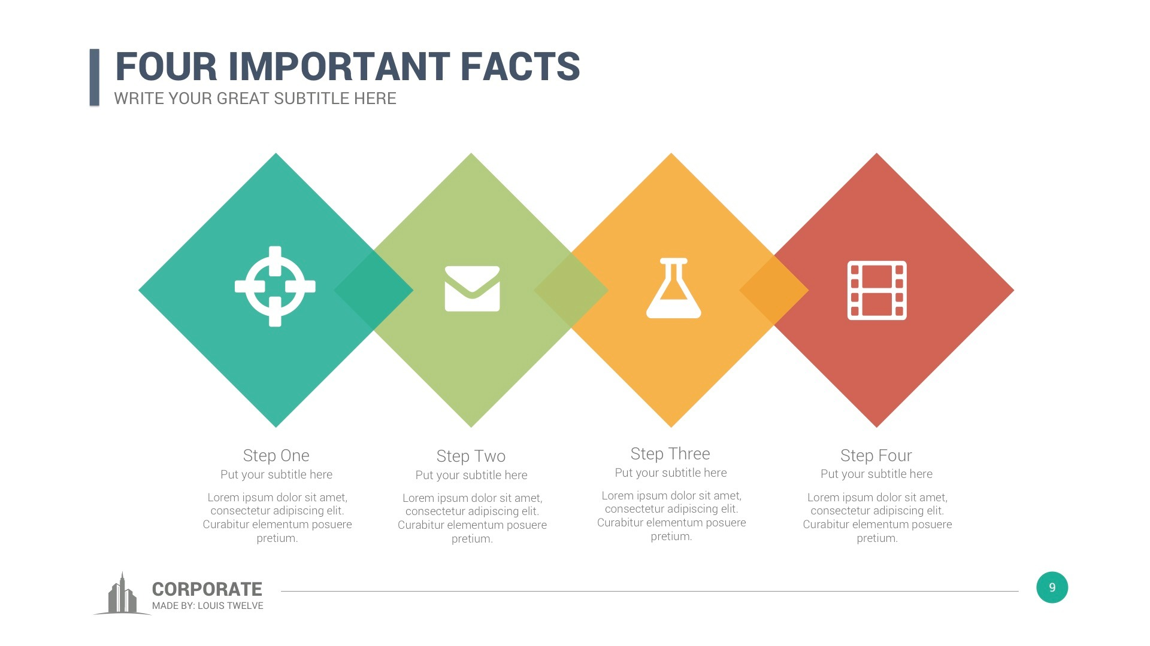
4
Quality Service by Design
1. Incorporation of Quality in the Service Package
Budget hotel case
Supporting facility
Facilitating goods
Information
Service
  An online computer tracks guest billing, reservation and registration process.
  Implicit service: Maids are trained to clean and make up rooms.
  Explicit service: Pleasant appearances of individuals at front office.
  Design of the building
  The air-conditioning
  The heating system
  Room furnishings are durable and easy to clean
  Disposal plastic cups are used instead of glass
Source: Fitzsimmons and Fitzsimmons: Service Management

Slide 8
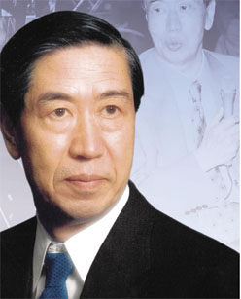
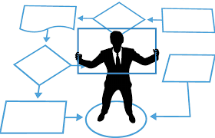
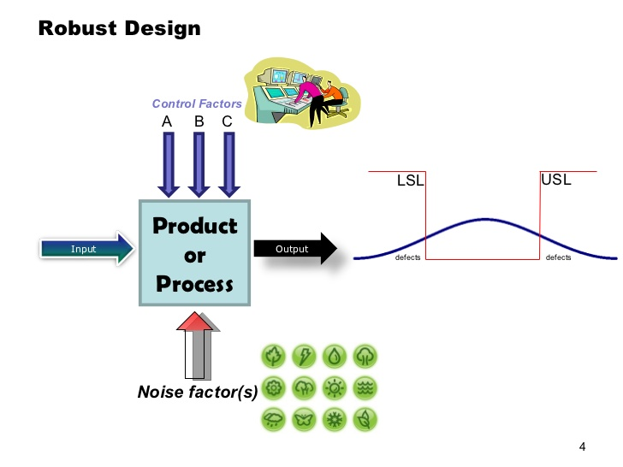
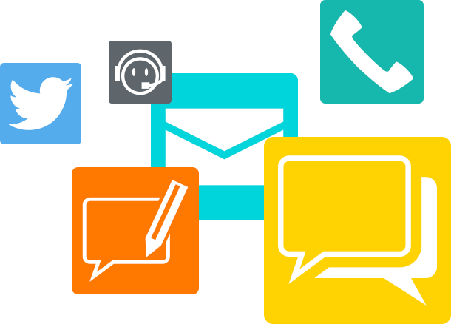
4
Quality Service by Design (Cont.)
2.Taguchi Method (Robust Design)
Who
What
Method
Application
Genichi Taguchi
Approaches to quality design
Focusing on setting a specific goal within an acceptable range
Manufacturing
Japanese
Ensure an ability to function under adverse conditions (Noise factors).
Service
Engineering and Statistician
Loss function is deviation of a characteristic from its target.
Source: Fitzsimmons and Fitzsimmons: Service Management

Slide 9
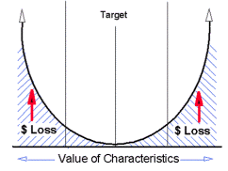
4
Quality Service by Design (Cont.)
2.Taguchi Method (Robust Design)
Lower limit
Higher limit
C (y)
y
Within the acceptable range, the cost is zero
The uncontrollable (noise) factors lead to cost of quality.
For example, consumer can wait for its room between 0 and 10 minutes
Loss function is measured by the square of the deviation from the target
After 10 minutes, she will leave. A wait time would translate to $100.
Source: Fitzsimmons and Fitzsimmons: Service Management, P154

Slide 10
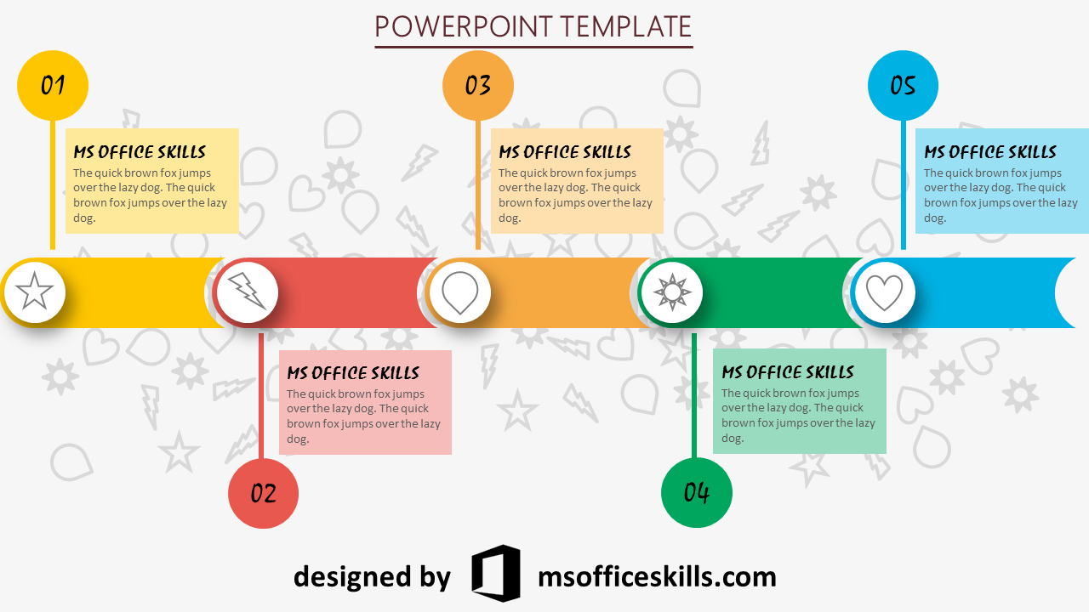
4
Quality Service by Design
3.Poka-Yoke
Error occurs, not because employees were incompetent, but due to interruptions in routine or lapses in attention- foolproof devices to prevent employee and customers mistakes.
1
Task
2
Treatment
3
Tangible
Doing work incorrectly
Doing work not required
Doing work in the wrong order
Doing work too slowly
Failure to acknowledge the customer
Failure to listen to the customer
Failure to react properly
Failure to clean facilities
Failure to provide clean uniforms
Failure to control environmental factors
Service Errors
1
Preparation
2
Encounter
3
Resolution
Failure to bring necessary materials
Failure to understand role in transaction
Failure to engage in correct service
Failure to remember steps in process
Failure to follow system flow
Failure to follow instructions
Failure to signal service failure
Failure to learn from experience
Failure to adjust expectations
Failure to execute post –encounter action
Customer Errors
Source: Fitzsimmons and Fitzsimmons: Service Management

Slide 11
4
Quality Service by Design (Cont.)
4. Quality Function Deployment
Quality Function Deployment is a planning process for products and services that starts with the voice of the customer by using the house of quality tool
4
Roof of the house - Note the strength of relationship between the service elements
1
Establish the aim of the project
3
Describe the elements of the service
2
Determine customer expectations :
interview
8
Assessment of competition
Weighted score
6
5
Body of matrix:
Relationship between service elements and customer expectations
7
Basement
Source: Fitzsimmons and Fitzsimmons: Service Management, P156

Slide 12
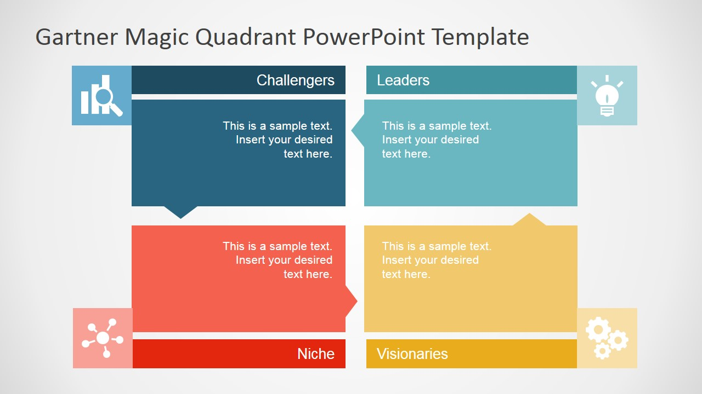
5
Achieving Service Quality
1. Cost of Quality
Products can be returned or exchanged if faulty; but what recourse does customer have to faulty services?
Prevention cost
External Failure Cost
  Costs associated with activities that keep failure from happening and minimize detection cost.
  Example: Quality Planning, Training Program, Recruitment and Selection
  Costs incurred to correct nonconforming work after delivery to customer.
  Example: Legal judgment, Negative-word of month, Investigation time
  Costs incurred to ascertain the condition of a service whether it conforms to safety standards.
  Example: Periodic inspection, Process Control, Collecting quality data
  Costs incurred to correct nonconforming work prior to delivery to the customer
  Example: Rework, Machine downtime
Detection Cost
Internal Failure Cost
Source: Fitzsimmons and Fitzsimmons: Service Management

Slide 13
5
Achieving Service Quality (Cont.)
2. Statistical Process Control
The performance of a service is judged by key indicators.
For example, the educational performance of a high school is measured by SAT. The effectiveness of a police department is judged by the crime rate.
A control chart is used to plot average values of a measure performance over time if the process remains in control.
x
6.9
Upper control limit
x
x
x
x
x
x
Mean response time, minutes
5.0
Average
x
x
x
3.1
Lower control limit
Times, days
Source: Fitzsimmons and Fitzsimmons: Service Management, P162

Slide 14
5
Achieving Service Quality (Cont.)
3. Unconditional Service Guarantee
There are five important feature to guarantee service
1
2
3
4
5
Unconditional
Easy to
Understand and communicate
Meaningful
Easy to Invoke
Easy to collect
Customer satisfaction is unconditional without exceptions
The guarantee should be important to the customer in financial as well as in service terms
A dissatisfied customer should not hassled with writing letters to invoke a guarantee.
The best guarantees are resolved on the spot
Customer should know precisely what to expect from a guarantee measure term.
L.L Bean, a Maine mail-order house accepts all returns by providing refunds and credits.
Bennigan’s promises that if a lunch is not served in 15 minutes, the diner receives a free meal
Domino’s Pizza guarantee that if an order is not delivered within 30 minutes, the customer gets $3 off rather than a free pizza
Cititravel guarantees the lowest airfares and a refund of the difference.
Bennigan’s and Domino’s Pizza
Source: Fitzsimmons and Fitzsimmons: Service Management

Slide 15
5
Achieving Service Quality (Cont.)
3. Unconditional Service Guarantee
However, the service guarantee can be redefined as the management view
Set clear standards
Promotes an understanding of the service delivery system
A company should set clear standards to knows when the service has failed.
5
1
3
Before a guarantee is made, managers must identify the possible failure in their system.
Focus on customer
Guarantee feedback
Build customer loyalty
Customers invoking a guarantee provide valuable information for quality assessment.
4
A guarantee forces a company to identify its customer expectation.
2
A guarantee builds markets share by keeping the loyal customers.
Source: Fitzsimmons and Fitzsimmons: Service Management

Slide 16
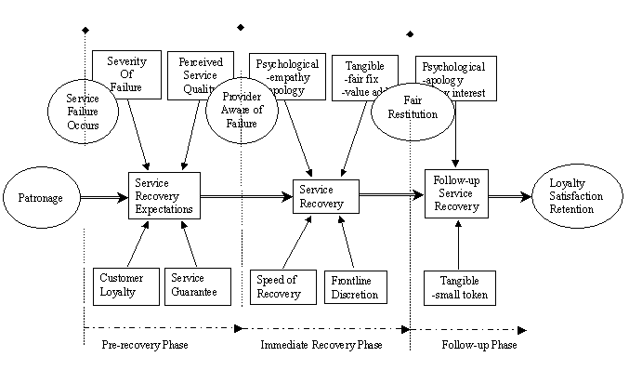

6
Service Recovery Framework
Even with the best quality intentions, service failures do occur. What to do then?
1
1
2
3
Source: Fitzsimmons and Fitzsimmons: Service Management, P165

Slide 17
6
Service Recovery Framework (Cont.)
There are four basic approaches address to service recovery.
1
2
3
4
The case-by-case approach
Systematic response approach
Early intervention
Substitute service
  Addresses each customer’s complaint individually but could lead to perception of unfairness.
  Uses a protocol to handle complaints but needs prior identification of critical failure points and continuous updating
  Attempts to fix problem before the customer is affected.
  Allows rival firm to provide service but could lead to loss of customer.
Source: Fitzsimmons and Fitzsimmons: Service Management

Slide 18
Discussion
Base on the concept of five dimensions of service quality, give examples of at least two concerns in each dimension of your group service industry.
Base on the service quality gap model, give examples of possible service quality gap (for all 5 GAPs) in your group service industry.
Design questionnaires to measure quality of your group service industry in both in the form of customer satisfaction survey and walk-through audit.

Slide 19
Discussion
Give examples of cost of quality of your group service industry in terms of prevention cost, detection cost, internal failure cost and external failure cost.
Give one or more examples of your group industry unconditional service guarantee.
Give examples of your group industry service recovery when service failures occur.

Slide 20

Reference
James A. Fitzsimmons, Mona J. Fitzsimmons, Service Management:
Operation. Strategy, Information, Technology, 8th Edition. McGraw-
Hill (Chapter 6)

