Slide 1

BA 291 – Management process and organizing
By Aj. Parichat Jantori

Slide 2
Management process
Management is a process designed to acheive an organization‘s objectives by using its resources effectively and effieciently in a changing environment
Effectiveness
- Selecting the proper goal and achieving it
- Satisfy customer needs
- Concerning the business environment
Efficiency
- Provide one stop-shop service (reduce unnecessary process)
- Reduce waiting time
- Lowering product reject rates
- Using minimum the resources

Slide 3

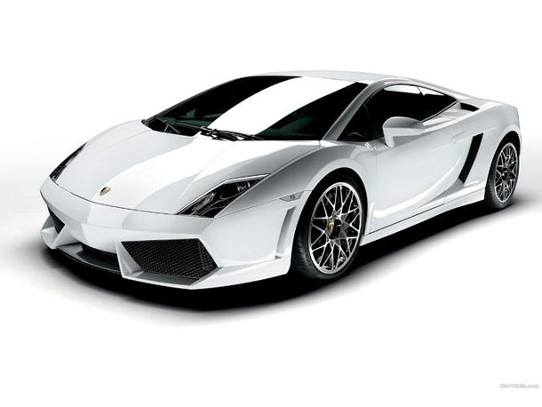
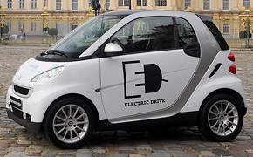
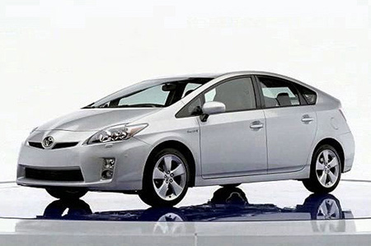
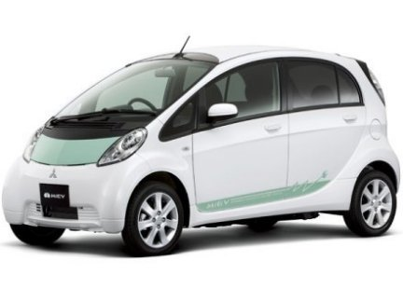

Slide 4
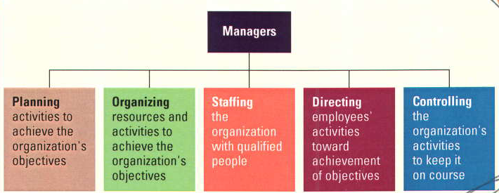
Management functions
organizing
Leading

Slide 5
Management functions
Planning – Process of determining the organization’s objectives and deciding how to accomplish them.
Organizing – Structuring of resources & activities to accomplish objectives efficiently & effectively.
Staffing – Hiring people to carry out the work of the organization.
Leading - Motivating and leading employees to achieve organizational objectives.
Controlling – Process of evaluating and correcting activities to keep organization on course

Slide 6
 | Planning | Organizing | Leading | Controlling
Active listening
Budgeting
Choosing effective leadership style
Coaching
Creating effective teams
Delegating
Designing motivating jobs
Developing trust
Interviewing
Management conflict

Slide 7
 | Planning | Organizing | Leading | Controlling
Managing resistance to change
Mentoring
Negotiating
Providing feedback
Running productive meeting
Scanning environment
Setting goals
Solving problems creatively

Slide 8
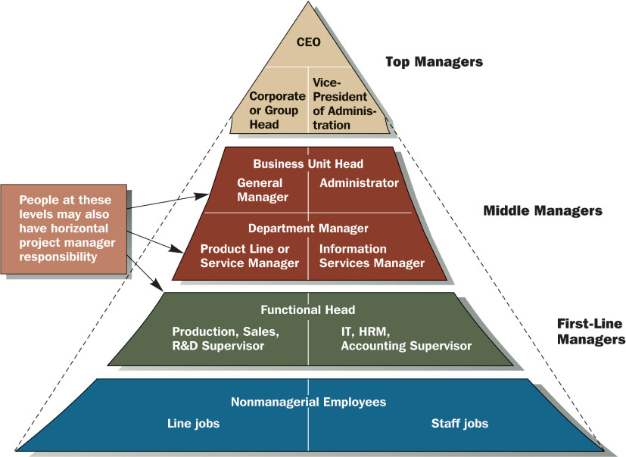
Level of management

Slide 9
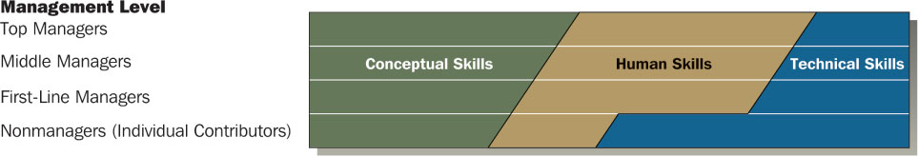
Managerial skills
Conceptual Skills – cognitive ability to see the organization as a whole system, ability to think strategically
Human Skills – the ability to work with and through other people
Technical Skills – the understanding and proficiency in the performance of specific tasks

Slide 10
Areas of management
Financial management
Production & operation management
Human resource management
Marketing management
IT management
Administrative management

Slide 11
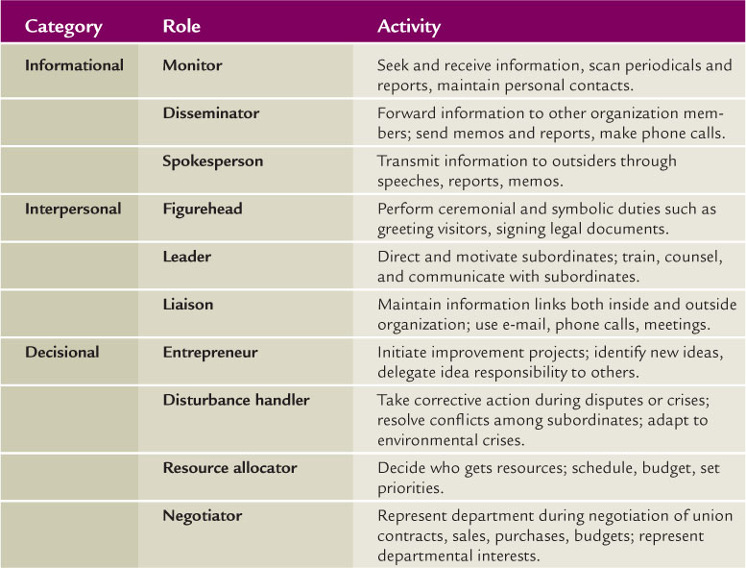
Managerial roles

Slide 12

Managers spend as much as 75% of their time working with others, inside and outside the organization
Managers spend a lot of time establishing and updating an agenda of goals and plans for carrying out their responsibilities
Managers spend a lot of time networking- building relationship and sharing information with people
Managers process ca. 36 pieces of mail each day
Managers spend a great deal of time confronting the complex and difficult challenges of the business world
In General, managers work 70-80 hours a week or even longer

Slide 13

Managers are needed in a wide variety of organizations. Experts suggest that employment will increase by millions of jobs by 2016. But the requirement for the job become more demanding with every passing year.
But salaries for managerial positions remain strong overall. Pay can very significantly depending on your level of experience, the size of the firm and the country where you live.

Slide 14
Manager salary
Senior relationship manager 70000 – 120000 (+ com)
Finance manager 65000 – 100000
HR manager 60000 – 120000
IT manager 60000 – 75000
Administration/ office manager 50000 – 80000
Marketing manager 55000 – 80000
Sales manager 50000 – 90000 (+ com + allowances)
(Kelly Services Thailand, 2010)
Notes:
http://money.cnn.com/galleries/2010/news/1004/gallery.top_ceo_pay/
http://www.worldsalaries.org/professor.shtml

Slide 15

Organizing
Organizing is the deployment of resources to achieve strategic goals by dividing labor into specific departments and job, formal lines and authority and mechanisms for coordinating diverse organizational tasks

Slide 16
Organizational Structure
Defines how tasks are divided, resources are deployed, and departments are coordinated
Set of formal tasks assigned
Formal reporting relationships
The design of systems to ensure effective coordination of employees across department

Slide 17
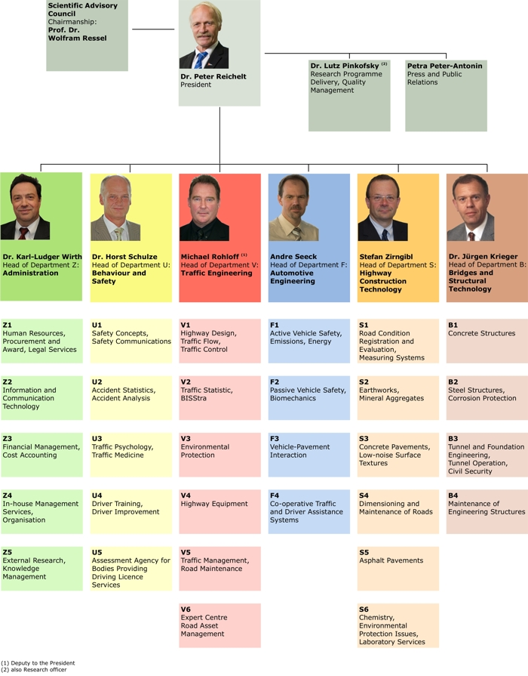
Organization Chart
Organization chart is a diagram that shows the structure of an organization and the relationships and relative ranks of its parts and positions/jobs
Visual representation
Set of formal tasks
Framework for vertical control
Formal reporting relationships

Slide 18

Organizational Structure – vertical structure
Work specialization
Sometimes called „division of labor“
The degree to which organizational task are subdivided into individual jobs so employees within each department perform only the tasks relevant to their specialize function
Jobs tend to be small, but they can be performed efficiently
Contra
Isolation
Lack of creativity and motivation
Boredom, stress
Poor quality
Pro
Efficiency
Learning effect
Productivity

Slide 19
Chain of Command
The line of authority extending from upper organizational levels to the lowest levels, which clarifies who reports to whom
Associated with two underlying principles
Unity of Command: each employee is held accountable to only one supervisor
Scalar Principle: a clearly defined line of authority in the organization that includes all employees
All persons in the organization should know to whom they report as well as the successive management levels all the way to the top

Slide 20
Authority, Responsibility, and Delegation
Responsibility: The duty to perform the task or activity an employee has been assigned. Typically, managers are assigned authority commensurate with responsibility
Authority: The power to make committment, to use resource and take actions.
Accountability: The people with authority and responsibility are subjected to reporting and justifying task outcomes to those above them in the chain of command.
For organization to function well, everyone needs to know what they are accountable for and accept the responsibility and authority to performing it.

Slide 21

Authority, Responsibility, and Delegation
Delegation: The process managers use to transfer authority and responsibility to positions below them in the hierarchy
Most of the organizations today encourage managers to delegate authority to the lowest possible level to provide flexibility to meet customer needs and adapt to the environment
How to delegate:
Delegate the whole task
Select the right person
Delegate both authority & responsibility
Give thorough instruction
Maintain feedback, evaluate and reward performance

Slide 22
Span of Management
The number of employees reporting to a supervisor
Traditionally: 7 subordinates per manager, Today: 30-40 subordinates
Supervisor Involvement
  must be closely involved with subordinates, the span should be small
  need little involvement with subordinates, it can be large

Slide 23
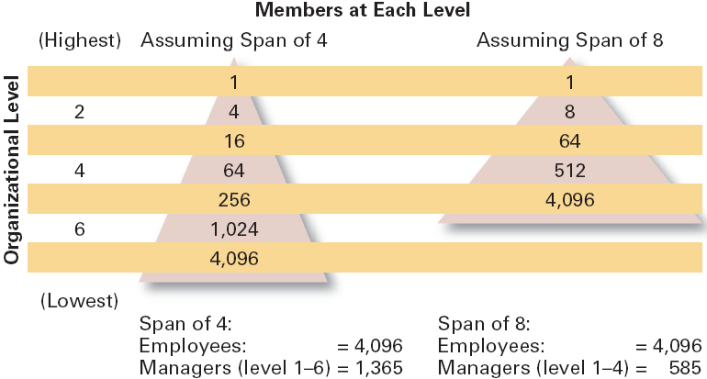

Slide 24
Span of Management – small or large?
Work is stable and routine
Subordinates perform similar work tasks
Subordinates are not concentrated in a single location
Subordinates are highly trained
Rules and procedure defining task activities are not available
Support systems and personnel are not available for the manager
Little time is required in nonsupervisory activities
Managers’ preferences and styles favor a large span

Slide 25

Centralization vs. Decentralization
Centralization: the location of decision authority
near top organizational levels
Decentralization: Decision making authority is
ddispersed throughout the organization

Slide 26
Centralization vs. Decentralization
  Environment is stable.
  Lower-level managers are not as capable or experienced at making decisions as upper-level managers.
  Lower-level managers do not want to have a say in decisions.
  Organization is facing a crisis or the risk of company failure.
  Company is large.
  Effective implementation of company strategies depends on managers retaining say over what happens.
  Environment is complex, uncertain.
  Lower-level managers are capable and experienced at making decisions.
  Lower-level managers want a voice in decisions.
  Corporate culture is open to allowing managers to have a say in what happens.
  Company is geographically dispersed.
  Effective implementation of company strategies depends on managers having involvement and flexibility to make decisions.
Centralization
Decentralization

Slide 27
Departmentalization
The basis for grouping positions into departments and departments into the total organization
Traditional approaches:
Functional structure
Division structure
Matrix structure
Contemporary approaches:
Team-based structure
Network structure
Virtual structure

Slide 28
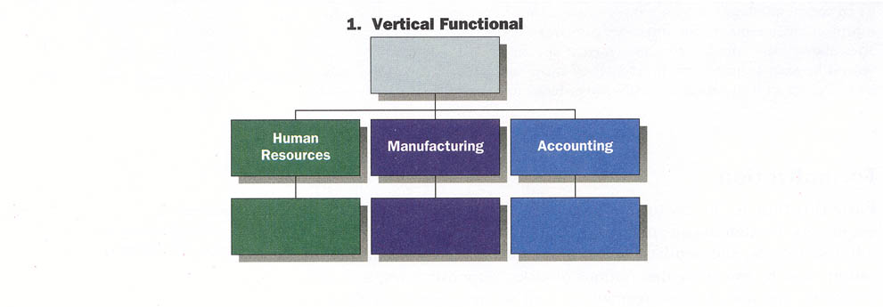
Functional Structure
Grouping of positions into departments based on similar skills, expertise, work activities, and resource use
Strengths: Cost-saving advantages from specialization, minimal duplication of people and equipment
Weakness: Functional specialist become insulted and have little understanding of what other units are doing, slow response to external changes

Slide 29
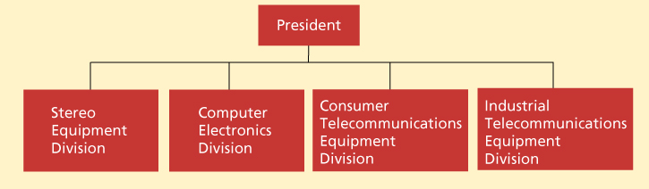
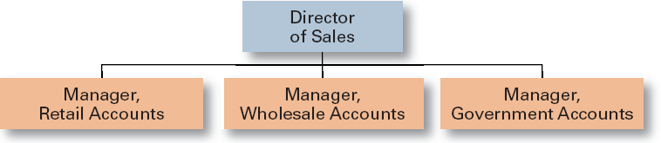
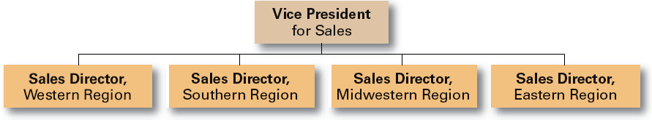
Division Structure
An organizational structure in which departments are grouped based on similar organizational outputs
structured by
Product
Customer
Geographic

Slide 30
Division Structure
Strengths
- Allows for focus on specific customers/ markets/ products
- Good structure for growth along geographical/ product lines
- Easy pinpointing responsibility (division managers are responsible for what happens to their products and service)
- Fast response and flexible to local needs
Weakness
Duplication of activities and resources increases cost and reduces efficiency
Coordinating and integration are difficult
May be difficult to manage diverse product lines

Slide 31
Matrix Structure
A structure in which the tasks of the organization are grouped along two organizational dimensions simultaneously
It normally utilizes functional and divisional chains of command simultaneously in the same part of the organization
Matrix structure has dual lines of authority (2 supervisors)

Slide 32
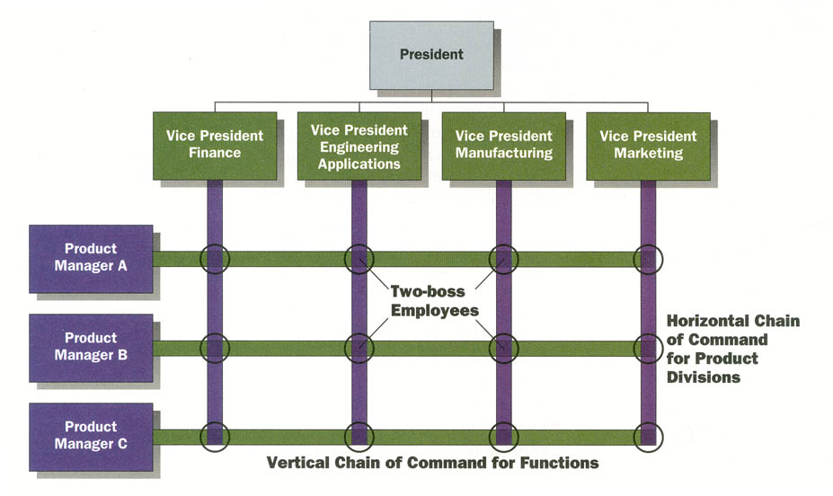
Matrix structure

Slide 33
Matrix structure
Strengths
Fluid and flexible design that an respond to environmental changes
Faster decision making
Interdisciplinary cooperation
Development of both generalist and specialist
Weakness
Lack of control
“two bosses” may lead to conflict
Communication difficulties

Slide 34
Line vs. Staff departments
Line Authority
individuals in management positions have the formal power to direct and control immediate subordinates
Line department performs tasks that reflect the organization’s primary goals and mission
Staff Authority
granted to staff specialists in their area of expertise
Staff department supports line department by giving advices

Slide 35

Team Approach
Most widespread trend in departmentalization in recent years
Gives managers a way to delegate authority, push responsibility to lower levels and be more flexible to responsive to changes
Team-based structure: Structure in which the entire organization is made up of teams that coordinate their work and work directly with customers to accomplish the organization‘s goals

Slide 36
Team-based Structure
Advantages
Reduce barriers among departments, increased compromise
Shorter response time, quicker decisions
Employee are more involved and empowered – high motivation
Reduced administrative overhead
Disadvantages
No clear chain of command, Dual loyalties and conflict
Time and resources spent on meeting

Slide 37
Network Approach
An organizational structure that disaggregates major function to separate companies that are brokered by a small headquarters organization
- Operating an “outsource” mode
HUB
Designer
HR Agency
Marketer
Manufacturer
Notes:
http://www.thaiairways.com/about-thai/company-profile/en/organization-chart.htm

Slide 38
Network approach
Advantages
Global competitiveness
Workforce flexibility challenge
Reduced administrative overhead
Disadvantages
Fragmentation make it difficult to develop control system
Can lose organization part
Difficult to develop employee loyalty

Slide 39
Virtual Network Structure
A contemporary organizational structure that is founded on a set of alliances with other organizations what serve a wide variety of functions
Coalition of geographically dispersed individuals, groups, organizational units or entire organization that pool resources, capabilities and information to achieve common objectives, while decisively relying on information technology

Slide 40

Virtual Network Structure
Advantages
Worldwide pool of expertise
High flexibility and response
Reduced administrative overhead
Disadvantages
Lack of control, weak boundaries
Greater demands on managers
Communication difficulties and potential for misunderstanding

Slide 41

Organizational control
The systematic process through which managers regulate organizational activities to make them consistent with expectations established in plans
Managers control:
  Work processes
  Employee behavior
  Financial resources
  Profitability

Slide 42
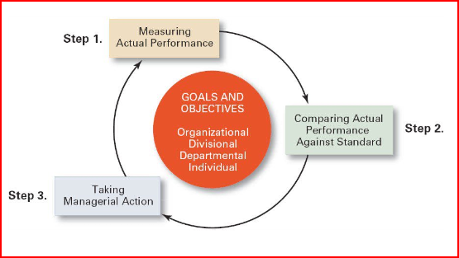
The control process
Setting standard and measurung: what we measure, how we measure
Comparing: determines the degree of variation between actual performance and the standard
Taking action: Action taken when the performance variation is unsatisfactory. Corrective action can be change in strategy, structure, redesign job or process, training program, fire employees

Slide 43
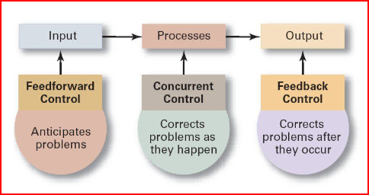
Type of control

