Slide 1
Economic Changes in Thailand 1950 - 1995

Slide 2
References
James Ingram: Economic Change in Thailand during1850- 1970, Chs. 11, 12
Chris Dixon: The Thai Economy: Uneven Development and Internationalisation, Chs. 3, 4

Slide 3
References
Peter Warr (ed.) (2005), Thailand Beyond the Crisis Ch.1

Slide 4
Issues:
45 years after the end of WW2:
How had the Thai economy changed?
What are the important factors which explain the economic changes?
What are important economic problems?

Slide 5
Period after WW II (1939 – 1945) and before the economic crisis in 1997 can be divided into 4 sub-periods, based on major macro-economic changes

Slide 6
Sub-period 1 : Postwar Recovery
(1946 - 1957)
Sub-period 2 : Stability
(1958 -1972)
Sub-period 3 : Turbulence
(1973 -1985)
Sub-period 4 : Boom
(1986 -1995)

Slide 7
Factors Affecting the Thai Economy
Natural resources
Human resources
Technology
World economic developments
Economic policies
Political situation

Slide 8
Thai Prime Ministers during the period
1938 – 1944 : Field Marshal Pibunsongkram (WW 2 : 1939 – 1945)
1944 – 1947 : ควง อภัยวงศ์ (Kuong) ทวี บุณยเกตุ (Tawee) ม.ร.ว. เสนีย์ ปราโมช (Seni) ดร. ปรีดี พนมยงค์ (Preedee) ถวัลย์ ธำรงนาวาสวัสดิ์ (Tawal) (A coup)

Slide 9
Thai Prime Ministers during the period
1947 – 1951 : ควง อภัยวงศ์ (Kuong)
1951 – 1957 : จอมพล ป. พิบูลสงคราม (Pibunsongkram staged a coup)
1957 – 1958 : นายพจน์ สารสิน (Pote), จอมพลถนอม กิตติขจร (Thanom)
1959 – 1963: จอมพลสฤษดิ์ ธนะรัชต์ (Sarit staged a coup)

Slide 10
Thai Prime Ministers during the period
1963 – 1973 : จอมพลถนอม กิตติขจร (Thanom)
1973 – 1977 : ศ. สัญญา ธรรมศักดิ์ (Sanya), ม.ร.ว. เสนีย์ ปราโมช (Seni), ม.ร.ว. คึกฤทธิ์ ปราโมช (Kukrit) , นายธานินทร์ กรัยวิเชียร (Thanin)
1977 – 1980: พลเอก เกรียงศักดิ์ ชมะนันทน์ (Kriengsak staged a coup)

Slide 11
Thai Prime Ministers during the period
1980 – 1988: พลเอก เปรม ติณสูลานนท์ (Prem)
1988 – 1991 : พลเอก ชาติชาย ชุณหวัณ (Chartchai)
1991 – 1992 : นายอานันท์ ปัณยารชุน (Anand from a coup)

Slide 12
Thai Prime Ministers during the period
1992 – 1995 : นายชวน หลีกภัย (Chuan)
1995 – 1996 : นายบรรหาร ศิลปอาชา (Banharn)
1996 – 1997 : พลเอก ชวลิต ยงใจยุทธ (Chawalit)
1997 – 2001 : นายชวน หลีกภัย (Chuan)

Slide 13
Postwar Recovery and Stability (1946-1972)
Effects of WW2 :
  Shortages of goods
  High inflation
  Practically no foreign exchange reserves

Slide 14
Postwar Recovery and Stability (1946-1972)
The Allied demanded war reparations in rice from Thailand:
  Multiple exchange rates (1947-1955)
  Rice premium (1955-mid 1980s)

Slide 15
Postwar Recovery and Stability (1946-1972)
Recovery
→ high economic growth of 6.6% during 1951-1969 (available national income data)
→ low inflation ~ 2% p.a.

Slide 19
Postwar Recovery and Stability (1946-1972)
Population :
  20 mill. In 1951
  35 mill. In 1969
  3.1% growth per year
  Income per capita growth over 3% p.a.

Slide 22
Postwar Recovery and Stability (1946-1972)
Exports more diversified into new crops
But imports of manufactures rose rapidly (esp. capital goods)
→ continuous trade and current account deficits since late 1950”s

Slide 25
Postwar Recovery and Stability (1946-1972)
Since 1963, domestic investment became larger than exports
  No longer true for export decline being matched by import reduction → more balance of payments difficulties when export falls
  Investment became an important cause of import rise and trade deficits

Slide 27
Postwar Recovery and Stability (1946-1972)
Substantial structural changes:
  Declining agriculture’s share in GDP; rapid rise in industry
  1951 1968
  Agriculture 50% 32%
  Industry 18% 31%
  Services 32% 37%

Slide 28
Postwar Recovery and Stability (1946-1972)
Agriculture still important in employment (80% of labor force) and export earnings
Diversify from rice to other new crops: maize, cassava, kenaf + existing crops: rubber, sugar cane, cotton

Slide 29
Postwar Recovery and Stability (1946-1972)
Rice: after long-term decline in yield per rai (1,600 sq. meters), reversing trend in 1960’s due to irrigation, improved seeds, and mechanization
Why decline?

Slide 30
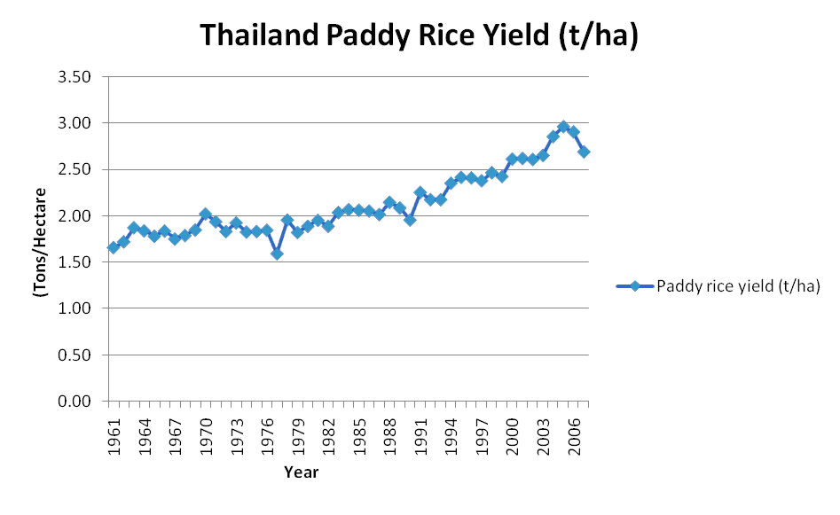

Slide 31
Postwar Recovery and Stability (1946-1972)
Rice Premium (export tax on rice): very controversial tax on rice export during 1955 and mid-1980’s

Slide 32
Postwar Recovery and Stability (1946-1972)
Pros for Rice Premium:
  Government revenue
  Keep inflation low
  Promote agricultural diversification
  Increase export prices (market power in the world)
  Reduce middlemen’s excess profit

Slide 33
Postwar Recovery and Stability (1946-1972)
Cons for Rice Premium:
  Depress farm price and income
  Cannot stabilize domestic prices
  Reduce incentive for farm productivity improvement

Slide 34
Postwar Recovery and Stability (1946-1972)
Other cash crops:
  Made possible by road construction into rural areas
  Regional specialization (kenaf in NE, maize in Central, rubber in South)
  Small farmers responding to price

Slide 35
Postwar Recovery and Stability (1946-1972)
Other cash crops:
  Produce in response to external demand (high rubber price during the Korean War in 1950’s); a new source of foreign exchange, reducing shares of traditional exports
  New crops + continuing rice growing (cultural and risk-reducing reasons)

Slide 36
Postwar Recovery and Stability (1946-1972)
Early 1950’s, expanded government role in industrial state enterprises (textiles, paper, glass, sugar, ….):
  3 motives: (Phibun government 1948-57)
    Prevent Chinese domination
    Government initiative needed
    Private gains by officials

Slide 37
Postwar Recovery and Stability (1946-1972)
Early 1950’s, expanded government role in industrial state enterprises (textiles, paper, glass, sugar, ….):
  Inefficiency and losses → Sarit’s policy change to encourage investment by private sector; government only invest in infrastructure (power, transport, communication) and “promotion”

Slide 38
Postwar Recovery and Stability (1946-1972)
Sarit’s regime (1958-63) followed World Bank’s advice:
  infrastructure invested by government, and promote private investment
  Economic planning
Dr. Puey Ungphakorn’s role as BOT governor and capable bureaucrat

Slide 39
Postwar Recovery and Stability (1946-1972)
Sarit began modern economic reform, setting up institutions (economic plans by NESDB, Board of Investment, Fiscal Policy Office)
Close relationship between military, politicians, government officials, and private investors/bankers led to corruption

Slide 40
Postwar Recovery and Stability (1946-1972)
Board of Investment (BOI) created in 1959
Promotion incentives: tax exemption, land ownership by foreign firms, no state competition and nationalization

Slide 41
Postwar Recovery and Stability (1946-1972)
Import tariffs and investment promotion → high growth in manufacturing: 15% of GDP in 1968; food processing and consumer goods

Slide 42
Postwar Recovery and Stability (1946-1972)
Tariff increases to protect local industry and generate government revenue
High rates on consumer goods and low on capital goods → high “effective” rates of protection for finished products

Slide 43
Postwar Recovery and Stability (1946-1972)
Share of capital goods in imports increased (25% to 47%), while share of consumer goods declined

Slide 44
Import Classification | 1950 | 1955 | 1960 | 1965 | 1969
Consumer goods | 59.0 | 48.8 | 39.2 | 31.3 | 25.8
Materials for consumer goods | 9.4 | 11.3 | 12.1 | 18.2 | 20.5
Materials for capital goods | 6.5 | 9.2 | 11.1 | 7.4 | 7.2
Capital goods | 25.1 | 30.7 | 37.6 | 43.1 | 46.5
Total | 100.0 | 100.0 | 100.0 | 100.0 | 100.0

Slide 45
Postwar Recovery and Stability (1946-1972)
Ingram concludes:
Industrial investment
→ imports of raw material and capital goods substituting for imports of finished consumer goods
→ no economies of scale, no export potential

Slide 46
Postwar Recovery and Stability (1946-1972)
Adopted a system of multiple exchange rate (1947-1955) to build up reserves and control inflation
  Some exports must sell FE at official ER, below market rate (10 vs 24 baht/$)

Slide 47
Postwar Recovery and Stability (1946-1972)
Adopted a system of multiple exchange rate (1947-1955)
  Bank of Thailand sells FE at official ER for “essential” imports
  For other transactions, buying and selling FE at market rate
  Switched to single rate, fixed with $ since 1955

Slide 48
Postwar Recovery and Stability (1946-1972)
Conservative monetary policy: money supply growth consistent with output + large FE reserves holding (current a/c deficits, but foreign aid, loans and FDI)
→ price stability

Slide 49
Postwar Recovery and Stability (1946-1972)
large FE reserves holding for fear of temporary BOP surplus
  Vietnam war and US military spending in Thailand; future US withdrawal

Slide 50
Postwar Recovery and Stability (1946-1972)
First national economic plan (1961-1966) and setting up NESDB: economic target setting and government investment in infrastructure (power, transport, irrigation, education, …..)
Now: beginning of the 11th plan (2012-2016)

Slide 51
Subperiod 1 : Postwar Recovery
(1946 - 1957)
Subperiod 2 : Stability
(1958 -1972)
Subperiod 3 : Turbulence
(1973 -1985)
Subperiod 4 : Boom
(1986 -1995)
51

Slide 52
Turbulence (1973-1985)
Economic growth increased the number of middle class and educated
End of the 1960s: the terrorism problem began in the Northeast

Slide 53
Turbulence (1973-1985)
Economic uncertainty and political instability
Two periods of oil crisis:
  1973/74 : four-fold oil price increase
  1979/80: big jump of oil price
90% of commercial energy from imported oil

Slide 54
Turbulence (1973-1985)
Oil share in total imports increased
  From 10% to 20% (1973/74)
  From 20% to 30% (1979/80)

Slide 55
Turbulence (1973-1985)
GDP growth fell
  To 4.1% in 1974
  To 4.9% in 1980
  Average growth = 6.5% p.a. during 1973-1985

Slide 56
Turbulence (1973-1985)
Economic slowdown created high rates of unemployment (even educated unemployed)
Double-digit inflation in 1973-74 and 1978-81

Slide 57
Turbulence (1973-1985)
Higher current a/c deficits:
  Not so high in 1973/74, being cushioned by high export prices in world markets
  6-7% of GDP in 1979-81

Slide 58
Turbulence (1973-1985)
Foreign debts went up sharply, reaching 30% of GDP in 1985
Most borrowing by state enterprises and military (buying weapons to fight terrorists)
Higher impact of the second oil crisis as agri. export prices fell

Slide 59
Turbulence (1973-1985)
Situation worsened by:
  US withdrawal from Vietnam war in 1976 → less military spending in Thailand
  War in Cambodia and insurgency in Thailand after 1976 → need for higher defence budget

Slide 60
Turbulence (1973-1985)
Situation worsened by:
  High world interest rates and economic recession in industrialized countries in early 1980’s
  Domestic political upheaval (14 October 1973, 6 October 1979)

Slide 61
Turbulence (1973-1985)
Policies coping with the problems:
  more active export promotion in the 1970’s: soft loans by Bank of Thailand; tax rebates for imported inputs used in export production

Slide 62
Turbulence (1973-1985)
Policies coping with the problems:
  price control and subsidies for oil products to contain inflation; but government budget deficits and energy inefficiency

Slide 63
Turbulence (1973-1985)
Policies coping with the problems:
  Indigenous energy: promote petroleum exploration → natural gas in Gulf of Thailand started flowing in 1981

Slide 64
Turbulence (1973-1985)
Policies coping with the problems:
  baht devaluation in 1981 and 1984, boosting exports
  Three economic plans (nos. 3, 4, 5) aim for rural development, poverty reduction, and economic restructuring/recovery

Slide 65
Turbulence (1973-1985)
Policies coping with the problems:
  Fiscal discipline and spending cuts
  Financial Institution Development Fund (FIDF) to cope with failure in financial institutions

Slide 66
Turbulence (1973-1985)
Policies coping with the problems:
  Eastern seaboard development: natural gas-related industrial complex; deep sea ports in 2 eastern provinces

Slide 67
Turbulence (1973-1985)
Manufacturing continued to increase its share in GDP and export (over 20% in 1980):
  more diversified industries: agro-business (chickens, canned pineapple), textiles, motor vehicle (highly protected)

Slide 68
Turbulence (1973-1985)
Manufacturing continued to increase its share in GDP and export (over 20% in 1980):
  Development of manufactured exports during the 1970’s: processed food, garments, wood products, leather, and electrical products

Slide 69
Turbulence (1973-1985)
Agriculture:
  Increased importance in marine and livestock (e.g. CP)
  Fluctuating and falling crop prices after first oil crisis
  Slow growth, and declining share in the economy (15% of GDP in 1985)

