Slide 1
Topic 10
Game Theory
(Chapter 14)

Slide 2
Game Theory Overview
What is Game Theory?
Game Theory is the study of mathematical models of strategic interaction among rational decision-makers.
The key pioneers of game theory were mathematicians John von Neumann and John Nash.
What is a Game?
Games are defined as strategic situations in which there are multiple participants. Furthermore, the outcome of the decision any individual makes is dependent on the decisions made by all of the other participants.

Slide 3
Game Theory Overview
Is Sudoku a “game?”
No, not the way we defined “game.” Sudoku is not a “game” because what you do when solving the game is independent of what anyone else does.
Is Chess a “game?”
Yes! Imagine that you are playing a game of chess with a friend. Whether you win or not will be dependent on the moves you make and the moves your friend makes.

Slide 4
Types of Games
Types of Games
One-shot: a game that is played once.
Repeated: a game that is played more than once.
Simultaneous-move: players make decisions at the same time.
Sequential-move: players takes turns to make decisions.
Most games that we will study are 2-player games, but they can be extended to n-player game (i.e. more than 2 players).

Slide 5
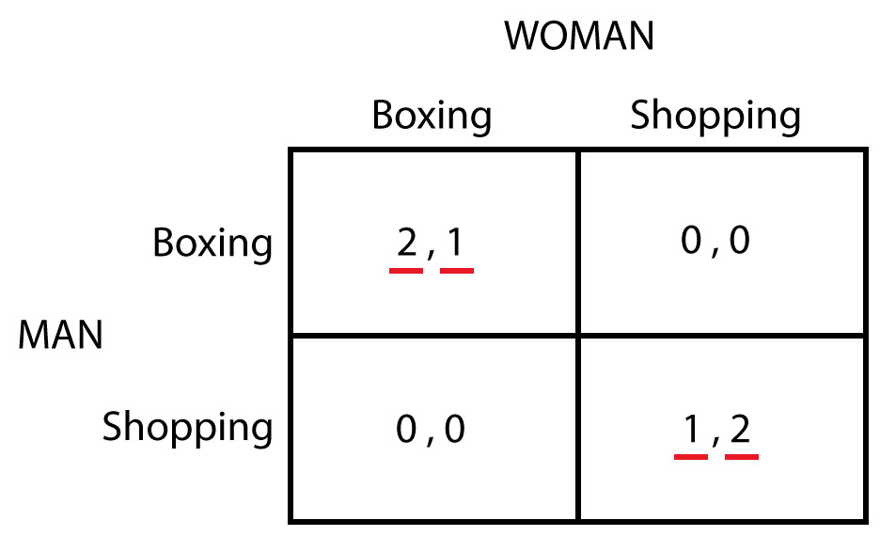
An Example
This is a one-shot, simultaneous-move game, called “Battle of the Sexes”.

Slide 6
Game Elements
Players: Agents participating in the game (Man, Woman)
Strategies: Actions that each player may take under any possible circumstance (Boxing, Shopping)
Outcomes: The various possible results of the game (four, each represented by one cell of matrix)
Payoffs: The benefit that each player gets from each possible outcome of the game (the numbers entered in each cell of the matrix)
For example, if both players choose Boxing, (2, 1) will be the outcome with 2 being the payoff of Man and 1 being the payoff of Woman.

Slide 7
Capacity Expansion Game
What is the likely outcome of this game?
We study Game Theory to answer such question.
Toyota
Honda

Slide 8
Nash Equilibrium
Definition: A Nash Equilibrium (NE) occurs when each player chooses a strategy that gives him/her the highest payoff, given the strategy chosen by the other player(s).
NE of Toyota vs. Honda Game: Each Firm Builds a New Plant.
Given Toyota builds a new plant, Honda's best response is to build a new plant.
Given Honda builds a new plant, Toyota's best response is to build a plant.
Why is the Nash Equilibrium plausible?
It is "self enforcing”, and no player would want to deviate from the NE. If a player deviates, he/she will get a lower payoff.

Slide 9
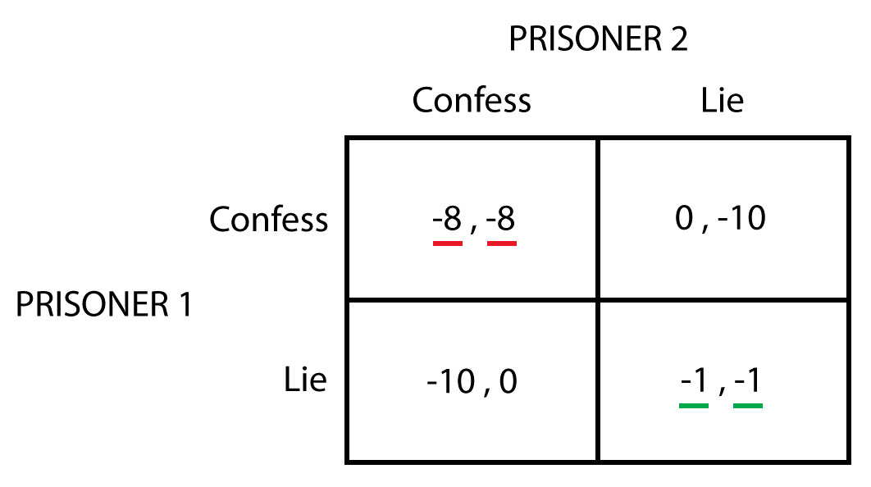
Prisoner's Dilemma
Definition: A game situation in which there is a conflict between the collective interest of all of the players and the self-interest of individual players is called a Prisoner's Dilemma.

Slide 10
Dominant and Dominated Strategies
Definition: A dominant strategy is a strategy that is better than any other strategy that a player might choose, no matter what strategy the other player follows.
Note: When a player has a dominant strategy, that strategy will be the player's Nash Equilibrium strategy.
Definition: A dominated strategy is a strategy such that the player has another strategy that gives a higher payoff, no matter what the other player does.
Note: Dominated strategies can be eliminated from consideration in order to solve the game more easily.

Slide 11
Dominant Strategy
Definition: A Dominant Strategy Equilibrium occurs when each player uses a dominant strategy.
Toyota
Honda

Slide 12
Dominated Strategy
Toyota
 | Build Large | Build Small | Do Not Build
Build Large | 0, 0 | 12, 8 | 18, 9
Build Small | 8, 12 | 16, 16 | 20, 15
Do Not Build | 9, 18 | 15, 20 | 18, 18
Honda
"Build Large" is dominated for each player, so this strategy will not be chosen by both players. We can eliminate it from our consideration.

Slide 13
Finding the NE

Slide 14
Nash Equilibrium Limitations
The Nash Equilibrium need not be unique.
The Game of Chicken, also known as the Hawk–Dove Game, is a model of conflict for two players in game theory.
The principle of the game is that while it is to both players’ benefit if one player yields, the other player's optimal choice depends on what their opponent is doing: if the player opponent yields, they should not, but if the opponent fails to yield, the player should.
The game of chicken has TWO NEs, which show that one player will win and one player will lose, but we cannot say who will win.

Slide 15
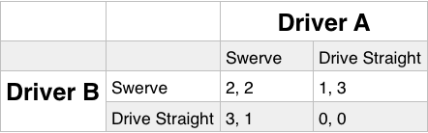
Nash Equilibrium Limitations
The Nash Equilibrium need not be unique.
The name "chicken" has its origins in a game in which two drivers drive towards each other on a collision course: one must swerve, or both may die in the crash, but if one driver swerves and the other does not, the one who swerved will be called a "chicken", meaning a coward.

Slide 16
Finding the NEs

Slide 17
Nash Equilibrium Limitations
Nash Equilibrium need not exist.
Matching pennies is a game, played by 2 players (A and B):
Each player has a penny and must secretly turn the penny to heads or tails.
The players then reveal their choices simultaneously.
If the pennies match (both heads or both tails), then one player (e.g. Player B) keeps both pennies.
If the pennies do not match (one head and one tail), then the other player (e.g. Player A) keeps both pennies.
Matching Pennies is a zero-sum game, which does not have NE.
Another example of a zero-sum game is Rock-Paper-Scissors.

Slide 18
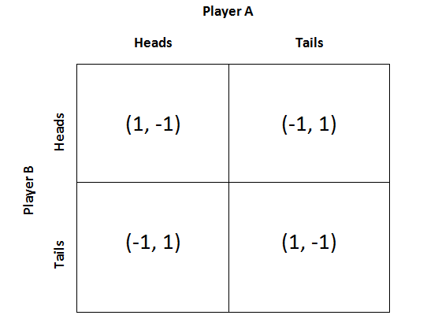
Nash Equilibrium Limitations
Nash Equilibrium need not exist.

Slide 19
Pure Strategies and Mixed Strategies
Pure Strategy – A specific choice of a strategy from the player’s possible strategies in a game.
Note: The games with the NE(s) so far has a pure strategy NE, i.e. players select their strategies from the choices they have.
Mixed Strategy – An assignment of a probability to each pure strategy. This allows for a player to randomly select a pure strategy.
Note: A game without a pure strategy NE, e.g. matching pennies, will always have at least one NE that involves a mixed strategy.

Slide 20
Finding the Mixed Strategy NE
This involves at least one player randomizing between the pure strategies, i.e. he/she will assign probabilities to the choices.
In matching pennies, each player will play Head with 50% probability and Tail with 50% probability.
Example: Matching Pennies

Slide 21
Repeated Prisoner’s Dilemma
So far, we considered only “one-shot” games, where players cannot cooperate, cooperation can arise in “repeated” games.
Cooperation can result from self-interested behaviour on the part of each player under certain circumstances:
“Grim Trigger” Strategy – One-time cheating by one player triggers the grim prospect of a permanent breakdown in cooperation for the remainder of the game.
“Tit-for-Tat” Strategy – A strategy in which you do to your opponent in this period what your opponent did to you in the last period.

Slide 22
Repeated Prisoner’s Dilemma

Slide 23
Repeated Prisoner’s Dilemma
Likelihood of cooperation increases under these conditions:
The players are patient.
Interactions between the players are frequent.
Cheating is easy to detect.
The one-time gain from cheating is relatively small.
Likelihood of cooperation diminishes under these conditions:
The players are impatient.
Interactions between the players are infrequent.
Cheating is hard to detect.
The one-time gain from cheating is large in comparison to the eventual cost of cheating.

Slide 24
Sequential-Move Games
Sequential-Move Games are games in which one player (the first mover) takes an action before another player (the second mover). The second mover observes the action taken by the first mover before deciding what action it should take.
A game tree shows the different strategies that each player can follow in the game and the order in which those strategies get chosen.
Backward Induction is a procedure for solving a sequential-move game by starting at the end of the game tree and finding the optimal decision for the player at each decision point.

Slide 25
Sequential-Move Games
Here, Honda moves first. After Honda chooses its strategy, Toyota then decides its strategy.

Slide 26
Sequential-Move Games
With Backward-Induction, the NE of the sequential-move game is Build Large for Honda and Do Not Build for Toyota.
Recall (from Page 12) the NE of the simultaneous-move version of this game is Build Small for both companies.

Slide 27
Sequential-Move Games
Sometimes, in sequential-move games, the first mover can adopt “strategic moves” which are actions taken in an early stage of a game that can alter the second mover’s behavior.
In the above example, the strategic move is for Honda to make commitment to “Build Large” when Toyota were to choose “Do Not Build”.
In short, strategic moves that seemingly limit options (i.e. by having the commitment) can actually make a player better off.
For a strategic move to work, it must be visible, understandable, and hard to reverse.

