Slide 1
DEPOSIT

Slide 2
Deposit is a finance transaction that transfers fund to another party such as bank for safekeeping or using as a collateral for securing loans

Slide 3
TYPE
There are four main types of deposit
Saving Account
Fixed Deposit Account
Current Account
Foreign Currency Deposit Account

Slide 4
What is
SAVING
ACCOUNT
A savings account is the account that commercial banks make out for retail customers ,which focuses on the comfortability of customer
Interest rate are paid to depositors ,which is computed on daily basis and compounded interest rate to paid on the last day of June and December.
Suitable for short term depositor who required liquidity

Slide 5
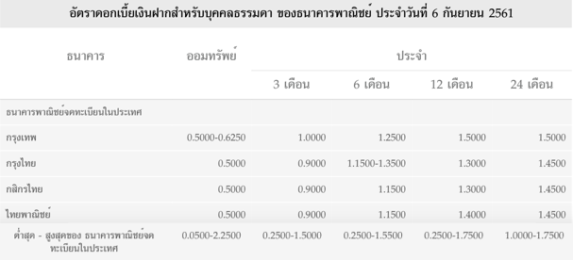

Slide 6


Benefit of SAVING ACCOUNT
Liquidity : as saver can deposit and withdraw the money in account anytime
Convenience : ATM (automated teller machine), Debit card, and Internet Banking
No time specification
No determination or very low requires of the minimum amount of deposit.

Slide 7
What is
FIXED
DEPOSIT
ACCOUNT
Also known as term deposit
Minimum deposit of 1,000 - 5,000 THB
A fixed account is an investment account and of which is a type of saving account providing a higher rate of interest
Having low liquidity, so it is compensated by the higher interest rate provided
Depositing money for a fixed period of time is 3, 6, 9, 12, 24, and 36 months
Tax 15%
Notes:
Tax 15% ของดอกเบี้ยที่ได้
ดอกเบี้ยรายปี annual percentage rate
ดอกเบี้ยทบต้น
compound interest
A fixed deposit (FD) is a financial instrument provided by banks or NBFCs which provides investors a higher rate of interest than a regular savings account, until the given maturity date. It may or may not require the creation of a separate account. It is known as a term deposit or time deposit in Canada, Australia, New Zealand, and the US, and as a bond in the United Kingdom and India.
They are considered to be very safe investments
เป็นบัญชีที่เหมาะสำหรับการออมแบบมีกำหนดระยะเวลาแน่นอน เช่น ระยะเวลาฝาก 3,6 เดือน 1 ปี เป็นต้น โดยปกติในการฝากแต่ละครั้งธนาคารจะกำหนดจำนวนเงินขั้นต่ำไว้ประมาณ 1,000 - 5,000 บาทและบัญชีเงินฝากประจำจะได้รับดอกเบี้ยสูงกว่าเงินฝากออมทรัพย์ เพราะเป็นเงินฝากที่มีระยะเวลานาน ทำให้ธนาคารสามารถนำไปหาผลประโยชน์ได้สะดวกกว่าเงินฝากประเภทอื่น แต่ดอกเบี้ยที่ได้รับต้องเสียภาษีในอัตราร้อยละ 15 ต่อปี (ในกรณีเป็นบุคคลธรรมดา) เว้นแต่จะเข้าข้อยกเว้น ในการถอนเงินผู้ฝากสามารถถอนเมื่อไหร่ก็ได้แต่ในกรณีที่ถอนก่อนครบกำหนด ผู้ฝากอาจไม่ได้รับดอกเบี้ย หรือได้รับดอกเบี้ยน้อยลงแล้วแต่เงื่อนไขที่ธนาคารกำหนด

Slide 9
Benefit of FIXED DEPOSIT ACCOUNT
Higher interest rate
Safe investment
Tax exemption Deposit : 1 year
Compound interest
condition
Age : 55 years old
Interest : ฿ 30,000
Notes:
This account give HIGHER RATE OF INTEREST : this returns are generally over the returns offered by a saving account.
SAFE INVESTMENT : FDs are risk free investment bc at the end of the maturity period you get an assured sum of money.
TAX EXEMPTION : Tax can be exempted if conditions are followed. deposit more than 1 year , age is over 55 years old and the sum of interest from all fixed deposit account is not over 30,000.
COMPOUND INTEREST calculation

Slide 10

What is
CURRENT ACCOUNT
Or
CHECKING
ACCOUNT
Transaction can be done by paying check
High level of liquidity
Customer can ask for overdraft
Required high amount of beginning balance
Non-interest bearing bank account.
Can have unlimited transactions
Notes:
Access may be in a variety of ways, such as cash withdrawals, use of debit cards, cheques (checks) and electronic transfer. In economic terms, the funds held in a transaction account are regarded as liquid funds and in accounting terms they are considered as cash.
การใช้เช็ค
Why paying check cause this account so liquid?
This account Can use ATM/Debit cards
Can have unlimited transactions like you can withdraw or deposits many time as much as you want in day-to-day activity.
Customer can ask for overdraft mean that you Can have negative balance (if your bank agrees and they usually charge you huge fees also.
current account is meant for individuals, business entities, government bodies, societies, trusts, institutions suit forสำหรับ องค์กร หน่วยงาน ธุรกิจ ประมานนี้
Suitable for Businessman or company
Current account refers to a running account, in which there is no limit on the operation, during a working day.
When you open the account they usually required you Huge amount of money
สามารถ transfers, overdraft facility, direct debits, no limit on the number of withdrawals/deposits, Internet Banking
Current (Checking) account is an active account which is meant for day to day monetary transactions.
Current Account is perfect for business entities, government departments, societies, institutions, etc. because they have to deal with daily money transactions
there is no restriction on the number and amount of transaction.
no passbook is issued by the bank to the current account holders.
current account requires high amount as the opening balance, to start the account.
Suitable for Businessman or company

Slide 11
Benefit of
CURRENT ACCOUNT
or
CHECKING
ACCOUNT
Unlimited transactions
Receiving and spending money without carrying cash
Money safety
Credit purchase
Overdraft facility
Collateral
Notes:
Liquidity in business sense as i mentioned before that a businessman can have unlimited time of deposit and withdraw.To run a business transactions smoothly
ง่าย สะดวก เช่น สามารถให้ messengerไปรับเงินค่าของได้ แต่ไม่ต้องกังวลว่าเค้าจะขโมยหรือป่าว เพราะหน้าเช็ค ก็เขียนชื่ออยู่แล้ว ว่าสั่งจ่ายใคร
Receiving and spending money without carrying cash
Credit purchase ในเรื่อง บางทีเงินไม่พอ สั่งจ่ายเช็คไปก่อนแล้วอีก 15 วัน ค่อยให้ เจ้าหนี้เบิกได้
Money safety
And lastly Collateral it is the legal process in term of borrow money in a short period of time
Check will act as a collateral in the sense that you have a close friend or you relative like you uncle say you want to borrow your uncle 100.000 baht and you know that you can pay back him next month you will Prepaid Cheque
for example check act as a collateral in the sense of when you want huge amount of money to borrow in a short period of time
Legal process
Cheque act as a collateral in term of legal process of confirmation that money borrowed from creditors would be fully paid by the debtors.
http://www.pattanakit.net/รวมบทความการจัดการธุรกิจ/ทำไมต้องมีบัญชีกระแสรายวัน.html

Slide 12
What is
FOREIGN CURRENCY DEPOSIT ACCOUNT
Deposit is foreign currency
To lessen the cost of exchanging the currency and Risk management in transactions with foreign currency
Interest rate depends on currency
Suitable for those who have payment in foreign currency
Fees
The principal and interest are not protected by Deposit Protection Agency
Notes:
The principal and interest are not protected by Deposit Protection Agency

Slide 13
Benefit of
FOREIGN CURRENCY DEPOSIT ACCOUNT
Mitigating incurred expenses in converting one currency to another
Minimizing risk over exchange rate fluctuation
Notes:
Great for those who have payments in foreign currency

Slide 14
EXAMPLE

Slide 15
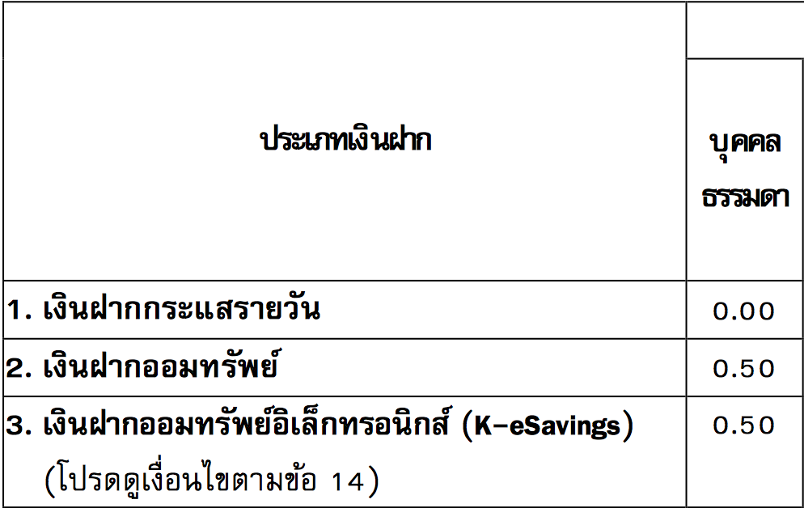
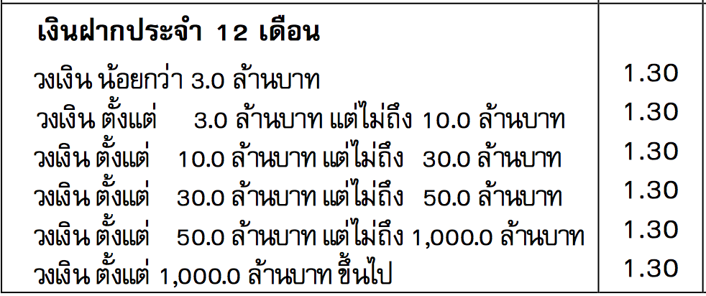
Compare the return
From deposit between saving account and fixed account
Kasikorn banK interest rate on 16 august 2018

Slide 16
SAVING ACCOUNT
Beginning to save
On 1st of january
Value of money
on 30th june
Value of money
on 31th December
Deposit 12,000 baht
12,030 baht
12,060.075 baht
Assume that customer not withdraw the money along the year
12,000x0.5%x6
=12,000+ 12
12,030x0.5%x6
=12,030+ 12
So, the interest that customer will get is 12,060.075 - 12,000 = 60.075 baht

Slide 17
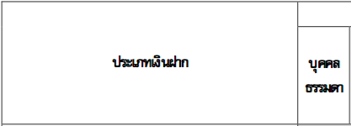
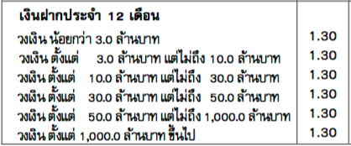
FIXED DEPOSIT ACCOUNT

Slide 18
Month | Deposit | Compounding | Interest
1 | ฿1,000 | ฿ 1,000 | ฿ 1.083
2 | ฿1,000 | ฿ 2,000 | ฿ 2.167
3 | ฿1,000 | ฿ 3,000 | ฿ 3.254
4 | ฿1,000 | ฿ 4,000 | ฿ 4.340
5 | ฿1,000 | ฿ 5,000 | ฿ 5.428
6 | ฿1,000 | ฿ 6,000 | ฿ 6.518
7 | ฿1,000 | ฿ 7,000 | ฿ 7.608
8 | ฿1,000 | ฿ 8,000 | ฿ 8.700
9 | ฿1,000 | ฿ 9,000 | ฿ 9.792
10 | ฿1,000 | ฿ 10,000 | ฿ 10.886
11 | ฿1,000 | ฿ 11,000 | ฿ 11.981
12 | ฿1,000 | ฿ 12,000 | ฿ 13.078
 |  | ฿ 12,000 | ฿ 84.835
FIXED DEPOSIT ACCOUNT
1.3%
2001.083
12
Compound interest multiplied with Interest rate per month
Deposit ฿ 1000 per month for 12 months
1.3%
Maturity period

Slide 19
RECOMMENDATION

Slide 20



Reason for deposition
To prevent money from unexpected event ,such as flood,fire and stealing.
Gain interest on the deposited money

Slide 21

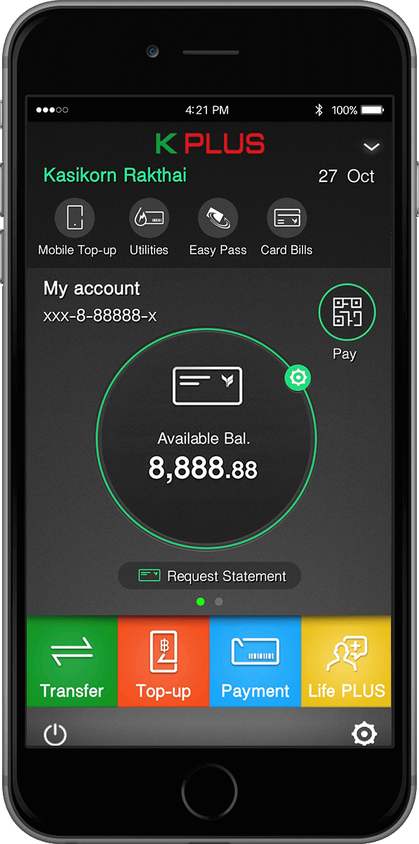
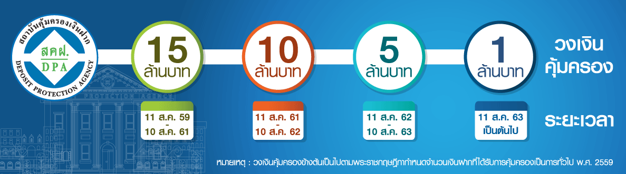
Reason for deposition
Deposit Protection
Agency
Pay money back when bankrupt
Cashless transaction
(fintech)

Slide 22
Q&A

Slide 23
THANK YOU

Slide 24
MEMBER
PATITTA EKVIRIYAKIJ 5904640116
JIDAPA CHOKKIJ 5904640496
NATTARIKA TITHIKUN 5904640637
CHANOKNUN LERTCHOKCHAI 5904640942
NETNAPHA LETRAKOONKIT 5904641718
SUTIPAT TIYAPANITKUN 5904641890

