Slide 1
Globalization and Populism

Slide 2
Globalization
Globalisation is the rising in connections of people and businesses through the growth of the international flow of money, ideas and culture. Globalization is primarily an economic process of integration which has social and cultural aspects as well.
Status quo

Slide 3
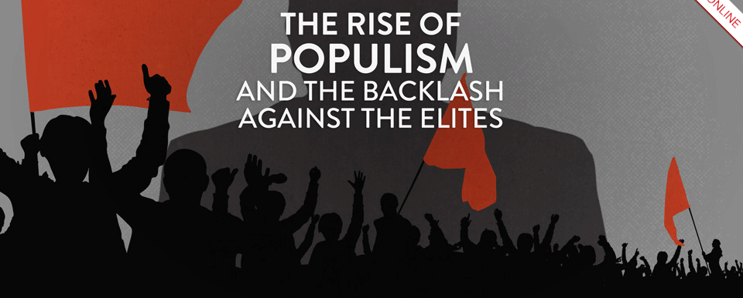
Populism
Populism or a populist political strategy can be quite simply defined “as a “thin ideology” that sets up a simple framework: that of a pure people versus a corrupt elite.” - Cas Mudde

Slide 4
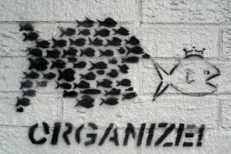
Divide society into two
  The “Elite” or the “Establishment” as the villain
  “The People,” the “Silent Majority,” the “Common Person,” or the “Forgotten Majority” as the ‘good’ people, who the populist promises to represent, listen to and who is the ‘good people’s’ only
  champion who will look after them.
  Populists define themselves as political
  outsiders, not corrupted by or not part of the
  old, exclusive nasty political system.

Slide 5
Some examples anyone?

Slide 6
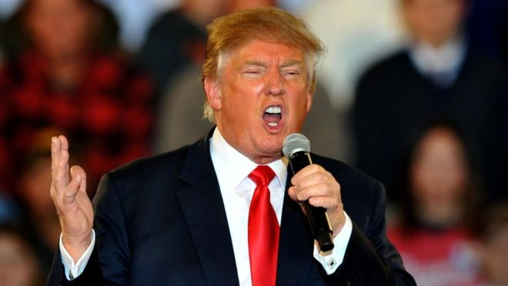

Slide 7
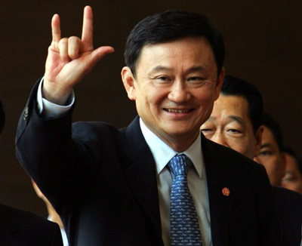

Slide 8
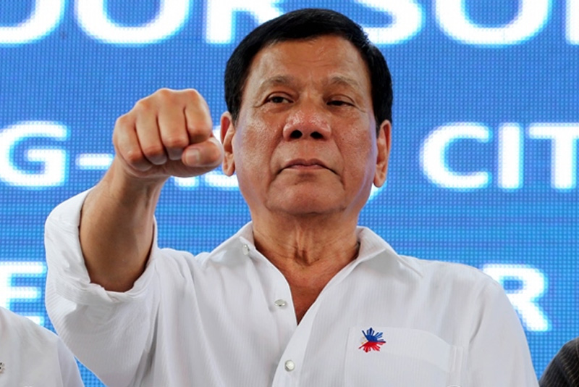

Slide 9
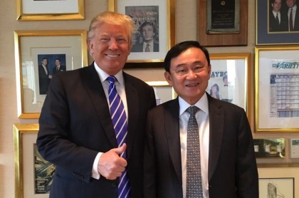

Slide 10
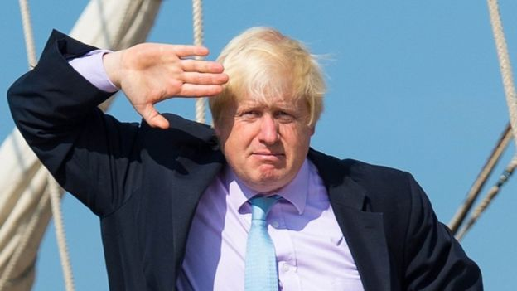

Slide 11
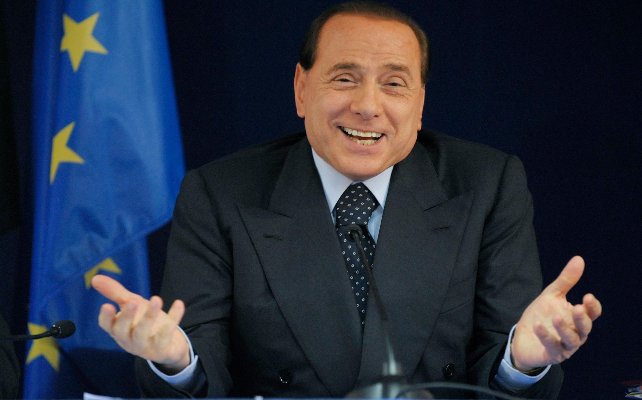

Slide 12
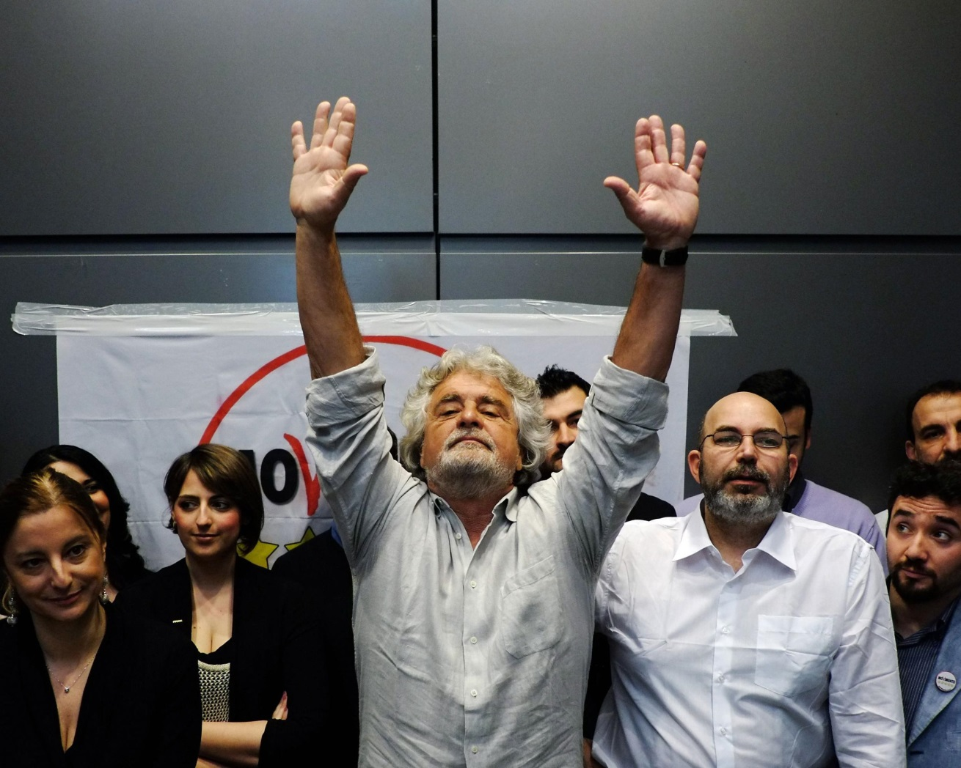
Five Star Movement Italy

Slide 13
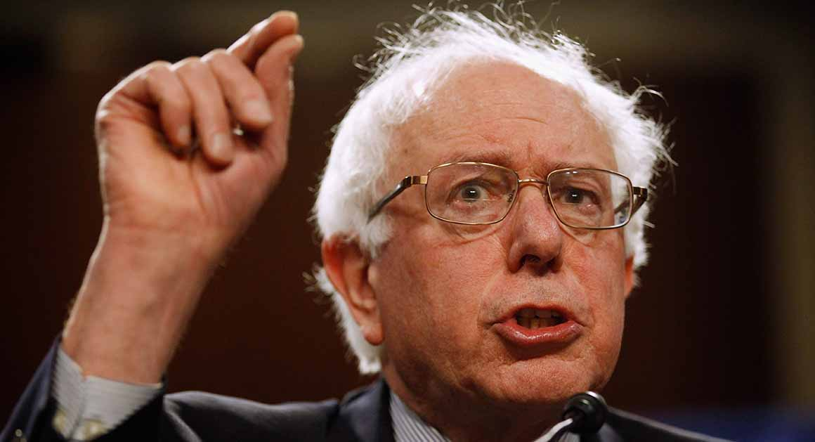

Slide 14
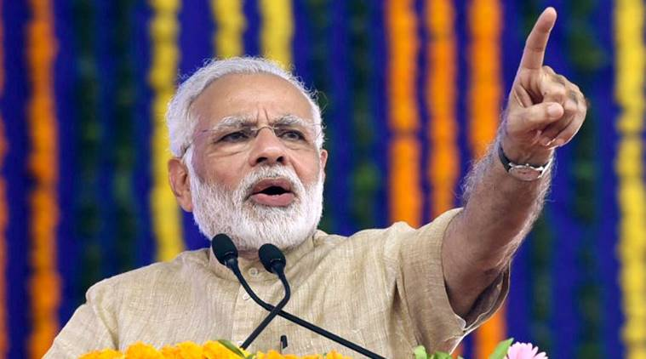

Slide 15
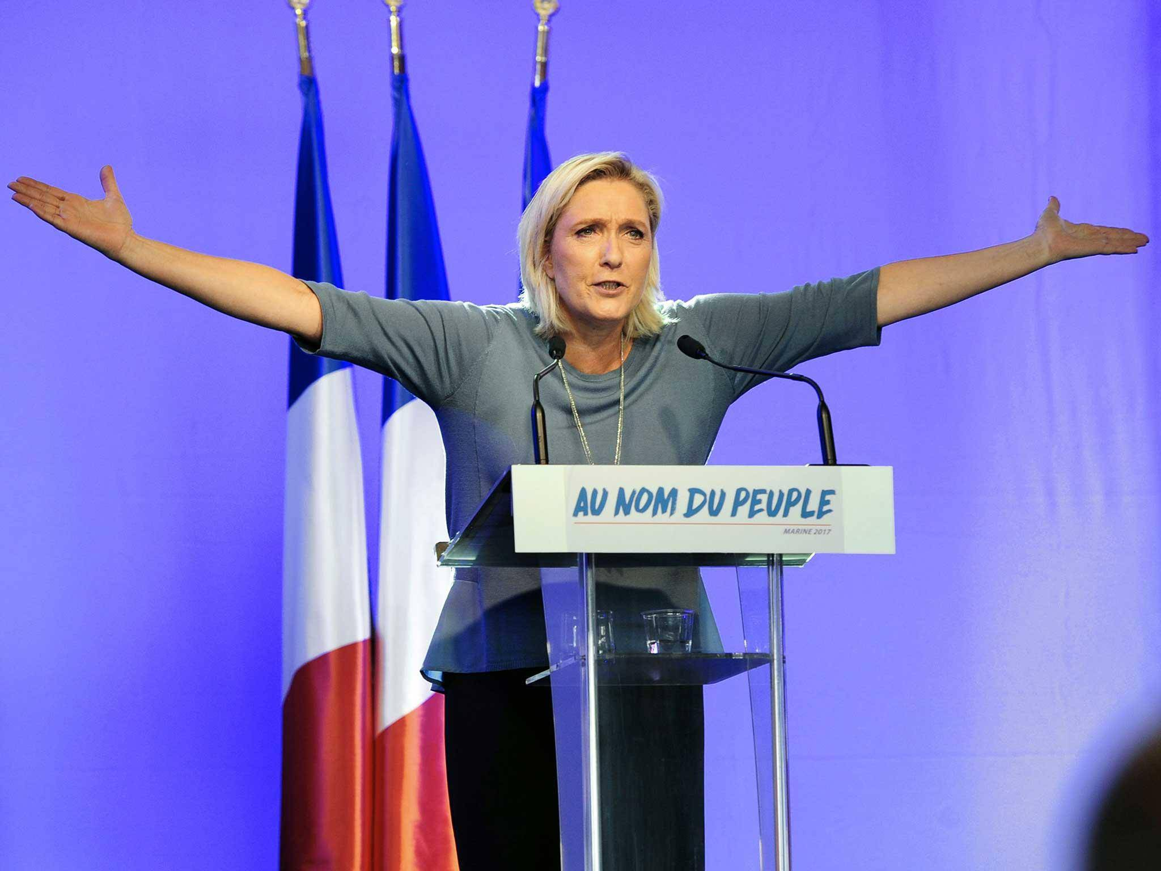

Slide 16
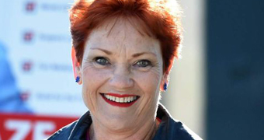

Slide 17
How do populists usually draw support?
They make irresponsible economic promises, usually targeted towards their supporters (middle-class or jobless in developed countries, poorly educated rural poor in developing)
They try to maximise their media attention or popular support by acting differently to the political status quo –
  wear different clothes
  speak differently
  fashion themselves as the ‘voice of the people.’
  Do a ‘stunt’ that no other status quo politician would dare

Slide 18
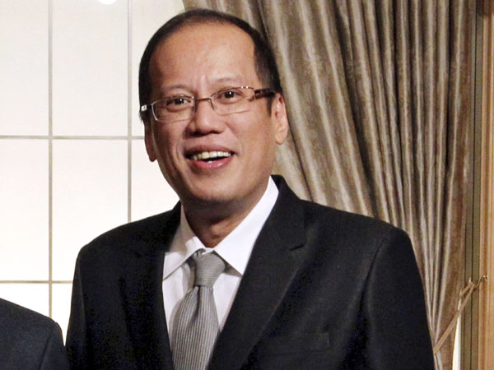
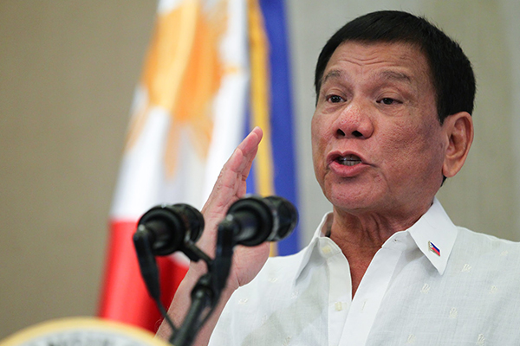

Slide 19
https://www.youtube.com/watch?v=niSLZDVApdQ bing
https://www.youtube.com/watch?v=AYD8nQ97HmU
https://www.youtube.com/watch?v=keTKNwrAx9E

Slide 20
Populism is a…
…thin ideology that considers society to be separated into two antagonistic camps, one is the ‘pure people’ and the other is the ‘corrupt elite,’ and that process of politics should be returned to the general will of the people.’

Slide 21





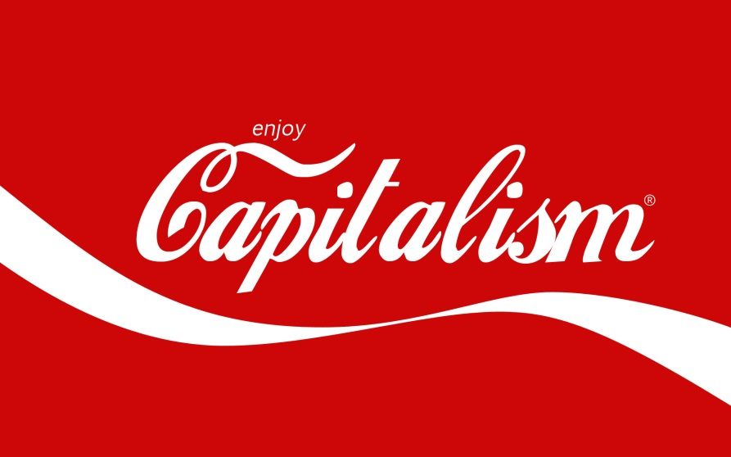


Thicc ideologies

Slide 22
…thin ideology that considers society to be separated into two antagonistic camps, one is the ‘pure people’ and the other is the ‘corrupt elite,’ and that process of politics should be returned to the general will of the people.’
Thin ideology (as opposed to a thick ideology) based on ‘common sense,’ critiquing the establishment and looking after the ‘common man’ or ‘pure people’.

Slide 23
Populism does not provide a comprehensive solution to a nation’s economic or social ills…
…but they are very good at identifying them.
Trump identified that states like Michigan, Wisconsin, Indiana, Ohio had not experienced any gains during Obama’s presidency. Inequality had risen. No new jobs in these states had been created… and he promised to represent them.

Slide 24
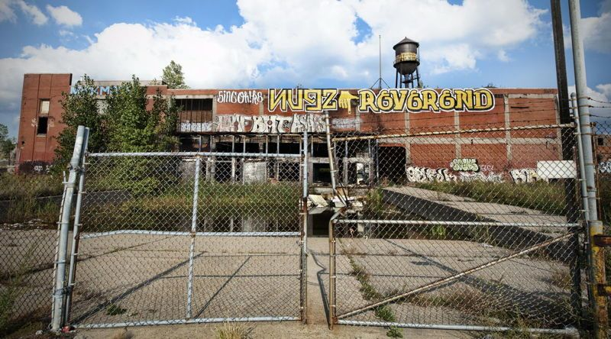

Slide 25
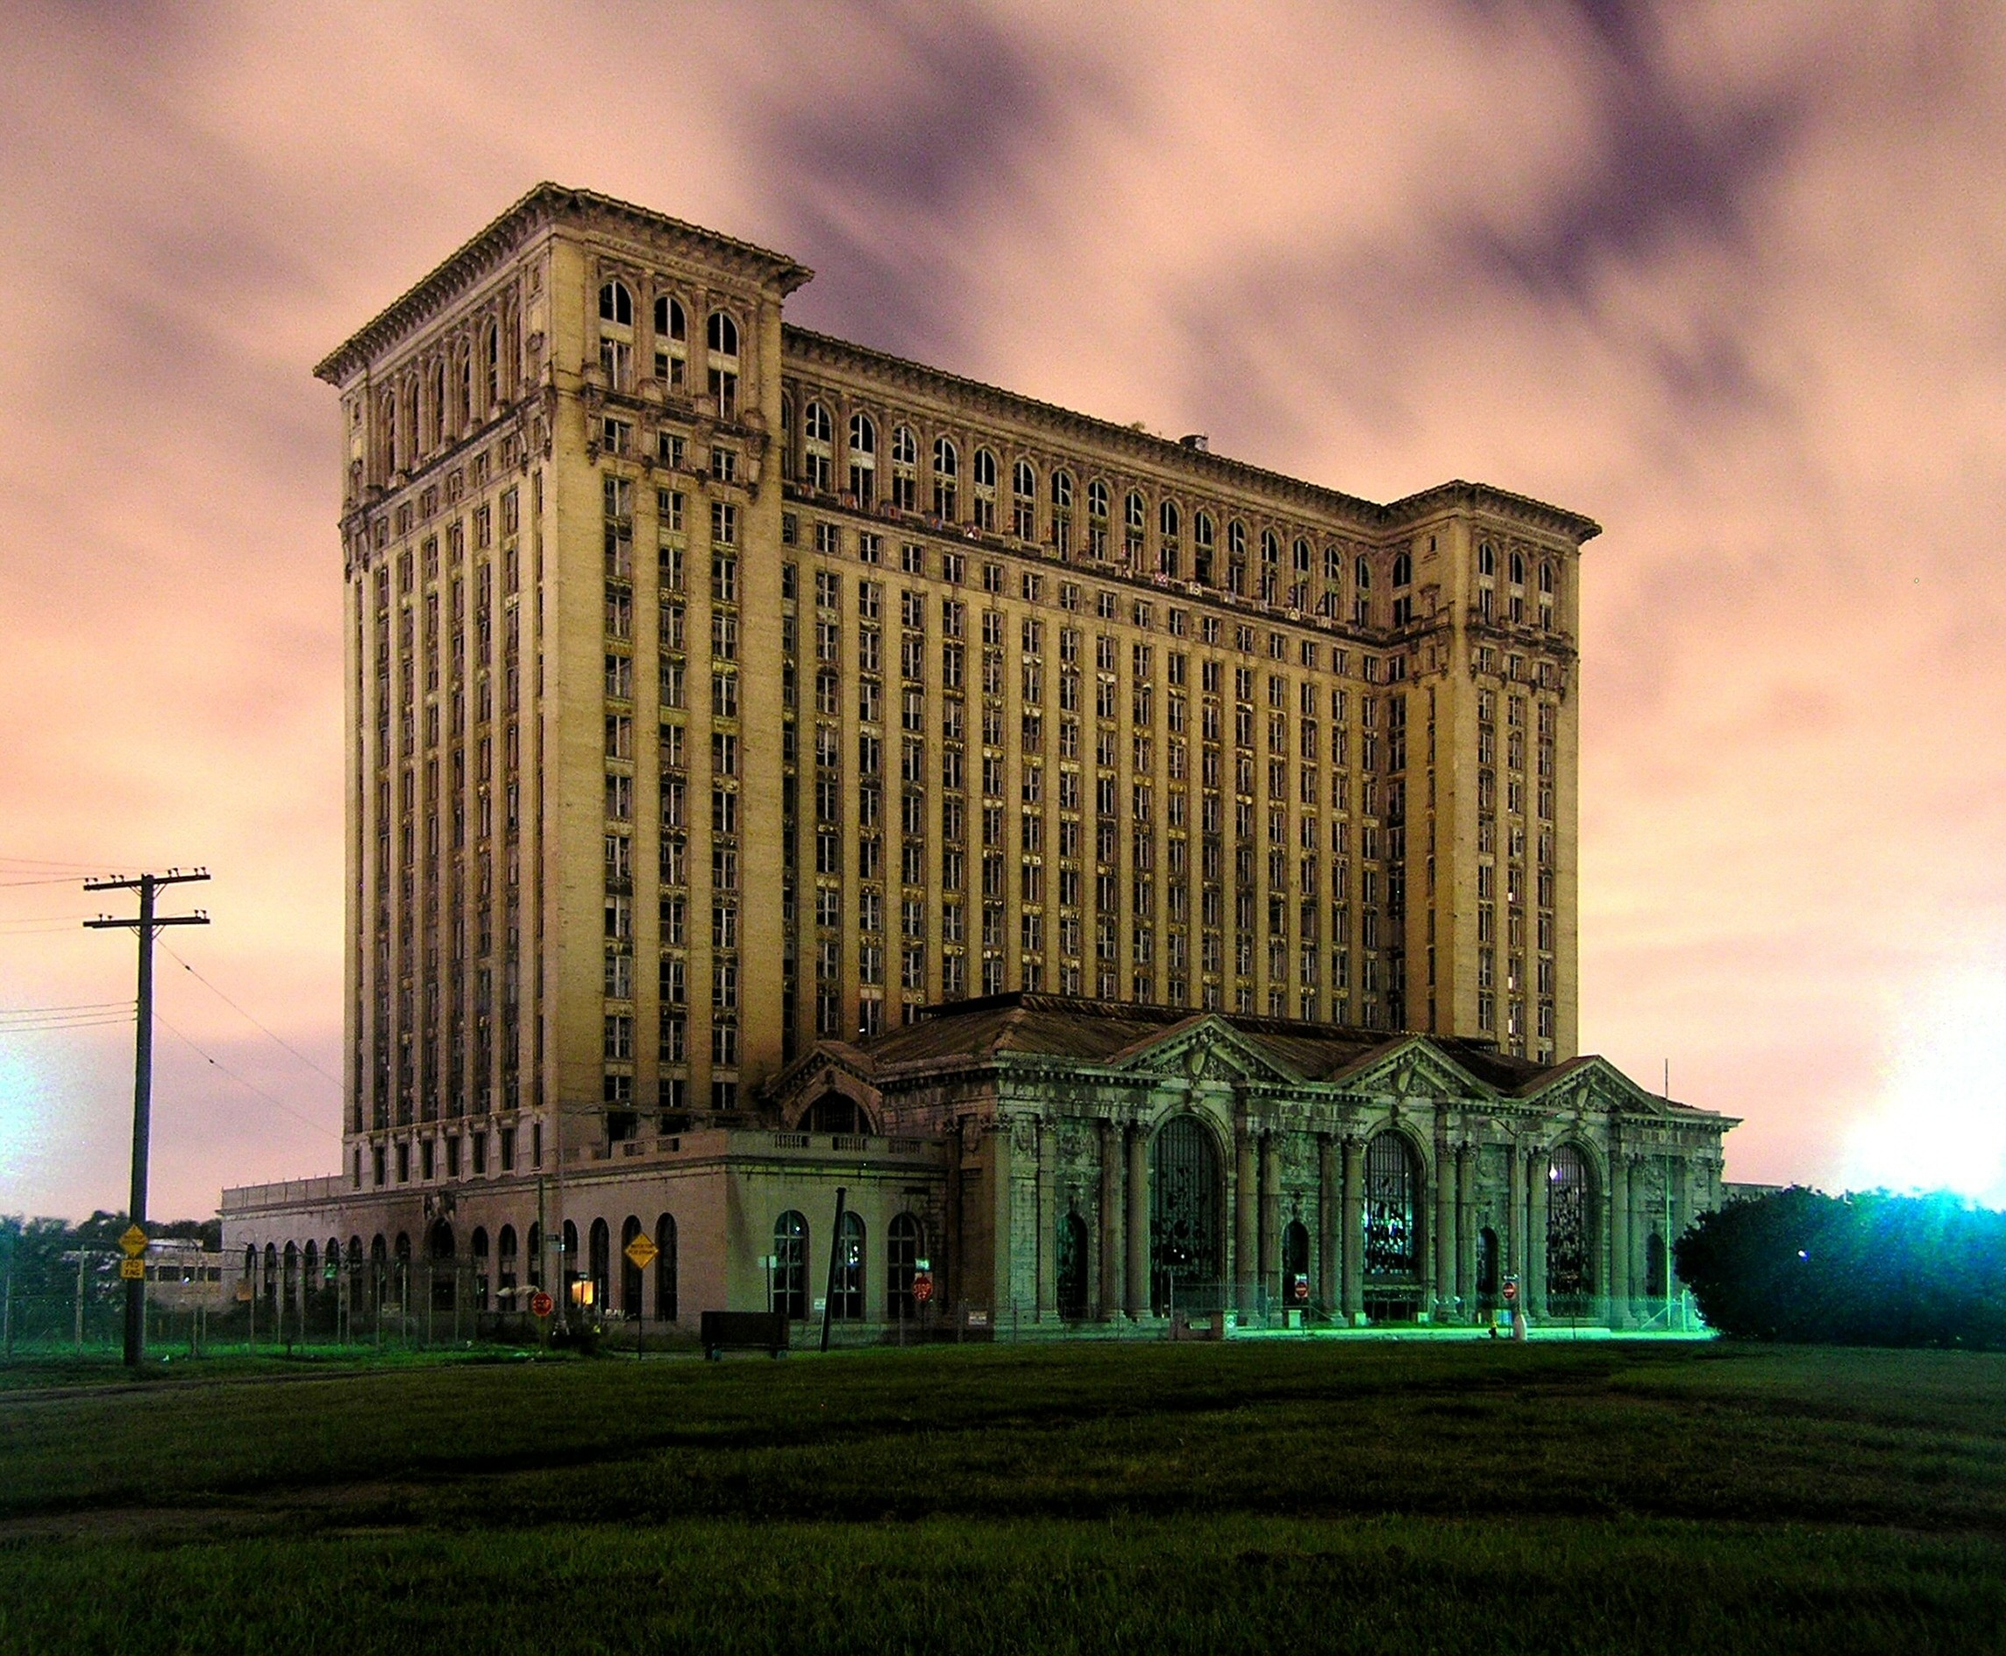

Slide 26
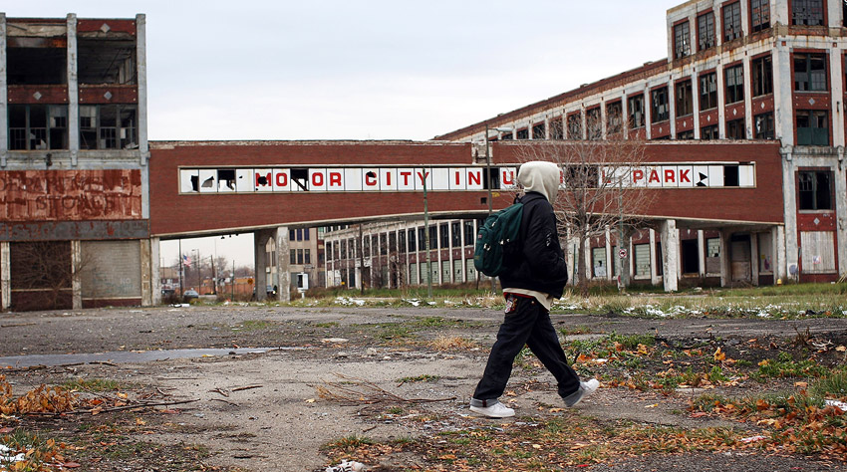

Slide 27
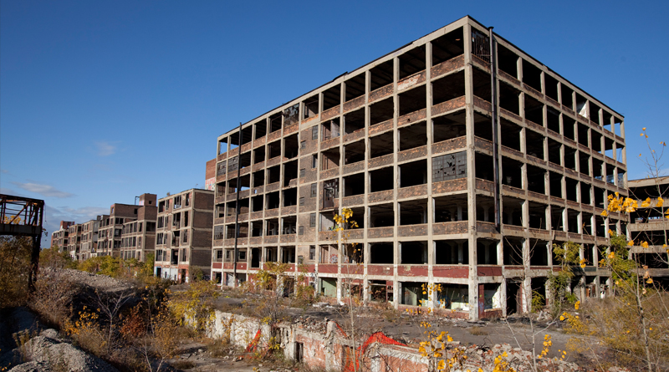

Slide 28
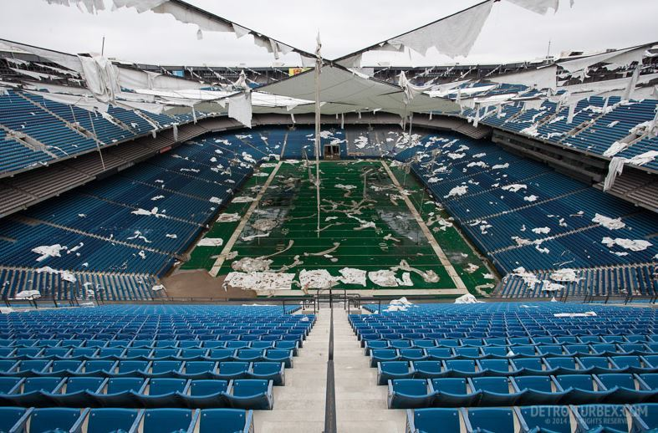

Slide 29
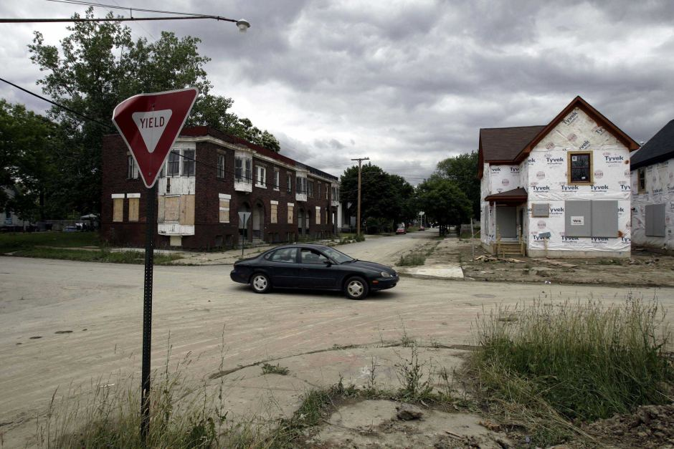

Slide 30
https://youtu.be/x5l1rOF9BsQ?t=32m49s

Slide 31
Thin ideologies do not provide a comprehensive solution to a nation’s economic or social ills…
…but they are very good at identifying them.
Trump identified that states like Michigan, Wisconsin, Indiana, Ohio had not experienced any gains during Obama’s presidency. Inequality had risen. No new jobs in these states had been created… and he promised to represent them.

Slide 32
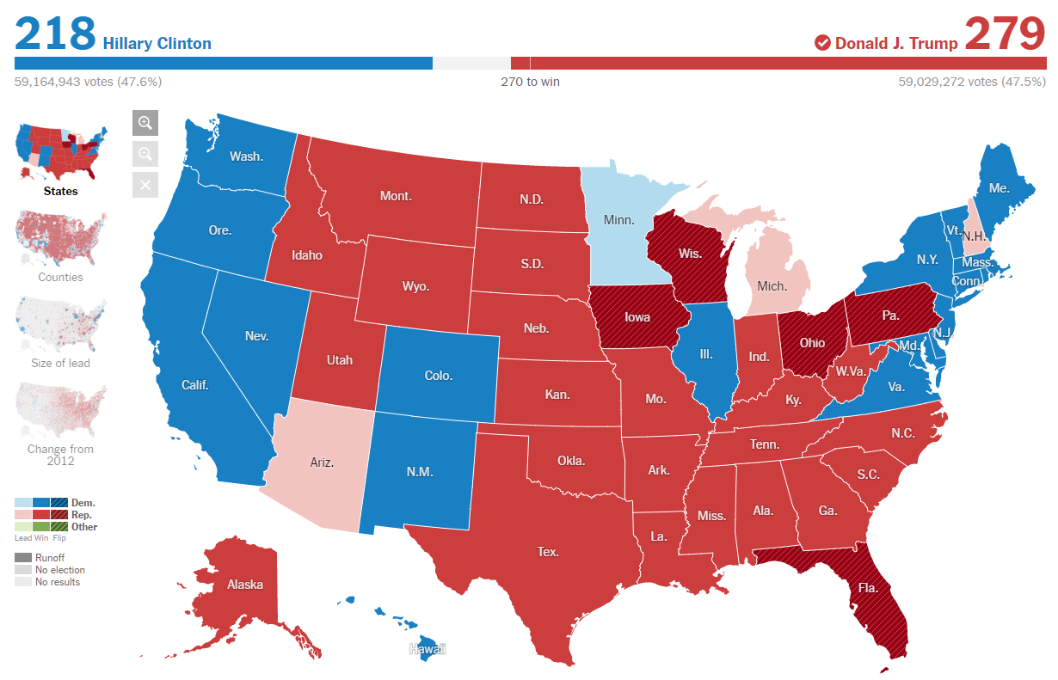

Slide 33
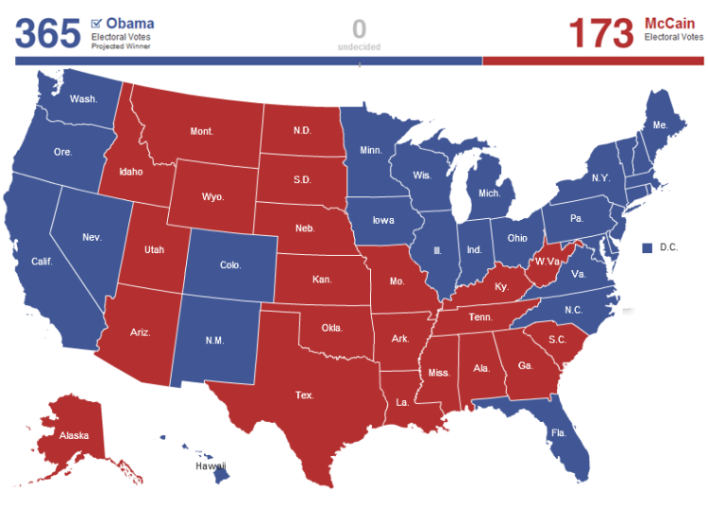

Slide 34
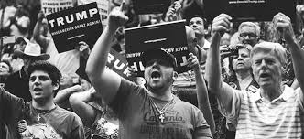
“The People”
Vague concept
Usually told that they are ‘forgotten’ or ‘ignored’ by the political establishment.
Populists are the ‘voice’ or the ‘representative’ of this forgotten people.

Slide 35
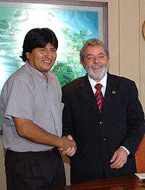

Slide 36
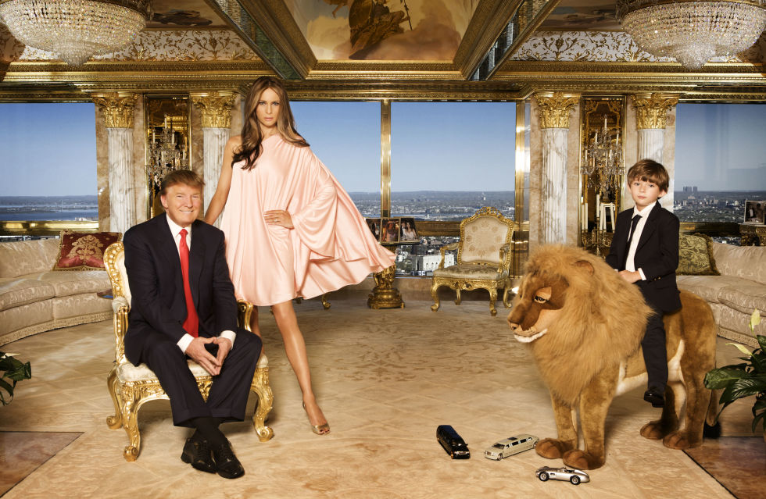

Slide 37
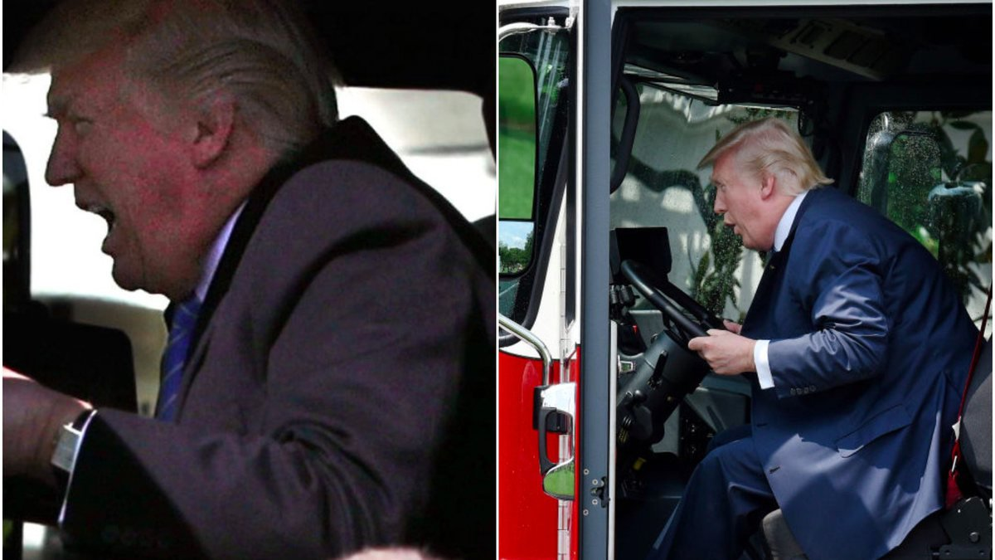

Slide 38
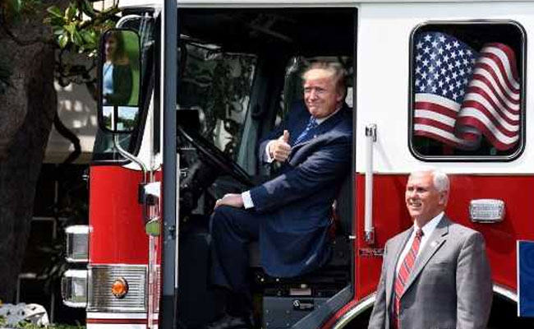

Slide 39
https://www.youtube.com/watch?v=N-TSHiOF-UA

Slide 40
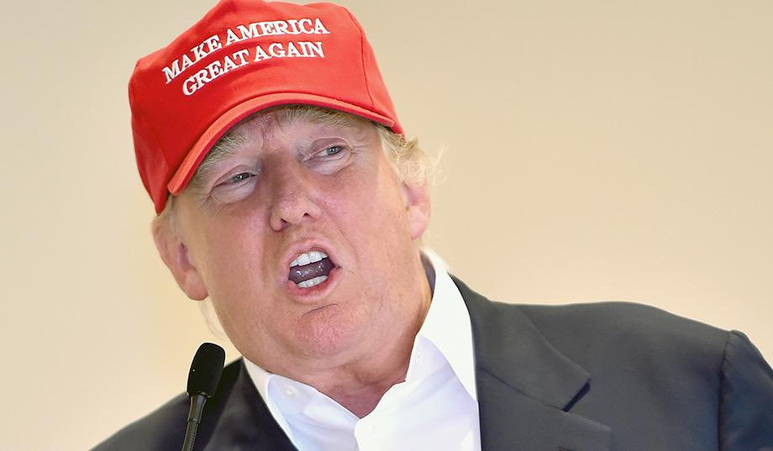

Slide 41
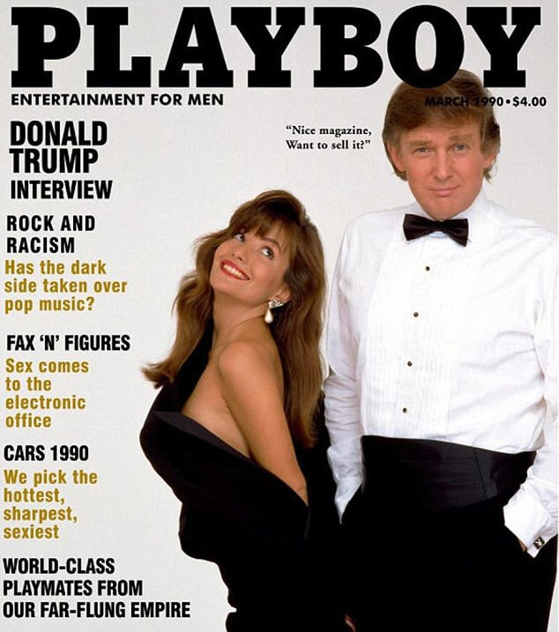


Slide 42
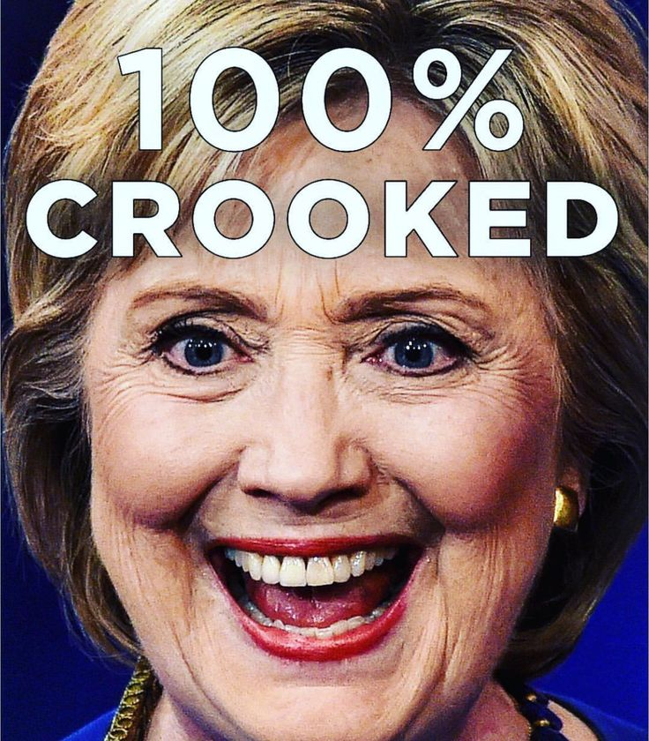
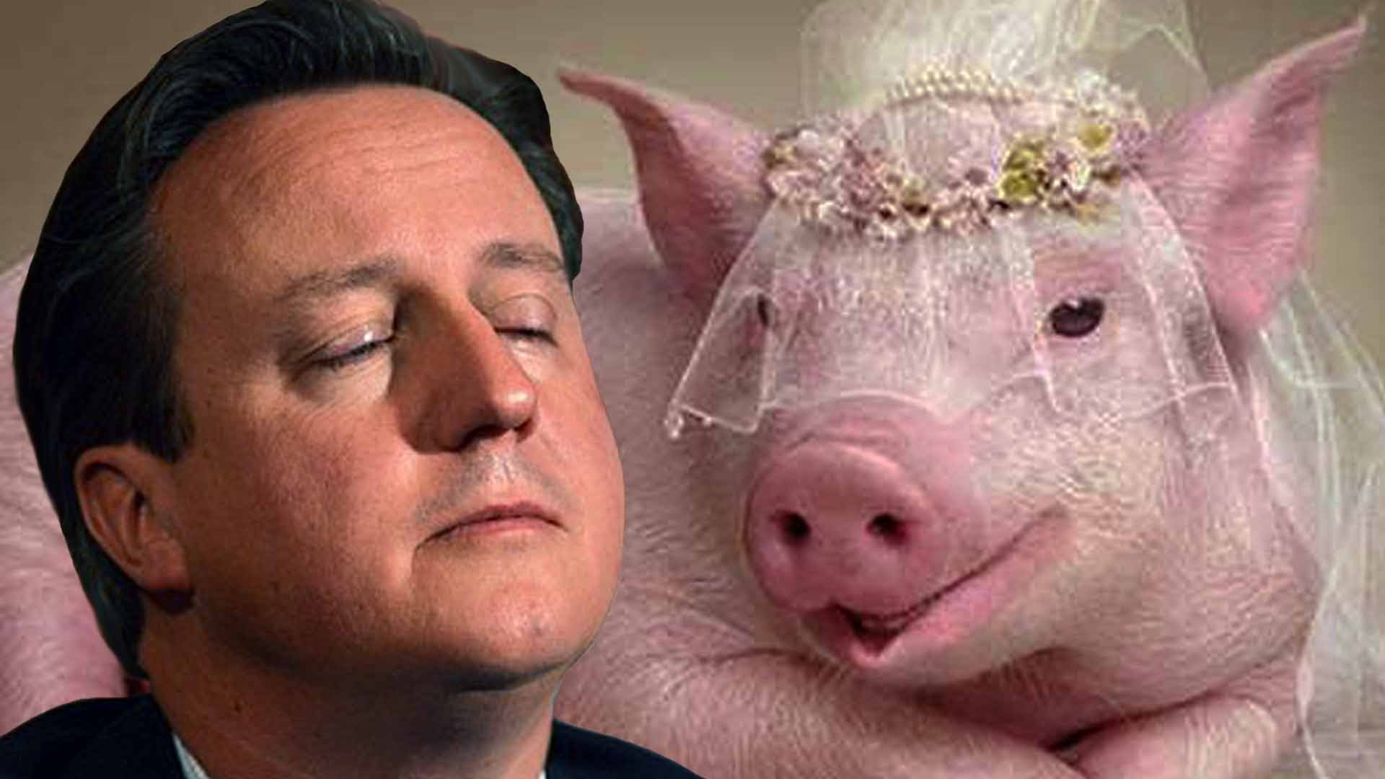

“The Elite”
Always the enemy
Juxtapose between the ‘good people’ and the ‘evil or corrupt elite’

Slide 43
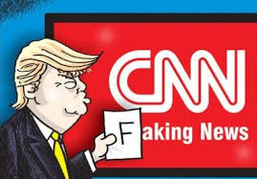
Fake News!

Slide 44
Acting in the Will of the People
They understand and listen to what the people want.
Duterte is a ‘common man’
Phue Thai goes into small villages (apparently other parties do not)
Donald Trump loves Twitter, because it claims it gives him a direct line between him and his supporters

Slide 45
Populists must…
1) find a way to separate themselves from the elite and
2) have some kind of connection to the people.

Slide 46
Find a way to separate themselves from the elite…
Funding his own election campaign
Crafting himself as an underdog
Making fights against the Democrat party, but also against the Republican party too
Claiming that as a really rich billionaire, he cannot be corrupted
For many of his faults, he has actually been really consistent in his political positions in the last 30 years.

Slide 47
Connect to the people
Trump already had a connection to the people through the media and reality TV for about 30 years.
He had a direct line to his supporters phones through Twitter
He fashioned himself as a common sense, non politically correct candidate. He speaks like an everyman in a language that is common in heartland of America.
He is an outsider, not part of the elite; and he is authentic and connected to the people.

Slide 48
What societies are susceptible to populism?
Demand side: it is often a response to a challenge or a crisis.
  US has 2 decades of political crisis
  Philippines has had decades of gvt corruption
  Thaksin was a response to the 1997 AFC
  European populists now are a response to immigrateion crisis

Slide 49
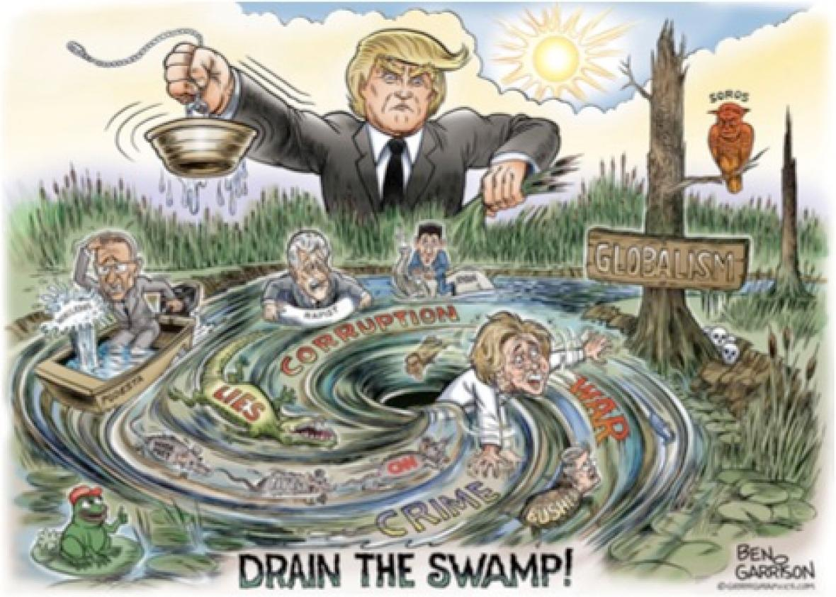

Slide 50
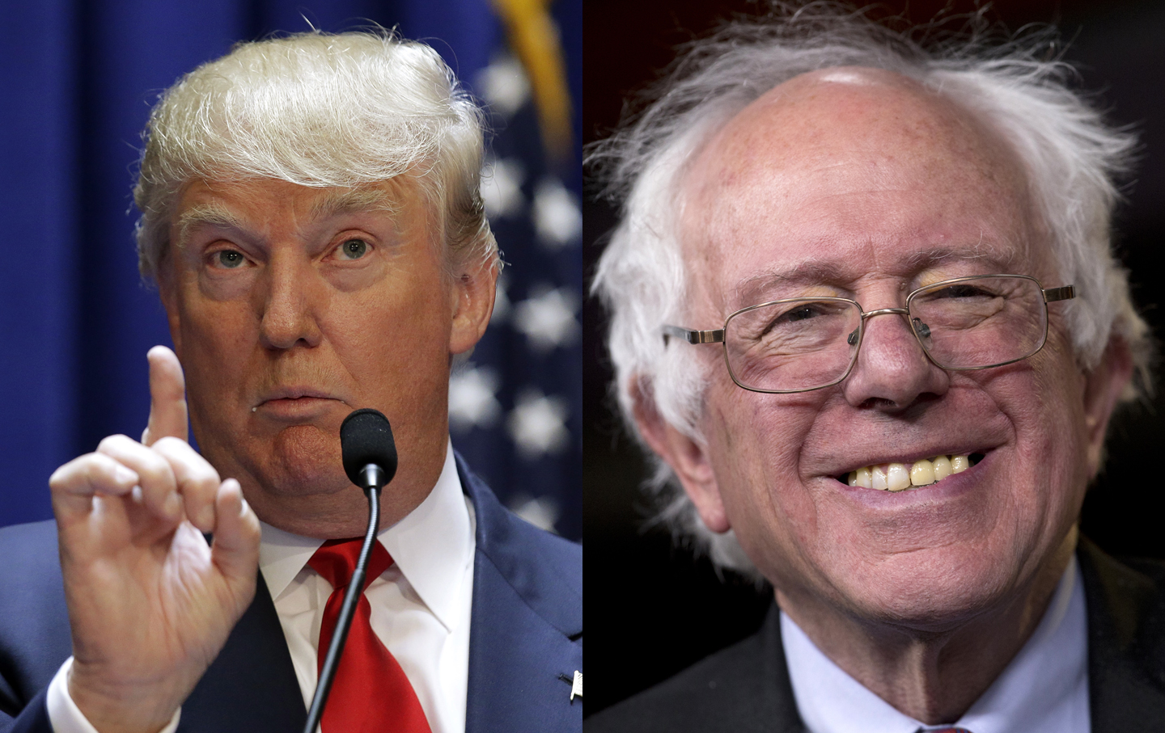

Slide 51
Homework
In your groups, please send a profile of 1 populist to jeh@outlook.co.th by Monday, 3 September 2018.

