Slide 1
Question Set #1
EE212 : Principles of Macroeconomics
Semester 2 / 2012
(Section 046402)
TA: Pitchaya Sunthanakul

Slide 2
(1) In a two-sector (household and business) model, suppose households receive the following compensation from business: wages $520, interest $30, rent $10, profits $80; consumption spending is $550 and business investment is $90.
Find (a) the market value of output and household saving.
(b) What is the relationship of saving and investment?

Slide 3
(2) (a) What is saving leakage from the circular flow?
(b) Why is investment spending viewed as a spending injection into the circular flow?
(3) what are direct and indirect taxes?

Slide 4
(4) From the following data for the U.S., establish the amount of domestic output available for the U.S. purchase and the total amount of goods and services available for U.S. purchase: GNP is $1000; gross exports equal $100 while gross imports are $150.
(b) Does U.S. GNP always equal U.S. purchases of goods and services when there are international transactions?
(c) What happened to U.S. GNP when U.S. imports increase ceteris paribus?

Slide 5
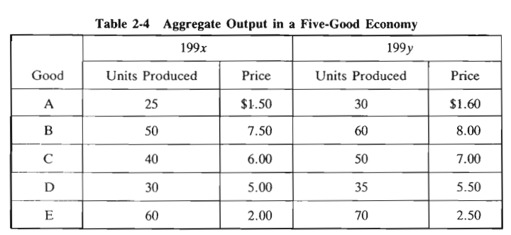
(5) what is the difference between personal income and national income?
(6) Table 2-4 represents the price of and units of aggregate output for 199x and 199y. (a) Present in Table 2-5, nominal GNP for 199x and 199y. (b) Also calculate in Table 2-5 real output for 199y by measuring 199y output in 199x prices. What is the purpose of such a calculation? (c) What is the GNP deflator in 199y?

Slide 7
(7) what is the GNP deflator?
(8) (a) what is the CPI? (b) Do increases in the CPI always indicate an increase in the consumer’s cost of living?

