Slide 1
What is Non-Bank Services
- Services offered by banks other than deposits, withdrawals, loans, and providing checking and savings account.
Notes:
Formally, they are services that do not meet legal definition of banks which is make deposit, withdrawal, loans and providing checking and saving account.

Slide 2
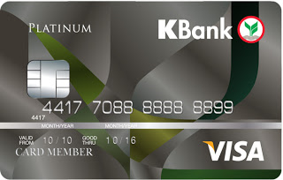
CREDIT CARD
Source: www.bot.or.th
Notes:
People use more credit card every year. This implies more convenient to consumer’s purchasing power → time value of money (pay in the future is better than paying today)
PS,, I’ve looked again, it happened that Debit card is non bank service ja..

Slide 3
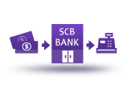
UTILITIES PAYMENT
CDM
ATM
Branches
Online banking
Call center
Ex. Electricity bill/ insurance premium/ car installment
Notes:
Bank makes utilities payment for their customer. They charge fee per bills for example make payment of electricity or water bill → fee
Methodd of paying utilities nowadays has cdm,….

Slide 4



LEASING SERVICES
Is the primarily method of raising finance to pay for assets. A lesser purchases assets and leases that assets to lessees.
Auto- leasing
Auto hire purchase
SCB “auto finance”
Notes:
Leasing services → facilitate business owner → conveninet transaction.
Auto hire purchase is _____
Auto refinance is _____
Ex. Purchase __ car → pay installment with banks
We are more familiar with auto leasing whereby the ownership of the automobile is transferred to clients when all the installlment is paid in full.

Slide 5
INVESTMENT SERVICES

Slide 6
FUND MANAGEMENT
Open-ended fund
Close-ended fund
Mutual Funds
Private Funds
Provident Funds
Notes:
Mutual Fund – is investment vehicle that allows retail investors to pool their funds to be invested in a portfolio of securities or other assets
Private Fund – engage in a management of fund or asset for a person ir group of persons who intend to take part in his/her own investment policies
Provident Fund – กองทุนสำรองเลี้ยงชีพ

Slide 7




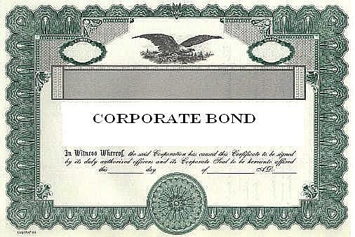





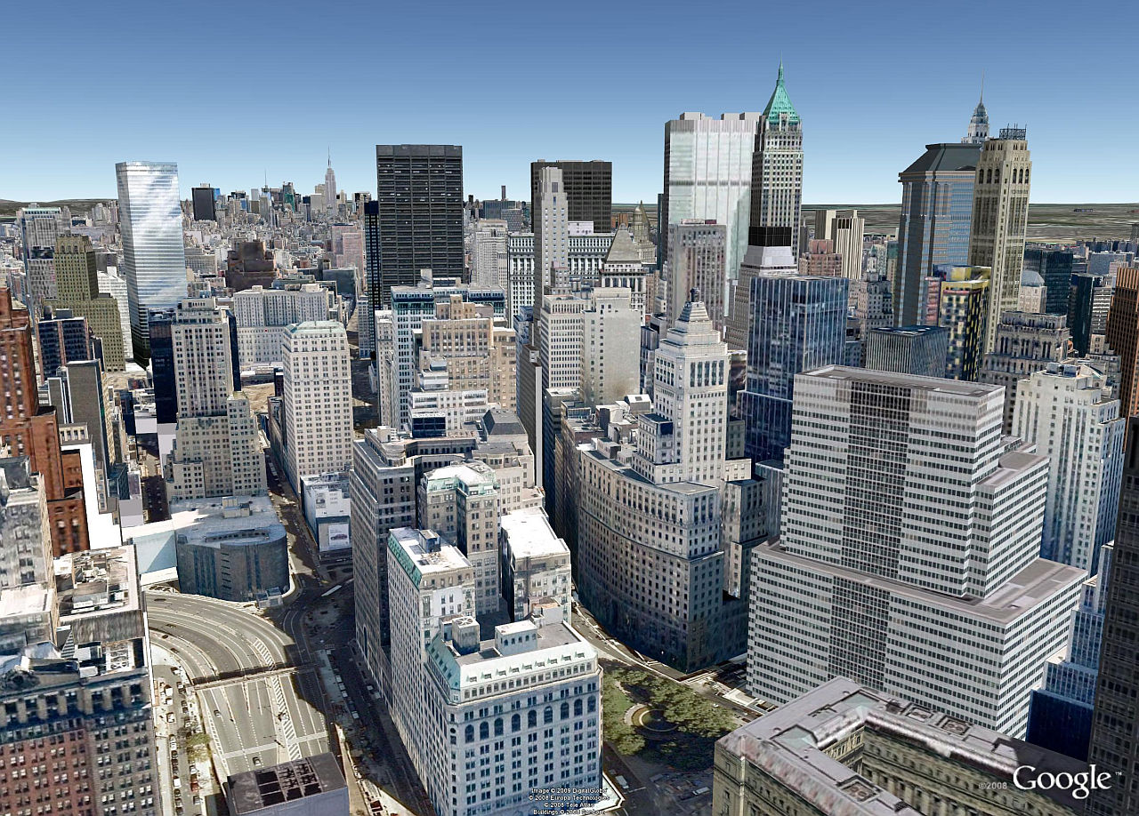
MUTUAL FUND
FUND MANAGER
Notes:
PS…. PLEASE ADD THAT THIS DIAGRAM BELONGS TO MUTUAL FUND NOI JI SINCE I ADJUSTED PREVIOUS SLIDE AND IM AFRAID IF I ADD, IT MAY DAMAGE TRANSITION OF DIAGRAM AHHH…. THANK YOUUU JAAA
-Bank as a asset management company sell INVESTMENT UNITS to retailers and invest the capital received in different types of investment ( based on its plans and purposes of the fund established) to seek return on investment

Slide 8

Brokerage services
Derivatives
Equities
Debts
Notes:
Customer consulting, open portfolio .
-They are MARKET MAKER
They quote a buy and sell price and facilitate transactions for financial assets. Such assets include equities, government and corporate debt, derivatives,
A major contribution of the market makers is improving the liquidity of financial assets in the market.

Slide 9
Factoring services
One of cash-management tools
Short term, non bank financing of account receivables
Factoring is not a loan;
  it does not create a liability on the balance sheet.
  It is the sale of an asset to factor—account receivable
  It speeds business cash flow
Notes:
-In a typical factoring arrangement, the client (you) makes a sale, delivers the product or service and generates an invoice. The factor (the funding source) buys the right to collect on that invoice by agreeing to pay (you) the invoice's face value less a discount--typically 2 to 6 percent (Sell at Discount). The factor pays 75 percent to 80 percent of the face value immediately and when your customer pays, factorforwards the remainder (less the discount and commission fee).
-Factoring is very common in certain industries, such as the clothing industry, where long receivables are part of the business cycle
http://www.entrepreneur.com/encyclopedia/factoring
http://www.businessdictionary.com/definition/factoring.html

Slide 10



Account
Receivables
CASH
Business Owner
Customers
Notes:
PS… I deleted RISKS out nabecoz if there is high risk it’s no longer called FACTORING,

Slide 11

Account
Receivables
Factors
(Bank)
Cash @ discount
CASH
Business Owner
Customers
Notes:
-In a typical factoring arrangement, the client (you) makes a sale, delivers the product or service and generates an invoice. The factor (the funding source) buys the right to collect on that invoice by agreeing to pay (you) the invoice's face value less a discount--typically 2 to 6 percent (Sell at Discount). The factor pays 75 percent to 80 percent of the face value immediately and when your customer pays, factorforwards the remainder (less the discount and commission fee).
--other way explaining diagram----To do this, factors purchase your credit-worthy accounts receivable at a small discount and convert your invoices (sales) into immediate cash. Partnering with a factor can relieve the problem that slow paying customers can create.
-Client needs to trade off between having capital earlier on hand and commission fee that has to be paid or deducted

Slide 12


Underwriting services
Debt Securities
  Debentures
  Bill of exchange/promissory notes
  Bonds
Equity Securities
Notes:
Underwriting refers to process that a large financial service provider uses to assess the eligibility of a customer to receive their products. Investment banker act on behalf of corporations to raise capital by issuing securities (primary market)
For example, For NOK belonged to Nok Air that recently offered IPO. SCBS took a lead in underwriting this stock

Slide 13

INSURANCE
LIFE INSURANCE (Bancassurance)
NON-LIFE
Source: Office of Insurance Commission as of May 2013

