Slide 1

BA 291 – operational management and control
By Aj. Parichat Jantori

Slide 2

Operations Management
Operations Management: The development and administration of the activities involved in transforming resources into goods and services
Operations managers oversee transformation process and the planning and designing of operation system, managing logistic, quality and productivity

Slide 3
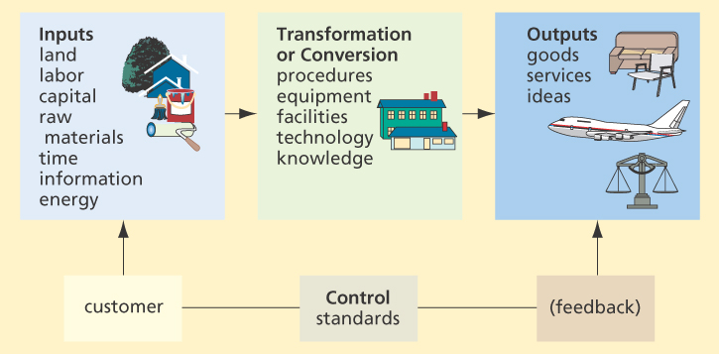
Transformation Process
Notes:
Ask: transformation process in service industry
Airlines input: employees, time , money, equipment
Process: booking flight, flying airplane, maintaining the equipment, training the crew
Output: flying passenger to the destination
More examples: p. 267

Slide 4
Manufacturing vs. Service Providers
  Produce tangible or intangible goods
  Most goods are manufactured prior to purchase, most services are performed after purchase
  Manufacturing can occur in an isolated environment, away form customers. Customer contact is significant component to most services.
  Uniformity of inputs – automated or customize
  Uniformity of outputs – similar or different
  Labor required – service is more labor intensive
  Measurement of productivity – service industry has great variation

Slide 5
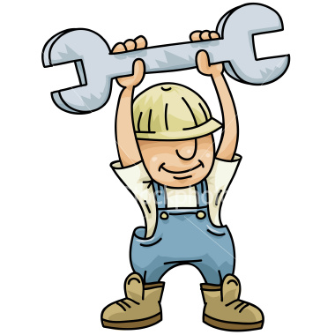
Why managing operations?
Increase output
Increase efficiency (productivity = output/ input)
Lower cost
Increase quality of products and services
Factors influenced productivity
Labor (quality of labor)
Capital fund
Management
Notes:
Labor (quality of labor) (10%)
Capital fund (38%)
Management (52%)

Slide 6
Planning and designing operation systems
Planning the products
Designing operations process
Planning capacity
Planning facilities

Slide 7
Planning and designing operation systems
Planning the products
  Determine what consumers want
  Design product to satisfy the want
  Marketing research (focus group, survey, observation)
  Types and quantities of raw materials
  Skills & quantity of labor
  Processes for transformation to outputs
  Cost and time intensive

Slide 8
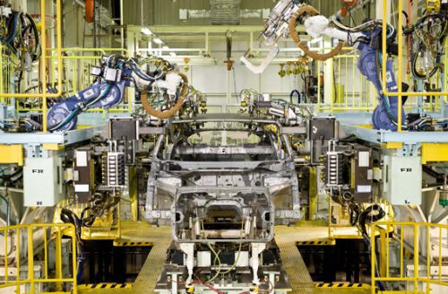
Planning and designing operation systems
Designing operations process
Typically, products are designed to be manufactured by one of three processes: standardization, modular design or customization

Slide 9
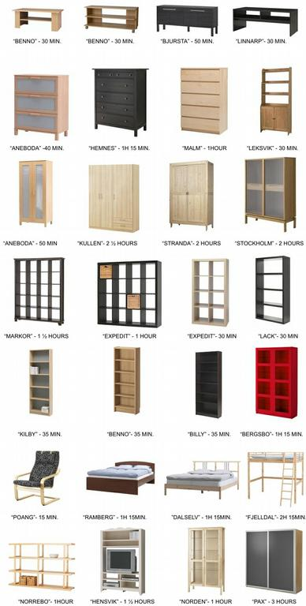
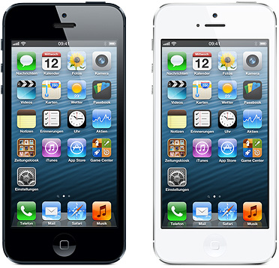

Planning and designing operation systems
Standardization: The making of identical interchangeable components or products

Slide 10
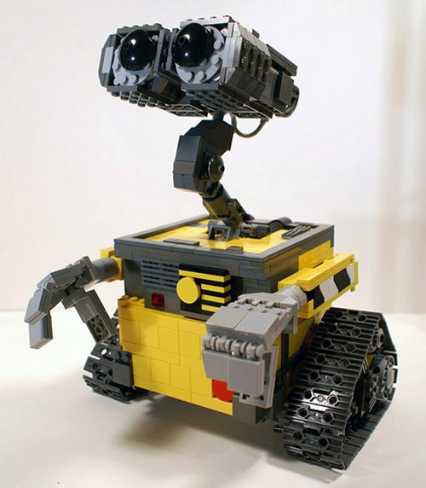
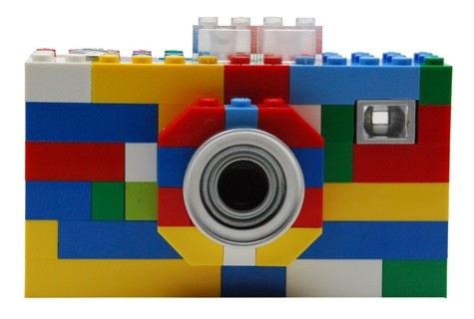
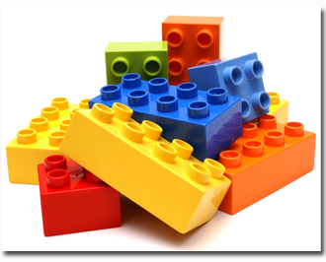
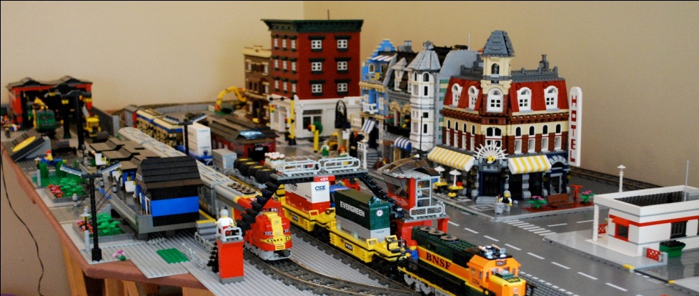
Planning and designing operation systems
Modular design: the creation of an item in self-contained units or modules that can be combined or interchanged to create different products

Slide 11
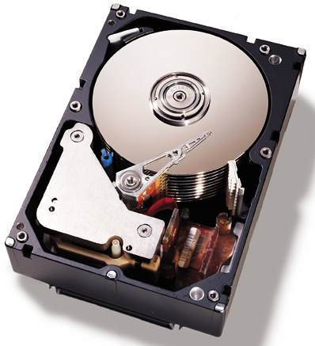
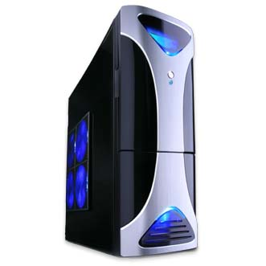
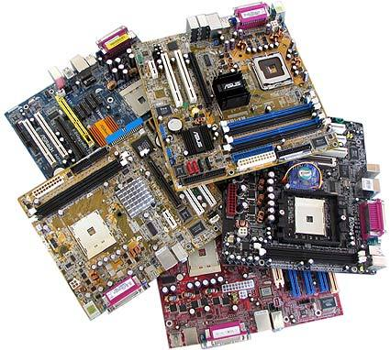
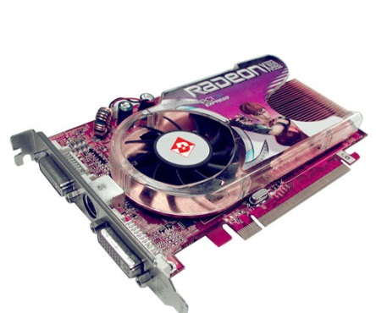

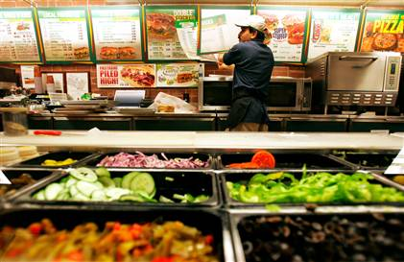
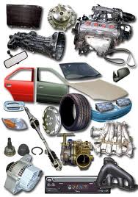
Planning and designing operation systems
Example of modular design

Slide 12
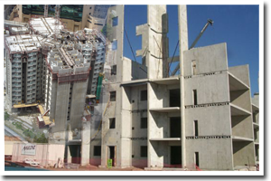
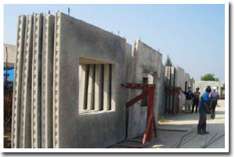
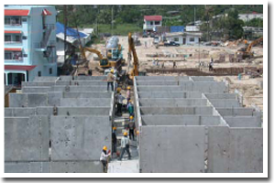
Planning and designing operation systems
Prefabrication
Notes:
http://www.smilingprefab.com/home_th.html

Slide 13
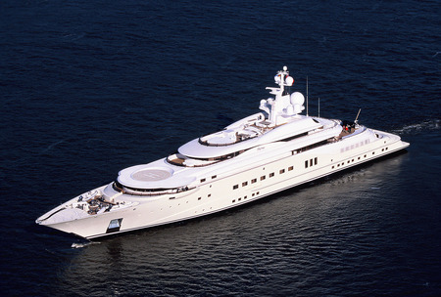
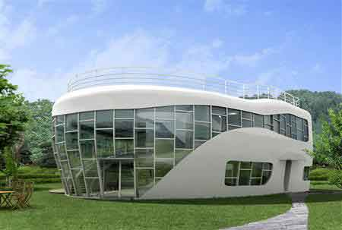

Planning and designing operation systems
Customization: making products to meet a particular customer’s needs or wants. The product produced in this way are generally unique.

Slide 14
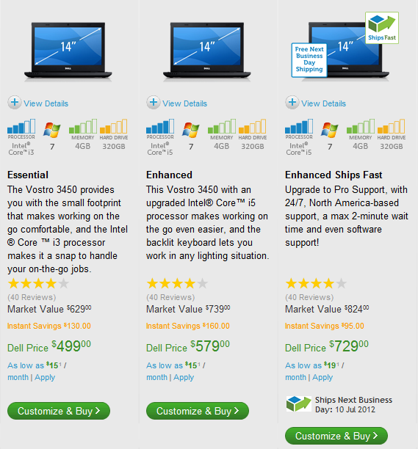
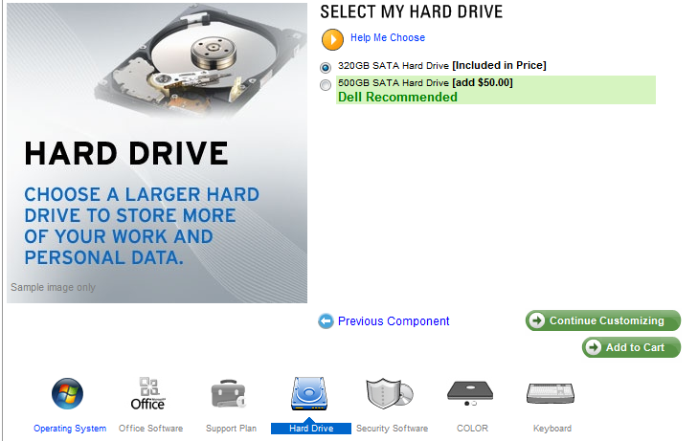
Planning and designing operation systems
Mass customization calls for a customer-centre in production and delivery processes, requiring the company to collaborate with individual customers to design each one's desired product or service, which is then constructed from a base of pre-engineered modules that can be assembled in myriad ways.
Dell computer
Automobile industry
Notes:
http://www.dell.com/us/p/laptops
http://www.mercedes-benz.de/content/germany/mpc/mpc_germany_website/de/home_mpc/passengercars/home/new_cars/configurator_showroom.flash.html

Slide 15
Planning and designing operation systems
Planning capacity
Capacity – The maximum load that an organizational unit can carry or operate
Capacity levels that fall shot can result in unmet demand but when there is more capacity available than needed, operating cost are driven up.
Notes:
If the operating rate is high, this is called "overcapacity", while if the operating rate is low, a situation of "excess capacity" or "surplus capacity" exists

Slide 16
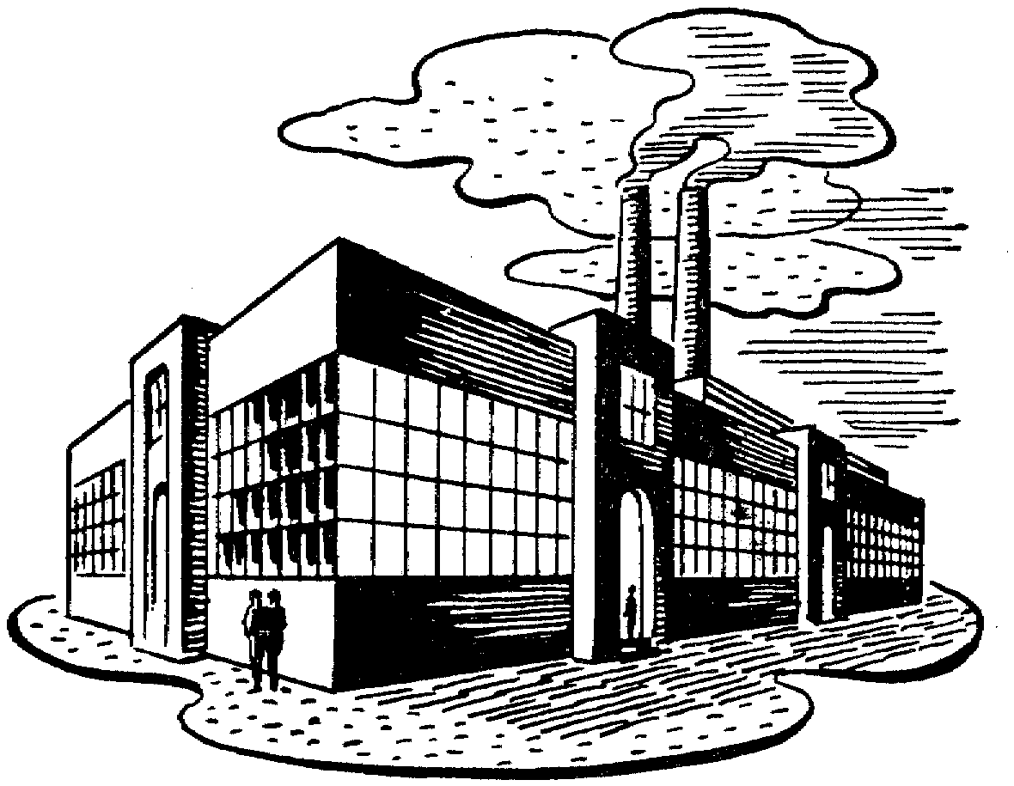
Planning and designing operation systems
Planning facilities location
Planning facility location
Facility location is the process of identifying the best geographic location for a service or production facility
Choosing country – region – exactly place
Factors affecting facility location
Customers, suppliers, labor, raw material, infrastructure
Transportation cost
The cost of land and construction
Law and regulations, financial support

Slide 17
Facility location
Making Location Decisions
  Step 1: Identify dominant location factors
  Step 2: Develop location alternatives
  Step 3: Evaluate locations alternatives
  - cost comparison method
  - factor rating method
  - break-even point

Slide 18
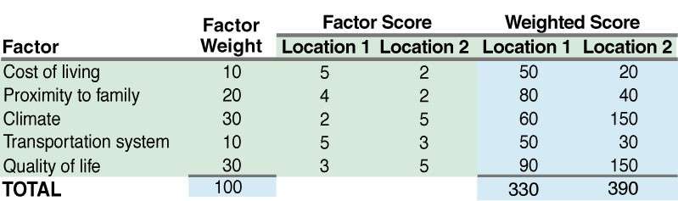
Evaluate Facility location
Factor Rating

Slide 19
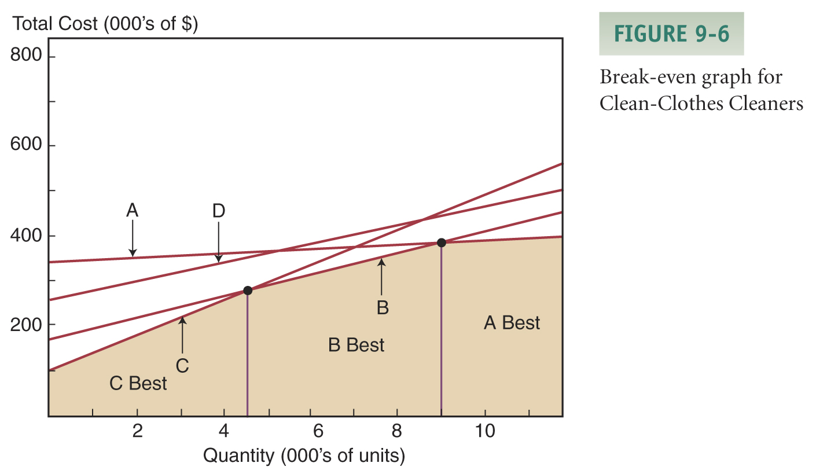
Facility location
Break-even Analysis
Clean-Clothes Cleaners is considering four possible sites for its new operation. They expect to clean 10,000 garments. The table and graph below are used for the analysis.
 | fix cost | var cost | var cost | total
Location A | 350000 | 5 | 50000 | 400000
Location B | 170000 | 25 | 250000 | 420000
Location D | 100000 | 40 | 400000 | 500000
Location E | 250000 | 20 | 200000 | 450000
Notes:
From the graph you can see that the two lowest cost intersections occur between C & B (4667 units) and B & A (9000 units)
The best alternative up to 4667 units is C, between 4667 and 9000 units the best is B, and above 9000 units the best site is A

Slide 20
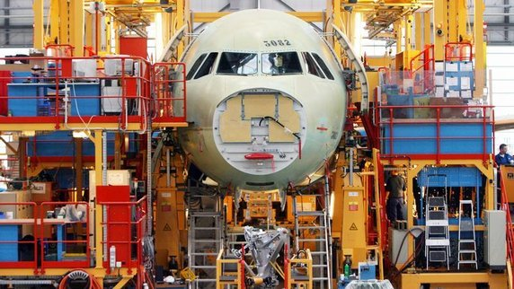
Planning and designing operation systems
Fixed-Position Layout--Project organization
  All resources needed for a product are brought to a central location. Normally used when a very large product is produced.
Planning facilities
layout

Slide 21
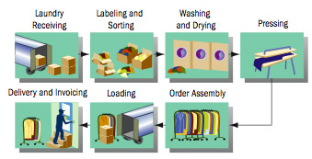
Planning and designing operation systems
Process Layout – a layout that organizes the transformation process into departments that group related processes. Each operation is performed in a different area.

Slide 22

Planning and designing operation systems
Product Layout (Continuous manufacturing organization, assembly line)
  Production is broken down into relatively simple tasks assigned to workers positioned along an assembly line. Workers remain in one location and the product moves from one worker (station) to another.
Notes:
http://www.youtube.com/watch?v=rXG1a6pU5K4&feature=related
http://www.youtube.com/watch?v=La73Oy9ZGVw&feature=related
http://www.youtube.com/watch?v=2aNn1nRD15c

Slide 23
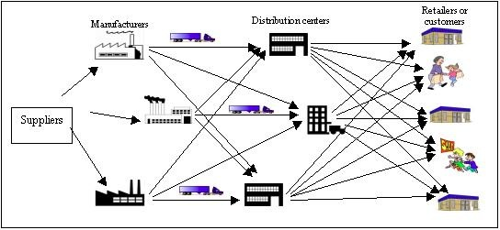
Managing the Supply Chain
Connecting and integrating all parties or members of the distribution system in order to satisfy customers
Include all the activities involved in obtaining and managing raw materials and component parts, managing finished products, packaging them and getting them to customers.

Slide 24
Purchasing and Inventory control
Purchasing or procurement is the buying of all the materials needed by the organization. The aim is to obtain items of the desired quality in the right quantities at the lowest possible cost.
Inventory control is the process of determining how many supplies and goods are needed and keeping track of quantities on hand, where each item is and who is responsible for it. Aim of inventory control is to determine the proper inventory level for each item.
Notes:
Inventory: all raw materials, components, completed or partially completed products, and pieces of equipment a firm uses

Slide 25
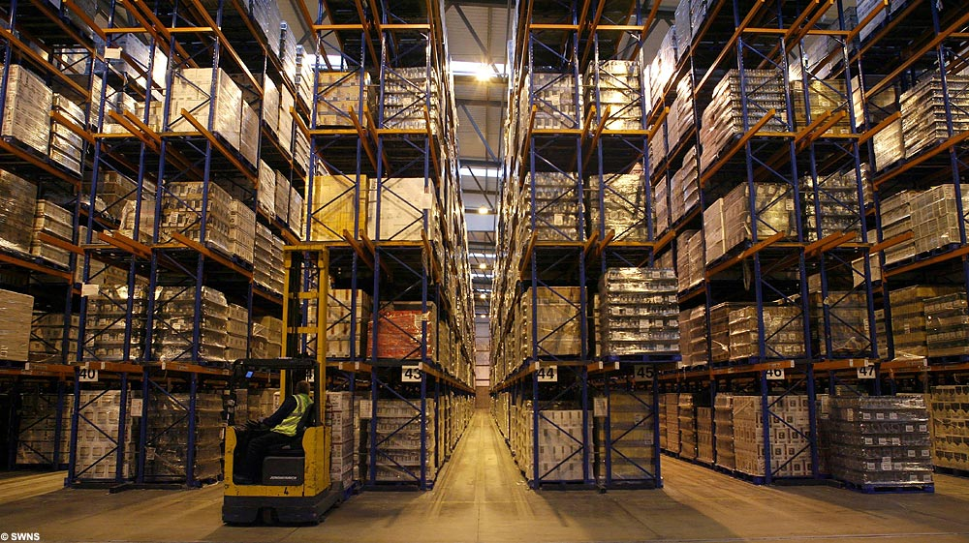
The important of inventory management
Inventory in the warehouse costs money
Money not tied up in inventory can be used in other productive ventures
Products lose value every day

Slide 26
Economic Order Quantity
Order in a large quantity
Economy of scales
Bulk discount
Order in a large quantity
High storage cost
EOQ is a model that identifies the optimum number of items in order to minimize the costs for managing them (ordering, storing)

Slide 27
Economic Order Quantity
Company XYZ sells television to customers. It buys the TVs directly from manufacturer at price 1000 bath each. Every oder will cost company XYZ 20 bath. Based on the statistic, customers demand for TV per year is 8000 units. The storage cost is 2 bath per units.
Ordered quantity | Frequence of order | Cost of order (OC) | Averaged storaged number | Storage cost | Total Cost
100 | 80.00 | 1600 | 50 | 100 | 1700
200 | 40.00 | 800 | 100 | 200 | 1000
300 | 26.67 | 533 | 150 | 300 | 833
400 | 20.00 | 400 | 200 | 400 | 800
500 | 16.00 | 320 | 250 | 500 | 820
600 | 13.33 | 267 | 300 | 600 | 867
700 | 11.43 | 229 | 350 | 700 | 929
800 | 10.00 | 200 | 400 | 800 | 1000
900 | 8.89 | 178 | 450 | 900 | 1078
1000 | 8.00 | 160 | 500 | 1000 | 1160

Slide 28
Economic Order Quantity

Slide 29
Just-in-time inventory management
An inventory control system that schedules materials to arrive precisely when they are needed on a production line.
Reducing raw material inventories: Suppliers deliver materials only at the exact moment need
Work-in process inventories are kept to minimum because goods are produced only as needed to service the next stage of production.
Finished good inventories are minimized by matching them exactly to sales demand.
Stockless system, zero inventory system
Notes:
JIT allows manufacturers to purchase and receive components just before they're needed on the assembly line, thus relieving manufacturers of the cost and burden of housing and managing idle parts
Labor strikes, stock outs, and port lockouts can quickly disrupt an entire supply chain while JIT processes are in place. "Adhering to the just-in-time concept can be expensive in times of emergency such as at ports" (Greenburg, 2002). When a ship arriving from Asia full of supplies cannot make it to shore, the company using JIT generally has very little inventory to compensate for the emergency. This lack of inventory is exactly what makes JIT so great to companies in reducing costs, yet making it risky as well by in some cases not having enough buffer inventories to react and keep the supply chain moving.
Every year markets experience seasonal demand fluctuations as well as fluctuations due to demand from disasters or other unforeseen events. "Just-in-time delivery leaves retailers and manufacturers with little inventory as the holiday season approaches" (Greenberg, 2002). Relying solely on JIT systems would leave supply chains in shock due to the overwhelming seasonal market demand at different times of the year for seasonal products. Not all products should be produced with JIT systems in place. Custom made items will not work well with JIT as JIT systems respond best to mass produced and highly automated production items.

Slide 30
Just-in-time inventory management
Strenghts | Weakness

Slide 31
Outsourcing
Outsourcing has become a component of supply chain management in operation. It refers to the contracting of manufacturing or other tasks to independent companies.
Reason for outsourcing – increase efficiency and customer satisfaction, lower cost

Slide 32

Quality Management
Quality is the degree to which a good or service meets the demands and requirements of customers.
Quality control is the processes an organization uses to maintain its established quality standard.
Quality is free; by contrast, not having high quality goods and services can be very expensive, especially in term of dissatisfied customers“
Notes:
United breaks guitar
http://www.youtube.com/watch?v=5YGc4zOqozo

Slide 33
Total quality management
Total Quality Management (TQM) – philosophy that uniform commitment to quality will promote a culture that meets customers’ perceptions of quality.

