Slide 1
Marketing Channels and Distribution

Slide 2
Marketing Channels: Delivering Customer Value
Topic Outline
Supply Chains and the Value Delivery Network
The Nature and Importance of Marketing Channels
Channel Behavior and Organization
Channel Design Decisions
Channel Management Decisions
Marketing Logistics and Supply Chain Management

Slide 3
Supply Chains and the
Value Delivery Network
Supply Chain Partners
Upstream partners include raw material suppliers, components, parts, information, finances, and expertise to create a product or service
Downstream partners include the marketing channels or distribution channels that look toward the customer

Slide 4
Supply Chains and the
Value Delivery Network
Supply Chain Views
Supply chain “make and sell” view includes the firm’s raw materials, productive inputs, and factory capacity
Demand chain “sense and respond” view suggests that planning starts with the needs of the target customer, and the firm responds to these needs by organizing a chain of resources and activities with the goal of creating customer value

Slide 5

Supply Chains and the
Value Delivery Network
Value Delivery Network
Value delivery network is the firm’s suppliers, distributors, and ultimately customers who partner with each other to improve the performance of the entire system

Slide 6
The Nature and Importance of Marketing Channels
How Channel Members Add Value
Intermediaries offer producers greater efficiency in making goods available to target markets. Through their contacts, experience, specialization, and scale of operations, intermediaries usually offer the firm more than it can achieve on its own.

Slide 7
The Nature and Importance of Marketing Channels
How Channel Members Add Value
From an economic view, intermediaries transform the assortment of products into assortments wanted by consumers
Channel members add value by bridging the major time, place, and possession gaps that separate goods and services from those who would use them
Notes:
Note to Instructor
The text gives the example of soap:
Unilever makes millions of bars of Lever 2000 hand soap each day, but you want to buy only a few bars at a time. So big food, drug, and discount retailers, such as Kroger, Walgreens, and Wal-Mart, buy Lever 2000 by the truckload and stock it on their store’s shelves. In turn, you can buy a single bar of Lever 2000, along with a shopping cart full of small quantities of toothpaste, shampoo, and other related products as you need them.

Slide 8
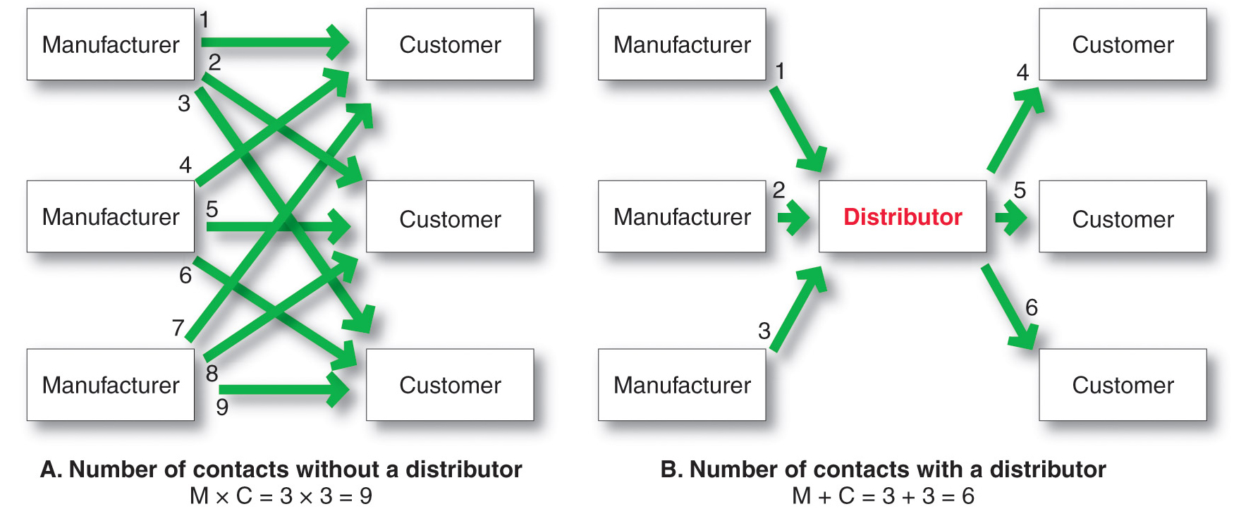
The Nature and Importance of Marketing Channels
How Channel Members Add Value

Slide 9
The Nature and Importance of Marketing Channels
How Channel Members Add Value
Information
Promotion
Contact
Matching
Negotiation
Physical distribution
Financing
Risk taking
Notes:
Note to Instructor
Channels perform the following functions:
Information: Gathering and distributing marketing research and intelligence information about actors and forces in the marketing environment needed for planning and aiding exchange.
Promotion: Developing and spreading persuasive communications about an offer.
Contact: Finding and communicating with prospective buyers.
Matching: Shaping and fitting the offer to the buyer’s needs, including activities such as manufacturing, grading, assembling, and packaging.
Negotiation: Reaching an agreement on price and other terms of the offer so that ownership or possession can be transferred.
Physical distribution: Transporting and storing goods.
Financing: Acquiring and using funds to cover the costs of the channel work.
Risk taking: Assuming the risks of carrying out the channel work

Slide 10

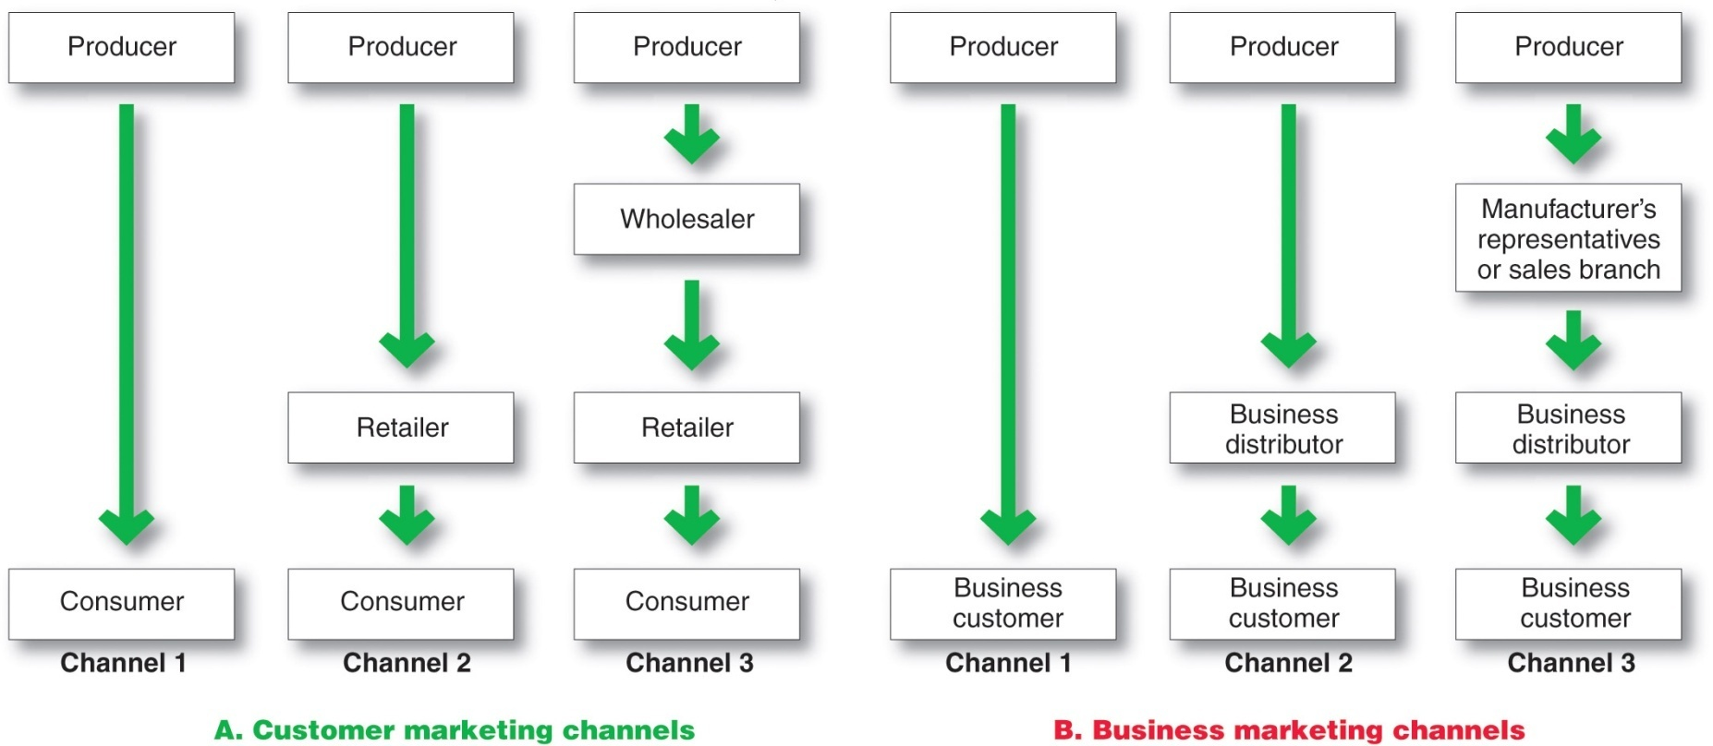
The Nature and Importance of Marketing Channels
Number of Channel Levels
Notes:
Note to Instructor
The remaining channels in Figure 12.2A are indirect marketing channels, containing one or more intermediaries.
Figure 12.2B shows some common business distribution channels. The business marketer can use its own sales force to sell directly to business customers. Or it can sell to various types of intermediaries, who in turn sell to these customers.
Channel 1, called a direct marketing channel, has no intermediary levels; the company sells directly to consumers.

Slide 11
The Nature and Importance of Marketing Channels
Number of Channel Levels
Connected by types of flows:
Physical flow of products
Flow of ownership
Payment flow
Information flow
Promotion flow

Slide 12
Channel Behavior and Organization
Channel Behavior
Marketing channel consists of firms that have partnered for their common good with each member playing a specialized role
Channel conflict refers to disagreement over goals, roles, and rewards by channel members
Horizontal conflict
Vertical conflict
Notes:
Note to Instructor
Horizontal conflict is conflict among members at the same channel level whereas vertical conflict is conflict between different levels of the same channel.

Slide 13
Channel Behavior and Organization
Conventional Distributions Systems
Conventional distribution systems consist of one or more independent producers, wholesalers, and retailers. Each seeks to maximize its own profits, and there is little control over the other members and no formal means for assigning roles and resolving conflict.

Slide 14
Channel Behavior and Organization
Vertical Marketing Systems
Vertical marketing systems (VMSs) provide channel leadership and consist of producers, wholesalers, and retailers acting as a unified system and consist of:
Corporate marketing systems
Contractual marketing systems
Administered marketing systems

Slide 15

Channel Behavior and Organization
Vertical Marketing Systems
Corporate vertical marketing system integrates successive stages of production and distribution under single ownership
Notes:
Note to Instructor
The text gives Zara as an example:
Zara has control over almost every aspect of the supply chain, from design and production to its own worldwide distribution network.
Zara makes 40 percent of its own fabrics and produces more than half of its own clothes, rather than relying on a hodgepodge of slow-moving suppliers.
New designs feed into Zara manufacturing centers, which ship finished products directly to 1,161 Zara stores in 68 countries, saving time, eliminating the need for warehouses, and keeping inventories low.
Effective vertical integration makes Zara faster, more flexible, and more efficient than international competitors such as Gap, Benetton, and H&M.

Slide 16
Channel Behavior and Organization
Vertical Marketing Systems
Contractual vertical marketing system consists of independent firms at different levels of production and distribution who join together through contracts to obtain more economies or sales impact than each could achieve alone. The most common form is the franchise organization.

Slide 17
Channel Behavior and Organization
Vertical Marketing Systems
Franchise organization links several stages in the production distribution process
  Manufacturer-sponsored retailer franchise system
  Manufacturer-sponsored wholesaler franchise system
  Service firm-sponsored retailer franchise system
Notes:
Note to Instructor

Slide 18
Channel Behavior and Organization
Vertical Marketing Systems
  Administered vertical marketing system has a few dominant channel members without common ownership. Leadership comes from size and power.

Slide 19
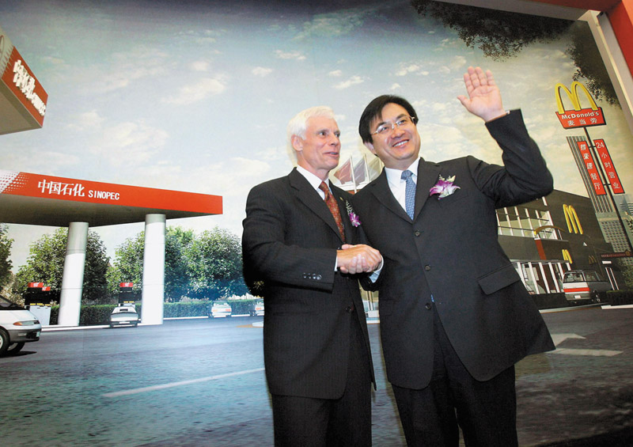
Channel Behavior and Organization
Horizontal Marketing System
  Horizontal marketing systems are when two or more companies at one level join together to follow a new marketing opportunity. Companies combine financial, production, or marketing resources to accomplish more than any one company could alone.
Notes:
Note to Instructor
Discussion Question
Can you think of an example where two companies join for a horizontal marketing system.
Students might notice that McDonald’s is in Wal-Mart or their gas station also has a coffee franchise.

Slide 20

Channel Behavior and Organization
Multichannel Distribution Systems
Hybrid Marketing Channels
  Multichannel Distribution systems (Hybrid marketing channels) are when a single firm sets up two or more marketing channels to reach one or more customer segments
Notes:
Note to Instructor
Many major grocers have partnered with Peapod for home delivery of groceries. This link brings you to the Peapod site. Many students may have tried this service.

Slide 21
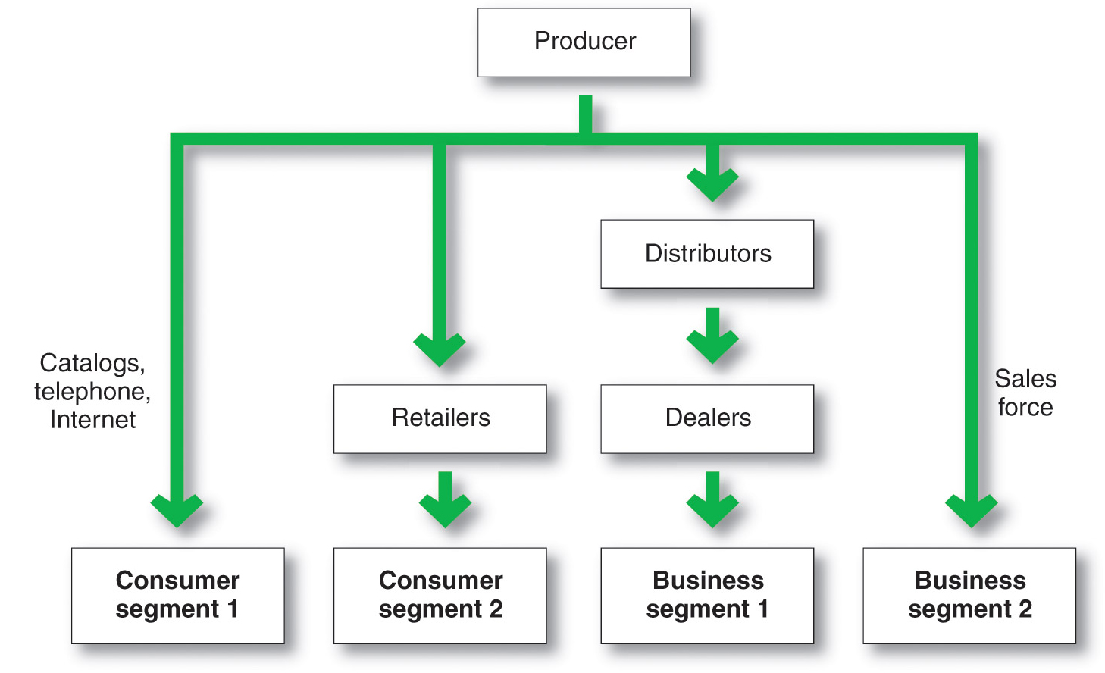
Channel Behavior and Organization
Multichannel Distribution System
Notes:
Note to Instructor
Prompt students to point out the advantages and challenges of multichannel systems:
Advantages
Increased sales and market coverage
New opportunities to tailor products and services to specific needs of diverse customer segments
Challenges
Hard to control
Create channel conflict

Slide 22
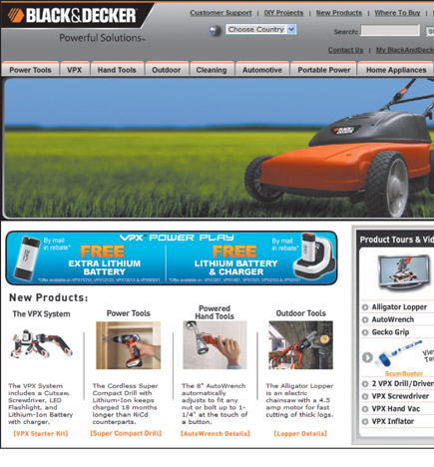
Channel Behavior and Organization
Changing Channel Organization
Disintermediation occurs when product or service producers cut out intermediaries and go directly to final buyers, or when radically new types of channel intermediaries displace traditional ones
Notes:
Note to Instructor
The link is to eBay. No doubt students are familiar with this site. Ask them how it might have displaced other channels like classified ads, yard sales, non-virtual auctions, etc.

Slide 23
Channel Design Decisions
Analyzing consumer needs
Setting channel objectives
Identifying major channel alternatives
Evaluation
Notes:
Note to Instructor
Discussion Questions
How might customer needs differ? Ask them how their needs on purchasing a book might differ from their parents? How does this translate to channel issues?
It will come down to analyzing customer needs in terms of:
Distance to travel
In person versus online
Breadth of assortment
Customer service

Slide 24
Channel Design Decisions
Setting Channel Objectives
Targeted levels of customer service
What segments to serve
Best channels to use
Minimizing the cost of meeting customer service requirements
Notes:
Note to Instructor
Objectives are influenced by the nature of the company, marketing intermediaries, competitors, and the environment.

Slide 25
Channel Design Decisions
Identifying Major Alternatives
Types of intermediaries
Number of marketing intermediaries
Responsibilities of channel members
Notes:
Note to Instructor
Types of intermediaries refers to channel members available to carry out channel work. Examples include the company sales force, manufacturer’s agency, and industrial distributors.

Slide 26
Channel Design Decisions
Identifying Major Alternatives
Intensive distribution
Candy and toothpaste
Exclusive distribution
Luxury automobiles and prestige clothing
Selective distribution
Television and home appliance
Notes:
Note to Instructor
In any channel producers and intermediaries need to agree on price policies, conditions of sale, territorial rights, and services provided by each party.

Slide 27
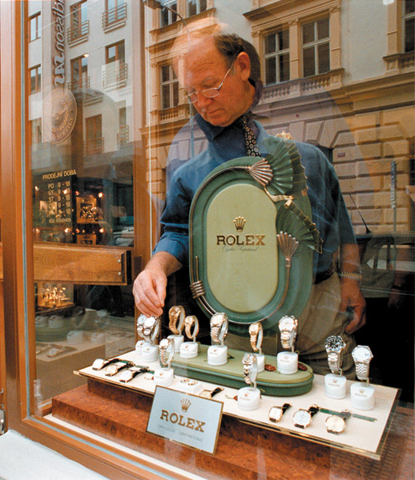
Channel Design Decisions
Evaluating the Major Alternatives
Each alternative should be evaluated against:
  Economic criteria
  Control
  Adaptive criteria
Notes:
Note to Instructor
Using economic criteria, a company compares the likely sales, costs, and profitability of different channel alternatives.
The company must also consider control issues. Using intermediaries usually means giving them some control over the marketing of the product, and some intermediaries take more control than others. Other things being equal, the company prefers to keep as much control as possible.
Finally, the company must apply adaptive criteria. Channels often involve long-term commitments, yet the company wants to keep the channel flexible so that it can adapt to environmental changes.

Slide 28
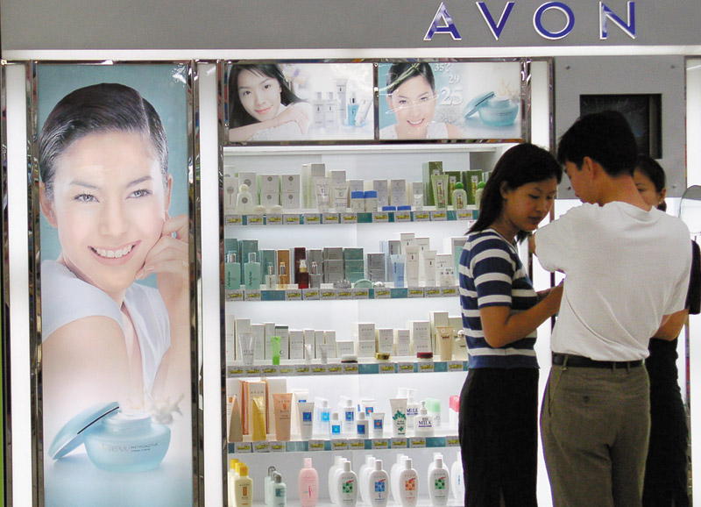
Channel Design Decisions
Designing International Distribution Channels
Channel systems can vary from country to country
Must be able to adapt channel strategies to the existing structures within each country

Slide 29
Channel Management Decisions
Selecting channel members
Managing channel members
Motivating channel members
Evaluating channel members
Notes:
Note to Instructor
Discussion Question
If you were a manufacturer, how would you select channel members?
Most likely they will look at years in business, profitability, and other products served. In managing channel members companies practice Partner relationship management (PRM) and supply chain management (SCM) to develop long term relationships.
Discussion Question
How do you motivate and evaluate channel members?
Some students might have worked in stores where the salespeople were given rewards for excellent sales or service.

Slide 30
Public Policy and Distribution Decisions
Exclusive distribution is when the seller allows only certain outlets to carry its products
Exclusive dealing is when the seller requires that the sellers not handle competitor’s products
Exclusive territorial agreements are where producer or seller limit territory
Tying agreements are agreements where the dealer must take most or all of the line
Notes:
Note to Instructor
Producers of a strong brand sometimes sell it to dealers only if the dealers will take some or all of the rest of the line. This is called full-line forcing. Such tying agreements are not necessarily illegal, but they do violate the Clayton Act if they tend to lessen competition substantially. The practice may prevent consumers from freely choosing among competing suppliers of these other brands.

Slide 31
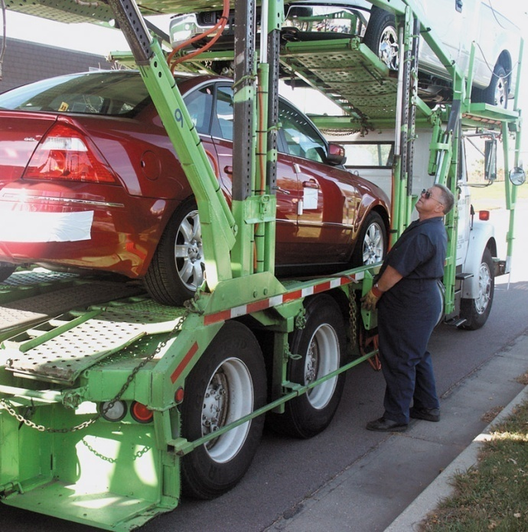
Marketing Logistics and
Supply Chain Management
Nature and Importance of Marketing Logistics
Marketing logistics (physical distribution) involves planning, implementing, and controlling the physical flow of goods, services, and related information from points of origin to points of consumption to meet consumer requirements at a profit
Notes:
Note to Instructor
Marketing logistics involves:
Outbound distribution—moving products from the factory to resellers and consumers.
Inbound distribution—moving products and materials from suppliers to the factory.
Reverse distribution—moving broken, unwanted, or excess products returned by consumers or resellers.

Slide 32
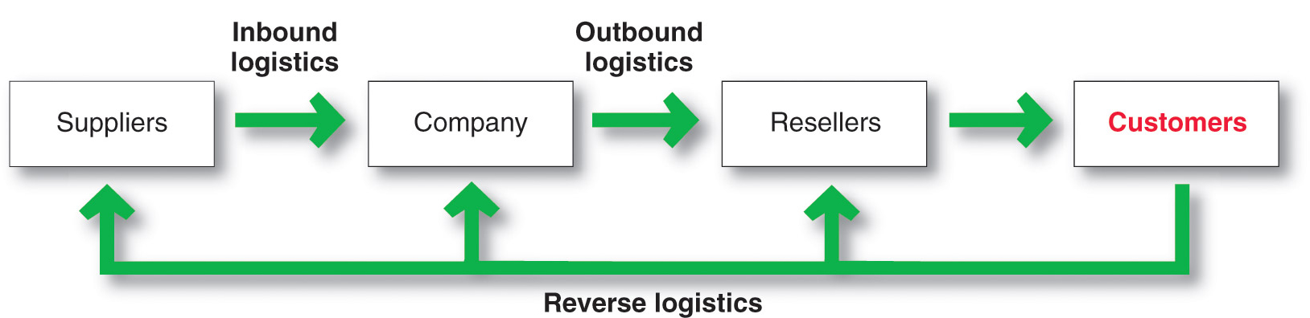
Marketing Logistics and Supply Chain Management
Nature and Importance of Marketing Logistics
Notes:
Note to Instructor
Discussion Question
What is the importance of logistics?
Their responses should include:
Competitive advantage by giving customers better service at lower prices.
Cost savings to the company and its customers.
Product variety requires improved logistics.
Information technology has created opportunities for distribution efficiency.

Slide 33
Marketing Logistics and
Supply Chain Management
Nature and Importance of Marketing Logistics
Supply chain management is the process of managing upstream and downstream value-added flows of materials, final goods, and related information among suppliers, the company, resellers, and final consumers

Slide 34
Marketing Logistics and
Supply Chain Management
Major Logistics Functions
Warehousing
Inventory management
Transportation
Logistics information management

Slide 35
Marketing Logistics and
Supply Chain Management
Warehousing Decisions
How many
What types
Where to locate
Warehouses
Distribution centers
Notes:
Note to Instructor
Distribution centers are designed to move goods rather than just store them. They are large and highly automated warehouses designed to receive goods from various plants and suppliers, take orders, fill them efficiently, and deliver goods to customers as quickly as possible. For example, Wal‑Mart operates a network of 112 huge U.S. distribution centers and another 57 around the globe. A single center, serves the daily needs of 75 to 100 Wal-Mart stores, typically contains some 1 million square feet of space (about 20 football fields) under a single roof.

Slide 36
Marketing Logistics and
Supply Chain Management
Inventory Management
Just-in-time systems
RFID
  Knowing exact product location
Smart shelves
  Placing orders automatically
Notes:
Note to Instructor
With such systems, producers and retailers carry only small inventories of parts or merchandise, often only enough for a few days of operations. New stock arrives exactly when needed, rather than being stored in inventory until being used. Just-in-time systems require accurate forecasting along with fast, frequent, and flexible delivery so that new supplies will be available when needed.

Slide 37
Marketing Logistics and
Supply Chain Management
Major Logistics Functions
Transportation affects the pricing of products, delivery performance, and condition of the goods when they arrive
Truck
Rail
Water
Pipeline
Air
Internet
Notes:
Note to Instructor
Many companies use intermodal transportation, which combines two or more modes of transportation.
Piggyback uses rail and truck
Fishyback uses water and truck
Airtruck uses air and truck

Slide 38
Marketing Logistics and
Supply Chain Management
Logistics Information Management
Logistics information management is the management of the flow of information, including customer orders, billing, inventory levels, and customer data
EDI (electronic data interchange)
VMI (vendor-managed inventory)

Slide 39
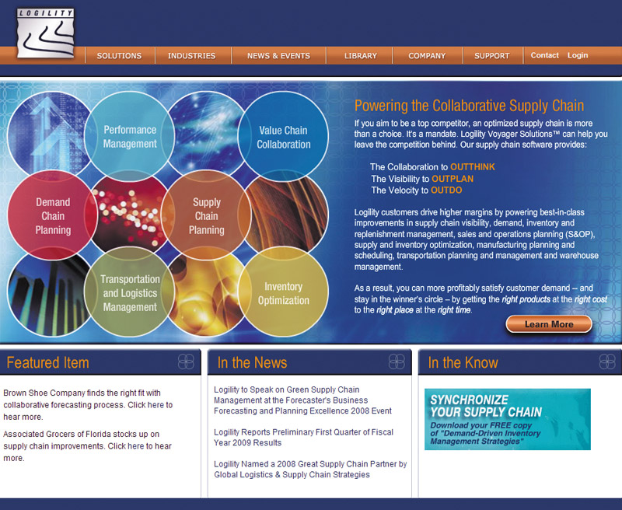
Marketing Logistics and
Supply Chain Management
Integrated Logistics Management
Integrated logistics management is the recognition that providing customer service and trimming distribution costs requires teamwork internally and externally

Slide 40

Marketing Logistics and
Supply Chain Management
Integrated Logistics Management
Third-party logistics is the outsourcing of logistics functions to third-party logistics providers (3PLs)
Notes:
Note to Instructor
Third party logistics offers the following:
Provide logistics functions more efficiently
Provide logistics functions at lower cost
Allow the company to focus on its core business
Are more knowledgeable of complex logistics

Slide 41
Retailing and Wholesaling
Topic Outline
Retailing
Wholesaling

Slide 42
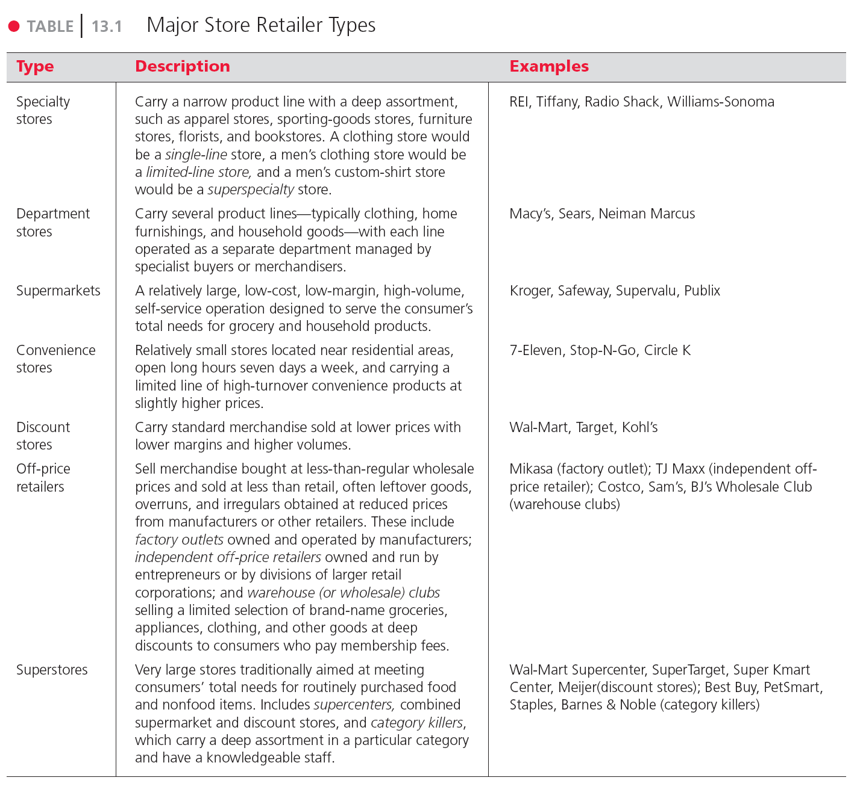
Table 13.1
Major Store Retailer Types

Slide 43
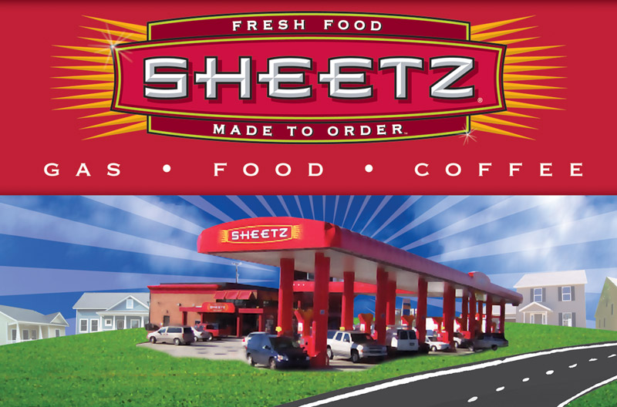
Retailing
Types of Retailers
Amount of service
Self-service
Limited service
Full service
Notes:
Self-service retailers serve customers who are willing to perform their own locate-compare-select process to save money. They include: Wal-Mart and Supermarkets.
Limited service retailers provide more sales assistance because they carry more shopping goods about which customers need more information. Examples include Sears and JC Penney.
Full-service retailers assist customers in every phase of the shopping process, resulting in higher costs that are passed on to the customer as higher prices. Includes department stores and specialty stores

Slide 44
Retailing
Product Line
Specialty stores
Narrow product line with deep assortment
Department stores
Wide variety of product lines
Convenience stores
Limited line of high-turnover goods
Superstores
Non-food goods
Category killers
Deep in category with sales staff
Notes:
Note to Instructor
Discussion Question
What are examples of these types of stores?
It might be difficult, depending on their geographic region, to find examples of superstores. Ask them where they would rather shop for a computer, a department store like Wal-Mart or a category killer like Best Buy? Why?

Slide 45
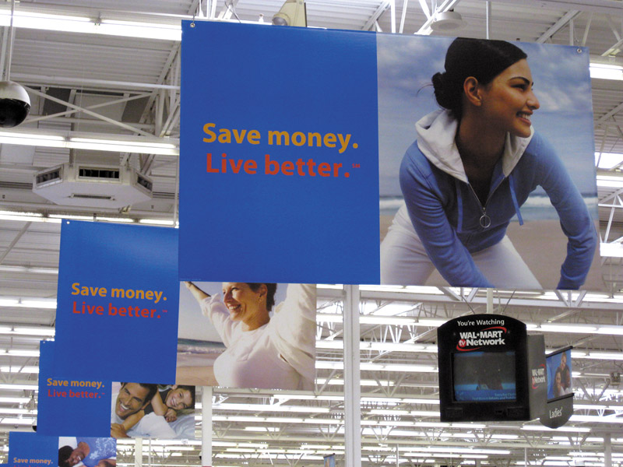
Retailing
Types of Retailers
Relative Prices
Discount stores
Off-price retailers
Factory outlets
Warehouse clubs
Notes:
Note to Instructor
Discount stores sell standard merchandise at lower prices by accepting lower margins and selling higher volume.
Independent off-price retailers either are owned and run by entrepreneurs or are divisions of larger retail corporations.
Off-price retailers buy at less-than-regular wholesale prices and charge customers less than retail.
Factory outlets are producer-operated stores. The link on this slide is to a Premium Factory Outlet mall. Students are probably familiar with these types of shopping locations.
Warehouse clubs are large warehouse-like facilities with few frills and offer ultra-low prices.

Slide 46
Retailing
Types of Retailers
Organizational Approach
Corporate chains
Voluntary chains
Retailer cooperatives
Franchise organizations
Merchandising conglomerates

Slide 47
Retailing
Types of Retailers
Organizational Approach
Corporate Chains are two or more outlets that are commonly owned and controlled
Size allows them to buy in large quantities at lower prices and gain promotional economies
  Sears
  CVS

Slide 48
Retailing
Types of Retailers
Organizational Approach
Voluntary chains are wholesale-sponsored groups of independent retailers that engage in group buying and common merchandising
IGA
Western Auto

Slide 49
Retailing
Types of Retailers
Organizational Approach
Retailer cooperatives is a group of independent retailers that band together to set up a joint-owned, central wholesale operation and conduct joint merchandising and promotion effort
Ace Hardware
Associated Grocers
Notes:
Note to Instructor
This link is to the homepage for Ace Hardware. Students are likely to be familiar with the brand but not know that many stores are individually owned and operated (although they might know this phrase). You can view the site for information specific to owners.

Slide 50
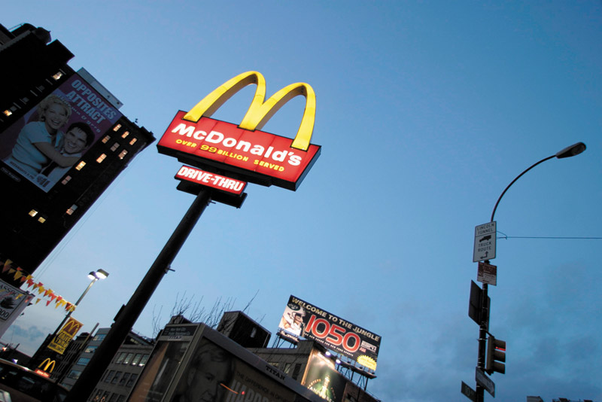
Retailing
Types of Retailers
Organizational Approach
Franchise organizations are based on some unique product or service; on a method of doing business; or on the trade name, good will, or patent that the franchisor has developed

Slide 51
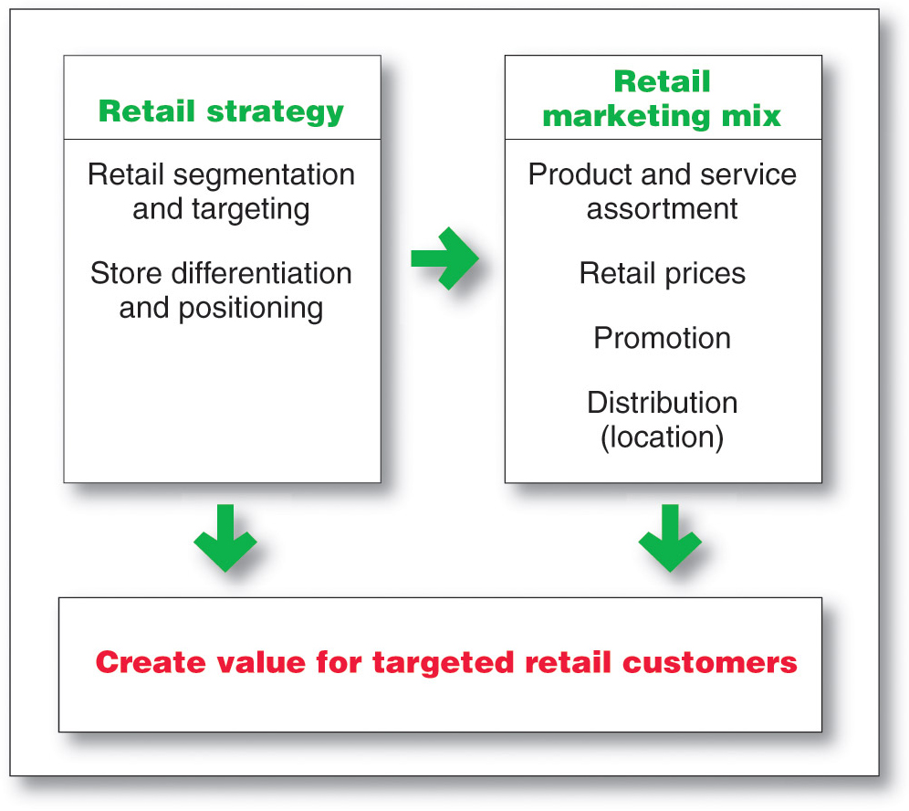
Retailing
Retailer Marketing Decisions

Slide 52
Wholesaling
Wholesaling includes all activities involved in selling goods and services to those buying for resale or business use
Selling and promoting
Buying assortment building
Bulk breaking
Warehousing
Transportation
Financing
Risk bearing
Market information
Management services and advice

