Slide 1
Chapter 18: The Analysis and Valuation of Bonds
Analysis of Investments &
Management of Portfolios
10TH EDITION
Reilly & Brown

Slide 2
The Fundamentals of Bond Valuation
The Present Value Model
where:
P_{m}=the current market price of the bond
n = the number of years to maturity
C_{i} = the annual coupon payment for bond i
i = the prevailing yield to maturity for this bond issue
P_{p}=the par value of the bond

Slide 3
The Fundamentals of Bond Valuation
  The Price-Yield Curve: There exists a inverse relationship between bond price and bond yield to maturity-its required rate of return
    If yield < coupon rate, bond will be priced at a premium to its par value
    If yield > coupon rate, bond will be priced at a discount to its par value
    Price-yield relationship is convex (not a straight line)
    See Exhibit 18.1

Slide 4
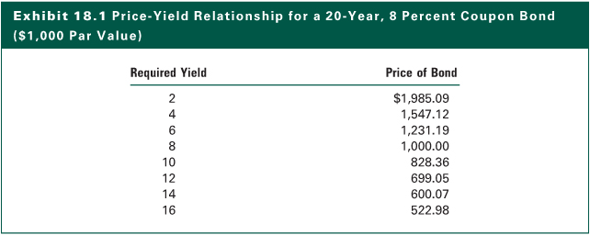
Exhibit 18.1

Slide 5
The Fundamentals of Bond Valuation
The Yield Model
  Instead of computing the bond price, one can use the same formula to compute the discount rate given the price paid for the bond
  It is the expected yield on the bond
where: i =the discount rate that will discount the cash flows to equal the current market price of the bond

Slide 6
Computing Bond Yields
Measures of Bond Yield
Yield Measure Purpose
Nominal Yield Measures the coupon rate
Current yield Measures current income rate
Promised yield to maturity Measures expected rate of return for bond held to maturity
Promised yield to call Measures expected rate of return for bond held to first call date
Realized (horizon) yield Measures expected rate of return for a bond likely to be sold prior to maturity. It considers specified reinvestment assumptions and an estimated sales price.

Slide 7
Computing Bond Yields
Nominal Yield
  It is simply the coupon rate of a particular issue
  For example , a bond with an 8 percent coupon has an 8 percent nominal yield
Current Yield
  Similar to dividend yield for stocks
  CY = C_{i}/P_{m}
  where:
  CY = the current yield on a bond
  C_{i} = the annual coupon payment of Bond i
  P_{m} = the current market price of the bond

Slide 8
Computing Bond Yields
Promised Yield to Maturity (YTM)
  It is computed in exactly the same way as described in the yield model earlier
  Widely used bond yield measure
  It assumes
    Investor holds bond to maturity
    All the bond’s cash flow is reinvested at the computed yield to maturity

Slide 9
Computing Bond Yields
Computing Promised Yield to Call (YTC)
  One needs to compute YTC for callable bonds
  Bond should be valued using YTC (not YTM) if the bond price is equal to or greater than its call price
where:
P_{m} = market price of the bond
C_{i} = annual coupon payment
nc = number of years to first call
P_{c} = call price of the bond

Slide 10
Computing Bond Yields
Realized (Horizon) Yield
  The realized yield over a horizon holding period is a variation on the promised yield equations
  Instead of the par value as in the YTM equation, the future selling price, P_{f}, is used
  Instead of the number of years to maturity as in the YTM equation, the holding period (years), hp, is used here

Slide 11
Calculating Future Bond Prices
The Pricing Formula
where:
P_{f} = the future selling price of the bond
P_{p} = the par value of the bond
C_{i} = annual coupon payment
n = number of years to maturity
hp = holding period of the bond in years
i = the expected market YTM at the end of the holding period

Slide 12
Calculating Future Bond Prices
Yield Adjustments for Tax-Exempt Bonds
  Municipal bonds, Treasury issues, and many agency obligations possess one common characteristic: Their interest income is partially or fully tax-exempt
  For fully tax-exempt bonds
where: FTEY = fully taxable yield equivalent
i = the promised yield on the tax exempt bond
T = the amount and type of tax exemption

Slide 13
Bond Valuation Using Spot Rates
The Concept
  Thus far, we have used one discount rate for all cash flows, reflecting the overall required rate
  The rates used to discount a cash flow at a certain point are called spot rates
where: P_{m} = the market price of the bond
C_{t} = the cash flow at time t
n = the number of years
i_{t} = the spot rate for Treasury securities at maturity t
See Exhibit 18.5

Slide 14
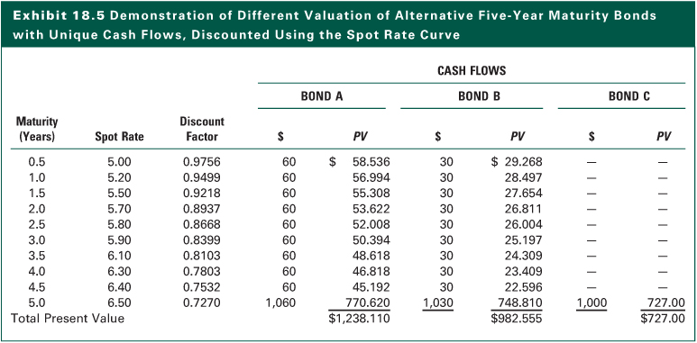
Exhibit 18.5

Slide 15
What Determines Interest Rates
Inverse relationship with bond prices
Forecasting interest rates
Fundamental determinants of interest rates
i = RFR + I + RP
where:
  RFR = real risk-free rate of interest
  I = expected rate of inflation
  RP = risk premium
  Conceptually
  i = f (Economic Forces + Issue Characteristics)

Slide 16
What Determines Interest Rates
Effect of Economic Factors
  Real growth rate
  Tightness or ease of capital market
  Expected inflation
  Supply and demand of loanable funds
Impact of Bond Characteristics
  Credit quality
  Term to maturity
  Indenture provisions
  Foreign bond risk including exchange rate risk and country risk

Slide 17
Term Structure of Interest Rates
It is a static function that relates the term to maturity to the yield to maturity for a sample of bonds at a given point in time
Exhibit 18.7 shows yield curves for a sample of U.S. Treasury obligations
Types of Yield Curves (Exhibit 18.8)
  Rising yield curve: Yields on short-term maturities are lower than longer maturities
  Flat yield curve: Equal yields on all issues
  Declining yield curve: Yields on short-term issues are higher than longer maturities

Slide 18
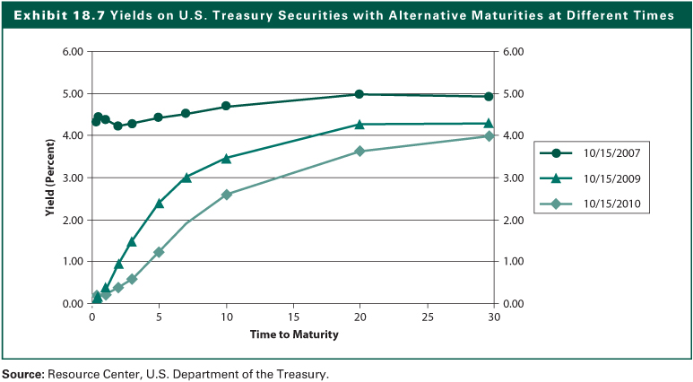
Exhibit 18.7

Slide 19
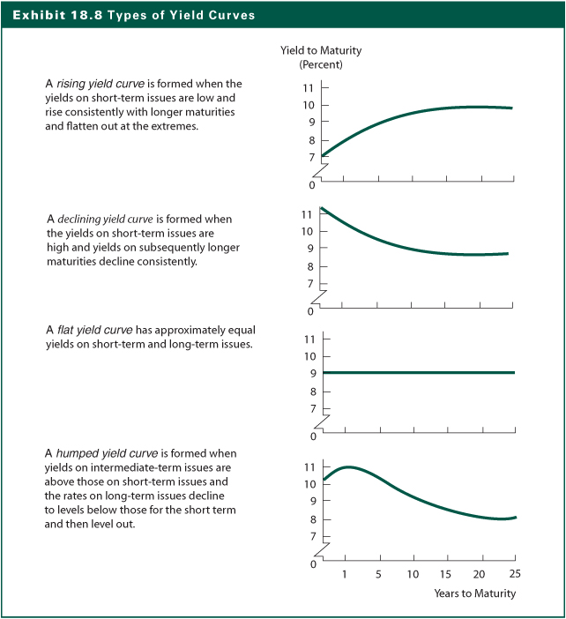
Exhibit 18.8

Slide 20
Spot Rates and Forward Rates
The Concept
  Spot rate: Defined as the discount rate for a cash flow at a specific maturity
  Forward rate: Refers to the expectation of future short-term rates
Creating the Theoretical Spot Rate Curve
Calculating Forward Rates from the Spot Rate Curve

Slide 21
Term-Structure Theories
Expectations Hypothesis
  Any long-term interest rate simply represents the geometric mean of current and future one-year interest rates expected to prevail over the maturity of the issue
  It can explain any shape of yield curve
    Expectations for rising short-term rates in the future cause a rising yield curve
    Expectations for falling short-term rates in the future will cause a declining yield curve
    Similar explanations account for flat and humped yield curves

Slide 22
Term-Structure Theories
Liquidity Preference Theory
  Long-term securities should provide higher returns than short-term obligations because investors are willing to sacrifice some yields to invest in short-maturity obligations to avoid the higher price volatility of long-maturity bonds
  This theory argues that the yield curve should generally slope upward and that any other shape should be viewed as a temporary aberration

Slide 23
Term-Structure Theories
Segmented-Market Hypothesis
  Different institutional investors have different maturity needs that lead them to confine their security selections to specific maturity segments; and yields for a segment depend on the supply and demand within that maturity segment
  This theory contends that the shape of the yield curve ultimately is a function of the investment policies of major financial institutions

Slide 24
Term-Structure Theories
Trading Implications of the Term Structure
  Information on maturities can help formulate yield expectations by simply observing the shape of the yield curve
  Based on these theories, bond investors use the prevailing yield curve to predict the shapes of future yield curves
  The maturity segments that are expected to experience the greatest yield changes give the investor the largest potential price change opportunities

Slide 25
Term-Structure Theories
Yield Spreads
  Major Yield Spreads
    Segments: Government bonds, agency bonds, and corporate bonds
    Sectors: Prime-grade municipal bonds versus good-grade municipal bonds, AA utilities versus BBB utilities
    Coupons or seasoning within a segment or sector
    Maturities within a given market segment or sector
  Magnitudes and direction of yield spreads can change over time

Slide 26
Price Volatility for Bonds
Bond price is a function of (1) par value (2) Coupon (3) Years to maturity (4) Prevailing market interest rate
Bond price change or volatility is measured as the percentage change in bond price
where:
EPB = the ending price of the bond
BPB = the beginning price of the bond

Slide 27
Price Volatility for Bonds
Five Important Relationships
  Bond prices move inversely to bond yields
  For a given change in yields, longer maturity bonds post larger price changes, thus bond price volatility is directly related to maturity
  Price volatility increases at a diminishing rate as term to maturity increases
  Price movements resulting from equal absolute increases or decreases in yield are not symmetrical
  Higher coupon issues show smaller percentage price fluctuation for a given change in yield, thus bond price volatility is inversely related to coupon

Slide 28
Price Volatility for Bonds
The Maturity Effect
  The longer-maturity bond experienced the greater price volatility
  Price volatility increased at a decreasing rate with maturity
  See Exhibit 18.12
The Coupon Effect
  Exhibit 18.13 shows that the inverse relationship between coupon rate and price volatility

Slide 29
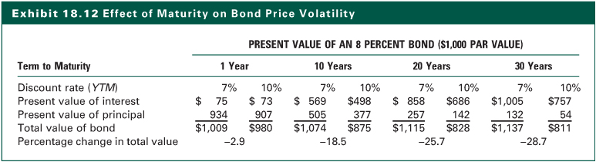
Exhibit 18.12

Slide 30
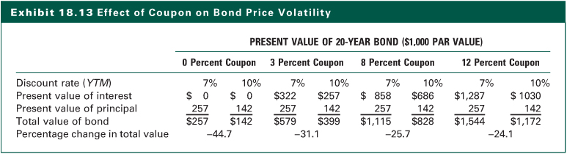
Exhibit 18.13

Slide 31
Price Volatility for Bonds
The Yield Level Effect (See Exhibit 18.14)
  If yield changes by a constant percentage, the change in the bond price is larger when the yields are at a higher level
  If yield changes by a constant basis-point, the change in the bond price is larger when the yields are at a lower level
Trading Strategies
  If interest rates are expected to decline, bonds with higher interest rate sensitivity should be selected
  If interest rates are expected to increase, bonds with lower interest rate sensitivity should be chosen

Slide 32
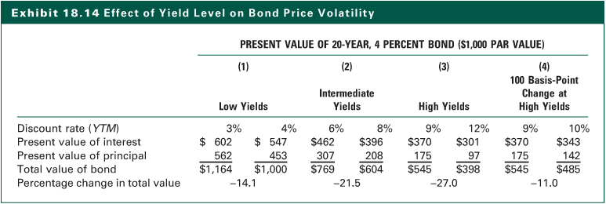
Exhibit 18.14

Slide 33
The Duration Measure
Since price volatility of a bond varies inversely with its coupon and directly with its term to maturity, it is necessary to determine the best combination of these two variables to achieve your objective
Duration as a measure of interest rate risk
  Macaulay Duration
  Modified Duration
  Effective Duration
  Empirical Duration

Slide 34
Macaulay Duration
The Formula
where:
t = time period in which the coupon or principal payment occurs
C_{t} = interest or principal payment that occurs in period t
i = yield to maturity on the bond

Slide 35
Macaulay Duration
The Characteristics
  Duration of a bond with coupons is always less than its term to maturity
  A zero-coupon bond’s duration equals its maturity
  Duration and coupon is inversely related
  There is a positive relationship between term to maturity and duration, but duration increases at a decreasing rate with maturity (Exhibit 18.16)
  YTM and duration is inversely related
  Sinking funds and call provisions can have a dramatic effect on a bond’s duration

Slide 36
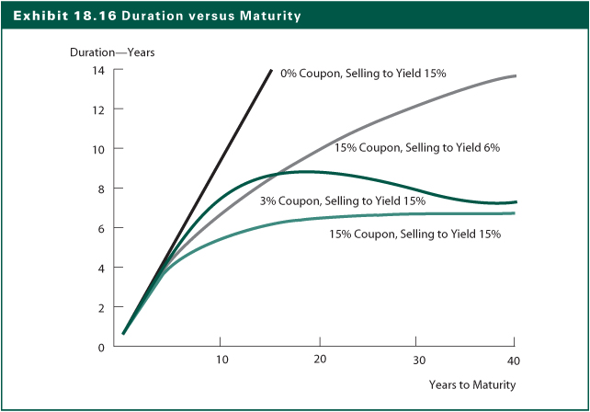
Exhibit 18.16

Slide 37
Modified Duration and Bond Price Volatility
Modified Duration Formula (D _{mod})
where:
m = number of payments a year
YTM = nominal YTM

Slide 38
Modified Duration and Bond Price Volatility
As A Measure of Bond Price Volatility
  Bond price movements will vary proportionally with modified duration for small changes in yields
where:
ΔP = change in price for the bond
P = beginning price for the bond
D_{mod} = the modified duration of the bond
Δi = yield change in basis points divided by 100

Slide 39
Modified Duration and Bond Price Volatility
Trading Strategies Using Modified Duration
  Longest-duration security provides the maximum price variation
  If you expect a decline in interest rates, increase the average modified duration of your bond portfolio to experience maximum price volatility
  If you expect an increase in interest rates, reduce the average modified duration to minimize your price decline
  Note that the modified duration of your portfolio is the market-value-weighted average of the modified durations of the individual bonds in the portfolio

Slide 40
Bond Convexity
Modified duration is a linear approximation of bond price change for small changes in market yields
However, price changes are not linear, but a curvilinear (convex) function of bond yields
Different bonds have different convex price-yield curve (Exhibit 18.20)

Slide 41
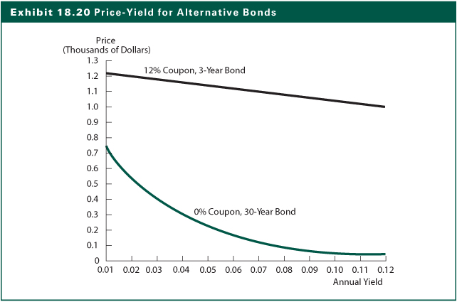
Exhibit 18.20

Slide 42
Bond Convexity
Price-Yield Relationship for Bonds
  The graph of prices relative to yields is not a straight line, but a curvilinear relationship
  This can be applied to a single bond, a portfolio of bonds, or any stream of future cash flows
  The convex price-yield relationship will differ among bonds or other cash flow streams depending on the coupon and maturity
  The convexity of the price-yield relationship declines slower as the yield increases
  Modified duration is the percentage change in price for a nominal change in yield

Slide 43
Bond Convexity
The Desirability of Convexity
  As yield increases, the rate at which the price of the bond declines becomes slower
  Similarly, when yields decline, the rate at which the price of the bond increases becomes faster
  For bonds with equal durations, bond with greater convexity would have better price performance
  The estimate using only modified duration will underestimate the actual price increase caused by a yield decline and overestimate the actual price decline caused by an increase in yields
  See Exhibit 18.21

Slide 44
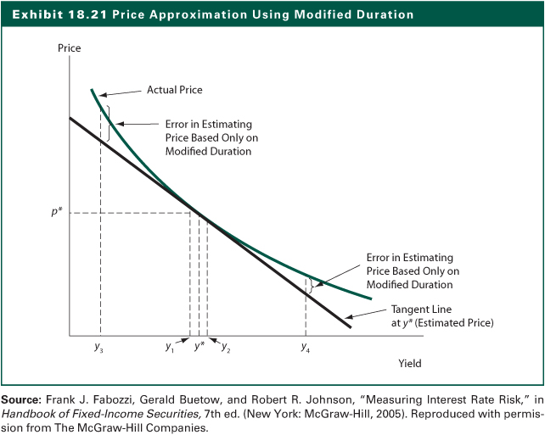
Exhibit 18.21

Slide 45
Bond Convexity
The Determinants of Convexity
  The Formula
  Important Relationships
    Inverse relationship between coupon and convexity
    Direct relationship between maturity and convexity
    Inverse relationship between yield and convexity
Computation of Convexity
  See Exhibit 18.22

Slide 46
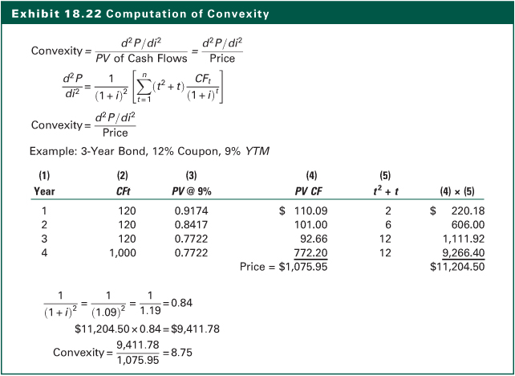
Exhibit 18.22

Slide 47
Duration and Convexity for Callable Bonds
Issuer has option to call bond and pay off with proceeds from a new issue sold at a lower yield
Embedded option
Difference in duration to maturity and duration to first call
Combination of a noncallable bond plus a call option that was sold to the issuer
Any increase in value of the call option reduces the value of the callable bond

Slide 48
Duration and Convexity for Callable Bonds
Option Adjusted Duration (OAD)
  Based on the probability that the issuing firm will exercise its call option
  OAD = Duration of the non-callable bond
  - Duration of the call option
  Negative option-adjusted duration may exist when an option that is very leveraged. An example is a mortgage-backed security that might decline in price when there is a decline in interest rates

Slide 49
Duration and Convexity for Callable Bonds
Convexity of Callable Bonds
  Noncallable bond has positive convexity: As yields declined, the price of the bond increased at a faster rate
  Callable bond has negative convexity: As rates decline, the price increases at a slower rate and eventually does not change at all
  See Exhibit 18.24

Slide 50
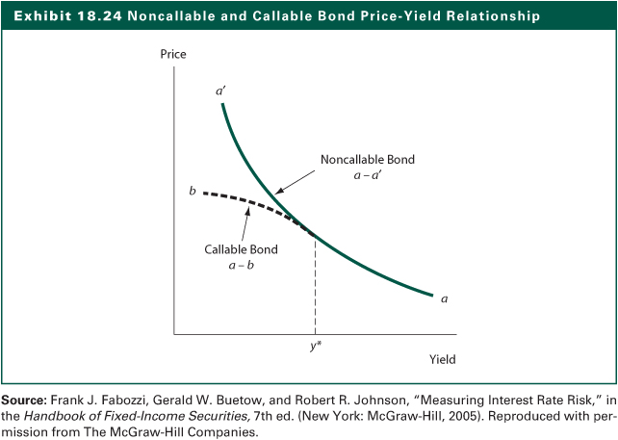
Exhibit 18.24

Slide 51
Limitations of Macaulay & Modified Duration
Percentage change estimates using modified duration only are good for small-yield changes
Difficult to determine the interest-rate sensitivity of a portfolio of bonds when there is a change in interest rates and the yield curve experiences a nonparallel shift
Initial assumption that cash flows from the bond are not affected by yield changes
Practitioners have developed the effective duration of a bond or any security due to these limitations

Slide 52
Limitations of Macaulay & Modified Duration
Effective Duration
  Measure of the interest rate sensitivity of an asset
  Use a pricing model to estimate the market prices surrounding a change in interest rates
  The Formulas
  Effective Duration (D_{Eff}) = [(P₋) – (P₊)] / 2PS
  Effective Convexity (C_{Eff}) = [(P₋) – (P₊)-2P] / PS²
Where:
P- = the estimated price after a downward shift in interest rates
P+ = the estimated price after a upward shift in interest rates
P = the current price
S = the assumed shift in the term structure

Slide 53
Limitations of Macaulay & Modified Duration
Effective duration greater than maturity
Negative effective duration
Empirical duration
  Needed when it is not possible to generate well-specified market price estimates in response to yield changes
  Empirical duration is computed as the actual percent change for an asset in response to a change in yield during a specified time period

Slide 54
Yield Spreads With Embedded Options
Static Yield Spreads
  Consider the total term structure
Option-Adjusted Spreads
  Consider changes in the term structure and alternative estimates of the volatility of interest rates

Slide 55
The Internet Investments Online
http://www.bondcalc.com
http://www.sifma.org
http://www.pimco.com
http://www.bonds-online.com

