Slide 1
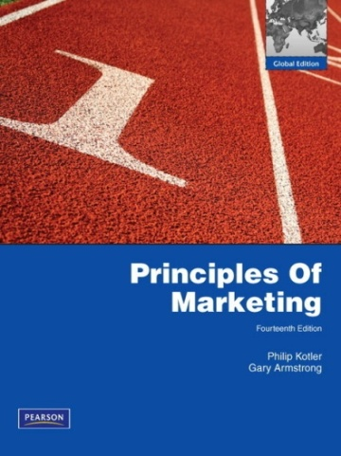
Chapter 1
Consumer Behavior
Chapter 5
Introduction
MK 202 Fundamentals of Marketing
By
Aj.Suwalya Khemvaraporn
Date: September 20,2012

Slide 2
Chapter Objective Outline
Model of Consumer Behavior
Characteristics Affecting Consumer Behavior
Types of Buying Decision Behavior
The Buyer Decision Process
The Buyer Decision Process for New Products

Slide 3
What’s so IMPORTANT?
How consumers think and act to affect the whats, whens, and hows of buying behavior, must understand the Whys…

Slide 4
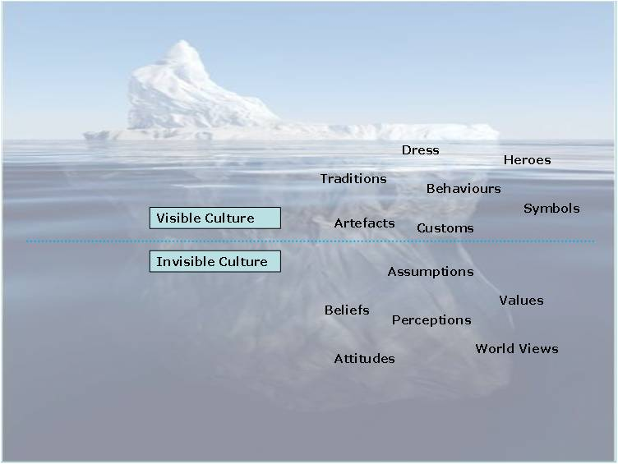
Iceberg Model …
whats, whens, and hows
Whys…

Slide 5
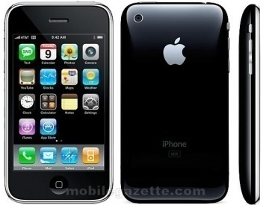
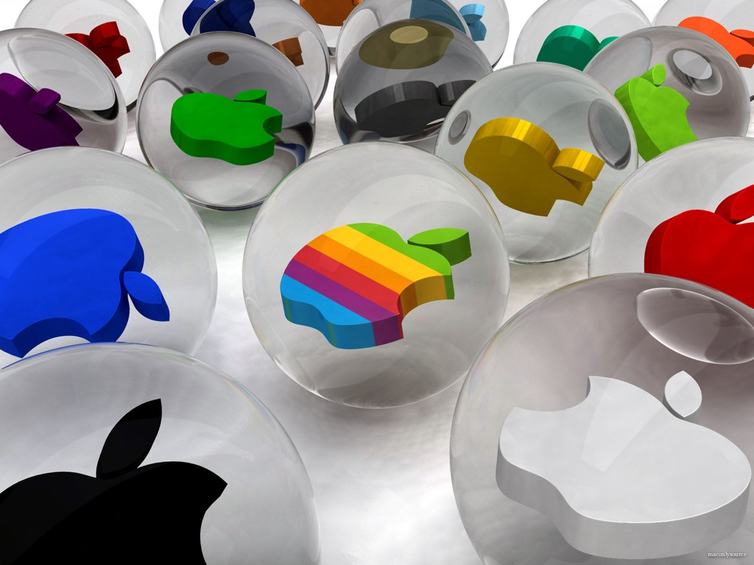
APPLE
The Urban Dictionary defines a Macolytes as “one who is fanatically devoted to Apple products as “He’s a Macolyte; don’t even think of mentioning Microsoft within earshot.
Apple is the epitome of cool – a company a cutlike following because it somehow manages to breathe a new life into every category it touches.
Thanks to Apple’s deep understanding of consumer behavior, the Apple brand engenders an intense loyalty in the hearts of core Apple customers. The consumer love affair with Apple has produced stunning sales and profit results.

Slide 6

What is Consumer Behavior?
Consumer buying behavior: The buying behavior of final consumers- individuals and households that buy goods and services for personal consumption.

Slide 7
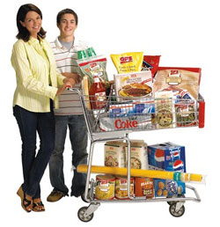

What is Consumer Behavior?
Consumer Market: All the individuals and households that buy or acquire goods and services for personal consumption.

Slide 8
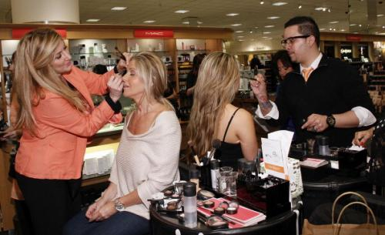
What is Consumer Behavior?
Consumers make many buying decisions every day, and the buying decision is the focal point of the market.
How do consumers respond to various marketing efforts the company might use?

Slide 9
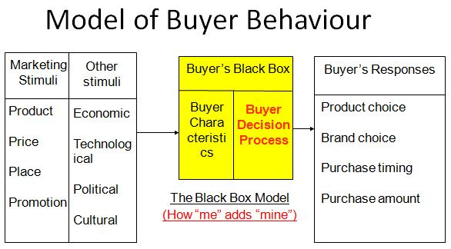
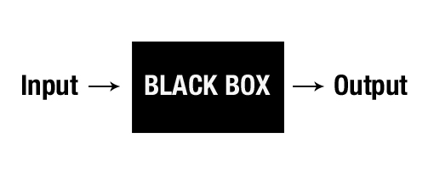
Figure 5.1 Model of Buying Behavior

Slide 10
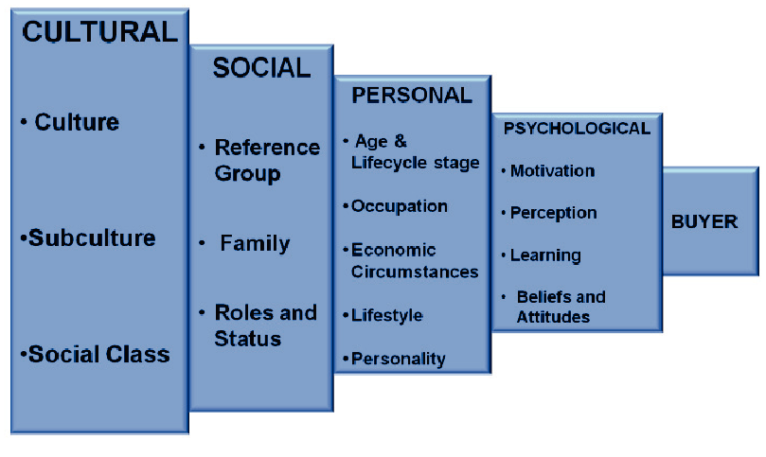
Figure 5.2 Factors Influencing Consumer Behavior

Slide 11
Figure 5.2 Factors Influencing Consumer Behavior

Slide 12

What is Culture?
Culture : The set of basic values, perceptions, wants and behaviors learned by a member of society from family and other important institutions.

Slide 13

Concept of
Culture
Culture provides the framework within which individual
and household
lifestyles
evolve.

Slide 14
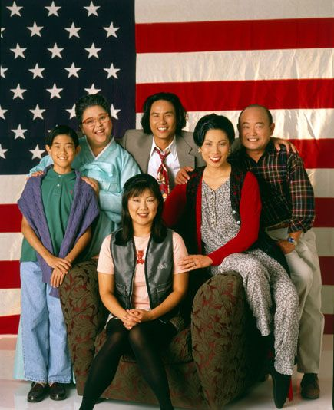

What is Subculture?
Subculture: A group of people with shared value systems based on common life experiences and situations.

Slide 15
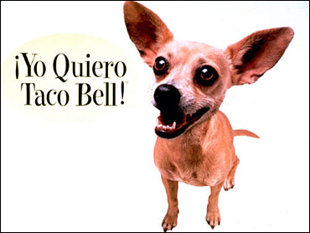
Subculture
Hispanic American Consumers
  50 million in population
  $950 billion in buying power
  $ 1.4 Trillion growth estimation by 2013
  P &G, McDonalds, Toyota, Burger King
  Walmart – Phoenix and Houston serve local Hispanics consumer under the name Supermercado de Walmart

Slide 16
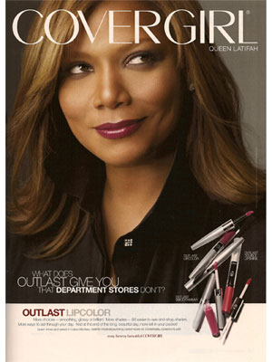
Subculture
African American Consumers
  42 million in population
  $913 billion in buying power
  $ 1.2 trillion growth by 2013
  Enjoy shopping more than other groups
  even for mundane groceries
  Queen Latifah presenter for Cover Girl line for women of color
  P&G supports a broader “My Black is Beautiful: Movement

Slide 17
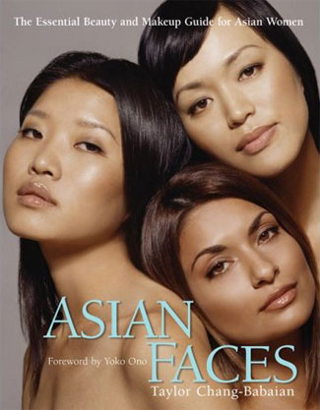
Subculture
Asian American Consumers
  Most affluent demographic segment
  15 million in population
  $500 billion in spending power
  $750 billion growth by 2013
  Shop most frequently and most brand conscious/can be fiercely brand loyal.
  McDonalds offer both English and Asian Languages

Slide 18

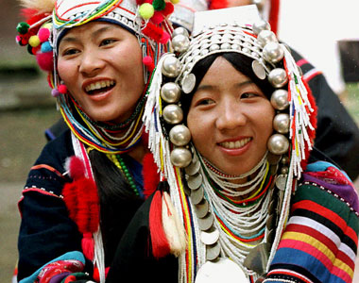
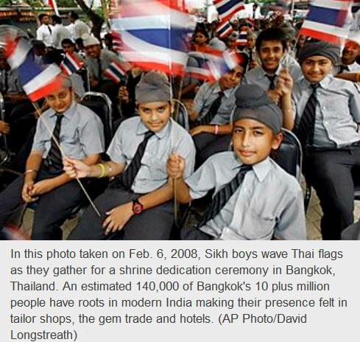
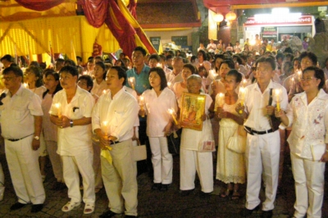
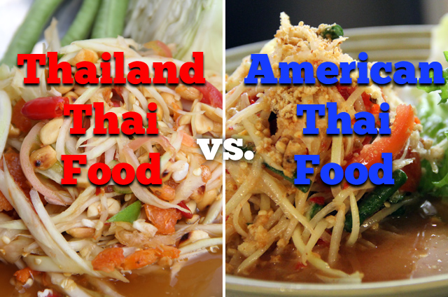
Subcultures in Thailand?

Slide 19


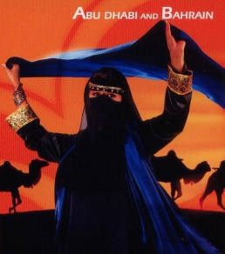
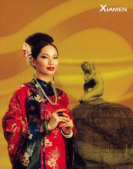

Cultural Factors Affect
Consumer Behavior and Marketing Strategy
Language
Marketing
Strategy
Consumer
Behavior
Demographics
Nonverbal
Communication
Values

Slide 20
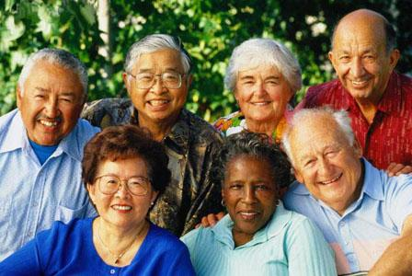
Mature Consumers
Baby boomers (Age 50-75) will account for 40% of adult consumers
Ages 65 and older will account of 20% of the population
Boost the most expendable case
  Remain attractive for companies in all industries from pharmaceuticals, furniture, groceries, beauty products, and clothing to consumer electronics, travel and entertainment and financial services.
  Expert notes” some 25% of Apple iPhones- the epitome of cool, cutting-edge product- have been bought by people over 50.”

Slide 21
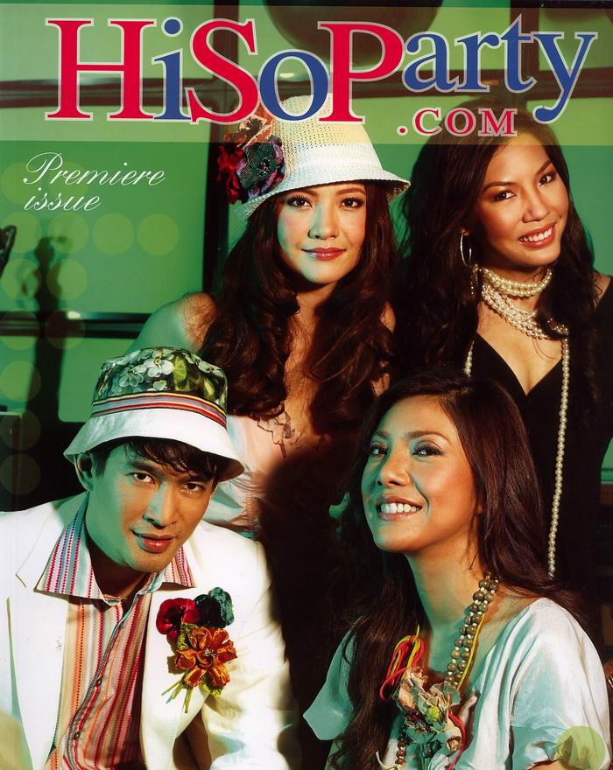
Social Factors
Social Class: Relatively permanent and ordered divisions in a society whose members share similar values, interests and behaviors.
Group: Two or more people who interact to accomplish individual or mutual goals.

Slide 22
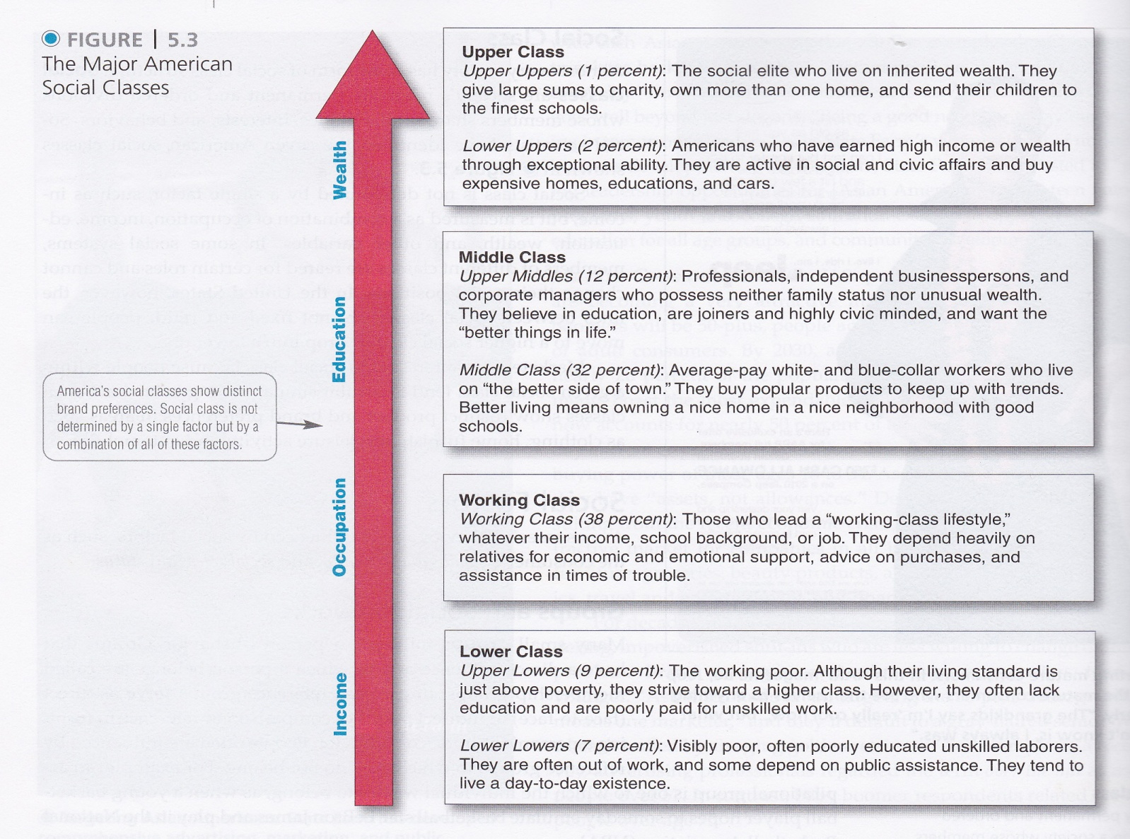
Figure 5.3 The Major American Social Classes

Slide 23
Figure 5.2 Factors Influencing Consumer Behavior

Slide 24

Word-of Mouth and Buzz Marketing
Opinion Leader (influentials or leading adopters): A person within a reference group who because of special skills, knowledge, personality, or other characteristics, exerts social influence on others.

Slide 25
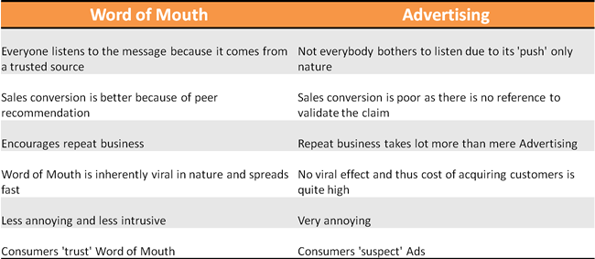
Pros and Cons

Slide 26
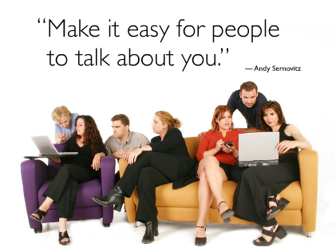
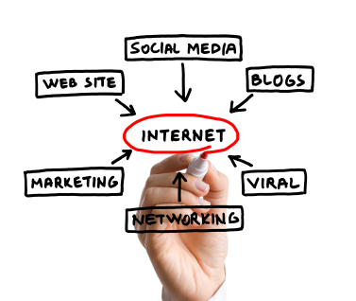
Online Social networks
Online Social Networks: Online social communities- blogs, social networking websites, or even virtual worlds- where people socialize or exchange information and opinions

Slide 27
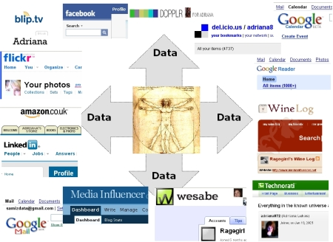

Slide 28
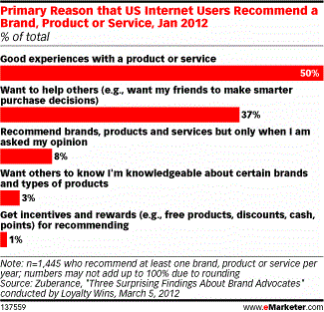

Slide 29
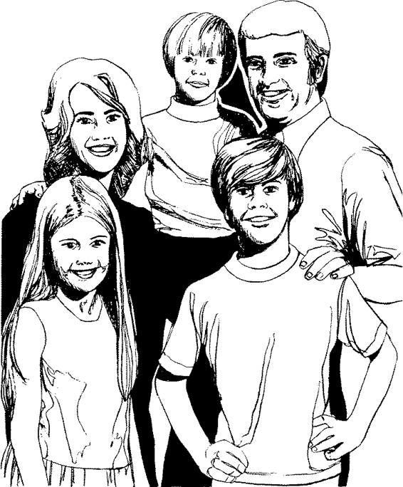
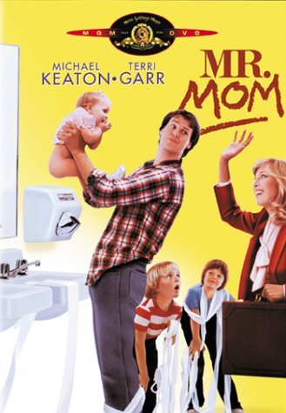
Family
Family buying: Family buying roles are changing, For example, 65 percent of men grocery shop regularly while women influence 5- percent of all new technology purchases. Technology companies are redesigning their products accordingly.

Slide 30
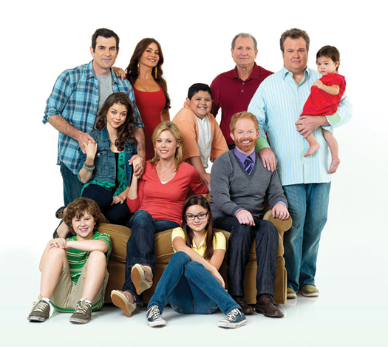
Family Decision Making
Purchase roles
  Initiator
  Information gatherer
  Influencer
  Decision Maker
  Purchaser
  User

Slide 31
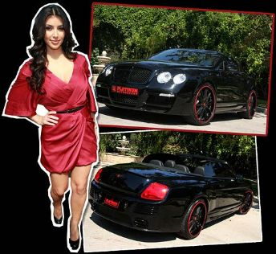
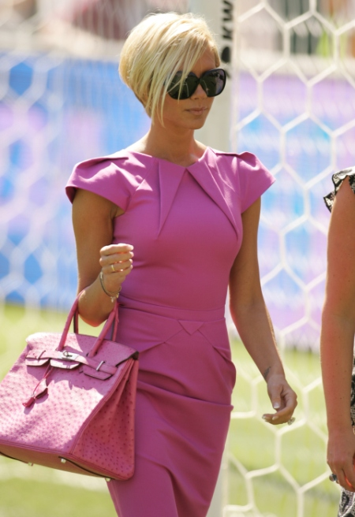
Roles and Status
Manager, committee member, club member…influences the purchase of goods and services

Slide 32
Figure 5.2 Factors Influencing Consumer Behavior

Slide 33

Personal Factors
Age and Life-Cycle Stage
  People change the goods and services they buy over their lifetimes.

Slide 34
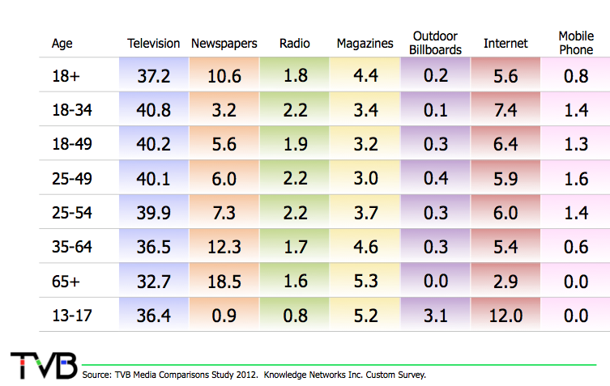
Media Influencers for Age groups

Slide 35
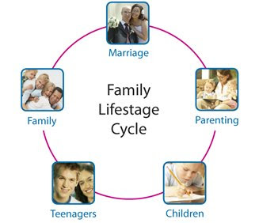
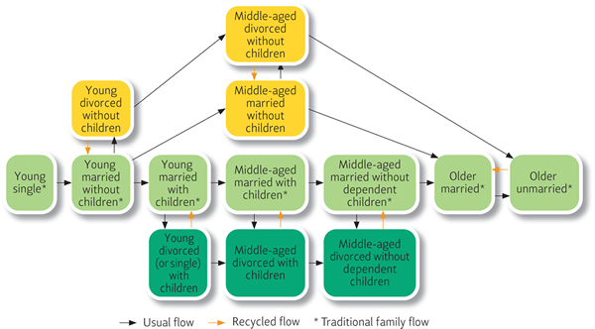
Stages in the Family Life Cycle
People change the goods and services they buy over their lifetimes

Slide 36
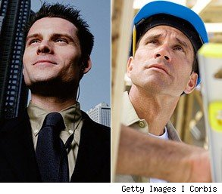
Personal Factors
Occupation: Blue -collar vs. White -collar workers
Economic situations
  Marketers watch trends in personal income, savings and interest rates

Slide 37
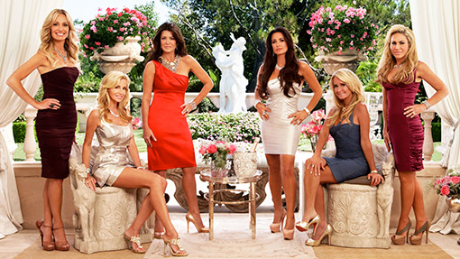
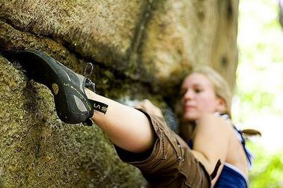
Lifestyle
Lifestyle: A person’s pattern of living as expressed in his or her activities, interests and opinions.

Slide 38
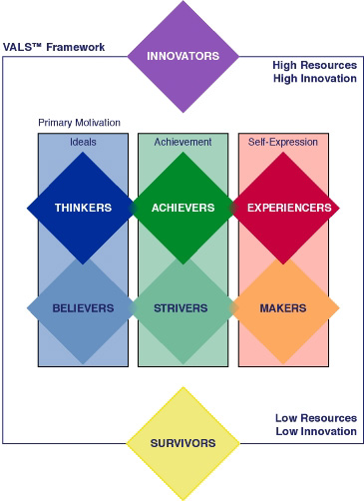
VALS FRAMEWORK - Lifestyle
VALS ("Values, Attitudes and Lifestyles") is a proprietary research methodology used for psychographic market. Market segmentation is designed to guide companies in tailoring their products and services to appeal to the people most likely to purchase them. VALS was developed in 1978 by social scientist and consumer futurist Arnold Mitchell and his colleagues at SRI International..

Slide 39
Innovators. These consumers are on the leading edge of change, have the highest incomes, and such high self-esteem and abundant resources that they can induldge in any or all self-orientations. They are located above the rectangle. Image is important to them as an expression of taste, idependence, and character. Their consumer choices are directed toward the "finer things in life."
Thinkers. These consumers are the high-resource group of those who are motivated by ideals. They are mature, responsible, well-educated professionals. Their leisure activities center on their homes, but they are well informed about what goes on in the world and are open to new ideas and social change. They have high incomes but are practical consumers and rational decision makers.
Believers. These consumers are the low-resource group of those who are motivated by ideals. They are conservative and predictable consumers who favor American products and established brands. Their lives are centered on family, community, and the nation. They have modest incomes.
Achievers. These consumers are the high-resource group of those who are motivated by achievement. They are successful work-oriented people who get their satisfaction from their jobs and families. They are politically conservative and respect authority and the status quo. They favor established products and services that show off their success to their peers.
Strivers. These consumers are the low-resource group of those who are motivated by achievements. They have values very similar to achievers but have fewer economic, social, and psychological resources. Style is extremely important to them as they strive to emulate people they admire.
Experiencers. These consumers are the high-resource group of those who are motivated by self-expression. They are the youngest of all the segments, with a median age of 25. They have a lot of energy, which they pour into physical exercise and social activities. They are avid consumers, spending heavily on clothing, fast-foods, music, and other youthful favorites, with particular emphasis on new products and services.
Makers. These consumers are the low-resource group of those who are motivated by self-expression. They are practical people who value self-sufficiency. They are focused on the familiar-family, work, and physical recreation-and have little interest in the broader world. As consumers, they appreciate practical and functional products.
Survivors. These consumers have the lowest incomes. They have too few resources to be included in any consumer self-orientation and are thus located below the rectangle. They are the oldest of all the segments, with a median age of 61. Within their limited means, they tend to be brand-loyal consumers.
Source: Wikipedia

Slide 40
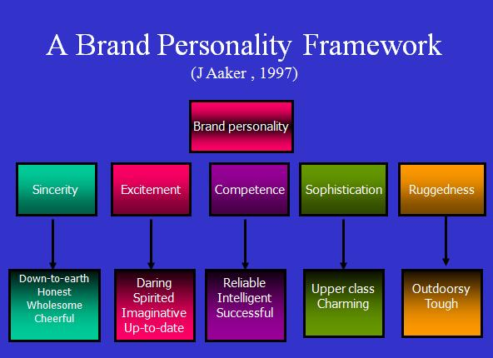
Personality
Personality: The unique psychological characteristics that distinguish a person or a group
Personality
& Image

Slide 41
Figure 5.2 Factors Influencing Consumer Behavior

Slide 42
Psychological Factors
Motivation (Drive): A need that is sufficiently pressing to direct he person to seek satisfaction of the need
  Research: Projective Techniques; interpretive consumer research – dig deeper into consumer psyches and develop better marketing strategies

Slide 43


Motivation Theory
Sigmund Freud: people are largely unconscious about the real psychological forces shaping their behavior
  Motivation: an aging baby boomer who buys a sporty convertible might explain that he simply like the feel of the wind in his thinning hair. At a deeper level, he may be buying a car to feel young and independent again.

Slide 44
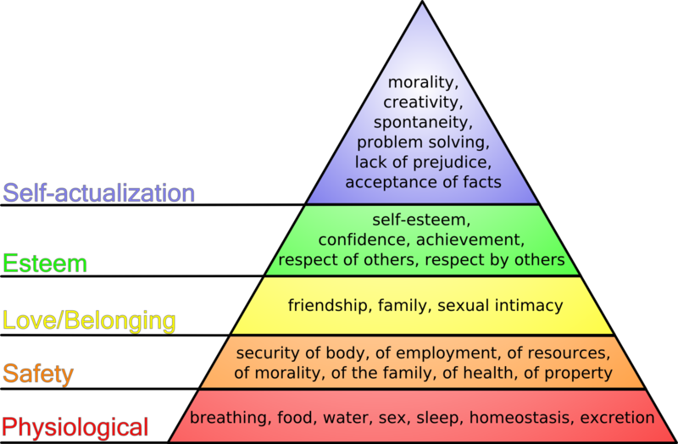
Motivation Theory
Maslow’s Hierarchy of needs

Slide 45
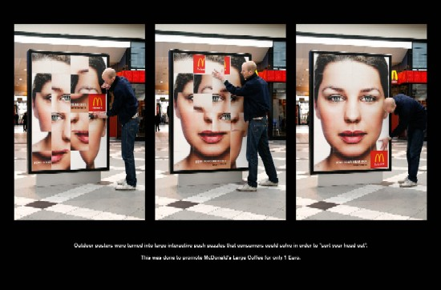
Perception
Perception is the process by which people select, organize and interpret information to form a meaningful picture of the word
  People are exposed to 3000-5000 ad messages daily

Slide 46
Perception
Selective Attention: the tendency for people to screen out most of the information to which they are exposed (marketers challenge: attract attention)
Selective Distortion: the tendency of people to interpret information in a way that will support what they already believe (marketers challenge: support/ define belief)
Selective Retention: consumers are likely to remember good points made about the brand they favor and forget good pointes made about competing brands (marketers challenge: leverage brand image)

Slide 47
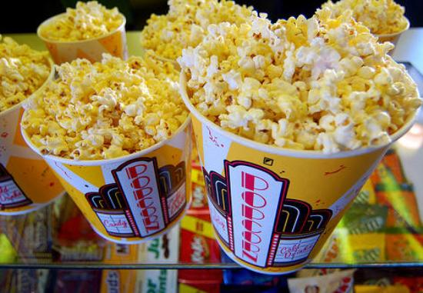
Perception
Subliminal advertising: consumers will be affected by marketing messages without even knowing it
  Example: “Eat popcorn” and “Drink Coca Cola” – on the screen in a New Jersey movie theater every five second for 1/300th of a second.
  Viewers didn’t consciously recognized the messages they absorbed them subconsciously and bought 58 percent more popcorn and 18 percent more coke

Slide 48



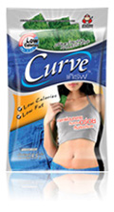
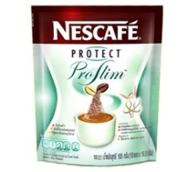
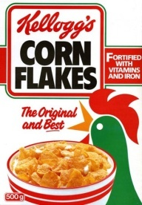

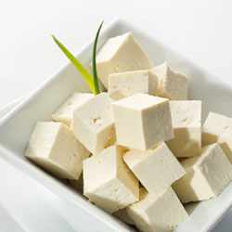
Positioning Map for Health & Beauty Enhancers in the Foods Category
Taste
Supplement Milk Shakes
Bird’s Nest
Yogurts
Fruit Juices
Teas
Fruits
Heath &Beauty
Enhancement
Bread
Cereal
Beauty Drinks
Rice
Herbs
Coconut oil
Tofu
Collagen foods
Chicken Essence
Dietary Supplements
Vegetables
Apple Cider
Vitamins

Slide 49
Learning
Learning: Changes in an individual behavior arising from experience
  A drive is a strong internal stimulus that calls for action
  A drive becomes a motive when directed toward a particular stimulus object
  Cues are minor stimulus : discounts, special price, spot several camera brands in a store window, etc.
  Cues might influence consumer response in interest to buy
  If experience is rewarding (Nikon), consumer will use camera more and more and response will be reinforced

Slide 50
Learning is a key to consumer behavior
Values
Attitudes
Tastes
Preferences
Skills
Feelings
Meanings
Behaviors
Culture
Sub -Culture
Social class
Purchase
And use
Behavior
Family
Friends
Learning
Institutions
Experiences
Mass media
Advertising

Slide 51
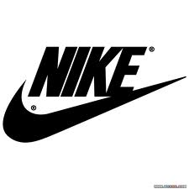

BRAND ASSOCIATIONS

Slide 52

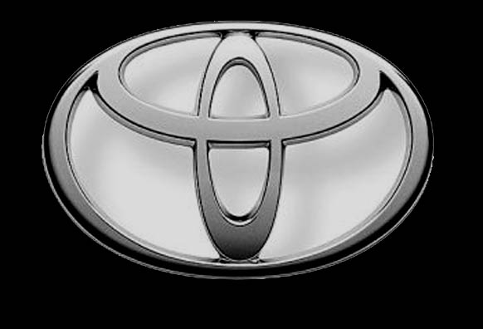



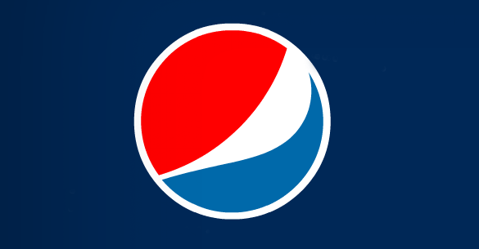


Slide 53

Belief and Attitude
Belief: A descriptive thought that a person holds about something
Attitude: A person’s consistently favorable or unfavorable evaluations, feelings, and tendencies toward an object or idea

Slide 54
Attitude Components and Manifestations
Initiator Component Component Manifestation Attitude
Stimuli:
Product,
situations
Retail outlets,
sales
Personnel,
advertisements
And other
attitude objects
Affective
Emotions or feelings
About specific attributes
Or overall object
Overall
Orientation
Toward
object
Cognitive
Beliefs about specific
Attributes and overall object
Behavorial
Behavioral intentions
With respect to specific
Attributes or overall object

Slide 55

Belief and Attitude
Beliefs and Attitudes: By matching today’s attitudes about life and healthful living, the SoBe brand has become a leader in the New Age beverage category

Slide 56
Figure 5.2 Factors Influencing Consumer Behavior

Slide 57

Figure 5.5 Types of Buying Decision Behavior

Slide 58
Types of Buying Decision Behavior
Complex Buying Behavior: Consumer buying behavior in situations characterized by high consumer involvement in a purchase and significant perceived differences among brands
Dissonance-reducing buying behavior: Consumer buying behavior in situations characterized by high involvement but few perceived differences among brands (carpet)
  Post purchase dissonance (after-sale discomfort ; disadvantage of buying carpet or hear favorable things about other brands not purchased – therefore communications- assurance is important)

Slide 59
Types of Buying Decision Behavior
Habitual buying behavior: Consumers buying behavior in situations characterized by low-consumer involvement and few significantly perceived brand differences
Variety seeking behavior: Consumer buying behavior in situations characterized by low consumer involvement but significant perceived brand differences
  Challenger firms will encourage variety seeking by offering lower prices, special deals, coupons, free samples, and advertising that presents reasons for trying something new

Slide 60

The Buyer Decision Process

Slide 61
The Buyer Decision Process
Need recognition: The first step of the buyer decision process, in which the consumer recognizes a problem or need
  Internal stimuli-drive-external stimuli
Information search: The stage of the buyer decision process in which the consumer is aroused to search for more information, the consumer may simply have heightened attention or may to into an action information search
  Personal sources – family, friends, neighbors
  Commercial sources – advertising, salespeople, dealer, packages, websites
  Public sources -mass media, consumer rating org., internet searches
  Experiential sources – handling, examining and using the product
  COMMERCIAL SOURCES INFORM BUYER, PERSON SOURCES LEGITIMIZE OR EVALUATE PRODUCTS FOR BUYERS

Slide 62

The Buyer Decision Process
Alternative evaluation: The state of the buyer decision process in which the consumer uses information to evaluate brands in the choice set
  Careful calculations and logical thinking
  Attribute rating and weigh on importance

Slide 63


Evaluation of Alternatives

Slide 64
The Buyer Decision Process
Purchase Decision: The buyer’s decision about which brand to purchase
  Intention and purchase decision – the attitudes of others
  Unexpected situational factors- competitor drops price, economy getting worse
Post purchase behavior: The stage of the buyer decision process in which consumers take further action after purchase based on their satisfaction or dissatisfaction with a purchase
  Relationship between consumer’s expectations and product’s perceived performance
  Meets expectations-> satisfied; didn’t meet expectations -> dissatisfied; exceed expectations-> delighted
Cognitive dissonance: Buyer discomfort caused by postpurchase conflict

Slide 65
The Buyer Decision Process
Why is it important to satisfy customers?
  Customer satisfaction is key to building profitable relationships with customers- to keeping and growing consumers and reaping their lifetime customer value.
  Satisfied customers buy a product again, talk favorably to others about the product, pay less attention to competing brand and advertisement and buy other products from the company
  Marketers go beyond satisfying but aim to “Delight” the customer (Lexus)

Slide 66
The Buyer Decision for New Products
New Product: A good, service or idea that is perceived by some potential customers as new
Adoption process: The mental process through which an individual passes from first hearing about an innovation to final adoption

Slide 67


Slide 68


Targeting may also use diffusion of Innovation
The original adoption and the cellular phone. For the cancer cure, it would be almost instantaneous.
Let’s look closer now at the factors that affect this speed of the product adoption process: the characteristics of the innovative product and the extent to which early users encourage others to follow.
vs

Slide 69
Influence of Product Characteristics on Rate of Adoption
THERE ARE AT LEAST FIVE FACTORS THAT MEASURE HOW SOON A NEW PRODUCT WILL RECEIVE TRIAL:
The relative advantage: How superior is the innovation to the product or other problem-solving methods it was designed to compete against?
Compatibility: Does it fit with current product usage and end user activity?
Complexity: Will frustration or confusion arise in understanding the innovation’s basic idea?

Slide 70
Influence of Product Characteristics on Rate of Adoption
Divisibility: (trialability): How easily can trial portions of the product be purchased or use? Easier for food and beverages
Communicability: (observability) How likely is the product to appear in public places where it is easily seen and studied by potential users?

Slide 71

Figure 5.7 Adopter Categorization on the Basis of Relative Time of Adoption of Innovations
Share of all Adopters
Time of Adoption of Innovation

